Slide 1
Project ECHO® - UNM
HIV TeleECHO Clinic
Review of PrEP 2021 Guidelines
March 7th, 2023
Victoria A. Lopez, PharmD
PGY-1 Community Pharmacy Resident
Southwest CARE Center
Notes:
Version_ MM YYYY

Slide 2
Conflict of Interest Disclosure Statement
Speaker has nothing to disclose.
This presentation was reviewed by UNMHSC and SCAETC faculty to ensure it meets Continuing Education guidelines.
This project is supported by the Health Resources and Services Administration (HRSA) of the U.S. Department of Health and Human Services (HHS). Under grant number U1OHA33225 (South Central AIDS Education and Training Center). It was awarded to the University of New Mexico. No percentage of this project was financed with non-governmental sources. This information or content and conclusions are those of the authors and should not be construed as the official position or policy of, nor should any endorsements be inferred by HRSA, HHS, or the U.S. Government.

Slide 3
Abbreviations and Definitions
PrEP = preexposure prophylaxis
HIV = human immunodeficiency virus
STI = sexually transmitted infection
CAB = cabotegravir
F = emtricitabine
TDF = tenofovir disoproxil fumarate
TAF = tenofovir alafenamide
eCrCl = estimated creatinine clearance
TGW = transgender women, assigned male sex at birth whose gender identity is female
MSM = men who have sex with men
PWID = persons who inject drugs
FDA = Food and Drug Administration
https://www.cdc.gov/hiv/pdf/risk/prep/cdc-hiv-prep-guidelines-2021.pdf

Slide 4
Learning Objectives
Recognize
Recognize indications and screening requirements for PrEP
Describe
Describe PrEP 2021 Guideline updates
Review
Review long-acting cabotegravir
Notes:
The learning objective for today include recognizing indications and screening for PrEP, Describe PrEP 2021 guideline updates and last, review pertinent formation for long acting cabotegravir as a PrEP medication, including dosing, monitoring and counseling points.

Slide 5
HIV Statistics in America
1.1 million American are currently living with HIV
38,00 Americans are newly diagnosed each year
400,000 more Americans will be newly diagnosed over 10 years
https://www.hiv.gov/federal-response/ending-the-hiv-epidemic/overview

Slide 6
HIV National Strategic Plan
https://www.hiv.gov/federal-response/ending-the-hiv-epidemic/overview
Notes:
Some baseline trends in the US – can see that the incidence of new infections has slightly decreased over the past few years but has remained relatively stable
The new HIV National Strategic Plan developed by the US DHHS has a goal of ending the HIV epidemic in the United States by 2030, including a 75% reduction in new HIV infections by 2025 and a 90% reduction by 2030.

Slide 7
HIV National Strategic Plan
https://www.hiv.gov/federal-response/ending-the-hiv-epidemic/overview
https://files.hiv.gov/s3fs-public/HIV-National-Strategic-Plan-2021-2025.pdf
Notes:
Some baseline trends in the US – can see that the incidence of new infections has slightly decreased over the past few years but has remained relatively stable
The new HIV National Strategic Plan developed by the US DHHS has a goal of ending the HIV epidemic in the United States by 2030, including a 75% reduction in new HIV infections by 2025 and a 90% reduction by 2030.

Slide 8
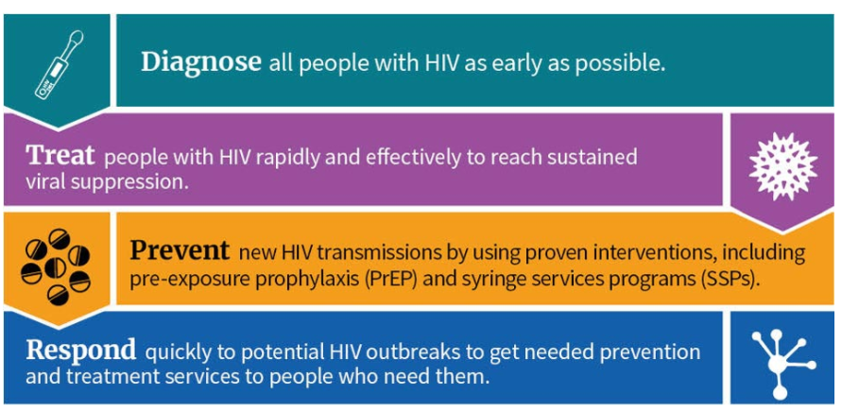
HIV National Strategic Plan
https://www.hiv.gov/federal-response/ending-the-hiv-epidemic/overview
https://files.hiv.gov/s3fs-public/HIV-National-Strategic-Plan-2021-2025.pdf
Notes:
The goal for PrEP is to have at least 50% of people who have an indication for prep to be prescribed prep by 2025 and remain 50% by 2030
Overall goal: Increase the estimated percentage of people with indications for PrEP classified as having been prescribed PrEP to at least 50% by 2025 and remain 50% by 2030

Slide 9
Why PrEP?
https://www.cdc.gov/mmwr/volumes/68/wr/mm6827a1.htm
Notes:
Stats from 2019
Why PrEP? Well, it is a powerful way to prevent HIV transmission when taken according to the guideline. Oral daily PrEP has been shown to reduce HIV transmission by 99%. On-demand dosing, only studied in MSM & TGW, has been shown to be 86% efficacious in prevention of HIV Transmission.
Statistics from 2019 have shown an increase of PrEP use from 6% to 35% among MSM, however, MORE PrEP Use is Need; especially among black and Hispanic MSM. Shortly, I will be discussing the disparities associated with PrEP use.
How can healthcare providers help End HIV? Assessing all patient’s risk for HIV , testing for HIV- it is recommended that everyone be assess for HIV at least once in their life time, Prescribe PrEP when needed or asked for and use CDC resources.

Slide 10
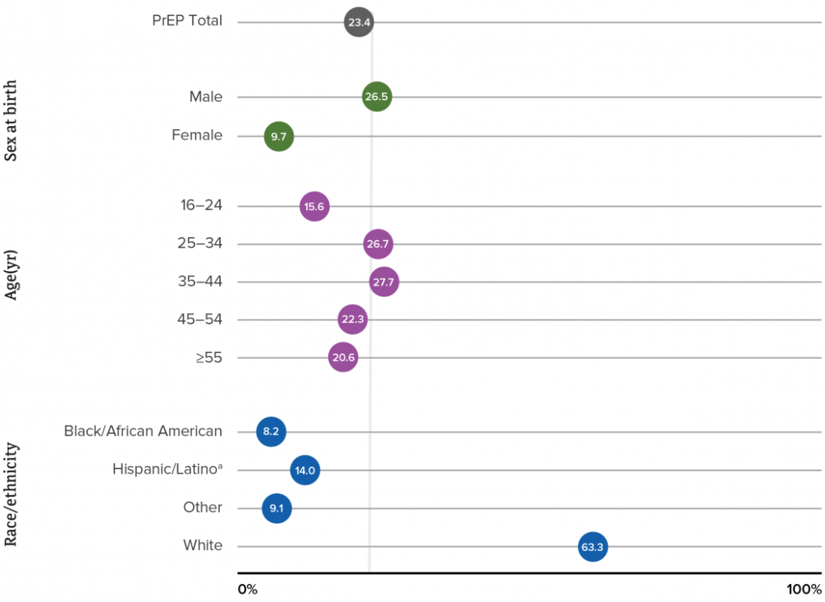
PrEP Coverage 2019
https://www.cdc.gov/hiv/library/reports/hiv-surveillance/vol-26-no-2/content/national-profile.html#7
Notes:
These numbers for PrEP coverage for persons in the USA 16 or older in 2019. As you can see, currently only 23% of persons who has an indication for PrEP are currently being prescribed PrEP.

Slide 11
PrEP Coverage 2019
https://www.cdc.gov/hiv/library/reports/hiv-surveillance/vol-26-no-2/content/national-profile.html#7
Notes:
Only 9.7% of cis-females with an indication for PrEP were currently prescribed PrEP. Cis-female account for 20% of newly diagnosed HIV infections

Slide 12
PrEP Coverage 2019
https://www.cdc.gov/hiv/library/reports/hiv-surveillance/vol-26-no-2/content/national-profile.html#7
Notes:
When looking at age range, only 15.6% of 16-24s with a PrEP indication are currently being prescribed PrEP. However, this age group was the second highest for newly diagnosed HIV cases in 2019.

Slide 13
PrEP Coverage 2019
https://www.cdc.gov/hiv/library/reports/hiv-surveillance/vol-26-no-2/content/national-profile.html#7
Notes:
Overall, Black/African American people accounted for 42% of newly diagnosed HIV cases in the US for 2019. Of those newly diagnosed HIV cases in Black/African Americans MSM accounted for 79% of cases. I’d just like to remind you that cis-females account for 20% of newly diagnosed HIV infections, Black/African American cis-females account for almost 2/3s of these.

Slide 14
PrEP Coverage 2019
https://www.cdc.gov/hiv/library/reports/hiv-surveillance/vol-26-no-2/content/national-profile.html#7
Notes:
Hispanic/Latino accounted for 29% of newly diagnosed HIV cases in America for 2019. Of these newly diagnosed HIV cases within the Hispanic/Latino population, MSM accounted for 85% of them.
Other population to note, are transgender and persons who inject drugs. A recent CDC study found that four in 10 transgender women in seven major U.S. cities have HIV. Expanding PrEP use among transgender women is key to decreasing new HIV infections in this population. The survey showed that 32% of HIV-negative transgender women reported using PrEP, even though 92% were aware of the medication. Previous studies have also revealed high knowledge of PrEP and its benefits but very low uptake among transgender women.

Slide 15
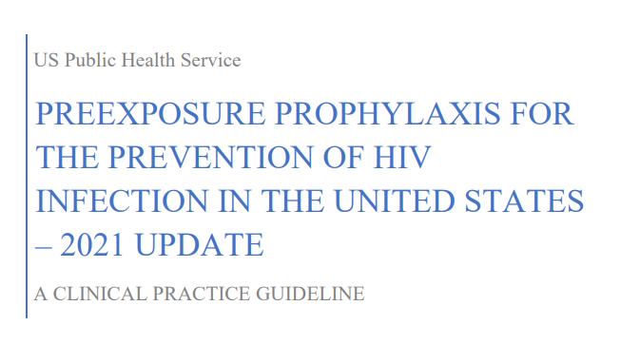
2021 PrEP Guidelines
https://www.cdc.gov/hiv/pdf/risk/prep/cdc-hiv-prep-guidelines-2021.pdf

Slide 16
Important Updates
Inform all sexually active adults and adolescents about PrEP & prescribe to anyone who asks for it
Addition of F/TAF, injectable cabotegravir (CAB)
Monitoring labs
Addition of procedures for a non-daily regimen (“2-1-1”)
https://www.cdc.gov/hiv/pdf/risk/prep/cdc-hiv-prep-guidelines-2021.pdf

Slide 17
Indications for PrEP
All sexually active adult and adolescent patients should receive information about PrEP
Prescribe PrEP per patient request or risk factors:
If anal or vaginal sex in past 6 months
> 1 partners with unknown HIV status and inconsistent condom use
HIV+ partner with unknown or detectable viral load
Bacterial STI in past 6 months
Injection drug use within last 6 months
Shared injection equipment
HIV+ injecting partner
https://www.cdc.gov/hiv/pdf/risk/prep/cdc-hiv-prep-guidelines-2021.pdf
Notes:
UPDATE: educate all patients about PrEP if sexually active
-Important to take a targeted sexual history to assess risk – make it routine for ALL patients
-Other than the RFs listed above, if a patient requests PrEP, just give it to them
-always think about integrating other preventional/clinical care services for non-HIV related health threats that PWID are at risk for, such as hep B/C, abscess, endocarditis, overdose

Slide 18
Screening/Baseline Laboratory Tests
Confirmed negative HIV test
Within 1 week
FDA-approved tests: https://www.cdc.gov/hiv/testing/laboratorytests.html
Must rule out acute HIV infection
STI testing
Gonorrhea, chlamydia, syphilis
Refer to 2021 STI guidelines for recommendations by patient population: https://www.cdc.gov/std/treatment-guidelines/default.htm
Oral PrEP
HIV
eCrCl
CAB
HIV
STI testing
STI testing
Hep B/C serologies
Lipid panel (F/TAF only)
https://www.cdc.gov/hiv/pdf/risk/prep/cdc-hiv-prep-guidelines-2021.pdf
Notes:
-Chlamydia in women doesn’t actually increase the risk of HIV acquisition
-Different screening recs for adolescents, MSM, transgender and gender diverse persons, etc
Initial PrEP screening and baseline labs include a a onfirmed negative HIV test within 1 week of PrEP initiation. Acute HIV infection must be ruled out before initiating PrEP, due to potential resistence concerns- PrEP medications are incomplete HIV treatment regimens and increase the risk of developing resistance to these medication in undiagnosed HIV. STI testing should be performed and the all sites of exposure should be testing. I know with my PrEP patients, we often are preforming 3 site STI testing, but really it depends on the type of exposure and what the patient would like to test. In addition to STI & HIV assessment, the guidelines recommend HEP B/C seriologies and lipid panel for patients on Descovy, this is due to the TAF component which has shown to increase lipids. How they guidelines do not discuss what should be done once there is an observed increase in lipids. I strongly recommend assessing all patients Hepatitis serologies, even tho the guideline

Slide 19
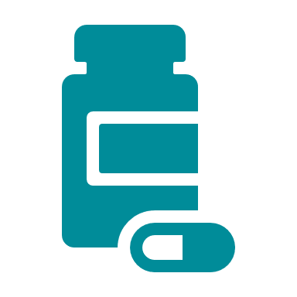
Options for PrEP
Medication | Dosing | Dosing Adjustments | Patient Populations
F/TDF Truvada® | 200 mg/300 mg PO daily | Avoid in eCrCl <60 mL/min | PWID Men Women
F/TAF Descovy® | 200 mg/25 mg PO daily | Avoid in eCrCl <30 mL/min | Men TGW
CAB injectable Apretude® | 600 mg IM (3 ml) Q2 months Lead-in optional: 30 mg PO daily x 4 weeks | None needed *Severe renal and hepatic impairment not studied* | Men Women TGW
https://www.cdc.gov/hiv/pdf/risk/prep/cdc-hiv-prep-guidelines-2021.pdf
Notes:
Guidelines don’t differentiate between F/TDF vs F/TAF preference since they haven’t seen differences in bone metabolism and renal function between the two groups; most of the studies w/ toxicities are in treatment of HIV-infected patients

Slide 20
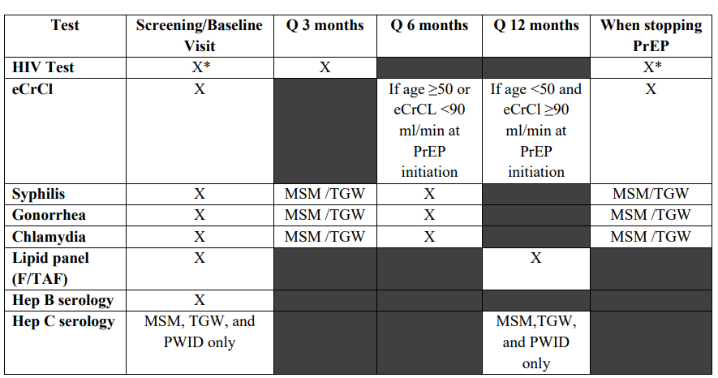
Oral PrEP Monitoring
https://www.cdc.gov/hiv/pdf/risk/prep/cdc-hiv-prep-guidelines-2021.pdf

Slide 21
Oral PrEP Monitoring
https://www.cdc.gov/hiv/pdf/risk/prep/cdc-hiv-prep-guidelines-2021.pdf

Slide 22
Optional Assessments
Bone health
DEXA not routinely recommended before starting treatment or during treatment
Can consider if history of pathologic or fragility bone fracture
Medication adherence drug monitoring
No FDA-approved point of care tests for drug levels in urine or blood
Can consider measuring tenofovir and emtricitabine levels
https://www.cdc.gov/hiv/pdf/risk/prep/cdc-hiv-prep-guidelines-2021.pdf
Notes:
DEXA, LFTS, CBC, UA not routinely indicated
DEXA may be considered if there is a history of pathologic or fragility bone fracture. May also consider monitoring medications levels but it is not necessary and there is no FDA-approved poc test to monitor levels in urine/blood.

Slide 23
Injectable Cabotegravir
FDA-approved December 2021
Brand name: Apretude®
Formulation: extended-release injectable suspension
Route: gluteal IM administration only by a healthcare provider
Initial Injection
600 mg CAB IM x 1
Month 1
600 mg CAB IM x 1
Month 3+
600 mg CAB IM Q2 months
Optional
CAB 30 mg PO daily x 4 weeks
Dosing Schedule
https://www.cdc.gov/hiv/pdf/risk/prep/cdc-hiv-prep-guidelines-2021.pdf
Apretude Package Insert. 12/2021 | https://www.businesswire.com/news/home/20211220005863/en/
Notes:
Just approved!! On 12/20/21. initially planned for late Jan but got it done early
Gluteal muscle only b/c PK of other sites unknown
The studies had pts on CAB 30 mg PO daily x 5 weeks prior to first injection but because there were no safety concerns identified, a PO lead-in was not required
Alright, this brings us to the newest kid on the block for PrEP, which is LA cabotegravir brand name Apretude approved in 2021. It is a 600mg gluteal injection administered by a health provider. The dosing schedule include the option oral lead in consisting of cab 30mg for 28 days. I would recommend this oral lead in to asses tolerability. Followed by the firs gluteal 600mg injection, 1 month later is the second injection and then after the injection is given every 2 months. Within 7 days of the scheduled dose.

Slide 24
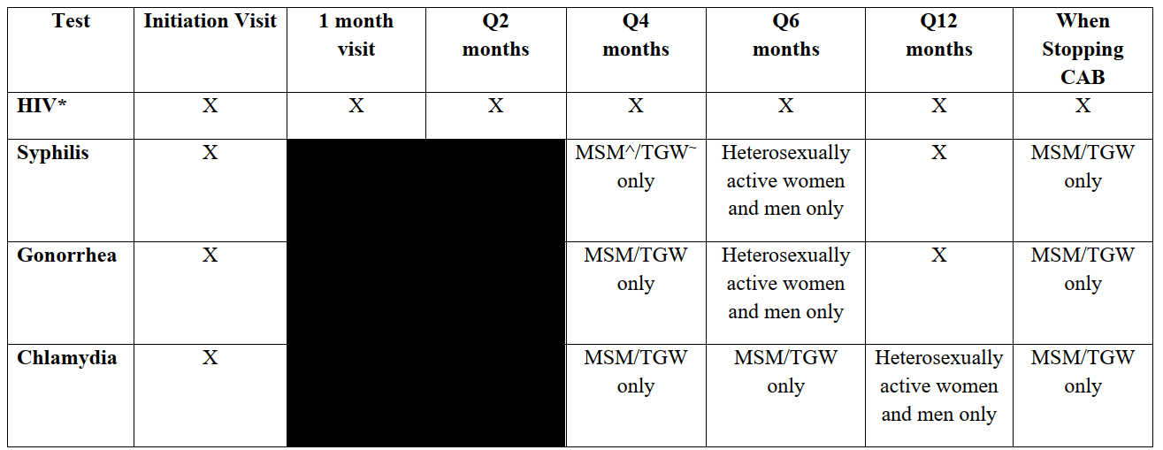
Cabotegravir Monitoring
Compared to oral PrEP, Q2 month follow-up visits and monitoring recommended
https://www.cdc.gov/hiv/pdf/risk/prep/cdc-hiv-prep-guidelines-2021.pdf
Notes:
Compared to oral prep, which have scheduled follow-up appointments Q3 months, Cab has follow-ups Q2months and should be assess for HIV at every appointment, and STI assessment various depending on the population and exposure risk. I recommend always assessing the patients risks and using these as a minimum requirement for testing. The guidelines recommend MSM/TGW be assessed every 4 months and heterosexual active women/men be assess annually for syphilis& gonorrhea and annually for chlamydia.

Slide 25
Cabotegravir Counseling Points
Adverse reactions:
Injection site reactions
Diarrhea
Nausea
Patient education:
Injection site reaction management: can take over-the-counter pain medications or apply a warm compress/heating pad
Risk of acquiring drug-resistant HIV infection during the CAB “tail” (declining drug levels)
If plan on stopping CAB injections and at risk for acquiring HIV, prescribe F/TDF or F/TAF for 8 weeks after the last injection
Unclear time to maximal protection
https://www.cdc.gov/hiv/pdf/risk/prep/cdc-hiv-prep-guidelines-2021.pdf
Notes:
-Injection site rxns: gen mild-mod, lasted a few days; typically with the first 2-3 injections
-In the HPTN 077 trial, the median time to undetectable CAB plasma levels was 44 weeks for men and 67 weeks for women -No data are yet available from clinical trials in men or women to estimate the time from initiation of CAB injections to maximal protection against HIV acquisition

Slide 26
Non-daily Oral PrEP
“2-1-1” or “on-demand” dosing with F/TDF (NOT FDA-approved)
MSM only
Alternative for patients having intermittent sexual activity
IPERGAY and Prévenir trials: >86% efficacy
Prescribing recommendations:
Give a 30-day supply
Need follow-up visit and negative HIV test
https://www.cdc.gov/hiv/pdf/risk/prep/cdc-hiv-prep-guidelines-2021.pdf
Notes:
IPERGAY and Prévenir trials showed high preventive efficacy of 86% or more – note that the trials were NOT done in the US
30 days – idea that it should cover 7 events if having sex less than once weekly

Slide 27
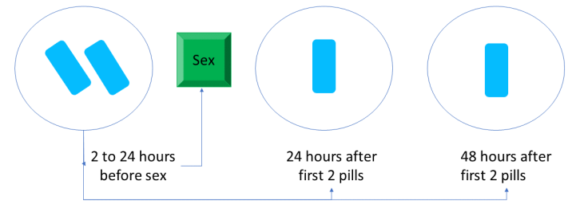
“On-Demand” Dosing
If continual dosing needed:
Take 1 pill daily until 48 hrs after last sexual event
If gap of < 7 days between last pill and next sexual event, resume 1 pill daily
If gap > 7 days, restart with 2 pills prior to sex
https://www.cdc.gov/hiv/pdf/risk/prep/cdc-hiv-prep-guidelines-2021.pdf
Notes:
Scheduling:
2 pills 2-24 hrs prior (24 preferred) to sex
1 pill 24 hrs after, then 1 pill 48 hrs the initial dose
If still having sex after the 2-1-1 doses, take 1 pill eadh day until 48 hrs after last sexual event
If a gap of <7 days occurs between the last pill and the next sexual event, resume 1 pill daily.
If a gap of ≥7 days occurs between the last pill and next sexual event, start again with 2 pills

Slide 28
Summary of Major Changes from the 2021 PrEP Guidelines
F/TAF
Not indicated for cisgender women
Monitor lipids annually
Injectable CAB
Optional PO lead-in dosing
Q2 month injections + follow-up/monitoring
“On-demand” PrEP
Alternative for MSM only
Lower efficacy than daily PrEP
https://www.cdc.gov/hiv/pdf/risk/prep/cdc-hiv-prep-guidelines-2021.pdf

Slide 29
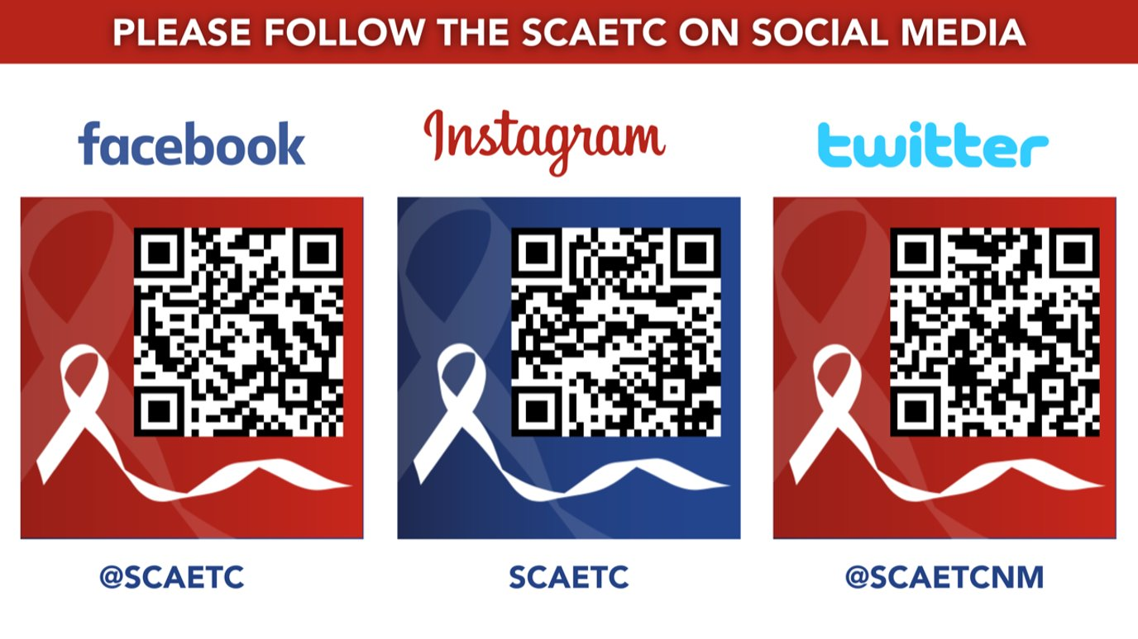
SCAETC Social Media

Slide 30
Resources
National Clinician Consultation Center http://nccc.ucsf.edu/
HIV Management
Perinatal HIV
HIV PrEP
HIV PEP line
HCV Management
Substance Use Management
Present case on ECHO http://echo.unm.edu hivecho@salud.unm.edu
AETC National HIV Curriculum https://aidsetc.org/nhc
AETC National Coordinating Resource Center https://targethiv.org/library/aetc-national-coordinating-resource-center-0
Additional trainings scaetcecho@salud.unm.edu
www.scaetc.org
Notes:
Find additional TeleECHO sessions in your area: https://echo.unm.edu/locations-2/echo-hubs-superhubs-united-states/
https://hsc.unm.edu/echo/get-involved/join-an-echo/
IDEA Platform: Infectious Diseases Education & Assessment. https://idea.medicine.uw.edu/
AETC National HIV Curriculum: 6 core modules for self study; regularly updated; CME, CNE
Hepatitis C Online Curriculum: https://www.hepatitisc.uw.edu/
Hepatitis B Online Curriculum: https://www.hepatitisb.uw.edu/
National STD Curriculum: https://www.std.uw.edu/

