Slide 1
Clinical Pearls for Managing Diabetes in Patients with HIV
Emily Kirkpatrick, PharmD, BCIDP, AAHIVP
Clinical Pharmacy Specialist, Infectious Diseases
Department of Pharmacotherapy and Pharmacy Services
University Health
Notes:
Version date_05 2023

Slide 2
Conflict of Interest Disclosure Statement
The presenter has no conflicts to declare.
This program is supported by the Health Resources and Services Administration (HRSA) of the U.S. Department of Health and Human Services (HHS) as part of an award totaling $3,132,205, with 0% financed with non-governmental sources. The contents are those of the author(s) and do not necessarily represent the official views of, nor an endorsement of, by HRSA, HHS, or the U.S. Government. For more information, please visit HRSA.gov.

Slide 3
Use of Trade/Brand Names
This program is supported by the Health Resources and Services Administration (HRSA) of the U.S. Department of Health and Human Services (HHS) as part of an award totaling $3,132,205, with 0% financed with non-governmental sources.
The views expressed do not necessarily reflect the official policies of the Department of Health and Human Services, nor does mention of trade names, commercial practices, or organizations imply endorsement by the U.S. Government. Any trade/brand names for products mentioned during this presentation are for training and identification purposes only.
Notes:
NOTE: THIS SLIDE MUST BE INCLUDED IF TRADE AND/OR BRAND NAMES FOR MEDICATIONS ARE USED IN THE PRESENTATION.
IT MAY BE DELETED IF THERE IS NO REFERENCE TO TRADE NAMES, INCLUDING PRESENTATIONS IN WHICH ONLY GENERIC MEDICATION NAMES ARE MENTIONED.
TRADE NAMES MUST BE PUT IN PARENTHESES AFTER THE GENERIC NAME THE FIRST TIME IT IS MENTIONED - E.G., FLUOXETINE (PROZAC). TRADE NAMES SHOULD ONLY BE MENTIONED FOR THE INITIAL REFERENCE AND THE GENERIC NAME ONLY SHOULD BE USED AFTER THAT. THIS APPLIES EQUALLY TO ALL MEDICATIONS OR PRODUCTS MENTIONED IN THIS PRESENTATION.

Slide 4
Learning Objectives
Identify risk factors associated with diabetes in patients with HIV (PWH).
Summarize key updates in the 2023 American Diabetes Association Standards of Care.
Review newer classes of diabetes medications and their place in therapy.
Discuss implementation of new diabetes therapy options for patients with HIV (PWH).

Slide 5
Diabetes Risk and HIV
Patients with HIV have an increased risk of diabetes
Risk for diabetes may be enhanced by antiretroviral therapy (ART)
Patients with HIV on ART can have discordance between their Hgb A1c and plasma glucose readings, leading to under-diagnosis of diabetes
Sarkar S, et al. Curr Diab Rep. 2021 Mar 17;21(5):13.
Noubissi EC, et al. Curr Diab Rep. 2018 Oct 8;18(11):125.

Slide 6
Diabetes Pathogenesis
Patient Factors
Obesity
HCV co-infection
HIV Factors
Residual immune activation/inflammation
Choice of ART
Genetic factors (family history, race)
Concomitant medications (steroids, atypical antipsychotics)
Sarkar S, et al. Curr Diab Rep. 2021 Mar 17;21(5):13.
Noubissi EC, et al. Curr Diab Rep. 2018 Oct 8;18(11):125.

Slide 7
Diabetes Risk and ART
Protease inhibitors
Insulin resistance and decreased insulin secretion
Nucleoside reverse transcriptase inhibitors
Thymidine analogs – changes in fat distribution
Integrase strand inhibitors
Increased weight gain concern
Lipodystrophy
Increased weight gain with tenofovir AF based regimens
Recent data indicates potential impact on glycemic control
Sarkar S, et al. Curr Diab Rep. 2021 Mar 17;21(5):13.
Noubissi EC, et al. Curr Diab Rep. 2018 Oct 8;18(11):125.
Notes:
Thymidine analogs: zidovudine + stavudine; greater visceral adipose tissue area and reduced subcutaneous fat

Slide 8
Highlights from the American diabetes association 2023 standards of care

Slide 9
Screening
Patients with HIV should be screened for diabetes and pre-diabetes with a fasting glucose test:
Before starting ART
At the time of ART switch
3-6 months after starting or switching ART
ElSayed NA, et al. Diabetes Care 2023;46(Suppl. 1):S19-S40.

Slide 10
Hgb A1c and Plasma Glucose Discordance
Kim PS, et al. Diabetes Care. 2009 Sep;32(9):1591-3.
Notes:
Study showing glucose levels significantly higher than anticipated by A1c levels – example shown here is that patients with HIV that had a plasma glucose of 150 would have A1c of ~6.5, whereas uninfected patients would have A1c of ~7.5
Reasons:
Higher risk of anemia – lower Hgb A1c levels due to decreased red blood cell survival
May be associated with NRTI use

Slide 11
Updates to Goals of Therapy
Hgb A1c Goal
< 7%
< 8%; consider for patients with limited life expectancy or where treatment risks outweigh benefit
Blood Pressure Goal
< 130/80 for all patients
Statin Therapy
Diabetes, Age 40-75 years old without atherosclerotic CV disease: moderate intensity statin
Diabetes, Age 40-75 at higher CV risk: high intensity statin with target LDL <70
Diabetes and atherosclerotic CV disease: high intensity statin with target LDL <55
ElSayed NA, et al. Diabetes Care 2023;46(Suppl. 1):S1-S301.

Slide 12
ElSayed NA, et al. Diabetes Care 2023;46(Suppl. 1):S140-S157.

Slide 13
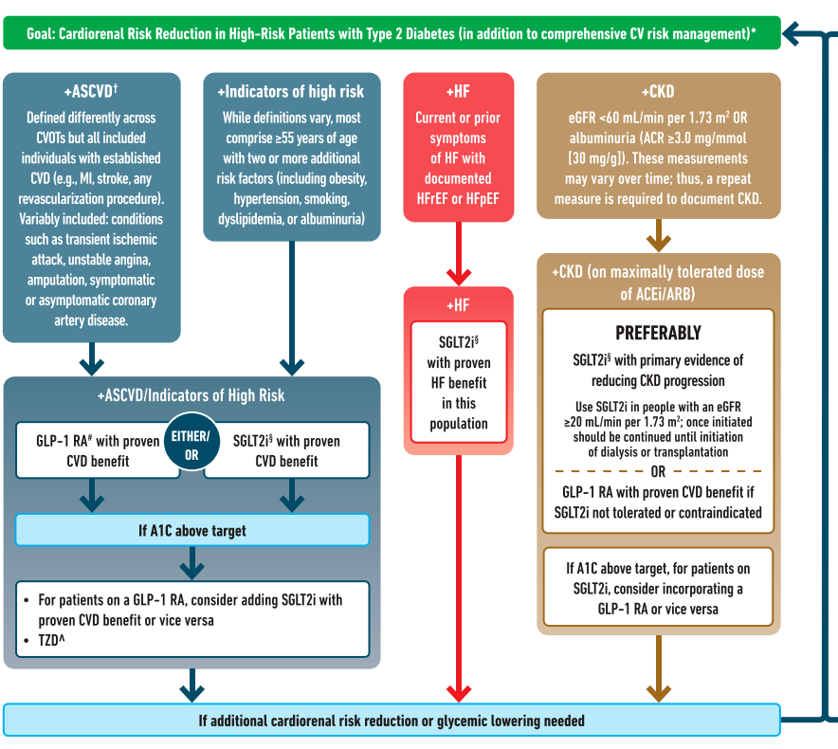
ElSayed NA, et al. Diabetes Care 2023;46(Suppl. 1):S140-S157.

Slide 14
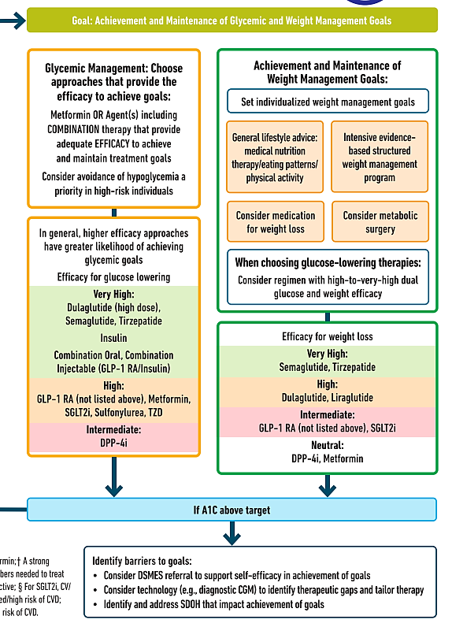
ElSayed NA, et al. Diabetes Care 2023;46(Suppl. 1):S140-S157.

Slide 15
SGLT- 2 Inhibitors
Efficacy | Weight Change | CV Effects | Renal Effects
Intermediate to high Lowers A1c 0.5-1% | Loss (intermediate) 1-3 lbs | Benefit on MACE: Empagliflozin Canagliflozin Benefit for heart failure: All 4 agents | Reduce progression of diabetic kidney disease: Empagliflozin Dapagliflozin Canagliflozin
Mechanism: decrease glucose reabsorption in the kidneys
Empagliflozin (Jardiance)
Canagliflozin (Invokana)
Dapagliflozin (Farxiga)
Ertugliflozin (Steglatro)
CV: Cardiovascular
MACE: major adverse cardiac events
ElSayed NA, et al. Diabetes Care 2023;46(Suppl. 1):S140-S157.
Notes:
MOA: decreases glucose reabsorption in the kidneys
MACE outcomes – cardiovascular death, myocardial infarction, or ischemic stroke
Benefit for heart failure = less heart failure related hospitalizations

Slide 16
SGLT-2 Considerations
Side Effects
Rare side effects
Other
Hypotension
Urinary tract infections (UTIs)
Genital fungal infections
Diabetic ketoacidosis (DKA), including euglycemic DKA
Counsel to discontinue 3-4 days before scheduled surgeries, during critical illness, or during prolonged fasting
Glucose lowering effect decreases at lower eGFRs
Cardiovascular and renal benefits still seen
ElSayed NA, et al. Diabetes Care 2023;46(Suppl. 1):S140-S157.
eGFR: estimated glomerular filtration rate
Notes:
Risk of DKA <1% in the clinical trials
Discuss modifying hypertension medications if needed to avoid hypotension
Discuss hygiene counseling
eGFR=estimated glomerular filtration rate

Slide 17
GLP-1 Agonists
Efficacy | Weight Change | CV Effects | Renal Effects
High to very high Lowers A1c 0.5-1.6% | Loss (intermediate to high) 8-12 lbs | Benefit on MACE: Liraglutide Semaglutide Dulaglutide All with neutral effect on heart failure | Benefit (driven by albuminuria outcomes): Liraglutide Semaglutide Dulaglutide
Liraglutide (Victoza)
Exenatide (Byetta)
Semaglutide (Ozempic)
Dulaglutide (Trulicity)
Lixisenatide (Adlyxin)
Exenatide XR (Bydureon)
Mechanism:
Increase insulin release with food
Slows gastric emptying
Promotes satiety
Suppresses glucagon
ElSayed NA, et al. Diabetes Care 2023;46(Suppl. 1):S140-S157.
Notes:
MOA:
Increases insulin release with food
Slows gastric emptying
Promotes satiety
Suppresses glucagon

Slide 18
GLP-1 Agonist Considerations
Side effects
Nausea, diarrhea, constipation
Injection site reactions
Pancreatitis
Black box warning: thyroid C-cell tumors
Daily-Twice Daily
Exenatide (BID)
Liraglutide (daily)
Once weekly
Exenatide XR
Dulaglutide
Semaglutide
Lixisenatide (daily)
GI side effects are typically temporary
Counsel patients on diet strategies to mitigate
ElSayed NA, et al. Diabetes Care 2023;46(Suppl. 1):S140-S157.
Notes:
CI in patients with personal or family history of medullary thyroid carcinoma or in patients with multiple endocrine neoplasia syndrome type 2
Diet strategies: reduce meal size, mindful eating practices (stop eating once full), decreasing intake of high fat or spicy foods
Weekly dosing may be easier for some patients but others may forget taking it once a week – counsel to tie to an activity

Slide 19
GLP-1 Agonist Considerations
Titrate slowly for tolerability – starting doses are not effective for glucose management
Medication | Dose Titration
Liraglutide | 0.6 mg once daily for 1 week, then 1.2 mg once daily Can increase to 1.8 mg if needed
Semaglutide | 0.25 mg once weekly for 4 weeks, then 0.5 mg once weekly Further titration to 1 mg or 2 mg available – allow 4 weeks between dose changes
Dulaglutide | 0.75 mg once weekly for 4 weeks, then 1.5 mg once weekly Further titration to 3 mg or 4.5 mg available – allow 4 weeks between dose changes

Slide 20
Management of Patients on RWHAP
Diabetes medications are covered by the local pharmacy assistance program (LPAP)
Formularies vary by service delivery area
Providers may request the permanent addition of medications to formulary
RWHAP=Ryan White HIV/AIDS Program

Slide 21
San Antonio LPAP Drug Formulary
Notes:
Consider commenting on not mixing GLP-1 agonists and DPP4 inhibitors

Slide 22
Summary: SGLT-2 Inhibitors
Pros
Low risk of hypoglycemia
Lower blood pressure
Cons
Hgb A1c reduction only 0.5-1%
UTI/fungal infection risk
Cost
Some weight loss
CV and renal benefits
Decreases heart failure hospitalizations
Notes:
CV=cardiovascular

Slide 23
Summary: GLP-1 Agonists
Pros
>1% Hgb A1c reduction
Weekly dosing options to help with adherence
Some issues with tolerability
Patient must be willing to do an injection
Cons
CV and renal benefits
Weight loss
Low risk of hypoglycemia
Cost

Slide 24
Summary
Patients with HIV are at a higher risk of developing diabetes
Patients with HIV should be screened using fasting glucose
Management of diabetes in HIV patients should follow the ADA Standards of Care
GLP-1 agonists and SGLT-2 inhibitors can provide cardiovascular and renal benefits
Work with your LPAP to ensure Ryan White patients have access to at least one medication in each class

Slide 25
SCAETC Social Media

Slide 26
Resources
National Clinician Consultation Center http://nccc.ucsf.edu/
HIV Management
Perinatal HIV
HIV PrEP
HIV PEP line
HCV Management
Substance Use Management
AETC National HIV Curriculum https://aidsetc.org/nhc
AETC National Coordinating Resource Center https://targethiv.org/library/aetc-national-coordinating-resource-center-0
Notes:
Find an HIV-related topic TeleECHO in your area: https://echo.unm.edu/locations-2/echo-hubs-superhubs-united-states/
IDEA Platform: Infectious Diseases Education & Assessment. https://idea.medicine.uw.edu/
AETC National HIV Curriculum: 6 core modules for self study; regularly updated; CME, CNE
Hepatitis C Online Curriculum: https://www.hepatitisc.uw.edu/
Hepatitis B Online Curriculum: https://www.hepatitisb.uw.edu/
National STD Curriculum: https://www.std.uw.edu/

