Slide 1
Francine Cournos, M.D. Co-Principal Investigator, Northeast/Caribbean AETC Professor of Clinical Psychiatry, Columbia University fc15@cumc.columbia.edu August 31, 2023
Addressing Depression in People with HIV

Slide 2
Learning Objectives
Learn approaches to distinguishing between distress, major depression, and bipolar depression.
Understand which treatments for depression can be most realistically implemented in HIV/primary care.
Be able to cite some of the common psychiatric conditions that are comorbid with depression and how they can affect treatment.
2

Slide 3
Disclosures
Dr. Francine Cournos has no disclosures
Funding for this presentation was made possible by U1OHA29291 from the Health Resources and Services Administration HIV/AIDS Bureau. The views expressed do not necessarily reflect the official policies of the Department of Health and Human Services nor does mention of trade names, commercial practices, or organizations imply endorsement by the U.S. Government. Any trade/brand names for products mentioned during this presentation are for training and identification purposes only.
This program is supported by the Health Resources and Services Administration (HRSA) of the U.S. Department of Health and Human Services (HHS) under grant number U1OHA30535 as part of an award totaling $4.2m. The contents are those of the author(s) and do not necessarily represent the official views of, nor an endorsement, by HRSA, HHS, or the U.S. Government. For more information, please visit HRSA.gov.
“Funding for this presentation was made possible by cooperative agreement U1OHA30535 from the Health Resources and Services Administration HIV/AIDS Bureau. The views expressed do not necessarily reflect the official policies of the Department of Health and Human Services nor does mention of trade names, commercial practices, or organizations imply endorsement by the U.S. Government. Any trade/brand names for products mentioned during this presentation are for training and identification purposes only.”
3
Notes:
The HRSA disclosures must remain as part of our grant requirements.

Slide 4
Globally, Depression Is Referred to As a “Common Mental Disorder”
Depressive disorders and anxiety disorders are called “common mental disorders” because they are frequently seen in the general population.
These disorders appear to be more common in the general U.S. population than in many other countries.
Common mental disorders affect not only patients, but also their health care workers.
Although the stigma of depression has lessened, it remains a major barrier to diagnosing and treating depressive disorders among patients and providers.
4

Slide 5
Depression During the COVID-19 Pandemic
Rates of depression increased during the COVID- 19 pandemic, and health care workers were among the most severely impacted groups.
The COVID-19 pandemic further exposed the social determinants of health and mental health in the U.S., including racial discrimination and income inequality.
Discussion continues about our “mental heath crisis”.
While this talk is focused on people living with HIV, COVID-19 has taught us that we’re all in this together, patients and health care workers alike.
5

Slide 6
Depression and Disability, Morbidity and Mortality
Globally, mental illnesses account for 23% of years of life lived with disability (YLD) (Vos, et.al., Lancet, 2012)
Of the 20 most common causes of years lived with disability, mental illnesses account for seven of them; depression ranks highest
Major depression (#2)
Anxiety disorders (#7)
Drug use disorders (#12)
Alcohol use disorders (#15)
Schizophrenia (#16)
Bipolar disorder (#18)
Dysthymia (#19)
6

Slide 7
Depression As an Illness Is Found in Two Types of Psychiatric Disorders
Depressive disorders, which include:
Major depression
Persistent depressive disorder (includes what was previously called dysthymia)
Bipolar disorders (depressive phase), which include:
Bipolar 1 (mania is/has been present)
Bipolar 2 (hypomania is/has been present)
Cyclothymia (cycling moods that don’t meet meet full criteria for bipolar 1 or 2)
7

Slide 8
Major Depression is Best Conceptualized as a Medical Co-morbidity of HIV Infection
Major depression is as much a physical illness as it is a mental illness
AFFECTIVE
Depressed mood
Loss of interest
Guilt, worthlessness
Hopelessness
Suicidal ideation
SOMATIC
Appetite/Weight loss
Sleep disturbance
Agitation/retardation
Fatigue
Loss of concentration
Evidence suggests a bidirectional relationship between depression and inflammation
Khandaker, et. Al., Psychol Med, 2017.
8

Slide 9
Mental Illnesses Are also Physical Illnesses Because the Brain and the Body are One
The brain controls life’s essential involuntary bodily functions, such as breathing and heart rate.
The brain tells the body what voluntary physical actions it must take to survive, such as eating or running away.
The body provides continuous feedback to the brain, such as my stomach is full, or my muscles are tired.
Strong emotions are expressions of the brain and body acting in unison, e.g., “a knot in my stomach”, “a lump in my throat”, “chills ran down my spine”, etc.
9

Slide 10
Distinguish Between Mental Distress And Mental Disorders
Mental Distress
Can occur in response to any adversity.
Often does not meet criteria for a psychiatric diagnosis or require specialized mental health interventions.
Often responds well to supportive strategies.
Mental Disorders
Usually cause either persistent severe subjective distress and/or functional impairment.
Meets recognized diagnostic criteria (ICD, DSM).
Calls for evidenced informed mental health interventions such as medication and psychotherapy.
10

Slide 11
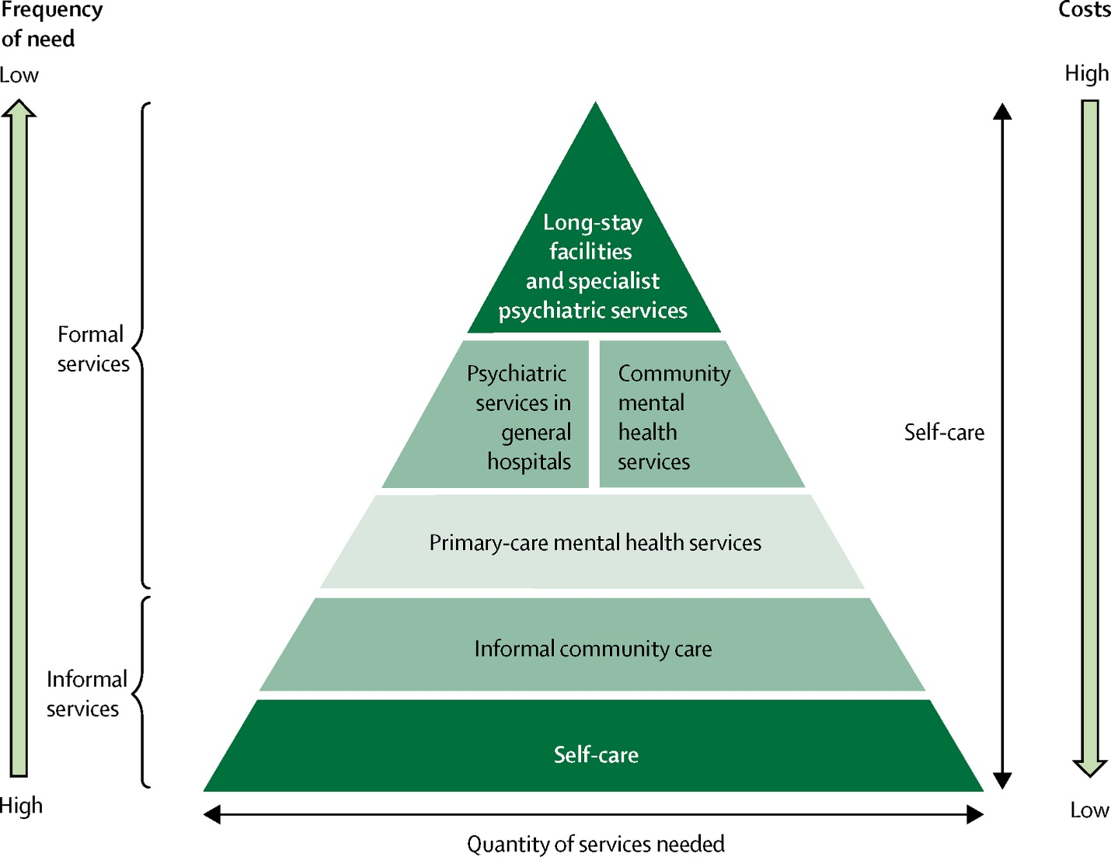
Conceptualizing Depression Care with The WHO Pyramid of Mental Health Services
Main Points
The number of available behavioral health (BH) care providers is always limited.
For minimal/mild depressive symptoms that do not cross the threshold into disorders, we need to rely primarily on self care, community care and primary care
11

Slide 12
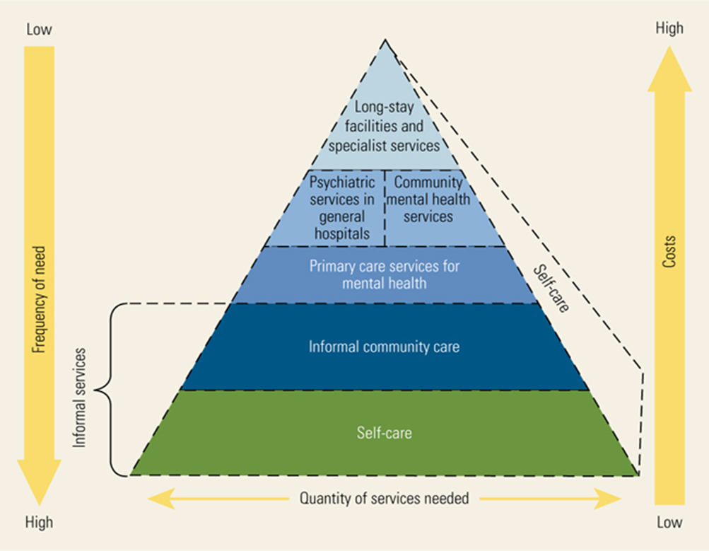
The WHO Pyramid of Mental Health Services
Patel V, et. al., Mental, Neurological and Substance Use Disorders, World Bank, 2015".
12

Slide 13
The National HIV Curriculum Has Tools to Screen for Depression and other Psychiatric Illnesses
13

Slide 14
Some Tools in the National HIV Curriculum Are Linked to Automatic Calculators
Screening Calculators & Tools: The HIV National Curriculum: www.aidetc.org/nhc
Mental Disorders Screening
Anxiety: GAD-2
Anxiety: GAD-7
Dementia: IHDS
Depression: PHQ-2
Depression: PHQ-9
PTSD: PC-PTSD-5
Substance Use Screening
Alcohol: AUDIT-C
Alcohol: CAGE
CAGE-AID
Drug Abuse: TICS
Opioid: Risk Tool
14

Slide 15
PHQ-2 and PHQ-9 Screening Tools for Depression
Readily available online at no charge
Already translated into multiple languages (but not necessarily validated)
Well studied in general medical populations
Easy to administer or self administer
Can be used to screen and/or make a probable diagnosis
Can be used to follow patients’ progress
15

Slide 16
Screening for Depression: PHQ-2
Over the last two weeks how often have you been bothered by any of the following problems:
Little interest or pleasure in doing things.
0=Not at all
1=Several days
2=More than half the days
3=Nearly every day
Feeling down, depressed or hopeless.
0=Not at all
1=Several days
2=More than half the days
3=Nearly every day
If the score is 3 or more, major depression is likely; consider further screening with the PHQ9. This screener can also be used as a yes/no questionnaire; if yes to either question, screen with the PHQ9.
Kroenke, et. al. Medical Care 2003
16

Slide 17
PHQ-9 for Depression: Items Rated from 0-3
1. Little interest or pleasure in doing things
2. Feeling down, depressed, or hopeless
3. Trouble falling or staying asleep, or sleeping too much
4. Feeling tired or having little energy
5. Poor appetite or overeating
6. Feeling bad about yourself — or that you are a failure or have let yourself or your family down
7. Trouble concentrating on things, such as reading the newspaper or watching television
8. Moving or speaking so slowly that other people could have noticed? Or the opposite — being so fidgety or restless that you have been moving around a lot more than usual
9. Thoughts that you would be better off dead or of hurting yourself in some way*
[*Asking about suicide is safe and does not encourage suicidal behavior]
Spitzer et., al., JAMA, 1999
17

Slide 18
The Differential Diagnosis of Depressive Symptoms
Evaluate for and address underlying medical disorders and contributing biological factors, for example hypothyroidism, hypogonadism, prescribed medications, alcohol and other substances, etc.
Remember that depression is often associated with significant cognitive impairment.
Try to rule out bipolar disorder.
18

Slide 19
PHQ-9 Scores
1-4: Minimal depression
5-9: Mild depression
10-14: Moderate depression
15-19: Moderately severe depression
20-27: Severe depression
19

Slide 20
Responding to Minimal/Mild Symptoms of Depression (while addressing modifiable medical conditions)
There aren’t enough behavioral health providers to refer all people with minimal/mild depressive symptoms to specialized care.
Self-care and informal supports at lower levels of care on the WHO pyramid can improve symptoms and play a role in preventing the onset of more severe symptoms.
Informal care can address the social determinants of health (food, shelter, income support, etc.).
20

Slide 21
Self Care for Minimal/Mild Depressive Symptoms
All health care providers can review advice and/or employ behavioral change strategies with their patients focused on wellness and self care:
Identifying and utilizing pre-existing coping strategies
Reaching out to social supports
Physical activity, exercise
Eating and sleeping well
Mindfulness and meditation
Listening to music
Productive and pleasurable activities
Reducing negative stimuli, such as interpersonal conflict and excessive exposure to distressing news
Caution using alcohol and other substances for coping
21

Slide 22
Evidence-based Psychotherapies for Depression
Best studied psychotherapies for depression
Cognitive behavioral psychotherapies
Interpersonal psychotherapy
How psychotherapies are used to treat depression
By themselves for mild to moderate depression
In combination with antidepressant treatment
22

Slide 23
Antidepressant Treatment for Depression
There’s no “penicillin” for depression.
There are no clinically relevant biological tests that predict therapeutic responses to different antidepressants. There are some tests to assess drug metabolism, but they don’t directly predict medication efficacy.
We largely treat patients by trial and error, monitoring tolerability to side effects and degree of improvement.
Response (>50% reduction of symptoms) is a much less desirable outcome than remission (few or no symptoms).
23

Slide 24
Treatment of Unipolar Major Depression in the STAR*D Study: Overview
There were two endpoints: response (>50% reduction of symptoms) and remission (few or no symptoms). Step one was treatment with citalopram.
If citalopram treatment was not successful, step two contained seven options for either augmentation (with another medication or cognitive behavioral therapy) or switching to another antidepressant.
If step two failed there were further options in steps three and four.
Since 2003, hundreds of papers have been published about the STAR*D results.
Rush et. al., Am J Psychiatry, 2006
24

Slide 25
Treatment of Unipolar Major Depression The STAR*D Study: Results
Rates of acute remission (few or no symptoms):
Step 1: 37%
Step 2: 31%
Step 3: 14%
Step 4: 13%
Rates of response (>50% reduction of symptoms):
Step 1: 49%
Step 2: 29%
Step 3: 17%
Step 4: 16%
Rates of medication intolerance, relapse and dropout are not shown in this slide.
Rush et. al., Am J Psychiatry, 2006
25

Slide 26
Treatment of Unipolar Major Depression in the STAR*D Study: Implications
It is valuable for prescribers in primary/HIV care to know how to use several antidepressants and be willing to switch patients from one to another depending on patient outcomes (symptom improvement and tolerance of side effects).
If the patient does not improve sufficiently after both trials, refer to mental health specialty care if available. Refractory depression causes severe suffering and disability.
Other reasons to refer to specialty care, if available, include bipolar depression, psychotic depression, risk for suicide and/or violence, and diagnostic uncertainty.
26

Slide 27
Classes of Antidepressants
SSRIs
SNRIs
Bupropion
Tricyclics
MAO inhibitors
Zuranolone-–just approved as a short-term treatment for post-partum depression (corrects hormonal imbalance)
Adjunctive treatment with mood stabilizers and other medications
27

Slide 28
There are Treatments For Depressive Disorders that Are Refractory to Usual Psychotropic Medications
Brain stimulation treatments: Electroconvulsive therapy (ECT) was the first such treatment, but now there are two other FDA approved treatments, vagus nerve stimulation (VNS) and repetitive transcranial magnetic stimulation (rTMS).
Ketamine, a veterinary anesthetic, (also known as a drug of abuse and a psychedelic), has been approved by the FDA for refractory depression; must be used with specific safeguards.
Other psychedelic drugs (e.g psilocybin, MDMA, LSD) combined with guidance/therapy are under study for refractory depression, but clinical trials can be difficult to access.
28

Slide 29
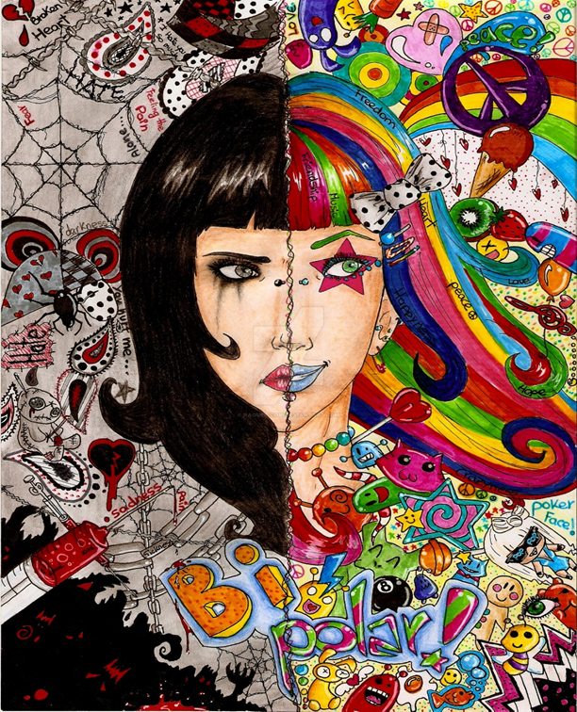
Bipolar Depression
Bipolar disorder is marked by extreme changes in mood (highs and lows), thought, energy and behavior. Changes in mood are intense and can last for hours, days, weeks or months.
People with this disorder typically seek help when they are in the depressive phase and are often initially diagnosed with unipolar depression. The average length of time to correct diagnosis and treatment is 10 years.
29

Slide 30
Distinguish Between Major Depression and Bipolar Depression
Bipolar depression accounts for most of time that people with bipolar disorder spend unwell.
This may help explain why, in primary care, over 3 in 20 patients diagnosed with a depressive disorder have unrecognized bipolar disorder.
First line pharmacologic treatment of bipolar depression is mood stabilizers (lithium, anticonvulsants, atypical antipsychotics), whereas for major depression it’s antidepressants.
Giving antidepressants alone, especially to people with bipolar 1 depression, may precipitate mania.
McIntyre, et al, Curr Med Res Opin, 2019; Devaney, et al, Gen Hosp Psych, 2019
30

Slide 31
Diagnosing Bipolar Disorder
There are no brief screens for bipolar disorder. The Mood Disorders Questionnaire (MDQ) is available but has 13 items.
Ask if the patient or a close relative has ever been told s/he has manic-depressive illness or bipolar disorder?”
Consider a few questions from the MDQ (based in the DSM-5):
Has there ever been a period of time when you were not your usual self, and you had much more energy than usual?”
Has there ever been a period of time when you got much less sleep than usual and found you didn’t really miss it?
If you get yes answers to any of the above questions, you might consider completing the MDQ (www.aidsetc.org/nhc) and/or referring the patient for a diagnostic evaluation.
31

Slide 32
Managing Bipolar Disorder
On average, bipolar disorders are more severe illnesses than depressive disorders. The DSM-5 has now created two separate categories for these conditions instead of lumping them together.
Most people with bipolar disorder need lifetime ongoing management for this condition to maximize social/occupational functioning and well being.
At the same time, there’s a long list of famous artists, fiction writers, inventors, politicians etc. with bipolar disorder.
People with bipolar disorder are most amenable to treatment during the depressive phase of the illness. Those who feel euphoric and energized during (hypo)mania often reject care while in that state.
32

Slide 33
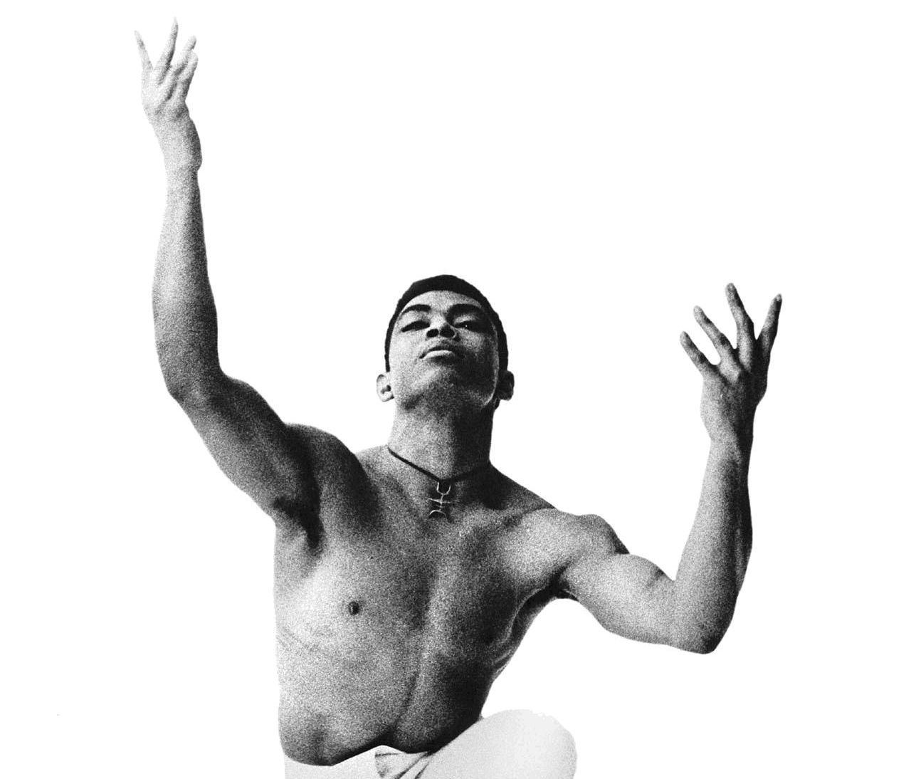
Bipolar Disorder is Associated with Creativity
Alvin Ailey was an American modern dancer who had bipolar disorder, alcohol and drug use, and HIV infection. He died of AIDS in 1989, but his work lives on through the Alvin Ailey American Dance Theater.
33

Slide 34
Alcohol/Substance Use Co-morbidity
Psychiatric disorders, including depressive disorders, carry a high degree of comorbidity with one another:
Our diagnoses are descriptive.
We have yet to understand the underlying biology that may tie our diagnoses together as different manifestations of the same vulnerability.
Siloed services for mental illness and substance use disorders are a major barrier to good care.
Most people with alcohol/substance use disorders receive no treatment for these conditions.
34

Slide 35
Alcohol/Substance Use Co-morbidity
A review of studies among people with bipolar disorders shows a 42% prevalence of alcohol use disorders, a 20% prevalence of cannabis use disorders and a 17% prevalence of other illicit drug use disorders.
In general, outcomes tend to be significantly worse among patients diagnosed as having both major depressive disorder and an alcohol/substance use disorder, compared with patients who have only one of these diagnoses.
Hunt, et al, J Affect Disord, 2016; Iqbal et al, Focus (Am Psychiatr Publ). Spring 2019
35

Slide 36
Alcohol/Substance Use Co-morbidity
Alcohol and substance use disorders tend to be one of the most problematic of psychiatric comorbidities among persons with depressive disorders and HIV because of their added negative impact on morbidity, mortality, and outcomes along the HIV care continuum.
In this case, two disorders = two treatments
Depressive disorders and alcohol/substance use disorders each require their own treatment because treating only one condition doesn’t usually result in sufficient improvement of the other condition.
36

Slide 37
Alcohol/Substance Use Co-morbidity
Alcohol and substance use disorders tend to be one of the most problematic of psychiatric comorbidities among persons with depressive disorders and HIV because of their added negative impact on morbidity, mortality, and outcomes along the HIV care continuum.
In this case, two disorders = two treatments
Depressive disorders and alcohol/substance use disorders each require their own treatment because treating only one condition doesn’t usually result in sufficient improvement of the other condition.
37

Slide 38
Outcomes of Depression Treatment in People with HIV
People with HIV often achieve comparable outcomes with depression treatment as the general population (relevant antidepressant research is very limited).
General outcomes include:
Relief of suffering and improved quality of life
Reduced disability and cognitive dysfunction
Increased ability to function
Reduced mortality due to suicide and, in some studies, medical illness.
38

Slide 39
Conclusions
Depressive disorders are common among people with HIV, and they are highly treatable if providers persevere.
Rule out medical causes of depression among people with HIV.
Distinguish between depressive symptoms and depressive disorders. Symptom severity helps determine treatment.
Consider whether depression is part of a bipolar disorder.
Psychotherapies and medications are effective treatments. Self care is always essential. Addressing social determinants helps.
The treatment chosen will depend on patient preference and the treatment capacities of a specific (HIV) care setting.
39

