Slide 1
Project ECHO® - UNM
HIV ECHO Clinic
Syphilis Screening & Treatment
Ana-Alicia Leonso, MD
Infectious Disease Fellow, PGY-4
University of New Mexico Health Science Center
Notes:
Version_ 07 2023

Slide 2
Conflict of Interest Disclosure Statement
Speaker has nothing to disclose.
This presentation was reviewed by UNMHSC and SCAETC faculty to ensure it meets Continuing Education guidelines.

Slide 3
Learning Objectives
Correctly use/order and interpret the results of syphilis screening tests.
Identify how to treat syphilis at various stages according to CDC guidelines.

Slide 4
Recap of Syphilis Overview
Lowest # of cases in 2000, incidence increasing, peak in 2020
Highest rates:
Men who have sex with men (MSM), age group 25-29 yo
Black persons #1 (American Indian/Alaska Native #2)
Western US with New Mexico #5 in state rankings
Congenital syphilis rates high, especially in NM
HIV coinfection in primary & secondary syphilis cases:
46% of MSM, 8% of men who only have sex with women, 6% of women
Reference: Syphilis – National STD Curriculum. Updated 10/21/22
https://www.std.uw.edu/go/comprehensive-study/syphilis/core-concept/all
Notes:
Although surveillance data includes all stages of syphilis diagnosed, primary and secondary most accurately reflect new infections.
Congenital syphilis increase is likely related to the 235% increase in syphilis among women during the same time period
Additional 5% of cases are in men who have sex with men and women
Extremely high rates noted in DC

Slide 5
Recap of Syphilis Overview
Risk factors: injection drug use (IDU), exchange of sex for money or drugs, or incarceration in men
MSM: multiple/concurrent partners, anonymous sex, methamphetamine use
Women: having partners that have been incarcerated
Pregnant patients: unstable housing, multiple sex partners, concurrent sex and drug use, heroin use, late entry to prenatal care
Reference: Syphilis – National STD Curriculum. Updated 10/21/22
https://www.std.uw.edu/go/comprehensive-study/syphilis/core-concept/all
Notes:
Although surveillance data includes all stages of syphilis diagnosed, primary and secondary most accurately reflect new infections.
Congenital syphilis increase is likely related to the 235% increase in syphilis among women during the same time period
Additional 5% of cases are in men who have sex with men and women
Extremely high rates noted in DC

Slide 6
Recap of Syphilis Overview
Treponema pallidum - spirochete, corkscrew-shaped, motile
Enters circulatory system → lymphatics → regional nodes +/- central nervous
Transmission:
Sexual contact (highest risk during primary/secondary syphilis)
Hematogenous (mainly in utero - transplacental spread to fetus, at any stage)
Transmission through needle-sharing with IDU is infrequent
Primary: Inoculation & proliferation → activates immunity → painless “chancre”
Secondary: Hematogenous dissemination → nonpruritic rash (trunk, palms, soles), flat mucous patches, lymphadenopathy (LAD), patchy alopecia, Condylomata lata, visceral
Tertiary: Untreated for many years → Gummatous lesions, cardiovascular syphilis
Reference: Syphilis – National STD Curriculum. Updated 10/21/22
https://www.std.uw.edu/go/comprehensive-study/syphilis/core-concept/all
Notes:
Trepa “to turn” –nema “thread” (Greek) pallida “pale” (Latin)
Cannot be seen under light microscopy and cannot be cultivated on culture media, only on live rabbit tissues
Rare to have congenital disease due to contact with maternal genital lesions during live vaginal delivery

Slide 7
Recap of Syphilis Overview
Neurosyphilis (NS): early form resembles aseptic meningitis or stroke-like syndrome with seizures, late form wide variety of symptoms including dementia
Ocular: wide range acute/chronic manifestations, most commonly uveitis +/- NS
Otic: typically, sensorineural hearing loss, also tinnitus, vertigo, or combination +/- NS
Latent: Persistence of T. pallidum without signs/symptoms; sero-reactivity + no past syphilis diagnosis + no active manifestations; can occur at any stage
Early latent: <1 year duration; no signs/symptoms or unequivocal, seroconversion or reactive test with possible exposure within 12 months, sustained (>2 weeks) ≥ 4-fold titer increase, or contact with a sex partner that had untreated syphilis
Late latent: >1 year; does not meet criteria for early latent syphilis
Reference: Syphilis – National STD Curriculum. Updated 10/21/22
https://www.std.uw.edu/go/comprehensive-study/syphilis/core-concept/all

Slide 8
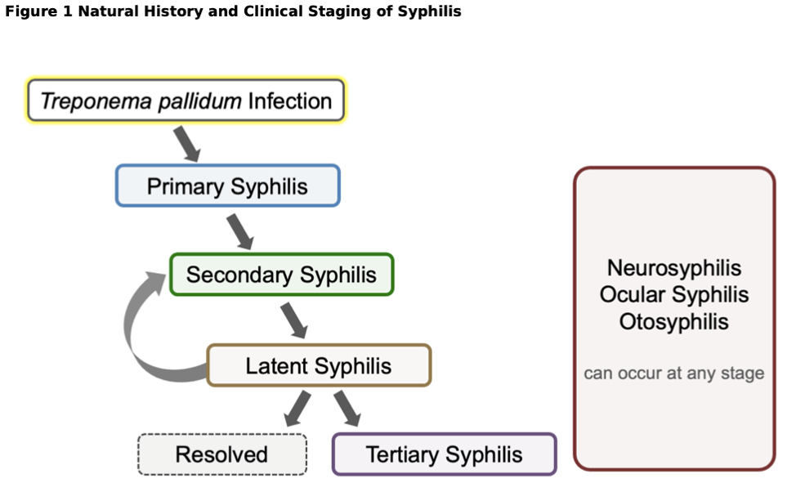
Reference: Syphilis – National STD Curriculum. Updated 10/21/22 https://www.std.uw.edu/go/comprehensive-study/syphilis/core-concept/all
Notes:
Infection to primary (chancre, regional LAD) 2-6 weeks Neuroinvasion
Primary to secondary (rash, generalized LAD) 1-3 months Early neurosyphilis
Secondary to latency (70% lifetime risk) 1-3 months V
Latent to tertiary (gumma, CV disease) months-decades Late neurosyphilis

Slide 9
Congenital Syphilis
Untreated syphilis in pregnancy → wide range of outcomes (infant death and stillbirth) and infant could be born with or without signs/symptoms
Transmission at any stage, highest risk in early stages & maternal acquisition in 3rd trimester
Early congenital syphilis: manifestations of syphilis at < 2 years of age
Rhinitis, Lymphadenopathy (LAD), hematologic changes, hepatosplenomegaly, jaundice, bone changes, ophthalmic manifestations, rash, pseudoparalysis
Late congenital syphilis: manifestations at >2 years of age
Frontal bossing, saddle nose, hard palate perforation, Hutchinson’s teeth, saber shins, short maxilla, eye disease and deafness
Reference: Syphilis – National STD Curriculum. Updated 10/21/22 https://www.std.uw.edu/go/comprehensive-study/syphilis/core-concept/all
Notes:
osteochondritis, diaphyseal osteomyelitis, periostitis
cataracts, glaucoma, intersitial keratitis, optic neuritis, chorioretinitis, pigmentary chorioretinopathy
anemia, thrombocytopenia
Saber shins = tibial thickening
caused by scarring and chronic inflammatory changes from persistent infection

Slide 10
Recap of Syphilis Overview
Screening:
MSM, persons with HIV (PWH), and gender diverse patients → at least annual
Pregnant persons → each pregnancy, first prenatal visit, first encounter with health- care facility, retest at 28 weeks gestation or if stillborn is delivered at >20 weeks
Diagnosis: clinical criteria + lab testing
Direct detection: direct fluorescent antibody (DFA) detects T. pallidum antigen (Ag) in tissue via treponeme-specific antibody (Ab), biopsy tissue staining (silver or immuno-histochemical stain) for spirochetes
Serology: requires use of both treponemal tests and non-treponemal tests due to risks of false-positive and false-negative results if only one type is used
NS: lumbar puncture with positive cerebrospinal fluid analysis (elevated WBC +/-elevated protein level) + positive serology + new neurological signs/symptoms
Reference: Syphilis – National STD Curriculum. Updated 10/21/22
https://www.std.uw.edu/go/comprehensive-study/syphilis/core-concept/all
Notes:
Early infectious syphilis (primary, secondary, early latent)
No routine screening in men who only have sex with women & nonpregnant patients
Consider opt-out screening in correctional centers with high local transmission rates

Slide 11
Recap of Syphilis Overview
Treponemal tests: qualitative, measure Ab against T. pallidum Ag
Enzyme immunoassays (EIA), chemiluminescence assays (CIA), particle agglutination (TPPA), fluorescent antibody absorption (FTA-ABS)
Detect IgG +/- IgM, more specific, reactive earlier in disease, often reactive for life
Nontreponemal tests: quantitative, measure Ab against nonspecific lipoidal Ag (cardiolipin, lecithin), reported as titers
Venereal Disease Research laboratory (VDRL) & rapid plasma regain (RPR) tests
Can be negative in early/late disease, titers decrease over time
Interpretation of RPR:
Any (+) RPR is significant if T. pallidum Ab (+)
Highest in secondary syphilis
New infection = 4-fold (2-dilution) increase in titer
Adequate treatment = 4-fold (2-dilution) decrease in titer
Reference: Syphilis – National STD Curriculum. Updated 10/21/22
https://www.std.uw.edu/go/comprehensive-study/syphilis/core-concept/all
Notes:
15-20% become nonreactive
False positive: autoimmune disease (AID), other spirochetes (Lyme), malaria, leprosy
False positive: AID, IDU, old age, pregnancy, other spirochetes, HSV or HIV infection, and recent vaccination
False negatives: Prozone Effect (see next slide) - very high serum Ab supersaturates the test Ag interfering with the Ag-Ab lattice network needed to visualize a flocculation reaction
Tests can be elevated in untreated primary/secondary syphilis without NS
CSF WBC can be elevated in HIV (CD4 <350 cells/mm³ or serology titer >1:32), so some experts suggest higher cutoff in this case (WBC >20 cells/mm³ instead of >5)
CSF VDRL has high specificity but low sensitivity (assuming no blood contamination of CSF)
If VDRL is negative, but there is high clinical suspicion for NS and other CSF results are abnormal, either treat empirically or can get treponemal CSF FTA-ABS to confirm

Slide 12
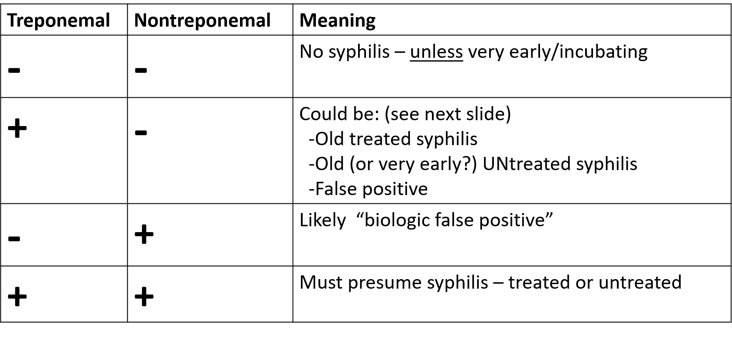
Result Interpretation
If (+) treponemal test with (-) nontreponemal test → get 2nd (different type) treponemal test
Positive → treat unless they have documented previous treatment
Negative → Likely false positive or can get a third type of treponemal test
Reference: Original Slide from presentation by Elaine Thomas, MD UNMHSC
Notes:
Need very good H&P to assess for signs of prior primary or secondary symptoms
If false positive is suspected or patient not previously treated, retest with another treponemal test (TPPA)

Slide 13
Treatment
Treat according to disease stage
Ensure correct long-acting benzathine penicillin (Bicillin-LA)
Penicillin (PCN) allergy?
Take a good history as many patients are not truly allergic
Alternative if true PCN allergy: Doxycycline 100 mg PO bid
Cannot use alternative in:
Pregnancy or neurosyphilis – HAS TO BE penicillin; get expert advice
Requires desensitization protocol to be done
Limited data suggest that IM or IV ceftriaxone 1-2 grams daily x 10-14 days can be an alternative for neurosyphilis
Reference: Original Slide from presentation by Elaine Thomas, MD UNMHSC
Notes:
Bloody taps
HIV, concurrent ART + syphilis treatment may improve clinical response to treatment

Slide 14
Treatment for Pregnant People
High priority to prevent transplacental transmission
Still treated according to disease stage
No alternatives for PCN allergy – require desensitization
Some experts recommend additional Bicillin LA 2.4 mu IM dose one week after initial one for primary, secondary, early latent disease
Treatment with any antibiotic other than PCN or treatment in the last month of pregnancy is inadequate for the fetus
Inform patients that syphilis treatment can induce early labor
Reference: Syphilis – National STD Curriculum. Updated 10/21/22 https://www.std.uw.edu/go/comprehensive-study/syphilis/core-concept/all

Slide 15
Treatment
Stage | Duration | Signs | Treatment
Primary | 3-6 weeks after infection | Chancre, regional LAD | Bicillin LA 2.4 mu IM x 1 dose Doxycycline 100 mg PO bid x 14 days
Secondary | 6-12 weeks after infection | Rash, LAD, fever, mucosal patches, Condylomata lata, alopecia, nephritis, hepatitis | Bicillin LA 2.4 mu IM x 1 dose Doxycycline 14 days
Early Latent | <1 year after infection | No clinical manifestations | Bicillin LA 2.4 mu IM x 1 dose Doxycycline 14 days
Late Latent | >1 year after infection | No clinical manifestations | Bicillin LA 2.4 mu IM x 3 once weekly doses Doxycycline 100 mg PO x 28 days
Tertiary | Many years later | Neurological/cardiovascular disease, Gummatous lesions | Bicillin LA 2.4 mu IM x 3 once weekly doses Doxycycline 28 days
Neurosyphilis Ocular/Otic Syphilis | Any stage | Meningitis, vasculitis, otic, ocular | PCN-G 18-24 million units IV daily x 10-14 days
Reference: Adapted Slide from presentation by Michelle Iandiorio, MD UNMHSC SCAETC
Notes:
Latent unknown duration: treat as late latent
PCN given as 3-4 million units q4hr or CI
If adherence to therapy can be ensured, an acceptable alternative is a 10- to 14-day course of intramuscular procaine penicillin G 2.4 million units once daily plus probenecid 500 mg orally four times a day
Some experts recommend giving additional therapy with intramuscular benzathine penicillin G 2.4 million units once per week for up to 3 weeks—starting after the completion of the 10- to 14-day regimen—to provide a total duration of therapy comparable to the treatment for late latent syphilis; although this approach is often used, data are lacking to support this enhanced treatment regimen.[26] In addition, there is insufficient data to support the use of systemic corticosteroids as adjunctive therapy for neurosyphilis, ocular syphilis, or otosyphilis.
Missed doses – restart regimen if >10-14 days between doses for most cases and >9 days for pregnant women

Slide 16
Congenital Syphilis Treatment
Depends on age (neonates vs infants/children) & probability of infection (confirmed, highly probable, possible, less likely) in neonates
Neonates confirmed/probable:
Penicillin (PCN G) 100k–150k units/kg/day (50k units/kg/dose IV q12hrs in first 7 days of life and q8hrs thereafter) for 10 days
Neonates possible/less likely:
IM benzathine PCN G 50k units/kg in a single dose with follow-up
Infants/children:
PCN G 200k–300k units/kg/day (50k units/kg/dose by IV q4–6hrs) for 10 days
Reference: Syphilis – National STD Curriculum. Updated 10/21/22 https://www.std.uw.edu/go/comprehensive-study/syphilis/core-concept/all

Slide 17
Jarisch-Herxheimer Reaction
Self-limited reaction, systemic inflammatory response, associated with initiation of syphilis treatment
Likely due to release of endotoxin-like substances, NOT an allergy
Typical signs: fever, malaise, nausea, vomiting; less frequently chills, tachycardia, hyperventilation, hypotension, worsened rash, leukocytosis
Most often occurs with early syphilis treatment (especially secondary) likely due to higher bacterial burden
Typically begins within several hours after initiating treatment (nearly always within 24 hours)
Management: Supportive care, hydration, antipyretics
Reference: Syphilis – National STD Curriculum. Updated 10/21/22 https://www.std.uw.edu/go/comprehensive-study/syphilis/core-concept/all
Notes:
Usually resolves spontaneously within 24 hours

Slide 18
National Shortage
https://www.cdc.gov/std/treatment/drug-notices.htm

Slide 19
CDC Guidelines for Management
Get baseline RPR on or near treatment day
Careful history & exam including neurological & eye exams
Test for other sexually transmitted infections (STIs) and HIV
Report case to Department of Health
Test and TREAT all partners
Advise patient to abstain from sex for one week after treatment of themselves and all their partners
Follow-up titer at 3, 6, and 12 months – expected 4-fold drop by 6 months
Patient could become serofast (+RPR after adequate treatment – usually low titer)
Treatment failure:
Persistent/recurrence of signs/symptoms or
New symptoms of early infection or
4-fold increase in RPR persisting >2 weeks
Reference: Adapted Slide from presentation by Michelle Iandiorio, MD UNMHSC SCAETC
Notes:
Test HIV again 3 months later
If RPR negative, but high clinical suspicion, repeat RPR in 1-2 weeks
Should allow up to 12 months before determining if tx failure has occurred
Up to 40% of people become serofast
Evaluation for neurosyphilis with lumbar puncture and CSF evaluation is recommended if new neurologic manifestations are present or there are no recent sexual exposures (in the prior 6 months in persons treated for primary or secondary syphilis and the prior 12 months for person treated for latent and other stages of syphilis
Sex partner notification/test/treatment:
-all sex partners in the last 90 days prior to dx if early syphilis
-if >90 days since last partner, notify only the most recent partner and treat presumptively for early syphilis if unreliable/follow-up uncertain, or wait to treat if reliable with f/u
-Some places w/high prevalence will notify/presumptively treat if late latent syphilis w/high titer (>1:32)
-Long-term partners of late latent syphilis should have screening and testing based on test

Slide 20
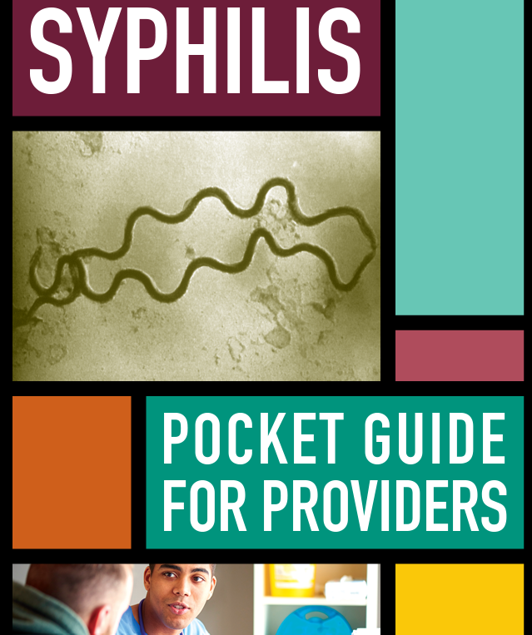
https://www.cdc.gov/std/products/provider-pocket-guides.htm

Slide 21
https://www.cdc.gov/std/products/provider-pocket-guides.htm
Notes:
Includes section on wide variety of different types of STIs, screening recommendations including for sexual assault, guide on taking a sexual history, clinical tools for partner mgmt., vaccines, etc, AND an alert page

Slide 22
References
Syphilis – National STD Curriculum. Updated 10/21/22 https://www.std.uw.edu/go/comprehensive-study/syphilis/core-concept/all
Jurado, R. L., Campbell, J., & Martin, P. D. (1993). Prozone phenomenon in secondary syphilis. Has its time arrived?. Archives of internal medicine, 153(21), 2496–2498.
Moon, J., Yu, D. A., Yoon, H. S., Cho, S., & Park, H. S. (2018). Syphilitic Gumma: A Rare Form of Cutaneous Tertiary Syphilis. Annals of dermatology, 30(6), 749–751. https://doi.org/10.5021/ad.2018.30.6.749
Baughn RE, Musher DM. Secondary syphilitic lesions. Clin Microbiol Rev. 2005 Jan;18(1):205-16. doi: 10.1128/CMR.18.1.205-216.2005. PMID: 15653827; PMCID: PMC544174.
https://www.cdc.gov/std/treatment-guidelines/syphilis.htm
https://www.cdc.gov/std/treatment-guidelines/provider-resources.htm#MobileApp
https://www.cdc.gov/std/statistics/prevalence-2020-at-a-glance.htm
https://www.cdc.gov/std/products/provider-pocket-guides.htm

Slide 23
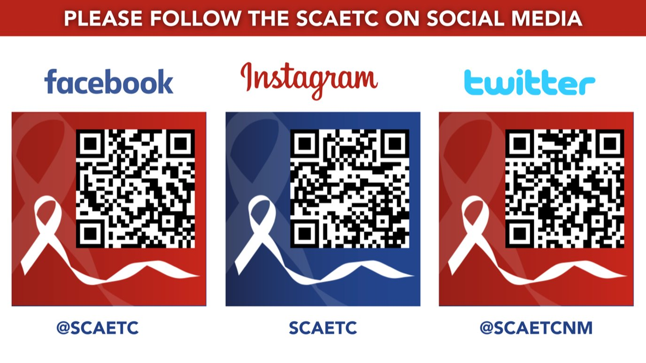
SCAETC Social Media

Slide 24
Resources
National Clinician Consultation Center http://nccc.ucsf.edu/
HIV Management
Perinatal HIV
HIV PrEP
HIV PEP line
HCV Management
Substance Use Management
Present case on ECHO http://echo.unm.edu hivecho@salud.unm.edu
AETC National HIV Curriculum https://aidsetc.org/nhc
AETC National Coordinating Resource Center https://targethiv.org/library/aetc-national-coordinating-resource-center-0
Additional trainings scaetcecho@salud.unm.edu
www.scaetc.org
Notes:
Find additional TeleECHO sessions in your area: https://echo.unm.edu/locations-2/echo-hubs-superhubs-united-states/
https://hsc.unm.edu/echo/get-involved/join-an-echo/
IDEA Platform: Infectious Diseases Education & Assessment. https://idea.medicine.uw.edu/
AETC National HIV Curriculum: 6 core modules for self study; regularly updated; CME, CNE
Hepatitis C Online Curriculum: https://www.hepatitisc.uw.edu/
Hepatitis B Online Curriculum: https://www.hepatitisb.uw.edu/
National STD Curriculum: https://www.std.uw.edu/

