Slide 1
HIV 101
Brent Cotter, MSc, PA-C, AAHIVS
Advanced Practice Provider
University of Kentucky

Slide 2
Disclosures
None

Slide 3
Objectives
Upon completion of this educational activity, you will be able to:
Understand current statistics of HIV epidemiology
Recognize and name at-risk groups of people for HIV infection
Understand testing and screening for HIV
Familiarize with HIV linkage to care and treatment

Slide 4
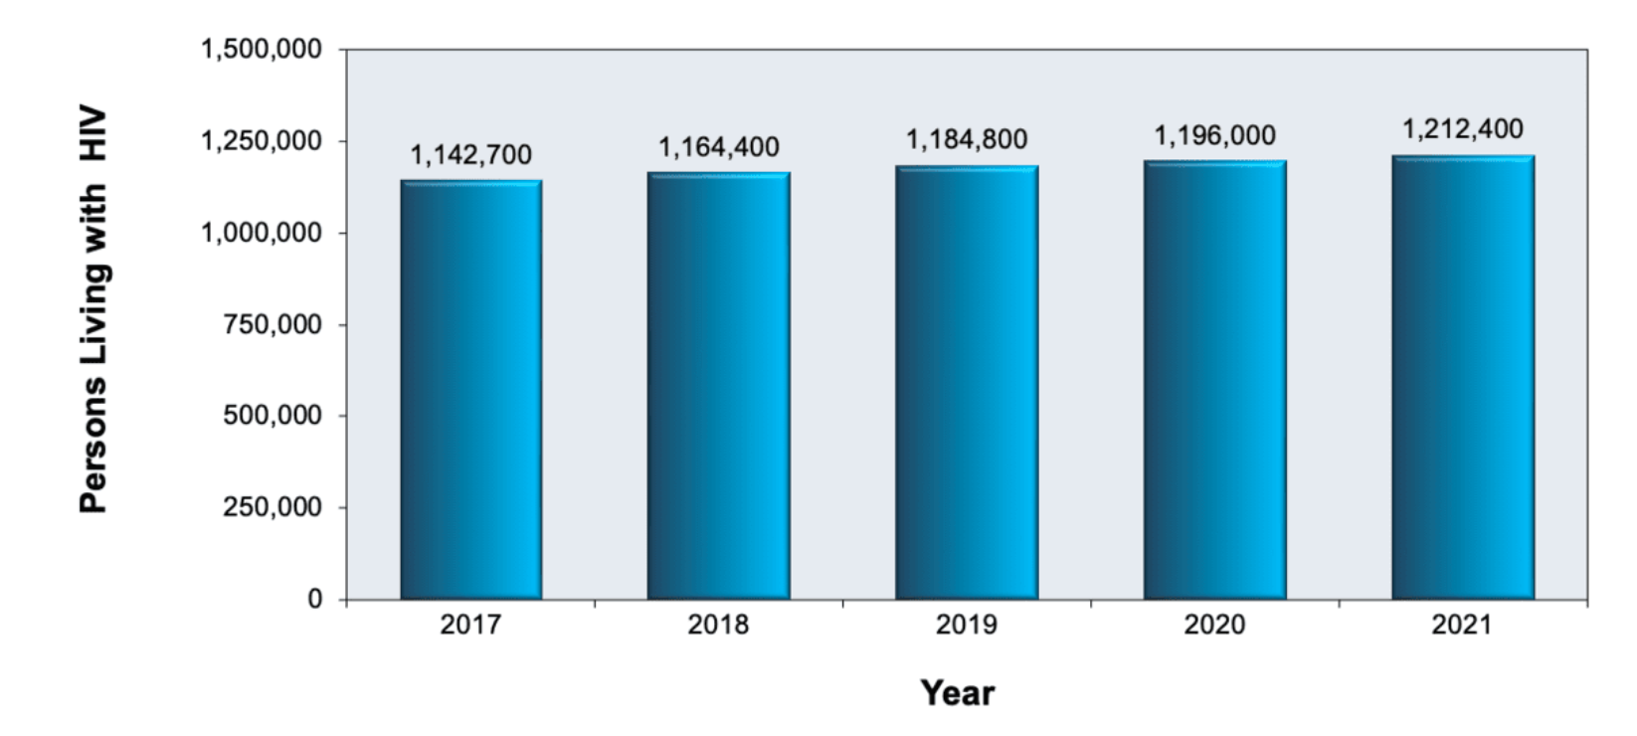
HIV Epidemiology in the US
Source: Source: Centers for Disease Control and Prevention. Estimated HIV Incidence and Prevalence in the United States, 2017–2021.
Notes:
Numbers include diagnosed and undiagnosed HIV

Slide 5
Estimated number of new HIV infections in the US by region
Notes:
https://www.hiv.gov/hiv-basics/overview/data-and-trends/statistics/

Slide 6
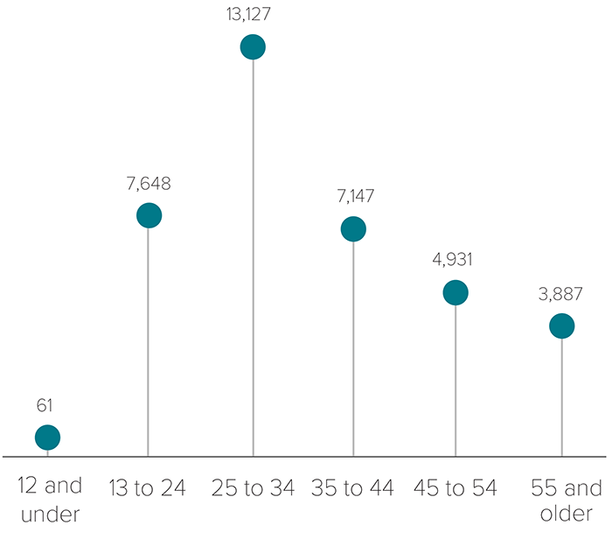
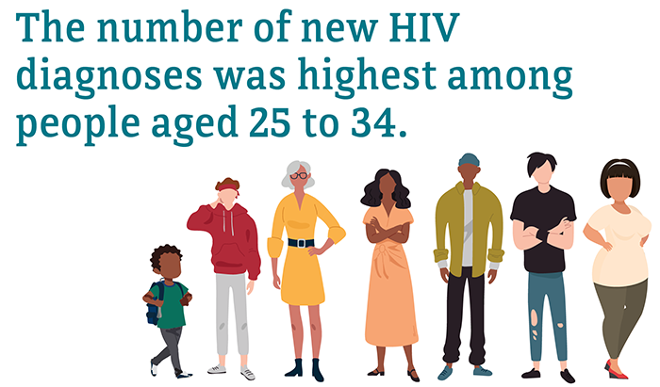
HIV and Age
Source: CDC. Diagnoses of HIV infection in the United States and dependent areas, 2019. HIV Surveillance Report 2021;32.
Notes:
HIV prevalence rates by race in the United States > 13 years of age

Slide 7
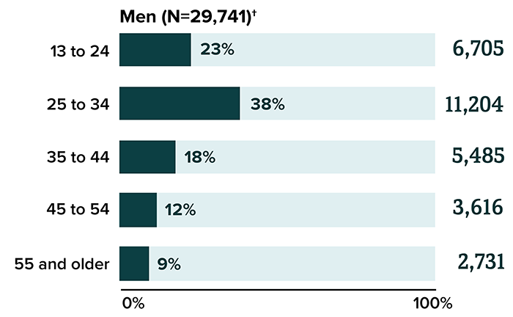
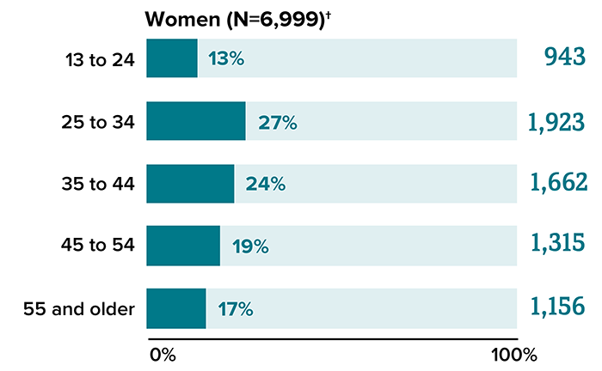
HIV and Age
Source: CDC. Diagnoses of HIV infection in the United States and dependent areas, 2019. HIV Surveillance Report 2021;32.
Notes:
HIV prevalence rates by race in the United States > 13 years of age

Slide 8
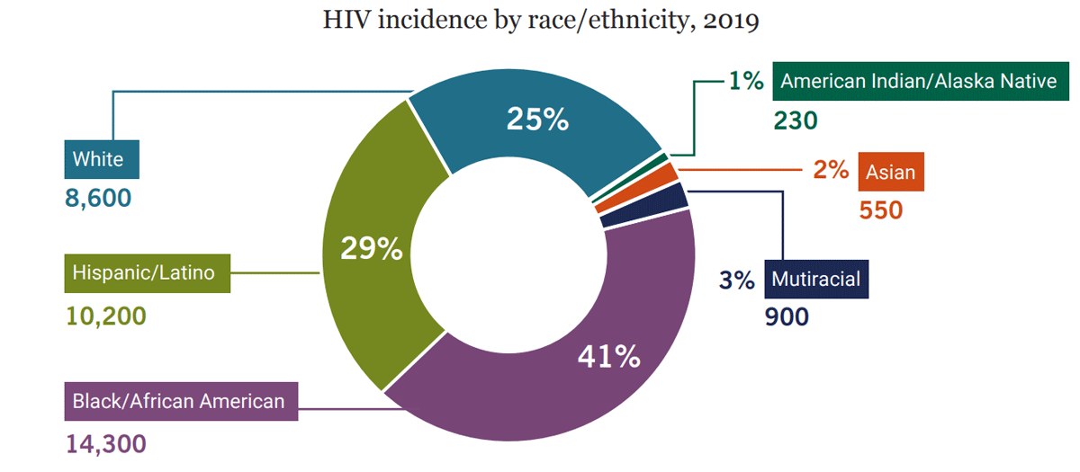
HIV and Race/Ethnicity
Source: CDC, Estimated HIV incidence and prevalence in the United States, 2015–2019, HIV Surveillance Supplemental Report 2021;26(1).
Notes:
HIV prevalence rates by race in the United States > 13 years of age

Slide 9
HIV and Race/Ethnicity
Source: CDC, Estimated HIV incidence and prevalence in the United States, 2015–2019, HIV Surveillance Supplemental Report 2021;26(1) and US Census Bureau, Quick Facts—United States.

Slide 10
HIV and Race/Ethnicity
According to CDC in 2019:
26% of new HIV infections were among Black gay and bisexual men
23% among Latino gay and bisexual men
45% among gay and bisexual men under the age of 35.
Notes:
HIV prevalence rates by race in the United States > 13 years of age

Slide 12
HIV Epidemiology Summary
HIV in 2023
39 million people with HIV (PWH) worldwide
26 million PWH on antiretroviral therapy (ART)
~1.2 million PWH in US at end of 2019 according to CDC
13% of the 1.2 million (about 160,000) do not know they have HIV
Of those in the US, most reside in the south
MSM, black/AA people, and hispanic/latino people are high risk populations
IVDU growing
Notes:
Numbers include diagnosed and undiagnosed HIV

Slide 13
What is HIV?
Human Immunodeficiency Virus
Human retrovirus
Reverse transcriptase
Tropism for CD4+ T-cells
HIV-1, HIV-2
Viral load
Measure of viral copies / mL blood
Presence = HIV infection
CD4+
Normal = 550 –2200 cells/mm³

Slide 14
HIV Life Cycle

Slide 15
How is HIV Transmitted?
Sex
Oral
Vaginal
Anal
Blood
Needle sharing
Accidental needle stick
Bloody fluid to open cut/mucous membrane
Transfusion (1 in 1.5 million risk)
Pregnancy
Breastfeeding (15% risk if continued for 2 years; 30% if newly acquired infection)
Resource rich
Resource limited

Slide 16
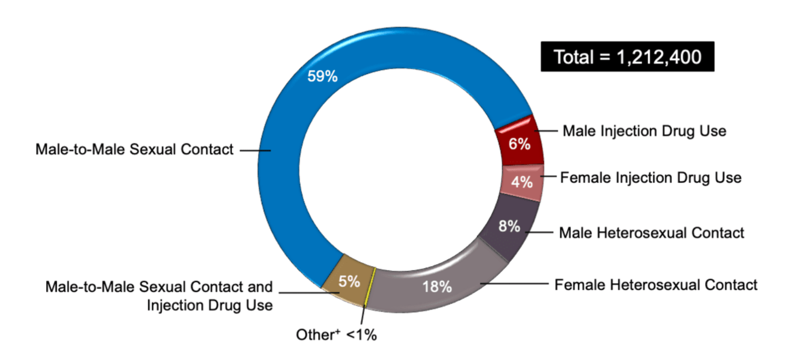
HIV Transmission
Notes:
HIV prevalence by transmission category- CDC 2021 data

Slide 17
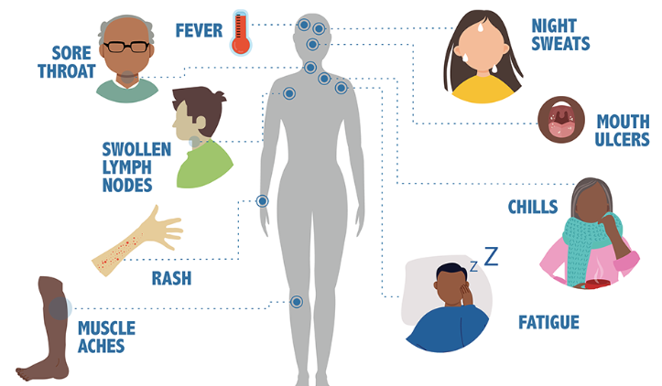
Stage 1: Acute HIV infection
2 to 4 weeks after infection:
Notes:
If HIV goes untreated then there are a series of stages patients may experience
Stage 1: acute HIV infection
high amount of HIV in blood, flu like symptoms
https://www.cdc.gov/hiv/basics/whatishiv.html

Slide 18
Stage 2: Chronic HIV infection
Asymptomatic
HIV remains active
Transmittable
May last decades

Slide 19
Stage 3: AIDS
Acquired Immunodeficiency Syndrome
Severe stage
Definition of AIDS:
CD4 count <200 or <14%
and/or
1 or more AIDS-defining illness/condition

Slide 20
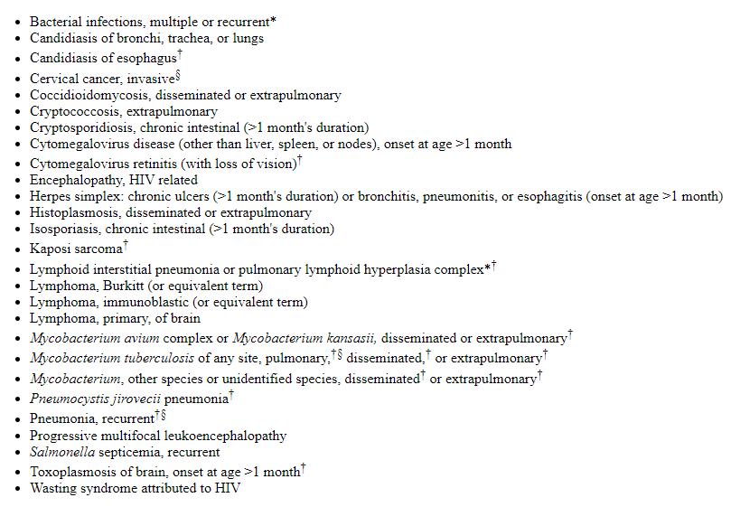
AIDS-defining Conditions

Slide 21
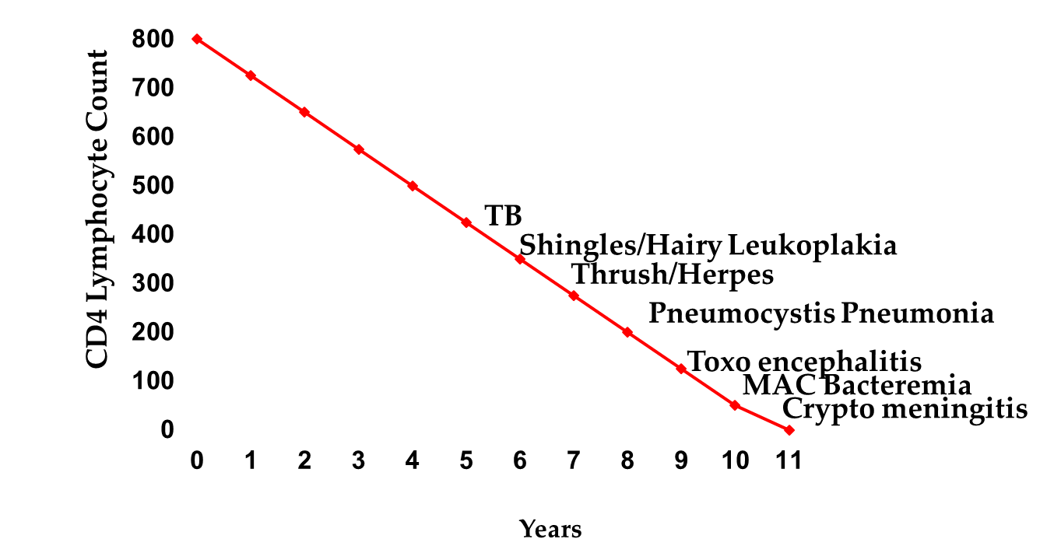
Opportunistic infection risk with CD4 count

Slide 22
Testing and Screening
U.S. Preventive Services Task Force (USPSTF) 2019 update:
Clinicians should screen all adults age 15 to 65 years for HIV
All pregnant persons should be screened for HIV during pregnancy and during each pregnancy
Repeat screening is reasonable for those
At increased risk for HIV acquisition
Living or receiving medical care in high-prevalence setting

Slide 23
Testing and Screening
HIV antigen-antibody = preferred screening tests for HIV
The immunoassays detect HIV-1 p24 antigen and antibodies (IgM and IgG) to HIV-1 and HIV-2
All reactive HIV-1/2 antigen-antibody tests require confirmatory testing

Slide 24
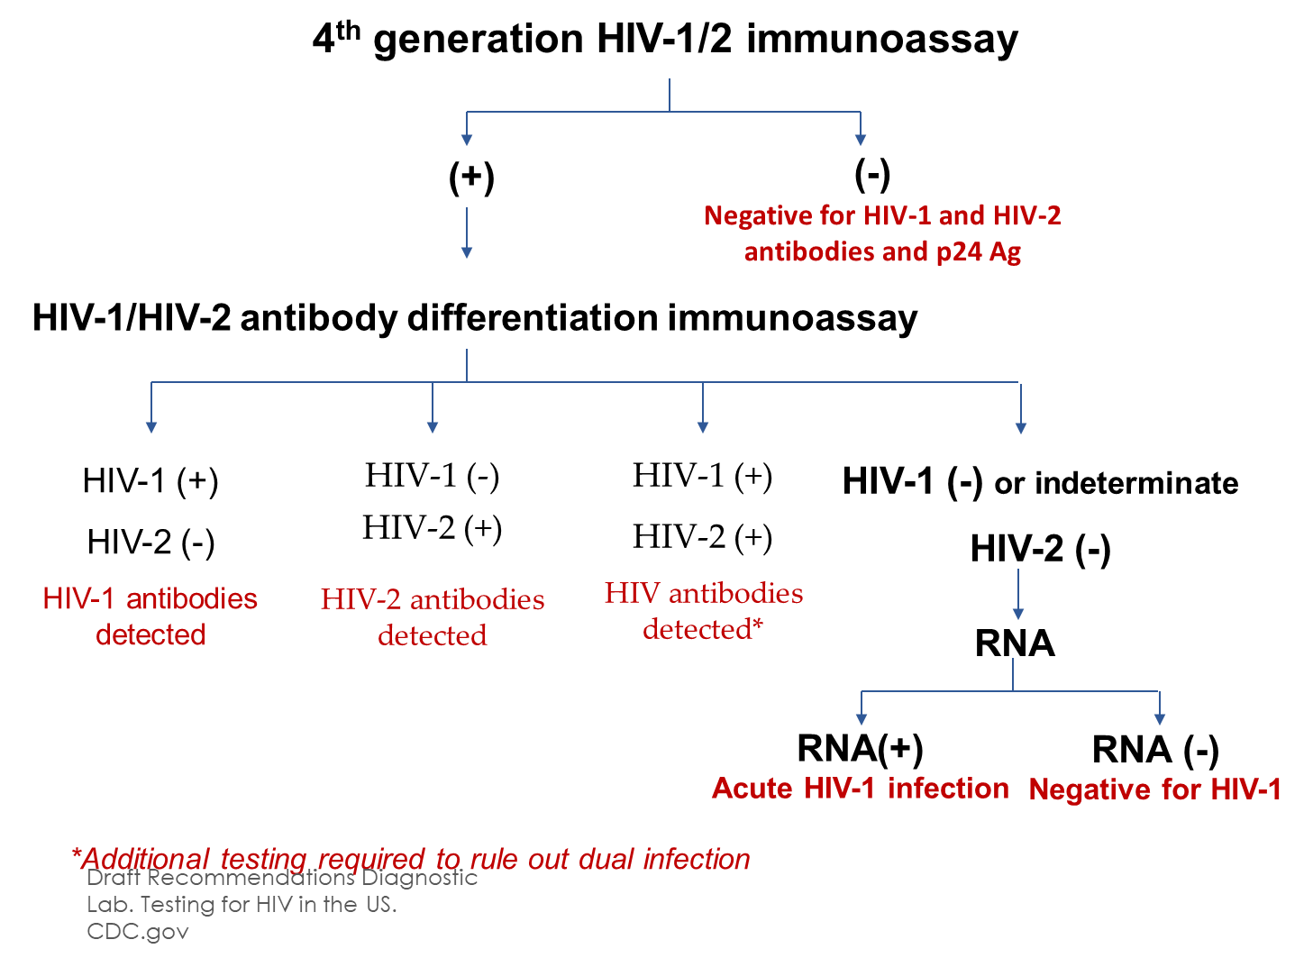

Slide 25
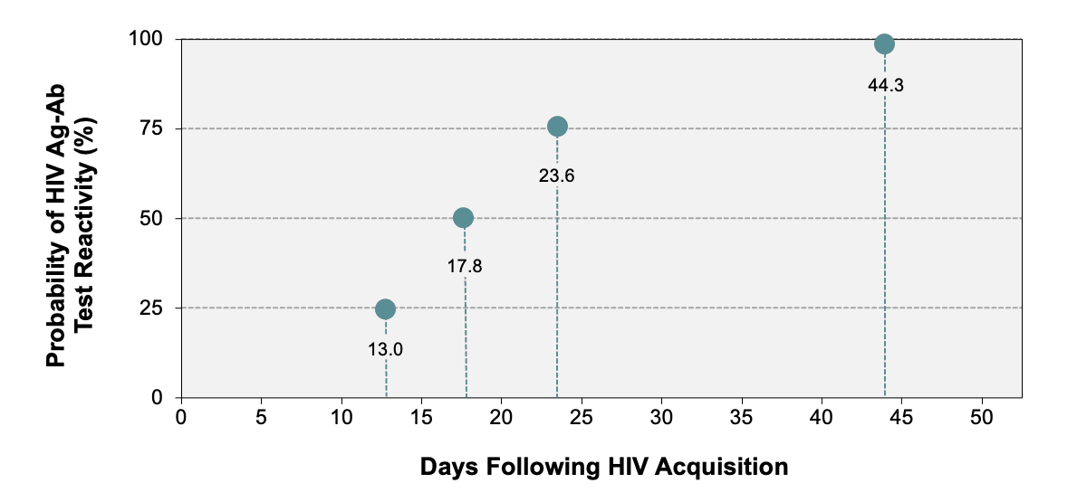
Testing and Screening
Source: Delaney KP, Hanson DL, Masciotra S, Ethridge SF, Wesolowski L, Owen SM. Time Until Emergence of HIV Test Reactivity Following Infection With HIV-1: Implications for Interpreting Test Results and Retesting After Exposure. Clin Infect Dis. 2017;64:53-9.
Notes:
Delaney KP, Hanson DL, Masciotra S, Ethridge SF, Wesolowski L, Owen SM. Time Until Emergence of HIV Test Reactivity Following Infection With HIV-1: Implications for Interpreting Test Results and Retesting After Exposure. Clin Infect Dis. 2017;64:53-9.

Slide 26
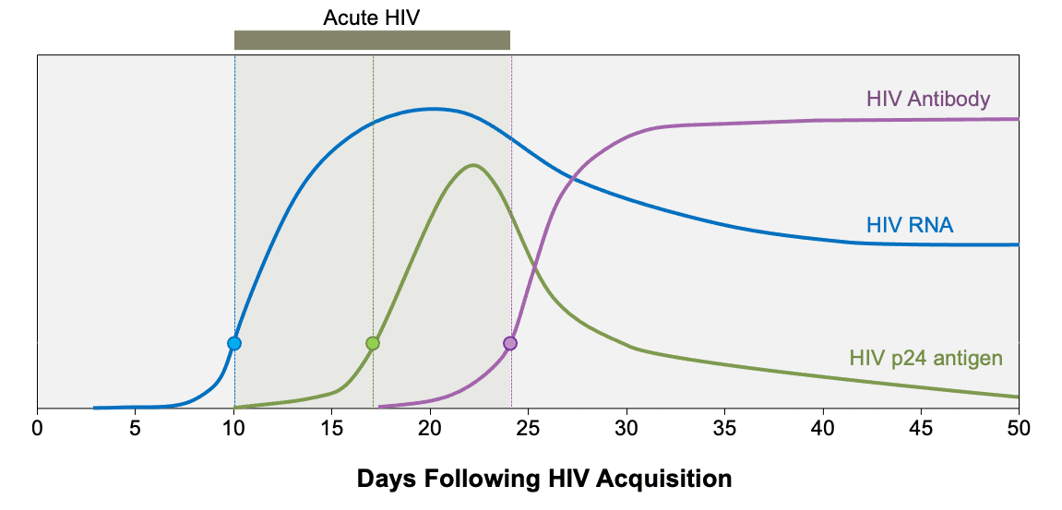
Testing and Screening
Notes:
https://www.hiv.uw.edu/go/screening-diagnosis/diagnostic-testing/core-concept/all

Slide 27
Case: Deon
23 y.o. Black MSM
PMH IVDU methamphetamine for 4 years.
He shares needles when he uses meth and goes to parties on the weekend where he engages in sex with multiple anonymous partners mostly without condom use.

Slide 28
Case: Deon
About 4 weeks ago, Deon noticed a rash over his torso that began to spread to his arms and legs.
He noticed severe fatigue, sore throat, and just not feeling like himself.

Slide 29
Case: Deon
Deon's symptoms continued to worsen, so he decided to go to a local urgent care clinic where the provider decided to obtain a series of tests.
Deon was negative for flu, COVID-19, and strep A.
Gonorrhea, Chlamydia, and RPR (syphilis) negative.
The provider consulted a colleague who recommended obtaining an HIV test

Slide 30
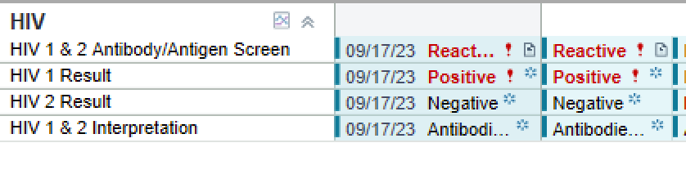
Case: Deon
The next day, HIV Ab/Ag screening returned positive for HIV-1.

Slide 31
Case: Deon
The next day, HIV Ab/Ag screening returned positive for HIV-1.
What test should be ordered next, if not already ordered, to confirm the diagnosis?

Slide 32
Case: Deon
An HIV RNA quantitative PCR returned detectable at 1,250,000 copies/ML.
What should happen next?

Slide 36
Finding HIV Providers
Local Health Department
HIV.gov's locator: https://locator.hiv.gov/
KY HIV/AIDS hotline: 1-844-294-2448
Toll-free
American Academy of HIV Medicine:
https://providers.aahivm.org/referral-link-search

Slide 37
Case: Deon
Deon was referred by the UTC to a local HIV clinic.
When should Deon be started on HIV treatment?

Slide 38
Rapid (Immediate) ART Start
HIV ART started on same day as first clinic visit or upon diagnosis
Appropriate for those with confirmed HIV infection or those with suspected acute HIV infection
Inappropriate for those with HIV with certain CNS infections
Compressed/targeted HIV history with baseline labs drawn
Certain ART regimens recommended for 30 day supply and follow up in 1-2 weeks

Slide 39
Case: Deon
Deon was scheduled for an appointment with an HIV clinic where he had a series of labs collected but no results available other than HIV testing.
Deon met with a clinical pharmacist the same day and was started on Biktarvy 1 tablet PO once per day.

Slide 40
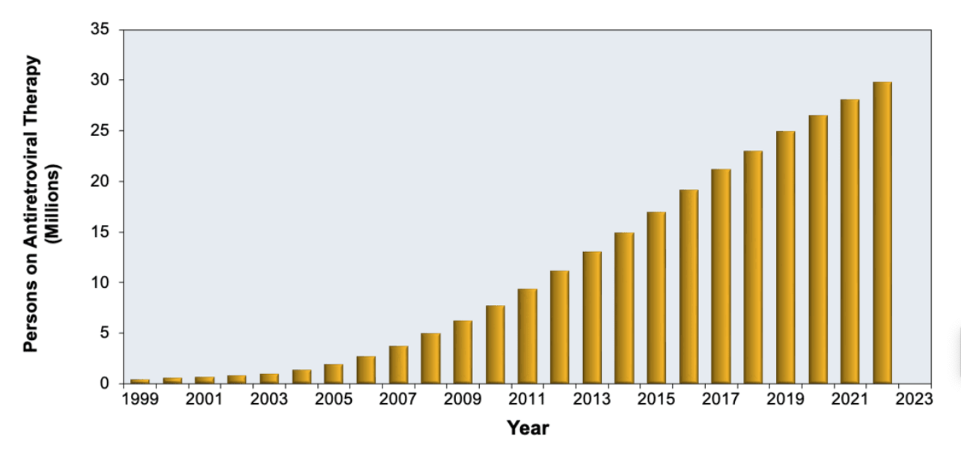
HIV Treatment
Persons with HIV on Antiretroviral Therapy-Global, 1999-2022
Source: World Health Organization (WHO)
Notes:
https://apps.who.int/gho/data/view.main.23300REGION?lang=en

Slide 41
HIV Treatment
HIV/AIDS-related deaths have fallen by approximately 69% since 2004 (2 million) and by 51% since 2010 (1.3 million).
The global decline in AIDS-related deaths has been attributed to the expanded availability and use of antiretroviral therapy in many regions of the world.

Slide 42
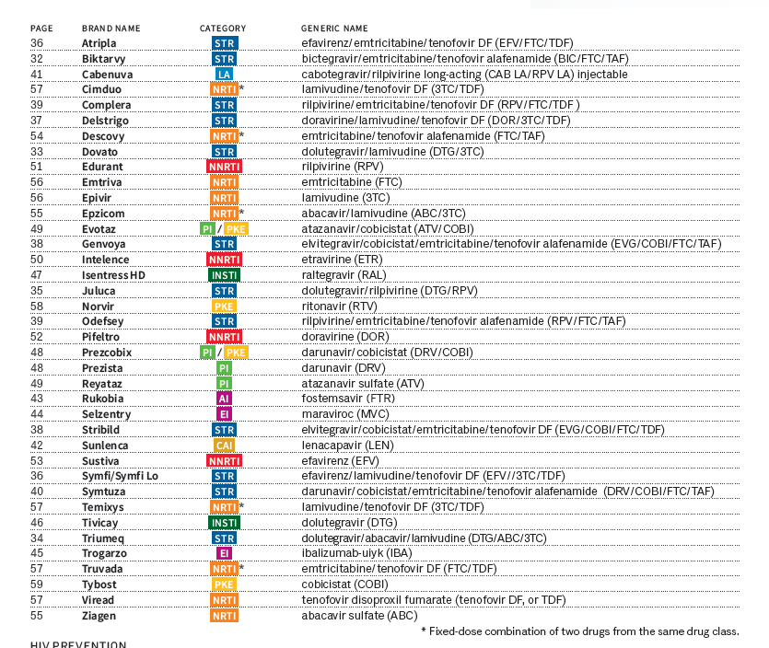
HIV Treatment

Slide 43
HIV Treatment
Many different treatment options for treatment of HIV
Selection of ART (Antiretroviral therapy)
Must consider several factors:
Treatment experienced vs naïve
Labs (Resistance? Renal or liver dysfunction? Lipids?)
Drug Interactions
Ability to be pregnant
Food requirements
Potential risks (e.g. weight gain, GI upset, etc.)
Pill burden
Patient preference

Slide 44
HIV Treatment
Complete ART regimen = medications from two or more drug classes
ART Drug Classes:
Integrase strand inhibitors
Nucleoside reverse transcriptase inhibitors
Protease inhibitors
Non-nucleoside reverse transcriptase inhibitors
Entry Inhibitors/Attachment Inhibitors

Slide 45
HIV Life Cycle

Slide 46
HIV Treatment

Slide 48
Lab monitoring
Baseline labs
4 to 8 weeks after ART initiation:
HIV Quantitative Viral Load (HIV VL)
Comprehensive Metabolic Panel (CMP)
Every 3 to 6 months or as clinically indicated:
HIV VL
Every 6 months or as clinically indicated:
CMP

Slide 49
Lab monitoring
CD4 count:
Baseline/entry to care/ART start
CD4 count <300 cells/mm3
Every 3 months
First 2 years of ART + CD4 count >300 cells/mm3
Every 6 months
After 2 years on ART + consistently undetectable HIV viral load:
CD4 300-500 cells/mm3 --> Every 12 months
CD4 count >500 cells/mm3 --> Optional monitoring
Notes:
https://clinicalinfo.hiv.gov/en/guidelines/hiv-clinical-guidelines-adult-and-adolescent-arv/tests-initial-assessment-and-follow-full

Slide 52
U=U
HPTN 052
no linked transmissions were observed when the treated partner’s viral load was stably suppressed by antiretroviral treatment.
PARTNER
1,166 HIV mixed status couples (both heterosexual couples and gay male couples) from 14 European countries.
All couples reported condomless sex, and the index partner was virally suppressed.
From September 2010 to May 2014 the study found no sexual transmission of HIV among mixed HIV status couples when the index partner was virologically suppressed

Slide 53
Case: Deon
6 weeks after starting Biktarvy, Deon's viral load is undetectable (<40 copies/mL) and CD4 count is 650 cells/mL.
More energy and symptoms resolved
In a monogomous relationship with HIV negative male partner who is on PrEP
Enrolled in a sober living program for stimulant use disorder

Slide 54
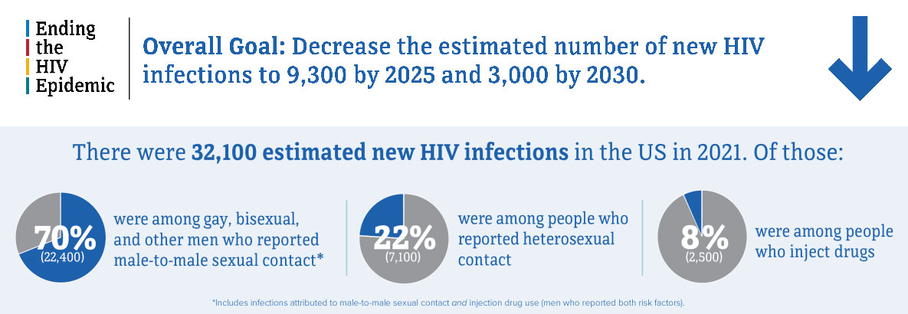
HIV Prevention Efforts
Ending the HIV Epidemic in the U.S. (EHE)
Coordinated by the US Department of HHS
Goals:
Reduce new HIV infections in the U.S. by 75% by 2025 and by 90% by 2030
Advance health equity by scaling up key HIV prevention and treatment strategies
Notes:
https://www.cdc.gov/endhiv/index.html

Slide 55
HIV Prevention Efforts
Ending the HIV Epidemic in the U.S. (EHE)
Incidence
Goal reduce new HIV infections in the U.S. by 75% by 2025 and by 90% by 2030
In 2021 the incidence of HIV in the US was estimated at 32,100 new HIV infections
Knowledge of status
Goal: increase knowledge of HIV status to 95% by 2025
In 2021, 87% of people with HIV received a diagnosis
Viral Suppression
Goal: increase the percentage of people diagnosed with HIV who are virally suppressed to 95% by 2025
In 2021, 66% of people diagnosed with HIV were virally suppressed
Notes:
https://www.cdc.gov/endhiv/index.html

Slide 56
CDC and the EHE
Diagnosis all people LWH as early as possible
Treat PWH rapidly and effectively to achieve viral suppression
Prevent HIV by promoting access to PrEP and SSPs
CDC responds quickly to potential HIV outbreaks
Notes:
Diagnosis all people LWH as early as possible
Treat PWH rapidly and effectively to achieve viral suppression
Prevent HIV by promoting access to PrEP and SSPs
CDC responds quickly to potential HIV outbreaks

Slide 57
HIV Prevention Efforts
PrEP (Pre-Exposure Prophylaxis)
Ending the HIV Epidemic
CDC's Lets Stop HIV Together
Notes:
https://clinicalinfo.hiv.gov/en/guidelines/hiv-clinical-guidelines-adult-and-adolescent-arv/tests-initial-assessment-and-follow-full

Slide 58
How to Advocate
Education
HIV National Curriculum
American Academy HIV Medicine
HIV SpecialistTM
Vote
Social Media
Lets Stop HIV Together
Instagram: @stophivtogether
HIV.gov
Instagram: @hivgov

Slide 59
Citations
Centers for Disease Control and Prevention. (n.d.). Centers for Disease Control and Prevention. https://www.cdc.gov/
HIV and AIDS resources. HIV.gov. (1970, October 15). https://www.hiv.gov/
National HIV curriculum. (n.d.). https://www.hiv.uw.edu/
Berry, J., & Vazquez, E. (2023). A guide to the drug guide. Positively Aware, 27(March+April 2023), 27–28.
Stern, J. (2023). What makes HIV such a retro-virus?. Positively Aware, 27(March+April 2023), 22–23.

Slide 60
Q&A

Slide 61
AETC Program
National Centers and National HIV Curriculum
National Coordinating Resource Center serves as the central web based
repository for AETC Program training and capacity building resources; its
website includes a free virtual library with training and technical assistance
materials, a program directory, and a calendar of trainings and other events.
Learn more: https ://aidsetc.org
National Clinician Consultation Center provides free, peer to peer,
expert advice for health professionals on HIV prevention, care, and treatment
and related topics. Learn more: https ://nccc.ucsf.edu
National HIV Curriculum provides ongoing, up to date HIV training and
information for health professionals through a free, web based curriculum;
also provides free CME credits, CNE contact hours, CE contact hours, and
maintenance of certification credits. Learn more: www.hiv.uw.edu

