Slide 1
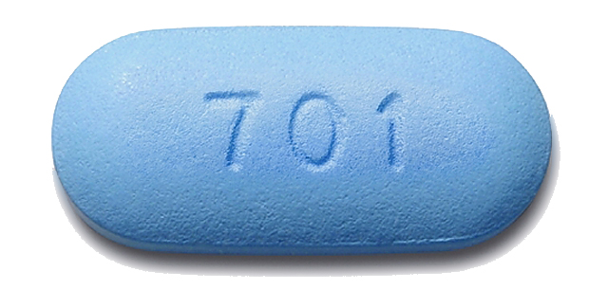
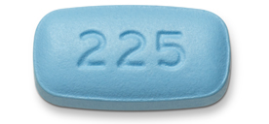
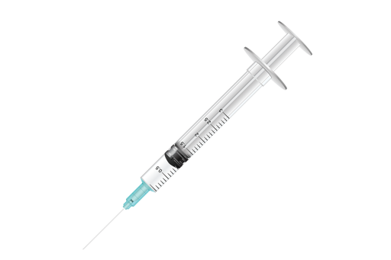
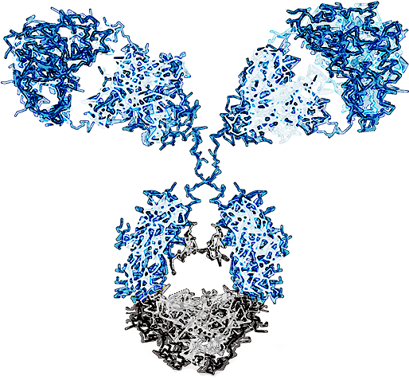
PrEP
Beyond
Pills
New Technologies in Biomedical HIV Prevention

Slide 2
Christopher B. Hurt, MD
Associate Professor of Medicine
Director, North Carolina HIV Training & Education Center
Site PI, Ryan White HIV/AIDS Program Part D, UNC ID Clinic
Co-Leader, UNC CFAR Collaborative HIV Epidemiology & Prevention Scientific Working Group
Institute for Global Health & Infectious Diseases
University of North Carolina at Chapel Hill
School of Medicine
As of 1 Oct 2018, Dr. Hurt receives salary support for supervising UNC site activities in a Gilead-funded study of PrEP (DISCOVER).
Dr. Hurt is supported by the Centers for Disease Control and Prevention (ELC-2017-J3), Health Resources and Services Administration (HRSA-17-039, U1OHA30535), the National Institute on Drug Abuse (UH3DA044823), and the National Institute of Allergy and Infectious Diseases (P30AI50410, UM1AI069423, UM1AI068619, UM1AI068614).
The views expressed are not necessarily those of CDC, HRSA, or the NIH.
18 September 2020

Slide 3
Objectives
List three ways in which pre-exposure prophylaxis (PrEP) may be delivered in the future.
Describe the results of HPTN 083 and what this means for PrEP in the near term.
Identify the agent currently under investigation as implantable PrEP.
Explain how broadly neutralizing antibodies work to prevent HIV infections.

Slide 4
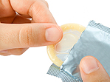
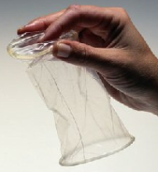
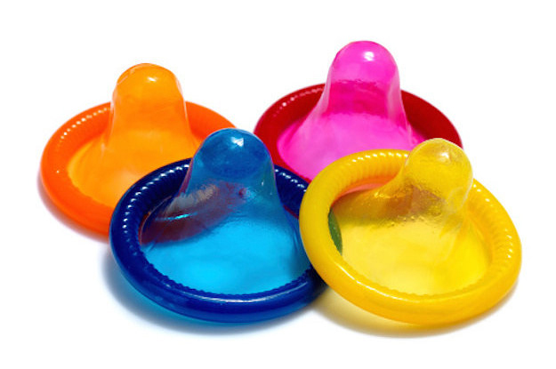
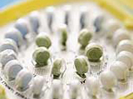
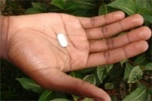
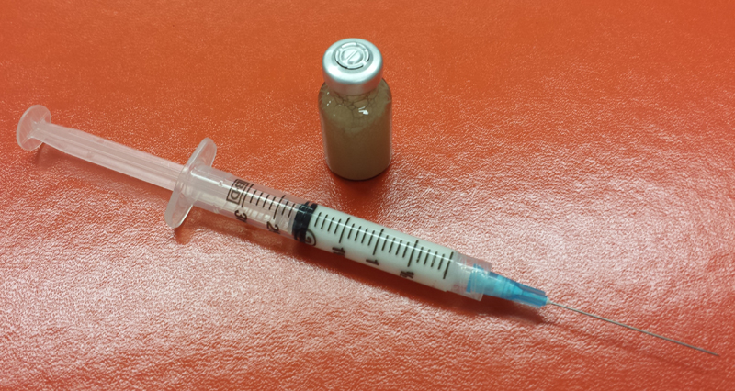
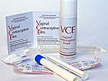
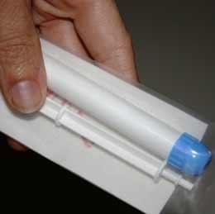
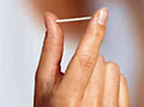
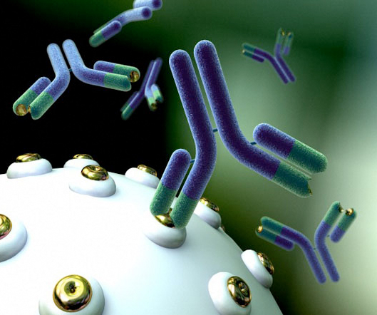
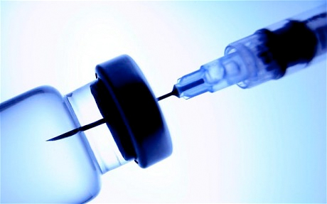
Pregnancy Prevention | HIV Prevention
Education & behavior modification | Education & behavior modification
Condoms | Condoms
Rings | Rings
Birth control pill & injection | PrEP (oral & injectable)
“Morning-after pill” | Post-exposure prophylaxis
Spermicide | Topical microbicides
Implantable birth control | Broadly neutralizing Abs Implantables
Vasectomy/Tubal Ligation | Vaccination
Adapted from HPTN

Slide 5
Pregnancy Prevention | HIV Prevention
Education & behavior modification | Education & behavior modification
Condoms | Condoms
Rings | Rings
Birth control pill & injection | PrEP (oral & injectable)
“Morning-after pill” | Post-exposure prophylaxis
Spermicide | Topical microbicides
Implantable birth control | Broadly neutralizing Abs Implantables
Vasectomy/Tubal Ligation | Vaccination
Adapted from HPTN

Slide 6
Pregnancy Prevention | HIV Prevention
Education & behavior modification | Education & behavior modification
Condoms | Condoms
Rings | Rings
Birth control pill & injection | PrEP (oral & injectable)
“Morning-after pill” | Post-exposure prophylaxis
Spermicide | Topical microbicides
Implantable birth control | Broadly neutralizing Implantables
Vasectomy/Tubal Ligation | Vaccination
Adapted from HPTN

Slide 7
Rings

Slide 8
ASPIRE Monthly dapivirine (DPV) ring
2629 cisgender women aged 18-45 Malawi, South Africa, Uganda, Zimbabwe
July 2012 – August 2015
27%
56%
61%
lower incidence overall 71 infections on DPV, 97 on placebo (95%CI: 1, 46)
lower incidence among participants > 21 years old (95%CI: 31, 71)
lower incidence among participants ≥ 25 years old (95%CI: 32, 77)
Younger women didn’t adhere
Baeten JM, et al. N Engl J Med. 2016;375(22):2121-2132

Slide 9
The Ring Study Monthly dapivirine ring
1959 cis women aged 18-45 South Africa and Uganda
April 2012 – December 2016
31%
15%
37%
lower incidence overall 77 infections on DPV, 56 on placebo (HR 0.69; 95%CI: 0.49, 0.99)
lower incidence among participants ≤ 21 years old (HR 0.85; 95%CI: 0.45, 1.60)
lower incidence among participants > 21 years old (HR 0.63; 95%CI: 0.41, 0.97)
Nel A, et al. N Engl J Med. 2016;375(22):2133-2143

Slide 10
Open-label extensions ASPIRE → HOPE
Ring → DREAM
Placebo incidence is estimated
39%
63%
lower incidence
among 1465 open-label recipients in HOPE (95%CI: 14, 65)
lower incidence among 941 open-label recipients in DREAM (95%CI: 0.86, 2.33)
https://www.prepwatch.org/nextgen-prep/dapivirine-vaginal-ring/

Slide 11
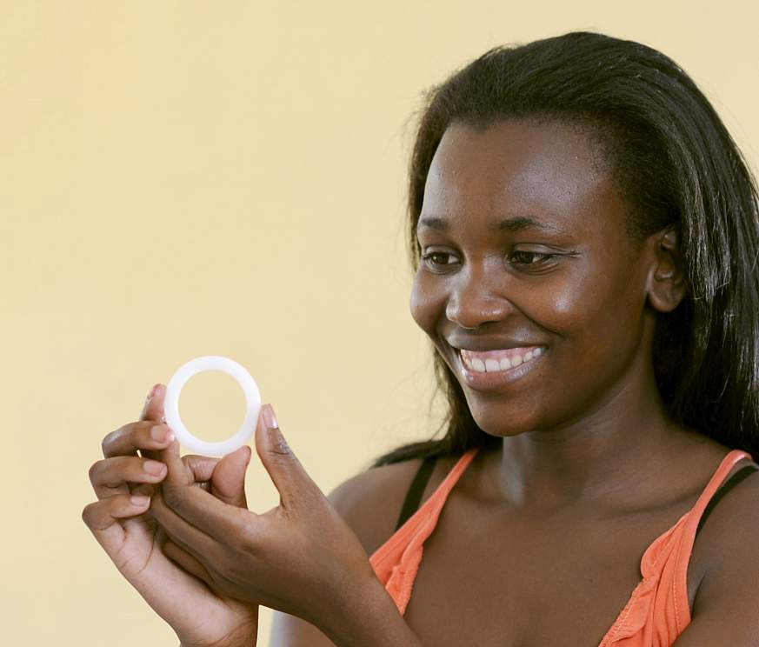
Where does dapivirine go from here?
Positive opinion from European Medicines Agency in July 2020
FDA application anticipated in 2020
Three-month version in development
Coformulation with levonorgestrel in development

Slide 12
Long-Acting Injectables (LAIs)

Slide 13
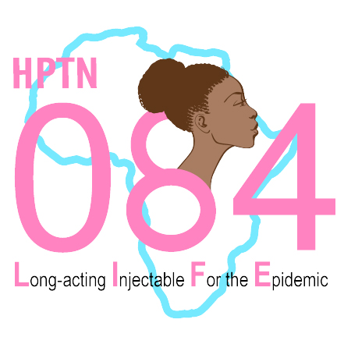
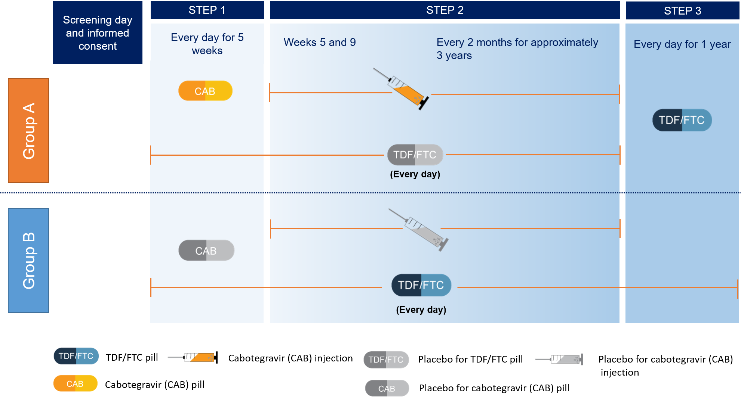
HPTN 083 & 084
Oral FTC/TDF vs Injectable Cabotegravir-LA
MSM & TGW (083) and Cisgender Women (084)

Slide 14
HPTN 083
Oral FTC/TDF vs Injectable CAB-LA for men who have sex with men (MSM) & transgender women (TGW)
December 2016 – May 2020
4566
50%
50%
at-risk persons (target N = 5000)
87.5% MSM 12.4% TGW
daily FTC/TDF (n=2284)
long-acting injected cabotegravir
(n=2282)
37%
49.7%
26
from US (n=1698)
of US participants were Black
(n=844)
median age (IQR 22-32)
Landovitz RJ, et al. AIDS 2020. Abstract OAXLB01

Slide 15
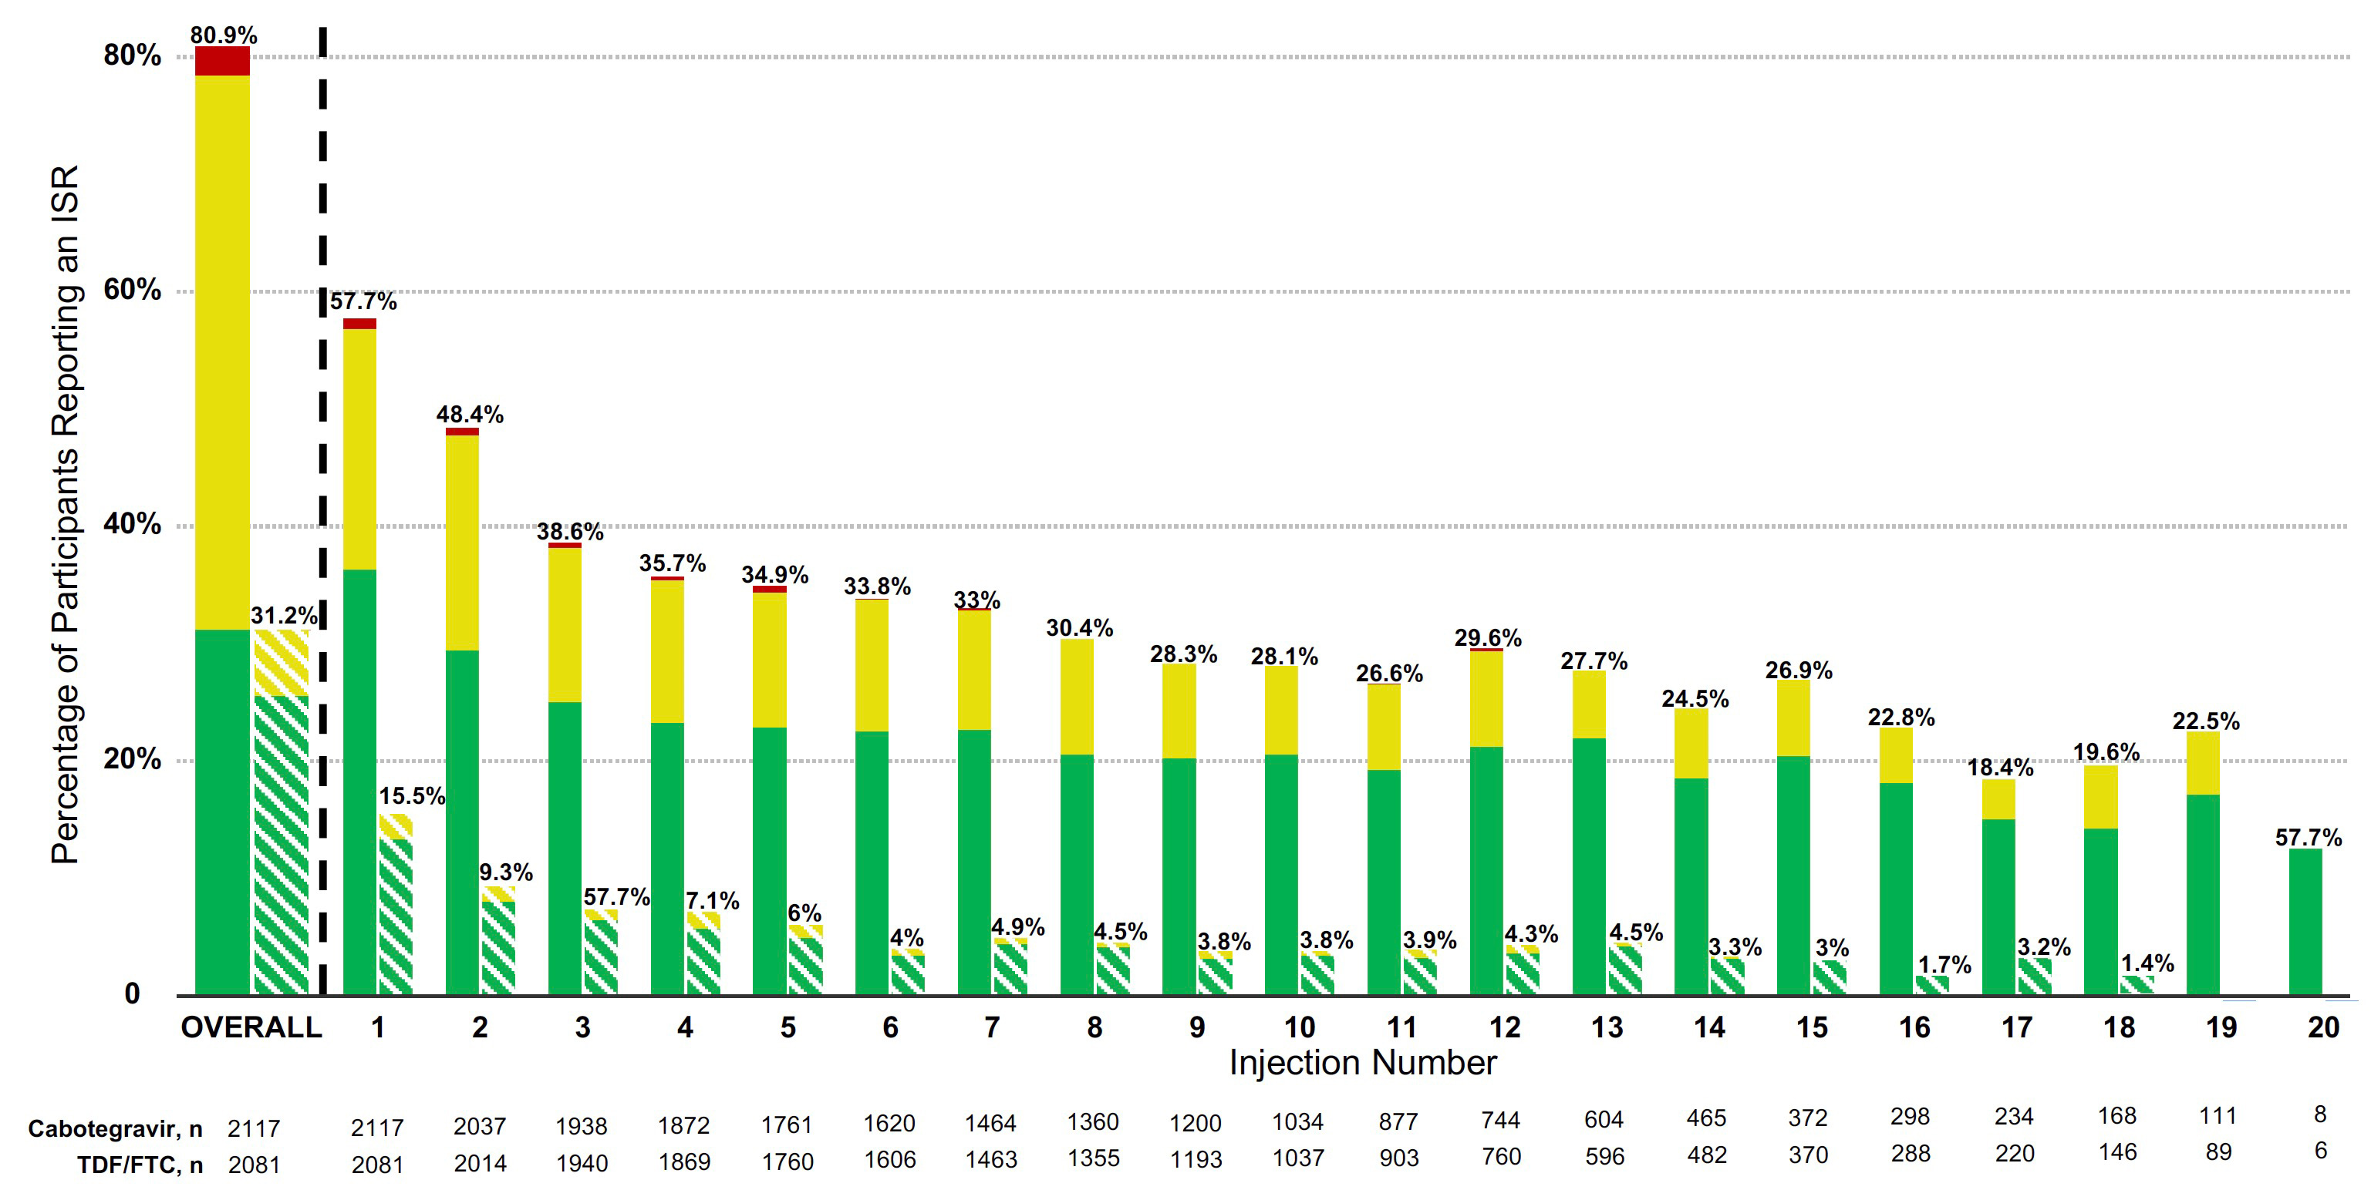
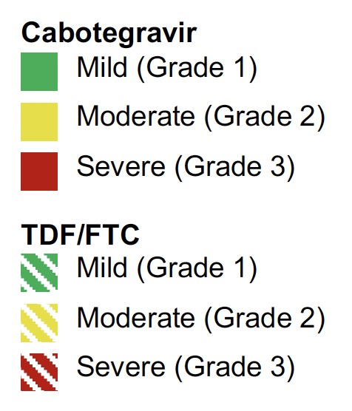
HPTN 083 Oral FTC/TDF vs Injectable CAB-LA for MSM & TGW
47 (2.2%) of CAB participants permanently discontinued due to an adverse effect of an injection
Severity of an injection site reaction was strongly associated with odds of permanently discontinuing
Landovitz RJ, et al. AIDS 2020. Abstract OAXLB01

Slide 16
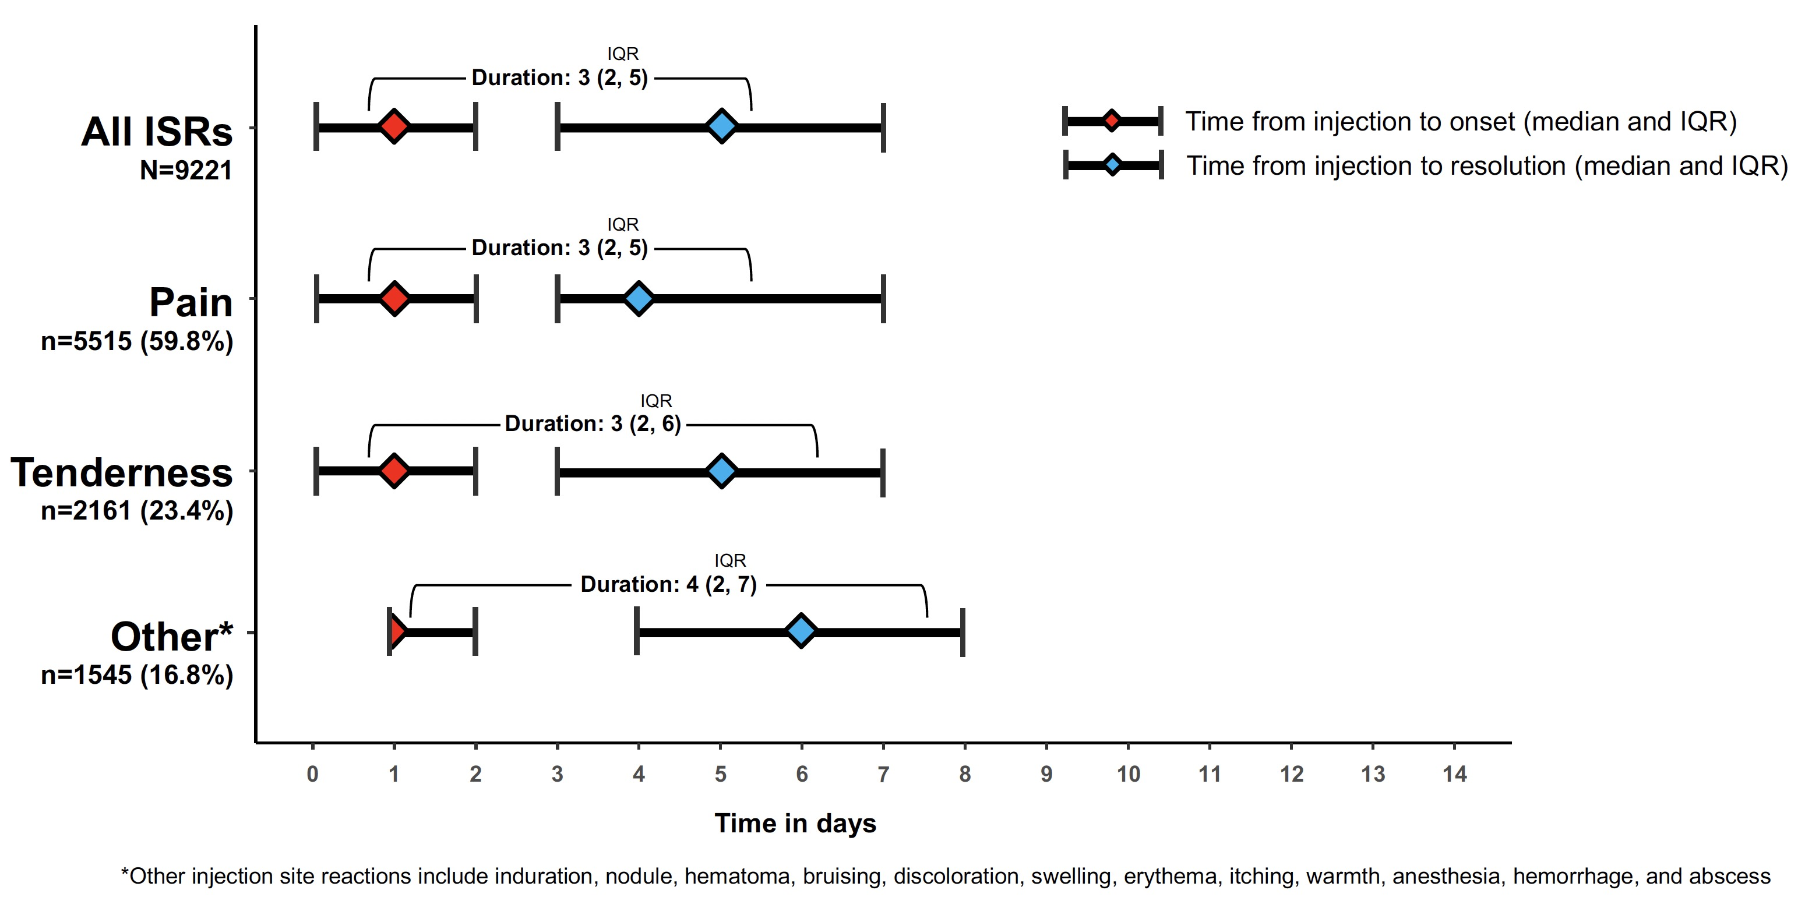
HPTN 083 Oral FTC/TDF vs Injectable CAB-LA for MSM & TGW
Landovitz RJ, et al. AIDS 2020. Abstract OAXLB01

Slide 17
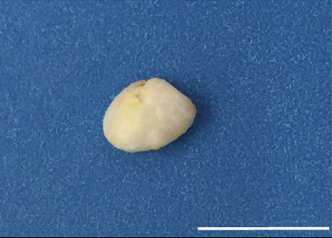
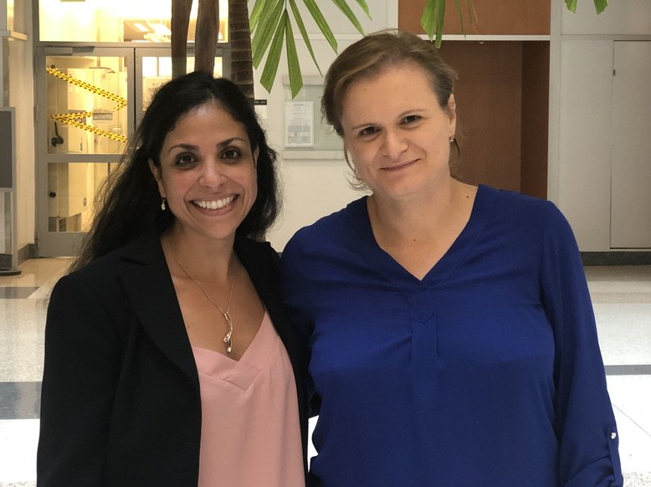
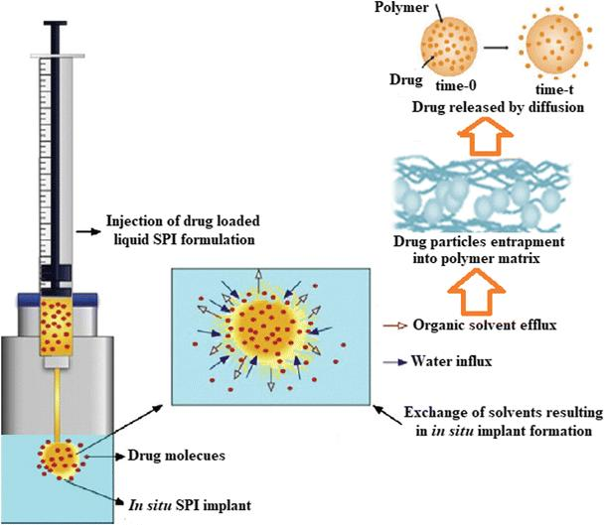
What if you could just remove it?
S. Rahima Benhabbour, PhD and Martina Kovarova, PhD
Kovarova M, Benhabbour SR, et al. Nat Commun. 2018;9(1):4156.

Slide 18
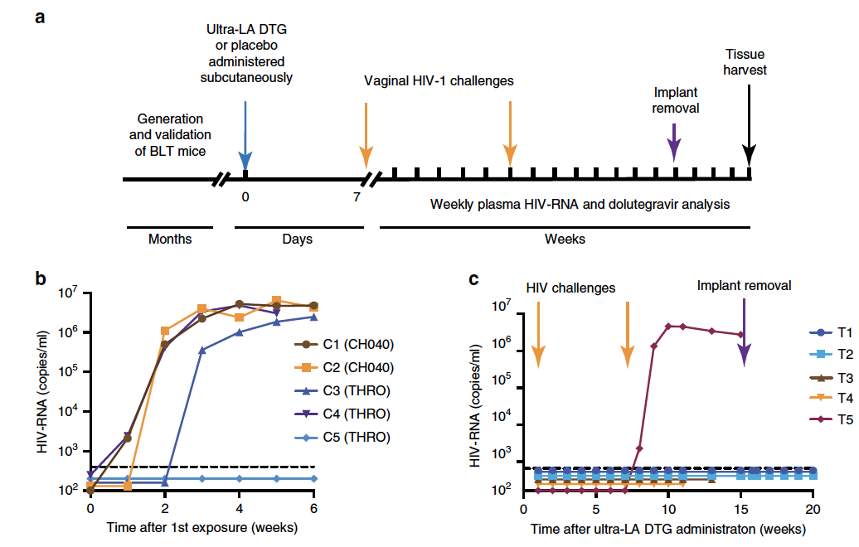
What if you could just remove it?
Kovarova M, Benhabbour SR, et al. Nat Commun. 2018;9(1):4156.

Slide 19
Implants

Slide 20
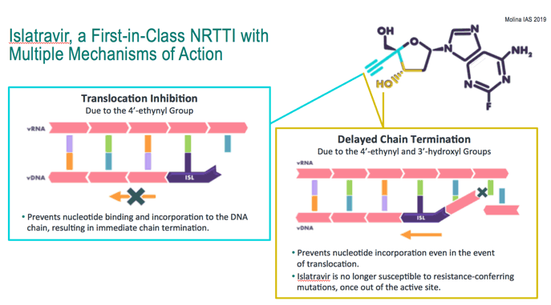
Islatravir First-in-class nucleoside reverse transcriptase translocation inhibitor ^{NRTTI} Formerly known as MK-8591
Two mechanisms of action
https://www.natap.org/2019/EACS/EACS_81.htm

Slide 21
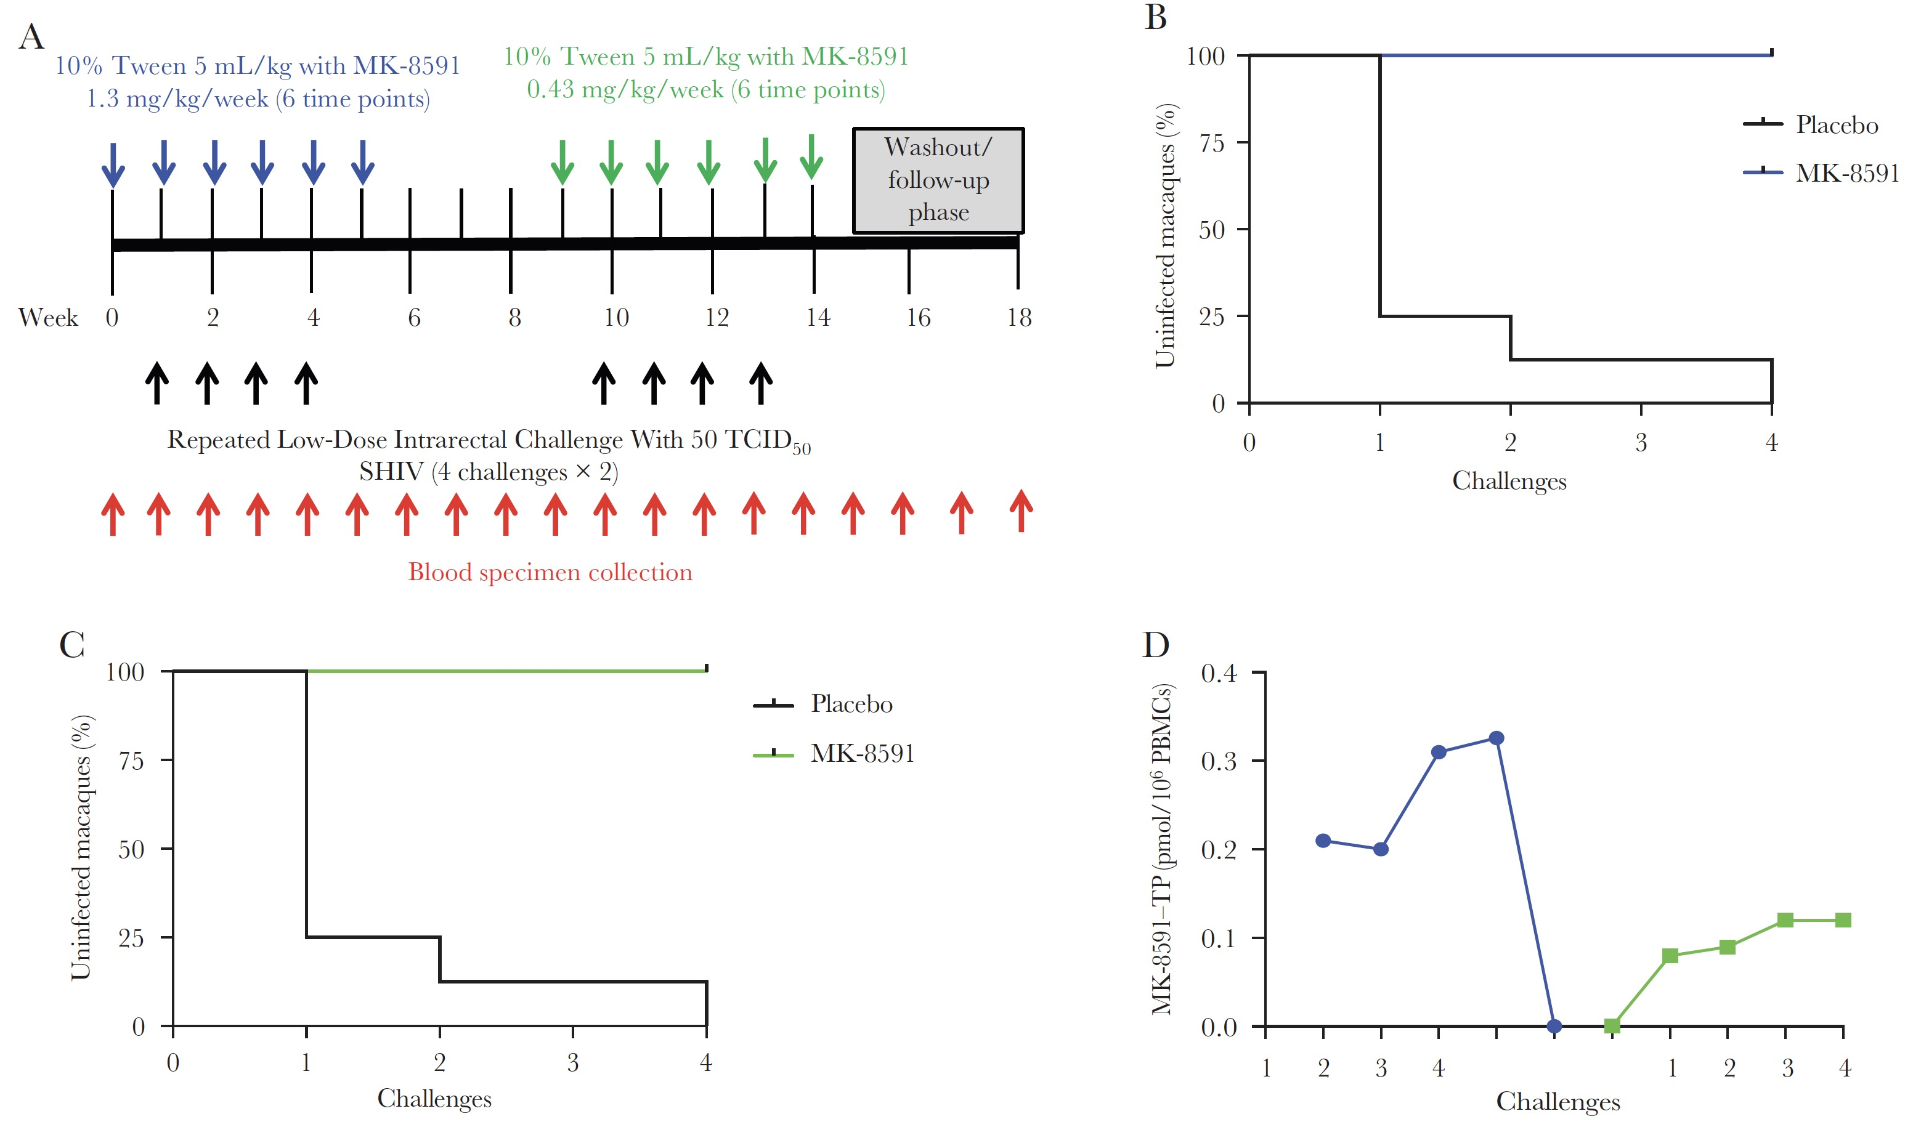
Islatravir PO once weekly protects macaques
Markowitz M, et al. J Infect Dis. 2020;221(9):1398-1406

Slide 22
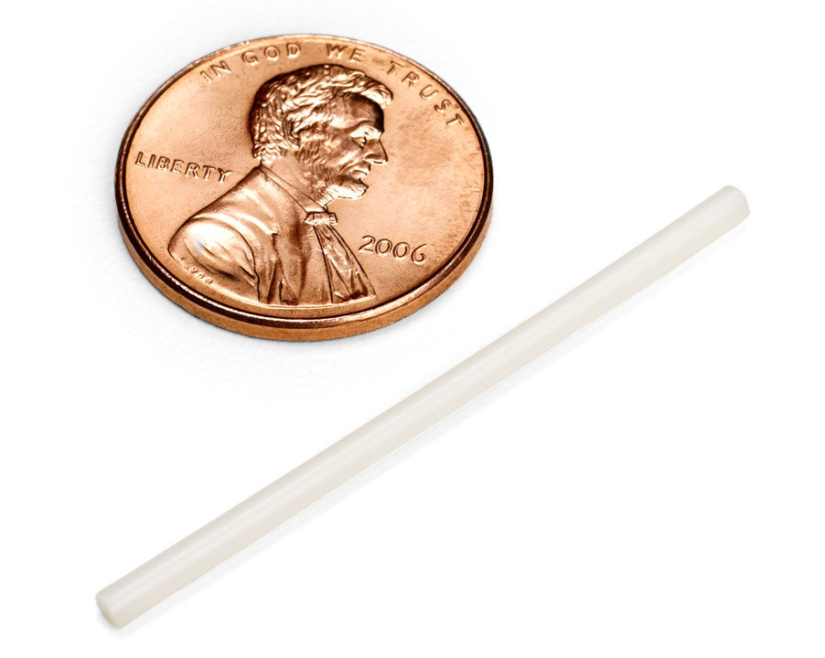
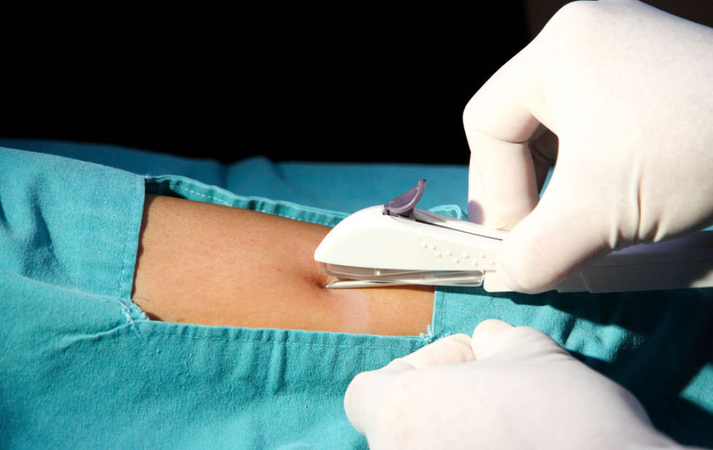
Islatravir prototype similar to Nexplanon
https://www.sfaf.org/collections/beta/islatravir-a-potential-prep-hiv-drug-now-being-tested/

Slide 23
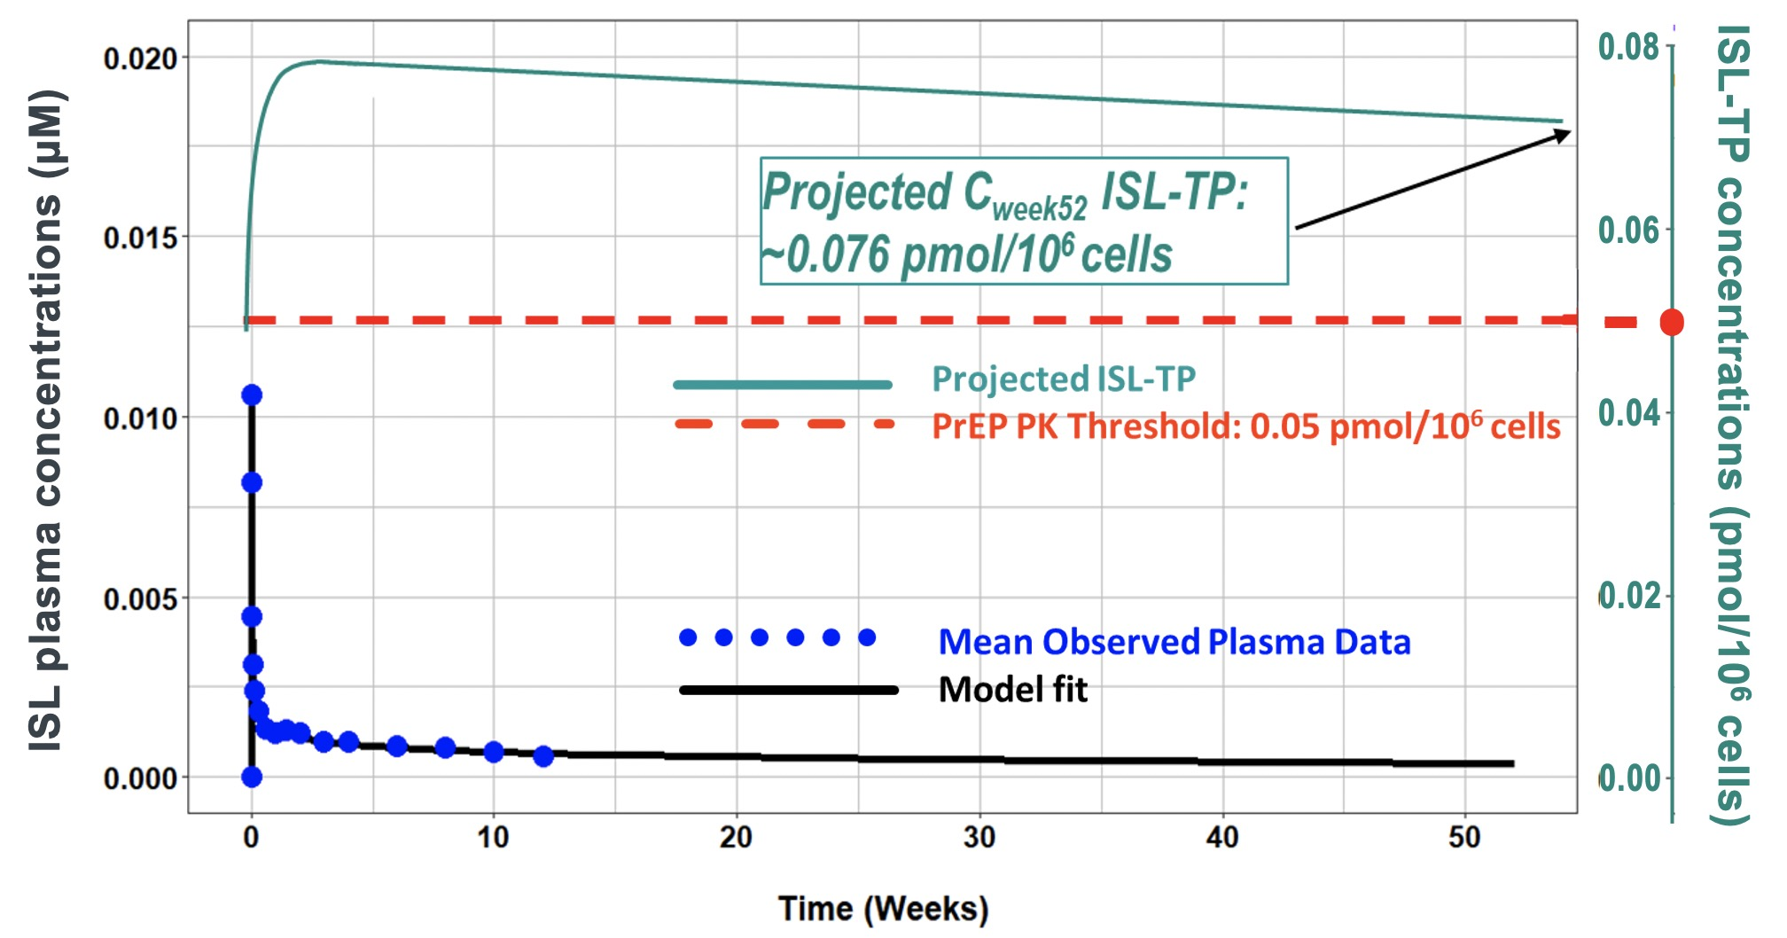
Islatravir levels predicted to last 1 year
Matthews RP, et al. IAS 2019 Mexico City. Abstract TUAC0401LB
http://programme.ias2019.org/Programme/Session/167

Slide 24
bnAbs

Slide 25
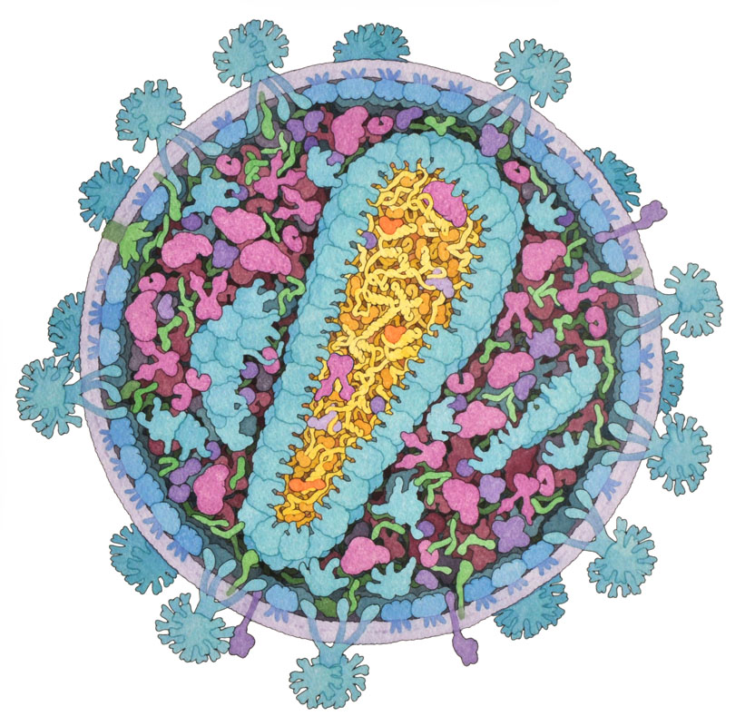

Slide 28
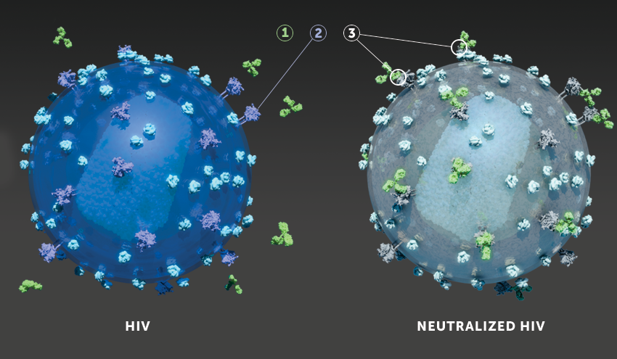
http://www.hvtn.org/en/science/HVTN-studies/AMPstudy.html

Slide 29
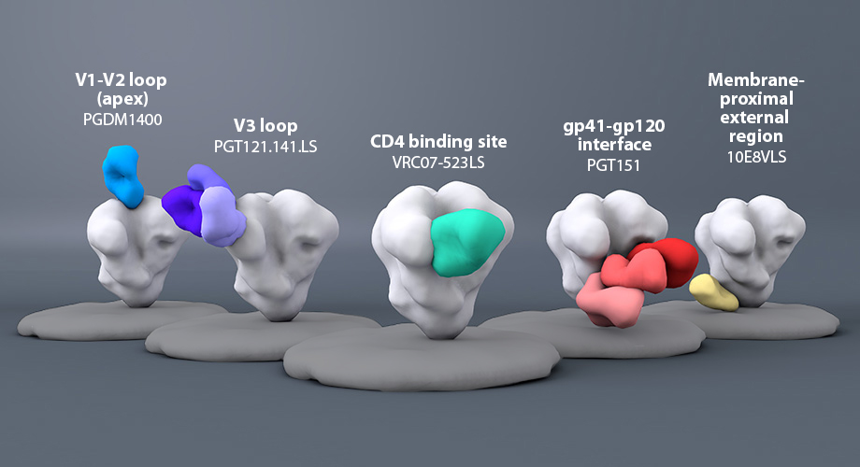
Image from: https://www.scripps.edu/news-and-events/press-room/2019/20190710-burton-nih-award-new-hiv-vaccination.html

Slide 30
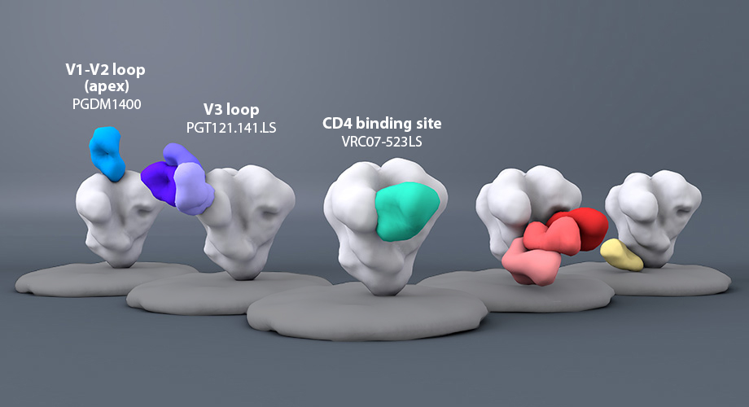
Image from: https://www.scripps.edu/news-and-events/press-room/2019/20190710-burton-nih-award-new-hiv-vaccination.html

Slide 31
Breadth & potency of bnAbs are important
How many viruses circulating in transmission networks will the antibody neutralize?

Slide 32
Breadth & potency of bnAbs are important
How many viruses circulating in transmission networks will the antibody neutralize?

Slide 33
Breadth & potency of bnAbs are important
How many viruses circulating in transmission networks will the antibody neutralize?
How much of an antibody “dose” is required to neutralize viruses?
Very potent
Not potent

Slide 34
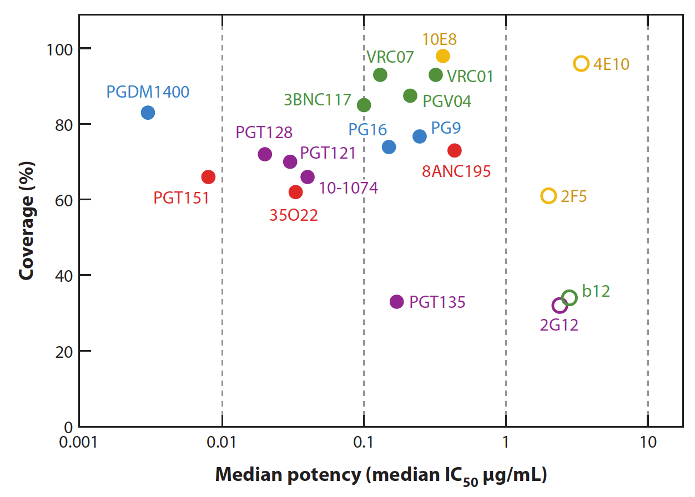
Breadth & potency of bnAbs are important
Increasing breadth
Increasing potency
Burton DR, Hangartner L. Annu Rev Immunol. 2016;34:635-659
Open circle: 1st generation mAb CD4 binding site High-mannose patch
Filled circle: 2nd generation mAb Apex-specific gp120-gp140 interface
Membrane proximal external region (MPER)

Slide 35
Four bnAbs are the focus of current studies
Increasing breadth
Increasing potency
Burton DR, Hangartner L. Annu Rev Immunol. 2016;34:635-659
Open circle: 1st generation mAb CD4 binding site High-mannose patch
Filled circle: 2nd generation mAb Apex-specific gp120-gp140 interface
Membrane proximal external region (MPER)

Slide 36
Antibody-Mediated Prevention Study (VRC01)

Slide 37
Questions?
Please email me!
Christopher Hurt, MD
churt@med.unc.edu

