Slide 1
HIV Post-Exposure Prophylaxis (PEP)
Britt Nigon, MPH
Program Manager
Sascha Bianchi, MPH
PEP Coordinator
Arizona AIDS Education & Training Center Infectious Disease, University of Arizona

Slide 2
Disclaimer
“This presentation is supported by the Health Resources and Services Administration (HRSA) of the U.S. Department of Health and Human Services (HHS) as part of an award totaling $3,278,366. The contents are those of the author(s) and do not necessarily represent the official views of, nor an endorsement, by HRSA, HHS or the U.S. Government.”
The views and opinions expressed in this presentation are not necessarily those of the Pacific AIDS Education and Training Centers (PAETC), the Regents of the University of California or its San Francisco campus (UCSF or collectively, University) nor of our funder the Health Resources and Services Administration (HRSA). Neither PAETC, University, HRSA nor any of their officers, board members, agents, employees, students or volunteers make any warranty, express or implied, including the warranties of merchantability and fitness for a particular purpose; nor assume any legal liability or responsibility for the accuracy, completeness or usefulness of information [,apparatus, product] or process assessed or described; nor represent that its use would not infringe privately owned rights.

Slide 3




WHO
?
Notes:
Who we are

Slide 4


WHAT
Medical care for People with HIV
Prevention through Pre- and Post- Exposure Prophylaxis
Notes:
What we do

Slide 5



WHY
Notes:
Why we’re in this training

Slide 6
HOW
By the end of this session, participants will be able to:
  Explain basic HIV concepts and terms
  Understand and describe what PEP is
  Describe the types of exposures that warrant PEP medication
  Understand PEP initiation and follow-up processes
  Identify resources to help patients access PEP medication
Notes:
How advocates can help

Slide 7
Learning Mindset
We all come from different experiences and lenses of the work.
This is a space to ask questions, get guidance, and learn from each other.
No one is expected to leave as an expert in HIV care, PrEP, or nPEP.
Take what is useful.

Slide 8
Arizona AETC
Provide healthcare professionals with the knowledge and skills necessary to provide outstanding care to people with or at risk for HIV.
Educational programs about HIV infection for healthcare professionals
Clinical training at HIV patient care sites
Timely updates to health care professionals on HIV-related treatment and care issues
Information about HIV service programs and resources

Slide 9

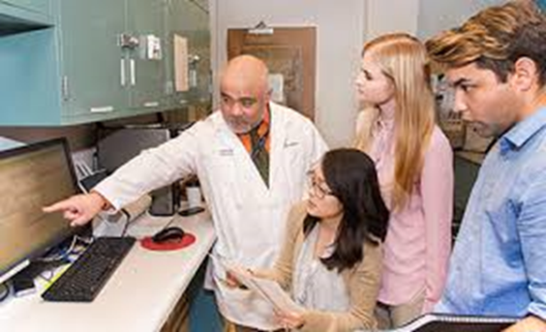
Petersen HIV Clinic
‘State of the art medicine with a small clinic feel’
Clinic Profile
HIV Medical Providers: 10
HIV Program Staff: 18
HIV Patients: ~865
PrEP Patients: ~200
nPEP: >300 (7-14/month)
Notes:
Maybe not necessary since we are short on time
I don’t think we need to talk about our funding sources. Just who we are

Slide 10
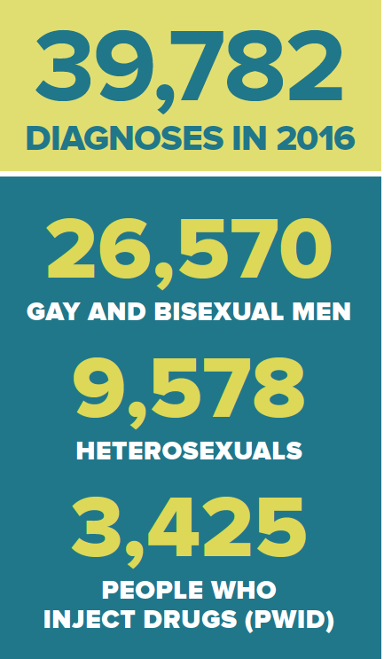
HIV in the United States
1.2 million people with HIV
1 in 7 people are unaware of their HIV infection
Southern states bear the greatest burden of HIV, accounting for 50% of new infections in 2014.
From 2008 to 2014, the estimated number of annual HIV infections in the U.S. declined 18%.
In 2016, there were 39,782 new diagnoses
Notes:
From 2008 to 2014, the estimated number of annual HIV infections in the U.S. declined 18%.
Gay and bisexual men, particularly young African American gay and bisexual men, are most affected.
The same group of young men and women (age 18–25) most at risk for sexual assault are also the fastest growing groups contracting HIV (El-Bassel, Cadeira, Ruglass & Gilbert, 2009; Greenwood et al., 2002; Petroll, Hare & Pinkerton, 2008).

Slide 11
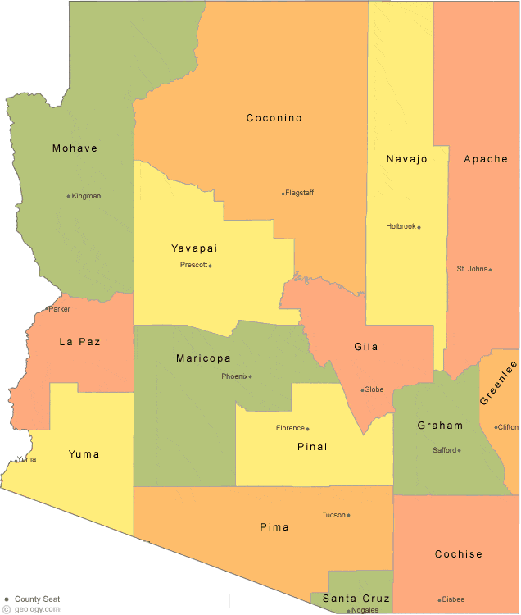
HIV in Arizona
    Total People with HIV in Arizona: 18,190
Total People with HIV in Southern Arizona: 3,186
  Pima – 2,863
  Cochise – 228
  Santa Cruz – 53
  Graham – 35
  Greenlee – 7
Total Ryan White Service Providers: 4
  UA’s Petersen HIV Clinic
  El Rio SIA
  Southern Arizona AIDS Foundation
  Pima County Health Department
Total UA Petersen Clinic patients: +/- 865
5 counties
23,071 square miles
Notes:
Total People Living with HIV/AIDS in Arizona: 17,464
Total People Living with HIV in Southern Arizona
Pima – 2,611
Santa Cruz – 50
Cochise – 228
Graham – 32
Greenlee Counties – 7
TOTAL = 2,793 approximate
Total Ryan White Service Providers: 3
UA’s Petersen HIV Clinic
El Rio SIA
Southern Arizona AIDS Foundation
Total UA Petersen Clinic patients: +/- 1000

Slide 12
HIV Basics

Slide 13
HIV Overview – 5-5-5
5 fluids containing HIV
  Blood
  Semen (pre-cum)
  Vaginal Fluid
  Breast Milk
  Rectal Fluid
5 routes of transmission
  Condomless Sexual Activity (Anal, Vaginal, Oral)
  Sharing IDU syringes/works
  Vertical Transmission
  Blood Transfusion
  Occupational Exposure
5 conditions for transmission

Slide 14



5 conditions for transmission
1. 2+ people
2. At least one person HIV+
3. One of the 5 fluids present
4. Pathway into the bloodstream
5. Activity to get fluid into bloodstream

Slide 15
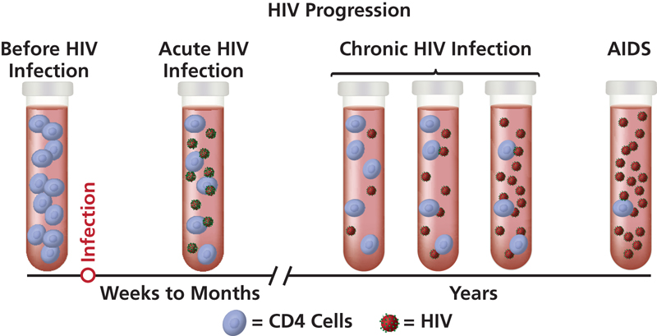
HIV/AIDS Basics
CD4 Count: Want this number to be high
Viral Load: Want this number to be low
Notes:
Before we discuss how to prevent HIV, let’s talk about what it is”

Slide 16
HIV/AIDS Basics
Fluids that CAN transmit HIV
Blood And Visibly Bloody Body Fluids
Semen
Vaginal Secretions
Cerebrospinal Fluid
Synovial Fluid
Pleural Fluid
Peritoneal Fluid
Pericardial Fluid
Amniotic Fluid
Fluids that CANNOT transmit HIV
Feces
Nasal Secretions
Saliva
Sputum
Sweat
Tears
Urine
Vomitus

Slide 17
Acute HIV Infection
40-90% develop symptoms of acute HIV
Usually begin 2-4 weeks after exposure
Notes:
Acute HIV symptoms are often missed. Emphasize importance of sexual history

Slide 18
Exposure Risks
(average, per episode, involving HIV-infected source patient)
Percutaneous (blood) Mucous membrane exposure | 0.3% 0.09%
Receptive anal intercourse | 0.3 - 3%
Insertive anal intercourse | 0.06%
Receptive vaginal intercourse | 0.1 – 0.2%
Insertive vaginal intercourse | 0.03 – 0.14%
Receptive oral (male) | 0.06%
Female-female orogenital | 4 case reports
IDU needle sharing | 0.67%
Vertical (no prophylaxis) | 24%
Notes:
Receptive anal intercourse – 3 out of 100
Receptive vaginal intercourse – 1 out of 1000
Needle sharing about 6 or 7 out of 100
Vertical (mother – child, no intervention)
1. Bell DM. Am J Med 1997;102(suppl 5B):9--15.
2. Ippolito G et al. Arch Int Med 1993;153:1451--8.
3. Am J Epidemiology 1999;150:306-11.
4. Am J Epidemiology 1999;150:306-11.
5. MMWR 47;RR-17, 1998.
6. NEJM 336(15):1072-8. (rates in Europe & U.S.)
7. Am J Epidemiology 1999;150:306-11.
8. Rothenberg RB et al. AIDS 1998;12:2095-2105.
9. MMWR 47;RR-17, 1998.
10. ACTG 076

Slide 19
HIV Testing

Slide 20
With the most recent HIV tests, how soon can the virus be detected from the date of contraction?
36-72 hours
10-14 days
3-4 weeks
1-3 months
Notes:
Poll Title: With the most recent HIV tests, how soon can the virus be detected from the date of contraction?
https://www.polleverywhere.com/multiple_choice_polls/d94wCHHbev1E828

Slide 21



4th Generation HIV testing
Can detect HIV as early as 2 weeks after infection
Looks for HIV antibodies and something called p24 antigens
Can be performed in a hospital lab

Slide 22
HIV Prevention

Slide 23
True or False: There are pills you can take to prevent getting HIV
.
True
False
Notes:
Poll Title: True or False: There are pills you can take to prevent contraction of HIV.
https://www.polleverywhere.com/multiple_choice_polls/axYTuU102sTg3ug

Slide 24



What is Post-Exposure Prophylaxis (PEP)?
A 28-day course of antiretroviral medication taken AFTER potential HIV exposure.
Consists of 2 pills.
One pill is a combination of two medications.
PEP is an urgent request to be handled as soon as possible.
PEP is not effective if initiated after 72 hours

Slide 25
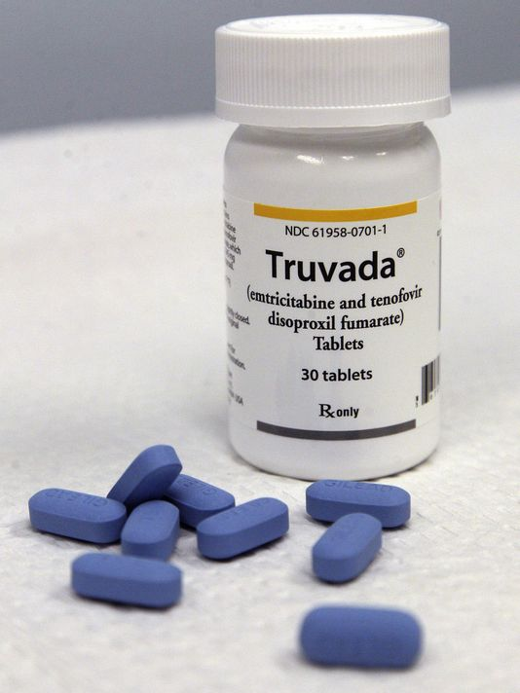
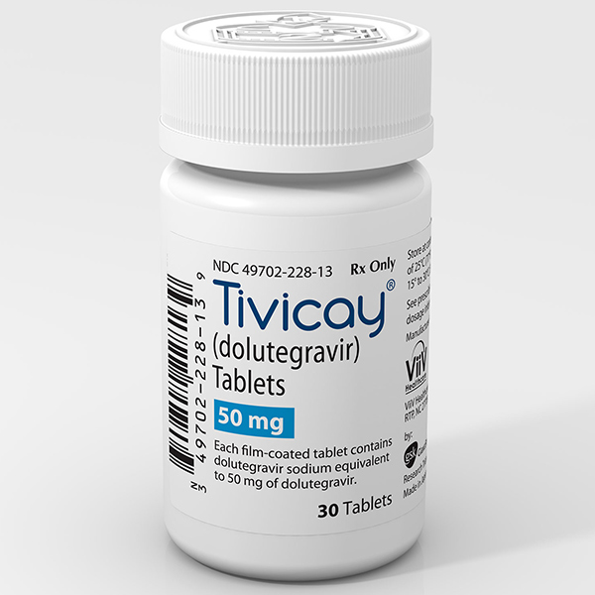
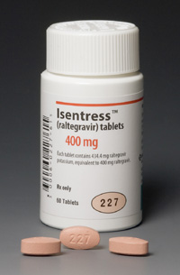
Post-Exposure Prophylaxis (PEP) Regimens
PEP
Medications
+
or
=

Slide 26
When is PEP recommended?
HIGHER-RISK Exposures
LOWER-RISK Exposures
  Vaginal or anal intercourse with HIV+ or unknown status
  Needle sharing with HIV+ or unknown status
  Injuries with exposure to blood or other potentially infected fluids (needlestick, injuries, human bites)
  Oral-vaginal contact
  Oral-anal contact
  Receptive penile-oral contact
  Insertive penile-oral contact
  Factors That Increase Risk
  Source person is known to be HIV-infected with high viral load
  Oral mucosa is not intact (oral lesions, wounds)
  Presence of genital ulcer or STD
Notes:
Unprotected vaginal or anal sex with someone who is HIV infected or their status is unknown
Needle sharing with someone who is infected with HIV or their status is unknown
Oral sex is considered lower risk exposures
Factors that increase risk – viral load, oral lesions or wounds, presence of genital ulcer/ std

Slide 27
When is PEP NOT recommended?
NEGLIGIBLE RISK
Oral-to-oral contact without mucosal damage
  Examples: kissing or mouth-to-mouth resuscitation
Human bites not involving blood
Exposure to solid-bore needles or sharps not in recent contact with blood

Slide 28
When to initiate PEP
Risk for HIV Infection
Negligible Risk
< 72 hours since exposure
> 72 hours since exposure
Source known to be living with HIV
Source of unknown status
PEP IS RECOMMENDED
as soon as possible
Case-by-case determination
PEP NOT recommended

Slide 29
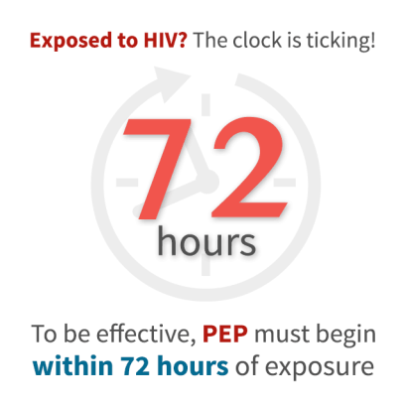
Initiating PEP
If the decision is made to administer post-exposure prophylaxis, it should be started as early as possible after an exposure
Post-exposure prophylaxis is not indicated if the patient presents for care more than 72 hours after an exposure

Slide 30
Baseline Testing at Hospital
HIV antigen/antibody combo test
Pregnancy test for women
CMP (complete metabolic panel)
Hepatitis Panel
Gonorrhea* and Chlamydia*
Syphilis
STD screening is recommended for PEP. However, in the case of sexual assault they are not necessary because patients are empirically treated.

Slide 31
Treatment options at Hospital
Emergency contraception
Azithromycin & ceftriaxone to prevent chlamydia, gonorrhea, and trichomonas
HPV and TDAP vaccines (if they haven’t already received the full vaccination)
HIV Post Exposure Prophylaxis
This is where you come in!
Notes:
Emphasize that PEP doesn’t just happen.

Slide 32
Recommended PEP Regimen
Tenofovir + emtricitabine [Truvada]
+ dolutegravir (Tivicay) or raltegravir (Isentress)
    Excellent tolerability
    Proven potency in established HIV infection
    Highly effective in reducing transmission if taken as prescribed
    Ease of administration
Many providers
don’t know this
This is where you come in
PEP
Medications
+
or
=
Notes:
May touch on side effects we see with survivors – more side effects reported (GI and sleep disturbances) could be attributed to meds…but…they have been through a trauma and prophylactically treated for everything (ceftriaxone injection, 1 gram azithromycin, flagyl, plan b, plus PEP, plus any pain killers, also may have been given rohipnol, may be sobering up from drugs/alcohol – understandable that they feel very sick. Give PEP a few days before stopping.
AG: agree! Seems important to mention

Slide 33
Timing is everything!
*PEP is most effective when taken as soon as possible.

Slide 34
PEP Navigation
Notes:
Talked about who we are, HIV basics, HIV testing, HIV prevention. This section advocate role in obtain PEP therapy for survivors

Slide 35
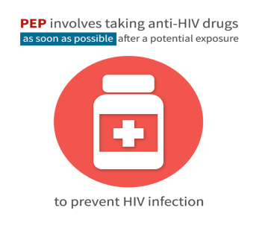
PEP and SACASA
HIV transmission during sexual assault is highly under-researched
Physical trauma sustained by sexual assault survivors can contribute to increased HIV risk
PEP is a harm reduction and prevention method recommended by the CDC
Collaboration is key in accessing PEP
Notes:
The types and frequency of genital injuries sustained by sexual assault victims are typically classified in relation to tears, ecchymosis, abrasions, and redness. Each may contribute to increased HIV risk through bleeding, breaks in skin and inflammation.
Reference - Klot JF, Auerbach JD, Berry MR. Sexual Violence and HIV Transmission: Summary Proceedings of a Scientific Research Planning Meeting. American journal of reproductive immunology (New York, NY : 1989). 2013;69(0 1):5-19. doi:10.1111/aji.12033.

Slide 36




PEP Process Overview
TMC/
SACASA
Initiate PEP within 72 hours.
Conduct baseline testing.
Ensure patient is able to access at least 3 days of medication.
Petersen
Clinics
Ensure patient accesses remainder of medication.
Follow-up within 1 week.
Follow-up at 4-6 weeks.
Notes:
Initiate PEP within 72 hours
Conduct baseline testing
Ensure patient is able to access at least 3 days of medication
Ensure patient accesses remainder of medication
Follow-up within 1 week
Follow-up at 4-6 weeks

Slide 37



What YOU can do
Keep track of the 72-hour window
Have the patient sign Petersen Clinic Release of Info (ROI) form and fax it to the number listed
Answer survivor’s questions about baseline testing and side effects
Give survivor the 3-day bridge form
Ensure patient is able to access at least 3 days of medication
Email us to let us ensure the ROI was received.
Notes:
Initiate PEP within 72 hours
Conduct baseline testing
Ensure patient is able to access at least 3 days of medication
Ensure patient accesses remainder of medication
Follow-up within 1 week
Follow-up at 4-6 weeks

Slide 38
Share with patient that
PEP includes 28 days of medication, lab work, and follow up medical appointments
Side effects are minimal and might include stomach upset, nausea or fatigue
There are no permanent long-term side effects of medication
Patients need follow up HIV testing at 4-6 weeks and 3 months to rule out infection

Slide 39
Challenges in Accessing PEP
Survivor presents at local ED and is informed that unless she files police report, she is not allowed to have SAFE exam/MFE.
Patient does not want to file a police report at this time, so she is not referred to TMC and the SACASA advocate is not contacted.
Patient is not aware of all options and refuses PEP in ED. Patient is linked to Petersen clinic and decides to begin PEP. Narrowing PEP window and reducing PEP efficacy.
Notes:
Many parties involved:
CBO/County Health/other care provider/internet/word of mouth providing initial PEP messages
ER
Urgent care
PHC or PCP for follow up
Pharmacy

Slide 40
True or False: A survivor must complete a SANE exam/medical forensic exam in order to be prescribed PEP and linked to the Petersen Clinic
True
False

Slide 41
Challenges in Accessing PEP at the Pharmacy
Survivor presents at ED, undergoes MFE and is prescribed PEP. Patient takes both PEP prescriptions to a local pharmacy but is unable to get the medication because they don’t have money for their copay. Patient leaves pharmacy without medication.
Notes:
Many parties involved:
CBO/County Health/other care provider/internet/word of mouth providing initial PEP messages
ER
Urgent care
PHC or PCP for follow up
Pharmacy
Alternative comment – Survivor completes SANE exam, does not take the first dose of PEP in the ED and is handed a prescription for PEP to be filled at pharmacy of choice.

Slide 42
True or False: PEP is most effective if taken every day as directed.
True
False

Slide 43
When not to refer patients to Petersen Clinics
When the survivor is a minor (under 18 years of age)
If the exposure happened more than 72 hours ago
Notes:
If the patient is not interested in using PEP

Slide 44
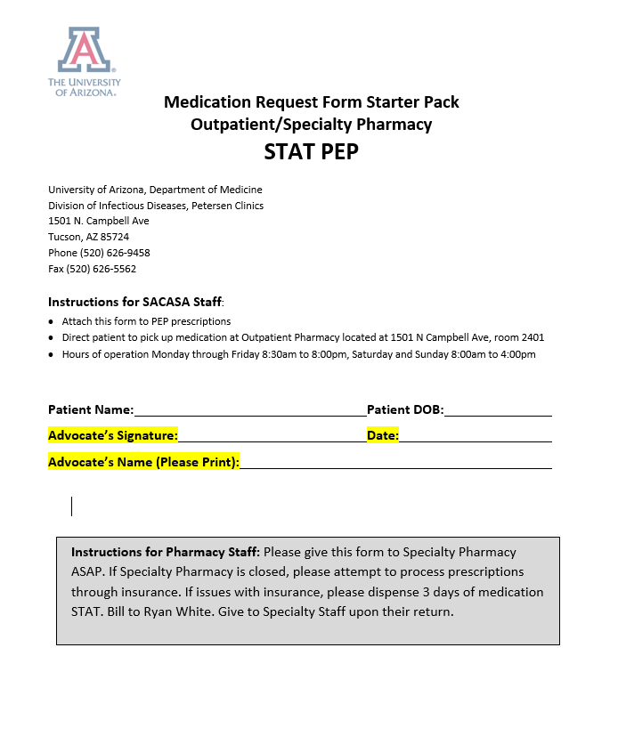
Three Day Bridge Meds
Patients who are referred to the Petersen Clinic for follow up care can get a free 3-day bridge at Banner UMC – Tucson Outpatient Pharmacy
1625 N. Campbell Ave 85724
Open M-F 7-8pm, Sat.-Sun. 8-6pm
Attach this note to paper prescriptions before survivor leaves TMC

Slide 45
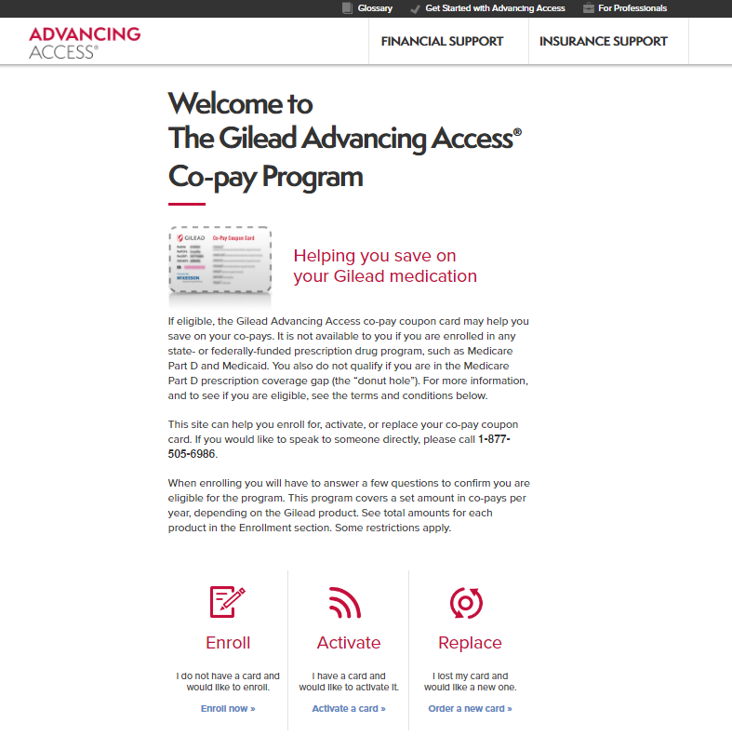
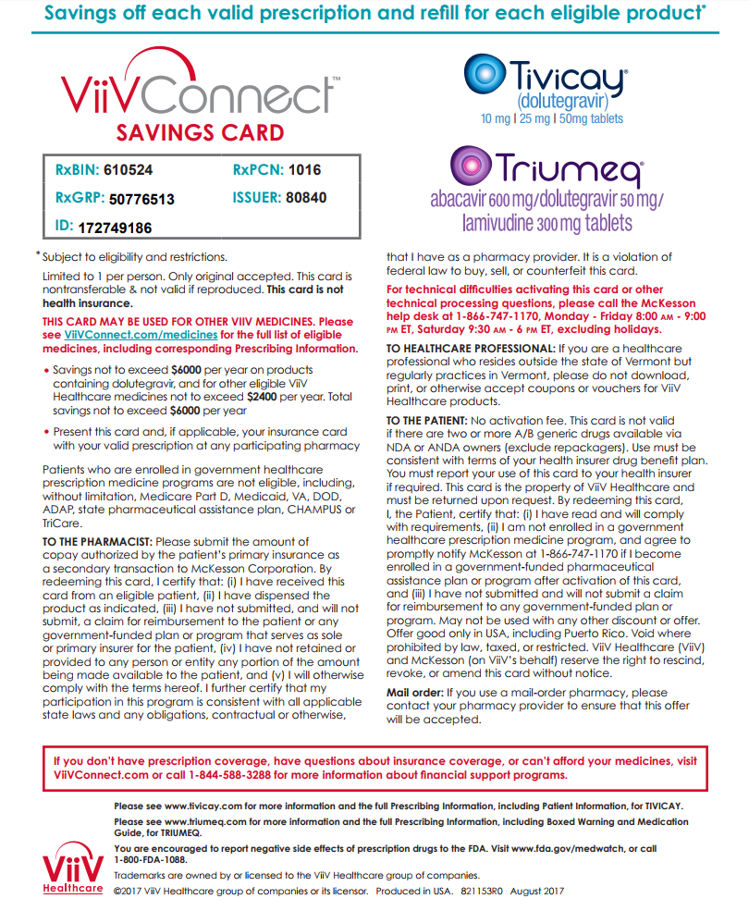

Copay Assistance/Free Medications Available!

Slide 46
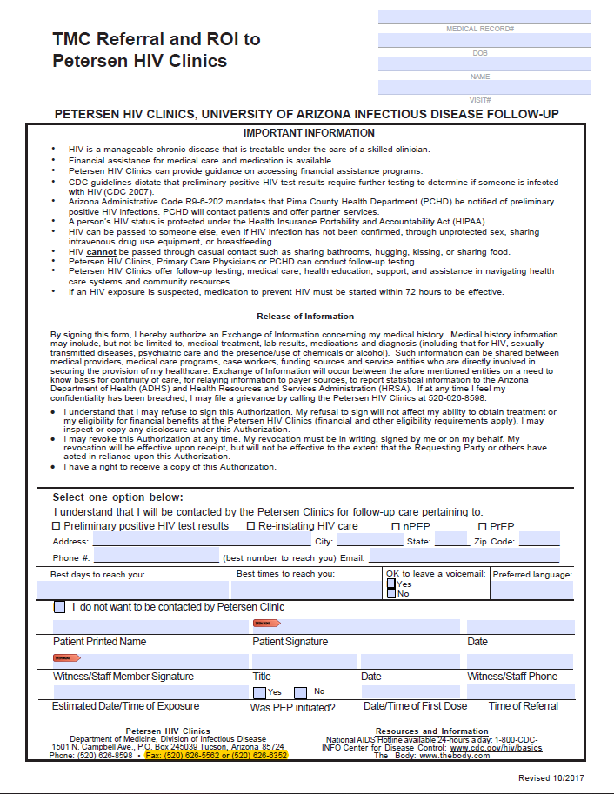
Release of Information
“Don’t say goodbye without the ROI!”

Slide 47
Follow-Up Plan Petersen Clinics
Complete the ROI form for ID referral (fax or secure email ROI to Petersen Clinic)
Petersen Clinics will call patient next business day to schedule follow-up appointment
Reinforce PEP discharge instructions, treatment adherence, and share availability should concerns come up before the follow-up appointment
Help patient navigate patient assistance program if needed to access medications
Notes:
Secure email, go back to ED if no meds

Slide 48
PEP Follow-up Care at Petersen Clinic
1 Week
Evaluate for acute HIV
4-6 Weeks
Lab-based HIV antigen/antibody combo
3 Months
Follow-up with primary care or community provider
Lab-based HIV antigen/antibody combo
Assess for adherence and side effects
Provide any necessary referrals
CMP, STIs, Pregnancy test

Slide 49
The PEP STEPs
Start PEP ASAP (within 72 hours)
Three-day bridge – Fill out Medication Request Form
Ensure patient has both RXs plus Medication Request Form
Petersen Clinic Linkage – ROI

Slide 50


Thank you!
Britt Nigon, MPH
Program Manager, Arizona AETC
University of Arizona, Infectious Disease
(520) 626-7635
bmnigon@deptofmed.arizona.edu
Sascha Bianchi, MPH
Clinical Coordinator, Petersen Clinics
University of Arizona, Infectious Disease
(520) 626-9458
sbianchi@deptofmed.arizona.edu

