Slide 1
Leveraging mHealth, telehealth, and at-home testing in rural areas: Implications for the HIV care continuum
Randolph D. Hubach, PhD, MPH
Oklahoma State University—Center for Health Sciences
Notes:
Version date_ 05 2021

Slide 2
Conflict of Interest Disclosure Statement
The presenter has no conflicts to declare.
This project is supported by the Health Resources and Services Administration (HRSA) of the U.S. Department of Health and Human Services (HHS). Under grant number U1OHA33225 (South Central AIDS Education and Training Center). It was awarded to the University of New Mexico. No percentage of this project was financed with non-governmental sources. This information or content and conclusions are those of the authors and should not be construed as the official position or policy of, nor should any endorsements be inferred by HRSA, HHS, or the U.S. Government.

Slide 3
Learning Objectives
Assess health inequities in relation to accessing culturally competent medical care.
Evaluate the role of rurality and cultural norms on primary, secondary, and tertiary HIV prevention intervention.
Identify shifting paradigms in HIV care and related public health/medical intervention.

Slide 4
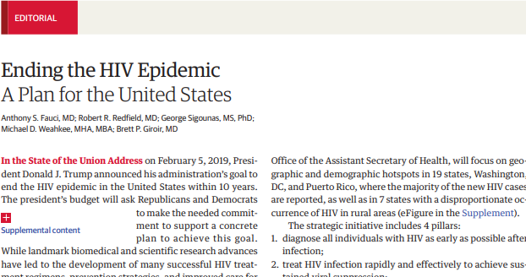
Ending the Epidemic: A Plan for America

Slide 5
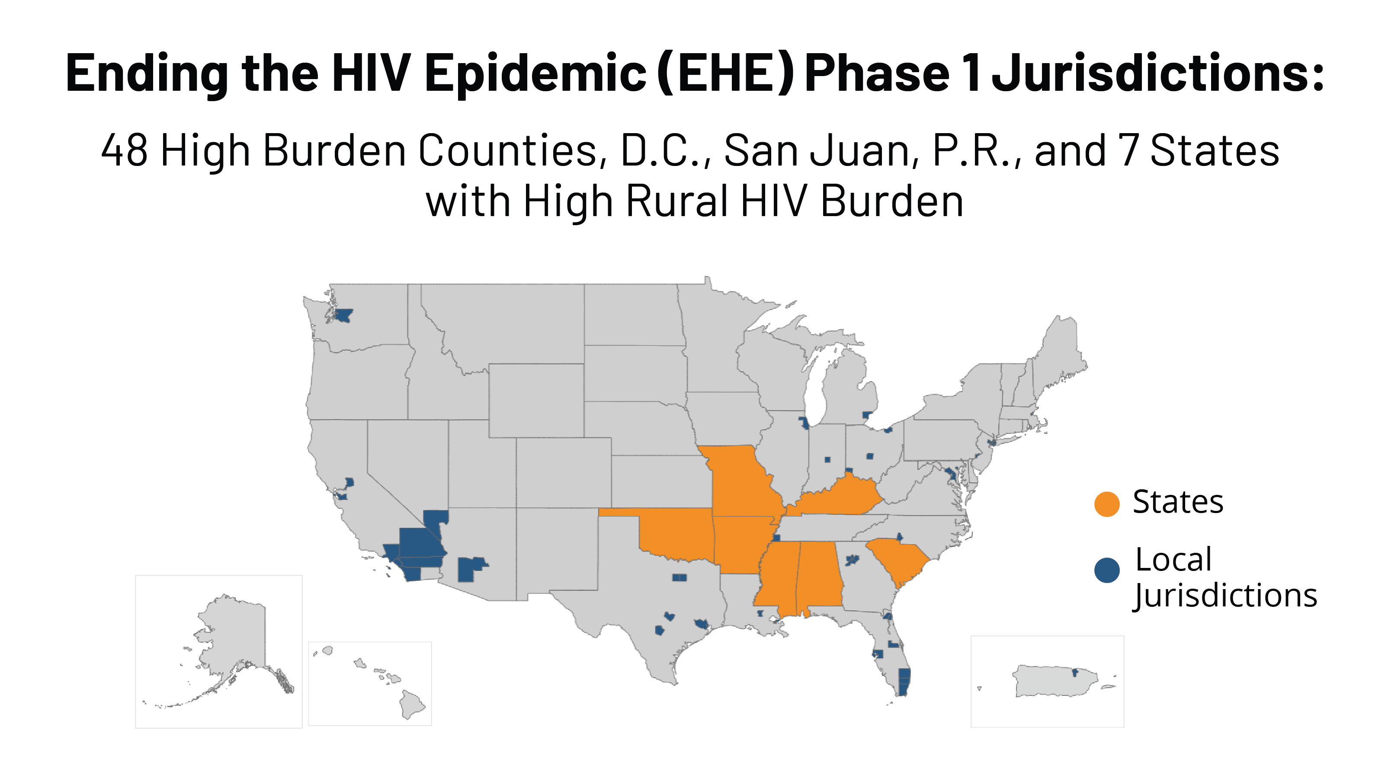

Slide 6
Role of Place: Rural Health
Current debate on what is urban and what is rural
Classification shortcomings
New approach: “How rural is it?”
Accounts for population size, density, distance to metropolitan areas
Extreme rurality is absent from most areas

Slide 7
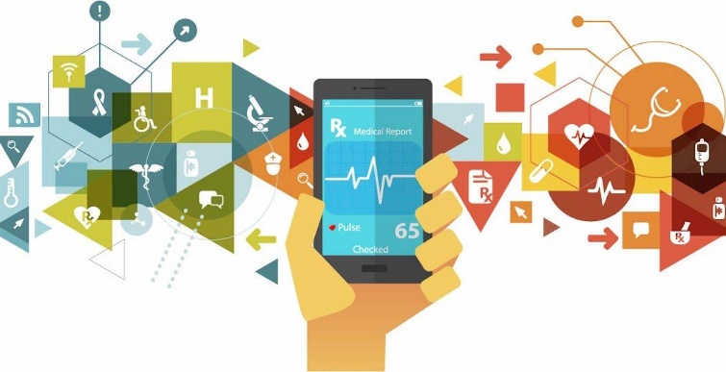
Background
Rural populations
Experience numerous barriers to medical and mental health care
Less likely to be engaged than their urban counterparts
Lack of access to affirming providers
↑ Substance use; ↓ mental health—including loneliness and isolation
↓ access to HIV testing
Telemedicine and mHealth
At-home testing

Slide 8
Background
Rural Context
Geographic estrangement from other men who have sex with men (MSM)
Estrangement from venues that serve gay and bisexual men
Medical and mental health shortage areas
Systemic homophobia
Structural stigma
May not identify as “gay” or “bisexual” and thus may not include themselves as a member of LGBT community

Slide 9
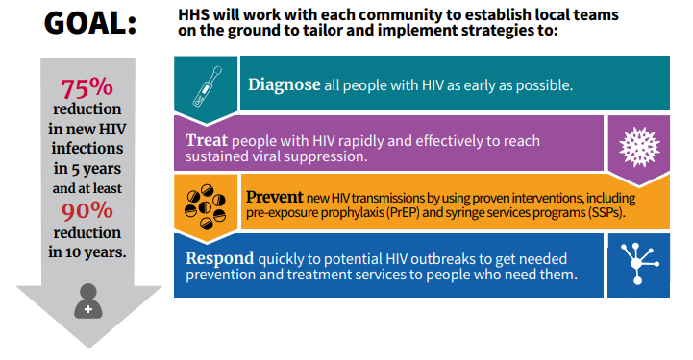
Ending the Epidemic: A Plan for America

Slide 10
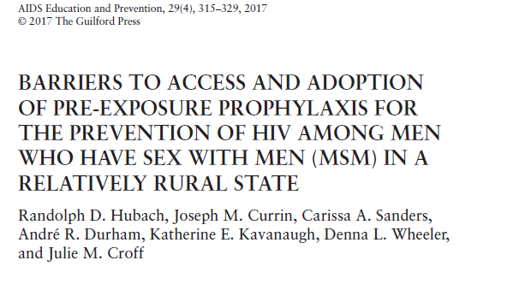
Previous Studies & Findings
Breakdowns in the PrEP continuum for rural MSM
Low uptake among rural MSM
Geographic isolation
Access to providers
LGBT-sensitive medical care
Limited HIV & STI screening
PrEP and HIV-related stigma
Structural level
Within group

Slide 11
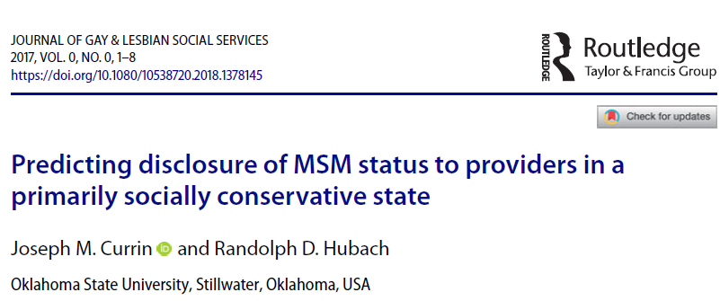
Previous Studies & Findings
Aimed to predict what influences MSM to inform their providers of their sexual behaviors
Age
For every year decrease in age, the odds were 4% higher that a participant inform their provider
Level of disclosure
For every unit decrease in NOS-D (overall disclosure in one’s life) there was a 3% decrease in the odds that a person would disclose to a provider
Disclosure to medical providers vs mental health providers

Slide 12
Results
Telemedicine Appeal
Negative experiences with medical and mental health providers within their communities that led to them 1) seeking another provider within an urban center or 2) falling out of routine necessary care
Ability to utilize telemedicine to overcome known barriers to care, such as distance to a local provider or specialist, was appealing

Slide 13
Results
There is a community clinic here (rural Oklahoma town)… but after the first visit, they dumped me as a client or as a patient because they didn't want to see me because they're a somehow Christian-oriented organization and they didn't want me there because I'm gay… but it's very frustrating and then I went through 4 years with no healthcare at all. Now I go to Tulsa to a clinic. I love them, but it's an obstacle to get there.
Well for probably about 15, or more than 15 years, I haven't had steady medical care… at the same time I was getting diabetes. So you know when you go five years with diabetes without getting medical care it would be a gift from the universe to be able to do it by video conferencing online.

Slide 14
Results
Telemedicine Appeal
Access to knowledgeable and affirming providers
This kind of goes back into being comfortable with somebody who does specialize or has experience with LGBTQ health in addition to saving time, trying to find somebody ‘cause it's the closest specialist is an hour away versus a telehealth appointment and that's gonna really impact the ease of access.
‘Cause going into a doctor's office with that kind of thing (sexual health concern). And especially from a rural area, sometimes you don't know what kind of doctor you're going to have. So it's hard to ask them those kinds of questions

Slide 15
Results
Telemedicine Appeal
Enhances patient-provider communication
I'm from a rural town in southeastern Oklahoma where this sort of thing (discussing sexual orientation/behavior), I would not be comfortable talking to with the doctor I have there.
I think it would make me more willing to, or more comfortable with it, to be honest with you. Um, I think with him not being in the same room would, uh, be a little more, uh, soothing I guess so that you're not, uh, apprehensive about disclosing anything, Talking to somebody on the internet is easier than saying something to their face while they're in person.

Slide 16
Findings
At-Home Testing Appeal
Access to testing programs that were
Convenient, reliable, to the extent possible confidential
I would just feel awkward, like going into a store and buying, buying [sic] it like at my pharmacy or something. I don’t think I would feel comfortable checking out with that. Um, yeah, so just getting it in the mail where it’s just in a box and you can just open it. It’s a lot easier.

Slide 17
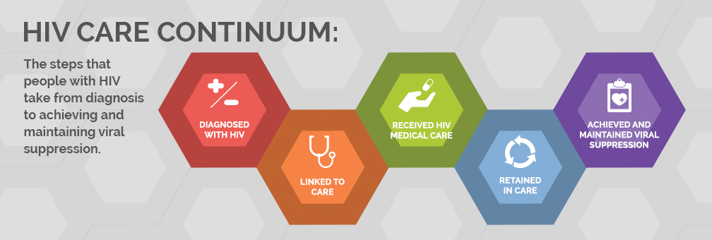
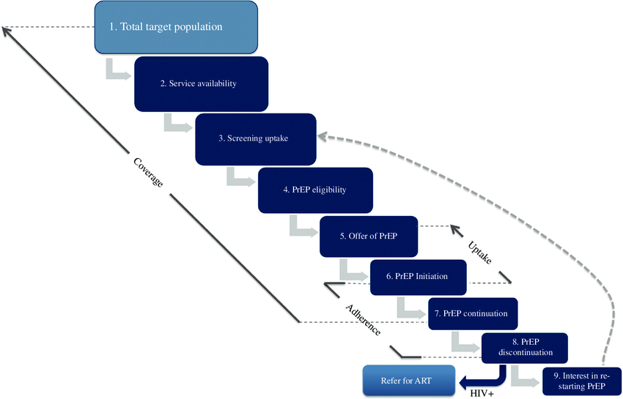
Implications

Slide 18
Implications
COVID-19 and HIV
Recent ramp up of telemedicine due to COVID-19 has led some rural populations to recently experience telemedicine visits for linkage to their care provider
Has led to a greater need for virtual healthcare services and advancements in telehealth and telemedicine services being provided
Increasing primary and secondary prevention activities to rural at-risk populations
HHS allocated $20 million for expansion of telehealth services
Potential paradigm shift in the delivery of care for rural and underserved populations in the near future
Notes:
HHS=health and human services

Slide 19
Thank You
Randolph.Hubach@okstate.edu
https://www.sexualhealthresearch.org

Slide 20
Resources
National Clinical Consultation Center http://nccc.ucsf.edu/
HIV Management
Perinatal HIV
HIV PrEP
HIV PEP line
HCV Management
Substance Use Management
AETC National HIV Curriculum https://aidsetc.org/nhc
AETC National Coordinating Resource Center https://targethiv.org/library/aetc-national-coordinating-resource-center-0
Additional trainings scaetcecho@salud.unm.edu
www.SCAETC.org

