Slide 1
COVID-19 and HIV in Arizona Epi Update
Arizona Department of Health Services
1

Slide 2
Disclaimer
“This presentation is supported by the Health Resources and Services Administration (HRSA) of the U.S. Department of Health and Human Services (HHS) as part of an award totaling $3,278,366. The contents are those of the author(s) and do not necessarily represent the official views of, nor an endorsement, by HRSA, HHS or the U.S. Government.”
The views and opinions expressed in this presentation are not necessarily those of the Pacific AIDS Education and Training Centers (PAETC), the Regents of the University of California or its San Francisco campus (UCSF or collectively, University) nor of our funder the Health Resources and Services Administration (HRSA). Neither PAETC, University, HRSA nor any of their officers, board members, agents, employees, students or volunteers make any warranty, express or implied, including the warranties of merchantability and fitness for a particular purpose; nor assume any legal liability or responsibility for the accuracy, completeness or usefulness of information [,apparatus, product] or process assessed or described; nor represent that its use would not infringe privately owned rights.

Slide 3
Goals of Presentation
Understand relationship between COVID-19 and HIV in Arizona
Understand impact of COVID-19 on persons with HIV
3

Slide 4
2019 Arizona HIV/AIDS Epidemiology Data Summary
4

Slide 5
HIV Incidence and Prevalence 2019
776
Newly diagnosed persons with HIV in Arizona.
18,462
persons with HIV in Arizona.
Notes:
75% of all PLWH in RWPA

Slide 6
Arizona Continuum Data, 2019
6
Notes:
Perhaps mention that we are using “new” CDC guidelines to create our care continuum. Linkage to Care uses a different denominator and thus cannot be compared to the other stages of the HIV/AIDS care continuum.
Definitions:
Linkage to Care: Percent of individuals newly diagnosed with HIV/AIDS in the year of interest who were linked to care within 30 days of their diagnosis.
HIV-Diagnosed: Individuals who were diagnosed with HIV/AIDS before the end of the previous year.
Receipt of Care: PLWH who received one or more lab test (i.e. viral load, CD4, or HIV genotype) in the year of interest.
Retained in Care: PLWH who received two or more lab tests (i.e. viral load, CD4, or HIV genotype) that were at least 90 days apart in the year of interest.
Viral Suppression: PLWH who has a viral load test result in the year of interest, and the result was less than or equal to 200 copies/mL.

Slide 7
Higher diagnosis rates among 20-24 year olds in Arizona
7

Slide 8
Black Non-Hispanics highest rates of new HIV cases in Arizona
NH=Non-Hispanic
A/PI/H=Asian/Pacific Islander/Native Hawaiian AI/AN=American Indian/Alaska Native
8

Slide 9
COVID-19 AND HIV IN ARIZONA
9

Slide 10
COVID-19 and HIV Overview (1)
1,674
persons dually diagnosed with COVID-19 and HIV in Arizona as of February 28, 2021
of
18,462
people are living with HIV in Arizona.
10
Notes:
9% of people living with HIV/AIDS have been diagnosed with COVID-19 as of February 28,2021

Slide 11
COVID-19 and HIV Overview (2)
9%
of persons living with HIV in Arizona have been diagnosed with COVID-19 as of February 28, 2021
11%
of all Arizonans have been diagnosed with COVID-19 as of February 28, 2021.
11

Slide 12
COVID-19 and HIV Overview (3)
1,674
persons dually diagnosed with COVID-19 and HIV in Arizona as of February 28, 2021
of
18,462
people are living with HIV in Arizona.
823,694
persons diagnosed with COVID-19 in Arizona as of February 28, 2021
of
7,278,717
people are living in Arizona.
12
Notes:
9% of people living with HIV/AIDS have been diagnosed with COVID-19 as of February 28,2021

Slide 13
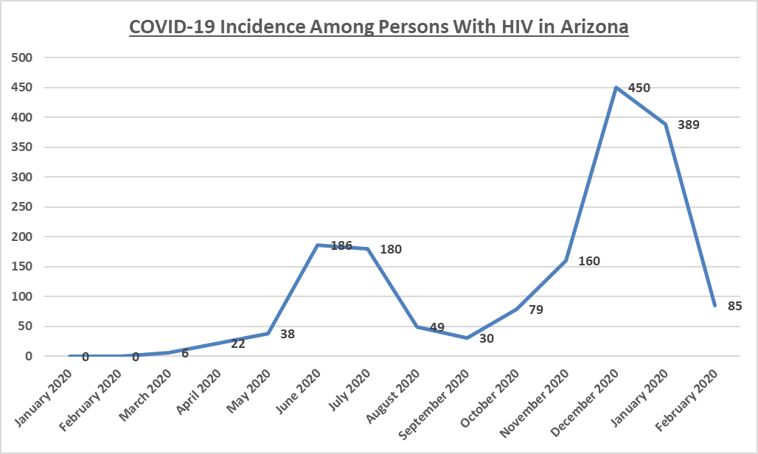
Covid-19 Incidence
13

Slide 14
General COVID-19 Incidence In Arizona
14

Slide 15
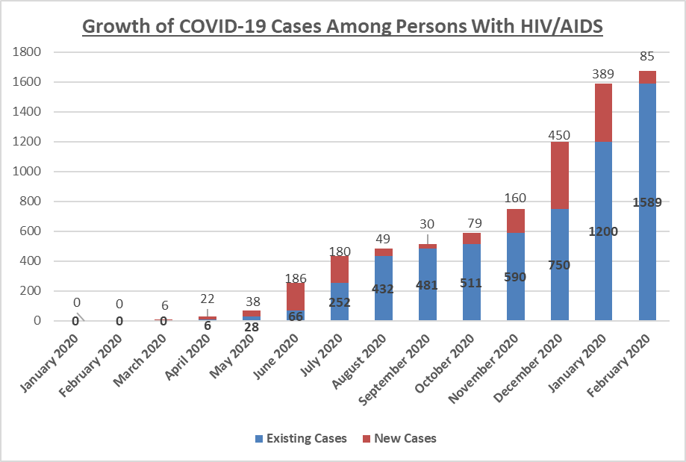
Covid-19 Among People with HIV
15

Slide 16
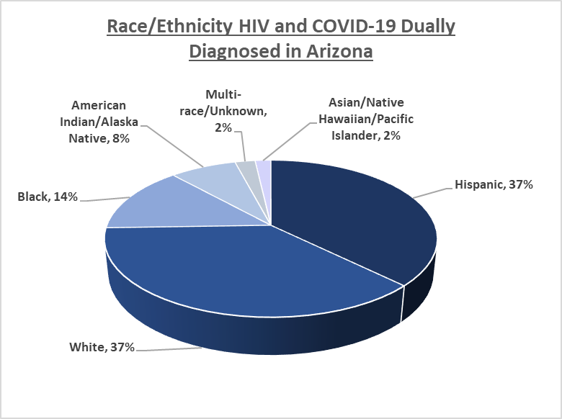
Race & Ethnicity Among Dually Diagnosed
16

Slide 17
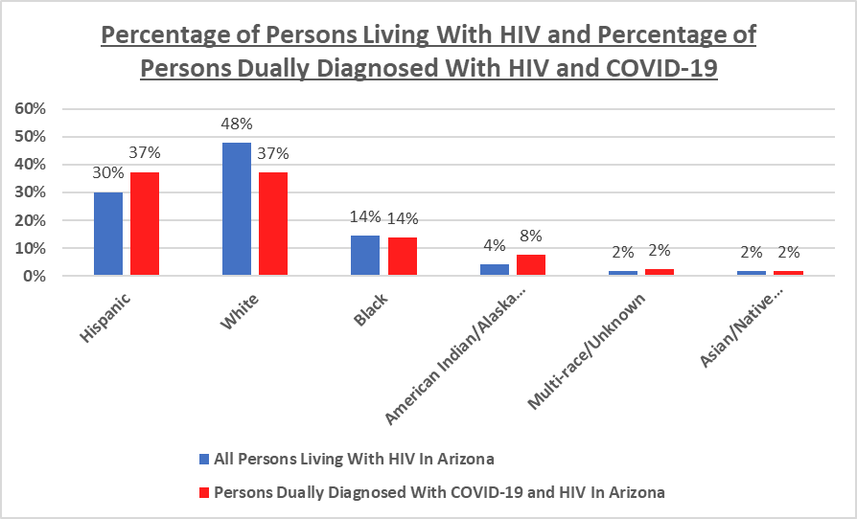
Dual Diagnoses, by percentage
17
Notes:
There are more persons who identify as Hispanic/Latino/Latinx living with HIV and COVID-19 relative to their proportion of the overall HIV population.
There are more persons who identify as American Indian/Alaska Native living with HIV and COVID-19 relative to their proportion of the overall HIV population. The number with COVID-19 is double the representation in the general HIV positive population.
The White population dually diagnosed with COVID-19 and HIV is lower indicating a proportionately lesser impact of COVID-19 among persons with HIV in Arizona.
The Black population

Slide 18
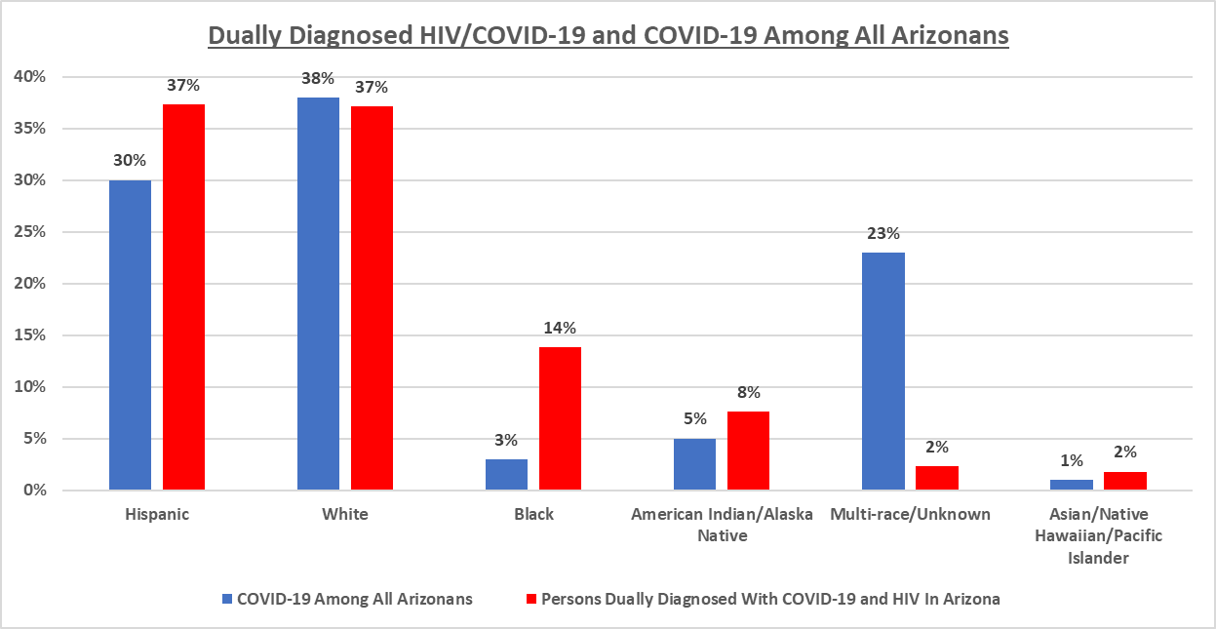
Dual Diagnoses in AZ
18
Notes:
Many lab reports for COVID -19 don’t include race/ethnicity data so Unknown is overrepresented in COVID-19 general population data.

Slide 19
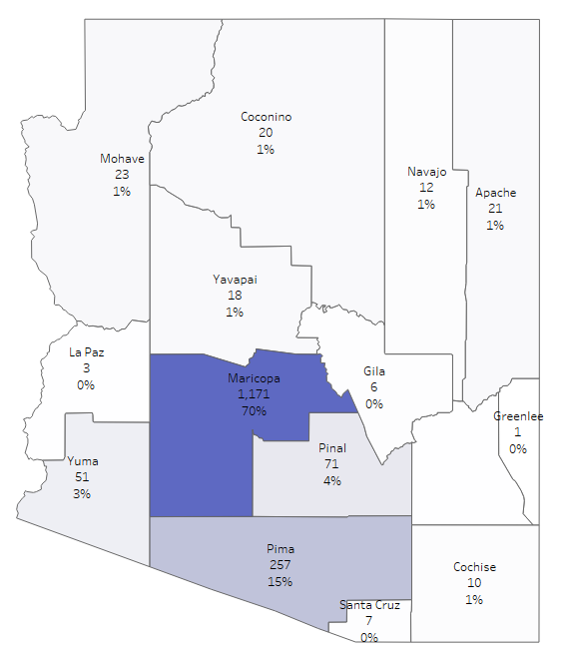
Covid-19 Prevalence by County
19

Slide 20
COVID-19 and HIV Overview
59
persons dually diagnosed with COVID-19 and HIV have died in Arizona.
This includes all deaths and COVID-19 may not have been the cause of death.
20
Notes:
Talk about limitations of death data reporting

Slide 21
Thank you!
THANK YOU!
Ricardo Fernández
ricardo.fernandez@azdhs.gov
602-364-3854
azhealth.gov
21

