Slide 1
Tips for Managing Digital Design Projects August 24, 2022 3:30 - 4:30 pm
AETC National Coordinating Resource Center
Nicolé Mandel, Website Manager
Judy Collins, Marketing Coordinator
Dominic Stanislaus, Program Assistant

Slide 2
Presenters
Nicol$é$ Mandel
AETC NCRC, Website Manager
TargetHIV, Project Manager
Judy Collins
Marketing Coordinator
AETC NCRC
Dominic Stanislaus
Program Assistant
AETC NCRC

Slide 3
Goal
Demystify the digital design, development, and deployment process by sharing tips and lessons learned through the HIV Care Tools mobile app development project and the redesign of existing products. In this session, participants will learn how to:
Identify audience needs
Identify resources and services for design development
Outline steps for development & deployment
Identify opportunities & approaches for marketing and promotion

Slide 4
Background
Our pre-printed fact sheets on clinical topics were very popular demonstrating a demand for short-format content and materials that can be distributed at in-person trainings
A survey of AETC NCRC website users found that clinicians who use apps use them for content like reference guides and clinical calculators
Our funder wanted us consider sustainability when developing resources
EHE funding became available but had a short shelf life (had to spend it ASAP)

Slide 5
Our Project: Pocket Cards Update
Before: Preprinted & PDF

Slide 6
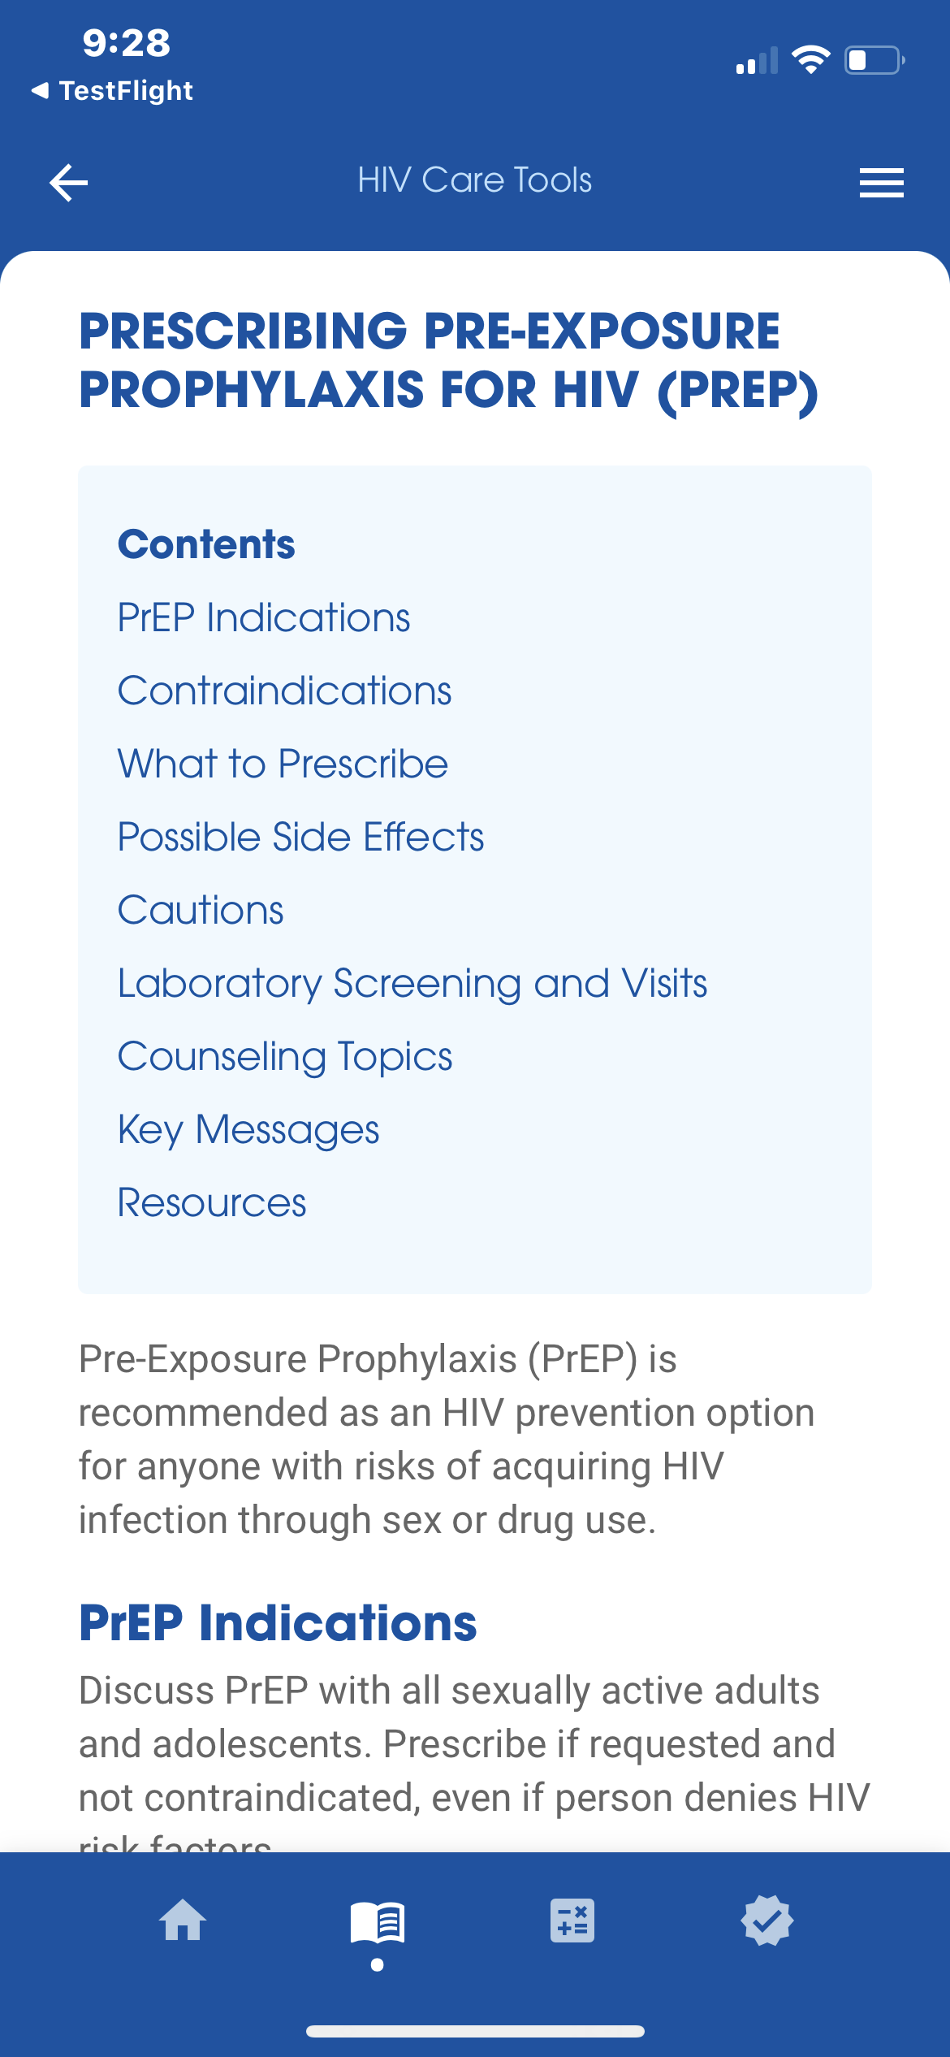
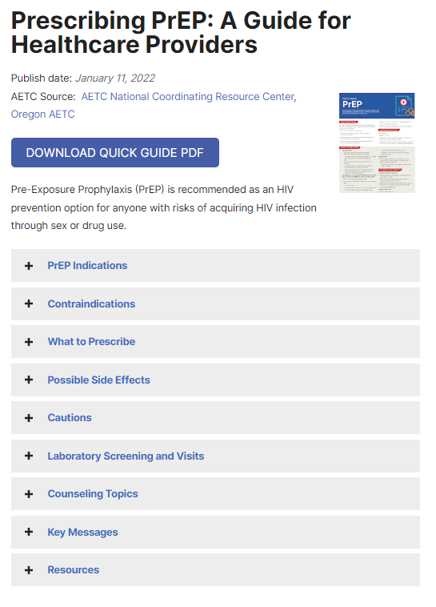
New Design & Format
After: Self-print PDF, Web & App

Slide 7
Scope of Work
Requirements for all versions
Easy to update
Accessible
Brand-consistent
Print version
Printable from a standard office printer
App version
Easy to navigate
Shareable via email or text
Available without Internet access
IOS and Android
Web version
Scannable
Easy to navigate from multiple devices

Slide 8
Our Strategy
Used in-house resources for project management, content, online versions, and marketing
Worked with a designer with both print and web experience to create a new templates
Partnered with an app developer with health sector experience and both design and development skills, and experience

Slide 9
Project Management
Create a project outline
# of products or components
Steps or stages of development for each product or component
Budget
Timeline
Personnel
Identify resources & services
Referrals
University or program/department vendor list
Interns or Students

Slide 10
Project Management Stages
Design & Development
Goals & objectives
Marketing
Audience review & plan
Launch & Outreach
Video
Promotional slides
Postcards
Newsletters
Website
Email
Articles
Social Media
Wireframe/storyboard
Review
Design
Technical specifications
Testing & feedback
Market analysis
Messaging & copy
Photos & assets
Partners/collaborators
Events/conferences

Slide 11
The Project Manager’s Role
Liaison between designer/developer and content authors
Identify subject matter experts
Version control for content
Quality assurance/testing
Manage timeline
Launch & promotion

Slide 12
App Design & Development Process
Design
Work with someone who understands mobile UI/UX and can speak the developer's language
Use wireframing to work through behavior (what happens when you touch here, etc.) in addition to design
Development
Establish your own QA process. Be thorough and include multiple perspectives.
Publishing
2 main shops: App Store (IOS) and Google Play store (Android)
Apple store can be hard to get in to
Plan
Do
Check
Act

Slide 13
Pro Design Tip: Define the Audience
Personas
Think about your audience(s) in some detail
Work with your subject matter experts to make sure they ring true
Survey potential users or otherwise gather data where you can
Use in design, development, marketing, and evaluation

Slide 14
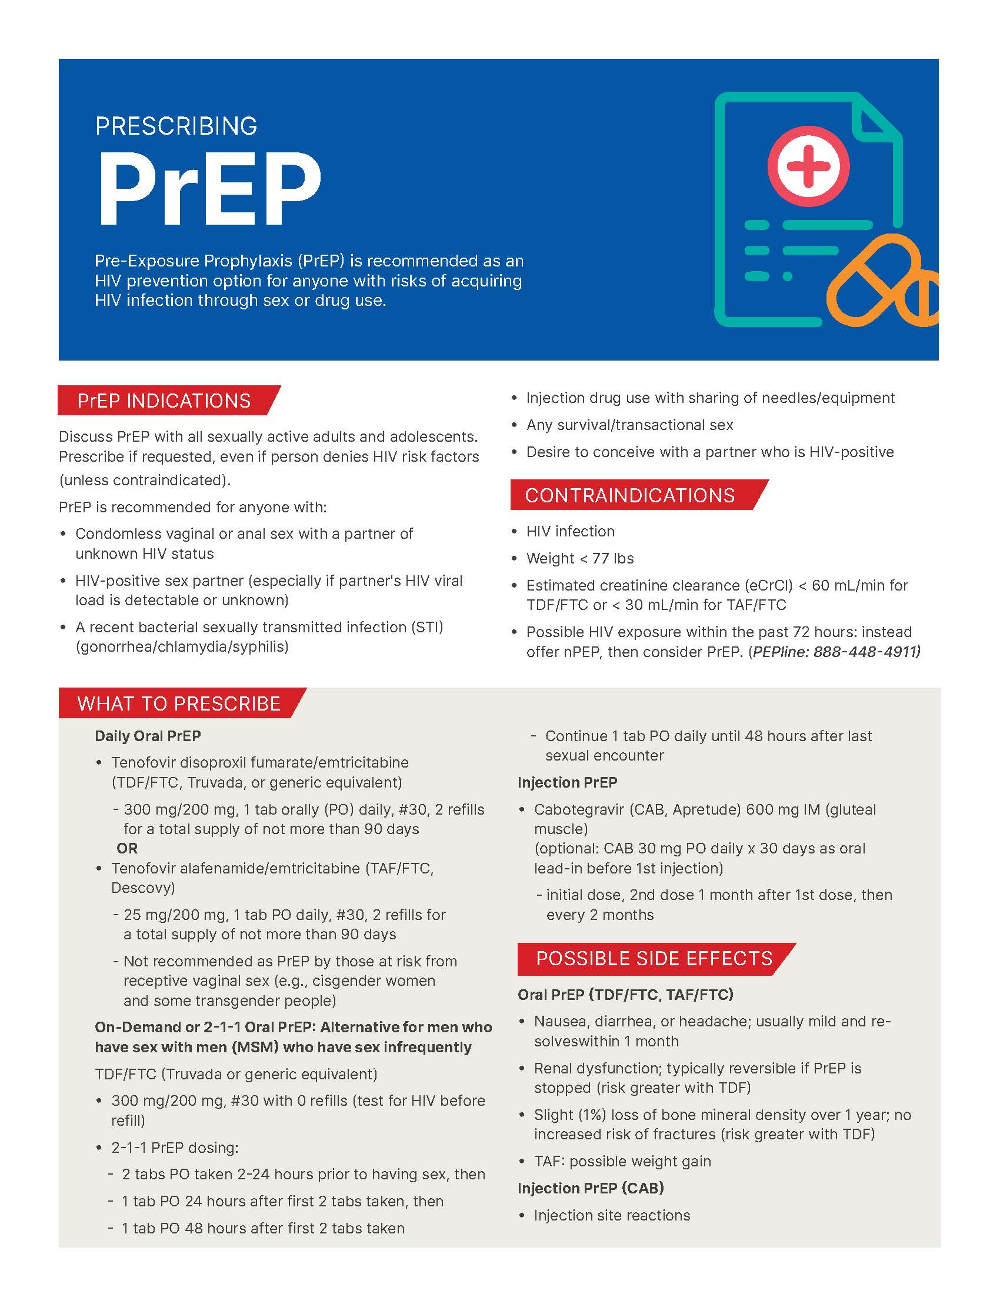
Materials Redesign Process
From pocket guide to print-friendly PDF
Back-and-forth via PDF
Make sure you actually print it out
LOTS of editorial involvement with the authors
From pocket guide to web format
We already had templates/design patterns that we could use
Wait until the content was nailed down

Slide 15
Project Management Tips
Familiarize yourself with the language
Use project management tools, e.g., Box, Trello, Google Docs, Jira
Research your resources and services
Tap into your team’s strengths
Communicate often, discuss updates & challenges
Google is your friend!

Slide 16
Marketing Approaches
Identify opportunities & approaches for marketing and promotion
Websites
Social Media
Videos
E-mail listservs and newsletters
Collaborate with partners & agencies
Conferences & events
Direct mail

Slide 17
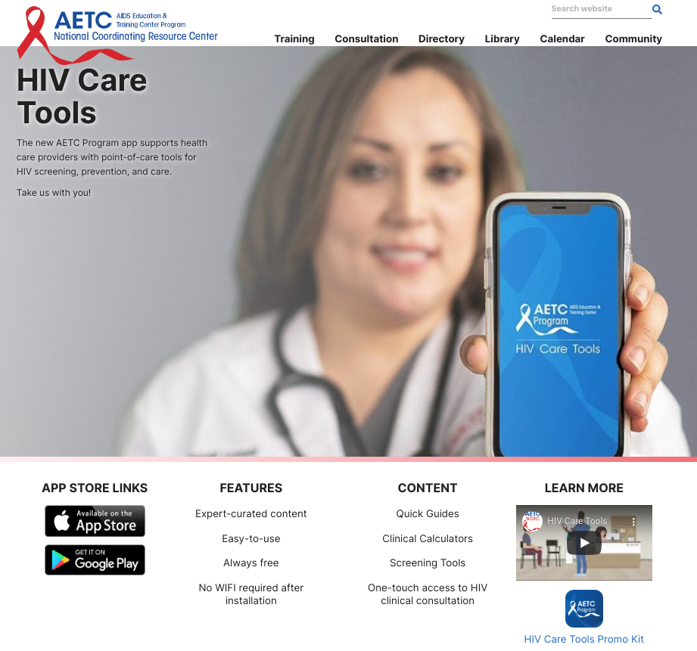
Marketing tips
Create engaging visuals using Canva or other free graphic design tools
Prepare marketing materials for your website, ex: HIV Care Tools webpage
Contract with a videographer to create a promo video
Write a short article or blog story

Slide 18
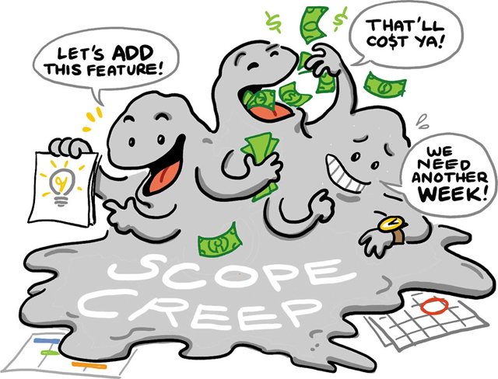
Challenges & Tips
If possible, start early in the fiscal year
Do your homework
Resist scope creep
Look for more than one vendor
Pad your timeline
Plan for accessibility
Plan for future updates and additional versions (sustainability)

Slide 19
Key Takeaways
Project management is project management
Tap into your existing resources – use who you know
Stay organized
Follow the script
Have a back-up plan

Slide 20
Project Management & Design Resources
Trello https://trello.com/en
Box https://www.box.com/
Google Docs https://docs.google.com/
Jira Software by Atlassian https://www.atlassian.com/software/jira
Canva https://www.canva.com/

