Slide 1
Modern Approaches to Youth With HIV
Michelle Collins-Ogle, MD, FAAP, FPIDS
Montefiore Adolescent and Youth Sexual-health Clinic, Inc.
Associate Professor of Pediatrics Einstein College of Medicine Pediatric and Adolescent HIV Children’s Hospital at Montefiore
1

Slide 2
Faculty Disclosure
No disclosures
This program is supported by the Health Resources and Services Administration (HRSA) of the U.S. Department of Health and Human Services (HHS) under grant number U1OHA30535 as part of an award totaling $4.2m. The contents are those of the author(s) and do not necessarily represent the official views of, nor an endorsement, by HRSA, HHS, or the U.S. Government. For more information, please visit HRSA.gov.
“Funding for this presentation was made possible by cooperative agreement U1OHA30535 from the Health Resources and Services Administration HIV/AIDS Bureau. The views expressed do not necessarily reflect the official policies of the Department of Health and Human Services nor does mention of trade names, commercial practices, or organizations imply endorsement by the U.S. Government. Any trade/brand names for products mentioned during this presentation are for training and identification purposes only.”

Slide 3
Educational Need/Practice Gap
Gap = Difference between current practice and optimal practice relevant to the educational need
Need = The issue/problem that underlies the practice gap

Slide 4
Objectives
Upon completion of this presentation, learners should be better able to:
Summarize the global threat of HIV among adolescents
Identify the challenges related to providing comprehensive medical care for adolescents with HIV including transgender and nonbinary youth
Describe the challenges involved with transitioning adolescents with HIV to adult care and strategies to overcome them
Identify the challenges related to messaging U=U in the adolescent population and implication for patient care

Slide 5
Expected Outcome
Better understand nuances in providing HIV care for adolescents, particularly transgender and nonbinary youth.
Use the Status Neutral Approach in providing comprehensive sexual health care for youth.

Slide 6
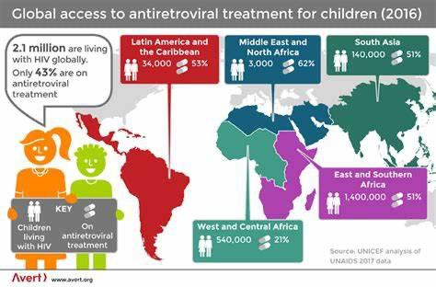
Globally HIV Remains a Significant Challenge in Children

Slide 7
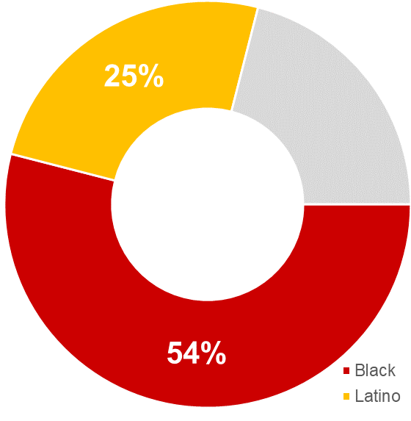
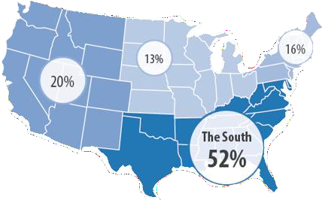
Incidence of HIV Diagnoses among MSM Youth of Color
Men Who Have Sex With Men (MSM)
accounted for 70% of youth newly diagnosed with HIV in 2019
70%
Of those, 79% were Young Men of Color, primarily in the South
CDC. (2018). Fact Sheet: HIV
and Youth.
CDC. (2017). Fact Sheet: HIV
Surveillance Report.

Slide 8
#1. What percent of adolescents 13-24 yrs. are virally suppressed?
14%
35%
27%
50%
There is no data in this age group

Slide 9
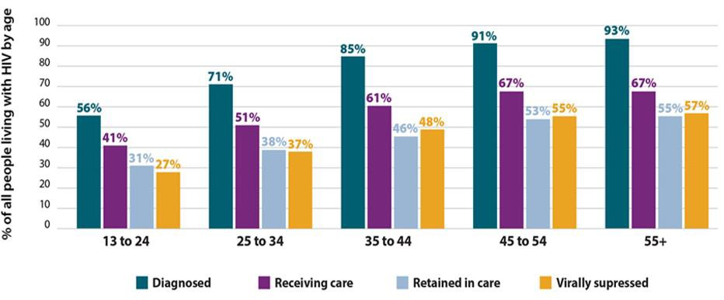
CDC HIV Care Continuum 2017
CDC. (2017). Monitoring Selected National HIV Prevention and Care Objectives by Using HIV Surveillance Data United States and 6 dependent areas, 2015. HIV Surveillance Report. 22 (2), 1-63.

Slide 10
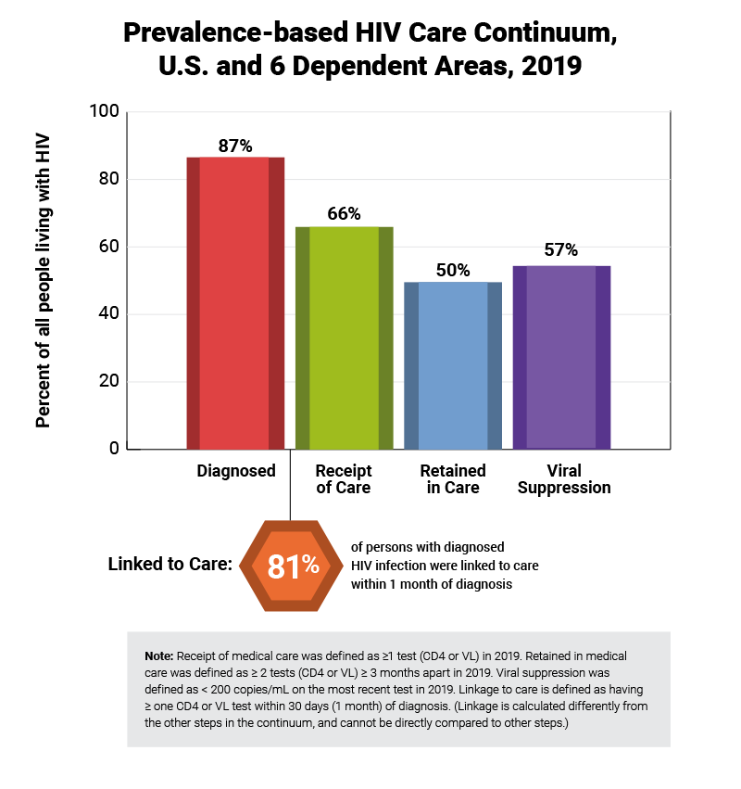
CDC HIV Care Continuum

Slide 11
#2. Which of the following is NOT CORRECT about perinatally acquired HIV infection?
Children with HIV may experience delayed puberty and adrenarche
compared with similarly aged HIV negative children
A reported newly emerging group of children with perinatal HIV are first being diagnosed in adolescence.
The majority of adolescents with perinatal HIV enter healthcare as asymptomatic and with minimal immune dysfunction
Mental illness and substance abuse are important co-morbidities for adolescents regardless of mode of HIV acquisition
You can’t trick me, all statements are correct.

Slide 12
Optimizing the Care Cascade: HIV Diagnosis and Linkage to Care
Most youth with HIV are asymptomatic
Routine testing in pediatric and adolescent care clinics
All testing sites should be centers for referral and engagement
Outreach-based (schools, venues) address consent and confidentiality with minors
Know the laws in your state
Test all youth at least once
Undisclosed sexual activity/abuse and perinatally acquired
Improve referral and engagement for sexual health
Significant numbers of youth with HIV are out of care

Slide 13
Optimizing the Care Cascade: Viral Suppression
Rapid Start – adherence can be difficult for children and adolescents
Medication Dosing – children and adolescents LWH are still growing; dosing medicine is based on weight or stage of development, not age.
Psychological developmental issues
Concrete and present-oriented thinking
Non-adherence to medication rebellion as a form of independence
Mistrust providers – trust misinformation from peers
Perinatally Acquired HIV – have unique needs
Viral suppression – 13-24 is 27% and 25-34 is 37%
*CDC 2017

Slide 14
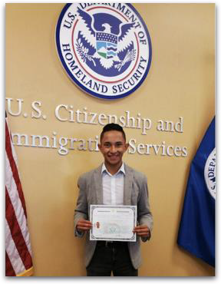
My mom doesn’t know I’m gay; don’t te l her I have
AIDS

Slide 15
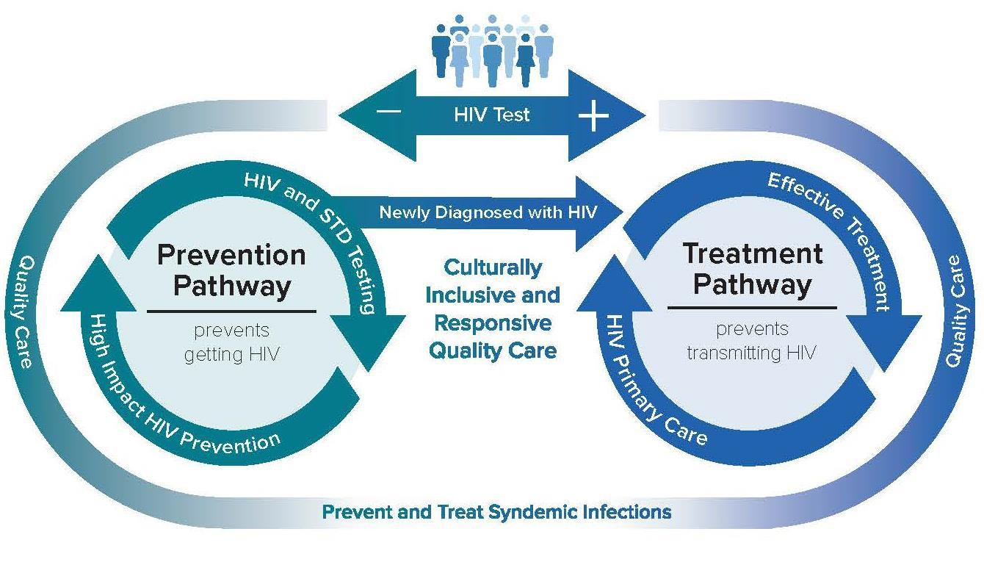
Status Neutral Approach: Adolescent focused Care
Decreases Stigma
Dramatically decrease new HIV infections
Supports optimal health through continual
engagement in comprehensive care
Increases opportunities for more efficient service delivery Improves health equity

Slide 16
Building A Program focused on Adolescents and Young Adults
Montefiore Adolescent and Youth Sexual-Health Clinic (MAYS)
Division of Pediatric Infectious Diseases
People living with HIV, PrEP, PEP
High Risk HIV negative Transgender / Non-binary
**HIV exposed (uninfected / infected) babies
**Other STI exposures (Syphilis, GC, Hep B/C)
Division of Allergy and Immunology People living with HIV, PrEP, PEP Division of Adolescent Medicine
Gender Affirming Care
Division of Psychiatry / Behavioral Health
Oval Center - Adult Infectious Diseases

Slide 17
Status Neutral Approach and Adolescents
Goals - Meet youth where they are, destigmatize sexual health and
gender affirming care
Expand access to pediatric and adolescent people at risk for Sexually transmitted Infections including HIV. End the Epidemic!!
Expand access to gender affirming care for pediatric and adolescent people.
Provide options to care for people living with HIV

Slide 18
Adolescents and Youth Susceptibility to HIV/STI
Independence Health insurance Homeless
Exploring Sexuality
Peer
Relationships
Gender Identity
•
Vulnerable HIV/STI
Gender power imbalance
Sexual abuse
Body Image Trans / homophobia

Slide 19
Challenges with LGBTQ Youth with HIV
-Same developmental challenges as all youth
-Must develop healthy, integrated identity amidst negative stereotypes/prejudice, often without family support
-More susceptible to emotional distress, psychiatric morbidity, multiple disparities, stigma, abuse, violence, isolation, suicide
-Particular challenges of TG youth: childhood to adolescence
-Sexuality and healthy relationships

Slide 20
What’s your plan for transitioning adolescents?
Adolescent Readiness to Transition Survey
There is NO standardized assessment or “Transition Team” for transition
readiness in adolescents with HIV
Readiness is multifactorial and also depends on the age of diagnosis.
We hold on to adolescents too long or not long enough
Adolescents with HIV should receive medical care in an adolescent clinic or by a pediatrician / adolescent clinician within a multi-specialty clinic (Specialty Team)
ARTS
Assess adolescents during early and late adolescence
Screen for substance abuse, mental health concerns
LGBTQ, sexually active, birth control, reproductive desires
History of adherence challenges

Slide 21
Undetectable = Untransmittable
U=U works for sustained “undetectables” adherent to ART and in care
US: 2019, 57% of PLWH achieve VS (CDC HIV Surveillance Supplemental Report 2021)
NYC: Overall, 87% of all PWH were virally suppressed in 2019
(2020, NY Annual Surveillance report)
Youth less likely to sustain VLS (27%)
How do these estimates reflect U=U potential?
Transgender and Non-binary youth
Personal and structural instability
Newly diagnosed linked to care

Slide 22
I didn’t keep my appointments because I didn’t care.
Now I love myself for the first time, I feel happy.

Slide 23
Which of the following best describes how you think of yourself?
Based on total trans adults
Trans, nonbinary 40%
Trans woman 22%
Trans, gender non-conforming 22%
Trans man 12%
None of these/Some other way 3%
Percentages may not total 100 percent due to rounding.
Source: Nov. 10-Dec. 1, 2022, Washington Post- KFF poll of 515 U.S. trans adults with an error margin of +/- 7 percentage points

Slide 24
Transgender Adolescents of Color and HIV: Unique Challenges in Preventing New Infections
HIV estimated prevalence 9.2% for all transgender persons nationally with a significantly higher prevalence for transgender women at 14.1%. A paucity of published data exists defining the risk of HIV in transgender or non-binary (TGNB) youth of color.
Recent CDC data reported the urgent need for more HIV prevention and treatment services in this population.
TGNB youth of color have numerous risk factors for HIV infection, including unstable housing, under or uninsured, unemployment, and substance use disorder.
We assessed key social determinants of health (SDOH) in TGNB youth of color and the impact on their ability to prioritize and access HIV prevention in our PrEP program in the Bronx, NY

Slide 25
METHODS
In 2021-22 we conducted an assessment of 101 sexually active TGNB youth 14-27 years to evaluate potential barriers to HIV prevention by querying the 4 U's: 1) Unemployed, 2) Uninsured/Underinsured, 3) Unstable housing, and 4) substance Use disorder.
The assessment also questioned medical gender affirmation and HIV/STI prevention. Information obtained was used to assess knowledge gaps that affect their understanding of HIV risk.
Based on results, we implemented a research tool, ARTISTA (Assess Risk for Transmitted Infections in Sexually active Transgender Adolescents) to improve gaps in understanding HIV/STI risk in TGNB youth.

Slide 26
Social Determinants of Health in TGNB Youth in the Bronx
Figure 1: Assessment of Key SDOH in TGNB Youth of Color in the Bronx : 4 U’s
23% Unemployment
11% Unstable Housing
10% Underinsured
40% SubstanceUse Disorder
Unemployment
Unstable Housing
Underinsured
Substance Use Disorder
26

Slide 27
RESULTS AND CONCLUSION
SDOH | Initiated PrEP
Total Sexually Active TGNB Assessed ₁₀₁ | 24% (24)
Unemployed _{23%} | 5
Unstable Housing _{11%} | 3
Uninsured or Underinsured _{10%} | 3
Substance Use Disorder _{40%} | 10
More than one of the above SDOH _{66%} | 3
Gender affirming care is associated with access and willingness for STI testing and counseling to inform them of their individual risk for HIV
SDOH, specifically the 4 U’s negatively impact TGNB youth of color in the Bronx and
are prioritized over HIV prevention
We are restructuring our PrEP program to better understand the impact of ARTISTA
and SDOH on improved PrEP uptake in TGNB youth of color

Slide 28
Modern Approaches to Youth With HIV Take Away Points
Integrating care through the Status Neutral Approach has the potential to destigmatize sexual health care, including HIV.
Challenges with LGBTQ Youth Living with HIV
Mental health and substance abuse are important co-morbidities for adolescents regardless of mode of HIV acquisition
U=U is not universally understood in adolescents and young adults.
Gender affirming care is associated with access and willingness for STI testing and counseling to inform them of their individual risk for HIV

Slide 29
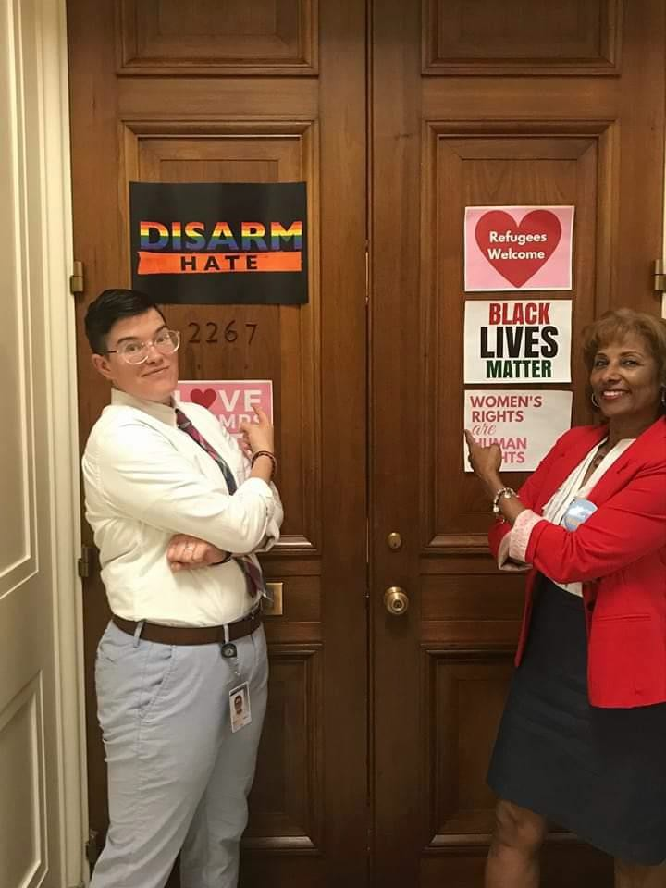
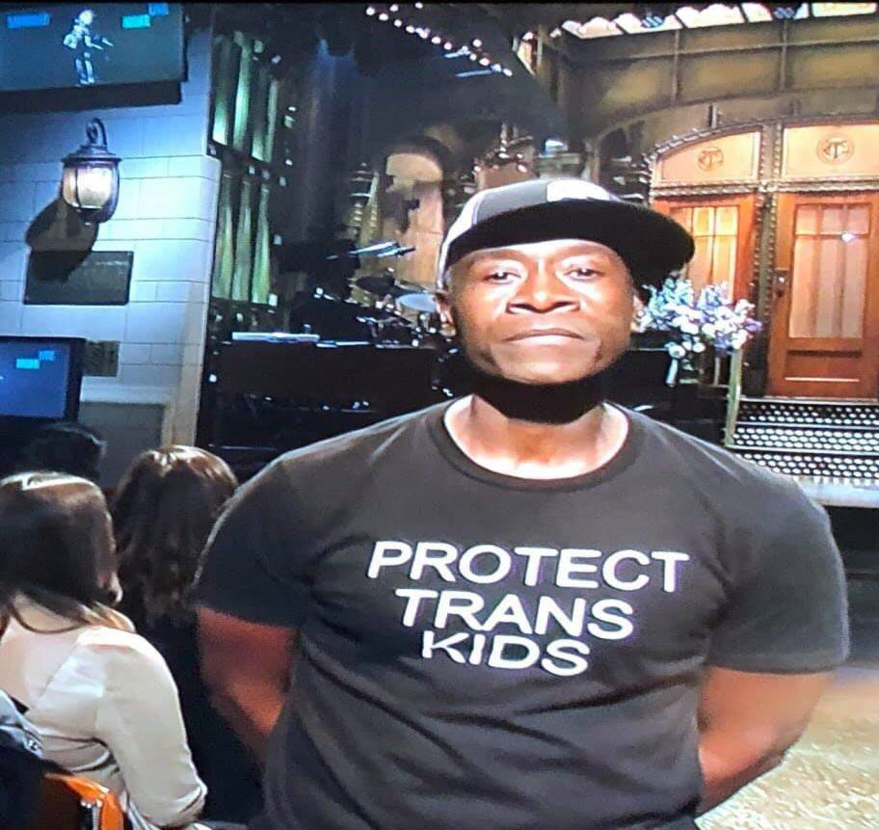
Engage Allies on Transgender Rights

Slide 30
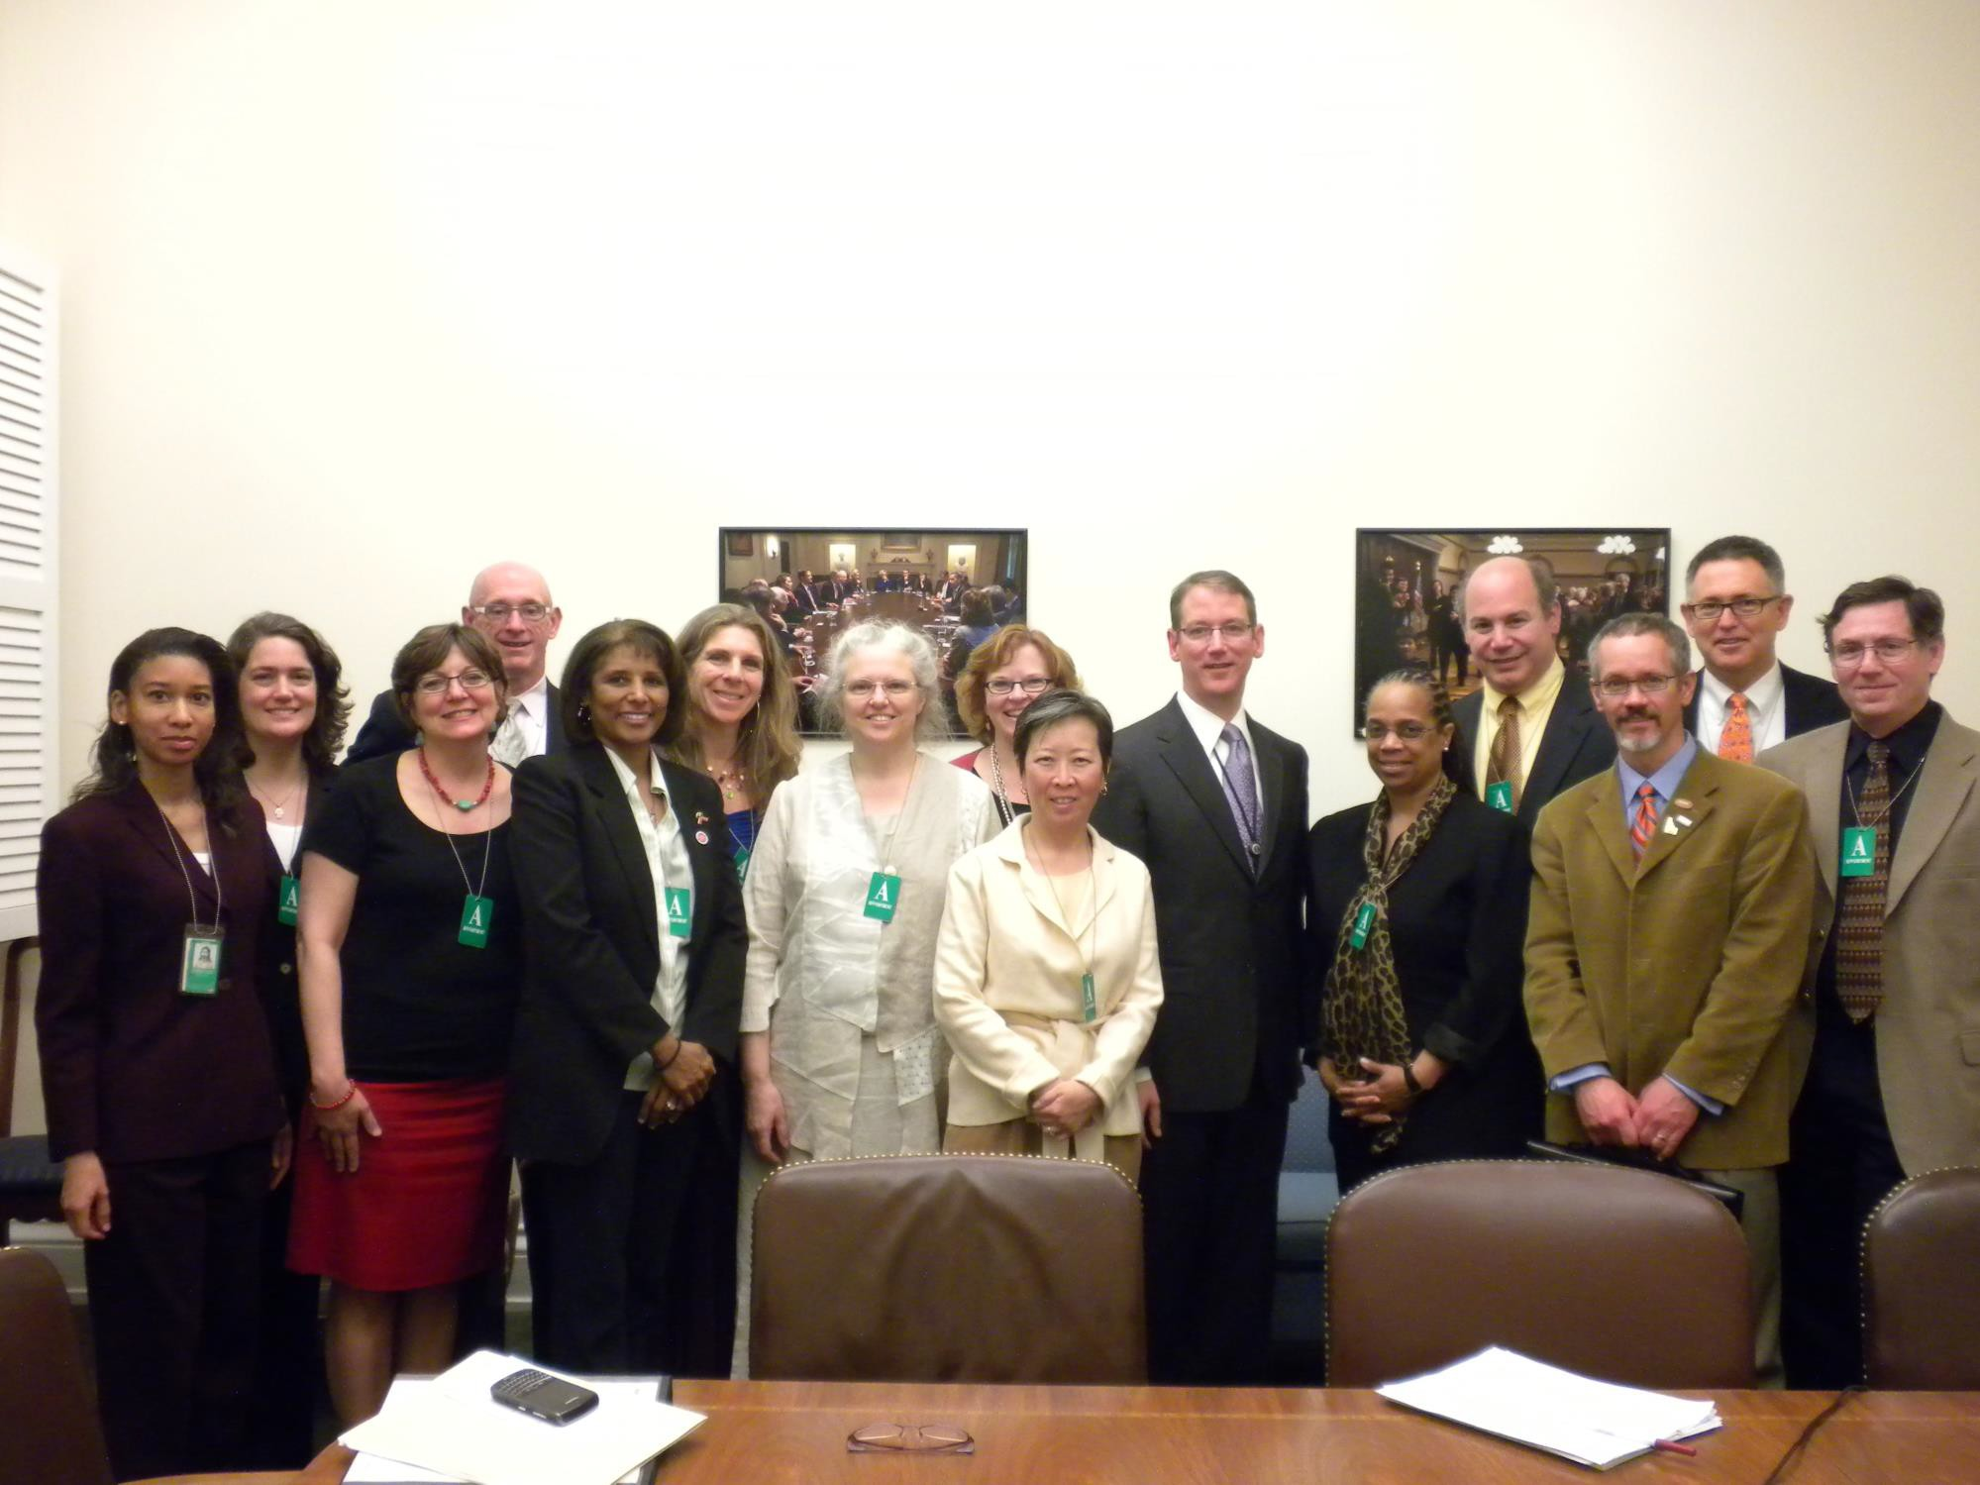

Slide 31
Q&A

Slide 32
AETC Program
National Centers and National HIV Curriculum
National Coordinating Resource Center serves as the central web based repository for AETC Program training and capacity building resources; its website includes a free virtual library with training and technical assistance materials, a program directory, and a calendar of trainings and other events. Learn more: https ://aidsetc.org
National Clinician Consultation Center provides free, peer to peer,
expert advice for health professionals on HIV prevention, care, and treatment and related topics. Learn more: https ://nccc.ucsf.edu
National HIV Curriculum provides ongoing, up to date HIV training and information for health professionals through a free, web based curriculum; also provides free CME credits, CNE contact hours, CE contact hours, and maintenance of certification credits. Learn more: www.hiv.uw.edu

