Slide 1
HCV Treatment Interruptions: Stop Treatment or Keep Going?
Paulina Deming, PharmD, PhC
Associate Professor of Pharmacy-College of Pharmacy
Associate Director- Viral Hepatitis Programs, Project ECHO
University of New Mexico Health Sciences Center
Notes:
Version date_04 2023
Target audience: prescribing providers, pharmacists, nurses

Slide 2
Conflict of Interest Disclosure Statement
Speaker has nothing to disclose
This program is supported by the Health Resources and Services Administration (HRSA) of the U.S. Department of Health and Human Services (HHS) as part of an award totaling $3,132,205, with 0% financed with non-governmental sources. The views expressed do not necessarily reflect the official policies of the Department of Health and Human Services, nor does mention of trade names, commercial practices, or organizations imply endorsement by the U.S. Government. Any trade/brand names for products mentioned during this presentation are for training and identification purposes only.

Slide 3
Learning Objectives
Apply the guidance provided by the AASLD/IDSA on hepatitis C virus (HCV) direct acting antiviral (DAA) treatment interruptions
Identify when patients should have DAA therapy continued vs. when DAA therapy should be stopped
Describe the data in patients with incomplete

Slide 4
Patient Case
A patient starts HCV treatment. After 3 weeks of treatment, he goes on a week-long trip and forgets his meds. He contacts the clinic to ask what he should do. He’s missed a week of treatment.
What should be done with his HCV therapy?
A. Continue HCV therapy
B. Stop treatment

Slide 5
Notes:
Do not modify the notes in this section to avoid tampering with the Poll Everywhere activity. More info at polleverywhere.com/support A patient starts HCV treatment. After 3 weeks of treatment, he goes on a week-long trip and forgets his meds. He contacts the clinic to ask what he should do. He's missed a week of treatment. What should be done with his HCV therapy?
https://www.polleverywhere.com/multiple_choice_polls/ZvcDFZKo8slg1Y8q1pcfb

Slide 6
Patient Case
A patient starts HCV treatment. After 2 weeks of treatment, he becomes sick. By week 3 of treatment, he stops taking his meds and is subsequently admitted to the hospital. When he contacts the HCV clinic, he has missed approximately 10 days of HCV therapy.
What should be done with his HCV therapy?
A. Continue HCV therapy
B. Stop treatment

Slide 7
Notes:
Do not modify the notes in this section to avoid tampering with the Poll Everywhere activity. More info at polleverywhere.com/support What should be done with his HCV therapy?
https://www.polleverywhere.com/multiple_choice_polls/xIK50Swhhi9e9ZiNSe0Ms

Slide 8
Patient Case
A patient receives their first month of HCV treatment. At treatment week 4, the patient is lost to follow up. 3 months later, the patient returns to clinic.
What should be done with this patient’s HCV therapy?
A. Resume HCV therapy
B. Stop treatment

Slide 9
Notes:
Do not modify the notes in this section to avoid tampering with the Poll Everywhere activity. More info at polleverywhere.com/support A patient receives their first month of HCV treatment. At treatment week 4, the patient is lost to follow up. 3 months later, the patient returns to clinic. What should be done with this patient's HCV therapy?
https://www.polleverywhere.com/multiple_choice_polls/DZJXY1ney2ZSCDqXLZU3s

Slide 10
Effects of Incomplete Treatment Adherence
International, open-label, single arm multi-center study of persons with recent injection drug use (within 6 months)
19 sites in 7 countries
Received sofosbuvir/velpatasvir for 12 weeks in 1-week electronic blister pack
Cunningham EB et al. Int J of Drug Policy. 2018;62:14-23.
Notes:
Sites were Australia, Europe, Canada, US,
103 participants: 48 yo, 72% male, 48% high school ed or higher
56% receiving OST at baseline, 74% reported injection drug use in last month; 12% neither injected drugs nor recived OST
84 days is course (76/84 is 90% or missed 8 days)
Most common non-adherence was 1-2 days (61% of episodes)
11% of episodes lasted 7 or more days

Slide 11
Overall SVR Not Affected
94% adherent patients vs
94% non-adherent (p=0.944)
SVR = sustained virologic response
Cunningham EB et al. Int J of Drug Policy. 2018;62:14-23.
Notes:
Adherence declined over the course of therapy and was associated with:
Recent stimulant injection (cocaine and/or amphetamines) at treatment initiation and during treatment
Inconsistent dose timing (>240 min)

Slide 12
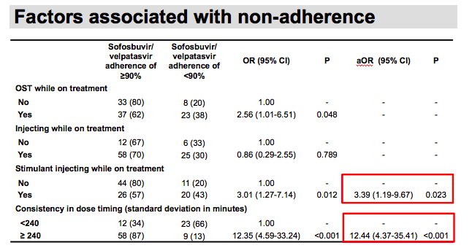
33 (32%) patients considered non-adherent (<90% adherence)
Adherence declined over the course of therapy

Slide 13
Clinical Trials Data with GLE/PIB
Pooled analysis of 2091 patients with HCV genotypes 1-6
Adherence
97% (2024/2091) at all
study visits
67% of those considered
non-adherent had <80%
adherence during >1 study visit
1 patient had <120% adherence
Brown A et al. Liver Int. 2020;40:778-786.
Notes:
8 clinical trials pooled analysis patients with and without cirrhosis

Slide 14
SVR Based on Treatment Duration & Adherence
SVR=sustained virologic suppression
Brown A et al. Liver Int. 2020;40:778-786.
Notes:
SVR=sustained virologic suppression

Slide 15
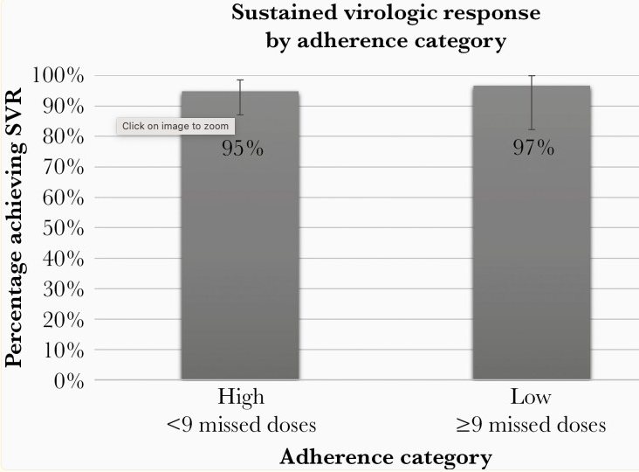
Nonadherence in Patients with HIV/HCV Coinfection
110 started HCV treatment; 5 stopped after receipt of 28 tablets
Median time to complete 84-day course of therapy was 85 days (range 76-127 days)
High adherence: median # of missed doses =1 (range 0-8)
76 participants (72%)
Low adherence: median number of missed doses= 14 (range 9-43)
29 participants (28%)
28/29 achieved SVR (97%)
Ward KM et al. J Infect Dis. 2022;225:903-911.
Notes:
None of the 5 who stopped achieved SVR (3 AE, 2 self)
At baseline, 98 had blood alcohol assessed by Peth and 33 had a result consistent with moderate to heavy alcohol use over the preceeding 14 days
Mod to heavy use was associated with non-adherence to treatment
44 out of 100 participants had positive urine tox indicating recent cocaine or heroin use, not associated with non-adherence
Strategies used to facilitate treatment uptake included usual care, uc care plus peer support, uc plus cash incentive
High adherence 90% or more
2 did not achieve SVR in high adherence (1 died)
Data from more recent studies support treatment persistence among PWID and high cure rates despite suboptimal adherence, with SVR achieved despite mean adherence as low as 39% (Coffin et al., 2019; Ward et al., 2022),[Coffin 2019/p8,5;Ward2022] or missed medications ≥5 days (Moga et al., 2022) [Moga 2022variable] or ≥2 weeks (Litwin et al., 2022b). [Litwin2022/p17] Additional studies reported SVR of 91% with 91% of patients >80% adherent (Matthews et al., 2021),[Matthews2021/p832] and SVR 88% with 88% of patients ≥80% adherent (Litwin et al., 2020).[Litwin2020OFID/p2-3] In the prospective, open-label observational ANCHOR study (Novel Model of Hepatitis C Treatment as an Anchor to Prevent HIV, Initiate Opioid Agonist Therapy, and Reduce Risky Behavior), SVR was not associated with imperfect daily adherence (P=0.35) after SOF/VEL therapy in 100 patients in the setting of buprenorphine collocation with HCV treatment (Rosenthal et al., 2020)

Slide 16
755 participants: -379 assigned to patient navigation
-376 participants modified directly observed therapy (mDOT)
- Adherence captured by electronic blister pack
PWID = people who inject drugs
Litwin AH et al. Lancet Gastroenterol Hepatol. 2022;7:1112-1127.
Notes:
755 paticipants

Slide 17
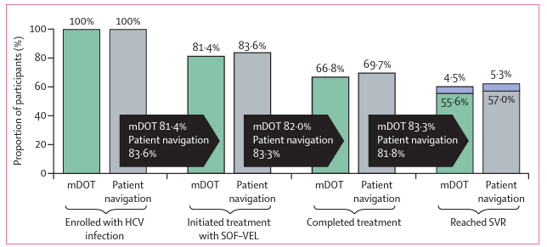
HERO Study Group
Litwin AH et al. Lancet Gastroenterol Hepatol. 2022;7:1112-1127.
Notes:
Housing insecurity associated with lower hcv treatment initiation
Although adherence higher in the modified directly observed group, there was no difference in SVR
Additional evidence from the pragmatic HERO study, which treated more than 750 PWID actively using drugs, demonstrated that high SVR (>95%) was achieved in patients who were <50% adherent. Individuals who missed ≥14 consecutive doses achieved an SVR rate of 85% compared to 93% in those who missed between 8 and 13 consecutive doses and 97% in patients who missed <7 consecutive doses (per protocol population) (Litwin et al., 2022a; Litwin et al., 2022b)[Litwin 2022/slide17-18] (Table 2).

Slide 18
HERO SVR and Predictors of SVR
Per protocol SVR
91% (226/248) in mDOT vs 93% (235/253) with patient navigator
Modified ITT SVR
74% (counted no SVR outcome as no SVR)
High # lost to follow up (19%)
Adherence overall 74%; higher in mDOT (78%) vs patient navigator (73%)
SVR significantly associated with adherence, treatment duration, & completion
ITT = intention to treat; DOT=directly observed therapy
Litwin AH et al. Lancet Gastroenterol Hepatol. 2022;7:1112-1127.
Notes:
SVR rates were similar with modified DOT (directly observed therapy) and patient navigator models
Specifically, a 10% increase in adherence was significantly associated with SVR,
SVR was also significantly associated with completion of treatment and with the number of days on treatment, a 10 day increase in time on treatment was significantly assoc with SVR (a 10% increase in was associated with 60% greater odds of SVR)
Other:
Adherence dropped over the course of the treatment but was highest among in opioid treatment programs on mDOT as compared to patient navigator
Predictors of adherence were age over 40, last drug use 5-12 weeks ago compared to within the last 4 weeks
Per protocol: participants who were assigned, intitiated treatment, complied with assigned model without crossover, had a determined SVR status
Modified ITT: randomly assigned and initiated treatment
ITT: randomly assigned

Slide 19
SVR Rates in Patients With Premature HCV Treatment End
Retrospective review of patients who stopped DAA therapy before expected end of treatment
365 patients
Mostly male (58.4%)
Mean age 60.5
53 (14.5%) HIV-HCV coinfection
Cirrhosis in 251 (68.8%) patients
Premature end of treatment
164 (44.9%) stopped DAA at least 2 wks before end of treatment
In patients with F0-F3 fibrosis:
SVR 50% if < 4 wks of treatment (n=2/4)
SVR 99.1% if > 4 wks of treatment (n=109/110)
In patients with cirrhosis:
SVR 83.3% if <8 wks (n=25/30)
SVR 94.6% if >8 wks (n=209/221)
Fabbiani M et al. J Viral Hepat. 2021;28:558-563.
Notes:
High SVR with at least 4 weeks of treatment if no cirrhosis
For patients with cirrhosis, at least 8 weeks of treatment

Slide 20
SVR in Short Course HCV Therapy: SOF/VEL
188 participants: 93 short course therapy arm (6 weeks) and 95 in long-term (12 weeks) treatment with sofosbuvir/velpatasvir (SOF/VEL)
SVR 81.7% vs 90.5% by ITT
SVR 89.4% (n= 76/85) vs 97.7% (n= 86/88) in modified ITT (excluded reinfection, death, lost to follow up)
Among participants with >90% adherence with an SVR12 visit
SVR 93.2% in short course arm
SVR 100% in long course arm
Matthews GV et al. J Hepatol. 2021;75:829-839.
Notes:
In a study of short course therapy where participants received 6 weeks of sof/vel, the overall SVR did not meet the non-inferiority endpoint
However, in the analysis of patients who received 6 weeks of therapy and had 90% adherence who attended the SVR12 appointment
2 deaths in short course
90% adherence in short course = 42 days is 6 weeks (38 days is 90%), so no more than 4 days missed
90% adherence in long= 84 days (76 days is 90%) so no more than 14 days missed

Slide 21
SVR in Short Course HCV Therapy: GLE/PIB
Open-label, multicenter pilot study of adults (n=30) with recent (<12 months) HCV infection treated with glecaprevir/pibrentasvir (GLE/PIB) x 6 weeks
SVR 90% (27/30) by ITT; SVR 96% (27/28) by PP
100% of participants had adherence >95%
Martinello M et al. Hepatol. 2020;72:7-18.
Notes:
All men, most had sexual HCV acquisition, predominantly GT1 (25/30)
Among participants with HIV coinfection, 87% SVR by ITT (20/23) and 95% by PP (20/21)
Of 3 non-SVR12: 1 virological failure; 1 pt died 4 weeks post and 1 pt LTFU
Adherence assessed by pill count and self report questionnaire

Slide 22
Patient Case
A patient starts HCV treatment. After 3 weeks of treatment, he goes on a week-long trip and forgets his meds. He contacts the clinic to ask what he should do. He’s missed a week of treatment.
What should be done with his HCV therapy?
A. Continue HCV therapy
B. Stop treatment

Slide 23
Notes:
Do not modify the notes in this section to avoid tampering with the Poll Everywhere activity. More info at polleverywhere.com/support A patient starts HCV treatment. After 3 weeks of treatment, he goes on a week-long trip and forgets his meds. He contacts the clinic to ask what he should do. He's missed a week of treatment. What should be done with his HCV therapy?
https://www.polleverywhere.com/multiple_choice_polls/zjj4gbEOjkYiGFm98RoLZ?state=opened&flow=Default&onscreen=persist

Slide 24
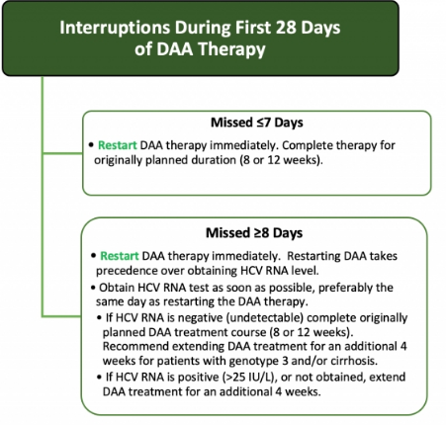
AASLD/IDSA Guidance on Incomplete Adherence: First 28 days of therapy
https://www.hcvguidelines.org/

Slide 25
Patient Case
A patient starts HCV treatment. After 2 weeks of treatment, he becomes sick. By week 3 of treatment, he stops taking his meds and is subsequently admitted to the hospital. When he contacts the HCV clinic, he has missed approximately 10 days of HCV therapy.
What should be done with his HCV therapy?
A. Continue HCV therapy
B. Stop treatment

Slide 26
Notes:
Do not modify the notes in this section to avoid tampering with the Poll Everywhere activity. More info at polleverywhere.com/support What should be done with his HCV therapy?
https://www.polleverywhere.com/multiple_choice_polls/Wrbmy3Ay8xKdCc1ldfbi8?state=opened&flow=Default&onscreen=persist

Slide 27
AASLD/IDSA Guidance on Incomplete Adherence: First 28 days of therapy
https://www.hcvguidelines.org/
https://www.hcvguidelines.org/

Slide 28
Patient Case
A patient receives their first month of HCV treatment. At treatment week 4, the patient is lost to follow up. 3 months later, the patient returns to clinic.
What should be done with this patient’s HCV therapy?
A. Resume HCV therapy
B. Stop treatment

Slide 29
Notes:
Do not modify the notes in this section to avoid tampering with the Poll Everywhere activity. More info at polleverywhere.com/support A patient receives their first month of HCV treatment. At treatment week 4, the patient is lost to follow up. 3 months later, the patient returns to clinic. What should be done with this patient's HCV therapy?
https://www.polleverywhere.com/multiple_choice_polls/etkyCwLgqAT7rprxP5GXR?state=opened&flow=Default&onscreen=persist

Slide 30
AASLD/IDSA Guidance on Incomplete Adherence: After initial 28 days of treatment
https://www.hcvguidelines.org/

Slide 31
Key Points
Patients who miss consecutive doses of HCV meds should be restarted on therapy as soon as possible
Therapy should be stopped if missed >21 days of consecutive doses
Optimal treatment outcomes observed with >90% treatment adherence and full course of HCV therapy but
SVR can be achieved with imperfect adherence and shorter courses of therapy
Patients with incomplete treatment adherence should be asked about factors which impair adherence and every attempt made to address and minimize these barriers

Slide 32
SCAETC Social Media

Slide 33
References
Brown A, Welzel TM, Conway B, Negro F, Braun N. Adherence to pan-genotypic glecaprevir/pibrenasvir and efficacy in HCV infected patients: A pooled analysis. Liver Int. 2020;40:778-786.
Cunningham, E. B., Amin, J., Feld, J. J., Bruneau, J., Dalgard, O., Powis, J., et al. (2018). Adherence to sofosbuvir and velpatasvir among people with chronic HCV infection and recent injection drug use: The SIMPLIFY study. Int J Drug Policy. 62; 2018:14-23.
Fabbiani M, Lombardi A, Colaneri M, Del Poggio P, Perini P, et al. High rates of sustained virological response despite premature discontinuation of directly acting antivirals in HCV-infected patients treated in a real-life setting. J Viral Hepat. 2021:28:558-563.
Litwin AH, Lum PJ, Taylor LE, Mehta SH, Tsui JI, et al. Patient-centered models of hepatitis C treatment for people who inject drugs: a multicenter, pragmatic randomized trial. Lancet Gastroenterol Hepatol. 2022;7:1112-1127.
Martinello M, Orkin C, Cooke G, Bhagani S, Gane E et al. Hepatology. 72;2020:7-18.
Matthews GV, Bhagani S, Van der Valk M, Rockstroh J, Feld J et al. Sofosbuvir/velpatasvir for 12 vs. 6 weeks for the treatment of recently acquired hepatitis C infection. J Hepatol. 2021:75:829-839.
Ward KM, Falade-Nwulia O, Moon J, Sutcliffe CG, Brinkey S et al. Nonadherence to ledipasvir/sofosbuvir did not predict sustained virologic response in a randomized controlled trial of human immunodeficiency virus/hepatitis C virus coinfected persons who use drugs. J Infect Dis. 2022;225:903-911.

Slide 34
Resources
National Clinician Consultation Center http://nccc.ucsf.edu/
HIV Management
Perinatal HIV
HIV PrEP
HIV PEP line
HCV Management
Substance Use Management
Present case on ECHO hivecho@salud.unm.edu
AETC National HIV Curriculum https://aidsetc.org/nhc
AETC National Coordinating Resource Center https://targethiv.org/library/aetc-national-coordinating-resource-center-0
Additional trainings scaetcecho@salud.unm.edu
www.scaetc.org
Notes:
Find an HIV-related topic TeleECHO in your area: https://echo.unm.edu/locations-2/echo-hubs-superhubs-united-states/
IDEA Platform: Infectious Diseases Education & Assessment. https://idea.medicine.uw.edu/
AETC National HIV Curriculum: 6 core modules for self study; regularly updated; CME, CNE
Hepatitis C Online Curriculum: https://www.hepatitisc.uw.edu/
Hepatitis B Online Curriculum: https://www.hepatitisb.uw.edu/
National STD Curriculum: https://www.std.uw.edu/

