Slide 1
HIV & LGBTQ+ Stigmas and Cultural Humility
Maria E. Mancebo, MS | EHE & Provider Initiatives Manager
Pronouns: they/she
Sexual Health and Harm Reduction Services
Oklahoma State Department of Health
Notes:
Version date_07 2023

Slide 2
Conflict of Interest Disclosure Statement
Speaker has nothing to disclose
This program is supported by the Health Resources and Services Administration (HRSA) of the U.S. Department of Health and Human Services (HHS) as part of an award totaling $3,132,205, with 0% financed with non-governmental sources. The contents are those of the author(s) and do not necessarily represent the official views of, nor an endorsement of, by HRSA, HHS, or the U.S. Government. For more information, please visit HRSA.gov. Any trade/brand names for products mentioned during this presentation are for training and identification purposes only.

Slide 3
Learning Objectives
Understand sexual orientation and gender identity (SO/GI) components and Two-Spirit, Lesbian, Gay, Bisexual, Transgender, Queer or Questioning and additional sexual orientations and sexual identities (2SLGBTQIA+) identity
Define stigma and describe how it contributes to 2SLGBTQIA+ health and HIV disparities
Identify strategies and best practices for reducing stigma and affirming 2SLGBTQIA+ clients

Slide 4
Community Agreements
Be respectful- we all come from and have different backgrounds, attitudes, values, beliefs, and experiences with sexuality
Challenge yourself, be open to vulnerability
Aim for curiosity, not perfection
Take care of yourself

Slide 5
Understanding Sexual Orientation & Gender Identity (SO/GI)

Slide 6
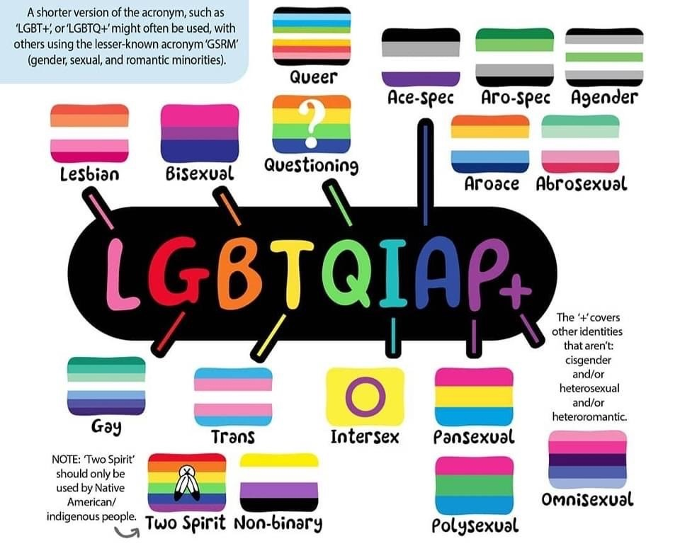
Understanding Sexual Orientation & Gender Identity (SO/GI)
Grounding Principles:
Knowledge about SO/GI is essential to providing affirming, quality health care
Language is powerful and shapes our perceptions
2SLGBTQIA+ individuals have always existed
Vocabulary around gender and sexuality is ever-evolving
Victoria Barron, The Acronym Explained (2021)
SEAETC Cultural Humility & Reducing Stigma and Discrimination (2020)

Slide 7
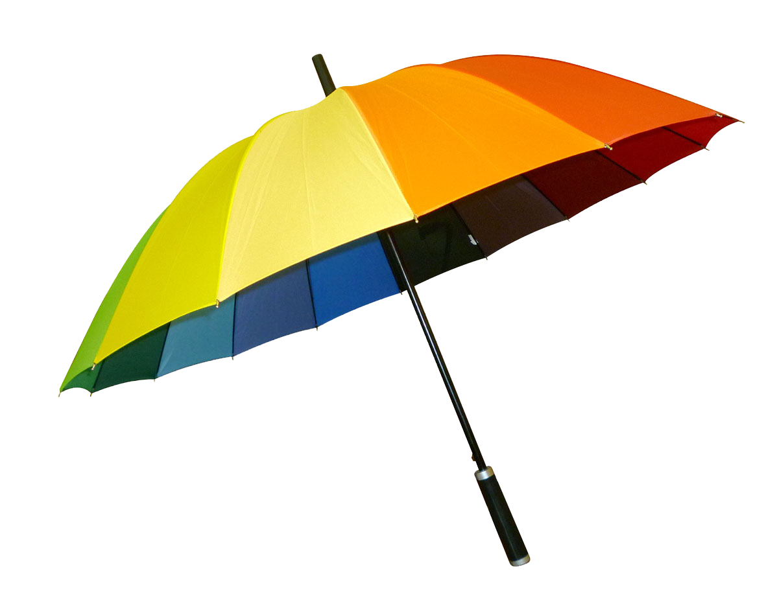
Understanding Sexual Orientation & Gender Identity (SO/GI)
Umbrella Terminology:
2SLGBTQ+ is an acronym meant to encompasses a wide range of diverse sexualities and genders, i.e. non-heterosexual, non-cisgender
May also be described as:
Queer
Sexual & gender minority
Sexual & gender diverse
++++
2S L G B T Q +
Sexual Identity
Lesbian
Gay
Bisexual
Queer, Questioning
Asexual, Aromantic, Ace
++++
Gender Identity
2Spirit (Two-spirit)
Transgender
Queer, Genderqueer
Intersex (Sex-assignment)
++++
The Safe Zone Project
SEAETC Cultural Humility & Reducing Stigma and Discrimination (2020)

Slide 8
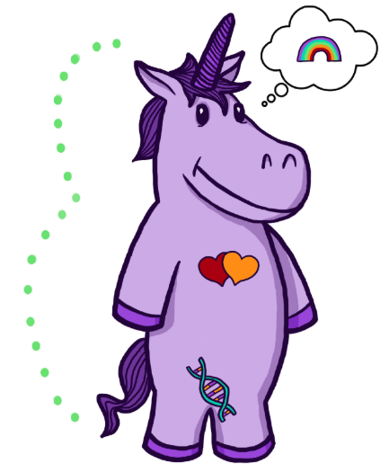
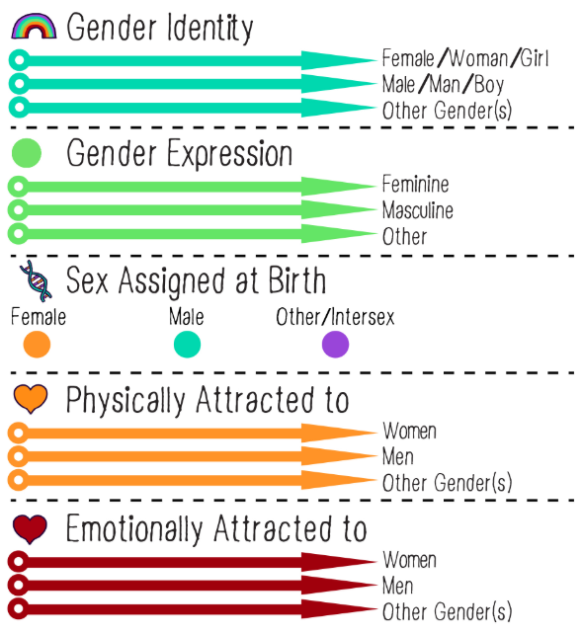
The Gender Unicorn
Components of
Gender Identity
Components of
Sexual Orientation
Trans Student Educational Resources (2015)

Slide 9
Sexual Orientation
How one characterizes their attraction to others from a variety of factors including but not limited to gender identity, gender expression/presentation, and sex assigned at birth
Physical attraction: sexual attraction and capacity for arousal towards others
Emotional attraction: emotional attraction and capacity for romantic connection towards others
Identity
Behavior
Attraction/ Desire
Sexual Orientation ≠ Gender Identity
Trans Student Educational Resources, Landyn Pan and Anna Moore (2015)
Florida International University, Dr. Erica Jayne Friedman, (modifications to original)
https://doi.org/10.17226/26424

Slide 10
Sex Assigned at Birth
Sometimes referred to as “sex,” “physical sex,” “anatomical sex,” or “biological sex”
Usually refers to one’s external genitalia and used to label one as “male” or “female” or “intersex”
Also includes one’s internal reproductive organs, chromosomes and hormones, although these factors are not typically taken into account when assigned
Trans Student Educational Resources (2015)

Slide 11
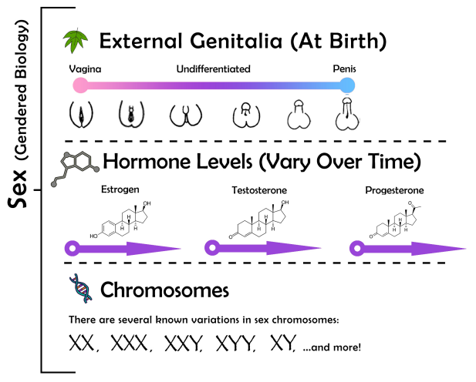
Intersex/ differences of sex development (DSD)
An umbrella term for differences in sex traits or reproductive anatomy
Genitalia, hormones, internal anatomy, or chromosomes can develop in many ways
It is estimated that 1.7% of people are born with intersex traits – that’s about the same number of people who are born with red hair
Trans Student Educational Resources, Landyn Pan and Anna Moore (2015)
Florida International University, Dr. Erica Jayne Friedman, (modifications to original)

Slide 12
Gender Expression
This is one’s “public” gender; how one presents their gender in the world
Sometimes described as “feminine,” “masculine,” or “neutral/undefined” and can include clothing, hair style, or mannerisms, etc.
Related to gender roles affected by how society, culture, community, and family perceive, interact with, and try to shape our gender
Never assume a person’s gender identity based on their appearance or mannerisms!
Trans Student Educational Resources (2015)

Slide 13
Gender Identity
Name one uses to convey their gender
One’s deeply held, internal sense of self as masculine, feminine, a blend of both, neither, or something else
Can correspond to (cisgender), or differ (transgender), from one’s sex assigned at birth
Can evolve and shift over time, especially as someone gains access to a broader gender vocabulary
Gender Identity ≠ Sexual Orientation
Trans Student Educational Resources (2015)

Slide 14
The SIEO Model
Gender Identity |  |  | Sexual Orientation
Sex Assigned at Birth | Gender Identity | Gender Expression | Sexual Orientation
Female (AFAB) Male (AMAB) Intersex/ difference of sex development | Cisgender Transgender Non-binary Genderqueer Agender Two-spirit ++++ | Feminine Masculine Androgynous Butch Femme Drag king/ queen ++++ | Heterosexual Lesbian Gay Bisexual Queer Asexual Same gender loving Pansexual Demisexual ++++
Teaching Transgender Toolkit (2015)

Slide 15
Personal Pronouns
Subjective | Objective | Possessive | Reflexive | Examples
She | Her | Hers | Herself | She is in the waiting room. The doctor is ready to see her. The chart is hers.
He | Him | His | Himself | He is in the waiting room. The doctor is ready to see him. The chart is his.
They | Them | Theirs | Themself | They are in the waiting room. The doctor is ready to see them. The chart is theirs.
Ze | Hir/Zir | Hirs/Zirs | Hirself/Zirself | Ze is in the waiting room. The doctor is ready to see zir. The chart is zirs.
Trans Student Educational Resources (2015)

Slide 16
Personal Pronouns
ASK
You cannot tell someone’s name or pronouns just by looking at them
RESPECT
If someone takes the time to let you know their name and pronouns, use and respect it. It is not up to you to decide someone else’s identity
PRACTICE
If you have difficulty using someone’s pronoun and name, practice. Ask co-workers, peers, friends to point out when you’ve made a mistake
Respectfully ask someone for their prononuns:
“Sorry, I forgot to ask. I use they/them/theirs pronouns, how about you?”
“I wanted to check in before I assumed—what are your pronouns?”
Practice gender neutral language:
Freshman > first year student
Boyfriend/girlfriend > romantic/sexual partner
Breastfeeding > chestfeeding
Trans Student Educational Resources (2015)
National LGBT Health Education Center (2017)

Slide 17
LGBTQ+ Across Generations
~20 million adults in the US identifies as LGBT
 | Millennials (Ages 24-40) | Gen X (Ages 41-57) | Baby Boomers (Ages 58-77) | (78+)
Identified as LGBTQ+ | 20% | 12% | 7% | 5%
Identified as Transgender Non-Binary (T/NB) | 12% | 6% | 3% | 3%
Considered themselves allies of the LGBTQ community | 63% | 53% | 51% | 39%
HRC, Understanding the Size of the LGBTQ+ Community (2021)
GLAAD, Accelerating Acceptance (2017)

Slide 18
Celebrate 2SLGBTQIA+ Pride!
June is PRIDE Month:
On June 28, 1970, on the one year anniversary of the Stonewall Uprising, the first Pride marches were held in New York, Los Angeles and Chicago
Since then, 2SLGBTQ+ people around the world have continued to gather in June to commemorate, celebrate, protest, and march for equality and acceptance and to honor activist past and present
Trans Icons Marsha P. Johnson and Sylvia Rivera, ca. 1989-1990. The Rudy Grillo Collection, Rudy Grillo / LGBT Community Center Archive.
Library of Congress, Meg Metcalf
wams.nyhistory.org

Slide 19
LGBTQ+ & HIV Stigma and Health Inequities

Slide 20
What is Stigma?
Internalized (or Self-) Stigma
Feeling shame, fault, or unworthiness because of marginalized identity
Anticipated Stigma:
Fear of perceived prejudice or discrimination; expecting mistreatment or oppression
Enacted Stigma
Real experiences of discrimination and mistreatment based on marginalized identity
Stigma is influence by co-occurring/overlapping forces:
Distinguishing and labeling group differences
Associating differences with undesirable attributes
Othering or separating “us” from “them”
Status loss & discrimination that leads to unequal treatment
In a context or power and control
SEAETC, Cultural Humility & Reducing Stigma and Discrimination (2020)
https://doi.org/10.1016/j.pcl.2016.07.003
SEAETC Cultural Humility & Reducing Stigma and Discrimination (2020)

Slide 21
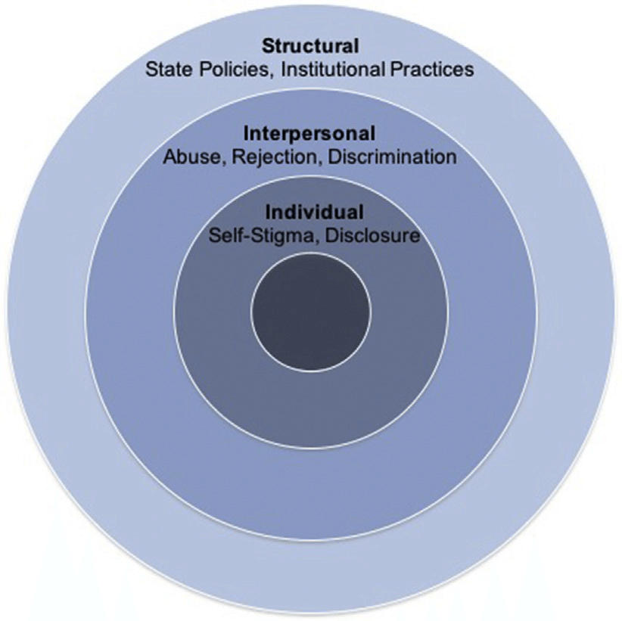
What is Stigma?
SEAETC, Cultural Humility & Reducing Stigma and Discrimination (2020)
https://doi.org/10.1016/j.pcl.2016.07.003
SEAETC Cultural Humility & Reducing Stigma and Discrimination (2020)

Slide 22
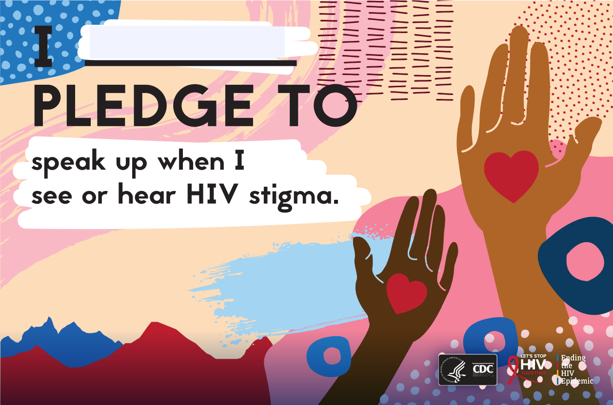
What is Stigma?
Health & HIV Stigma:
Social disqualification of individuals based on a specific health condition or aspect of one’s identity
Negative attitudes and beliefs about people with HIV
Examples of HIV Stigma:
Believing that only certain groups of people can get HIV
Making moral judgements about people who take steps to prevent HIV transmission
Feeling that people deserve to get HIV because of their choices
SEAETC, Cultural Humility & Reducing Stigma and Discrimination (2020)
CDC, Let’s Stop HIV Together
SEAETC Cultural Humility & Reducing Stigma and Discrimination (2020)

Slide 23
What is Minority Stress?
Minority stress refers to the excess stress to which individuals from stigmatized social categories are exposed as a result of their social (minority) position.
Unique- Additive to general stressors that are experienced by all people and therefore require adaptations above and beyond those required in the nonstigmatized
Chronic- related to relatively stable social structures such as laws and social policies
Socially based- stem from social structural forces rather than individual event or conditions
SEAETC, Cultural Humility & Reducing Stigma and Discrimination (2020)
https://doi.org/10.1016/j.pcl.2016.07.003
Notes:
minority stress
Stigma, prejudice, and discrimination create a hostile and stressful social environment that contribute to social, emotional, mental, and other health problems.
What are other minority classifications or stressors could also apply here?
Intersectionality: the interconnectedness of social categorizations such as race, class, and gender as they apply to a given individual or group, regarded as creating overlapping and interdependent systems of discrimination or disadvantage. For example, a woman of color may face sexism in the workplace, which is compounded by racism
-------
How do these contribute to poor health outcomes?
A substantial body of research has shown that experiences with stigma make minority individuals vigilant of their social environment to anticipate and avoid stigmatizing encounters. This contributes to chronic stress and avoidance of going to the doctor, example.
Chronic stress and sustained elevated cortisol levels contribute to cardiovascular, immune, digestive, and other health complications
stress of growing up in social environments that target gays and lesbians for social exclusion may exert biological effects that are similar to other chronic life stressors.
Repeated encounters with stigma and minority stressors may lead LGB individuals to ruminate, which is a maladaptive emotion regulation strategy characterized by repeated focus on the causes and symptoms of distress. This contributes to psychological distress and potential avoidance of encounters that are associated with the stressor
Stigma and minority stressors may increase feelings of loneliness among LGBT individuals, which in turn can affect interpersonal relationships.
classification ended in 1973 with the removal of homosexuality from the second edition of the Diagnostic and Statistical Manual of Mental Disorders (DSM;American Psychiatric Association, 1973),
LGBTQ Disparities
Greater risk of
Suicide related behaviors- 2015 national trans survey 40% of trans have attempted suicide
Mood disorders
Eating disorders
Substance use (alcohol, tobacco, other drug)
Lsebian/bisexual women have higher rates of breast and cervical cancer; trans men and women at greater risk
Gay/bisexual men and trans women more likely to have hiv
Less liely to have insurance- employment discrimination
Less likely to fill prescriptons
More likely to refused care
Recently, researchers have returned to the study of mental health of LGB populations. Evidence from this research suggests that compared with their heterosexual counterparts, gay men and lesbians suffer from more mental health problems including substance use disorders, affective disorders, and suicide (Cochran, 2001;Gilman et al., 2001;Herrell et al., 1999;Sandfort, de Graaf, Bijl, & Schnabel, 2001). Researchers’ preferred explanation for the cause of the higher prevalence of disorders among LGB people is that stigma, prejudice, and discrimination create a stressful social environment that can lead to mental health problems in people who belong to stigmatized minority groups (Friedman, 1999). This hypothesis can be described in terms of minority stress (Brooks, 1981;Meyer, 1995).
The concept of social stress extends stress theory by suggesting that conditions in the social environment, not only personal events, are sources of stress that may lead to mental and physical ill effects. Social stress might therefore be expected to have a strong impact in the lives of people belonging to stigmatized social categories, including categories related to socioeconomic status, race/ethnicity, gender, or sexuality. According to these formulations, prejudice and discrimination related to low socioeconomic status, racism, sexism, or homophobia—much like the changes precipitated by personal life events that are common to all people—can induce changes that require adaptation and can therefore be conceptualized as stressful (Allison, 1998;Barnett, Biener, & Baruch, 1987;Clark, Anderson, Clark, & Williams, 1999;Meyer, 1995;Mirowsky & Ross, 1989;Pearlin, 1999b).
characteristics of minority identity can augment or weaken the impact of stress (box g). For example, minority stressors may have a greater impact on health outcomes when the LGB identity is prominent than when it is secondary to the person’s selfdefinition (Thoits, 1999). Second, LGB identity may also be a source of strength (box h) when it is associated with opportunities for affiliation, social support, and coping that can ameliorate the impact of stress (Branscombe, Schmitt, & Harvey, 1999;Crocker & Major, 1989;Miller & Major, 2000)
Allport (1954) described vigilance as one of the traits that targets of prejudice develop in defensive coping. This concept helps to explain the stressful effect of stigma. Like other minority group members, LGB people learn to anticipate—indeed, expect—negative regard from members of the dominant culture. To ward off potential negative regard, discrimination, and violence they must maintain vigilance. The greater one’s perceived stigma, the greater the need for vigilance in interactions with dominant group members. By definition such vigilance is chronic in that it is repeatedly and continually evoked in the everyday life of the minority person. Crocker et al. (1998) described this as the “need to be constantly ‘on guard’ … alert, or mindful of the possibility that the other person is prejudiced” (p. 517).
https://www.ncbi.nlm.nih.gov/pmc/articles/PMC2072932/pdf/nihms32623.pdf

Slide 24
What is Minority Stress?
Examples of Anti-LGBTQ+ stressors:
Homophobia- The fear of, discrimination against, or hatred of lesbian or gay people or those who are perceived as such
Transphobia- the fear of, discrimination against, or hatred of transgender or gender non-conforming people or those who are perceived as such
Cis-heteronormativity- a pervasive system of belief (on an individual, systemic, and ideological level) that being cisgender and heterosexual, and associated ways of being are the default, and “normal”
SEAETC, Cultural Humility & Reducing Stigma and Discrimination (2020)
https://doi.org/10.1016/j.pcl.2016.07.003
Notes:
minority stress
Stigma, prejudice, and discrimination create a hostile and stressful social environment that contribute to social, emotional, mental, and other health problems.
What are other minority classifications or stressors could also apply here?
Intersectionality: the interconnectedness of social categorizations such as race, class, and gender as they apply to a given individual or group, regarded as creating overlapping and interdependent systems of discrimination or disadvantage. For example, a woman of color may face sexism in the workplace, which is compounded by racism
-------
How do these contribute to poor health outcomes?
A substantial body of research has shown that experiences with stigma make minority individuals vigilant of their social environment to anticipate and avoid stigmatizing encounters. This contributes to chronic stress and avoidance of going to the doctor, example.
Chronic stress and sustained elevated cortisol levels contribute to cardiovascular, immune, digestive, and other health complications
stress of growing up in social environments that target gays and lesbians for social exclusion may exert biological effects that are similar to other chronic life stressors.
Repeated encounters with stigma and minority stressors may lead LGB individuals to ruminate, which is a maladaptive emotion regulation strategy characterized by repeated focus on the causes and symptoms of distress. This contributes to psychological distress and potential avoidance of encounters that are associated with the stressor
Stigma and minority stressors may increase feelings of loneliness among LGBT individuals, which in turn can affect interpersonal relationships.
classification ended in 1973 with the removal of homosexuality from the second edition of the Diagnostic and Statistical Manual of Mental Disorders (DSM;American Psychiatric Association, 1973),
LGBTQ Disparities
Greater risk of
Suicide related behaviors- 2015 national trans survey 40% of trans have attempted suicide
Mood disorders
Eating disorders
Substance use (alcohol, tobacco, other drug)
Lsebian/bisexual women have higher rates of breast and cervical cancer; trans men and women at greater risk
Gay/bisexual men and trans women more likely to have hiv
Less liely to have insurance- employment discrimination
Less likely to fill prescriptons
More likely to refused care
Recently, researchers have returned to the study of mental health of LGB populations. Evidence from this research suggests that compared with their heterosexual counterparts, gay men and lesbians suffer from more mental health problems including substance use disorders, affective disorders, and suicide (Cochran, 2001;Gilman et al., 2001;Herrell et al., 1999;Sandfort, de Graaf, Bijl, & Schnabel, 2001). Researchers’ preferred explanation for the cause of the higher prevalence of disorders among LGB people is that stigma, prejudice, and discrimination create a stressful social environment that can lead to mental health problems in people who belong to stigmatized minority groups (Friedman, 1999). This hypothesis can be described in terms of minority stress (Brooks, 1981;Meyer, 1995).
The concept of social stress extends stress theory by suggesting that conditions in the social environment, not only personal events, are sources of stress that may lead to mental and physical ill effects. Social stress might therefore be expected to have a strong impact in the lives of people belonging to stigmatized social categories, including categories related to socioeconomic status, race/ethnicity, gender, or sexuality. According to these formulations, prejudice and discrimination related to low socioeconomic status, racism, sexism, or homophobia—much like the changes precipitated by personal life events that are common to all people—can induce changes that require adaptation and can therefore be conceptualized as stressful (Allison, 1998;Barnett, Biener, & Baruch, 1987;Clark, Anderson, Clark, & Williams, 1999;Meyer, 1995;Mirowsky & Ross, 1989;Pearlin, 1999b).
characteristics of minority identity can augment or weaken the impact of stress (box g). For example, minority stressors may have a greater impact on health outcomes when the LGB identity is prominent than when it is secondary to the person’s selfdefinition (Thoits, 1999). Second, LGB identity may also be a source of strength (box h) when it is associated with opportunities for affiliation, social support, and coping that can ameliorate the impact of stress (Branscombe, Schmitt, & Harvey, 1999;Crocker & Major, 1989;Miller & Major, 2000)
Allport (1954) described vigilance as one of the traits that targets of prejudice develop in defensive coping. This concept helps to explain the stressful effect of stigma. Like other minority group members, LGB people learn to anticipate—indeed, expect—negative regard from members of the dominant culture. To ward off potential negative regard, discrimination, and violence they must maintain vigilance. The greater one’s perceived stigma, the greater the need for vigilance in interactions with dominant group members. By definition such vigilance is chronic in that it is repeatedly and continually evoked in the everyday life of the minority person. Crocker et al. (1998) described this as the “need to be constantly ‘on guard’ … alert, or mindful of the possibility that the other person is prejudiced” (p. 517).
https://www.ncbi.nlm.nih.gov/pmc/articles/PMC2072932/pdf/nihms32623.pdf

Slide 25
The Pyramid of Hate
The pyramid of hate is a way of understanding the effects and consequences of biases and prejudices, and how it can escalate into violence and other atrocities.
As you move up the pyramid, attitudes and actions become more extreme but fewer people express or accept them
As you move down the pyramid, the actions and thoughts become less extreme, but are reflected in large numbers of people
Each high elevation of the pyramid builds on and amplifies the thinking and behavior of the lower parts of the pyramid
Legal action is appropriate for dealing with actions at the upper end of the pyramid
Educational action is necessary to address the thoughts and behaviors of the lower end of the pyramid
Global Campus Asia Pacific, Institute of Human Rights and Peace Studies, Mahidol University (2020)
Anti-Defamation League (2019)
SEAETC Cultural Humility & Reducing Stigma and Discrimination (2020)

Slide 26
The Pyramid of Hate
Global Campus Asia Pacific, Institute of Human Rights and Peace Studies, Mahidol University (2020)
Anti-Defamation League (2019)
SEAETC Cultural Humility & Reducing Stigma and Discrimination (2020)

Slide 27
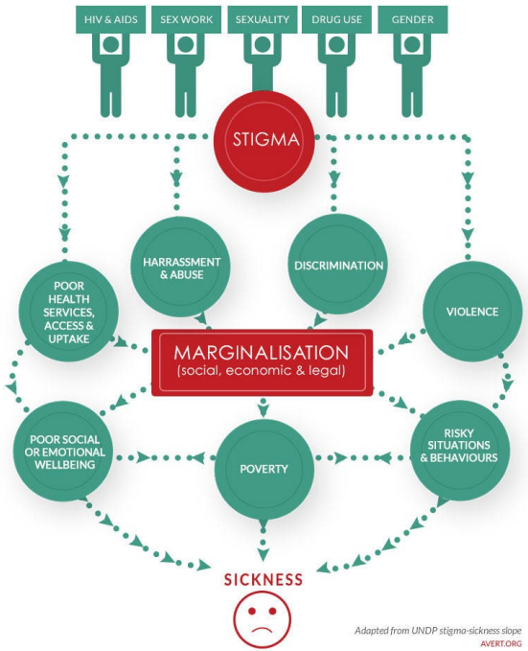
Stigma + Minority Stress
Health Disparity:
A particular type of health difference that is closely linked with social, economic, and/or environmental disadvantage.
Health Inequity:
Disparities in health that are a result of systemic, avoidable and unjust social and economic policies and practices that create barriers to opportunity.
SEAETC, Cultural Humility & Reducing Stigma and Discrimination (2020)
https://doi.org/10.1016/j.pcl.2016.07.003

Slide 28
Stigma + Minority Stress
Stigma + Minority Stress contribute to adverse health outcomes in LGBTQ+ population
Alcohol and drug use
Sexual risk behaviors
Suicide and depression
Anxiety and mood disorders
Poor self-esteem
SEAETC, Cultural Humility & Reducing Stigma and Discrimination (2020)
https://doi.org/10.1016/j.pcl.2016.07.003

Slide 29
Stigma + Engagement with Care
More than 1 in 3 LGBTQ Americans faced discrimination of some kind in the past year
15% postponed/avoided needed medical care due to discrimination
16% postponed/avoided preventive screenings due to discrimination
14% reported a provider being visibly uncomfortable due to their sexual orientation
8% reported providers intentionally refusing to recognize family members
Center for American Progress, The State of the LGBTQ Community (2020)

Slide 30
Stigma + Engagement with Care
More than 3 in 5 Transgender Americans faced discrimination of some kind in the past year
28% postponed/avoided needed medical care
40% postponed/avoided preventive screenings due to discrimination
38% reported a provider being visibly uncomfortable due to their gender identity
32% reported provider intentionally misgendering them or using the wrong name
18% percent reported a provider refused to see them at all because of their gender identity
Center for American Progress, The State of the LGBTQ Community (2020)

Slide 31
Stigma + Health Disparities: HIV
Gay, bisexual, and other men who have sex with men (MSM) are the population most affected by HIV in the U.S.
MSM accounted for 69% of new HIV diagnoses
1 in 6 MSM with HIV are unaware of their status
Black/African American MSM accounted for 26% (9,123) of new HIV diagnoses and 37.9% of diagnoses among all MSM.
Hispanic/Latino MSM made up 22% (7,820) of new HIV diagnoses and 32.5% of diagnosis among all MSM.
Lifetime risk of HIV diagnosis: 1 in 2 for Black MSM, 1 in 4 for Latino MSM, 1 in 11 for White MSM
CDC, CROI (2016)
CDC, HIV & Transgender Communities (2019)
CDC, HIV Surveillance Among Transgender Women (2021)

Slide 32
Stigma + Health Disparities: HIV
Transgender people account for approximately 2% of new HIV diagnoses in 2019.
93% of diagnoses of HIV infections was among transgender women
42% of transgender women had HIV among transgender adults and adolescents
41% of transgender people diagnosed with HIV live in the South
CDC, CROI (2016)
CDC, HIV & Transgender Communities (2019)
CDC, HIV Surveillance Among Transgender Women (2021)

Slide 33
Stigma + Health Disparities: Pre-Exposure Prophylaxis (PrEP)
MSM
Black and Latinx MSM were less likely than White MSM:
To be aware of PrEP (86%, 87%, 95% respectively)
To have discussed PrEP with a provider (43%, 44% 58% respectively)
Reported taking PrEP (26%, 30%, 42% respectively)
Transgender
Among those familiar with PrEP, 72% regard it favorably
3% of transgender people reported taking PrEP
Those who reported higher levels of nonaffirmation of their gender identity were less likely to currently use PrEP
http://dx.doi.org/10.15585/mmwr.mm6837a2
https://doi.org/10.1002/jia2.25391
10.1097/QAI.0000000000002403

Slide 34
Stigma + Health Disparities: Pre-Exposure Prophylaxis (PrEP)
Trans MSM
84.1% had heard of PrEP
33.3% reported lifetime PrEP use: 21.8% currently taking PrEP and 11.5% having stopped taking PrEP.
Among participants currently taking PrEP, 64.8% met indications for PrEP; Of those who had stopped taking PrEP, 75.9% met PrEP indications.
Trans Women
Trans women were less likely than MSM to:
Be aware of PrEP (79.1% vs. 96.7)
Have discussed PrEP with a provider (35.5% vs. 54.9%)
Report taking PrEP (14.6% vs. 39.8%)
Report being adherent to PrEP (among those who used PrEP; 70.4% vs. 87.4%).
http://dx.doi.org/10.15585/mmwr.mm6837a2
https://doi.org/10.1002/jia2.25391
10.1097/QAI.0000000000002403

Slide 35
Reducing Stigma & Affirming LGBTQ+ Clients

Slide 36
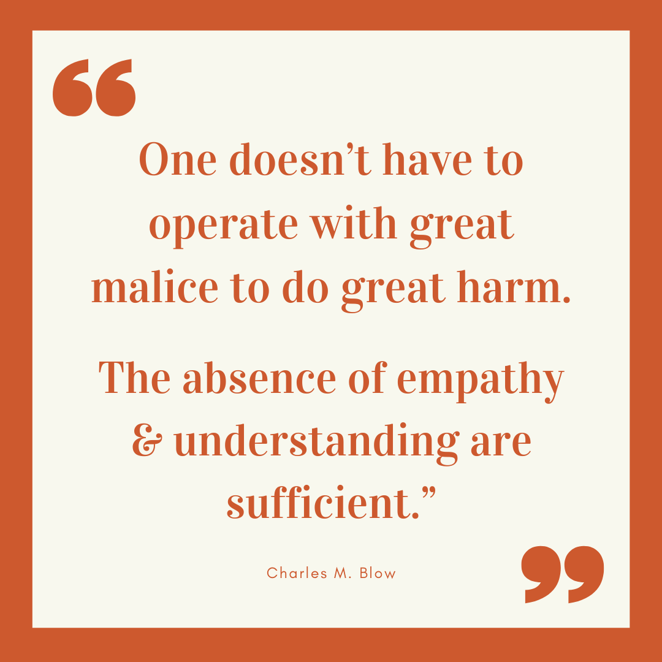
How do we Reduce LGBTQ+ Stigma?
Cultural Responsiveness
The ability of individuals and systems to respond to people of all cultures with respect, in a manner that affirms the worth and preserves the dignity of individuals, families, and communities
Cultural Humility
The dynamic, ongoing commitment in which individuals recognize that their own experiences or identities may not project onto the experiences or identities of others
SEAETC, Cultural Humility & Reducing Stigma and Discrimination (2020)
UCSF, Transgender Care & Treatment Guidelines (2016)
Brené Brown on Empathy vs. Sympathy (2017)

Slide 37
Practicing Cultural Humility
Self-awareness
Thoughtfully appreciate the multicultural identities of others.
Interpersonal
Demonstrate genuineness, empathy, warmth, openness, and flexibility to facilitate engagement throughout service delivery.
Approach information about cultural groups or characteristics in a strengths-based manner.
Institutional
Engage patients or community members from various cultural groups in the development/evaluation of your services.
Conduct ongoing individual and organizational assessment of cultural and linguistic competence to identify areas for growth.
SEAETC, Cultural Humility & Reducing Stigma and Discrimination (2020)
UCSF, Transgender Care & Treatment Guidelines (2016)

Slide 38
Practicing Cultural Humility
How to challenge implicit bias
Stereotype replacement — recognizing that a response is based on stereotype and consciously adjusting the response
Individualization — Seeing the person as an individual rather than a stereotype (e.g., learning about their personal history and the context that brought them to the doctor’s office or health center)
Perspective taking — “Putting yourself in the other person’s shoes”
Increasing opportunities for contact with individuals from different groups — Expanding one’s network of friends and colleagues or attending events where people of other racial and ethnic groups, gender identities, sexual orientation, and other groups may be present
Partnership building — Reframing the interaction with the patient as one between collaborating equals, rather than between a high-status person and a low-status person
SEAETC, Cultural Humility & Reducing Stigma and Discrimination (2020)

Slide 39
Reducing Stigma
Language Matters- part 1
“People First” Language People- first describes a way of speaking that tries to avoid perceived and subconscious dehumanization when discussing other people. This can be applied to any group that is defined by a trait or condition rather than being defined first and foremost as a human being.
e.g.: Person living with HIV rather than HIV infected person
Be respectful of aspects of a person’s identity and the words they use to describe themselves.
e.g.: same-gender loving (SGL) rather than “gay”; non-binary/neo pronouns
SEAETC, Cultural Humility & Reducing Stigma and Discrimination (2020)
National LGBT Health Education Center, Affirmative Care for Transgender & GNC People (2016)
Notes:
When it comes to illnesses and health issues, putting the person before the diagnosis describes what the person has rather than what they are. Using a sentence structure where the person comes first allows for this.
-----
Front-line staff play a key role in creating a health care environment that responds to the needs of transgender and gender non-conforming (TGNC) people. Everyone, no matter their gender identity or expression, appreciates friendly and courteous service. In addition, TGNC people have unique needs when interacting with the health care system. First and foremost, many TGNC people experience stigma and discrimination in their daily lives, including when seeking health care. In light of past adverse experiences in health care settings, many fear being treated disrespectfully by health care staff, which can lead them to delay necessary health care services. Additionally, the names that TGNC people use may not match those listed on their health insurance or medical records. Mistakes can easily be made when talking with patients as well as when coding and billing for insurance
Transgender people or gender-diverse people may use a pronoun that is different from what you might assume, so asking everyone what pronouns they use can help show trans people they are welcome in your organization.
Respecting people’s core identity and the words they use to describe themselves is at the heart of putting People First. Additionally, as numerous social determinants of health also impact HIV rates, particularly in marginalized groups such as women, youth, and people of color, it is important to use nonjudgmental terminology to be inclusive of PLHIV whose lifestyle choices, relationships, household compositions, living arrangements, etc. may differ from that of more privileged groups. We want to promote understanding, respect, and dignity for all people no matter what medical conditions they may be diagnosed with. Using appropriate language (Table 1) can help reduce stigma and change the general public’s opinion about people living with HIV. The more awareness we bring to the issue the more change we can make for people living with HIV.
We want to promote understanding, respect, and dignity for all people no matter what medical conditions they may be diagnosed with. Using appropriate language (Table 1) can help reduce stigma and change the general public’s opinion about people living with HIV. The more awareness we bring to the issue the more change we can make for people living with HIV.
https://www.lgbtqiahealtheducation.org/wp-content/uploads/2016/12/Affirmative-Care-for-Transgender-and-Gender-Non-conforming-People-Best-Practices-for-Front-line-Health-Care-Staff.pdf
TERMS TO AVOID: The following terms are considered offensive by mostand should not be used: she-male, he-she, tranny, “real” woman, “real” man, transgendered, and “a transgender.”
https://www.lgbtqiahealtheducation.org/wp-content/uploads/2016/12/Affirmative-Care-for-Transgender-and-Gender-Non-conforming-People-Best-Practices-for-Front-line-Health-Care-Staff.pdf
Outdated or Inaccurate Terminology: ▪ Hermaphrodite (n.) – “Intersex” is preferred. ▪ Pre-op or post-op (adj.) – A set of terms to describe a transgender person that focuses on whether that person has had sex reassignment surgery (SRS). Places invasive focus on the individual’s body. ▪ Transgendered (adj.) – Grammatically inaccurate. Transgender is preferred. ▪ Transsexual (adj.) – Sometimes used in medical literature or by some transgender people to describe those who have transitioned through medical interventions. Transgender is preferred, unless the individual explicitly identifies as transsexual.
https://www.seaetc.com/wp-content/uploads/2021/07/Stigma-Handbook-June-2021.pdf
https://endstigmaendhiv.com/wp-content/uploads/2021/06/Anti-Stigma-HIV-language-.pdf

Slide 40
Reducing Stigma
Language Matters - part 2
Use nonjudgmental terminology to be inclusive of individuals whose lifestyle choices, relationships, household compositions, living arrangements, etc. may differ from that of other groups.
e.g.: condomless sex rather than unprotected sex; having multiple partners rather than promiscuous
Create a shame free zone; do not use shame to motivate a client.
e.g.: “we missed you yesterday, is everything okay?” rather than “Why did you miss your appointment?”
SEAETC, Cultural Humility & Reducing Stigma and Discrimination (2020)
National LGBT Health Education Center, Affirmative Care for Transgender & GNC People (2016)

Slide 41
Affirming T/NB Clients - part 1
It is important to maintain a culture of respect with transgender and gender diverse clients.
Stay relaxed and make eye contact:
Speak with T/NB patients just as you speak with all of your patients.
Avoid asking unnecessary questions:
Before asking a T/NB person a personal question, first ask yourself:
Is my question necessary for their care or am I asking it out of my own curiosity? If it is out of your own curiosity, it is not appropriate to ask.
Think instead about:
What do I know?
What do I need to know?
How can I ask for the information I need to know in a sensitive way?
National LGBT Health Education Center, Affirmative Care for Transgender & GNC People (2016)
UCSF, Transgender Care & Treatment Guidelines (2016)

Slide 42
Affirming T/NB Clients - part 2
It is important to maintain a culture of respect with transgender and gender diverse clients.
Do not gossip or joke about T/NB people:
Only discuss a patient’s T/NB identity with those who need to know for providing appropriate and sensitive care. This is consistent with policies concerning discussion of all patients.
Continue to use the name and pronouns indicated by the patient, even when they are not present:
This will help maintain respect for the patient and help other staff members learn the patient’s preferences.
Create an environment of accountability:
Don’t be afraid to politely correct your colleagues if they use the wrong names and pronouns, or if they make insensitive comments.
National LGBT Health Education Center, Affirmative Care for Transgender & GNC People (2016)
UCSF, Transgender Care & Treatment Guidelines (2016)

Slide 43
SCAETC Social Media
Notes:
Find an HIV-related topic TeleECHO in your area: https://echo.unm.edu/locations-2/echo-hubs-superhubs-united-states/
IDEA Platform: Infectious Diseases Education & Assessment. https://idea.medicine.uw.edu/
AETC National HIV Curriculum: 6 core modules for self study; regularly updated; CME, CNE
Hepatitis C Online Curriculum: https://www.hepatitisc.uw.edu/
Hepatitis B Online Curriculum: https://www.hepatitisb.uw.edu/
National STD Curriculum: https://www.std.uw.edu/

Slide 44
Resources
National Clinician Consultation Center http://nccc.ucsf.edu/
HIV Management
Perinatal HIV
HIV PrEP
HIV PEP line
HCV Management
Substance Use Management
Present case on ECHO https://hsc.unm.edu/scaetc/programs-services/echo.html
AETC National HIV Curriculum https://aidsetc.org/nhc
AETC National Coordinating Resource Center https://targethiv.org/library/aetc-national-coordinating-resource-center-0
Additional trainings scaetcecho@salud.unm.edu
www.scaetc.org
Notes:
Find an HIV-related topic TeleECHO in your area: https://echo.unm.edu/locations-2/echo-hubs-superhubs-united-states/
IDEA Platform: Infectious Diseases Education & Assessment. https://idea.medicine.uw.edu/
AETC National HIV Curriculum: 6 core modules for self study; regularly updated; CME, CNE
Hepatitis C Online Curriculum: https://www.hepatitisc.uw.edu/
Hepatitis B Online Curriculum: https://www.hepatitisb.uw.edu/
National STD Curriculum: https://www.std.uw.edu/
Clinical apps for HIV care https://aidsetc.org/resource/clinician-mobile-apps-hiv-related-care

Slide 45
Resources
Resources for Understanding SO/GI and Reducing Stigma
Gender Unicorn:
https://transstudent.org/gender/
LGBTQIA+ Glossary of Terms for Health Care Teams:
https://www.lgbtqiahealtheducation.org/publication/lgbtqia-glossary-of-terms-for-health-care-teams/
Measuring Sex, Gender Identity, and Sexual Orientation (NASEM, 2022):
http://nap.edu/26424
INTERSEX 101- Everything you want to know!:
https://secureservercdn.net/198.71.233.216/7np.6b9.myftpupload.com/wp-content/uploads/2017/03/INTERSEX101.pdf
https://interactadvocates.org/
Gender Inclusive Language:
http://www.phsa.ca/transcarebc/Documents/HealthProf/Gender_Inclusive_Language_Clinical.pdf
https://apastyle.apa.org/style-grammar-guidelines/bias-free-language/gender
Resources for Understanding SO/GI and Reducing Stigma (cont’d)
Disorders of Sex Development (DSD):
https://www.ncbi.nlm.nih.gov/pmc/articles/PMC5866176/pdf/nihms922328.pdf
Cultural Humility & Reducing Stigma and Discrimination Handbook (SEAETC):
https://www.seaetc.com/wp-content/uploads/2021/07/Stigma-Handbook-June-2021.pdf
stigmatizing language v. preferred language begins page 8
Brené Brown on Empathy (video):
https://youtu.be/1Evwgu369Jw
Transgender Standards of Care & Guidelines
Standards of Care for the Health of Transsexual, Transgender, and Gender Nonconforming People (WPATH):
https://www.wpath.org/publications/soc
Guidelines for the Primary and Gender-Affirming Care of Transgender and Gender Nonbinary People (UCSF):
https://transcare.ucsf.edu/guidelines
CDC, Let’s Stop HIV Together
SEAETC Cultural Humility & Reducing Stigma and Discrimination (2020)

Slide 46
Thank you!
We can all help end stigma through our words and actions in our everyday lives.
Maria Mancebo
EHE & Provider Initiatives Manager
(405) 982-7105
Maria.Mancebo@health.ok.gov

