Slide 1
HIV Epidemiology HIV Testing
Jessica Fridge, MSPH
Louisiana, OPH, STD/HIV/Hepatitis Program
Surveillance Manager
Notes:
Version date_08 2023
Target participants: all members of healthcare team

Slide 2
Conflict of Interest Disclosure Statement
Presenter has no disclosures
This program is supported by the Health Resources and Services Administration (HRSA) of the U.S. Department of Health and Human Services (HHS) as part of an award totaling $4,205,743 with 0% financed with non-governmental sources. The contents are those of the author(s) and do not necessarily represent the official views of, nor does mention of trade names, commercial practices, or organizations imply an endorsement by HRSA, HHS, or the U.S. Government. For more information, please visit HRSA.gov. Any trade/brand names for products mentioned during this presentation are for training and identification purposes only.
Notes:
PLWH now PWH per HRSA guidance

Slide 3
Unconscious Bias Disclosure
SCAETC recognizes that language is constantly evolving, and while we make every effort to avoid bias and stigmatizing terms, we acknowledge that unintentional lapses may occur in our presentations.
We value your feedback and encourage you to share any concerns related to language, images, or concepts that may be offensive or stigmatizing.
Your input will help us refine and improve our presentations, ensuring they remain inclusive and respectful to participants.

Slide 4
Learning Objectives
By the end of this session, you should be able to:
Demonstrate current trends of HIV in the U.S and Louisiana.
Review basic HIV terminology with Centers for Disease Control (CDC) screening recommendations.
Review different HIV screening tests.

Slide 5
HIV Global Epidemiology
Globally there is an estimated 36.7 million people living with HIV infection.
34.9 million adults
1.8 million children under the age of 15
In the U.S the CDC estimates that more than 1.2 million people are living with HIV

Slide 6
Ending the HIV Epidemic (EHE)
Ending the Epidemic: DHHS 2019 . https://www.hhs.gov/sites/default/files/ending-the-hiv-epidemic-fact-sheet.pdf?language=es

Slide 7
HIV Epidemic in the United States
30,403 new cases in 2020
17% decline, most likely due to COVID-19 interruptions
52% of new diagnoses occurred in South
57% occurred among those 15-34 years of age
16% were 50 or older
42% new diagnoses among Black Americans & 26% among Hispanics/Latinos
18% were females, 72% male (gender assigned at birth)
71% were gay or bisexual men
https://www.cdc.gov/hiv/statistics/overview/ataglance.html
https://www.cdc.gov/hiv/statistics/overview/ataglance.html
Notes:
2018 HIV Surveillance Report
The most affected subpopulation is African American gay and bisexual men (42% of new HIV diagnoses in 2018 with accounted for 13% of the US population⁾
Rates of Diagnoses of HIV Infection among Adults and Adolescents, by Age at Diagnosis, 2008–2012—U.S. 50,000 new patients infected with HIV/yr. http://www.cdc.gov/hiv/library/reports/surveillance/
37,600 new patients infected with HIV/yr in the U.S.²⁰¹⁴
Highest increases in youth (13-25), MSM, racial minorities
Implies the need for alternatives/additions to condoms
Additional statistics about disparities
2 out of every 5 patients newly diagnosed with HIV are youth
African American MSM have 5x the national average of new HIV diagnoses. African Americans make up 12% of US population but 44% of new HIV diagnoses.
One of every 2 women newly infected with HIV is African American.
New HIV diagnoses in Native American population increased 19% between 2005 to 2014 & 63% in MSM
Transgender patients have 3x the national average of new HIV diagnoses
Hispanics make up 18% of US population but 25% of new HIV diagnoses.
2019 Surveillance report
In 2019, the largest percentage of HIV infections were attributed to MMSC (66%), followed by heterosexual contact (22%).
In 2019, Black/African American persons made up approximately 12% of the population of the United States but accounted for 41% of HIV infections. White persons made up 62% of the population of the United States but accounted for 25% of HIV infections. Hispanic/Latino persons made up 17% of the population of the United States but accounted for 29% of HIV infections.
The estimated HIV incidence for American Indian/Alaskan Native persons should be used with caution because the RSE is 30%–50% .

Slide 8
… But Disparities Exist
New HIV diagnoses in Native American population increased 22% between 2015 to 2019 (31% in Native American men with male sex partners)
From 2010 to 2016, HIV diagnoses increased 6% among Hispanic/Latinx
The most affected subpopulation is African American/Black gay and bisexual men
https://www.cdc.gov/hiv/statistics/overview/ataglance.html
https://www.cdc.gov/hiv/statistics/overview/ataglance.html
Notes:
2018 HIV Surveillance Report
The most affected subpopulation is African American gay and bisexual men (42% of new HIV diagnoses in 2018 with accounted for 13% of the US population⁾
Rates of Diagnoses of HIV Infection among Adults and Adolescents, by Age at Diagnosis, 2008–2012—U.S. 50,000 new patients infected with HIV/yr. http://www.cdc.gov/hiv/library/reports/surveillance/
37,600 new patients infected with HIV/yr in the U.S.²⁰¹⁴
Highest increases in youth (13-25), MSM, racial minorities
Implies the need for alternatives/additions to condoms
Additional statistics about disparities
2 out of every 5 patients newly diagnosed with HIV are youth
African American MSM have 5x the national average of new HIV diagnoses. African Americans make up 12% of US population but 44% of new HIV diagnoses.
One of every 2 women newly infected with HIV is African American.
New HIV diagnoses in Native American population increased 19% between 2005 to 2014 & 63% in MSM
Transgender patients have 3x the national average of new HIV diagnoses
Hispanics make up 18% of US population but 25% of new HIV diagnoses.
2019 Surveillance report
In 2019, the largest percentage of HIV infections were attributed to MMSC (66%), followed by heterosexual contact (22%).
In 2019, Black/African American persons made up approximately 12% of the population of the United States but accounted for 41% of HIV infections. White persons made up 62% of the population of the United States but accounted for 25% of HIV infections. Hispanic/Latino persons made up 17% of the population of the United States but accounted for 29% of HIV infections.
The estimated HIV incidence for American Indian/Alaskan Native persons should be used with caution because the RSE is 30%–50% .

Slide 9
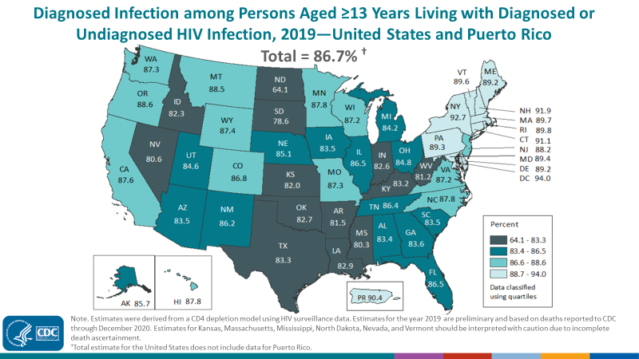
Undiagnosed HIV
In U.S., 13% don’t know their status
In SCAETC region, 17-20% don’t know their status
Notes:
Estimated 13% of people in the US living with HIV infection are unaware of their diagnosis
Darker the color, the fewer the people with HIV have been diagnosed
HIV Screening is Important for Prevention & Treatment of HIV.
Those who don’t know their status thought to account for 30-50% of new infections (Marks, et al. 2006)

Slide 10
Late-stage diagnosis is associated with more morbidity and potential increased transmission
Late-stage diagnosis (2017)
Natural history of HIV: steady decline in CD4 count
Centers for Disease Control and Prevention. Monitoring selected national HIV prevention and care objectives by using HIV surveillance data—United States and 6 U.S. dependent areas, 2017. HIV Surveillance Supplemental Report. 2019;24(No. 3):1-74. Published June 2019
Notes:
2017 data
This means that patients have had undiagnosed HIV infections for about 10 years.
Stage 3 HIV: CD4<200 or CD4<14% or any CD4 with active opportunistic infection or malignancy
HIV Screening is Important for Treatment of HIV
21% new HIV diagnoses in the U.S. already have advanced disease (21% stage 3, 51% stage 2+3)
People who know they are infected can start HIV treatment
HIV treatment (HAART/ART) results in viral suppression and markedly reduced transmission¹⁻³
Studies show the benefit of ART on all people with HIV (PWH)^{4,5}
1. Cohen MS, et al. NEJM 2011;365:493-505. 2. Skarbinski J, et al. JAMA Intern Med 2015;175:588-96. 3. Rodger AJ et al. JAMA 2016;316(2):1-11. 4. Smith et al. JAIDS 2013; 63S2:S187-99. 5. Kitahata MM, et al. NEJM 2009;360:1815-26.
HIV infection, stage 0: First positive HIV test result within 6 months after a negative HIV test result. The stage remains stage 0 until 6 months after the first positive test result. After 6 months, the stage may be classified as 1, 2, 3, or unknown if based on a CD4 test result or the diagnosis of an The diagnosis of an AIDS-defining condition or a low CD4 test result before the 6 months have elapsed does not change the stage from stage 0 to stage 3.
HIV infection, stages 1, 2, and 3: Documentation of an AIDS-defining OI (excluding stage 0 as described above) is stage 3. Otherwise, the stage is determined by the lowest CD4 lymphocyte test result:
Stage 1—CD4 lymphocyte count of ≥500 or a CD4 percentage of total lymphocytes of ≥26
Stage 2—CD4 lymphocyte count of 200–499 or a CD4 percentage of total lymphocytes of 14–25
Stage 3—CD4 lymphocyte count of <200 or a CD4 percentage of total lymphocytes of <14 or documentation of an AIDS-defining condition.
HIV infection, stage unknown: No reported information on AIDS-defining conditions and no information available on CD4 count or percentage.

Slide 11
Epidemiology in Louisiana
As of December 2022, a total of 22,777 people were living with HIV infection (PWH) in Louisiana and were aware of their status
Of these 11,071 persons (49%) prior Stage 3 (AIDS) diagnosis
In 2022, 894 new HIV cases were diagnosed in Louisiana.
24% (n=215) occurred in New Orleans
19% (n=169) occurred in Baton Rouge
14% (n=125) occurred in Shreveport
Louisiana Department of Health. LA HIV, AIDS, and Early Syphilis Surveillance

Slide 12
Epidemiology in Louisiana
Majority of new HIV diagnoses were male
76% male, 24% female
Majority of new HIV diagnoses were among Black people
63% Black, 24% White, 10% Hispanic/Latinx
Black people make up 32% of Louisiana’s population
People diagnosed across all age groups
57% 15-34 years old
16% 50 and older
21 of Louisiana’s 64 parishes had more than 400 PWH per 100,000 residents (prevalence rate)
Louisiana Department of Health. LA HIV, AIDS, and Early Syphilis Surveillance Quarterly Report 2018. June 30, 2018
Notes:
2022

Slide 13
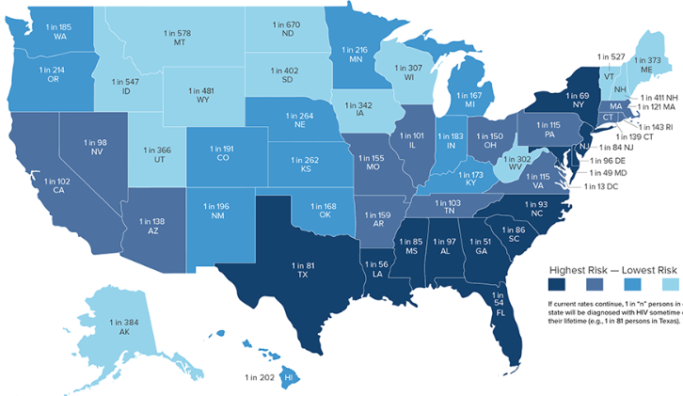
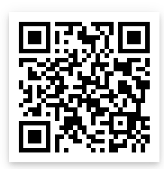
Lifetime Risk of HIV Diagnosis, by State
1:56
Hess KL, Hu X, Lansky A, Mermin J, Hall HI. Lifetime Risk of a Diagnosis of HIV Infection in the United States. Annals of epidemiology. 2017;27(4):238-243
Notes:
Age-specific HIV diagnosis, mortality, and population data were used to derive lifetime and age-specific risk estimates of receiving a diagnosis of HIV infection. The estimates highlight different risks across populations and the need for continued improvements in prevention and treatment. They can also be used to communicate the risk of HIV infection and increase public awareness of HIV.
People living in the South are more likely to be diagnosed with HIV over the course of their lifetime than other Americans, with the highest risk in Washington, DC (1 in 13), Maryland (1 in 49), Georgia (1 in 51), Florida (1 in 54), and Louisiana (1 in 56).
1 in 56 persons will be diagnosed with HIV sometime in their lifetime in Louisiana

Slide 14
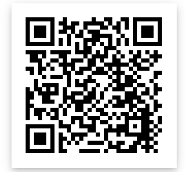
Lifetime Risk of HIV Diagnosis, 2016
Lifetime Risk of Diagnosis Among MSM by Race/ Ethnicity, 2016
https://www.cdc.gov/nchhstp/newsroom/2016/croi-2016.html
Notes:
The estimates highlight different risks across populations and the need for continued improvements in prevention and treatment. They can also be used to communicate the risk of HIV infection and increase public awareness of HIV. African Americans are by far the most affected racial or ethnic group with a lifetime HIV risk of 1 in 20 for men (compared to 1 in 132 for whites) and 1 in 48 for women (compared to 1 in 880 for whites).
Where you live can affect your risk of getting HIV:
-high rate of HIV in your community
-lack of access to healthcare
-poverty
If current HIV diagnoses rates persist, about 1 in 2 black men who have sex with men (MSM) and 1 in 4 Latino MSM in the United States will be diagnosed with HIV during their lifetime

Slide 15
Who should be screened for HIV?
Per the CDC (2006)
All patients aged 13-64 years
All patients initiating treatment for tuberculosis
All patients seeking treatment for sexually transmitted infections (STIs)
Pregnant women
First prenatal care visit, repeat in 3rd trimester
Notes:
Men Who Have Sex With MenAt least annually for sexually active MSM if HIV status is unknown or negative and the patient or their sex partner(s) have had more than one sex partner since most recent HIV test^{2,10,12}
Consider the benefits of offering more frequent HIV screening (e.g., every 3–6 months) to MSM at increased risk for acquiring HIV infection.²
PREG WOMEN All pregnant women should be screened at first prenatal visit (opt-out)^{9, 10}
Retest in the 3rd trimester if at high risk (people who use drugs, have STIs during pregnancy, have multiple sex partners during pregnancy, have a new sex partner during pregnancy, live in areas with high HIV prevalence, or have partners with HIV)¹¹
Rapid testing should be performed at delivery if not previously screened during pregnancy¹⁰

Slide 16
Who should be screened for HIV?
Repeat Yearly Screening for “high risk”
injection-drug users and their sex partners
persons who exchange sex for money or drugs
sex partners of PWH
Gay or bisexual men or heterosexual persons who themselves or whose sex partners have had more than one sex partner since their most recent HIV test
Notes:
Men Who Have Sex With MenAt least annually for sexually active MSM if HIV status is unknown or negative and the patient or their sex partner(s) have had more than one sex partner since most recent HIV test^{2,10,12}
Consider the benefits of offering more frequent HIV screening (e.g., every 3–6 months) to MSM at increased risk for acquiring HIV infection.²
PREG WOMEN All pregnant women should be screened at first prenatal visit (opt-out)^{9, 10}
Retest in the 3rd trimester if at high risk (people who use drugs, have STIs during pregnancy, have multiple sex partners during pregnancy, have a new sex partner during pregnancy, live in areas with high HIV prevalence, or have partners with HIV)¹¹
Rapid testing should be performed at delivery if not previously screened during pregnancy¹⁰

Slide 17
Primary Care Providers Role in CDC recommendations for testing
Can make a substantial contribution to the implementation of expanded CDC HIV screening recommendations by:
advising 1-time screening for all of their adult patients who are sexually active and repeat screening for high-risk patients
Need to be knowledgeable about screening recommendations and available diagnostic tests including:
rapid tests and 4th generation tests that can identify acute HIV infection.
Important role in linkage and retention in HIV Care
P. Leone, 2018 HIV Testing and Diagnosis
Notes:
IV Testing and Diagnosis
Author: Peter Leone, MD (More Info)
Editors in Chief: Daniel R. Kuritzkes, MD; Joseph J. Eron, Jr., MD
Last Reviewed: 1/9/18 (What's New)

Slide 18
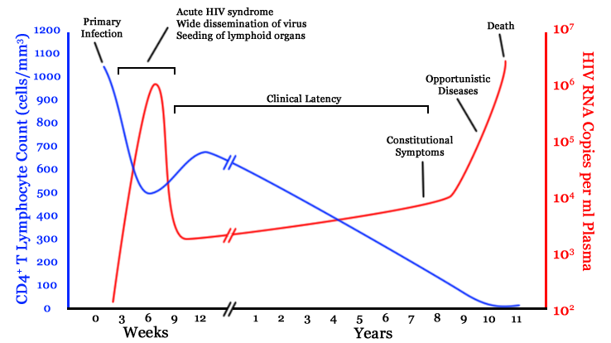
https://www.researchgate.net/figure/A-generalized-graph-of-the-relationship-between-HIV-copies-viral-load-and-CD4-counts_fig1_242611621
Notes:
relationship between HIV copies (viral load) and CD4 counts over the average course of untreated HIV infection
*The initial incubation period upon infection is asymptomatic and usually lasts between two to
four weeks.
• The second stage that of acute infection, lasts an average of 28 days and can include symptoms
such as fever; it is accompanied by a marked drop in the numbers of circulating CD4+ T cells.
*two weeks to twenty years and beyond. A strong immune defense reduces the number of viral
particles in the blood stream, marking the start of the infection’s clinical latency stage.
• AIDS, the fourth and ﬁnal stage of HIV infection shows the decline of CD4+ T cell numbers
below a critical level of 200 cells per L, cell-mediated immunity is lost, and common opportunistic
infections and tumors, most of which are normally controlled by robust CD4+ T cell-mediated
immunity which then start to aﬀect the patient

Slide 19
HIV Testing Definitions
Window Period: time between HIV exposure and when HIV can be detected in the body (accurate testing result)
Acute HIV Infection- Develops 2-4 weeks after HIV infection, some people exhibit flu like symptoms

Slide 20
https://www.hiv.uw.edu/
Notes:
Acute HIV Infection
Acute HIV infection is the earliest stage of HIV infection, and it generally develops within 2 to 4 weeks after infection with HIV. During this time, some people have flu-like symptoms, such as fever, headache, and rash. In the acute stage of infection, HIV multiplies rapidly and spreads throughout the body. The virus attacks and destroys the infection-fighting CD4 cells (CD4 T lymphocyte) of the immune system. During the acute HIV infection stage, the level of HIV in the blood is very high, which greatly increases the risk of HIV transmission. A person may experience significant health benefits if they start ART during this stage.
Chronic HIV Infection
The second stage of HIV infection is chronic HIV infection (also called asymptomatic HIV infection or clinical latency). During this stage, HIV continues to multiply in the body but at very low levels. People with chronic HIV infection may not have any HIV-related symptoms. Without ART, chronic HIV infection usually advances to AIDS in 10 years or longer, though in some people it may advance faster. People who are taking ART may be in this stage for several decades. While it is still possible to transmit HIV to others during this stage, people who take ART exactly as prescribed and maintain an undetectable viral load have effectively no risk of transmitting HIV to an HIV-negative partner through sex.

Slide 21
Types of HIV screening tests
Antibody tests
Rapid test that can
detect HIV 23-90
days after infection
Antigen/Antibody test
Antigen is a part of the virus
Can detect HIV
18-90 days after
HIV infection
Notes:
A person’s initial HIV test will usually be either an antibody test or an antigen/antibody test. When an HIV test is positive, a follow-up test will be conducted. .
Antibody tests check for HIV antibodies in blood or oral fluid. HIV antibodies are disease-fighting proteins that the body produces in response to HIV infection. Most rapid tests and home use tests are antibody tests.
Antigen/antibody tests can detect both HIV antibodies and HIV antigens (a part of the virus) in the blood.

Slide 22
HIV Viral Tests
Nucleic Acid Test (NAT) -
can detect HIV 10-33 days after HIV infection.
HIV Viral load or Polymerase Chain Reaction (PCR) serology test- results in actual number or quantitative result of individual’s HIV virus.
Not used for diagnosis, these are monitoring tests for persons who are diagnosed
Notes:
NATs look for HIV in the blood. NATs are very expensive and not routinely used for HIV screening unless the person had a high-risk exposure or a possible exposure with early symptoms of HIV infection.

Slide 24
Strategies to prevention
Identify high risk populations
Screen according to the CDC recommendations
Link patients to preventative services in the community
Pregnant women and women of child-bearing age screened for HIV and syphilis

Slide 25
PEP vs. PrEP
Post-Exposure Prophylaxis
Given after high-risk exposure to reduce risk of HIV infection
Start within 72 hours of exposure
1 month course of daily 3-drug regimen
Pre-Exposure Prophylaxis
Given before high-risk exposure to reduce risk of HIV infection
Start at least 7 days prior to exposure
Oral 2-drug regimen or long-acting injection
https://www.cdc.gov/hiv/pdf/programresources/cdc-hiv-npep-guidelines.pdf
https://www.cdc.gov/hiv/pdf/risk/prep/cdc-hiv-prep-guidelines-2021.pdf
Notes:
PEP: Antiretroviral medication taken by someone who does NOT have HIV but who has had a potentially significant exposure in order to reduce the risk of infection with HIV
Taken daily for 28 days, started <72 hours after high risk activity (i.e. sexual activity, IDU) or unintentional exposure (i.e. occupational) with a known/potentially HIV-positive contact in order to reduce the risk of being infected with HIV. Occupational exposure: Needle stick, splash, bite. Non-occupational exposure: Unprotected sex, sexual assault, condom break, shared needles.
PrEP: Antiretroviral medication taken by someone who does NOT have HIV in order to prevent infection with HIV. Taken daily before high risk activity (intercourse, IDU) with a known/potentially HIV-positive contact in order to reduce the risk of being infected with HIV.
https://www.cdc.gov/hiv/pdf/programresources/cdc-hiv-npep-guidelines.pdf
https://www.fda.gov/Drugs/DrugSafety/ucm608112.htm
https://www.cdc.gov/hiv/pdf/risk/prep/cdc-hiv-prep-guidelines-2017.pdf
https://www.cdc.gov/hiv/risk/prep/index.html
https://www.cdc.gov/hiv/guidelines/preventing.html

Slide 26
Linkage to Care
All persons diagnosed with HIV should be linked to care as soon as possible and supported to retain in yearly care
All persons diagnosed and living with HIV should be started on antiretroviral therapy (ART) as soon as possible

Slide 27
HIV Treatment as Prevention
Cohen, et al. NEJM 2011; 365: 493-505. Skarbinski J, et al. JAMA Intern Med 2015;175:588-96.
Bavinton BR, et al. Lancet HIV. 2018. IAS 2018 Conferencehttp://programme.aids2018.org/Abstract/Abstract/13470
Notes:
HIV Undetectable=Untransmittable (U=U), or Treatment as Prevention
For nearly two decades, scientists have recognized that viral load is a key determinant of HIV transmission
clear-cut evidence that consistent suppression of HIV with ART prevents sexual transmission of the virus.
starting and sustaining treatment for HIV early, when the immune system is relatively healthy, essentially eliminated transmission of the virus. No HIV transmission was observed when ART consistently, durably suppressed the virus in the partner with HIV.

Slide 28
Summary
HIV infections have declined approximately by 8% since 2015 overall in the US
One in 8 people living with HIV do not know the have HIV
Screening for HIV is recommended by the CDC at least once and more frequently based on risk and pregnant women
PEP and PrEP can decrease HIV transmission
Linkage to care for HIV patients is vital for prevention
U=U

Slide 29
References
https://www.hiv.gov/federal-response/ending-the-hiv-epidemic/overview
https://files.hiv.gov/s3fs-public/HIV-National-Strategic-Plan-2021-2025.pdf
https://www.cdc.gov/stophivtogether/campaigns/hiv-stigma/index.html
https://www.cdc.gov/niosh/topics/bbp/universal.html
nPEP Guidelines: https://www.cdc.gov/hiv/pdf/programresources/cdc-hiv-npep-guidelines.pdf
SpiraAI, Marx PA, Patterson BK, et al. J ExpMed 1996;183:215–25.
CDC 2021 PrEP Guidelines: https://www.cdc.gov/hiv/pdf/risk/prep/cdc-hiv-prep-guidelines-2021.pdf
USPSTF Preexposure Prophylaxis for the Prevention of HIV Infection. JAMA 2019;321(22):2203-2213.
https://www.cdc.gov/hiv/risk/estimates/riskbehaviors.html
https://www.poz.com/pdfs/P04-14p53.risk_transmission.pdf
Louisiana Data: STD/HIV/Hepatitis Reports - Louisiana Health Hub - STD/HIV/Hepatitis Program

Slide 30
Resources
National Clinician Consultation Center http://nccc.ucsf.edu/
HIV Management
Perinatal HIV
HIV PrEP
HIV PEP line
HCV Management
Substance Use Management
Present case on ECHO https://echo.unm.edu/locations-2/echo-hubs-superhubs-united-states/
AETC National HIV Curriculum https://aidsetc.org/nhc
AETC National Coordinating Resource Center https://targethiv.org/library/aetc-national-coordinating-resource-center-0
HIVMA Resource Directory https://www.hivma.org/globalassets/ektron-import/hivma/hivma-resource-directory.pdf
Additional trainings scaetcecho@salud.unm.edu
www.scaetc.org
Notes:
Find an HIV-related topic TeleECHO in your area: https://echo.unm.edu/locations-2/echo-hubs-superhubs-united-states/
IDEA Platform: Infectious Diseases Education & Assessment. https://idea.medicine.uw.edu/
AETC National HIV Curriculum: 6 core modules for self study; regularly updated; CME, CNE
Hepatitis C Online Curriculum: https://www.hepatitisc.uw.edu/
Hepatitis B Online Curriculum: https://www.hepatitisb.uw.edu/
National STD Curriculum: https://www.std.uw.edu/

Slide 31
SCAETC Social Media

Slide 32
If you are interested in other training opportunities, contact:
Dana Gray, SCAETC Program Director LSU Health – New Orleans, School of Public Health dgray@lsuhsc.edu or (504) 568-5647
Visit us at: https://hsc.unm.edu/scaetc/ or
https://sph.lsuhsc.edu/service/south-central-aetc/scaetc-events/

