Slide 1
HIV Antiretroviral Therapy Resistance: Top Tips to Know
Zachary Shepard, MD
Baylor College of Medicine
Notes:
Version date_ 10 2023
Target audience: prescribing providers and pharmacists familiar with basics of antiretroviral therapy

Slide 2
Collaboration

Slide 3
Conflict of Interest Disclosure Statement
Speaker has nothing to disclose
This program is supported by the Health Resources and Services Administration (HRSA) of the U.S. Department of Health and Human Services (HHS) as part of an award totaling $4,205,743 with 0% financed with non-governmental sources. The contents are those of the author(s) and do not necessarily represent the official views of, nor an endorsement of, by HRSA, HHS, or the U.S. Government. For more information, please visit HRSA.gov.

Slide 4
Use of Trade/Brand Names
This program is supported by the Health Resources and Services Administration (HRSA) of the U.S. Department of Health and Human Services (HHS) as part of an award totaling $4,205,743, with 0% financed with non-governmental sources.
The views expressed do not necessarily reflect the official policies of the Department of Health and Human Services, nor does mention of trade names, commercial practices, or organizations imply endorsement by the U.S. Government. Any trade/brand names for products mentioned during this presentation are for training and identification purposes only.
Notes:
NOTE: THIS SLIDE MUST BE INCLUDED IF TRADE AND/OR BRAND NAMES FOR MEDICATIONS ARE USED IN THE PRESENTATION.
IT MAY BE DELETED IF THERE IS NO REFERENCE TO TRADE NAMES, INCLUDING PRESENTATIONS IN WHICH ONLY GENERIC MEDICATION NAMES ARE MENTIONED.
TRADE NAMES MUST BE PUT IN PARENTHESES AFTER THE GENERIC NAME THE FIRST TIME IT IS MENTIONED - E.G., FLUOXETINE (PROZAC). TRADE NAMES SHOULD ONLY BE MENTIONED FOR THE INITIAL REFERENCE AND THE GENERIC NAME ONLY SHOULD BE USED AFTER THAT. THIS APPLIES EQUALLY TO ALL MEDICATIONS OR PRODUCTS MENTIONED IN THIS PRESENTATION.

Slide 5
Unconscious Bias Disclosure
SCAETC recognizes that language is constantly evolving, and while we make every effort to avoid bias and stigmatizing terms, we acknowledge that unintentional lapses may occur in our presentations.
We value your feedback and encourage you to share any concerns related to language, images, or concepts that may be offensive or stigmatizing.
Your input will help us refine and improve our presentations, ensuring they remain inclusive and respectful to participants.

Slide 6
Learning Objectives
Understand the basic concepts of antiretroviral therapy (ART) virologic failure and resistance testing.
Identify signature mutations for main classes of antiretrovirals (ARV).

Slide 7
Antiretroviral failure and resistance testing

Slide 8
Case example
A 40-year-old man (DMAB; he/him) presents for follow-up.
Diagnosed with HIV 11 months ago (CD4 41 cells/mm³ at diagnosis, baseline genotype showed no resistance mutations). At that time, he was started on bictegravir, tenofovir alafenamide, and emtricitabine.
Viral Load initially 809,000 copies/mL with subsequent drop to 51 within 2 months of starting ART. Since that time VL has remained detectable (55 --> 58 --> 94).
What would you do next?
DMAB = Designated Male at Birth; VL= HIV Viral Load (quantitative PCR)
Notes:
DMAB= designated male at birth; he/him pronouns; cis-gendered man
Biktarvy® (bictegravir/tenofovir alafenamide/emtricitabine); first-line ART single-tablet regimen
CD4 normal range is between 500-1500 cells/mm^3.
Stage 3 HIV (advanced HIV) is CD4<200, 14%, or any CD4 with active opportunistic infection or HIV-associated malignancy
Slide updated 10/3/2023

Slide 9
Virologic suppression and failure
Virologic suppression: HIV RNA below level of detection (after 24 weeks of ART)
Low-level viremia: detectable HIV RNA >20 but <200
Virologic blip: isolated detectable HIV-RNA level that is followed by a return to virologic suppression in a patient previously suppressed
Virologic failure: HIV RNA>=200 copies
Notes:
Slide updated 10/3/2023

Slide 10
Low-Level Viremia
Notes:
Slide added 10/3/2023

Slide 11
Impact of low-level viremia (LLV) on clinical and virological outcomes in patients with HIV (PWH)
17,902 patients from North America and Europe who achieved VL <50 copies within 3-9mo of starting ART
LLV 50-199 (2x consecutive VL between 50-199) – 624 patients (3.5%)
LLV 200-499 (2x consecutive VL between 200-499) – 482 patients (2.7%)
Primary outcome was clinical events (AIDS event or death)
Secondary outcome was virologic failure (2x consecutive VL >500)
AIDS 2015; 29:373-383.
Notes:
Slide added 10/3/2023

Slide 12
Impact of low-level viremia on clinical and virological outcomes in patient with treated HIV (ART-CC)
AIDS 2015; 29:373-383.
Notes:
ART-CC=antiretroviral therapy cohort collaboration

Slide 13
Proportion of PWH without virologic failure
LLV 50-199
No LLV
The Antiretroviral Therapy Cohort Collaboration (ART-CC). Impact of low-level viremia on clinical and virological outcomes in treated HIV-1-infected patients. AIDS 29(3):p 373-383, January 28, 2015. | DOI: 10.1097/QAD.0000000000000544
LLV 200-499
AIDS 2015; 29:373-383.
Notes:
Those without low level viremia and those with low level viremia <200 copies/mL were similarly unlikely to have virologic failure over 10 year observation time period.
Similar likelihood of developing virologic failure over 2 years in those with LLV 200-499 and over 10yrs for LLV<200.
The Antiretroviral Therapy Cohort Collaboration (ART-CC). Impact of low-level viremia on clinical and virological outcomes in treated HIV-1-infected patients. AIDS 29(3):p 373-383, January 28, 2015. | DOI: 10.1097/QAD.0000000000000544
Slide added 10/3/2023

Slide 14
Low-Level Viremia
Assess for any potential drug-drug interactions or drug absorption challenges
Typically, does not require a change in treatment
Believed to have a relatively low rate of emerging resistance
Continue current ART; monitor VL at least every 3months
Notes:
Assess for any potential drug-drug interactions
- i.e., cation-containing minerals and integrase strand transfer inhibitors
Assess for any potential drug absorption challenges
- boosted PI without food
- rilpivirine when patient on a proton pump inhibitor
Slide Added 10/3/2023

Slide 15
Virologic Blips
Notes:
Slide added 10/3/2023

Slide 16
Intermittent HIV-1 Viremia (Blips) and Drug Resistance in Patients Receiving ART
10 patients who had achieved virologic suppression (VL <50 for >6mo) underwent blood sampling 3x/week for 36 visits
Viral load and drug concentrations were measured
Genotyping assay used before/during/after blips
Nettles, RE et al. JAMA. 2005;293(7):817-829.
Notes:
Nettles RE, Kieffer TL, Kwon P, et al. Intermittent HIV-1 Viremia (Blips) and Drug Resistance in Patients Receiving HAART. JAMA. 2005;293(7):817–829. doi:10.1001/jama.293.7.817
Slide added 10/3/2023

Slide 17
Blips in PWH on ART
Blips were detected in 9 of 10 patients
Blips had short duration (median time <3 days)
Blips were typically low magnitude (median, 79 copies/mL)
Blips were not related to illness, vaccination, or antiretroviral drug concentrations
No new resistance mutations were seen
Nettles, RE et al. JAMA. 2005;293(7):817-829.
Notes:
Slide added 10/3/2023

Slide 18
Viral blip: After virologic suppression, an isolated detectable HIV RNA that is followed by a return to virologic suppression
Not associated with new resistance mutations
Nettles, RE et al. JAMA. 2005;293(7):817-829.
Notes:
Slide modified 10/3/2023

Slide 19
Virologic Failure
Notes:
Slide added 10/3/2023

Slide 20
Causes of Virologic Failure
Suboptimal adherence to antiretroviral therapy regimen
Psychological and social factors: interrupted access to medications, unstable housing, untreated depression, active substance use disorder
Adverse drug effects
Drug-drug interactions and food requirements
HIV resistance associated mutations

Slide 21
Resistance testing
HIV genotype (for reverse transcriptase, protease and integrase genes) is recommended
Obtain genotype while the patient is taking failing regimen or within 4 weeks after stopping treatment
A phenotype may be considered for persons with known or suspected complex mutation patterns
Notes:
Obtain genotype while the patient is taking failing regimen or within 4 weeks after stopping treatment. This will increase likelihood that relevant resistance mutations are detected. After a prolonged period.
Phenotypes are more expensive and take longer for results to return so are not appropriate for straight forward cases.

Slide 22
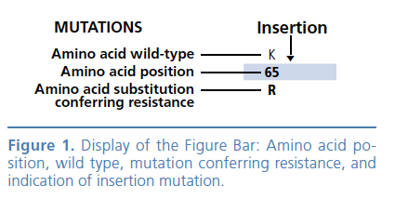
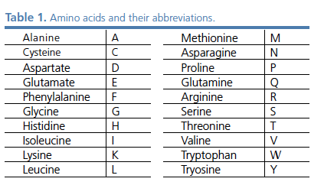
Genotype testing
https://monogrambio.labcorp.com/resources/genotyping/genosure-prime

Slide 23
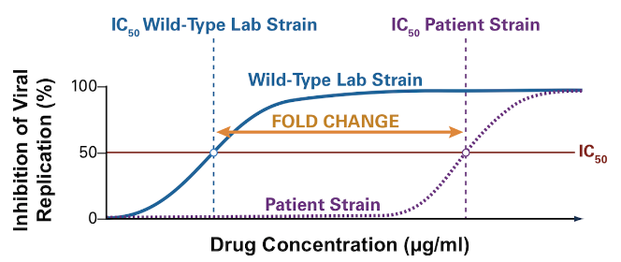
Phenotypic Testing
Useful in patients with known or suspected complex drug mutations
Compares viral replication to a reference strain of HIV
Ratio of the IC50 of test and reference viruses is reported as the fold increase in IC50 (i.e., X-fold resistance)
IC50 = Half-maximal concentration; Image: hiv.uw.edu
Notes:
Slide added 10/3/2023
https://www.hiv.uw.edu/go/antiretroviral-therapy/evaluation-management-virologic-failure/core-concept/all#hiv-drug-resistance-assays
Figure 17 - Method for Calculating Level of Phenotypic Resistance This graph shows the method for calculating the level of phenotypic resistance of a single antiretroviral medication. The antiretroviral drug is tested on a patient's HIV isolate and a laboratory reference (wild-type strain). The IC50 represents the concentration of the antiretroviral drug required to cause 50% inhibition of HIV replication. The fold change is calculated by dividing the IC50 of the patient's isolate by the IC50 of the wild-type laboratory strain. As shown, as the curve shifts to the right, a higher concentration of drug would be required to inhibit HIV replication and thus the strain of HIV would be more resistant. The further the curve shifts to the right (for the patient's HIV strain tested), the greater the level of resistance

Slide 24
Phenotype testing
https://monogrambio.labcorp.com/resources/combined-assays/phenosenser-gt

Slide 25
Tropism Assay
Tropism test detects CCR5 coreceptor use (which predicts maraviroc activity)
In patients with low level viremia may consider genotype of proviral HIV DNA
https://monogrambio.labcorp.com/resources/
Notes:
CCR5 = Chemokine Receptor Type 5

Slide 26
Suggested approach when viremia is present
HIV RNA >20 but <200: continue same ART regimen, recheck VL in 3 months
HIV RNA >=200 but <1000: individualized decision (address adherence and continue same ART, empirically change ART, consider proviral DNA genotype)
HIV RNA >=1000 and HIV genotype without mutations: address adherence, drug interactions, food requirements, close monitoring of VL
HIV RNA>=1000 and HIV genotype with mutations: build a new ART regimen
Notes:
Proviral DNA is viral DNA that is integrated into the host genome.
Reference: Ellis, KE et al. Clinical outcomes following the use of archived proviral HIV-1 DNA genotype to guide ART adjustment. Open Forum Infect Dis. 2020 Jan; 7(1):ofz533. https://www.ncbi.nlm.nih.gov/pmc/articles/PMC6942490/

Slide 27
Building a new ART regimen
Goal: virologic suppression
A new regimen can include two fully active ARV drugs if at least one has a high resistance barrier (dolutegravir or boosted darunavir)
Fully active drug = expected to have uncompromised activity after reviewing patient’s ART history, current and previous genotype results, and whether drug has a new mechanistic action
If no fully active drug with a high resistance barrier is available, then every effort should be made to include three fully active drugs

Slide 28
Building a new ART regimen
Adding a single, fully active drug to the regimen is not recommended because of the risk of rapid development of resistance
In patients with HBV (hepatitis B virus) co-infection, drugs that are active against HBV should be continued as part of the new ART regimen (discontinuation of these drugs may lead to the HBV reactivation and serious hepatocellular damage)

Slide 29
Resistance associated mutations

Slide 30
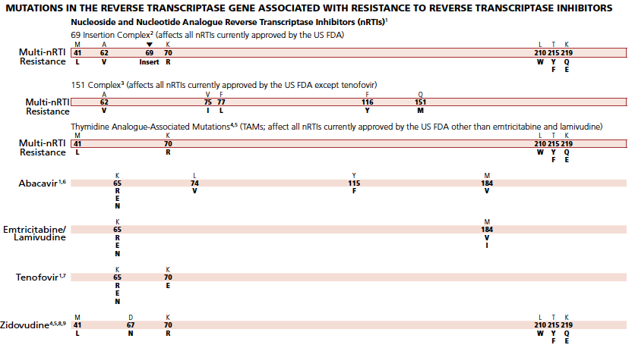
NRTI mutations
NRTI = Nucleotide Reverse Transcriptase inhibitors;
Image: https://www.iasusa.org/resources/hiv-drug-resistance-mutations/
Notes:
NRTI=nucleoside reverse transcriptase inhibitors

Slide 31
NRTI Mutations
Position | Selected by (resistance to) | Notes
M184V | Lamivudine/Emtricitabine | Increases susceptibility to tenofovir and zidovudine
K65R | Tenofovir/Abacavir | Resistance to all NRTIs except zidovudine (which has increased susceptibility)
L74V | Abacavir | Increases susceptibility to zidovudine
69 insertion complex and Q151M complex |  | Cross-resistance to ALL NRTIs
Thymidine Analogue Mutations (TAMS) |  | See next slide
Notes:
Slide modified 10/3/2023

Slide 32
NRTI TAMS mutations
Selected by zidovudine (AZT) and stavudine (d4T)
There are two types (pathways):
Type 1: M41L, L210W, and T215Y (greater resistance, even to tenofovir disoproxil fumarate; TDF)
Type 2: D67N, K70R, T215F, and K219Q/E
TAMS may occur simultaneously with M184V
AZT = Zidovudine; TAMS = Thymidine Analogue Resistance Mutations

Slide 33
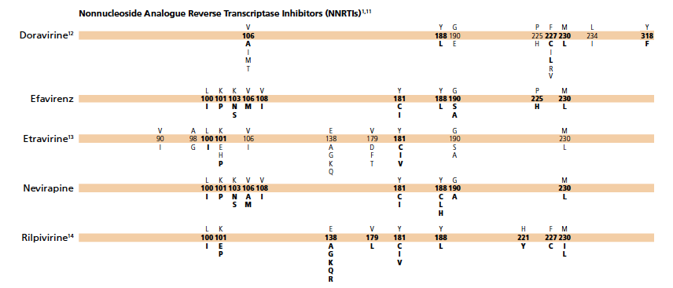
NNRTI mutations
NNRTI=non-nucleoside reverse transcriptase inhibitors
https://www.iasusa.org/resources/hiv-drug-resistance-mutations/

Slide 34
NNRTI Mutations
Position | Selected by (resistance to) | Notes
K103N | Efavirenz/Nevirapine | Rilpivirine, Doravirine, Etravirine unaffected
E138K | Rilpivirine | Reduced susceptibility to all NNRTIs except Doravirine
K101E; Y181C | Nevirapine, Etravirine, Rilpivirine | Reduced susceptibility to all NNRTIs except (maybe) Doravirine
Y188 |  | Reduced susceptibility to all NNRTIs (except possibly etravirine)
Notes:
NNRTI=non-nucleoside reverse transcriptase inhibitors

Slide 35
NNRTI mutations
K103N: Selected by efavirenz (does not affect rilpivirine, doravirine or etravirine)
E138K: Selected by rilpivirine
K101E, Y181C: affects all NNRTIs (probably except doravirine)
Y188: affects all NNRTI (probably except etravirine)
K103N, E138K, K101E, Y181C, Y188 = Nonpolymorphic mutations
Notes:
NNRTI=non-nucleoside reverse transcriptase inhibitors
K103N=resistance against efavirenz and nevirapine
Slide modified 10/3/2023

Slide 36
PI mutations
Protease Inhibitors = PI
https://www.iasusa.org/resources/hiv-drug-resistance-mutations/

Slide 37
Protease Inhibitor mutations
Several mutations are needed to confer resistance to a PI
Resistance mutations to PI are classified as major or minor
No need to memorize them
Notes:
Because several mutations needed to confer resistance, they have a higher barrier to resistance than other ARV agents (except for dolutegravir and bictegravir INSTIs which have high barrier to resistance)

Slide 38
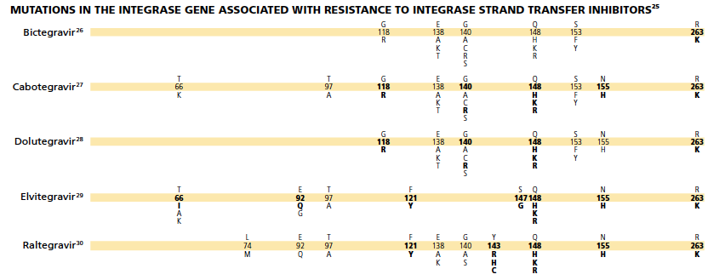
INSTI mutations
INSTI=integrase strand transfer inhibitors
https://www.iasusa.org/resources/hiv-drug-resistance-mutations/

Slide 39
INSTI Mutations
Position | Selected by (resistance to) | Notes
N155H, Q148H, G140S | Raltegravir, Elvitegravir | Minimal affected on Dolutegravir or Bictegravir if only one mutation is present
R263K | Dolutegravir, Bictegravir, Elvitegravir, Cabotegravir | Intermediate resistance across INSTI class
 |  | Many more integrase mutations have been reported in the last few years - usually occurring in combination
Notes:
INSTI=integrase strand transfer inhibitors
Slide modified 10/3/2023

Slide 40
HIV mutations study tools
Stanford HIV Drug Resistant Database: https://hivdb.stanford.edu/
International Antiviral Society – USA HIV Drug Resistance Mutations
https://www.iasusa.org/resources/hiv-drug-resistance-mutations/

Slide 41
Conclusions
Virologic failure is defined as HIV RNA>=200
Order HIV genotype while the patient is taking failing regimen or within 4 weeks after stopping treatment
New ART regimen may include two fully active drugs if at least one has a high resistance barrier (dolutegravir or boosted darunavir)

Slide 42
Conclusions
Most relevant NRTI mutations: M184V (3TC/FTC), K65R (TDF/TAF), TAMs (41, 67, 70, 210, 215, and 219)
Most relevant NNRTI mutations: K103N (EFV), E138K (RPV), Y181C (all NNRTIs except DOR), Y188L (all NNRTI except ETR)
Most relevant integrase mutations: N155H, Q148H, G140S, R263K
3TC=lamivudine, FTC=etravirine; TDF/TAF=tenofovir; EFV=efavirenz; NVP=nevirapine; RPV=rilpivirine; DOR=doravirine; ETR=etravirine

Slide 43
References
Stanford HIV Drug Resistant Database: https://hivdb.stanford.edu/
International Antiviral Society – USA HIV Drug Resistance Mutations https://www.iasusa.org/resources/hiv-drug-resistance-mutations/
HIV Treatment Guidelines: https://clinicalinfo.hiv.gov/en/guidelines/hiv-clinical-guidelines-adult-and-adolescent-arv/

Slide 44
Resources
National Clinician Consultation Center http://nccc.ucsf.edu/
HIV Management
Perinatal HIV
HIV PrEP
HIV PEP line
HCV Management
Substance Use Management
Present on ECHO
https://hsc.unm.edu/scaetc/programs-services/echo.html​
AETC National HIV Curriculum https://aidsetc.org/nhc
AETC National Coordinating Resource Center https://targethiv.org/library/aetc-national-coordinating-resource-center-0
HIVMA Resource Directory https://www.hivma.org/globalassets/ektron-import/hivma/hivma-resource-directory.pdf
Additional trainings scaetcecho@salud.unm.edu
www.scaetc.org
Notes:
IDEA Platform: Infectious Diseases Education & Assessment. https://idea.medicine.uw.edu/
AETC National HIV Curriculum: 6 core modules for self study; regularly updated; CME, CNE
Hepatitis C Online Curriculum: https://www.hepatitisc.uw.edu/
Hepatitis B Online Curriculum: https://www.hepatitisb.uw.edu/
National STD Curriculum: https://www.std.uw.edu/

Slide 45
SCAETC Social Media

