Slide 1
Hit Me with Your Best Shot: Opportunities and Challenges in the Era of Injectable ART Sarah B. Jeter, PharmD, BCIDP, AAHIVP November 3, 2023

Slide 2
Disclosures
This program is supported by the Health Resources and Services Administration (HRSA) of the U.S. Department of Health and Human Services (HHS) under grant number U1OHA30535 as part of an award totaling $4.2m. The contents are those of the author(s) and do not necessarily represent the official views of, nor an endorsement, by HRSA, HHS, or the U.S. Government. For more information, please visit HRSA.gov.
“Funding for this presentation was made possible by cooperative agreement U1OHA30535 from the Health Resources and Services Administration HIV/AIDS Bureau. The views expressed do not necessarily reflect the official policies of the Department of Health and Human Services nor does mention of trade names, commercial practices, or organizations imply endorsement by the U.S. Government. Any trade/brand names for products mentioned during this presentation are for training and identification purposes only.”
This content is owned by the AETC, and is protected by copyright laws. Reproduction or distribution of the content without written permission of the sponsor is prohibited, and may result in legal action.

Slide 3
AETC Program National Centers and HIV Curriculum
National Coordinating Resource Center – serves as the central web –based repository for AETC Program training and capacity building resources; its website includes a free virtual library with training and technical assistance materials, a program directory, and a calendar of trainings and other events. Learn more: https://aidsetc.org/
National Clinical Consultation Center – provides free, peer-to-peer, expert advice for health professionals on HIV prevention, care, and treatment and related topics. Learn more: https://nccc/ucsf.edu
National HIV Curriculum – provides ongoing, up –to-date HIV training and information for health professionals through a free, web –based curriculum; also provides free CME credits, CNE contact hours, CE contact hours, and maintenance of certification credits. Learn more: www.hiv.uw.edu

Slide 4
Objectives
Review appropriate monitoring for patients on long-acting antiretrovirals for HIV treatment and prevention
Identify patients who are appropriate for long-acting antiretroviral therapy for HIV treatment and prevention
Discuss logistics of long-acting antiretroviral therapy implementation
Review opportunities for long-acting antiretroviral therapy in challenging populations

Slide 5
Why Long-Acting Injectables?
Anxiety around missing doses
Privacy concerns
Daily HIV reminder

Slide 6
Injectable Cabotegravir and Rilpivirne
Two antiretrovirals:
Cabotegravir (CAB) – integrase strand transfer inhibitor (INSTI)
Rilpivirine (RPV) – non-nucleoside reverse transcriptase inhibitor (NNRTI)
Oral lead-in products:
Vocabria® - cabotegravir
Edurant® - rilpivirine
Studied in three Phase 3 clinical trials:
FLAIR
ATLAS
ATLAS-2M
Swindells et al. NEJM 2020;382:1112-23
Orkin et al. NEJM 2020;382:1124-35
Orkin et al. Lancet. 2021 Dec 19;396(10267):1994-2005
Cabenuva [package insert]. Research Triangle Park, NC: Viiv Healthcare; 2021.

Slide 7
ATLAS – Study Design
Continued daily PI-, NNRTI-, or INSTI-based regimen
Randomized
(1:1)
Extension phase or transition to ATLAS-2M
Oral CAB + RPV
Long-acting CAB + long-acting RPV monthly injections
Day 1
4
48
52
96
Study Week
Swindells et al. NEJM 2020;382:1112-23

Slide 8
ATLAS – Results
98% of injections were administered within the permitted time window
Oral bridging
7 patients used oral bridge therapy to cover missed doses
4 to 29 days
Primary Endpoint (HIV RNA >50 copies/mL)
CAB/RPV: 5 patients
Oral Continuation: 3 patients
Adjusted difference: 0.6% (95% CI: -1.2 to 2.5)
Swindells et al. NEJM 2020;382:1112-23

Slide 9
ATLAS 2M
Overton et al. CROI 2020; Boston, MA. Presentation 3334

Slide 10
ATLAS 2M
Overton et al. CROI 2020; Boston, MA. Presentation 3334

Slide 11
FDA Approved Indication
A 2-drug co-packaged product of cabotegravir, an HIV-1 integrase strand transfer inhibitor (INSTI), and rilpivirine, and HIV-1 non-nucleoside reverse transcriptase inhibitor (NNRTI), is indicated as a complete regimen for the treatment of HIV-1 infection in adults and adolescents 12 years of age and older and weighing at least 35kg to replace the current antiretroviral regimen in those who are virologically suppressed (HIV-1 RNA <50 copies/mL) on a stable antiretroviral regimen with no history of treatment failure and with no known or suspected resistance to either cabotegravir and rilpvirine.
Cabenuva [package insert]. Research Triangle Park, NC: Viiv Healthcare; 2021.

Slide 12
HHS/NIH Guideline Recommendations
A long-acting ARV regimen of injectable cabotegravir (CAB) and rilpivirine (RPV) given every 1 or 2 months is an optimization option for patients who are engaged with their health care, virologically suppressed on oral therapy for 3 to 6 months, and who agree to make the frequent clinic visits needed to receive the injectable drugs
https://clinicalinfo.hiv.gov/en/guidelines/hiv-clinical-guidelines-adult-and-adolescent-arv/optimizing-antiretroviral-therapy?view=full

Slide 13
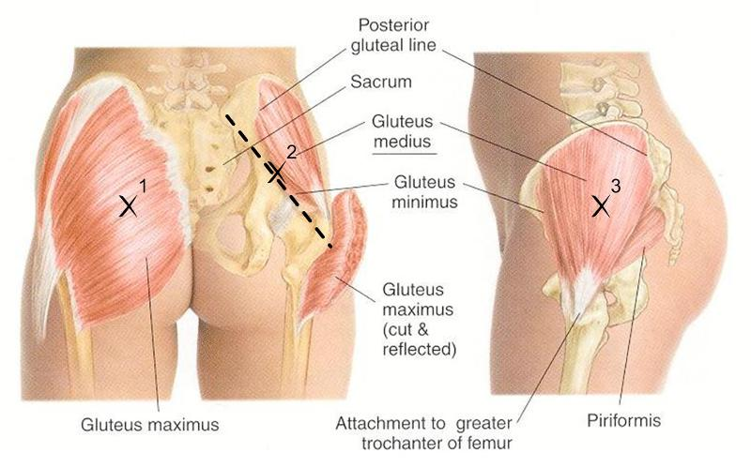
Dosing
Injections can be given in any order
Must be give at least 2 cm apart or on opposite sides
Use z-track method
Do not rub or massage injection site
Optional Oral Lead-In:
CAB 30mg PO daily
RPV 25mg PO daily
Every 4-Week Dosing:
CAB 400mg/2mL IM
RPV 600mg/2mL IM
Every 8-Week Dosing:
CAB 600mg/3mL IM
RPV 900mg/3mL IM
Cabenuva [package insert]. Research Triangle Park, NC: Viiv Healthcare; 2021.

Slide 14
Monthly Dosing Schedule
Optional Oral Lead-In
CAB 30mg
RPV 25mg
28 days
Loading Dose
CAB 600mg
RPV 900mg
1 dose
Maintenance Dose
CAB 400mg
RPV 600mg
Every 4 weeks
Cabenuva [package insert]. Research Triangle Park, NC: Viiv Healthcare; 2021.

Slide 15
Every Two Month Dosing Schedule
Optional Oral Lead-In
CAB 30mg
RPV 25mg
28 days
Loading Doses
CAB 600mg
RPV 900mg
2 doses 4 weeks apart
Maintenance Dose
CAB 600mg
RPV 900mg
Every 8 weeks
Cabenuva [package insert]. Research Triangle Park, NC: Viiv Healthcare; 2021.

Slide 16
Oral Bridging
Dosing Window
Monthly: 21 to 35 days
Every Two Months: 49 to 63 days
Monthly Dosing
Start fully suppressive oral regimen one month (+/-7 days) after last injection
May replace up two doses without reloading
Every Two Month Dosing
Start fully suppressive oral regimen two months (+/-7 days) after last injection
May replace one dose without reloading
Cabenuva [package insert]. Research Triangle Park, NC: Viiv Healthcare; 2021.

Slide 17
Missed Doses
Monthly: 21 to 35 day window between injections
Every Two Months: 49 to 63 day window between injections
Monthly Dosing |  |  | Every 2 Month Dosing
Time Since Last Injection | Plan |  | Time Since Last Injection | Plan
≤ 2 months | Admininster CAB 400mg/RPV 600mg as soon as possible |  | ≤ 3 months | Admininster CAB 600mg/RPV 900mg as soon as possible
> 2 months | Administer loading dose (CAB 600mg/RPV 900mg) as soon as possible. Continue maintenance doses thereafter |  | > 3 months | Administer 2 loading doses (CAB 600mg/RPV 900mg) four weeks apart as soon as possible. Continue maintenance doses thereafter
Cabenuva [package insert]. Research Triangle Park, NC: Viiv Healthcare; 2021.

Slide 18
Laboratory Monitoring
Follow current HHS and IAS-USA guidelines
4 to 8 weeks after switching therapy:
HIV viral load
Comprehensive metabolic panel
Increase ALT and AST were noted in 2% of clinical trial patients
https://clinicalinfo.hiv.gov/en/guidelines/hiv-clinical-guidelines-adult-and-adolescent-arv/tests-initial-assessment-follow-up?view=full
Cabenuva [package insert]. Research Triangle Park, NC: Viiv Healthcare; 2021.

Slide 19
Adverse Reactions
Adverse Effects (AE), n (%) | CAB + RPV LA (n=591) n (%) | Oral Therapy (n=591) n (%)
Any AE | 506 (86) | 444 (75)
Any grade 3/4/5 AE | 44 (7) | 35 (6)
Any drug-related AE | 165 (28) | 35 (6)
Any grade 3/4/5 drug-related AE | 8 (1) | 1 (<1)
Any AE leading to withdrawal | 17 (3) | 9 (2)
Any serious AE | 24 (4) | 25 (4)
Serious AE related to treatment | 1 (<1) | 1 (<1)
Common AEs† Nasopharyngitis Headache Upper respiratory tract infection Diarrhea Back Pain Influenza Pyrexia | 108 (18) 73 (12) 70 (12) 54 (9) 43 (7) 42 (7) 43 (7) | 90 (15) 38 (6) 53 (9) 40 (7) 23 (4) 34 (6) 13 (2)
Overton et al. IAS 2019; Mexico City, Mexico. Poster MOPEB257

Slide 20
Is my patient a good candidate?
Patient
Characteristics
Drug Interactions
Genotype History
Antiretroviral History

Slide 21
Remember. . .
Once you inject it, you can’t take it back!

Slide 22
Patient Characteristics
Adherence
Pregnancy Plans
Hepatitis B Status
Concomitant Medications

Slide 23
Injectable ART: UK HealthCare

Slide 24
UK HealthCare Infectious Diseases
Providers | Inpatient | Outpatient
Infectious Diseases 11 Physicians 4 Advanced Practice Providers Internal Medicine 2 Physicians 3 Advanced Practice Providers | UKHC Chandler Medical Center 569 beds Level 1 Trauma Center Tertiary referral center for Lexington, Eastern KY, and border regions of OH, VA, WVA, and TN UKHC Good Samaritan Hospital 302 beds Community hospital | Bluegrass Care Clinic Inpatient follow-up Hepatitis C treatment HIV pre-exposure prophylaxis (PrEP) Ryan White HIV clinic Ryan White HIV Clinic ~1700 patients Primary care and psychiatry Mental health Medical case management Onsite retail pharmacy 340B Status

Slide 25
Bluegrass Care Clinic Workflow
Referral
Benefits
Treatment
Provider refers patient to PharmD
UKSP completes benefits investigation
PharmD schedules patient for first injections
Pharmacy
Medical
Clinic RN administers dose
Clinic visit with PharmD for second check and education
UKSP completes PA and fills prescription
PharmD completes medical pre-certification
Front desk schedules next dose
PharmD sends benefits investigation request to UKSP*
Dose delivered to clinic by UKSP courier 1-3 days prior to appt
Dose comes from clinic stock
(“buy and bill’)
*University of Kentucky Specialty Pharmacy

Slide 26
Current Stats

Slide 27
A Closer Look
On Treatment
Medical – 89
Pharmacy – 11
Did Not Qualify
HBV – 2
Complex ART History – 3
Complex Past Medical History – 2
Chronic Kidney Disease – 1
Adherence Issues – 1
Resistance – 11
Stopped
Side Effects – 6
Poor Adherence – 6
HBV – 1
Moved – 3
Resistance – 1

Slide 28
Injectable ART: Lessons Learned

Slide 29
Getting Started
At UK HealthCare. . .
Moved clinic sites
Clinic manager retired
Switched electronic medical records
Identify key stakeholders
Physician champion
Clinic manager
Revenue/billing staff
Nursing staff
Pharmacist/pharmacy partners
Industry reimbursement specialists

Slide 30
Reimbursement
CAB 600mg/RPV 900mg
$4,853.04
Billed 300 units
Reimbursement
$11.32
Know your payors
Medical vs. pharmacy benefit coverage
Contact your billing or revenue cycle to ensure appropriately medical billing is in place
Work with your organization to ensure insurance contracts do not need to be renegotiated
Buy and bill model requires significant up-front investment
Use manufacturer payment assistance

Slide 31
Logistics
Patient on monthly dosing. Needed loading dose.
CAB 400mg/RPV 600mg given.
Implemented daily huddle. Working on therapy plan.
Careful coordination with clinic staff
Dedicated team for administration and ordering
Dedicated clinic times/days for administration
Use Excel, Tableau, EMR dashboard to organize patients
Requires cold chain storage

Slide 32
Treatment Failure
Patient without h/o resistance starts CAB/RPV
HIV RNA 4 months later
15,078 copies/mL
New INSTI* resistance
Carefully review genotype and ART exposure history
All history may not be available for review
Consider obtaining an archived genotype to assist
If you are concerned about failure, don’t be afraid to say no
*Integrase strand transfer inhibitor

Slide 33
Factors Associate with Treatment Failure
Multivariate analysis of pooled data in patients with confirmed virologic failure
Overall virologic failure rate: 1.4%
Unadjusted virologic failure rate per 100 years
Every 4-week: 0.42 (95% CI: 0.21 – 0.75)
Every 8-week: 0.54 (95% CI: 0.15 – 1.40)
Baseline factors associated with failure:
Pre-existing RPV resistance-associated mutations
A6/A1 HIV subtype
BMI ≥30 kg/m²
Orkin et al. 2023 Jun 21:ciad370.doi: 10.1093/cid/ciad370. Online ahead of print.

Slide 34
Genotype History
INSTI Mutations | NNRTI Mutations
G118R Q148K Q148R T66K+L74M E92Q+N155H E138A+Q148R E138K+Q148K/R G140C+Q148R G140S+Q148H/K/R Y143H+N155H Q148R+N155H | K101E/P E138A/G/K/R/Q V179L Y181C/I/V Y188L H221Y F227C M230I/L L100I+K103N
Cabenuva [package insert]. Research Triangle Park, NC: Viiv Healthcare; 2021.

Slide 35
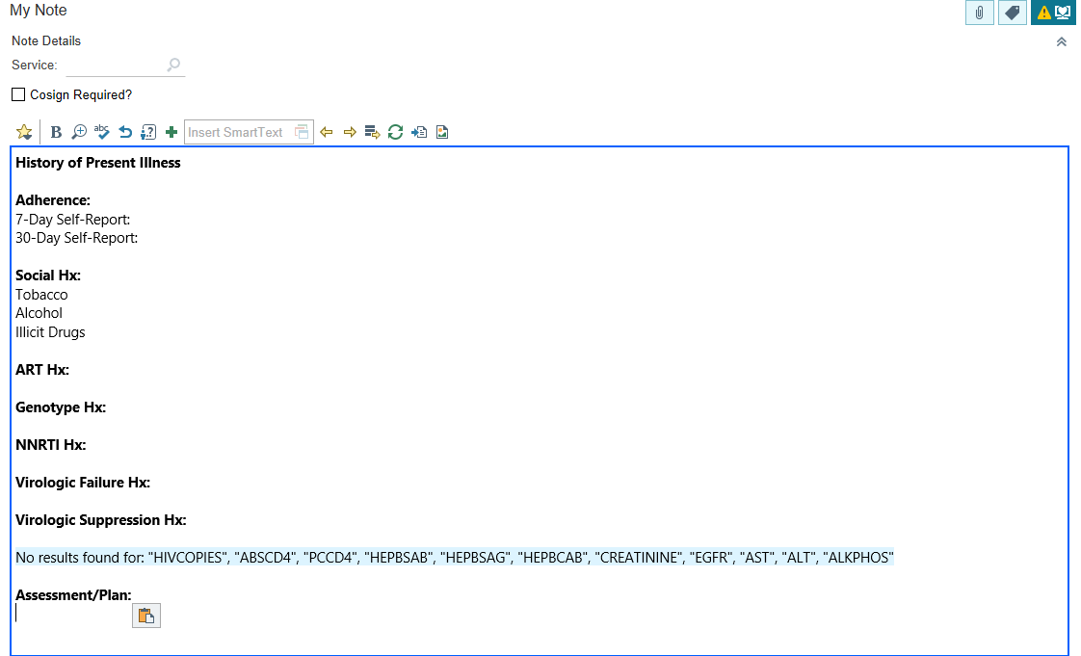
Note Template

Slide 36
Adherence
Patient starts CAB/RPV
After loading doses, is late for all subsequent injections
Provider switched patient back to oral ART
Have frank discussion with patient about importance of timely injections and open communication with clinic staff
Develop a patient contract
Develop a plan to contact patients who miss injection to reschedule within the appropriate window
Have a plan for oral bridging if needed
Develop an inpatient ART stewardship plan

Slide 37
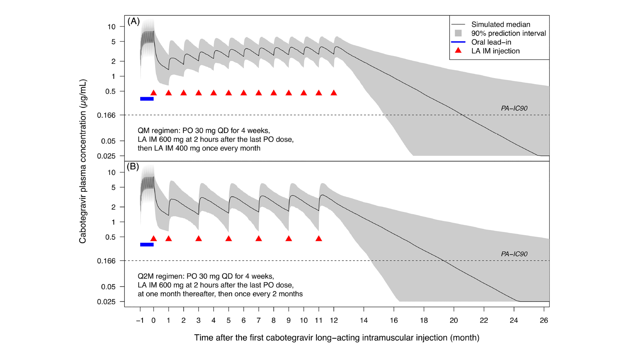
Adherence
Han K et al. Br J Clin Pharmacol. 2022;88:4607–4622.

Slide 38
Injectable ART: Opportunities

Slide 39
Challenging Populations: Poor Adherence
Christopoulos et al. Clin Infect Dis 2023;76(3):e645–e51
San Francisco Ward 86
15 viremic patients
12/15 virally suppressed
Breck et al. Clin Infect Dis 2023; doi: 10.1093/cid/ciad511 (online ahead of print)
University of Mississippi Ryan White Clinic
12 viremic patients
12/12 virally suppressed
D’Amico et al. HIV Med 2023;24(2):202-211
Data from manufacturer compassionate use program
28 viremic patients
16/28 virally suppressed

Slide 40
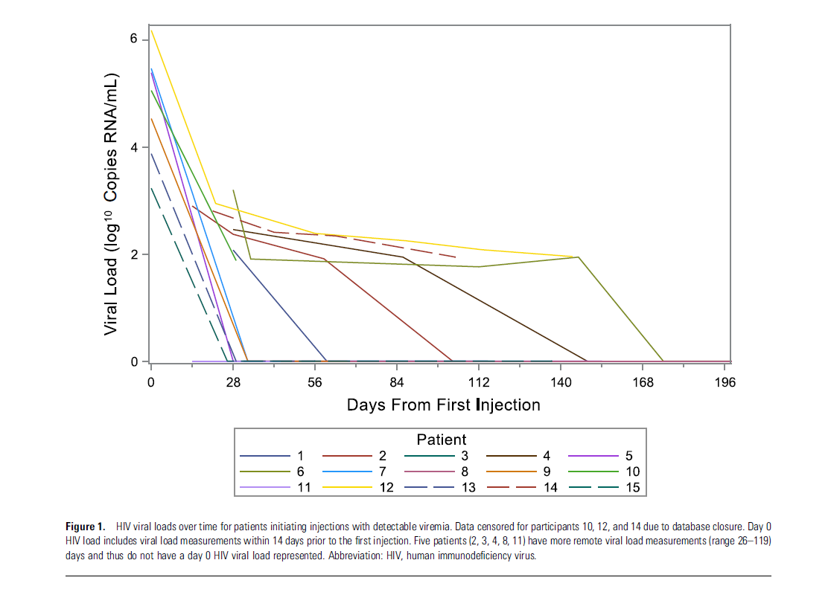
Challenging Populations: Poor Adherence
Christopoulos et al. Clin Infect Dis 2023;76(3):e645–e51

Slide 41
Challenging Populations: Our Experience
Case 1:
39-year-old woman
History of poor adherence
Recent ART: tenofovir AF/bictegravir/emtricitabine
Significant gag reflex when trying to swallow ART
Started monthly CAB 400mg/RPV 600mg when HIV RNA was 5,336 copies/mL and CD4 count 84 cells/mm³
Case 2:
52-year-old transgender female
History of poor adherence due to polysubstance use and significant mental health history
Started monthly CAB 400mg/RPV 600mg when HIV RNA was 1,148 copies/mL and CD4 count 220 cells/mm³

Slide 42
Time to Viral Load Suppression

Slide 43
Future of Salvage Therapy?

Slide 44
Possibilities
Addition of lenacapavir to CAB/RPV?
Injectable CAB/RPV in addition to oral therapy?
Injectable therapy in patients with low-level resistance?

Slide 45
A word from a patient
“Wow...
I'm literally in tears right now... I never thought I would live to see this day.”

Slide 46
Questions?

