Slide 1
Beyond the Flame: Navigating Smoking Cessation in HIV Care
Lorra Garey, PhD
University of Houston
Notes:
Version date: March 2024
Target participants: ID providers, Fellows, Residents & Students
Reviewed by MG: 3/29/24
Reviewed by KF: 4/1/24 – photo credits added
Submitted to SCAETC/HRSA: 4/1/24
HRSA Approved:

Slide 2
Conflict of Interest Disclosure Statement
Speaker has nothing to disclose
This program is supported by the Health Resources and Services Administration (HRSA) of the U.S. Department of Health and Human Services (HHS) as part of an award totaling $4,205,743 with 0% financed with non-governmental sources. The contents are those of the author(s) and do not necessarily represent the official views of, nor does mention of trade names, commercial practices, or organizations imply an endorsement by HRSA, HHS, or the U.S. Government. For more information, please visit HRSA.gov. Any trade/brand names for products mentioned during this presentation are for training and identification purposes only.
Notes:
Please add presenter disclosures here if any exist.

Slide 3
Use of Trade/Brand Names
This program is supported by the Health Resources and Services Administration (HRSA) of the U.S. Department of Health and Human Services (HHS) as part of an award totaling $4,205,743, with 0% financed with non-governmental sources.
The views expressed do not necessarily reflect the official policies of the Department of Health and Human Services, nor does mention of trade names, commercial practices, or organizations imply endorsement by the U.S. Government. Any trade/brand names for products mentioned during this presentation are for training and identification purposes only.
Notes:
NOTE: THIS SLIDE MUST BE INCLUDED IF TRADE AND/OR BRAND NAMES FOR MEDICATIONS ARE USED IN THE PRESENTATION.
IT MAY BE DELETED IF THERE IS NO REFERENCE TO TRADE NAMES, INCLUDING PRESENTATIONS IN WHICH ONLY GENERIC MEDICATION NAMES ARE MENTIONED.
TRADE NAMES MUST BE PUT IN PARENTHESES AFTER THE GENERIC NAME THE FIRST TIME IT IS MENTIONED - E.G., FLUOXETINE (PROZAC). TRADE NAMES SHOULD ONLY BE MENTIONED FOR THE INITIAL REFERENCE AND THE GENERIC NAME ONLY SHOULD BE USED AFTER THAT. THIS APPLIES EQUALLY TO ALL MEDICATIONS OR PRODUCTS MENTIONED IN THIS PRESENTATION.

Slide 4
Unconscious Bias Disclosure
SCAETC recognizes that language is constantly evolving, and while we make every effort to avoid bias and stigmatizing terms, we acknowledge that unintentional lapses may occur in our presentations.
We value your feedback and encourage you to share any concerns related to language, images, or concepts that may be offensive or stigmatizing.
Your input will help us refine and improve our presentations, ensuring they remain inclusive and respectful to participants.

Slide 5
Learning Objectives
Review trends in HIV and smoking to understand the importance of promoting smoking cessation among people with HIV (PWH)
Develop knowledge and skills to support smoking cessation among PWH
    5 A’s
    Pharmacotherapy
    Brief Behavioral Intervention
    Quitlines
Understand (some of) the challenges in smoking cessation among PWH and how to address them

Slide 6
HIV Disease: Changing Paradigm
Reduced mortality
  Introduction of HAART has contributed to a significant reduction in HIV-related deaths
HIV as a chronic disease
  PWH living longer, healthier and more productive lives
  Life expectancy comparable to general population with treatment
Changing morbidity/mortality
  Cancer, cardiovascular disease (CVD), diabetes, liver disease, etc.

Slide 7
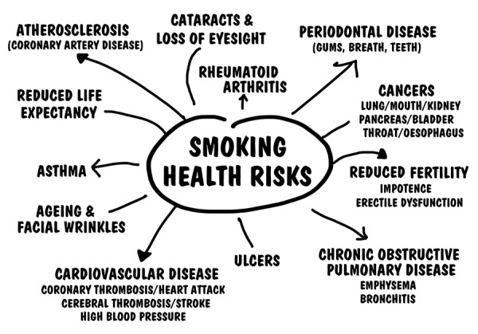
https://universityhealthnews.com/daily/lung-health/smoking-diseases/

Slide 8
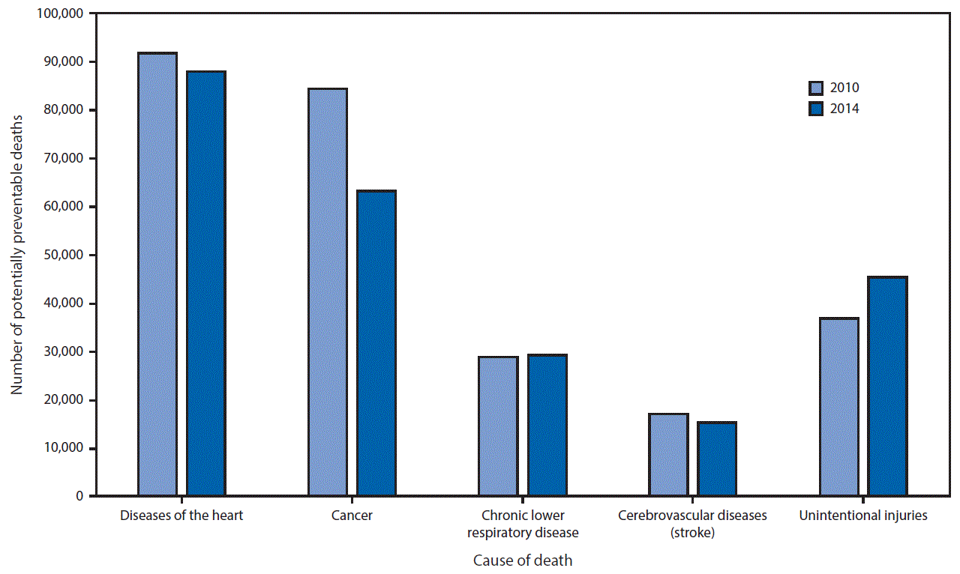
Number of potentially preventable deaths among the five leading causes of death, for persons aged <80 years — United States, 2010 and 2014
https://www.cdc.gov/mmwr/volumes/65/wr/mm6545a1.htm

Slide 9
Smoking Rates
General Population: 11.5%
People with HIV (PWH) are 3-4 times more likely to be smokers than those who do not have the disease, with prevalence of smoking among the general population of PWH reported between 34-47%.
https://cancercontrol.cancer.gov/brp/tcrb/tobacco-hiv

Slide 10
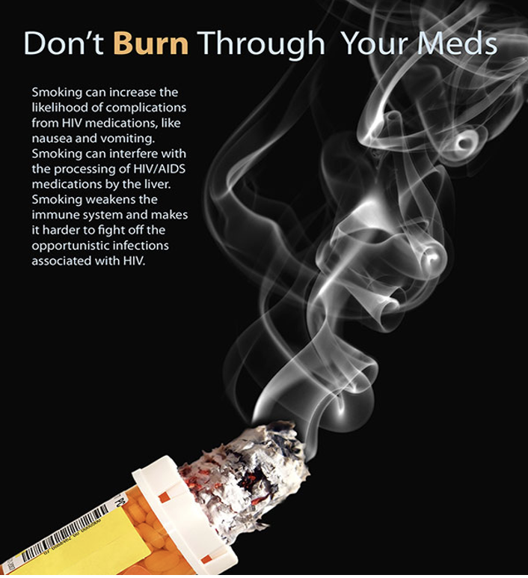
Impact of Smoking Cigarettes on PWH
Quicker progression to advanced HIV (HIV Stage 3)
PWH who smoke have greater odds of heart disease, cancer, cerebrovascular accident (CVA), and HIV-related infections than PWH who do not smoke
Weakens the immune system
Life expectancy among PWH who smoke is reduced by at least 16 years compared to PWH who do not smoke
https://www.dctfc.org/ad-campaign-hiv-tobacco

Slide 11
Call to Action
“Now that HAART-regimens have considerably improved the life expectancy in HIV-infected populations in industrialized countries, efforts to reduce smoking and alcohol consumption must be a priority in HIV medicine.”
Int J Epidemiol. 2005 Feb;34(1):130-1. doi: 10.1093/ije/dyh402.
Notes:
Editorial commentary on the previous study of mortality in France, 2000

Slide 12
Barriers to Smoking Cessation in PWH
Individual Level
Access (uninsured)
Lack of culturally appropriate interventions
Logistics (travel, babysitting, time off work, etc.)
Time commitment
Financial costs
Provider Level
Lack of knowledge of impact on disease status and medications
Co-morbidity–mental health diagnosis or substance use disorder
Smoking status not asked
Minimal tobacco treatment expertise
Not prioritized in treatment
Limited time

Slide 13
Motivation and Benefits of Quitting
Motivation: 74% of PWH who smoke report current interest in quitting
Quitting smoking has major and immediate health benefits for tobacco users, including PWH. These benefits include:
  Lower risk of lung cancer and many other types of cancer
  Reduced risk of heart disease, stroke, and COPD
    Cigarette smoking is the most important modifiable cardiovascular risk factor among PWH
  Reduced HIV-related symptom burden
  Improved quality of life
https://www.hiv.gov/hiv-basics/staying-in-hiv-care/other-related-health-issues/smoking
Notes:
https://www.hiv.gov/hiv-basics/staying-in-hiv-care/other-related-health-issues/smoking

Slide 14
Promoting Smoking Cessation in PWH
Persons with HIV, mental illnesses, and substance use disorders benefit from same interventions as general population
Combination of counseling and pharmacotherapy should be used whenever possible
Duration of treatment might be longer
View failed quit attempt as a practice, not failure

Slide 15
Treating Tobacco Use and Dependence: Clinical Practice Guideline
2008 UPDATE
U.S. Public Health Service
Clinical Practice Guideline
Am J Prev Med. 2008 Aug;35(2):158-76. doi: 10.1016/j.amepre.2008.04.009.
Notes:
The following is a summary of the 2008 PHS Clinical Practice Guideline Update: Treating Tobacco Use and dependence which was released May 7, 2008.

Slide 16
Tools for Smoking Cessation
5As (Ask, Advise, Assess, Assist, Arrange)
Pharmacotherapy
  Nicotine Replacement Therapies
  Other Medications (Bupropion, Varenicline)
Counseling and behavioral change strategies
  Combination pharmacotherapy and counseling/behavioral change strategies most effective
Quitlines

Slide 17
As a provider, what is your first step to help your patients quit smoking?

Slide 18
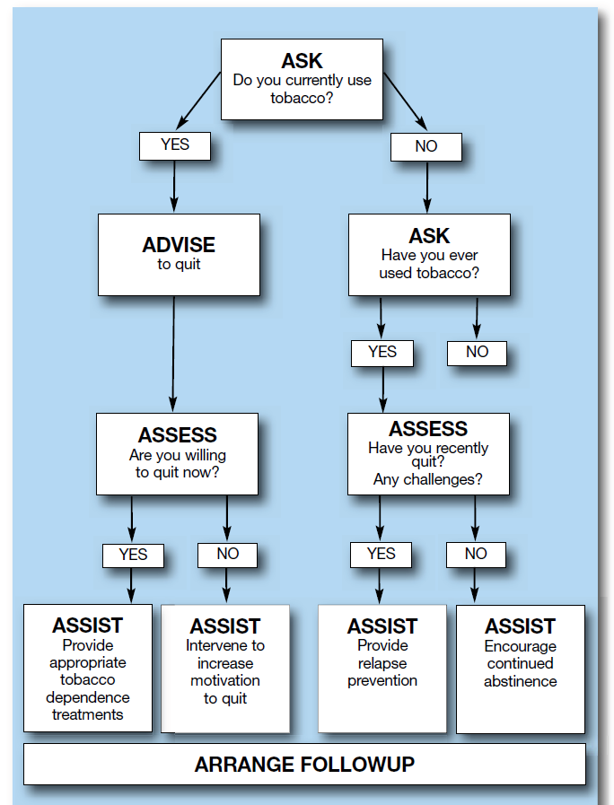
5 A’s Intervention
Ask: Systematically identify tobacco use at every visit
Advise: Encourage patients to quit their tobacco use in a clear, strong, personalized manner
Assess: Determine willingness to make a quit attempt
Assist: Provide referrals for medication, counseling, support group, or health education class
Arrange: Schedule follow up either in person or by phone call or text
Am J Prev Med. 2008 Aug;35(2):158-76.

Slide 19
Readiness and Confidence Ruler
Readiness
How ready are you to quit smoking ?
On a scale of 0 to 10, with 0 being not at all ready & 10 being very ready…
0 1 2 3 4 5 6 7 8 9 10
Not at all Somewhat Very
Confidence
How confident are you that you could stop smoking/using…, if you decided to? On a scale of 0 to 10, with 0 being not confident at all & 10 being very confident?
0 1 2 3 4 5 6 7 8 9 10
Not at all Somewhat Very

Slide 20

Motivational Interviewing
“Motivational interviewing is a client-centered, directive method for enhancing intrinsic motivation to change by exploring and resolving ambivalence.”

Slide 21
Principles of Motivational Interviewing
Express Empathy
  Seeks to understand the person’s feelings and perspectives without judging
  Acceptance facilitates change
  Skillful reflective listening is fundamental
  Ambivalence is normal
Develop Discrepancies
  Current behavior versus current and future goals
Roll with Resistance
Support Self-Efficacy

Slide 22
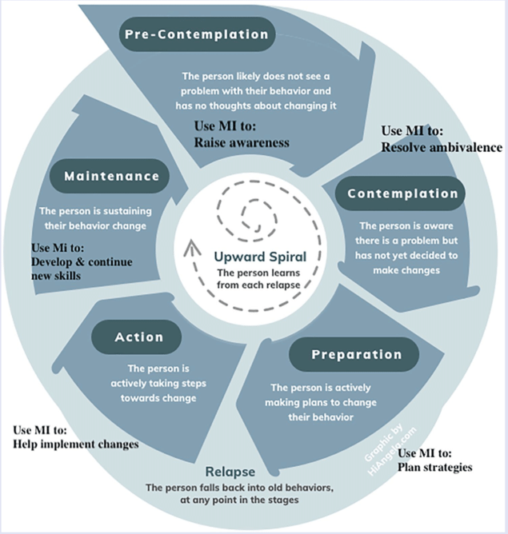
NASN Sch Nurse. 2020 Nov;35(6):344-351.

Slide 23
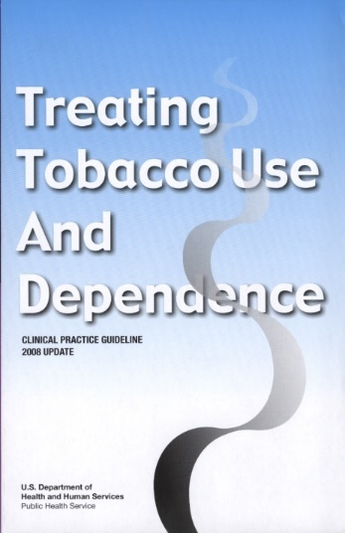
Pharmacotherapy
“Clinicians should encourage all patients attempting to quit to use effective medications for tobacco dependence treatment, except where contraindicated or for specific populations* for which there is insufficient evidence of effectiveness.”
* Includes pregnant women, smokeless tobacco users, light smokers, and adolescents.
Medications significantly improve success rates.
Fiore et al. (2008). Treating Tobacco Use and Dependence: 2008 Update.
Clinical Practice Guideline. Rockville, MD: USDHHS, PHS, May 2008.

Slide 24
Medications
The seven FDA approved medications for tobacco dependence treatment that reliably increase long-term smoking abstinence rates
  Medications containing Nicotine (NRT):
    Gum, Inhaler, Lozenge, Nasal spray, Patch
  Non nicotine Medications:
    Varenicline (Chantix)
    Bupropion (Wellbutrin or Zyban)
*Clinicians should consider the use of certain combinations of medications identified as effective
NRT= nicotine replacement therapy

Slide 25
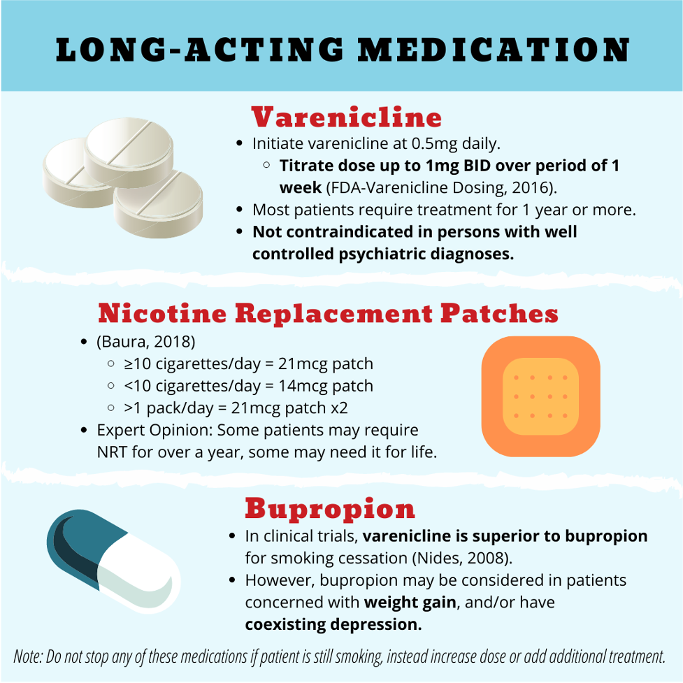
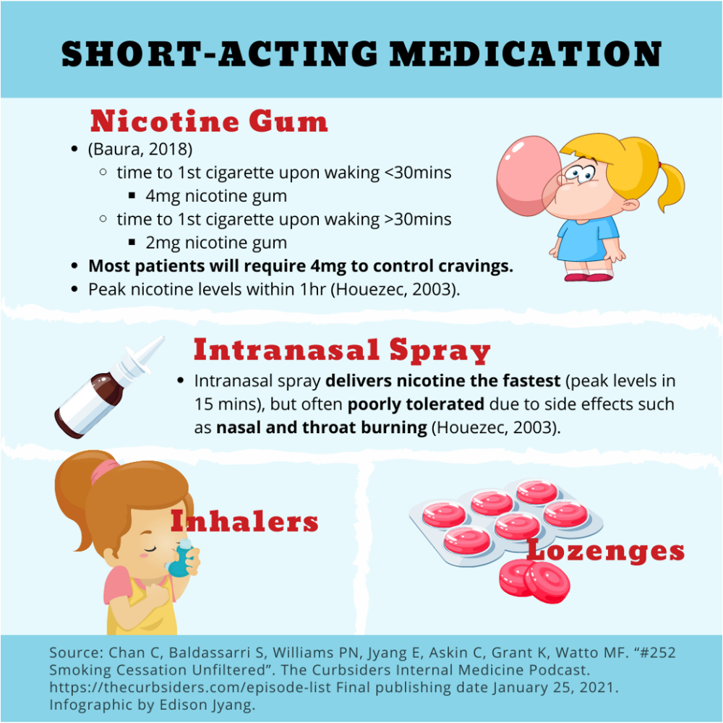

Slide 26
Medication | Number of arms | Estimated odds ratio (95% C. I.) | Estimated abstinence rate (95% C. I.)
Placebo | 80 | 1.0 | 13.8
Monotherapies
Varenicline (2 mg/day) | 5 | 3.1 (2.5, 3.8) | 33.2 (28.9, 37.8)
Nicotine Nasal Spray | 4 | 2.3 (1.7, 3.0) | 26.7 (21.5, 32.7)
High Dose Nicotine Patch ( > 25 mg) (These included both standard or long-term duration) | 4 | 2.3 (1.7, 3.0) | 26.5 (21.3, 32.5)
Long-Term Nicotine Gum (> 14 weeks) | 6 | 2.2 (1.5, 3.2) | 26.1 (19.7, 33.6)
Varenicline (1 mg/day) | 3 | 2.1 (1.5, 3.0) | 25.4 (19.6, 32.2)
Nicotine Inhaler | 6 | 2.1 (1.5, 2.9) | 24.8 (19.1, 31.6)
Bupropion SR | 26 | 2.0 (1.8, 2.2) | 24.2 (22.2, 26.4)
Nicotine Patch (6-14 weeks) | 32 | 1.9 (1.7, 2.2) | 23.4 (21.3, 25.8)
Long-Term Nicotine Patch (> 14 weeks) | 10 | 1.9 (1.7, 2.3) | 23.7 (21.0, 26.6)
Nicotine Gum (6-14 weeks) | 15 | 1.5 (1.2, 1.7) | 19.0 (16.5, 21.9)
Meta-analysis (2008): Effectiveness and abstinence rates for various medications and medication combinations compared to placebo at 6-months post-quit (n = 86 studies)
Am J Prev Med. 2008 Aug;35(2):158-76.

Slide 27

Medication | Number of arms | Estimated odds ratio (95% C. I.) | Estimated abstinence rate (95% C. I.)
Placebo | 80 | 1.0 | 13.8
Combination therapies
Patch (long-term; > 14 weeks) + ad lib NRT (gum or spray) | 3 | 3.6 (2.5, 5.2) | 36.5 (28.6, 45.3)
Patch + Bupropion SR | 3 | 2.5 (1.9, 3.4) | 28.9 (23.5, 35.1)
Patch + Inhaler | 2 | 2.2 (1.3, 3.6) | 25.8 (17.4, 36.5)
Meta-analysis (2008): Effectiveness and abstinence rates for various medications and medication combinations compared to placebo at 6-months post-quit (n = 86 studies)
Am J Prev Med. 2008 Aug;35(2):158-76.

Slide 28
Efficacy Relative to Patch
Medication | Number of arms | Estimated odds ratio (95% C. I.)
Nicotine Patch (reference group) | 32 | 1.0
Varenicline (2 mg/day) | 5 | 1.6 (1.3, 2.0)
Patch (long-term; >14 weeks) + NRT (gum or spray) [lozenge] | 3 | 1.9 (1.3, 2.7)
Patch + Bupropion SR | 3 | 1.3 (1.0, 1.8)
Am J Prev Med. 2008 Aug;35(2):158-76.

Slide 29
Behavioral Interventions
Cognitive Behavioral Therapy approach
  Thoughts
  Behavioral Change
  Stress/Emotion Management
Higher quit rates compared to no counseling
Having at least 4 individual brief (10-15 minute) appointments substantially improves abstinence rates (2-3 sessions: 16%; 4-8 sessions: 21%)
Dose response

Slide 30
Guide for Brief Intervention (4 sessions)
  Appointment 1: Preparing for the Quit Attempt
    Set quit date, clean environment, discuss medications, reasons for quitting, triggers
  Appointment 2: On or before the Quit Date
    Identify benefits or quitting, discuss barriers and challenges, methods for managing stress and triggers
  Appointment 3: Approximately 1 week after the Quit Date (Maintenance)
  Appointment 4: Approximately 1 Month after the Quit Date (Strategies for Relapse Prevention)

Slide 31
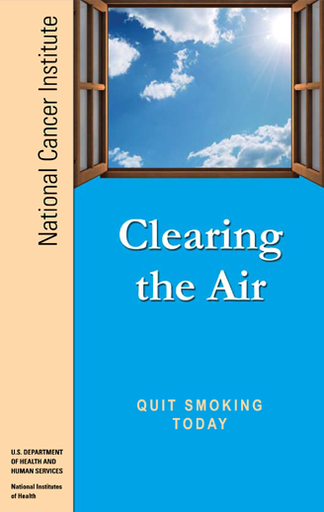
https://www.cancer.gov/publications/patient-education/clearing-the-air-pdf (only available in English)

Slide 32

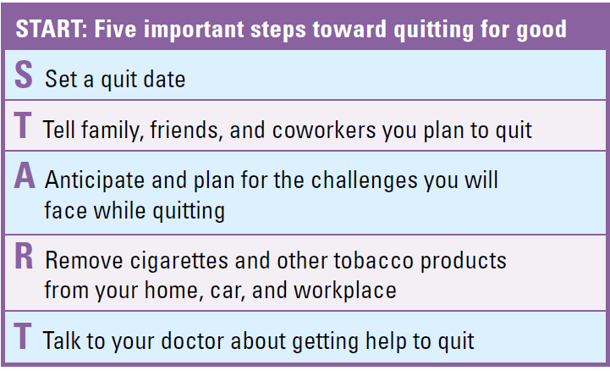
https://www.cancer.gov/publications/patient-education/clearing-the-air-pdf

Slide 33
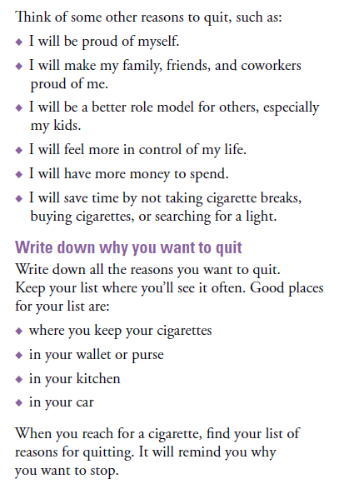
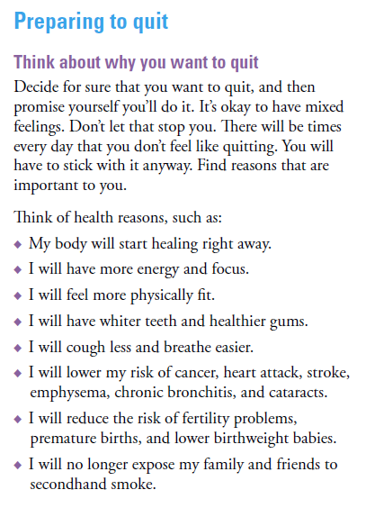
https://www.cancer.gov/publications/patient-education/clearing-the-air-pdf

Slide 34
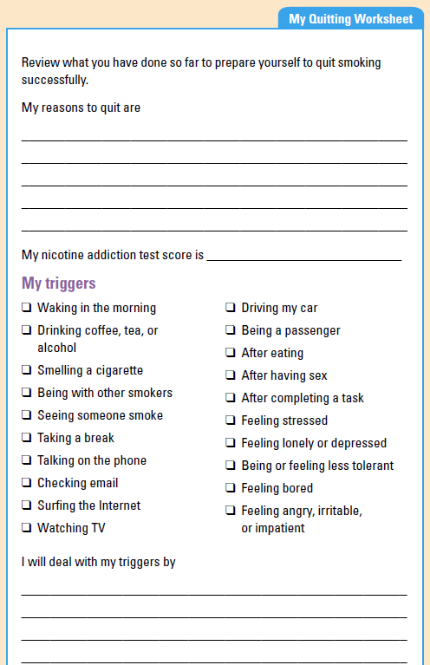
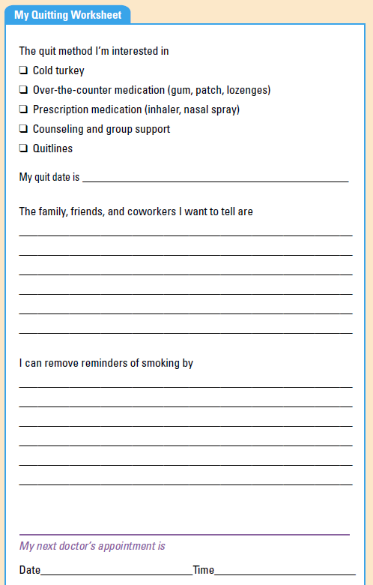
https://www.cancer.gov/publications/patient-education/clearing-the-air-pdf

Slide 35
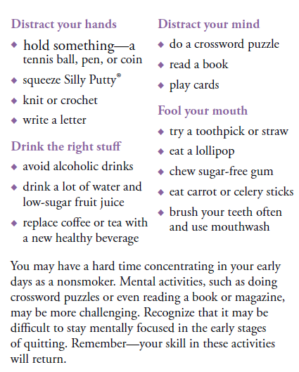
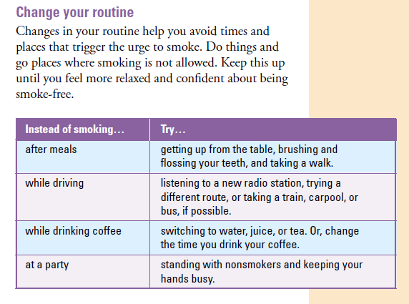
https://www.cancer.gov/publications/patient-education/clearing-the-air-pdf

Slide 36

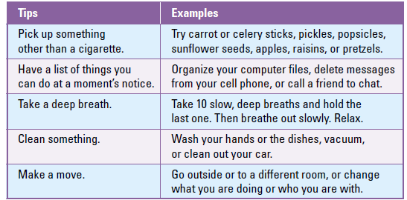
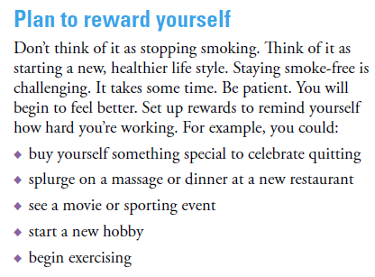
https://www.cancer.gov/publications/patient-education/clearing-the-air-pdf

Slide 37
Behavioral Skills
The 5 D’s
  Delay, Distract, Drink water, Deep breaths, Discuss
Manage Stress
  Physical activity, writing in a journal, spending time with friends
  Consider teaching additional brief relaxation methods (e.g. deep breathing)
Control the environment
  Tobacco proof the home and car
  Talk to support system about the decision to address tobacco use

Slide 38
Relapse is Expected
Discuss a slip and relapse, and the difference
When patients relapse, reframe the relapse as a learning opportunity:
  What can you do differently next time?
  Review triggers
Encourage patients to stay positive:
  Positive self talk
  Celebrate any gains
Assess current strategy with patient:
  May need to add a strategy or adjust intervention

Slide 39




Combination Treatment: Gold Standard

Slide 40
Combinations: Medication and Counseling
Effectiveness of and estimated abstinence rates for the combination of counseling and medication versus medication alone (n = 18 studies)
Treatment | Number of arms | Estimated odds ratio (95% C.I.) | Estimated abstinence rate (95% C.I.)
Medication alone | 8 | 1.0 | 21.7
Medication and counseling | 39 | 1.4 (1.2, 1.6) | 27.6 (25.0, 30.3)
Tobacco Use and Dependence Guideline Panel. Treating Tobacco Use and Dependence: 2008 Update. Rockville (MD): US Department of Health and Human Services; 2008 May. Table 6.22, Meta-analysis (2008): Effectiveness of and estimated abstinence rates for the combination of counseling and medication vs. medication alone (n = 18 studies)a. Available from: https://www.ncbi.nlm.nih.gov/books/NBK63943/table/A29578/

Slide 41
Combinations: Medication and Counseling
Effectiveness of and estimated abstinence rates for the combination of counseling and medication versus counseling alone (n = 9 studies)
Treatment | Number of arms | Estimated odds ratio (95% C.I.) | Estimated abstinence rate (95% C.I.)
Counseling alone | 11 | 1.0 | 14.6
Medication and counseling | 13 | 1.7 (1.3, 2.1) | 22.1 (18.1, 26.8)
Tobacco Use and Dependence Guideline Panel. Treating Tobacco Use and Dependence: 2008 Update. Rockville (MD): US Department of Health and Human Services; 2008 May. Table 6.24, Meta-analysis (2008): Effectiveness of and estimated abstinence rates for the combination of counseling and medication vs. medication alone (n = 9 studies)a. Available from: https://www.ncbi.nlm.nih.gov/books/NBK63943/table/A29578/

Slide 42
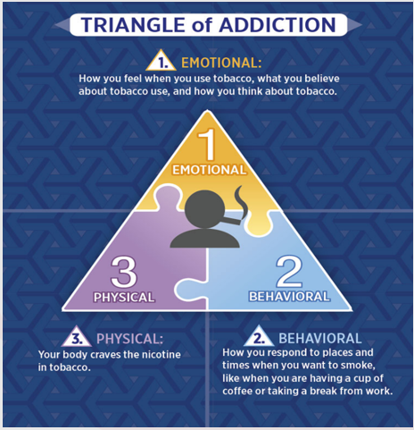
Treating Nicotine Addiction
Cigarette smoking is an addiction that has emotional, physical, and behavioral implications so treatment must address these areas
https://www.pimalung.com/pages/addiction.php

Slide 43
Quitlines
Telephone quitline counseling is effective with diverse populations and has broad reach. Clinicians and healthcare delivery systems should both ensure patient access to quitlines and promote quitline use.
Quitlines are appropriate and should be recommended for patients willing to quit, unwilling to quit, and recently quit.
Quitlines available in Spanish and English.
Some provide free medication.

Slide 44
Intervention | Number of arms | Estimated odds ratio (95% C.I.) | Estimated abstinence rate (95% C.I.)
Minimal or no counseling or self-help | 11 | 1.0 | 8.5
Quitline counseling | 11 | 1.6 (1.4, 1.8) | 12.7 (11.3, 14.2)
Intervention | Number of arms | Estimated odds ratio (95% C.I.) | Estimated abstinence rate (95% C.I.)
Medication alone | 6 | 1.0 | 23.2
Medication and Quitline counseling | 6 | 1.3 (1.1, 1.6) | 28.1 (24.5, 32.0)
Tobacco Use and Dependence Guideline Panel. Treating Tobacco Use and Dependence: 2008

Slide 45
Quitline Resources
Texas Tobacco Quitline
  1-877-YES-QUIT (1-877-937-7848)
  Nicotine replacement therapy and quit coaching sessions.
  Services are provided in both English and Spanish.
  Interpretation for other languages is available for phone services.
Free national quit help:
  1-800-QUIT-NOW (1-800-784-8669)
In Spanish:
  1-855-DÉJELO-YA (1-855-335-3569)
In Asian languages:
  Mandarin and Cantonese: 1-800-838-8917
  Korean: 1-800-556-5564
  Vietnamese: 1-800-778-8440

Slide 46

Challenge: Resources and Logistics
https://www.1zoom.me/en/wallpaper/607275/z6679.6/600x400

Slide 47



Challenge: General Treatment
https://www.cms.gov/priorities/innovation/key-concepts/person-centered-care
https://waghostwriter.com/64441/opinions/does-one-size-really-fit-all/
https://ownmygrowth.com/2024/03/02/adaptability/

Slide 48
Culturally Tailored, Accessible Treatment
MASP+ (app)
  Black adults with HIV who smoke
  Elevated negative mood
  Remotely completed
  Compensated
  Quittingplus.com
  RESTORE Laboratory
    Call 713-743-9311
  Thomas Street Clinic
    Call 713-873-4526
Vital (app)
  Latino/a adults with HIV who smoke
  Elevated negative mood
  Materials in Spanish and English
  Remotely completed
  Compensated
  Not yet launched

Slide 49
Conclusions
Nicotine dependence is chronic
Clinicians should expect relapse and repeated attempts to quit
Great spectrum of severity and addiction; treatment should be tailored accordingly
Treatment should be on going and multifaceted:
  Counseling
  Support/referral
  Appropriate pharmacotherapy

Slide 50
Conclusions
Significant, and immediate, benefits for PWH can be achieved by quitting
Significant public health benefits can be derived from reducing smoking among PWH
To further improve survival and quality of life for PWH, we MUST promote smoking cessation
Highly accessible resources are available in your community to support tailored smoking cessation treatment among PWH

Slide 51

Ongoing Training and Cultural Competence
https://economictimes.indiatimes.com/jobs/in-the-world-of-digitalisation-these-10-new-skills-will-help-you-to-stay-ahead/articleshow/59008347.cms?from=mdr

Slide 52
References
Joint United Nations Programme on HIV/AIDS. UNAIDS global AIDS update 2022. Geneva: Joint United Nations Programme on HIV/AIDS; 2022. https://www.unaids.org/sites/default/files/media_asset/2022-global-aids-update-summary_en.pdf
Deeks, S. G., Lewin, S. R., & Havlir, D. V. (2013). The end of AIDS: HIV infection as a chronic disease. The lancet, 382(9903), 1525-1533.
Sabin, C. A. (2013). Do people with HIV infection have a normal life expectancy in the era of combination antiretroviral therapy?. BMC medicine, 11, 1-7.
Miles, D. B., Bilal, U., Hutton, H., Lau, B., Lesko, C., Fojo, A., ... & Chander, G. (2019). Tobacco smoking, substance use, and mental health symptoms in people with HIV in an urban HIV clinic. Journal of health care for the poor and underserved, 30(3), 1083.
Bhalerao, A., & Cucullo, L. (2020). Impact of tobacco smoke in HIV progression: a major risk factor for the development of NeuroAIDS and associated CNS disorders. Journal of Public Health, 28, 259-270.
Miller, W. R., Zweben, A., DiClemente, C. C., & Rychtarik, R. G. (1992). Motivational enhancement therapy manual: A clinical research guide for therapists treating individuals with alcohol abuse and dependence. Rockville, MD: National Institute on Alcohol Abuse and Alcoholism.
Cartujano-Barrera, F., Lee D’Abundo, M., Arana-Chicas, E., Chock, S., Valera, P., Kamen, C. S., & Cupertino, A. P. (2021). Barriers and facilitators of smoking cessation among Latinos living with HIV: Perspectives from key leaders of community-based organizations and clinics. International journal of environmental research and public health, 18(7), 3437.
Pacek, L. R., Latkin, C., Crum, R. M., Stuart, E. A., & Knowlton, A. R. (2014). Interest in quitting and lifetime quit attempts among smokers living with HIV infection. Drug and alcohol dependence, 138, 220-224.
U.S. Department of Health and Human Services. HIV.gov: HIV and Smoking
Fiore, M. (2009). Treating tobacco use and dependence: 2008 update: clinical practice guideline. Diane Publishing.
https://www.ahrq.gov/prevention/guidelines/tobacco/index.html
https://www.uclaisap.org/slides/psattc/smoking-HIV-training-package/Smoking%20and%20HIV_Trainer%20Guide_FINAL.pdf
Tobacco Use and Dependence Guideline Panel. Treating Tobacco Use and Dependence: 2008 Update. Rockville (MD): US Department of Health and Human Services; 2008 May. 6, Evidence and Recommendations. Available from: https://www.ncbi.nlm.nih.gov/books/NBK63943/

Slide 53
Smoking Cessation Resources
Free guideline can be downloaded at: https://www.ahrq.gov/prevention/guidelines/tobacco/clinicians/index.html
SmokefreeTXT: A mobile text messaging service designed for adults and young adults across the United States who are trying to quit smoking.
National Quitline: 1–800–QUIT–NOW (1–800–784–8669).
http://www.smokefree.gov/resources.html (resources in Spanish and English)
Notes:
You may also add your own organization-specific resource slide in addition to the SCAETC Resources slide.

Slide 54
Smoking Cessation Resources
Free guideline can be downloaded at: https://www.ahrq.gov/prevention/guidelines/tobacco/clinicians/index.html
SmokefreeTXT: A mobile text messaging service designed for adults and young adults across the United States who are trying to quit smoking.
National Quitline: 1–800–QUIT–NOW (1–800–784–8669).
http://www.smokefree.gov/resources.html (resources in Spanish and English)
Notes:
You may also add your own organization-specific resource slide in addition to the SCAETC Resources slide.

Slide 55
Thank you kindly for your interest and attention.
Contact information:
Lorra Garey, PhD
llgarey@uh.edu
https://staffblogs.le.ac.uk/loproject/2014/05/08/limitedevidence/

Slide 56
Resources
National Clinician Consultation Center http://nccc.ucsf.edu/
  HIV Management
  Perinatal HIV
  HIV PrEP
  HIV PEP line
  HCV Management
  Substance Use Management
Present on ECHO
https://hsc.unm.edu/scaetc/programs-services/echo.html​
AETC National HIV Curriculum https://aidsetc.org/nhc
AETC National Coordinating Resource Center https://targethiv.org/library/aetc-national-coordinating-resource-center-0
HIVMA Resource Directory https://www.hivma.org/globalassets/ektron-import/hivma/hivma-resource-directory.pdf
Additional trainings scaetcecho@salud.unm.edu
www.scaetc.org
Notes:
IDEA Platform: Infectious Diseases Education & Assessment. https://idea.medicine.uw.edu/
AETC National HIV Curriculum: 6 core modules for self study; regularly updated; CME, CNE
Hepatitis C Online Curriculum: https://www.hepatitisc.uw.edu/
Hepatitis B Online Curriculum: https://www.hepatitisb.uw.edu/
National STD Curriculum: https://www.std.uw.edu/

Slide 57
