Slide 1
COVID-19 Update for Patients with HIV
Section 1:
Epidemiology, Virology, Clinical Presentation, Diagnostics
Notes:
V_04032020

Slide 2
Slide Set Contributors
Avenue 360, Houston: C.Mark Nichols, DDS
Baylor College of Medicine: Shital Patel, MD; Melanie Goebel, MD
Gallup IHS: Jonathan Iralu, MD, FACP
LSUHSC: Paula Seal, MD MPH
PHNT: Deborah Morris-Harris, MD, EMBA
UNMHSC: Carly Floyd, Pharm D PhC AAHIVM; Nestor Sosa, MD; Meghan Brett, MD; Michelle Iandiorio, MD
Valley AIDS Council: Pedro Coronado

Slide 3
Learning Objectives
Recognize the current pandemic and how it is effecting the nation and region.
Recognize the risk factors for severe COVID-19.
Identify strategies to reduce risk of COVID-19.
Identify strategies to stay healthy during COVID-19 pandemic that People with HIV (PWH) should consider.
Notes:
PLWH now PWH per HRSA guidance

Slide 4
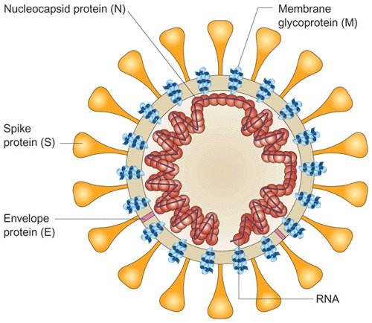
COVID-19
Viral upper respiratory syndrome caused by novel coronavirus, SARS CoV-2
Most people have mild illness (influenza-like, URI, gastroenteritis; or asymptomatic
Some may develop pneumonia
Some have severe symptoms and develop ARDS, septic shock
Notes:
80% mild or asymptomatic
Asymptomatic 18-25% (18% on cruise ship, now appears as many as 25% may be asymptomatic – concern for asymptomatic shed)

Slide 5
Transmission
Droplet exposure when infected person coughs or sneezes
Possible asymptomatic shedding
Contact from droplet on hand then exposure to eyes, nose, mouth
Huang, Ch et al. The Lancet. 2020; Vol 395
Notes:
Transmissibility reproductive number 1.4-3.28. Same or higher than prior influenza pandemics (Liu, Y et al. Journal of Travel Medicine, 2020 . Biggerstaf, M et al. BMC Infect Dis 2014;12:480.)
[less transmissible than measles or smallpox]
Virus has been found in feces but not clear if this is a potential risk exposure
No perinatal transmission reported

Slide 6
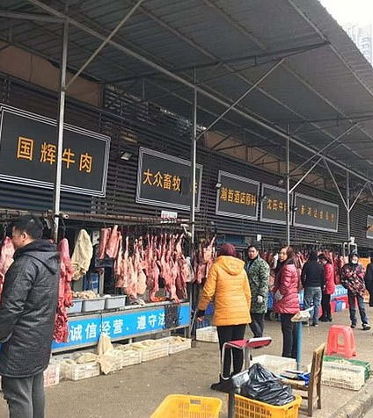
COVID-19 from SARS CoV-2
COVID-19 disease emerged in December 2019 in Wuhan, Hubei Province in China
Initial cases associated with Huanan Seafood market
Later extensive person-to-person transmission
Photo: DailyMail.com

Slide 7
COVID-19 Cases in the U.S.
https://www.cdc.gov/coronavirus/2019-ncov/cases-updates/cases-in-us.html Updated 4/2/20
Notes:
As of 4/2/20, total US cases: 213,144; total deaths: 4513
Travel-related: 1144; close contact: 3245; under investigation: 209,755
>1million confirmed cases in the world
NY has the countrie’s highes number of cases

Slide 8
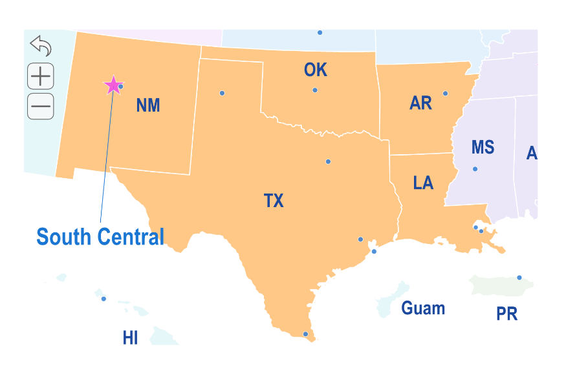
Reported COVID-19 Cases in Region
State | Cases | Cases per 100,000 | Deaths | Deaths per 100,000
NM | 403 | 19.3 | 7 | 0.3
TX | 4875 | 17.5 | 78 | 0.3
OK | 879 | 22.4 | 34 | 0.9
AR | 683 | 22.8 | 12 | 0.4
LA | 9150 | 196.2 | 310 | 6.6
As of 4/2/20
https://www.nytimes.com/interactive/2020/us/coronavirus-us-cases.html#states

Slide 9
COVID-19 Cases in the U.S.
Cumulative total cases through 4/1/20
Community transmission cases a rising concern in many areas
https://www.cdc.gov/coronavirus/2019-ncov/cases-updates/cases-in-us.html

Slide 10
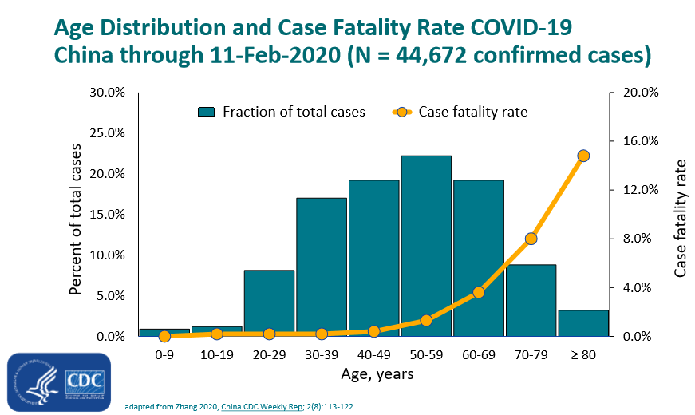
Notes:
4/2 WHO director in Europe said 95% coronavirus deaths in >60yo
10-15% of cases in <50yos are moderate-severe.
4/1 Currently 3rd leading cause of death in US

Slide 11
COVID-19 Virology
Nestor Sosa, MD
Chief, UNMHSC DOIM Division of Infectious Diseases
Notes:
V033020

Slide 12
Coronavirus
Size: 80-160 nm
Genome: 27-32kb RNA
Genes at 5’ end specify for RNA replication proteins (error prone=mutations)
Genes at 3’ end specify structural proteins (S, N, M, E)
Notes:
Receptor for SARS-CoV-2 is ACE-2: in alveolar epithelial cells, oral and nasal mucosa, nasopharynx, GI tract… (Hamming, I et al. Journal of Pathology. 2004; 203:631-637.

Slide 13
Origin of SARS CoV-2
Highest homology to a bat coronavirus
BetaCoV/bat/Yunnan/RaTG13/13
Intermediate mammal host is still unclear
Li et al analyzed 70 genomes from SARS CoV-2 and concluded that the Time to Most Common Ancestor (TMRCA) between 22-24 Nov 2019, and discarded Pangolins as likely intermediate host
JMedVirology onlinelibrary.wiley.com

Slide 14
Phylogenetic
Coronaviridae subfamily has two main genera: -Alphacoronavirus: -229E and NL63 -Betacoronavirus 3 Lineages Lineage A: -OC43 and –HKU1 Linage B: SARSCoV and SARS-CoV-2 Linage C: MERS-CoV

Slide 15
Forni, D et al. Trends in Microbiology. Jan 2017; Vo 25, No 1.

Slide 16
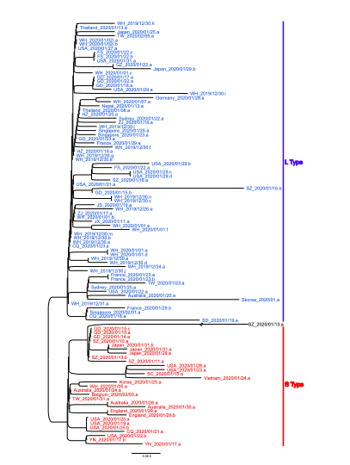
Genetic Types of SARS-CoV-2
L-type (70%)
S-type (30%)
Xiaolu Tang et al. Microbiology (accepted for publication).

Slide 17
Spectrum of Clinical Presentation in SARS-CoV-2
Paula Seal, MD MPH
Associate Professor, LSUHSC School of Medicine
Clinical Director, LSUHSC AETC

Slide 18
COVID-19 Clinical Manifestations
Time Course:
Incubation Period 5.1 days [2-14d]
Illness onset to discharge 22 days
Illness onset to death 18.5 days
Illness onset to intubation 14.5 days
Viral Shedding 22 days [8-37d]
Huang, Ch et al. The Lancet. 2020; Vol 395 Lauer et al, Ann Intern Med, 3/10/20, Zhou et al, Lancet, 2/13/20
Notes:
95th percentile: 12.5 days

Slide 19
Clinical Syndrome
Asymptomatic
Mild Illness
Influenza Like Illness, Upper Respiratory Tract Infection, Gastroenteritis
Pneumonia:
Mild to Severe
Severe symptoms with the development of ARDS
Sepsis
Septic Shock
WHO. “Clinical management of severe acute respiratory infection when 2019-CoVinfection is suspected: Interim guidance.
January 2020. https://www.who.int/docs/default-source/coronaviruse/clinical-management-of-novel-cov.pdf.

Slide 20
Clinical Syndromes in the Critically Ill
State of Washington, 21 patients in Intensive Care
At presentation:
Cough 48%
Fever 52%
Abnormal radiologic imaging 95%
Hospitalization:
15/21 Ventilated, 71% with ARDS
Cardiomyopathy 33% (7/21) -> 52% progressed to death
Arentz et al. JAMA 12 March 2020

Slide 21
COVID-19 Symptoms
Hospitalized Patients
Fever at admission | 45%
Fever during hospitalization | 83- 99%
Cough | 59-82%
Fatigue | 38-70%
Sputum | 34%
SOB | 19-31%
Myalgias | 11-15%
Sore Throat | 5-14%
Nausea and Vomiting | 1-5%
Diarrhea | 2-4%
Guan NEJM DOI: 10.1056/NEJMoa2002032. Chen Lancet 2020; 395:507-13
Notes:
No particular set of signs of symptoms can reliably discriminate COVID-19 from other respiratory viral illnesses
Pre-admission: non-specific viral syndrome, often with poor po intake and/or n/v
Some report reduced sense of taste (nonspecific finding seen in URI and allergic rhinitis)

Slide 22
Clinical Syndromes in the Critically Ill
State of Washington, 21 patients in Intensive Care
At presentation:
Cough 48%
Fever 52%
Abnormal radiologic imaging 95%
Hospitalization:
15/21 Ventilated, 71% with ARDS
Cardiomyopathy 33% (7/21) -> 52% progressed to death
Arentz et al. JAMA 12 March 2020

Slide 23
COVID-19 Gastrointestinal Symptoms
Retrospective analysis
1141 patients
Multicenter cross-sectional analysis
204 patients
GI symptom as the initial presentation in 3% of patients. Digestive symptoms at presentation 50. 5%.²
Lack of Appetite | 79%
Diarrhea | 34%
Vomiting | 3.9%
Abdominal Pain | 1.9%
GI symptom as the initial presentation in 16% of patients.¹
Nausea | 73%
Vomiting | 65%
Diarrhea | 37%
Abdominal Pain | 25%
¹ Lou DOI: 10.1016/j.cgh.2020.03.043. ² Pan AJG 10.14309/ajg.0000000000000620
Notes:
As the pandemic has progressive, gastrointestinal symptoms at presentation have been recognized.

Slide 24
Radiologic Abnormalities
Abnormal Chest Imaging often precedes symptoms
Ground Glass->consolidation approx. week 2-> resolving imaging week 3
Guan NEJM
Chen Lancet
Abnormal CT 86%
Ground glass 56%, Bilateral patchy shadowing 52%
Abnormal CXR 59%
Ground glass changes 20%, Bilateral patchy shadowing 37%
Abnormal CXR and CT
Bilateral patchy Pneumonia: 75%
Multiple Mottling and Ground glass: 14%
Guan NEJM DOI: 10.1056/NEJMoa2002032
Chen Lancet 2020; 395:507-13.

Slide 25
COVID-19 Progression of Respiratory Syndrome
Moderate
Severe
Mild SOB but requiring O2 supplementation (”silent hypoxia”)
Difficulty mobilizing thick secretions
CXR: diffuse infiltrates
Some progress to requiring high levels of O2
Increased secretions
CXR: progressive consolidation, infiltrates, edema
Original slide: M. Caridi-Scheible, MD; Emory
Notes:
From presentation given by Dr. Mark Caridi-Scheible at Emory via ECHO update 3/24/20
Recommend moving to ICU if >10L NC O2 requirement
Guafenisin and aggressive pulmonary hygiene, frequent suctioning, mucolytics, percussive therapy if needed

Slide 26
COVID-19 Severe Respiratory Syndrome
Some progress to respiratory collapse and may require intubation
Pulmonary edema and effusions
Thick, copious secretions
Waxing/waning fevers
Acute kidney injury
Rapidly rising CRP
Cytokine storm
Original slide: M. Caridi-Scheible, MD; Emory
Notes:
From presentation given by Dr. Mark Caridi-Scheible at Emory via Project ECHO
COVID-19 Clinical Rounds 3/24/20
Relatively normal compliance, even when needing high PEEP
Mod-severe V/Q mismatch
Early ATN, then AIN on microscopy
Need diuresis

Slide 27
COVID-19 Laboratory Abnormalities
Laboratory Values at Presentation
Lymphopenia | 70-83%
Thrombocytopenia | 36%
Leukopenia | 34%
Elevated CRP | 61%
Elevated LDH | 40-41%
Elevated ALT/AST | 21-22%
Elevated D-Dimer | 46%
Guan NEJM DOI: 10.1056/NEJMoa2002032. Wang JAMA 2020; 323(11):1-61-1069.
Notes:
Recommended surveillance labs: daily ABC, CBC with dif, CMP, CRP, d-dimer, LDH, PT

Slide 28
Risk Factors for Severe COVID-19
Age >55yo
Cardiovascular disease
Chronic respiratory disease
Diabetes mellitus
Hypertension
Cancer
Immunosuppression
Biologics, transplant
HIV: CD4<200, uncontrolled viremia
Wu. JAMA. DOI: 10.1001/jama.2020.2648, Guan NEJM DOI: 10.1056/NEJMoa2002032. Huang. Lancet. 2020; 395(10223):497-506., Wang JAMA 2020; 323(11):1-61-1069. CDC. COVID-19. https://www.cdc.gov/coronavirus/2019-ncov/
Notes:
PLWH have high rates of CVD, lung disease, and high prevalence of smoking – prioritize for diagnostic testing
in regards to risk in PLWH - consider the intersection of age; and comormidities that place pts at higher risk of complications from COVID-19

Slide 29
COVID-19 diagnostics
Deborah Morris-Harris, MD, EMBA
Chief Medical Officer, Prism Health North Texas
Clinical Director, PHNTX AETC

Slide 30
COVID-19 Testing
The gold standard for diagnosing COVID-19 disease is an RT-PCR from a nasopharyngeal specimen for SARS-CoV-2
The NP test had a 63% sensitivity when used on hospitalized patients in Wuhan, China (Oral pharyngeal swabs had a sensitivity of 32%)
Wang, Wenling et al. JAMA March 11, 2020 . doi: 10.1001/jama.2020.3786.
Notes:
Two target genes ORFlab and nucleocapsid protein are amplified using probe primers and an RNA template.
Preferred test is now the nasopharygeal swab PCR assay
Nasal swab with viral transport medium
Labcorp and Quest both offer this test
63% NP swabs positive in COVID-19 patients (93% for BAL) Wang,JAMA, 3/11/20
Cepheid Xpert nucleic acid amplification assay approved by FDA
Available as early as 3/30/2020
Many IHS sites have the Gene Xpert machine for GC/CT and TB testing
Assays take 45 min for this test
Remember that staff should be trained on how swabs are done to increase the yield of true positives and reduce false negative results

Slide 31
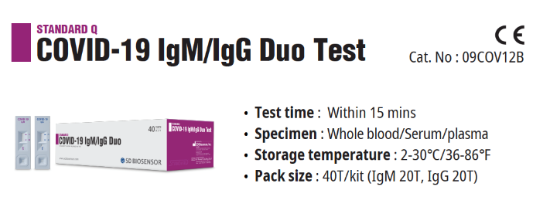
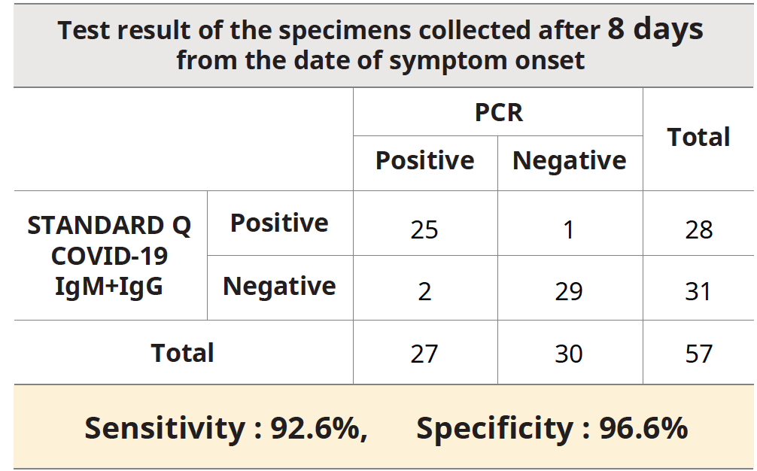
Antibody Tests
SD Biosensor has introduced COVID-19 IgM/IgG Duo
The Nucleocapsid protein of the core is relatively conserved among coronaviruses. This antigen is used as a tool for diagnosis of SARS-CoV-2.²
In case of negative PCR results due to a drop in titer of antigen, antibody tests can be useful to determine where patients are in the disease course.
Antibody tests are less sensitive than PCR tests early in the disease course.
Package Insert- available through Henry Schein
Li et. al. Development and Clinical Application of Rapid IgM-IgG Combined Antibody Test for
SARS-CoV-2 Infection Diagnosis. Journal of Medical Virology (2020).

Slide 32
Covid-19 in people with hiv
Melanie Goebel, MD; Infectious Disease Fellow, BCM
Shital M. Patel, MD;
Assistant Professor, Infectious Disease; Clinical Director BCM AETC
Baylor College of Medicine

Slide 33
Risk in Persons with HIV (PWH)
Incidence of COVID-19 in PLWH is unknown
As of March 24, 2020, one case report of patient in China with co-infection of SARS-CoV-2 and HIV-1 who recovered from viral pneumonia*
During prior SARS epidemic in 2002-2003, there were few case reports of SARS infection in PLWH
Other respiratory viruses (non-SARS coronavirus, rhinovirus, parainfluenza, influenza, human metapneumovirus) can cause pneumonia in PLWH
*Zhu F, et al. J Med Virol 2020.
Notes:
*Zhu F, Cao Y, Xu S, Zhou M. Co-infection of SARS-CoV-2 and HIV in a patient in Wuhan city, China. J Med Virol 2020.
Make sure HIV Service case managers know the different Ryan White programs to take advantage of support services

Slide 34
Children with HIV
Children are less likely to have severe COVID-19
Unknown if children with HIV have higher risk for severe disease
Keep immunizations up to date

Slide 35
Guidance for all PWH
Maintain adequate (> 30-day, ideally > 90-day) supply of ART and other chronic medications
Mail order delivery if possible
Delay switching ART regimens if feasible
Keep vaccinations (influenza, pneumococcal) up to date
Follow CDC recommendations for travel recommendations, social distancing and hand hygiene

Slide 36
Hospitalized patients with HIV and COVID-19
Continue ART
Avoid drug substitutions
For critically ill patients requiring tube feeding
Consult HIV specialist or pharmacist for ART options that can be crushed
Off-label or investigational treatment of COVID-19
Assess drug interactions between COVID-19 therapy and ART
PWH should be included in clinical trials for treatment of COVID-19 (https://clinicaltrials.gov/)
Notes:
Gilead is allowing compassionate use again https://www.gilead.com/news-and-press/company-statements/gilead-sciences-statement-on-access-to-remdesivir-outside-of-clinical-trials
https://www.gilead.com/science-and-medicine/research/compassionate-use
Clinical trials of remdesivir for COVID-19
https://www.clinicaltrials.gov/ct2/results?cond=covid-19&term=remdesivir&cntry=&state=&city=&dist=&Search=Search

Slide 37
Resources
Clinical Consultation Center http://nccc.ucsf.edu/
HIV Management
Perinatal HIV
HIV PrEP
HIV PEP line
HCV Management
Substance Use Management
Present case on ECHO http://echo.unm.edu hivecho@salud.unm.edu
AETC National HIV Curriculum https://aidsetc.org/nhc
AETC National Coordinating Resource Center https://targethiv.org/library/aetc-national-coordinating-resource-center-0
Additional trainings scaetcecho@salud.unm.edu
Notes:
Find an HIV TeleECHO clinic in your area: https://echo.unm.edu/locations-2/echo-hubs-superhubs-united-states/
Additional Local Trainings in NM: includes preceptorships, telephone/email consultation, on-site trainings, HIV TeleECHO; nmaetc@salud.unm.edu
AETC National HIV Curriculum: 6 core modules for self study; regularly updated; CME, CNE
Clinical Consultation Center HIV PrEP line: 888-448-7737 (9am-8pm ET M-F); https://nccc.ucsf.edu/clinician-consultation/prep-pre-exposure-prophylaxis/
AETC National HIV Curriculum, module on PrEP. https://www.hiv.uw.edu/go/prevention/preexposure-prophylaxis-prep
Clinical Consultation Center HIV PEP line: 888-448-4911 (9am-8pm ET M_F, 11am-8pm ET weekends & holidays); PEP Quick Guide: nccc.ucsf.edu/clinical-resources/pep-resources/pep-quick-guide-for-occupational-exposures/
AETC National HIV Curriculum, module on Non-occupational PEP. https://www.hiv.uw.edu/go/prevention/nonoccupational-postexposure-prophylaxis

Slide 38
References
AAHIVM: https://aahivm.org/hiv-care-covid-19/
CDC: https://www.cdc.gov/coronavirus/2019-ncov/need-extra-precautions/hiv.html?CDC_AA_refVal=https%3A%2F%2Fwww.cdc.gov%2Fcoronavirus%2F2019-ncov%2Fspecific-groups%2Fhiv.html
DHHS: https://aidsinfo.nih.gov/guidelines/html/8/covid-19-and-persons-with-hiv--interim-guidance-/554/interim-guidance-for-covid-19-and-persons-with-hiv
IDSA, HIVMA COVID-19: Special Considerations for People with HIV https://www.hivma.org/globalassets/covid-19-special-considerations_v5.pdf
WHO:https://www.who.int/news-room/q-a-detail/q-a-on-covid-19-hiv-and-antiretrovirals
AETC NCRC COVID-19 Resources for HIV providers https://aidsetc.org/resource/covid-19-resources-hiv-providers
HRSA COVID-19 Frequently Asked Questions https://bphc.hrsa.gov/emergency-response/coronavirus-frequently-asked-questions.html

Slide 39
References
Cao B, et al. 2020. A Trial of Lopinavir-Ritonavir in Adults Hospitalized with Severe Covid-19. N Engl J Med doi:10.1056/NEJMoa2001282.
Zhu F, Cao Y, Xu S, Zhou M. Co-infection of SARS-CoV-2 and HIV in a patient in Wuhan city, China. J Med Virol 2020.
www.hiv-druginteractions.org
COVID-19 drug interactions website: www.covid19-druginteractions.org
Natural Medicines Interaction Checker at www.naturalmedicines.therapeuticresearch.com
https://www.healthline.com/nutrition/immune-boosting-supplements
https://www.discovermagazine.com/health/can-natural-remedies-really-help-you-fight-the-coronavirus
https://www.pharmacytimes.com/news/what-are-drug-prevention-and-treatment-options-for-covid-19

Slide 40
References
Harm Reduction Coalition. Syringe Services and Harm Reduction Provider Operations During the COVID-19 Outbreak.
https://harmreduction.org/miscellaneous/covid-19-guidance-for-people-who-use-drugs-and-harm-reduction-programs/
Sex and COVID-19 https://www1.nyc.gov/assets/doh/downloads/pdf/imm/covid-sex-guidance.pdf
CDC: Coronavirus Disease 2019: Information for Healthcare Professionals https://www.cdc.gov/coronavirus/2019-nCoV/hcp/index.html
POZ: https://www.poz.com/article/people-hiv-need-know-new-coronavirus
https://www.nytimes.com/2020/03/28/nyregion/coronavirus-larry-kramer-aids.html?action=click&module=Features&pgtype=Homepage

