Slide 1
March 2021 AIDS Clinical Conference:
Virtual CROI 2021 Report Back
Jehan Budak, MD
Ruanne V. Barnabas, MBChB, MSc, DPhil
Adrienne Shapiro, MD, PhD, MSc
University of Washington
March 16, 2021

Slide 2
AIDS Clinical Conference:
Virtual CROI 2021 Report Back (ART)
Jehan Budak, MD
Acting Assistant Professor
Division of Allergy & Infectious Diseases
University of Washington
March 16, 2021

Slide 3
No conflicts of interest or relationships to disclose.

Slide 4
Outline
Update from IMPAACT 2010
Update from ATLAS-2M
Lenacapavir: Capella Study

Slide 5
Update from IMPAACT 2010

Slide 6
Background: IMPAACT 2010
ART options in pregnancy remain limited
IMPAACT 2010 is a global, multicenter, randomized trial of ART-naïve pregnant women with HIV started on:
  TAF/FTC + DTG vs
  TDF/FTC + DTG vs
  TDF/FTC/EFV
Interim results through delivery outcome (CROI 2020)
  DTG-containing arms had superior virologic efficacy
  TAF/FTC + DTG had lowest rate of adverse pregnancy outcome
Chinula L et al, Virtual CROI 2021, Abstract #177

Slide 7
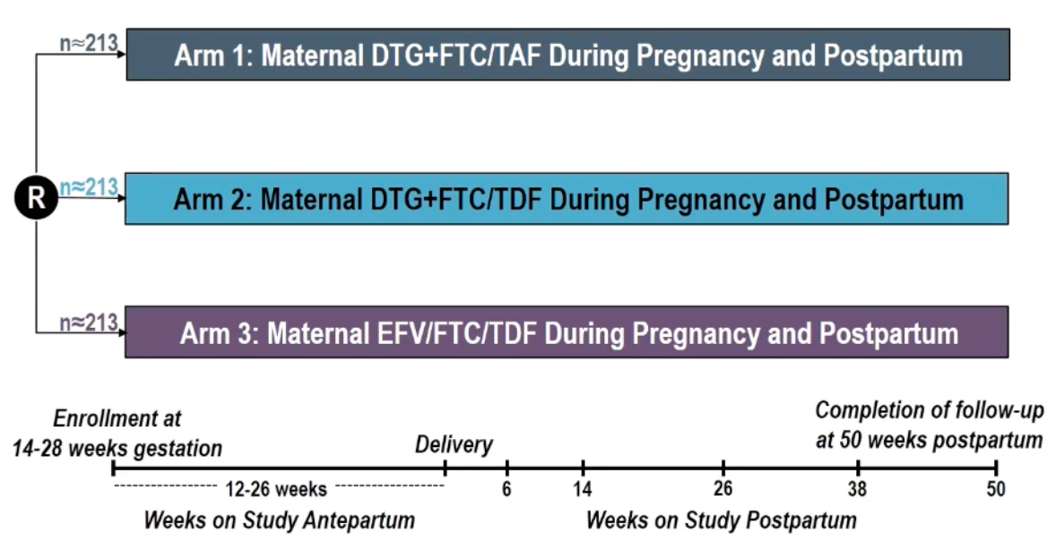
Study Design: IMPAACT 2010
Chinula L et al, Virtual CROI 2021, Abstract #177

Slide 8
Study Design: Maternal Baseline Characteristics
 | DTG+FTC/TAF (n=217) | DTG+FTC/TDF (n=215) | EFV/FTC/TDF (n=211) | Total (n=643)
Age (median years) | 26.8 | 26.0 | 26.6 | 26.6
Enrolled in Africa | 187 (86%) | 189 (88%) | 188 (89%) | 564 (88%)
Gestational age (median weeks) | 22.1 | 21.3 | 22.1 | 21.9
CD4 count (median cells/mm³) | 407 | 481 | 439 | 466
HIV-1 RNA (median copies/mL) | 781 | 715 | 1357 | 903
HIV-1 RNA <50 | 36 (16%) | 37 (17%) | 27 (13%) | 100 (16%)
ART in pregnancy prior to entry | 176 (81%) | 180 (84%) | 176 (83%) | 532 (83%)
Median days on ART | 6 | 6 | 6 | 6
BMI* (kg/m2), median (Q1,Q3) | 25.1 (22.5, 29.4) | 24.5 (22.0, 28.1) | 24.2 (21.5, 28.0) | 24.7 (22.0, 28.4)
Median duration of antepartum follow-up: 17.4 weeks, *Pre-pregnancy BMI was not available
Chinula L et al, Virtual CROI 2021, Abstract #177

Slide 9
Study Design: Outcomes to 50 Weeks Post-Partum
Virologic Efficacy
Safety Outcomes
  Maternal grade 3 or higher adverse events
  Infant grade 3 or higher adverse events
  Infant mortality
  Infant HIV infection
Chinula L et al, Virtual CROI 2021, Abstract #177

Slide 10
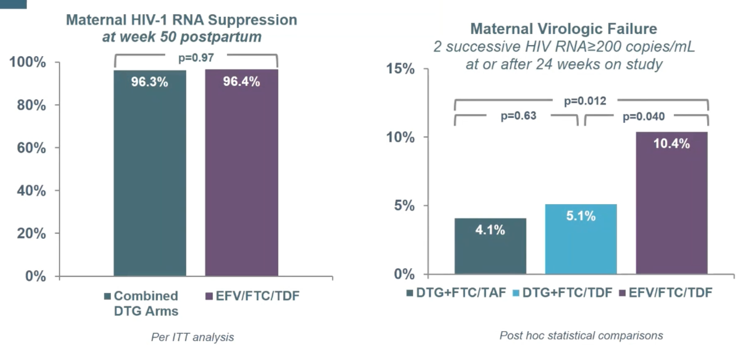
Results: IMPAACT 2010 Virologic Efficacy
Chinula L et al, Virtual CROI 2021, Abstract #177

Slide 11
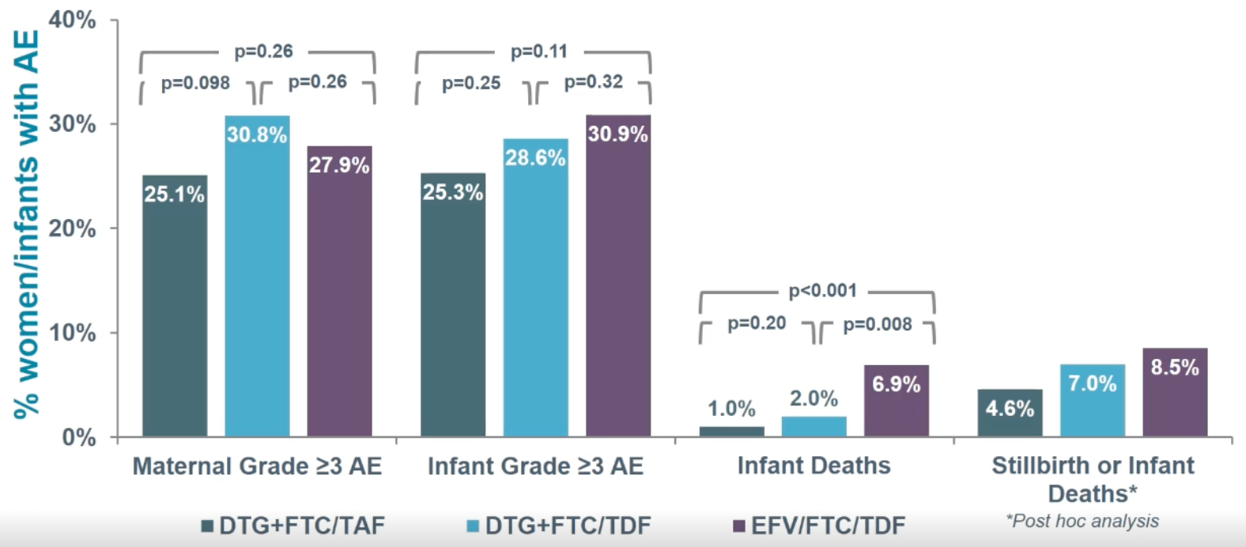
Results: IMPAACT 2010 Adverse Events
Maternal & Infant Grade 3 or Higher Adverse Events by Arm Through 50 Weeks Postpartum
Chinula L et al, Virtual CROI 2021, Abstract #177

Slide 12
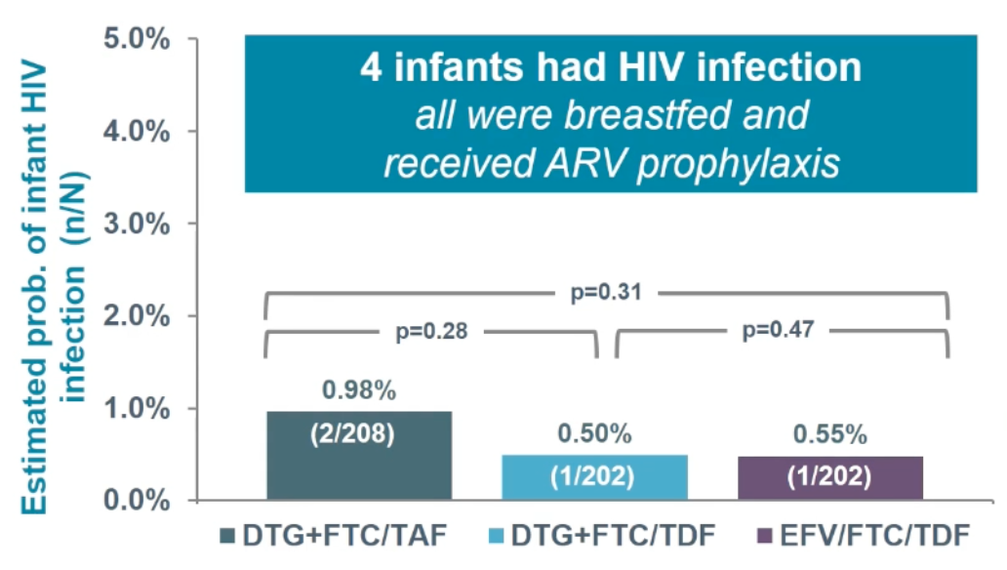
Results: IMPAACT 2010 Infant HIV Infection
Chinula L et al, Virtual CROI 2021, Abstract #177

Slide 13
Summary: IMPAACT 2010
TAF and DTG were safe through 50-week post-partum data
All regimens were safe and efficacious
  Infant mortality higher in EFV arm
  More women had virologic failure in the EFV arm
Take-Away Point: This provides additional reassuring data about DTG and TAF use in pregnancy and post-partum
Chinula L et al, Virtual CROI 2021, Abstract #177

Slide 14
Update from ATLAS-2M

Slide 15
Background: ATLAS-2M
ATLAS (CROI 2019): CAB/RPV IM q4w in treatment-experienced PWH was non-inferior to standard PO ART
  3 virologic failures occurred
ATLAS-2M (CROI 2020): CAB/RPV IM q8w in treatment-experienced PWH was non-inferior to q4w at 48 weeks
  Participants preferred q8w dosing
  10 virologic failures occurred (8 in q8w arm, 2 in q4w arm) and failed with both NNRTI and INSTI RAMs
Overton E et al, CROI 2020, Abstract #34.

Slide 16
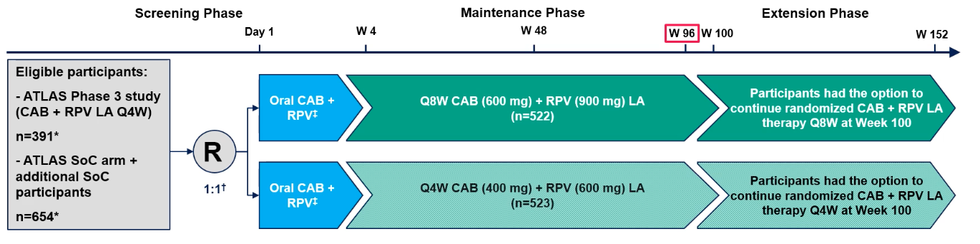
Study Design: ATLAS-2M
Primary Endpoint: Proportion of participants with HIV RNA ≥ 50 at week 48
Other Endpoints: Incidence of confirmed virologic failure (VF), incidence of viral resistance in participants with confirmed VF, safety and tolerability
Jaeger H et al, Virtual CROI 2021, Abstract #401

Slide 17
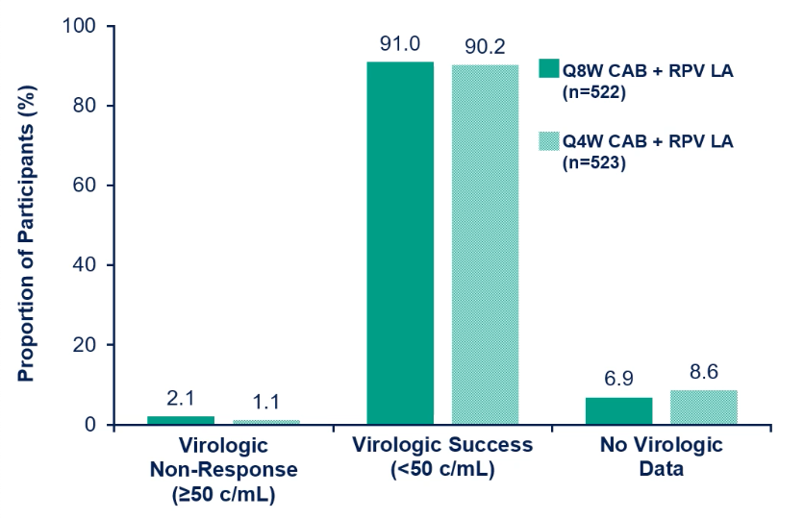
Results: ATLAS-2M 96 Week Data
Jaeger H et al, Virtual CROI 2021, Abstract #401

Slide 18
Results: ATLAS-2M Adverse Effects
Table adapted from Jaeger H et al:
 | Q8W n = 522 n (%) | Q4W n = 523 n (%)
Any adverse event (AE) | 488 (93) | 499 (95)
AE leading to withdrawal | 18 (3) | 19 (4)
# of injections | 12,832 | 23,855
Injection site reaction (ISR) events | 3400 | 4157
ISR pain | 2662 (21) | 3295 (14)
ISR nodule | 188 (1) | 297 (1)
ISR discomfort | 134 (1) | 148 (<1)
Median duration, days (IQR) | 3 (2,5) | 3 (2,5)
Participants withdrawing for injection-related reasons | 7 (1) | 11 (2)
Jaeger H et al, Virtual CROI 2021, Abstract #401

Slide 19
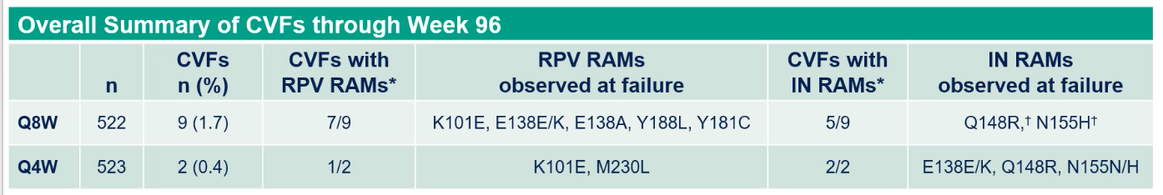
Results: ATLAS-2M Resistance
Key Points About Resistance:
Total VFs from ATLAS-2M = 11 (9 in q8w arm, 2 in q4w arm)
One additional VF occurred between weeks 48 and 96 in the q8w arm
  K103N and Y181C detected at VF & retrospectively at baseline in PBMC
  No INSTI RAMs present at VF or baseline, though substitution L74I was present at baseline
10/11 with confirmed VF resuppressed on an alternative regimen
All with confirmed VF retained DTG susceptibility
Jaeger H et al, Virtual CROI 2021, Abstract #401

Slide 20
Summary: ATLAS-2M 96-Week Data
Virologic efficacy, adverse events, and injection site reactions were similar in IM CAB/RPV q8w and q4w arms
Confirmed VF occurred in 11 total PWH
  9 in the q8w arm, 2 in the q4w arm
Most PWH with VF acquired both NNRTI and INSTI RAMs
Take-Away Point: Q8W dosing of CAB/RPV is effective and there are few VFs, but with failure, RAMs occurred
Jaeger H et al, Virtual CROI 2021, Abstract #401

Slide 21
Lenacapavir: Capella Study

Slide 22
Background: Lenacapavir
Novel HIV-1 capsid inhibitor formerly known as GS-6207 that can be given as a long-acting subcutaneous injection
Currently in development as a component of long-acting therapy for HIV-1
Has activity in NRTI, NNRTI, INSTI, and PI-resistant HIV-1
Segal-Maurer S et al, Virtual CROI 2021, Abstract #127

Slide 23
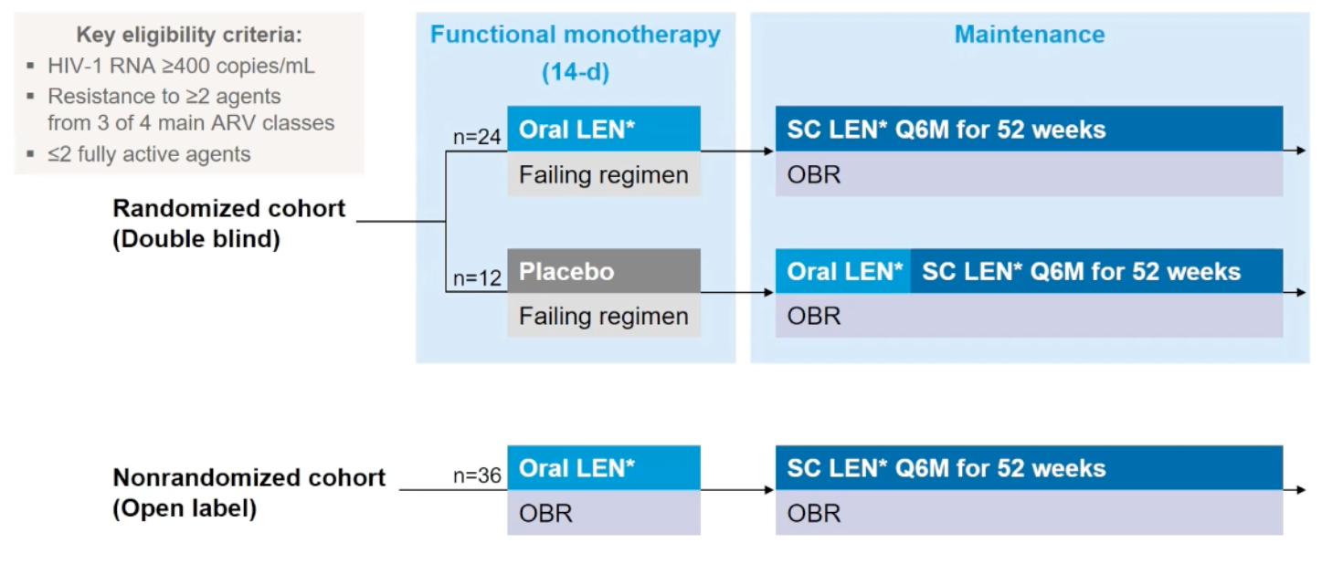
Study Design: Lenacapavir in MDR HIV-1
Segal-Maurer S et al, Virtual CROI 2021, Abstract #127

Slide 24
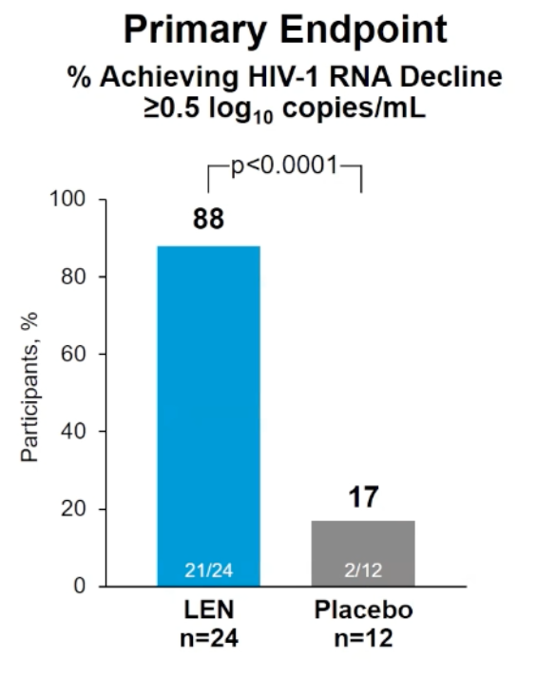
Results: Lenacapavir in MDR HIV-1
Participant Characteristics:
Median age: 52
Median CD4 cell count: 150 cells/mm³
Median number of prior ARV regimens: 11
Median years since HIV diagnosis: 24
Segal-Maurer S et al, Virtual CROI 2021, Abstract #127

Slide 25
Summary: Lenacapavir in MDR HIV-1
In the Capella study, early data shows that use of lenacapavir demonstrated antiviral activity against MDR HIV after 14 days and led to virologic suppression when paired with an OBR
Take-Away Point: Although much more data is needed, lenacapavir has the potential to become an important tool against MDR HIV in heavily treatment experienced PWH
Segal-Maurer S et al, Virtual CROI 2021, Abstract #127

Slide 26
ART Conclusions from Virtual CROI 2021
IMPAACT 2010: Data at 50 weeks post-partum show that TDF/FTC + DTG, TAF/FTC + DTG, and TDF/FTC/EFV are safe ART options during pregnancy and in the post-partum period
ATLAS-2M: Data at 96 weeks demonstrated virologic efficacy and safety of CAB/RPV IM q8w dosing, as compared to q4w dosing, with 11 total VFs
Capella Study: Early data of lenacapavir, a novel capsid inhibitor that can be administered in a long-acting fashion, demonstrated antiviral activity against MDR HIV
Chinula L et al, Virtual CROI 2021, Abstract #177; Jaeger H et al, Virtual CROI 2021, Abstract #401; Segal-Maurer S et al, Virtual CROI 2021, Abstract #127

Slide 28
ACC: vCROI Update
HIV Epidemiology and Transmission
ACC UPDATE
Ruanne V. Barnabas, MBChB, MSc, DPhil
University of Washington, Seattle, WA, USA
Regeneron Pharmaceuticals

Slide 29
Outline
Addressing gaps to eliminate disparities in access to HIV Treatment and Prevention
HIV Epidemiology
  Race and COVID-19 infection rates among people living with HIV in the US
HIV Transmission
  HIV Prevention
    Oral PrEP on Demand
    Long-acting injectable PrEP
Delivery of HIV Care during COVID-19
Lots of exciting work!

Slide 30
Racial Differences in COVID-19 Infection Rates Among PWH in the United States
Islam. CROI 2021. Abstr 141.

Slide 31

Race and COVID-19 Infection Rates Among People living with HIV: Background
Racial minorities disproportionately affected by COVID-19 and HIV^{[1,2]}
  HIV: Black MSM had the highest number of new HIV diagnoses in 2018, followed by Hispanic MSM, then White MSM
  COVID-19: Highest mortality rate among Blacks followed by American Indians/Alaska Natives, Hispanics/Latinos, Native Hawaiian/Pacific Islanders, Whites, and Asians
Using EMR data, this study examined racial and ethnic disparities in COVID-19 infection rates among people with and without HIV in the US National COVID Cohort Collaborative^{[3]}
1. CDC. HIV Surveillance Report. 2020;31. 2. The COVID Tracking Project. 3. Islam. CROI 2021. Abstr 141.
Slide credit: clinicaloptions.com
Notes:
MSM, men who have sex with men; People living with HIV, people with HIV.

Slide 32
Race and COVID-19 Infection Rates Among People living with HIV: COVID-19 Positivity by Race and HIV Status
60
P < 0.001
P < 0.001
50.1
44.1
Persons with HIV
Persons without HIV
40
27.9
% of COVID Positive Patients
P = 0.057
20
15.4
P = 0.844
8.6
7.5
2.4
2.4
0
Non-Hispanic
White
Non-Hispanic
Black
Hispanic
Non-Hispanic
Asian
Racial/Ethnic Categories
Islam. CROI 2021. Abstr 141. Reproduced with permission.
Slide credit: clinicaloptions.com
Notes:
NH, non-Hispanic; People living with HIV, people with HIV.

Slide 33
Race and COVID-19 Infection Rates Among People living with HIV: Odds of COVID-19 Positivity By Race/Ethnicity in People living with HIV
10
aOR: 2.18,
95% CI: 1.30-3.63
aOR: 2.17,
95% CI: 1.68-2.83
aOR: 1.59,
95% CI: 1.37-1.86
Adjusted OR (95% CI)*
1
Null value
Non-Hispanic
Black
Hispanic
Non-Hispanic
Asian
Racial/Ethnic Categories
*Reference category: non-Hispanic White; estimates adjusted for age, sex, Charlson-Deyo comorbidity score (modified to exclude HIV status).
Islam. CROI 2021. Abstr 141. Reproduced with permission.
Slide credit: clinicaloptions.com
Notes:
aOR, adjusted odds ratio; OR, odds ratio; NH, non-Hispanic; People living with HIV, people with HIV.

Slide 34
Race and COVID-19 Infection Rates Among People living with HIV: Conclusions
Racial and ethnic disparities evident among people living with HIV testing positive for COVID-19 in the US
Non-Hispanic Black, Hispanic, and non-Hispanic Asian patients with HIV more likely to contract COVID-19 vs non-Hispanic White patients
Limitations
  Data limited to US National COVID Cohort Collaborative dataset
  Racial and ethnicity data were missing from > 10% of dataset
  Sexual orientation or gender not available; birth sex was used
  Social determinants of health (eg, income, employment type, health insurance) not available
Represent structural inequities in access to health: parallels in HIV and COVID-19
Islam. CROI 2021. Abstr 141.
Slide credit: clinicaloptions.com
Notes:
People living with HIV, people with HIV.

Slide 35
DISPARITIES IN TIMELY RECEIPT OF ART PRESCRIPTION IN HIV CARE IN THE US, 2012-2018, CDC
Opportunities for outreach and innovation
What do we need to do to achieve equity?

Slide 36
Outline
Addressing gaps to eliminate disparities in access to Treatment and Prevention
HIV Epidemiology
  Race and COVID-19 infection rates among people living with HIV in the US
HIV Transmission
  HIV Prevention
    Oral PrEP on Demand
    Long-acting injectable PrEP
Delivery of HIV Care during COVID-19

Slide 37
ANRS Prévenir: High Efficacy of Daily or
On-Demand FTC/TDF PrEP Among Parisian MSM in Interim Analysis of Open-Label Prospective Cohort Study
Molina. CROI 2021. Abstr 148.

Slide 38
ANRS Prévenir: Background
ANRS IPERGAY: double-blind, randomized, placebo-controlled study showed on-demand FTC/TDF PrEP (taken before and after sex) highly effective in preventing HIV infection among MSM^{[1]}
  Relative reduction in HIV incidence with on-demand FTC/TDF vs placebo: 86% (95% CI: 40-98; P = .002)
  Relative reduction in HIV incidence during open-label extension phase: 97% (95% CI: 81-100)^{[2]}
Efficacy of on-demand PrEP in real-world settings not fully established
Current study among participants at high risk for HIV in Paris region designed to evaluate impact of on-demand and daily FTC/TDF PrEP on overall HIV incidence and HIV incidence with each dosing strategy among MSM^{[3]}
1. Molina. NEJM. 2015;373:2237. 2. Molina. Lancet HIV. 2017;4:e402. 3. Molina. CROI 2021. Abstr 148.
Slide credit: clinicaloptions.com
Notes:
FTC, emtricitabine; MSM, men who have sex with men; PrEP, pre-exposure prophylaxis; TDF, tenofovir disoproxil fumarate.

Slide 39
ANRS Prévenir: Study Design
Multicenter, open-label, prospective cohort study mainly in MSM (98.5%) from Paris
Beginning of Study
May 3, 2017
Current Analysis
Sept 20, 2020
HIV-negative adults at high risk of HIV infection with inconsistent condom use; eGFR ≥ 50 mL/min; HBsAg negative in on-demand arm
(N = 3059)*
Daily FTC/TDF PrEP†
(n = 1544)
On-Demand FTC/TDF PrEP†
(2-1-1: 2 doses before sex, 1 dose QD for 2 days after sex)
(n = 1515)
*Participants enrolled on arm of their choice with ability to switch. †Plus condoms, gels, risk reduction and adherence counseling, questionnaire on sexual behavior. Follow-up every 3 mos with STI and/or HIV testing, plasma creatinine measurement.
Primary endpoint: ≥ 15% reduction in new HIV diagnoses among MSM in Paris vs rate reported by National Surveillance network in 2016
Secondary endpoints: HIV incidence, PrEP adherence, sexual behavior, safety
Molina. CROI 2021. Abstr 148.
Slide credit: clinicaloptions.com
Notes:
eGFR, estimated glomerular filtration rate; FTC, emtricitabine; HBsAg, hepatitis B surface antigen; MSM, men who have sex with men; PrEP, pre-exposure prophylaxis; STI, sexually transmitted infection; TDF, tenofovir disoproxil fumarate.

Slide 40
ANRS Prévenir: HIV Incidence
mITT Analysis | Daily PrEP (2583.25 PYFU) | On-Demand PrEP (2553.68 PYFU) | IRR (95% CI)
HIV incidence/100 PY (95% CI) | 0.12 (0.02-0.34) | 0.12 (0.02-0.34) | 0.99 (0.13-7.38)
Global HIV incidence: 0.11/100 PY (95% CI: 0.04-0.23)
  PrEP stopped in all 6 cases of HIV infection
Mean follow-up: 22.1 mos (5633 PYFU)
Overall HIV infections averted: n = 361
  Assuming incidence of 6.6/100 PY as reported for placebo arm in ANRS IPERGAY study
Rate of study discontinuation: 14.4/100 PY
Molina. CROI 2021. Abstr 148.
Slide credit: clinicaloptions.com
Notes:
IRR, incidence rate ratio; mITT, modified intention-to-treat; PrEP, pre-exposure prophylaxis; PY, patient-years; PYFU, patient-years of follow-up.

Slide 41
ANRS Prévenir: STI Incidence
75.5
66.5
Until 2 mos before lockdown (May 2, 2017 - Jan 21, 2020)
2 mos before lockdown
(Jan 22, 2020 - Mar 16, 2020)
During lockdown
(Mar 17, 2020 - May 11, 2020
80
70
60
50
32.4
31.1
33.7
Incidence per 100 PY
37.8
40
25.3
30
13.0
15.7
11.7
10.6
7.9
20
10.8
13.4
10
8.5
0
Any STI
(P < .0001)
Chlamydia
(P < .0001)
Gonorrhea
(P < .0001)
Mycoplasma
(P = .3819)
Syphilis
(P = .1315)
Molina. CROI 2021. Abstr 148. Reproduced with permission.
Slide credit: clinicaloptions.com
Notes:
PY, patient-year; STI, sexually transmitted infection.

Slide 42
ANRS Prévenir: Conclusions
Among MSM electing to use daily or on-demand oral FTC/TDF PrEP for prevention of HIV infection:
  Both regimens highly effective for HIV prevention
    Overall HIV incidence (6 infections): 0.11/100 PY (95% CI: 0.04-0.23)
  Participants using daily FTC/TDF had more frequent sex
  Both regimens generally well tolerated with few discontinuations
  Most participants remained on study
  High incidence of STIs
Molina. CROI 2021. Abstr 148.
Slide credit: clinicaloptions.com
Notes:
FTC, emtricitabine; MSM, men who have sex with men; PrEP, pre-exposure prophylaxis; PY, patient-years; STIs, sexually transmitted diseases; TDF, tenofovir disoproxil fumarate.

Slide 43
HPTN 083: Incident Infections and Emergent Resistance in MSM and TGW Receiving Cabotegravir Long-Acting PrEP
Marzinke. CROI 2021. Abstr 153.

Slide 44
HPTN 083: Background
Efficacy of oral FTC/TDF as PrEP among MSM, TGW, and heterosexual men demonstrated across multiple placebo-controlled trials
  Reduction in HIV incidence vs placebo: daily dosing, 44% to 84%; on-demand dosing, 86%^{[1-4]}
PrEP with long-acting injectable CAB was significantly superior to daily oral FTC/TDF in reducing incident HIV infection among MSM and TGW at high risk of HIV infection in randomized phase IIb/III HPTN 083 study^{[5]}
Current report is a longitudinal analysis of HIV infections, viral load,
CAB concentrations, and emergent resistance in HPTN 083^{[6]}
1. Grant. NEJM. 2010;363:2587. 2. Thigpen. NEJM. 2012;367:423. 3. Baeten. NEJM. 2012;367:399.
4. Molina. NEJM. 2015;373:2237. 5. Landovitz. AIDS 2020. Abstr OAXLB0101. 6. Marzinke. CROI 2021. Abstr 153.
Slide credit: clinicaloptions.com
Notes:
CAB, cabotegravir; FTC, emtricitabine; MSM, men who have sex with men; PrEP, pre-exposure prophylaxis; TDF, tenofovir disoproxil fumarate; TGW, transgender women.

Slide 45

HPTN 083: Study Design
International, randomized, double-blind phase IIb/III study
  At interim analysis on May 14, 2020, with 25% of endpoints accrued, DSMB recommended termination of blinded study due to crossing of prespecified O’Brien-Fleming stopping bound
Wk 5
Step 1
Step 2
Step 3
HIV-uninfected MSM and TGW aged ≥ 18 yrs at high risk of HIV infection*; no HBV/HCV infection, contraindication to gluteal injection, seizures, or gluteal tattoos/skin conditions
(N = 4566)
CAB 30 mg PO QD +
PBO PO QD
(n = 2282)
CAB LA 600 mg IM Q2M† +
PBO PO QD for ~ 3 yrs
FTC/TDF PO QD
for 1 yr
FTC/TDF PO QD +
PBO PO QD
(n = 2284)
FTC/TDF PO QD +
PBO IM Q2M†‡ for ~ 3 yrs
*Any noncondom receptive anal intercourse, > 5 partners, stimulant drug use, incident rectal or urethral STI or incident syphilis in past 6 mos; or SexPro Score ≤ 16 (US only). †First 2 doses given in Wks 5 and 9, then every 2 mos thereafter. ‡PBO for CAB injection was a 20% intralipid solution.
Primary endpoints: incident HIV infections, grade ≥ 2 clinical and laboratory events
Analysis of HIV infections in CAB arm: group A) HIV positive test at study enrollment; group B) no recent CAB exposure; group C) Infected during CAB oral lead-in period; group D) Infected in setting of on-time CAB injections
Marzinke. CROI 2021. Landovitz. AIDS 2020. Abstr OAXLB0101. Abstr 153. NCT02720094.
Slide credit: clinicaloptions.com
Notes:
CAB, cabotegravir; DSMB, data and safety monitoring board; FTC, emtricitabine; HBV, hepatitis B virus; HCV, hepatitis C virus; LA, long acting; MSM, men who have sex with men; PBO, placebo; STI, sexually transmitted infection; TDF, tenofovir disoproxil fumarate; TGW, transgender women.

Slide 46
HPTN 083: HIV Incidence
HIV Incidence
Hazard Ratio (95% CI)
1.8
39 Infections
Favors CAB
Favors FTC/TDF
1.6
1.4
1.22
1.2
3187 PY
1
0.32
HIV Incidence Rate/100 PY
12 Infections
0.8
Superiority
0.6
Non-Inferiority
0.37
0.16
0.58
0.4
3204 PY
0.2
0
CAB
n = 2241
FTC/TDF
n = 2247
0
0.75
1
1.23
2
Marzinke. CROI 2021. Abstr 153. Reproduced with permission.
Slide credit: clinicaloptions.com
Notes:
CAB, cabotegravir; FTC, emtricitabine; NI, noninferiority; PY, patient-year; TDF, tenofovir disoproxil fumarate.

Slide 47




HPTN 083: HIV Infections in Cabotegravir Arm
4 baseline and 12 incident HIV infections observed in CAB arm
A1 93%
4
A2 93%
5.7
2.9
A3 90%
5
4
A4 97%
5.4
3.6
B1 78%
5.4
9.9
37.9
20.2
10
53.1
B2 ?
5
98.4
Step 1: Oral CAB lead-in
Step 2: CAB LA 600 mg IM
Step 2: CAB LA injection > 2 week overdue
Step 3: Open-label FTC/TDF
Step 3: Overdue FTC/TDF dispensation
Annual follow-up
Percent adherence to oral lead-in
CAB LA 600 mg IM
Open-label FTC/TDF dispensed
HIV-infection
First site positive HIV test
B3 100%
5.1
6.3
6.9
6.9
31
B4 95%
5.1
3.6
8.3
6.3
11.7
13.1
9
B5 3%
5
44.9
1.3
C1 96%
3.9
4
C2 98%
6.6
C3 96%
2.7
2.1
D1 100%
4.7
4
8
8
7.3
10.7
5.3
8
8
8
D2 97%
5
4
8
8
8
8
D3 97%
5.1
3.9
8
8.9
7.1
D4 90%
5
4
8
1.3
6.3
10
20
30
40
50
60
70
80
90
100
110
120
130
140
Wk
Slide credit: clinicaloptions.com
Marzinke. CROI 2021. Abstr 153. Reproduced with permission.
Notes:
CAB, cabotegravir; FTC, emtricitabine; TDF, tenofovir disoproxil fumarate.

Slide 48
HPTN 083: Conclusions
Most infections occurred in the TDF/FTC arm due to low adherence.
Suboptimal adherence observed in 37/39 incident infections in FTC/TDF arm
Of 12 incident HIV infections in CAB arm, 8 occurred due to low adherence/low conc.
4 observed in participants with on-time injections and sufficient CAB concentrations
Detection of HIV infection using standard testing algorithms delayed in patients receiving CAB LA → screen with viral load before starting CAB
INSTI resistance
  Observed upon viremic “escape” at higher CAB concentrations
  Not observed in 3 tail-phase infections or 1 tail “escape” case
  → Continue to monitor for INSTI resistance
Therefore, prompt diagnosis and initiation of ART are important to avoid resistance with CAB LA
Marzinke. CROI 2021. Abstr 153.
Slide credit: clinicaloptions.com
Notes:
CAB, cabotegravir; FTC, emtricitabine; LA, long acting; TDF, tenofovir disoproxil fumarate.

Slide 49
Outline
Addressing gaps to eliminate disparities in access to Treatment and Prevention
HIV Epidemiology
  Race and COVID-19 infection rates among people living with HIV in the US
HIV Transmission
  HIV Prevention
    Oral PrEP on Demand
    Long-acting injectable PrEP
Delivery of HIV Care during COVID-19
Lots of exciting work!

Slide 50
ART delivery adapted to COVID-19 restrictions
RESILIENCE OF HIV ACTIVITIES DURING COVID-19 PANDEMIC AT HEALTH FACILITIES IN AFRICA (ICAP)
Large study
COVID-19 pandemic acceleration from Q2 to Q3,
# HIV tested decreased along with declines in number of HIV+ persons identified and new ART initiations
Rebound was brisk as the pandemic progressed (Q4), demonstrating HIV program resilience.
The # on ART, VL testing and VLS continued to increase throughout the period.
This may have been, in part, due to recent expansions of non-HF-based differentiated service delivery models that include more diverse groups.

Slide 51
Deliver Health Study: Design
People living with HIV
Not on ART or Currently on ART
Clinically stable
Clinic group
Home delivery
ART initiation/
continuation
Clinic
Home
ART monitoring & resupply
Clinic
Home
One-time fee for home delivery was tiered based on participant income (ZAR 30, 60, and 90; ~$2, 4, 6).
Outcomes: Payment of fee, acceptability, viral suppression (<20 copies/mL)

Slide 52
Secondary objective results: Viral suppression
Overall
Home ART vs Clinic
RR = 1.21 (1.02 - 1.42)
Superior
p = 0.0259
306/414
269/426
Fee for home ART delivery and monitoring increased viral suppression
Clinic
Group
Home ART delivery
*Relative risks adjusted for age >30 years and gender

Slide 53




Discussion
A fee for home delivery and monitoring of ART significantly increased viral suppression – exceeding UNAIDS goal
Home ART was highly acceptable in the context of low income and high unemployment, and improved health outcomes as a result
Client fees may offset cost and increase treatment intention
ART dispensing and monitoring outside the clinic has the potential to simplify access for client-centered care

Slide 54
vCROI take home messages for Epi and Prevention
Disparities in access to care are opportunities for advocacy, innovation, scholarship, and collaboration
New tools will be available for HIV prevention
  Intermittent dosing for PrEP
  Long-acting injectable CAB
  OLE demonstration projects will help determine clinical guidelines
COVID-19 ART delivery and monitoring
  Could be superior to clinic based services
  Could address disparities
  Ongoing demonstration, monitoring, and evaluation will determine role of services outside the clinic

Slide 55

CROI Update:
HIV co-infections and comorbidities
Adrienne Shapiro, MD, PhD, MSc
Acting Assistant Professor, Departments of Global Health & Medicine (Division of Allergy & Infectious Diseases)
16 March 2021

Slide 56
Grant funding: Vir Biotechnology

Slide 57
HIV & COVID-19

Slide 58
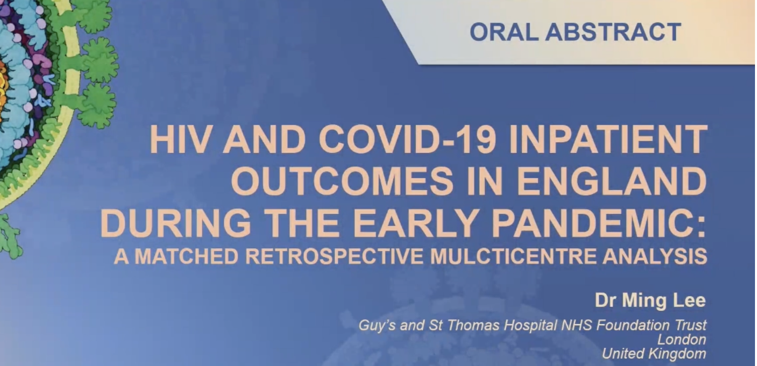
HIV & COVID-19
#142 Lee (UK): Multicenter retrospective matched cohort of PLWH hospitalized with PCR+ COVID-19 in the UK, Feb-May 2020. (N=68)
Matched up to 3:1 to persons without HIV hospitalized with COVID-19 on hospital site, gender, 5-year age band, SARS-CoV-2 test date week, socioeconomic index. (N=181)
Outcome: time to improvement or discharge
PLWH more likely to have CKD, ESRD, liver disease; less likely to have rheumatologic disease vs PLwoH
PLWH had longer time to improvement/discharge (HR 0.57, 95%CI 0.39-0.85, p=0.005) vs PLwoH in crude analysis, but attenuated difference & significance after adjusting for comorbidities, age, and race/ethnicity. (HR 0.7, 95% CI 0.43,1.17, p=0.18).
No difference in mortality seen
Conclusion: Among people hospitalized with COVID-19 in the UK, PLWH did not have significantly different outcomes vs. PLwoH after adjusting for other comorbidities

Slide 59

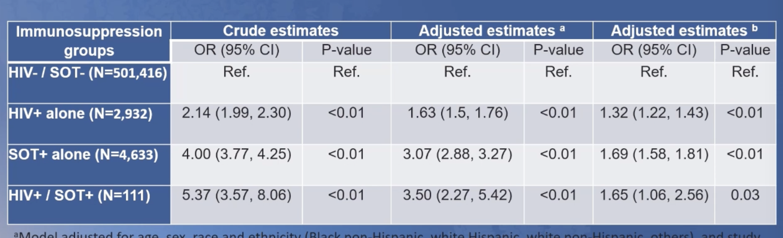
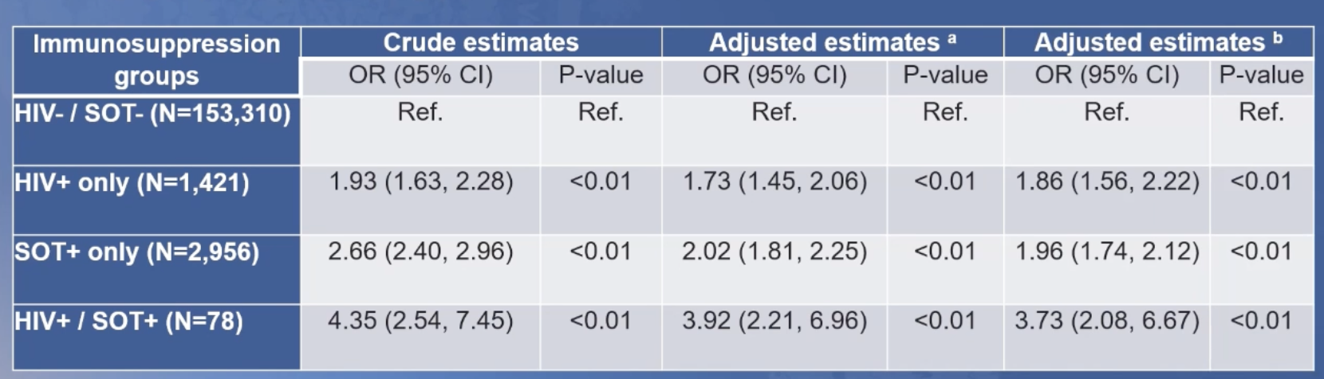
HIV & COVID-19
#103 Sun (USA): National Covid Cohort Collaborative – routinely collected clinical data from 39 centers across US. PCR+ COVID between Jan 2020-Feb 2021
Odds of hospitalization in people with immuno-suppression, defined as HIV or SOT
Odds of invasive mechanical ventilation in hospitalized patients with immuno-suppression, defined as HIV or SOT

Slide 60

HIV & COVID-19 Lightning round
# 548 Yendewa (USA): Large commercial healthcare database cohort: 297,194 COVID-19 cases, including 1638 (0.6%) PLWH (83% on ART, 48% virally suppressed). In this cohort, propensity score-matched PLWH had higher odds of hospitalization (OR 1.26; 95% CI(1.04,1.53), ICU and/or invasive mech vent (OR 1.32, 95% CI 1.10, 1.58), vs PLwoH; comparable mortality at 30d (2.9% vs 2.3% p=0.12).
# 547 Moran (USA): N=180 adults with HIV. Risk of hospitalization among PLWH with PCR+ COVID-19 is associated with # of comorbidities in a dose-dependent fashion. Age-adjusted OR for hospitalization (95% CI) of each additional comorbidity: 1.25 (1.01-1.53)
#543 Shapiro (USA): CNICS Cohort of PLWH (N=15,969); N=582 (3.6%) COVID-19 cases identified Mar-Dec 2020. Disproportionate # of COVID-19 cases in Black, Hispanic PLWH. Female, diabetes, BMI>=30 (but not CD4 count) associated with having COVID-19 among PLWH. Increased adjusted relative risk (95% CI) of hospitalization for PLWH w/ COVID-19 and:
Age >=60 | 1.78 (1.25, 2.54) | p=0.001 | ASCVD risk score | Per 10% incr 1.41 (1.25, 1.60) | p<0.001
CD4 <=350 | 2.29 (1.63, 3.22) | p<0.001 | DM2 | 1.45 (1.02, 2.06) | p=0.038
HCV | 1.53 (1.04,2.25) | p=0.03 | eGFR<60 | 2.28 (1.61, 3.24) | p=<0.001

Slide 61
TB & HIV

Slide 62
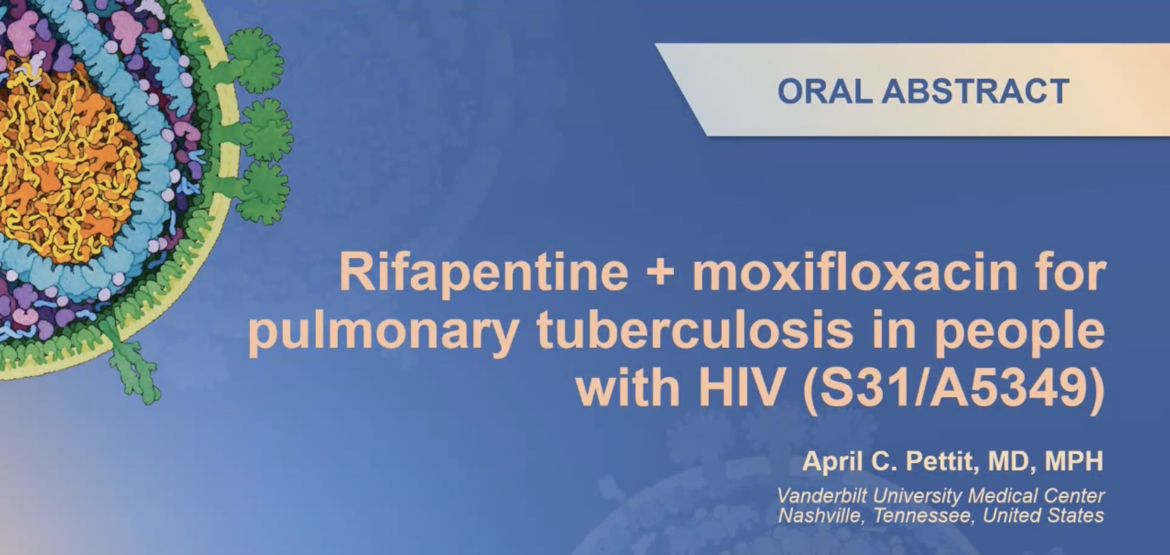
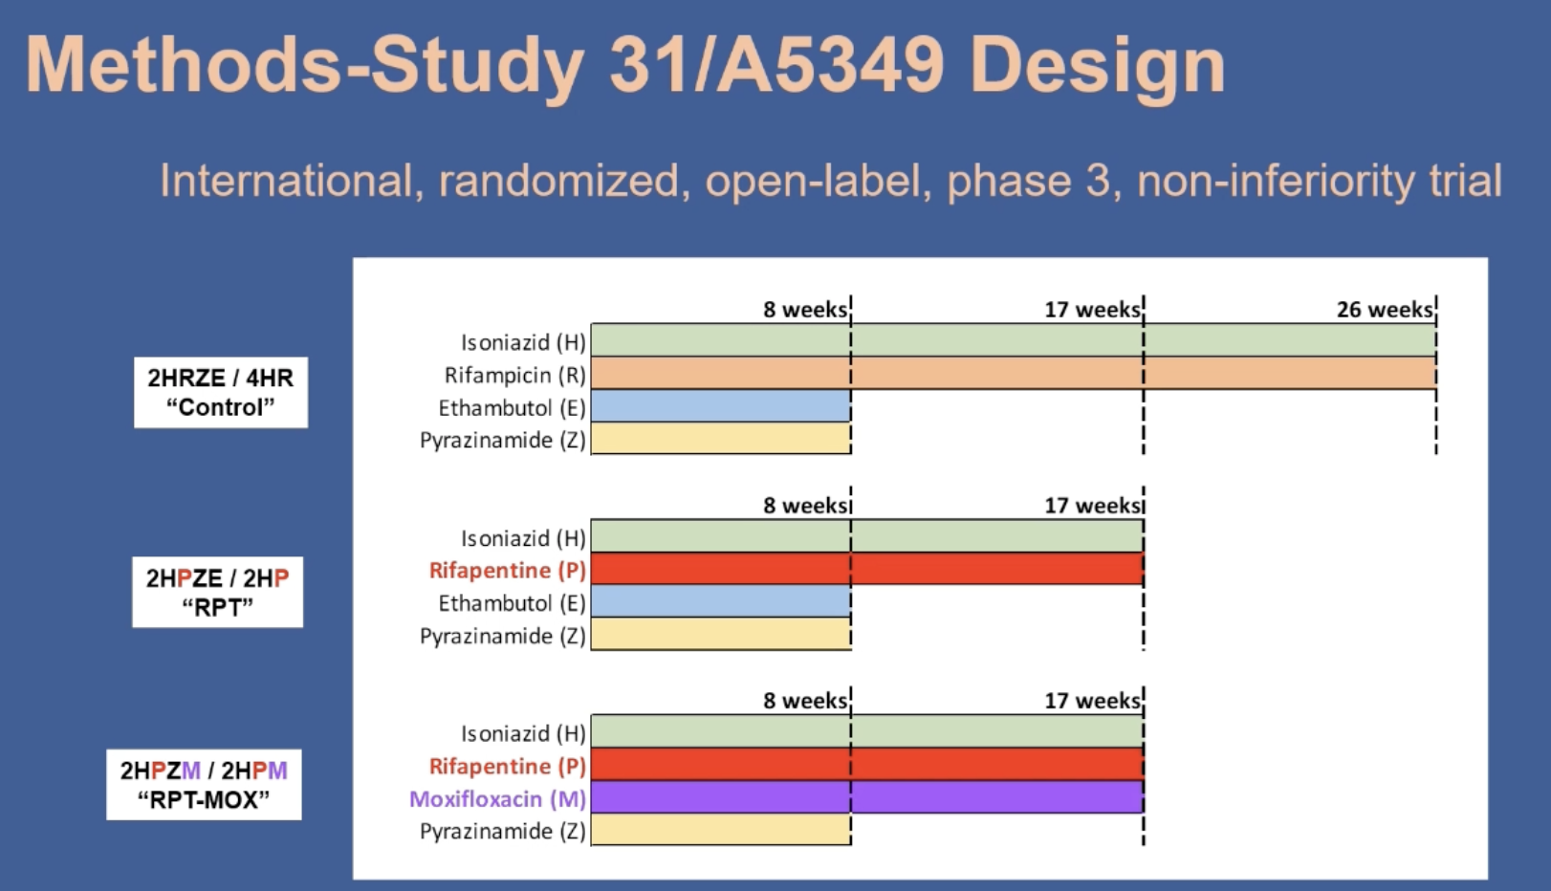
TB & HIV
Primary endpoint: TB-free survival @12M after randomization
Non-inf margin: 6.6%

Slide 63
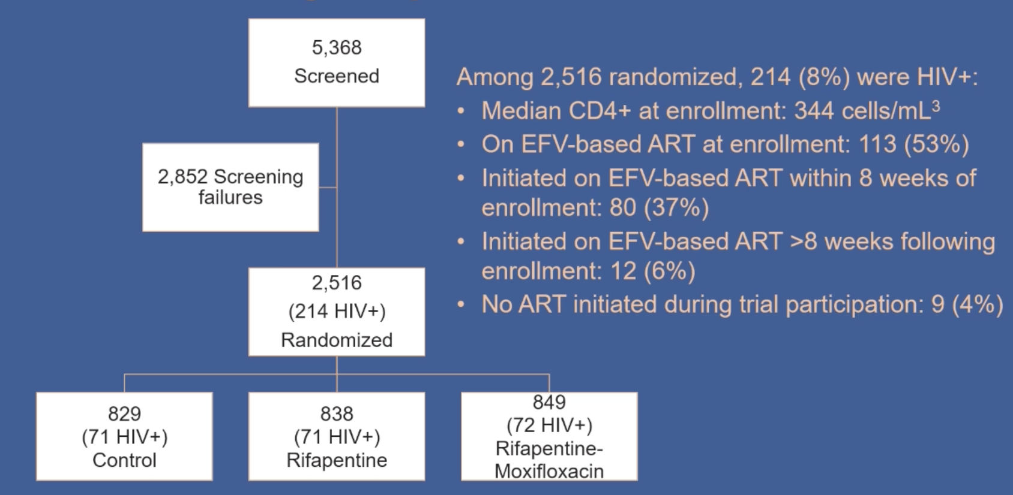
Criteria for PLWH
-CD4+ count>100 cells/mm3
-EFV-based ART
*already on EFV-based with VL <200
*starting EFV-based ART within 8 weeks of TB tx
TB & HIV

Slide 64
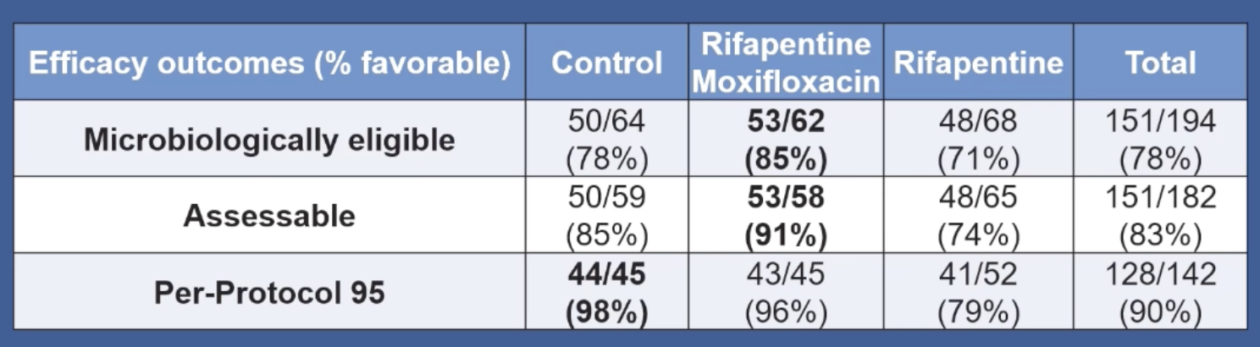
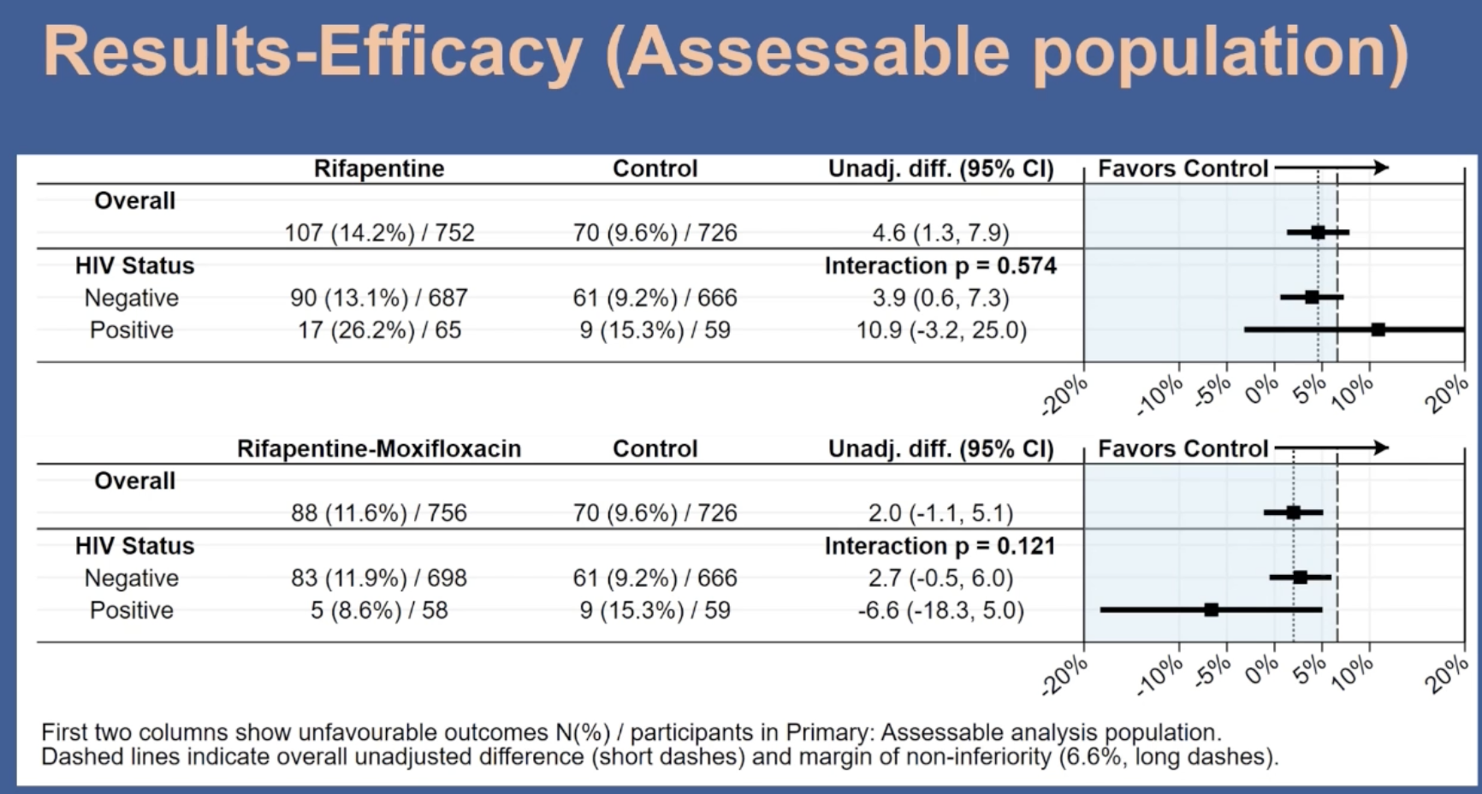
TB & HIV
4M RPT-MOXI non-inferior to 6M SOC in PLWH

Slide 65
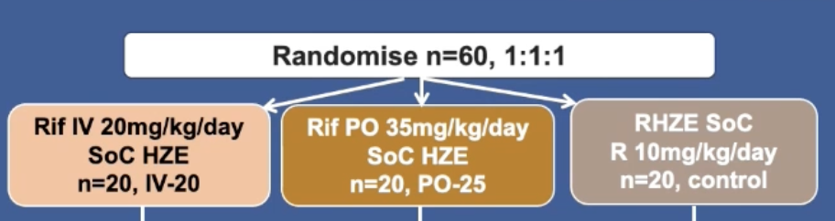

#131 Cresswell (Uganda):
Phase II TB Meningitis tx w/ high-dose RIF
-90% participants had HIV, median CD4+=50
-SOC RIF reached detectable CSF levels in <50%, vs 94% in both intensified arms
-No excess toxicity with high-dose RIF (not powered for clinical endpoints)
TB & HIV Lightning Round
#132 Sun (Taiwan): BIC/TAF/FTC with 1HP for LTBI in PLWH with VL <200
- N=50 started, 1 discontinued
-16 had VL rebound during 1HP, all re-suppressed at 3 & 6 months post-1HP
#178 Gupta (multi): Pregnancy outcomes in PLWH receiving 9M INH for prevention of TB
N=128 women with known pregnancy outcomes while on study
Increased risk of non-live birth (RR 1.92 (1.11, 3.33) and other adverse pregnancy outcome in INH-exposed 1st trimester

Slide 66
Hepatitis C

Slide 67

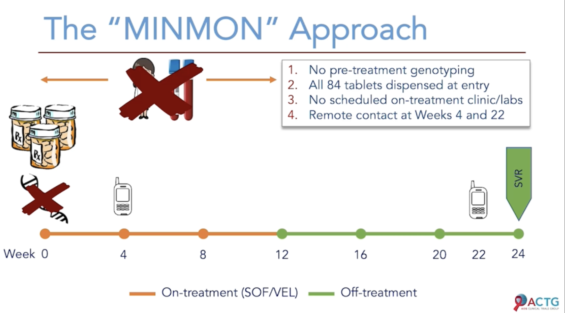
Hep C
#135
Epclusa

Slide 68
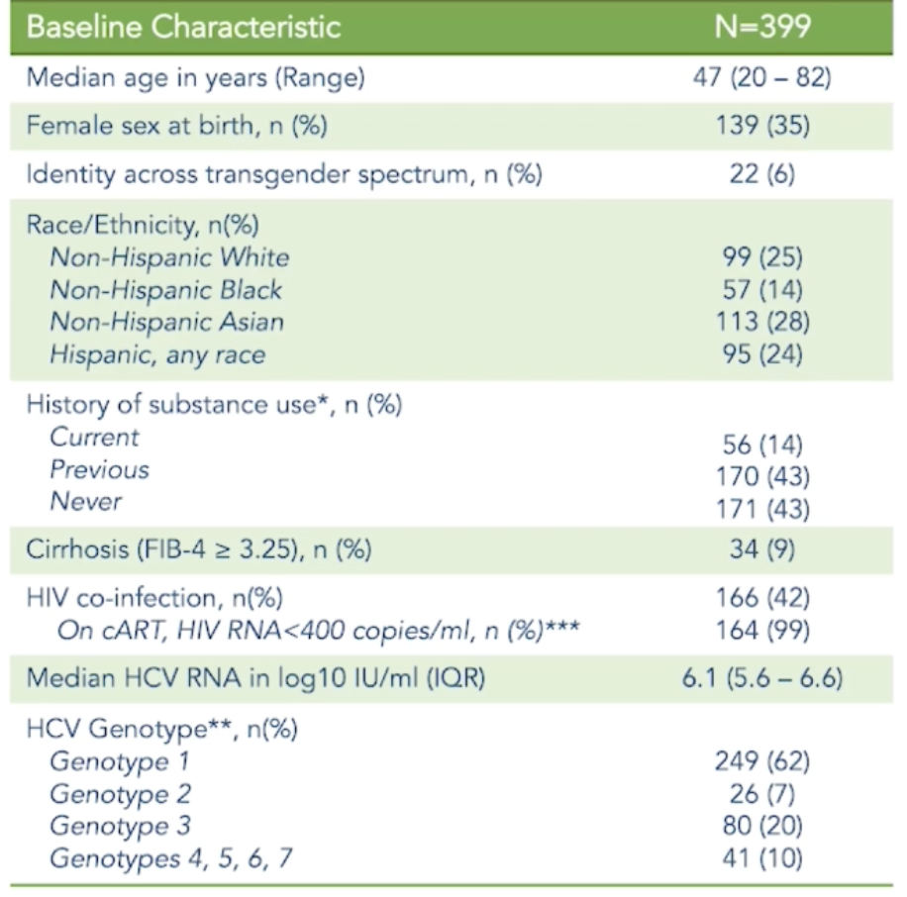
Exclusion:
De-compensated cirrhosis
Pregnancy
Chronic HBsAg+

Slide 69
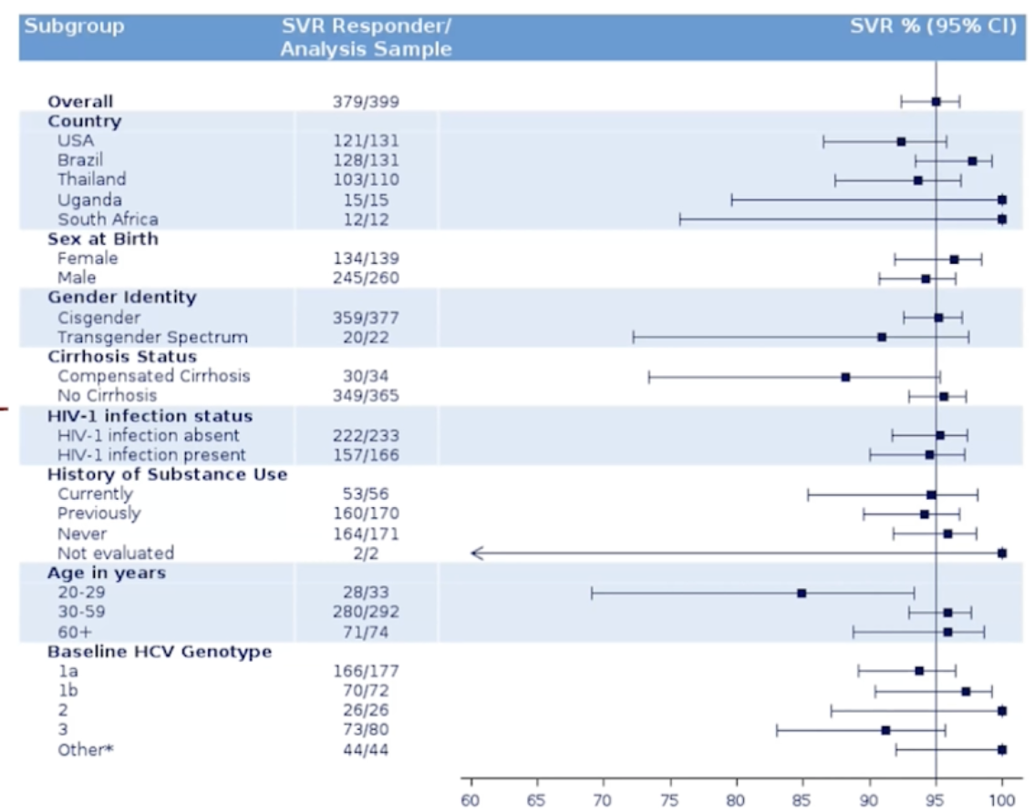
N=20 nonresponders (34% self-reported incompleted adherence)
SAE occurrence: 3.5%, none related to treatment or resulting in d/c study med

Slide 70
Multi-month dispensing, minimal-interaction HCV treatment safe and effective for treatment-naïve persons without decompensated cirrhosis
Limitations:
-No control group
-Not fully generalizable – PLWH limited to persons with VL<400 → may be more adherent
-Sequence data needed to determine non-response/relapse vs reinfection
Conclusions

Slide 71
#446 Reipold: Self-testing for HCV is acceptable and preliminarily feasible in multi-country study using an OraQuick HCV rapid antibody test.
N=775 PWID and MSM in Georgia, Kenya, Vietnam, China (unassisted ST), and gen pop in Egypt (assisted)
High acceptability (>90%) would use, variable ease of use & reliability of results.
HCV Lightning Round
#440 Martin: Cost-effectiveness modeling to determine testing frequency to achieve HCV elimination in MSM in the US (90% reduction in incidence by 2030):
q6M for MSM with HIV; annually for MSM using PrEP; at time of HIV testing for non-PrEP-using MSM
Modestly Increased frequency vs CDC/IDSA/AASLD guidelines
ICER: $35,000/QALY gained (WTP $100,000/QALY gained)

Slide 72
HIV & Malignancies

Slide 73
# 478 Sigel : VACS cohort analysis: No increased risk of toxicities/side effects in PLWH receiving chemo or XRT for lung cancer (stage I-III) vs PLwoH
#471 Chiao: In a cohort of male US Veterans with well-controlled HIV (N=25,088), colorectal cancer risk (total cases 105) was decreased (HR, 0.60; 95% CI, 0.36-1.00) in persons with a statin use history (vs never stains) and increased in persons with diabetes (HR, 1.57; 95% CI, 1.00-2.48). Lower nadir CD4 also associated with increased risk.
#473 Weiss: In a cohort of N=144 cis WLH screened for anal cancer and cervical HPV, 31% had bx-proven anal HSIL, anal HPV more common than cervical; high-risk HPV types not concordant between anal and cervical sites.
HIV & Malignancies Lightning Round

