Slide 1
Project ECHO® - UNM
HIV TeleECHO Clinic
Breastfeeding in HIV
August 17, 2021
Monica Douglas, PharmD
PGY-2 Pharmacy Resident, UNM Truman Health Services

Slide 2
Conflict of Interest Disclosure Statement
Speaker has nothing to disclose.
This presentation was reviewed by UNMHSC and SCAETC faculty to ensure it meets Continuing Education guidelines.
This project is supported by the Health Resources and Services Administration (HRSA) of the U.S. Department of Health and Human Services (HHS). Under grant number U1OHA33225 (South Central AIDS Education and Training Center). It was awarded to the University of New Mexico. No percentage of this project was financed with non-governmental sources. This information or content and conclusions are those of the authors and should not be construed as the official position or policy of, nor should any endorsements be inferred by HRSA, HHS, or the U.S. Government.

Slide 3
Learning Objectives
Describe the risk of HIV transmission via breastmilk
Recognize factors influencing decisions to breastfeed and recommendations for women with HIV
Identify risk reduction strategies in women with HIV who choose to breastfeeding

Slide 4
Breastfeeding in HIV
Breastfeeding contributes to risk of perinatal HIV transmission
Risk of transmission from breastfeeding is 15-20% over 2 years
Without maternal antiretroviral therapy (ART) and infant antiretrovirals (ARV)
Effective ART significantly reduces, but does not eliminate the risk of transmission via breastmilk
PROMISE Trial
HPTN 046 Study
DHHS HIV Perinatal Guidelines 2021.
Nduati R. JAMA 2000; 283(9): 1167-74.

Slide 5
DHHS Guidelines: Counseling and Managing Women with HIV in the United States Who Desire to Breastfeed
Breastfeeding is NOT recommended for women with HIV in the United States
Maternal ART does not eliminate risk of transmission via breast milk
Feeding alternatives readily available
Lack of safety data
Medication adherence challenges postpartum
29% of providers (n=93) reported caring for a patient who breastfed despite recommendation
DHHS HIV Perinatal Guidelines 2021.
Tuthill EL. J Int AIDS Soc. 2019; 22(1):e25224.

Slide 6
WHO Guidelines: Consolidated guidelines on HIV prevention, testing, treatment, service delivery and monitoring
Mothers with HIV should breastfeed for at least 12 months and may continue for up to 24 months or longer while being fully supported for ART adherence
Most effective way to reduce transmission is to reduce maternal viral load
Breastfeeding should only stop once a nutritionally adequate and safe diet can be provided
WHO HIV Guidelines 2021.

Slide 7
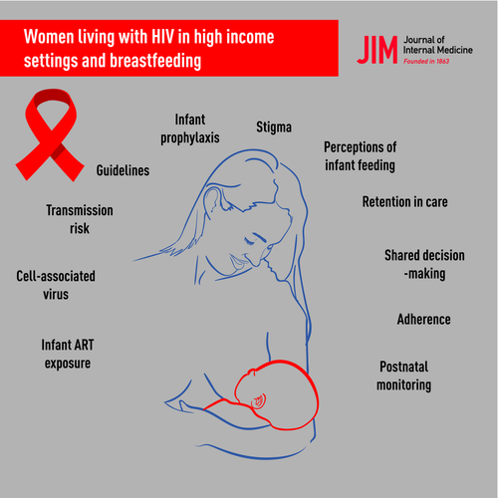
Decision to Breastfeed
Patient Considerations
Access to feeding alternatives
Social, familial, and personal pressure to breastfeed
Fear of disclosing HIV status
Moseholm E. J Intern Med. 2020; 287:19-31.
WHO HIV Guidelines 2021.

Slide 8
Decision to Breastfeed
Patient Considerations
Maternal benefits:
Promotes weight loss, decreased risk of postpartum depression, production of oxytocin and prolactin
Lowers risk for hypertension, type 2 diabetes, ovarian and breast cancer
Infant benefits:
Protection against infections and noncommunicable diseases (ex. asthma, allergies)
Improved overall survival and development
Additional benefits:
Emotional bonding, reduces food insecurity
CDC Breastfeeding 2021.
WHO HIV Guidelines 2021.

Slide 9
Decision to Breastfeed
Potential Risks
HIV transmission via breastmilk
Cell-associated viral transmission
Transmission despite undetectable plasma viral load
Drug toxicity in neonate
ARV drug resistance in neonate
DHHS HIV Perinatal Guidelines 2021.

Slide 10
HIV Transmission via Breastmilk
PROMISE Trial
Randomized, open-label strategy trial in HIV-1 infected women (not on ART) with CD4 counts ≥350 cells/mm³ and their HIV-1 uninfected newborns in 7 countries
Randomized at 6-14 days postpartum to maternal ART (mART) or infant nevirapine (iNVP) prophylaxis
Prophylaxis continued until 18 months after delivery or breastfeeding cessation, infant HIV-1 infection, or toxicity (whichever occurred first)
2431 mother-infant pairs; median CD4: 686 cells/mm³
Infant HIV-infection: 7/1219 (0.57%) in mART vs. 7/1211 (0.58%) iNVP group (HR 1.0, 96% repeated CI 0.3-3.1)
Flynn PM. J Acquir Immune Defic Syndr. 2018; 77(4):383-392.

Slide 11
HIV Transmission via Breastmilk
PROMISE Trial – Secondary Analysis
7 infant HIV-1 infections in each treatment arm
Median maternal viral load (MVL): mART 6,627 copies/mL vs. iNVP 59,816 copies/mL
Two notable cases of MVL “non-detected” or “detected but below 40 copies/mL” on same date of infant’s first positive HIV RNA
Baseline MVL and CD4 count not significantly associated with infant HIV-1 infection
Significantly associated with infant HIV-1 infection:
Time-varying MVL in mART arm (HR 13.96; 95% CI 3.12, 62.45)
Time-varying CD4 cell counts in mART arm (HR 0.18; 95% CI 0.03, 0.93)
Flynn PM. J Acquir Immune Defic Syndr. 2018; 77(4):383-392.

Slide 12
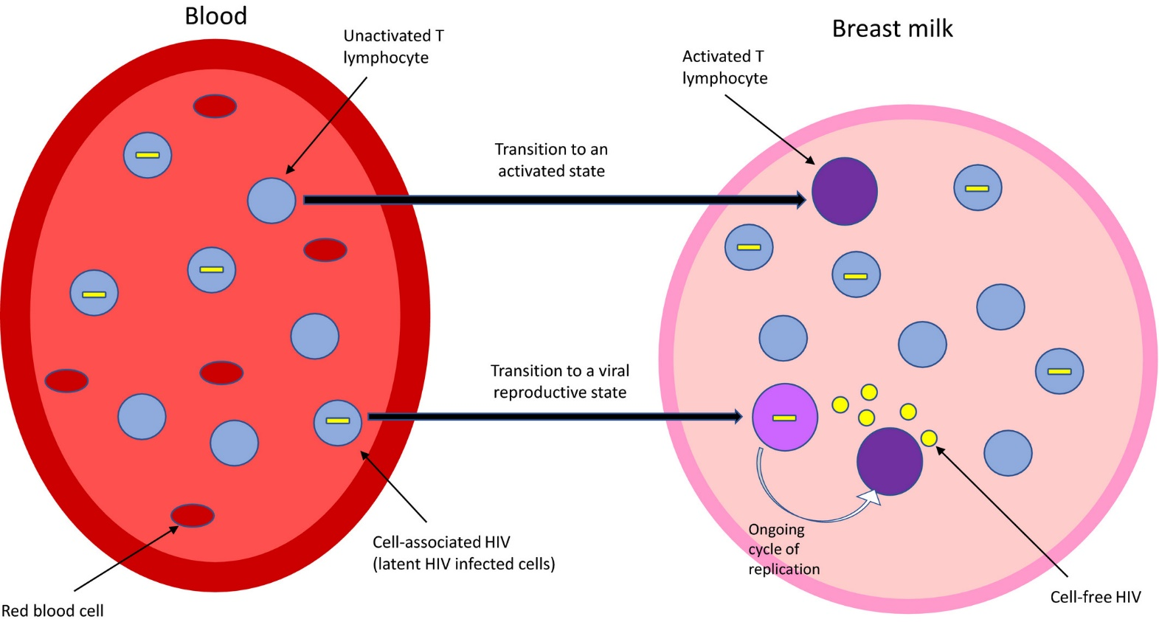
Cell-associated HIV Transmission
Cell-associated HIV: transmission via latent reservoir
Typically measured by HIV DNA
Cells become activated via extravasation or transepithelial migration
DHHS HIV Perinatal Guidelines 2021.
Moseholm E. J Intern Med. 2020; 287:19-31.

Slide 13
Safety of ARV in Neonates
Reported levels of ARVs in breastmilk lower than maternal plasma levels
BAN Study – subgroup analysis
Higher exposures of nucleoside/tide reverse transcriptase inhibitors (NRTIs)- zidovudine and lamivudine
Lower exposures of non-nucleoside/tide reverse transcriptase inhibitors (NNRTIs)- nevirapine, and protease inhibitors (PIs) - nelfinavir and lopinavir
Limited data for integrase inhibitors (INSTI) concentrations in breastmilk
Dolutegravir – 3% of plasma concentration
Davis NL. J Acquir Immune Defic Syndr. 2019; 80(4):467-473.
Waitt C. PLoS Med. 2019; 16(9):e1002895.

Slide 14
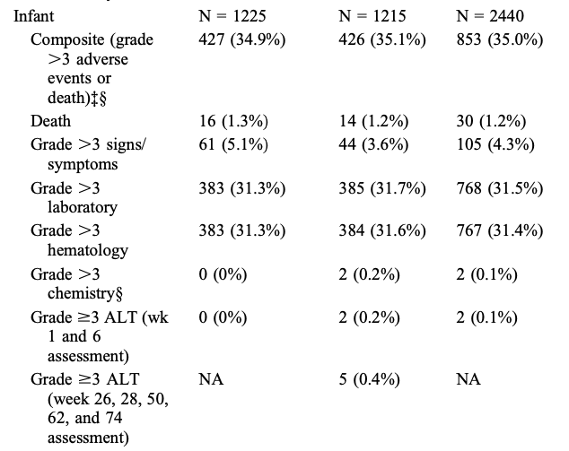
Safety of ARV in Neonates
PROMISE Trial
iNVP prophylaxis not associated with elevated infant toxicity versus mART (preferred regimen: tenofovir DF/emtricitabine + lopinavir/ritonavir)
Flynn PM. J Acquir Immune Defic Syndr. 2018; 77(4):383-392.

Slide 15
Reducing Transmission Risk:
Maternal Considerations
Support maternal ART adherence
Early identification of post-partum depression
Monitor maternal plasma viral loads every 1 to 2 months while breastfeeding
Identify and treat maternal mastitis and infant thrush
Increased risk of transmission via breastfeeding
DHHS HIV Perinatal Guidelines 2021.

Slide 16
Reducing Transmission Risk:
Neonatal Considerations
Administer at least 6 weeks of ARV prophylaxis with zidovudine and/or nevirapine (NVP) to infants
Daily nevirapine – most extensively studied prophylaxis in breastfeeding infants
HPTN 046 Trial: Evaluation of extended NVP prophylaxis (6 months)
1527 breastfeeding infants born to mothers with HIV-1 in four African countries
54% reduction in transmission at 6 months (1.1% vs. 2.4%)
Subgroup analysis of mothers on ART: transmission rate was extremely low (0% relative risk reduction)
Coovadia HM. Lancet. 2012; 379:221-8.
DHHS HIV Perinatal Guidelines 2021.

Slide 17
Additional Considerations
Exclusive breastfeeding vs. mixed feeding
Exclusive breastfeeding (first 6 months) associated with lower rates of transmission than mixed feeding (breast milk plus other liquid or solid foods)
Weaning
Rapid weaning (over several days) is not recommended
Potential for increased viral shedding into breast milk and an increased rate of transmission
Limitation of evidence: studies conducted prior to current ART accessibility in low-income countries
Coutsoudis A. Lancet. 1999; 354(9177):471-6.
Kuhn L. Sci Transl Med. 2013; 5(181):181ra51.

Slide 18
Supporting Informed Maternal Decisions
https://www.thewellproject.org/
https://www.llli.org/update-on-hiv-and-breastfeeding-public/
https://www.avert.org/hiv-transmission-prevention/pregnancy-childbirth-breastfeeding.

Slide 19
Conclusions
Current recommendations against breastfeeding for women with HIV are based on high availability of feeding resources in the United States
Women with HIV may choose to breastfeed for a variety of reasons
Utilizing risk reduction strategies is important to decrease risk of HIV transmission via breastmilk

Slide 20
Resources
National Clinician Consultation Center http://nccc.ucsf.edu/
HIV Management
Perinatal HIV
HIV PrEP
HIV PEP line
HCV Management
Substance Use Management
Present case on ECHO http://echo.unm.edu hivecho@salud.unm.edu
AETC National HIV Curriculum https://aidsetc.org/nhc
AETC National Coordinating Resource Center https://targethiv.org/library/aetc-national-coordinating-resource-center-0
Additional trainings scaetcecho@salud.unm.edu
www.scaetc.org
Notes:
Find additional TeleECHO sessions in your area: https://echo.unm.edu/locations-2/echo-hubs-superhubs-united-states/
https://hsc.unm.edu/echo/get-involved/join-an-echo/
IDEA Platform: Infectious Diseases Education & Assessment. https://idea.medicine.uw.edu/
AETC National HIV Curriculum: 6 core modules for self study; regularly updated; CME, CNE
Hepatitis C Online Curriculum: https://www.hepatitisc.uw.edu/
Hepatitis B Online Curriculum: https://www.hepatitisb.uw.edu/
National STD Curriculum: https://www.std.uw.edu/

Slide 21
References
DHHS HIV Perinatal Guidelines 2021.
Nduati R. JAMA 2000; 283(9): 1167-74.
Tuthill EL. J Int AIDS Soc. 2019; 22(1):e25224.
WHO HIV Guidelines 2021.
CDC Breastfeeding 2021.
Moseholm E. J Intern Med. 2020; 287:19-31.
Flynn PM. J Acquir Immune Defic Syndr. 2018; 77(4):383-392.
Davis NL. J Acquir Immune Defic Syndr. 2019; 80(4):467-473.
Waitt C. PLoS Med. 2019; 16(9):e1002895.
Coovadia HM. Lancet. 2012; 379:221-8.
Coutsoudis A. Lancet. 1999; 354(9177):471-6.
Kuhn L. Sci Transl Med. 2013; 5(181):181ra51.

