Slide 1
The Role of Primary Care in Addressing HIV and COVID Health Disparities
Deborah Morris-Harris MD
Chief Medical Officer, Prism Health North Texas
Clinical Director, SCAETC PHNTX Regional Partner
Notes:
Version date_ 06 2021
UTMB conference

Slide 2
Conflict of Interest Disclosure Statement
No conflicts of interest or financial disclosures
No discussion of off label use of medications or devices
This project is supported by the Health Resources and Services Administration (HRSA) of the U.S. Department of Health and Human Services (HHS). Under grant number U1OHA33225 (South Central AIDS Education and Training Center). It was awarded to the University of New Mexico. No percentage of this project was financed with non-governmental sources. This information or content and conclusions are those of the authors and should not be construed as the official position or policy of, nor should any endorsements be inferred by HRSA, HHS, or the U.S. Government.

Slide 3
Learning Objectives
Define primary care and its goals.
Discuss Patient Centered Medical Home (PCMH) as a best practice for the delivery of primary care.
Discuss the function of PCMH in addressing health care disparities.
Examine PCMH’s validation during the Syndemics of HIV and COVID-19.

Slide 4
Primary Care Defined
According to what became known as the Millis Commission report (1966), the primary physician will serve as the primary medical resource and counselor to an individual or a family. When a patient needs hospitalization, the services of other medical specialists, or other medical or paramedical assistance, the primary physician will see that the necessary arrangements are made, giving such responsibility to others as is appropriate, and retaining his own continuing and comprehensive responsibility (Millis, 1966, p. 37).
Notes:
Millis, J.S. The Graduate Education of Physicians. Report of the Citizens' Commission on Graduate Medical Education. Chicago: American Medical Association, 1966.

Slide 5
Primary Care and the Community
Abramson and Kark (1983) pioneered an emphasis on communities and their connections with health practitioners. They viewed community-oriented primary care (COPC) as "a strategy whereby elements of primary health care and of community medicine are systematically developed and brought together in a coordinated practice”
IOM in 1984 addressed COPC. That report described community-oriented primary care operationally as the provision of primary care services to a defined community, coupled with systematic efforts to identify and address the major health problems of that community through effective modifications in both the primary care services and other appropriate community health programs (IOM, 1984, p. 2).
Notes:
Abramson, J.H., and Kark, S.L. Community-Oriented Primary Care: Meaning and Scope. Pp. 21–59 in: Community-Oriented Primary Care—New Directions for Health Services. Washington, D.C.: National Academy Press, 1983
IOM. Community-Oriented Primary Care: A Practical Assessment . Volume I. The Committee Report. Washington, D.C.: National Academy Press, 1984.

Slide 6
The Goals of Primary Care
The primary care provider is the patient’s first and principal resource and is accessible and accountable
Care is continuous throughout the disease course and lifecycle of the patient
Care is comprehensive and includes the concerns of family members, caregivers, and the community

Slide 7
Title
A Model for Primary Care
Font 28-32
Font 24
https://www.kids-care.com/patient-centered-medical-home-pcmh/notes
https://www.foma.org/patient-centered-medical-home.html

Slide 8
Where did the Patient Centered Care concept come from?
American Academy of Pediatrics
American College of Physicians
American Osteopathic Association
American Academy of Family Physicians
First introduced by NCQA in 2008
O'Dell M. L. Missouri medicine. 2016 113(4), 301–304.
Notes:
O'Dell M. L. (2016). What is a Patient-Centered Medical Home?. Missouri medicine, 113(4), 301–304.
The Patient Centered Medical Home model grew out of pediatric practice, particularly in dealing with pediatric patients with complex needs
-originally envisioned as a source of patient information for children with complex needs as well as an attempt to coordinate care for these patients that often had multiple types of providers who were previously disconnected

Slide 9
What the Model Promises
Decreased emergency department visits
Decreased all-cause inpatient admissions
Improvements in diabetes quality measures
Higher rates of preventative health screenings
Decreased cost of care
Reduced health care disparities
The aphorism "a rising tide lifts all boats" is associated with the idea that improvements in general will benefit all participants
https://www.ncqa.org/programs/health-care-providers-practices/patient-centered-medical-home-pcmh/benefits-support/pcmh-evidence/
Notes:
Citation: National Committee for Quality Assurance Latest Evidence: Benefits of the Patient-Centered Medical Home June 2019
How do we justify the PCMH Model? How do we know it works?
We can examine data from multiple points of view; for the sake of time we will focus on these big “buckets”, but a detailed report is available on the National Committee for Quality Assurance (NCQA) Website, the latest from June 2019. The NCQA offers one of the main pathways to PCMH Certification through its PCMH Recognition Pathway
https://www.ncqa.org/wp-content/uploads/2019/09/20190926_PCMH_Evidence_Report.pdf
Has PCMH been shown to:
Decrease utilization (e.g. ED treat and release visits, hospitalization)? YES
Decrease cost? YES, demonstrated by decreased cost of care in Medicare Fee For Service patients.
Improve clinical quality? YES, via improved chronic disease management and preventive care metrics
Decrease disparities in care? YES

Slide 10
Principles of Patient Centered Care
Access Continuity
Care
Coordination
Comprehensive Team Based Care
Quality and Safety
Patient Centered Approach
Notes:
This is a brief overview of the main principle of Patient Centered Care, as agreed upon by multiple groups: American Academy of Pediatrics, American College of Physicians, American Osteopathic Association, American Academy of Family Physicians
And are required to be present in a practice looking for recognition as a PCMH by the NCQA.
Patient-centered care is a way of thinking and doing things that sees the people using health and social services as equal partners in planning, developing and monitoring care to make sure it meets their needs. It includes:
Access to care when and where the patient needs it
An ongoing relationship with a personal clinician and a care team who help provide continuous, comprehensive care
Care of all stages of life: acute care, chronic care, preventive services and end of life care
A team approach to providing for a patient’s health care needs; the team includes clinician, team members (clinical & non-clinical), and the patient/caregiver/family/ community

Slide 11
Title
Font 28-32
Font 24
Font 28-32
Font 24

Slide 12
The PCMH Care Team Interprofessional and Culturally Diverse
Provider Leadership
Nurse Coordination
Case Management Navigation
Behavioral Health Integration
Referral Specialist
ER, Hospital, Clinical Trial Networks
Continuous Quality Improvement Change Team
Engaged Patient

Slide 13
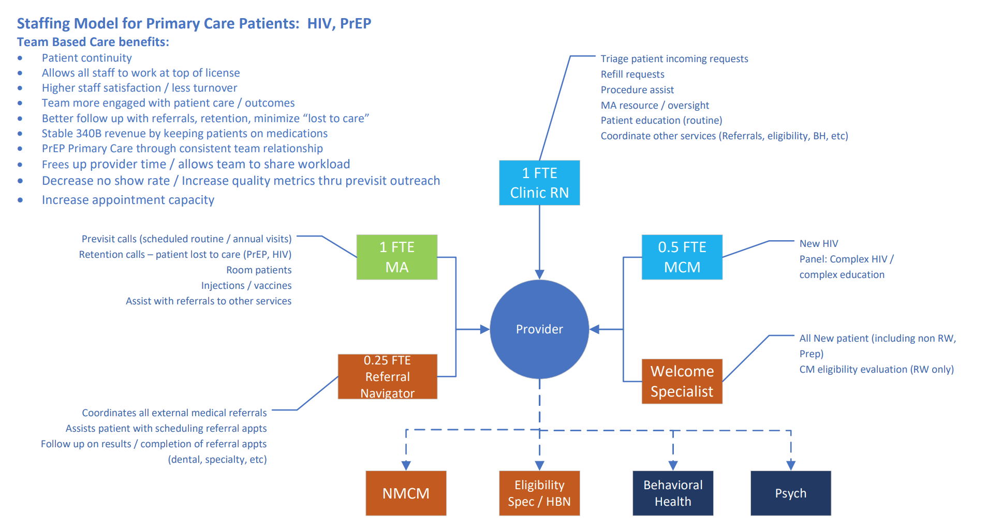
Prism Health North Texas
PCMH Model

Slide 14
Team-based care benefits
Patient continuity
Allows all staff to work at top of their license
Higher staff satisfaction, less turnover
Team more engaged with patient care outcomes
Better follow up with referrals, retention, minimize “lost to care”
Stable 340B revenue by keeping patients on medications
PrEP primary care through consistent team relationship
Frees up provider time; allows team to share workload
Decrease no show rate; increase quality metrics through pre-visit outreach
Increase appointment capacity

Slide 15
PCMH and Healthcare Disparities
PCMH’s goal is to improve healthcare outcomes for individuals and their communities
Patient-centered models co-create health by amplifying the voice of the patient and providing a safety net of high-touch teams to keep patients engaged
PCMH’s implementation strategy is one of continuous quality improvement using data driven measures, monitors, and mitigation efforts
PCMH as a model focuses on root cause analysis; strategy has potential to identify and mitigate inequities due to the social determinants of health

Slide 16
Knowing the Community
Housing- instability, household size, and density of dwellings
Employment
Transportation
Wi-fi
Cell Phones
Ventilation
Income
Racial/Ethnic Mix
Stigma

Slide 17
Resource Deserts
Dallas County
¹dallascounty.org/hhs, “About Us”
Notes:
¹dallascounty.org/hhs, “About Us”
²https://www.census.gov/data/developers/data-sets/acs-5year.html
3https://www.census.gov/quickfacts/dallascountytexas
⁴www.visitdallas.com/about/diverse-dallas/-latino.html
⁵ https://www.census.gov/quickfacts/dallascountytexas

Slide 18
Resource Deserts
Comparing social determinants of health
Characteristic | Measure | PHNTX | Dallas County
Income | Median | $9396 | $31,136²
Race | % Black | 45% | 24%³
Ethnicity | % Hispanic | 42% | 43% ⁴
Insurance | %Ryan White | 67% | 24% no insurance⁵
Number of Comorbidities | Median Index | 2 | unknown
¹dallascounty.org/hhs, “About Us” ²https://www.census.gov/data/developers/data-sets/acs-5year.html 3https://www.census.gov/quickfacts/dallascountytexas ⁴www.visitdallas.com/about/diverse-dallas/-latino.html ⁵ https://www.census.gov/quickfacts/dallascountytexas
Notes:
¹dallascounty.org/hhs, “About Us”
²https://www.census.gov/data/developers/data-sets/acs-5year.html
3https://www.census.gov/quickfacts/dallascountytexas
⁴www.visitdallas.com/about/diverse-dallas/-latino.html
⁵ https://www.census.gov/quickfacts/dallascountytexas

Slide 19
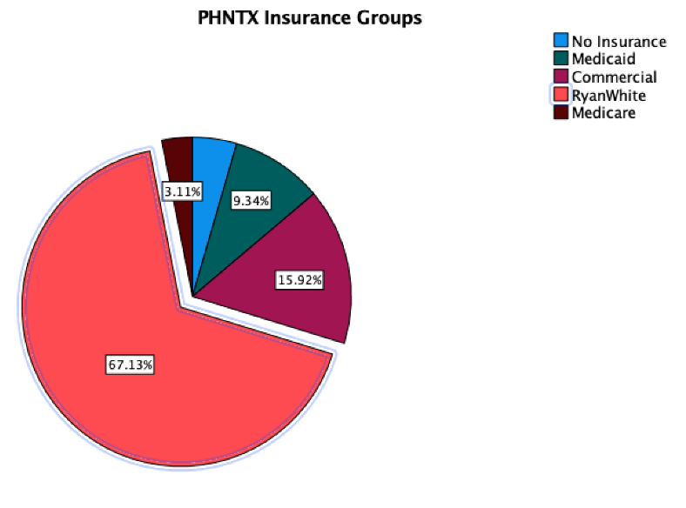
Insurers
No Insurance- 4.5%
Medicare -3.1%
Medicaid – 9.3%
Commercial – 15.2%
Ryan White – 67.1%
Notes:
PHNTX has 5 large categories of insurers:

Slide 20
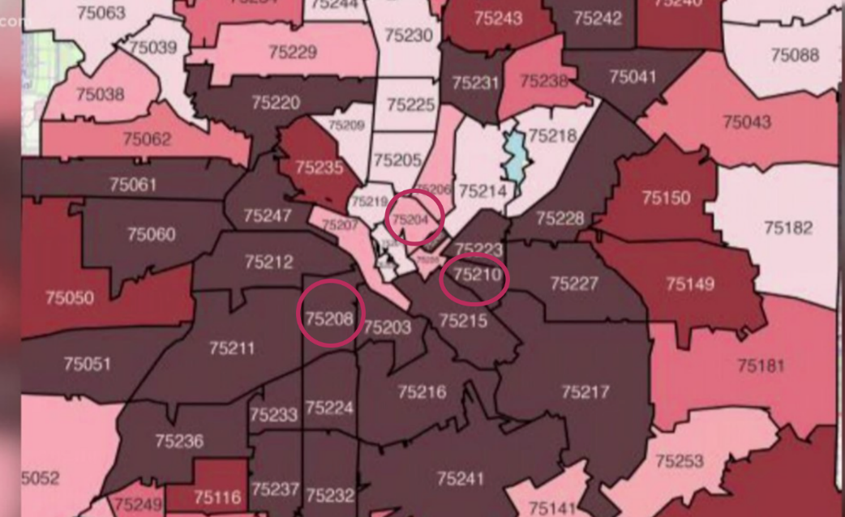
Service Area Three Well-Placed Clinic Locations
Unhealthiest Zip Codes in Dallas
New HIV Diagnoses
Clinics Located in Zip Codes: 75204, 75208, 75210
https://aidsvu.org/resources/#/
Notes:
Prism Health North Texas has three well-placed clinic locations. The clinics provide access to residents living in zip codes classified as being the unhealthiest and having the highest number of new HIV cases.
https://aidsvu.org/resources/#/

Slide 21
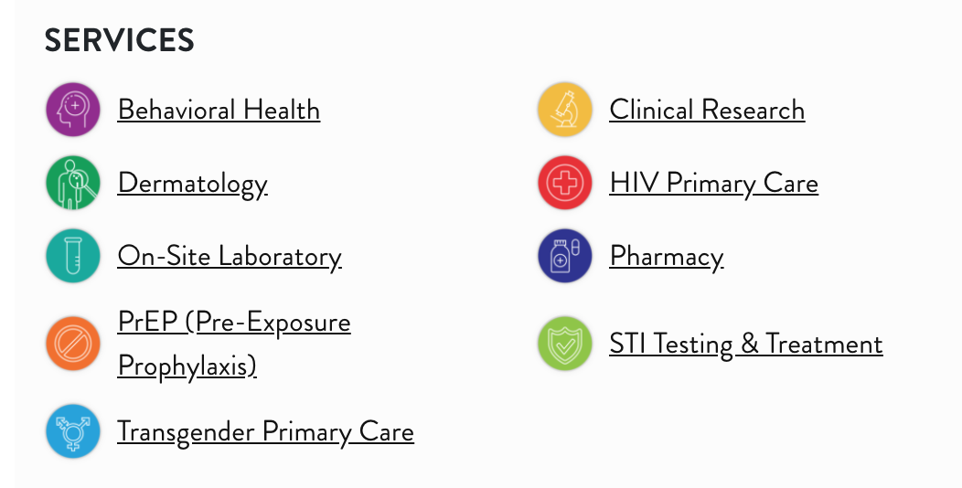
Services
Notes:
At its core, PHNTX provides adult primary HIV care including immunizations, preventative care, chronic disease management of DM and HTN, as well as wrap-around services like -dermatology, high resolution anoscopy, transgender care, substance misuse treatment, and psychiatric care, with onsite laboratories and pharmacies.
HIV prevention services ( STI testing and treatment and PrEP) are provided by CDC and state grants.

Slide 22
COVID-19 Disruption- Global and Local
Notes:
https://theconversation.com/coronavirus-mutations-what-weve-learned-so-far-145864
https://www.smithsonianmag.com/smart-news/slo-mo-video-shows-just-how-big-sneeze-clouds-can-get-180960257/

Slide 23
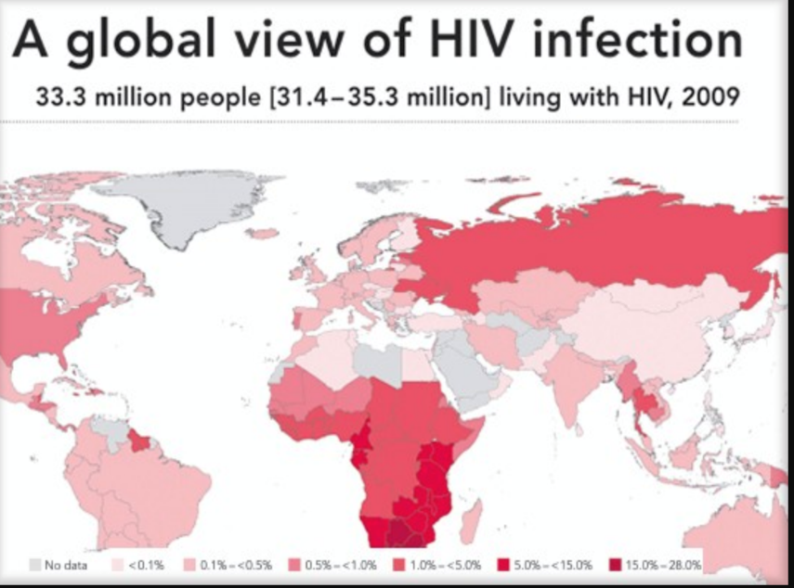
Syndemics Defined
151.6 million cases
Synergistic pandemics that contribute to an excess burden of disease in a population.
Notes:
Syndemics is a term coined by Singer in 1996. As a medical anthropologist, he observed the biopsychosocial impact of HIV/AIDS, Substance Abuse, Mental Health, and Violence on communities of color. Today there are 33 million cases of HIV worldwide; 151 million cases of COVID-19; and racism has become a global concern. These represent synergistic pandemics contributing to the excess burden of disease in marginalized populations.

Slide 24
The Digital Home
Primary Care Provider Access
Care Team Availability
Continuous Contact
Guided Self-care
Referrals and Follow-up

Slide 25
Telehealth Urgency, Challenges and Implementation
Telemedicine can be defined… as “the provision of healthcare services, through the use of ICT, in situations where the health professional and the patient are not in the same location.
It involves secure transmission of medical data and information, through text, sound, images or other forms needed for the prevention, diagnosis, treatment and follow-up of patients’’.
In response to “Shelter in Place Orders”, March 31, 2020, PHNTX launched its telehealth platform, integrated in the EMR Centricity Portal.
Challenges included- expanding bandwidth for >20 users, selecting software, purchasing tablets, web cams, and laptops. Provider training, template and protocol development, billing codes, and patient notification and training.
ICT=information communication technology; EMR=electronic medical record
Notes:
Information Communication Technology, consisting of telehealth, telephonic bidirectional documentation of patient encounters without video conferencing,
and telemedicine, providing two-way, real time interactive, audiovisual communication between the patient, and the physician or practitioner at the distant site using a hub and spoke model, was clearly the answer to maintaining patient engagement during "Shelter in Place."
On March 17th-CMS expanded telehealth benefits on a temporary and emergency basis under the 1135 waiver authority and Coronavirus Preparedness and Response Supplemental Appropriations Act.
The benefits are part of the broader effort by CMS and the White House Task Force to ensure that all Americans – particularly those at high-risk of complications from COVID-19 –were aware of easy-to-use, accessible benefits that could help keep them stay healthy while helping to contain community spread of this virus.
Reimbursement on a fee for service basis was available through the Healthcare Common Procedure Coding System
Challenges to implementation included- expanding the agency 's internet bandwidth to 1 Gigabyte for >20 users, selecting software, purchasing tablets, web cams, laptops, providing staff training, developing encounter templates and protocols. Patient notification and training followed in rapid sequence over a 10-day time period.
Implementation was successfully started on Wednesday, April 1, 2020.

Slide 26
Telehealth Appointment Types

Slide 27
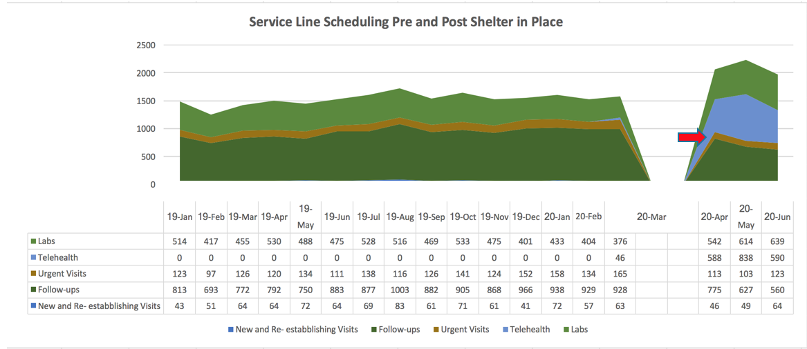
Results of Successful Telehealth Implementation
Notes:
The agency has tracked service lines including laboratory, follow-up visits, and urgent visits -pre-and post shelter in place.
The area in blue, represented by Telehealth starts abruptly in April and has quickly replaced 50% of follow-up visits.

Slide 28
Monitoring Clinic Demographics During the Pandemic
Characteristic | STI Clinic | PrEP Clinic | HIV Clinic | COVID-19 Cases Outpatient
Race
% Black 25% in Dallas | 53% | 20% | 45% | 33%
Ethnicity
% Hispanic 42% in Dallas | 30% | 45% | 42% | 60%
Age
Median (IQR) 33 in Dallas | 28 (23,36) | 31 (27,39) | 41 (32,52) | 34 (28,40)
Sex
% Female | 41% | 6% | 16% | 7%
Gender
% Trans 0.6% in US | 0.7% | 3.1% | 2%
Income
%< 100% FPL 19% in Dallas | 65% | 37% | 48% | 44%
Notes:
PHNTX serves: a disproportionate number of blacks, hispanic, trans gender and individuals earning less than 100% of the FPL. These patients have poor access to health care and distrust of most care providers.

Slide 29
No Language Disparity in Telehealth Usage
Patients Scheduled
Completed Appointments

Slide 30
Meeting the Needs- Agile Responses to Patients’ Voices
Testing
Self-care
Referral

Slide 31
2020 Outpatient Medical Service Expansions
Telehealth
Nutrition
Clinical Pharmacy
Psychiatry
Transgender Care
Anoscopy
COVID-19 Testing and Immunization
Same Day, Same Week Rapid Start

Slide 32
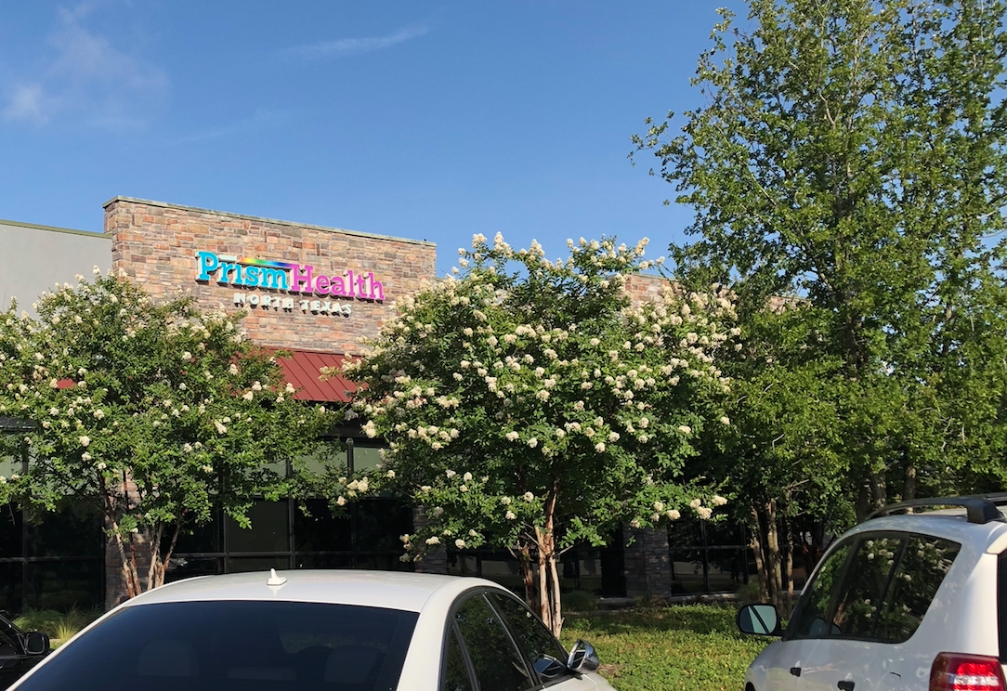
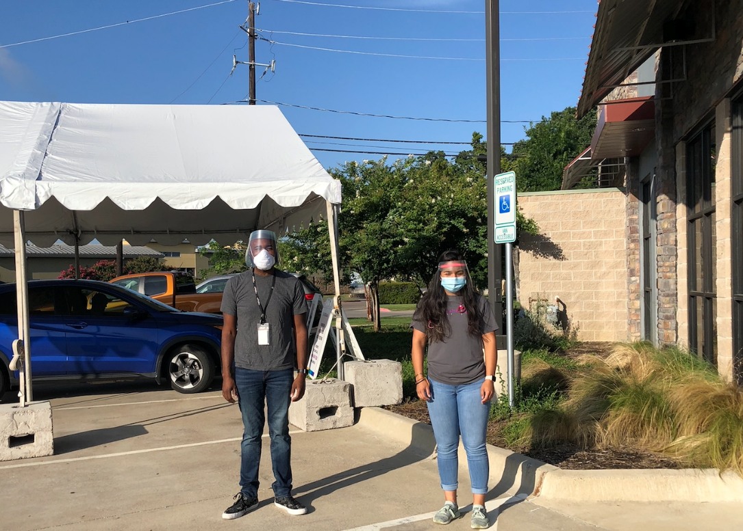
SARS-CoV-2 Testing- Convenience Coverage and Trust
Diverse and Representative Staffing

Slide 33
A Focus on Quality to Mitigate Disparities
Patient-Centered Medical Home (PCMH) Certification
Mental Health Certified Medical Home
Merit-Based Incentive Payment System Recognition, 3 years consecutively
Control of co-morbidities
HRSA’s HAB performance measures
Retention in Care
Viral Suppression
HAB= HIV/AIDS Bureau
Notes:
PHNTX was awarded ;
Patient- Centered Medical Home Certification
Mental Health Certified Medical Home
Merit-Based Incentive Payment System Recognition – 3 years consecutively
In addition, control of morbidities, retention in care and HIV viral suppression were above national benchmarks.

Slide 34
Controlling Comorbidities - HTN
The prevalence of hypertension (HTN) is increasing
30% of patients have Blood pressure (BP)>140/90
66% of patients have BP controlled by lifestyle and stepped-therapy
Notes:
Hypertension is the most prevalent co-morbid condition in our population, with 30% of patients with a BP of over 140/90. 65% of these patients are maintained at normal blood pressure readings with medications and continuous monitoring.

Slide 35
Type II Diabetes
The prevalence of Type II diabetes mellitus (DM) is increasing
9% of patients are diabetic
Control is defined as a HbA1c<9
79% of diabetic patients are controlled by lifestyle measures and intensive stepped-therapy
Notes:
Diabetes Mellitus Type II is the second most frequent co-morbidity at 9% of the HIV population; 79% of patients maintain blood sugars in an acceptable range with intensive medication therapy and diet. Recent studies suggest that some antiretroviral medications contribute to weight gain and DM in this population.

Slide 36
HRSA HIV/AIDS Bureau Performance Measures
Viral suppression
Retention in care

Slide 37
Viral Suppression at PHNTX 83-93%
Notes:
Viral Suppression requires daily adherence to antiretroviral medications, laboratory monitoring, and visits with a provider 3-4x/ year. The per cent of patients achieving this goal varies by race, ethnicity, sexual orientation, and age. Black women and youth have the lowest rates of viral suppression, but over the last two years are approaching the goal of 90% viral suppression.
A concept introduced by the United Nation’s programme on HIV/AIDS in 2013, 90-90-90 is a set of goals. The idea is that by 2020, 90% of people who are HIV infected will be diagnosed, 90% of people who are diagnosed will be on antiretroviral treatment and 90% of those who receive antiretrovirals will be virally suppressed
https://files.unaids.org/en/media/unaids/contentassets/documents/unaidspublication/2014/90-90-90_en.pdf

Slide 38
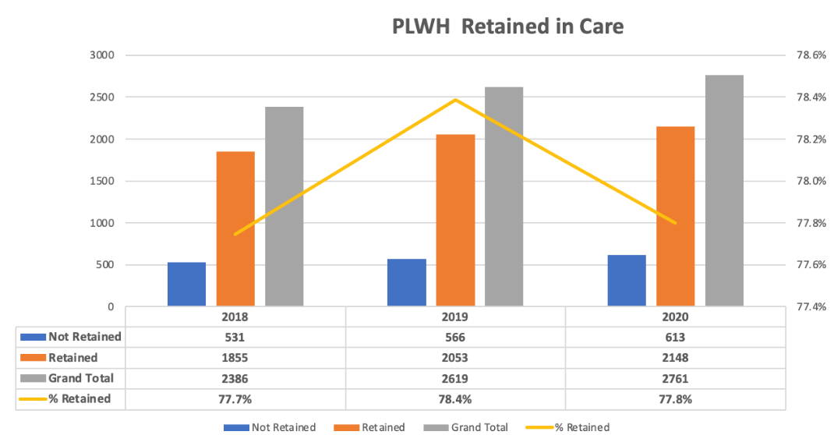
78% of PWH Retained in Care Through a Pandemic Year
PWH=people with HIV
Notes:
Retention in care requires two or more visits with a provider within 1 year, with a minimum of 60 days between visits. It is a marker for engagement. Even in a pandemic year, 78% of PHNTX patients have been retained in care

Slide 39
Disparity Groups Retained in Care
National Average
Notes:
National Average 60%; Aspiration 90% Interestingly the gaps are narrower among disparity groups with youth having the lowest retention rates.

Slide 40
Dallas County HIV Care Continuum
Notes:
Note in Dallas County those retained in care are 73% compared to PHNTX 78%; Viral Suppression at PHNTX is 89% compared to 63% for Dallas County.

Slide 41
Diagnosis and Prevention of COVID-19
841 tests were preformed
199 positive tests administered to 169 unique individuals
200 COVID-19 vaccines delivered to patients
Notes:
During the pandemic services were expanded to include centralized drive through testing and subsequently COVID-19 vaccine administration
169 unique positive patients ;

Slide 42
Disproportionate Share
National COVID-19 Disparities
PHNTX COVID-19 Disparities
Rate ratio compared to Non-Hispanic Whites | Black or African Americans | Hispanic or Latino
Cases | 1.5 | 2.1
Hospitalizations | 3x | 1
Deaths | 2x | 1
Notes:
The CDC reports the following outcomes which are age-adjusted incidence rates based on 2000 or 2010 Census data per 100,000 group members in the population
Note: Race and ethnicity are risk markers for other underlying conditions that affect health, including socioeconomic status, access to health care, and exposure to the virus related to occupation, e.g., among frontline, essential, and critical infrastructure workers
Blacks and Latinos had a nearly 3-fold age-adjusted risk of death from COVID-19.
https://www.cdc.gov/coronavirus/2019-ncov/community/health-equity/racial-ethnic-disparities/infographic-cases-hospitalization-death.html

Slide 43
PHNTX COVID-19 Outcomes
Morbidity
4 deaths (5% of admissions)
Hospital Admissions
75 (13% of ER visits)
ER Visits
578
Home Clinic
170 Unique Cases

Slide 44
Notes:
The COVID-19 tracking project revealed that the risk of hospitalization was also increased by the type and number of co-morbid conditions. HTN, DM, and obesity tripled the risk of admission, while chronic kidney disease quadrupled the risk. Three or more medical conditions increased hospitalizations by 5X.

Slide 45
Primary Care Mitigating in Hospital Death Rates
Receipt of statins (OR, 0.60; 95% CI, 0.56-0.65; P < .001), 40% reduction in death
Angiotensin-converting enzyme inhibitors (OR, 0.53; 95% CI, 0.46-0.60; P < .001), 47% reduction in death
Calcium channel blockers (OR, 0.73; 95% CI, 0.68-0.79; P < .001), 27% reduction in death
Notes:
Rosenthal and colleagues point out that negative impact of co-morbidities can be ameliorated by treatment. In hospital ( presumed continued outpatient therapy) with statins, ACE inhibitors, and calcium channel blockers was associated with a reduction in hospital mortality from 25-50%, adjusting for co-morbidity and payor source.

Slide 46
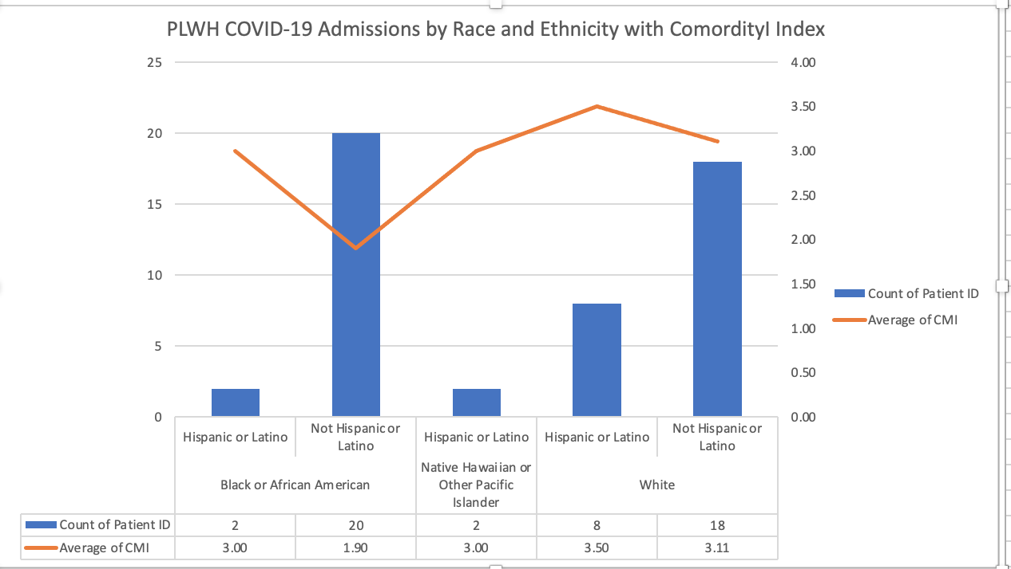
Multimorbidity and Disparate Outcomes
50 PHNTX Patients Admitted with COVID-19 and Number Comorbid Conditions Including HIV

Slide 47
Resource- Rich Primary Care Counterbalancing Disparities in Health Outcomes
Socioeconomic status
Undiagnosed/ Untreated Conditions
Knowledge Gaps
Narrow Social Networks
Leveraged State and Local Funds
Trusted Sources of diagnosis and treatment
Broad advocacy and knowledge networks
Notes:
Experience from a local Dallas Ryan White multisite clinic illustrates that a trusted source of diagnosis and treatment can leverage county, state, and federal funds to mitigate the impact of poverty, stress, narrow social networks, and untreated co-morbidities by offering testing, advocacy and referrals to outpatient clinical trials , such as bamlanivumab.

Slide 48
Primary Care Provider’s Role in Disrupting Unequal Outcomes Throughout the Continuum
Testing
Provider’s Order- Outpatient ER Inpatient
Evaluation
Admission
Treatments
Clinical Trials
ICU
Mechanical Ventilation
DNR
Discharge
Home
Hospice
LTAC
No advanced directives
Readmission
ER=emergency room; ICU=intensive care unit; DNR=do not resuscitate; LTAC=long term acute care
Notes:
Primary care providers can help to eliminate barriers at each step of the disparities continuum- ordering COVID-19 tests on outpatients, providing education regarding the need for admission, making referrals to outpatient infusion centers, working with hospitalists to continuing medications for co-morbidities shown to be protective, securing advanced directives, monitoring discharged patients and helping to prevent readmission, and finally directing patients to vaccine hubs.

Slide 49
Primary Care and PCMH Work
1 case | $ Cost of Poor Outcome
Viral Transmission | $501,000 ¹
CVD Admission for PCI | $22,058²
COVID Hospitalization <6 days | $51,389 ³
COVID-19 ER Visit in Texas | $2318⁴
Hospital Cost for Deceased Status >15 days LOS | $460,989.
COVID-19 Vaccination Prevents Outpatient Prescription Costs | $1000 ⁵
Total | $1,038,664
Reduces HIV Viral Transmission
Controls Comorbid Conditions
Reduces Hospitalizations
Reduces Length of Hospital Stay
Reduces Deaths due to COVID-19 in People with HIV
Preventing COVID-19/ Vaccination
PCMH=patient centered medical home; CVD=cardiovascular disease; PCI=percutaneous coronary intervention/angioplasty with stent; LOS=length of stay
Notes:
1 https://www.cdc.gov/nchhstp/budget/infographics/hiv.html#:~:text=CDC%E2%80%99S%20HIV%20WORK%20in%20the%20U.S.%20Saves%20Lives,cost%20to%20treat%20one%20person%20with%20HIV%20infection
2 Thirty-Day Readmission Rate and Costs After Percutaneous Coronary Intervention in the United States
Avnish Tripathi, MD, PhD, MPH, J. Dawn Abbott, MD, Gregg C. Fonarow, MD, Abdur R. Khan, MD, Neil G. Barry, IV, DO, MBA, Sohail Ikram, MD, Rita Coram, MD, Verghese Mathew, MD, Ajay J. Kirtane, MD, SM, Brahmajee K. Nallamothu, MD, MPH, Glenn A. Hirsch, MD, MHS, and Deepak L. Bhatt, MD, MPH
3 https://www.healthcarefinancenews.com/news/average-cost-hospital-care-covid-19-ranges-51000-78000-based-age#:~:text=Inpatient%20COVID%2D19%20hospitalizations%20could,%245.6%20billion%20and%20%249.9%20billion.
4 https://www.cbsnews.com/pictures/emergency-room-visit-cost-most-expensive-states/47/
5 https://healthpolicy.usc.edu/research/the-value-of-treatment-for-covid-19/
https://www.covid19treatmentguidelines.nih.gov/outpatient-management/

Slide 50
Any questions? Thank you!
Feel free to email:
Deborah Morris-Harris PhD, MD, EMBA
Deborah.Morris-Harris@PRISMNTX.org

Slide 51
Selected References
Millis, J.S. The Graduate Education of Physicians. Report of the Citizens' Commission on Graduate Medical Education. Chicago: American Medical Association, 1966.
Abramson, J.H., and Kark, S.L. Community-Oriented Primary Care: Meaning and Scope. Pp. 21–59 in: Community-Oriented Primary Care—New Directions for Health Services. Washington, D.C.: National Academy Press, 1983
IOM. Community-Oriented Primary Care: A Practical Assessment . Volume I. The Committee Report. Washington, D.C.: National Academy Press, 1984.
O'Dell M. L. (2016). What is a Patient-Centered Medical Home?. Missouri medicine, 113(4), 301–304
https://www.ncqa.org/wp-content/uploads/2019/09/20190926_PCMH_Evidence_Report.pdf
https://files.unaids.org/en/media/unaids/contentassets/documents/unaidspublication/2014/90-90-90_en.pdf
Geehan Suleyman, MD, MLS; Raef A. Fadel, DO; Kelly M. Malette, MD et.al. Clinical Characteristics and Morbidity Associated With Coronavirus Disease 2019 in a Series of Patients in Metropolitan Detroit. JAMA Network Open. 2020;3(6):e2012270. doi:10.1001/jamanetworkopen.2020.12270 **12.
Price-Haywood EG, Burton J, Fort D, Seoane L. Hospitalization and mortality among black patients and white patients with COVID-19. N Engl J Med. 2020;382(26):2534-2543. doi:10.1056/NEJMsa2011686
Ogedegbe G, Ravenell J, Adhikari et.al.,Assessment of Racial/Ethnic Disparities in Hospitalization and Mortality in Patients With COVID-19 in New York City, JAMA Network Open. 2020;3(12):e2026881. doi:10.1001
Azar KMJ, Shen Z, Romanelli RJ, et al. Disparities in outcomes among COVID-19 patients in a large health care system in California. Health Aff (Millwood). 2020;39(7):1253-1262. doi:10.1377

Slide 52
Resources
National Clinical Consultation Center http://nccc.ucsf.edu/
HIV Management
Perinatal HIV
HIV PrEP
HIV PEP line
HCV Management
Substance Use Management
Present case on ECHO http://echo.unm.edu
AETC National HIV Curriculum https://aidsetc.org/nhc
AETC National Coordinating Resource Center https://targethiv.org/library/aetc-national-coordinating-resource-center-0
Additional trainings scaetcecho@salud.unm.edu
www.SCAETC.org
Notes:
Find an HIV TeleECHO clinic in your area: https://echo.unm.edu/locations-2/echo-hubs-superhubs-united-states/
AETC National HIV Curriculum: 6 core modules for self study; regularly updated; CME, CNE
hivecho@salud.unm.edu

