Slide 1
Project ECHO® - UNM
HIV TeleECHO Clinic
ART Drug Interactions
August 31, 2021
Carly Floyd, PharmD, PhC, AAHIVP, CDCES, TTS
Clinical Pharmacist- Southwest CARE Center
Clinical Director- UNM AETC
Notes:
V_08 2021

Slide 2
Conflict of Interest Disclosure Statement
Speaker has nothing to disclose.
This presentation was reviewed by UNMHSC and SCAETC faculty to ensure it meets Continuing Education guidelines.
This project is supported by the Health Resources and Services Administration (HRSA) of the U.S. Department of Health and Human Services (HHS). Under grant number U1OHA33225 (South Central AIDS Education and Training Center). It was awarded to the University of New Mexico. No percentage of this project was financed with non-governmental sources. This information or content and conclusions are those of the authors and should not be construed as the official position or policy of, nor should any endorsements be inferred by HRSA, HHS, or the U.S. Government.

Slide 3
Learning Objectives
Recognize that antiretrovirals (ARVs) have multiple potential drug-drug interactions.
Identify a resource for the evaluation of drug-drug interactions.

Slide 4
Reasons for Drug Interactions
Polypharmacy
Average 6-10 medications
Co-morbidities
Renal or hepatic dysfunction
Absorption issues
Over the counter medications (OTCs) and herbals
Diet
Food requirement
https://clinicalinfo.hiv.gov/en/guidelines/adult-and-adolescent-arv/overview?view=full

Slide 5
Mechanism of Interactions
Pharmacokinetic (ADME)
Absorption (bioavailability)
Distribution
Metabolism
CYP450
uridine diphosphate glucuronosyltransferase (UGT)
Excretion
Pharmacodynamic
1. Dose Response
Dose directly affects response
2. Drug Receptor Complex
Ability of drug to reach target receptor
https://clinicalinfo.hiv.gov/en/guidelines/adult-and-adolescent-arv/overview?view=full

Slide 6
Drug Interactions with ARVs
Two enzyme systems:
CYP3A4 – most common
All protease inhibitors (PIs) & non-nucleoside/tide reverse transcriptase inhibitors (NNRTIs) metabolized by the hepatic CYP 450 system, particularly the CYP3A4
UGT1A1 enzyme
Primary metabolism for integrase inhibitors (INSTIs)-bictegravir (BIC), dolutegravir (DTG), and raltegravir (RAL)
Clinical Pharmacology

Slide 7
Common Class Interactions with ARVs
Anticonvulsants – lower levels of PIs, NNRTIs, INSTIs, & TAF
Phenobarbital
Phenytoin
Carbamazepine, Oxcarbazepine
Antimycobacterials
Clarithromycin – use alternative if NNRTI or boosted PI
Rifampin
Only safe with efavirenz, or with dose-adjusted RAL or DTG
Must use TDF (not TAF)
Rifabutin – generally safer than rifampin
Avoid bictegravir (BIC) or elvitegravir (EVG) regimens
Must use TDF (not TAF)
TAF = tenofovir alafenamide, TDF = tenofovir disoproxyl fumarate; www.hiv-druginteractions.org; DHHS HIV Guidelines 2021
Notes:
PI=protease inhibitor; NNRTI=non-nucleoside reverse transcriptase inhibitors; INSTI=integrase strand transfer inhibitors; TAF=tenofovir alafenamide (a nucleotide reverse transcriptase inhibitor); TDF=tenofovir disoproxil fumarate; RAL=raltegravir; DTG=dolutegravir; BIC=bictegravir
Anticonvulsants
Significant pharmacokinetic drug interactions occur with concomitant use of anticonvulsants and antiretroviral medications. Several anticonvulsant medications significantly lower antiretroviral drug levels, potentially leading to virologic failure.
This is particularly a concern with older anticonvulsants, particularly phenobarbital, phenytoin, carbamazepine, and oxcarbazepine, since these medications act as potent inducers of CYP enzymes
These older anticonvulsants can lower levels of PIs, NNRTIs, INSTIs, and also the newer co-formulated medications that contain tenofovir alafenamide
Antimycobacterials
- The interaction of antiretroviral therapy and medications used in treatment regimens for mycobacterial infections (including active and latent Mycobacterium tuberculosis as well as the nontuberculous mycobacteria, including Mycobacterium avium complex, or MAC) is well recognized
- Clarithromycin: Clarithromycin is a commonly used antimycobacterial for treatment of nontuberculous mycobacteria. An alternative to clarithromycin should be considered if using with an NNRTI or a PI boosted with ritonavir or cobicistat
- Rifampin: Rifampin significantly reduces the levels of PIs, NNRTIs, and INSTIs. The only antiretroviral anchor drugs that are acceptable for use with rifampin are efavirenz, raltegravir, and dolutegravir; when using rifampin with raltegravir or dolutegravir, dose adjustments of the INSTIs are necessary, including doubling the dose of raltegravir from 400 mg twice daily to 800 mg twice daily and increasing dolutegravir from 50 mg once daily to 50 mg twice daily.- -The regimen bictegravir-tenofovir alafenamide-emtricitabine should be avoided with rifampin due to reduced plasma concentrations of bictegravir.
- Rifabutin: The coadministration of rifabutin can safely be done with raltegravir or dolutegravir (without any dose adjustments) but should be avoided with regimens that contain bictegravir or elvitegravir boosted with cobicistat. With some antiretroviral regimens, dose adjustment of the antiretroviral medication or rifabutin may be needed.-
- Health care providers should also be aware that rifabutin, or any rifamycin, should not be used concurrently with tenofovir alafenamide, since rifamycins significantly reduce tenofovir levels.

Slide 8
Common Class Interactions with ARVs
Statins – CYP3A4 metabolism
Lovastatin
Simvastatin
Safe to use atorvastatin (<20mg), rosuvastatin (not a 3A4 substrate- start at lowest possible dose)
Antipsychotics – CYP3A4 metabolism
Levels of antipsychotics increased with boosted-regimens
NNRTIs- less significant interaction with rilpivirine or doravirine
www.hiv-druginteractions.org; DHHS HIV Guidelines 2021
Notes:
HMG-CoA Reductase Inhibitors (Statins)
The key pharmacokinetic drug interactions between antiretroviral medications and statins occur with the statins that are metabolized through the CYP3A4 pathway (simvastatin, lovastatin, and atorvastatin) when taken concomitantly with the potent CYP3A inhibitors ritonavir or cobicistat. Clinically important interactions also occur through induction of the CYP3A4 pathway by certain NNRTI medications, which do not cause adverse effects but can decrease statin efficacy.
Lovastatin and Simvastatin: The use of simvastatin or lovastatin is contraindicated in patients receiving PI-containing or cobicistat containing regimens due to significant increases in serum statin levels.
Atorvastatin: Levels of atorvastatin can also be increased by ritonavir-boosted PIs and cobicistat-containing regimens, though the increases in drug levels are not as substantial as seen with simvastatin and lovastatin. If atorvastatin is to be used in conjunction with a ritonavir-boosted PI and cobicistat-containing regimen, a low dose (20 mg or less of atorvastatin) should be used as initial therapy, since this dose is likely to provide the lipid-lowering effect equivalent to a dose 3 to 5 times higher if administered without a ritonavir-boosted PI or cobicistat-containing regimen.
Rosuvastatin is not a CYP3A4 substrate, but clinically relevant interactions with antiretroviral medications primarily occur through other transporters, specifically with OATP1B1 or BCRP.[73] When coadministering rosuvastatin with PIs or cobicistat-containing regimens, rosuvastatin should be initiated at the lowest possible dose, with close observation for evidence of statin toxicity.
Mental Health Medications
Antipsychotics: Many antipsychotic medications are metabolized by CYP450, in particular CYP3A4, and thus levels of antipsychotic medications may increase when used concurrently with cobicistat- or ritonavir-containing regimens. Several case reports have highlighted clinically significant adverse effects resulting from combining quetiapine and ritonavir-boosted PI regimens. Since most of the medications in NNRTI class decrease antipsychotic drug concentrations, primarily due to induction of CYP34A and CYP2D6 enzymes, caution is advised with coadministration of these agents; the use of rilpivirine or doravirine is less likely to lead to significant interactions with antipsychotic medications.

Slide 9
Common Class Interactions with ARVs
Selective Serotonin Reuptake Inhibitors (SSRIs)
Levels can be increased or decreased by ARVs
BIC, DTG, and RAL do not appear to impact SSRI levels
Benzodiazepines
Least drug interactions: lorazepam, oxazepam, temazepam
Do not use with boosted-regimens, PIs, NNRTIs (benzodiazepine concentration raised):
Alprazolam
Clonazepam (exception: appears to be safe with NNRTIs)
Diazepam
www.hiv-druginteractions.org; DHHS HIV Guidelines 2021
Notes:
Mental Health Medications
Selective Serotonin Reuptake Inhibitors (SSRIs): Similar to the interactions noted between antiretroviral medications and antipsychotics, SSRIs may also interact with pharmacologic boosters (cobicistat and ritonavir), PIs, and NNRTIs. In general, most SSRIs are safe with concurrent antiretroviral therapy; nonetheless, the effects of coadministration are variable, and treatment should be titrated to response. For example, lopinavir-ritonavir raises paroxetine levels, darunavir given with ritonavir lowers paroxetine levels, and efavirenz does not significantly impact paroxetine levels. Bictegravir, dolutegravir, and raltegravir do not appear to impact SSRI levels.
Benzodiazepines: In patients taking a PI, ritonavir, cobicistat, or an NNRTI, the safest benzodiazepines to use are those that are not metabolized via CYP-450; these include lorazepam, oxazepam and temazepam. Drug concentrations of other benzodiazepines, such as alprazolam, clonazepam, and diazepam, are likely to be increased by PIs, boosting agents (ritonavir and cobicistat), and NNRTIs, so these benzodiazepines and antiretroviral medications should not be used concurrently, with the exception that clonazepam appears to be safe in combination with NNRTIs.

Slide 10
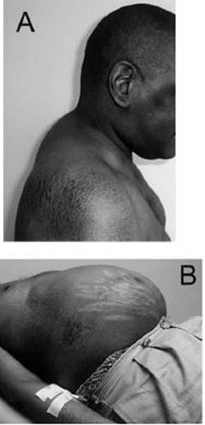
Drug-Induced Cushing’s Syndrome
Ritonavir and cobicistat (boosters)
Intranasal, inhaled, intra-articular, intramuscular steroid in patients on a boosted regimen
Budesonide
Fluticasone (available over the counter)
Triamcinolone
Mometasone
Beclomethasone is safe as it is not metabolized by CYP3A4
www.hiv-druginteractions.org; DHHS HIV Guidelines 2021
Notes:
Corticosteroids
The risk of significant pharmacokinetic drug interactions between antiretroviral therapy and corticosteroid treatment was first identified in patients taking the inhaled or nasal preparation of the corticosteroid fluticasone. Multiple subsequent reports have documented iatrogenic severe adrenal suppression and Cushing's syndrome in patients (children and adults) concomitantly receiving a corticosteroid and a ritonavir boosted antiretroviral regimen. A similar drug interaction between cobicistat and corticosteroids has been documented.
To mitigate these drug interactions in patients taking ritonavir or cobicistat, clinicians should consider using a corticosteroid other than fluticasone or budesonide, such as inhaled or nasal beclomethasone (which is not metabolized by the CYP3A4 enzyme and, thus, does not produce the same interaction).

Slide 11
Common Drug Interactions with ARVs: Require Dosage Modification or Cautious Use
Antifungals
Narcotics & treatment for opioid dependence
Ergot alkaloids
Antihistamines (astemizole)
Hepatitis C NS3/4A protease inhibitors
Antiplatelets
Oral hormonal contraceptives
Erectile dysfunction agents
Herbal products (St. John’s wort)
Acid-lowering medications
Anticoagulants
Cardiac medications
www.hiv-druginteractions.org; DHHS HIV Guidelines 2021

Slide 12
Drug Interactions with INSTIs
Cations – all INSTIs
Al+, Mg+, Ca+: take INSTI 2 hours before or 6 hours after cations
Significant decrease in RAL concentrations if dosed once daily, recommended to do BID dosing if cations needed
Multivitamins with minerals
Calcium carbonate
Raltegravir (RAL)
UGT1A1 (primary)
Rifampin – if RAL must be used, consider RAL 800mg BID
www.hiv-druginteractions.org; Clinical Pharmacology; https://clinicalinfo.hiv.gov/en/guidelines/adult-and-adolescent-arv/drug-interactions-between-integrase-inhibitors-and-other-drugs?view=full
Notes:
Calcium carbonate (Tums®)

Slide 13
Drug Interactions with INSTIs
Elvitegravir (EVG)- CYP3A4 (major) & UGT1A1/3
Boosted: Cobicistat – CYP3A4 (major) & 2D6 (weak)
Avoid use with lovastatin, simvastatin, simepravir, amiodarone, rivaroxaban, apixaban (EVG/c inhibits metabolism)
Decrease in EVG/c – nevirapine, carbamazepine, phenobarbital, phenytoin, rifampin/rifabutin, St. John’s wort
Dolutegravir (DTG) & Bictegravir (BIC) - UGT1A1 & some CYP3A4
Rifampin - inducer of UGT1A1 → decrease DTG & BIC [DTG can be used BID]
Rifabutin- DTG safe. Do not use with BIC
Metformin – DTG ↑ concentration, max metformin 1000mg daily [BIC not affected the same, can use full dose metformin if normal renal function]
www.hiv-druginteractions.org; Clinical Pharmacology; https://clinicalinfo.hiv.gov/en/guidelines/adult-and-adolescent-arv/drug-interactions-between-integrase-inhibitors-and-other-drugs?view=full
Notes:
Bictegravir/TAF/FTC & Rifabutin (per hiv-druginteractions.org):
Quality of evidence: Very Low
Summary: Coadministration is not recommended. Coadministration with bictegravir/emtricitabine/tenofovir alafenamide has not been studied. Coadministration of rifabutin (300 mg once daily) and bictegravir alone (75 mg once daily) decreased bictegravir Cmax, AUC and Cmin by 20%, 38% and 56%, respectively. Furthermore, rifabutin is an inducer of P-gp and is expected to decrease the absorption of tenofovir alafenamide absorption and thereby plasma concentrations.
Description: Co-administration is not recommended due to the expected decrease of tenofovir alafenamide. Coadministration of rifabutin (300 mg once daily) and bictegravir (75 mg once daily) decreased bictegravir AUC, Cmin and Cmax by 38%, 56% and 20%, respectively (due to induction of CYP3A and P-gp). The interaction has not been studied with tenofovir alafenamide. Co-administration of rifabutin may decrease tenofovir alafenamide plasma concentrations. Biktarvy Summary of Product Characteristics, Gilead Sciences Ltd, June 2019.
Coadministration may decrease concentrations of bictegravir and tenofovir alafenamide. Coadministration with rifabutin is not recommended. Coadministration of rifabutin (300 mg once daily) and bictegravir (75 mg once daily) decreased bictegravir Cmax, AUC and Cmin by 20%, 38% and 56%, respectively. Biktarvy Prescribing Information, Gilead Sciences Inc, August 2019.
Dolutegravir & rifabutin (per hiv-druginteractions.org):
Quality of evidence: Moderate
Summary: Rifabutin has no clinically significant effect on the pharmacokinetics of dolutegravir. Coadministration of rifabutin (300 mg once daily) and dolutegravir (50 mg once daily) increased dolutegravir Cmax by 16%, and decreased AUC and Ctrough by 5% and 30%. No dose adjustment is necessary.
Description: Coadministration had no significant effect on dolutegravir exposure (AUC and Ctrough decreased by 5% and 30% due to induction of UGT1A1 and CYP3A, Cmax increased by 16%). No dose adjustment is necessary. Tivicay Summary of Product Characteristics, ViiV Healthcare, March 2019.
Based on drug interaction trial results, rifabutin can be coadministered with dolutegravir without a dose adjustment. Coadministration of rifabutin (300 mg once daily) and dolutegravir (50 mg once daily) to 9 subjects increased dolutegravir Cmax by 16%, but decreased AUC and Ctrough by 5% and 30%. Tivicay US Prescribing Information, ViiV Healthcare, July 2019.
Coadministration of dolutegravir alone (50 mg once daily) and with rifabutin (300 mg once daily) was evaluated in 9 HIV-negative subjects. Rifabutin decreased dolutegravir AUC by 5% and Ctrough by 30%, but increased Cmax by 15%. The decrease in dolutegravir Ctrough is unlikely to be clinically significant given the known PK/PD relationships and data from phase 2b dose ranging studies. Safety, tolerability, and pharmacokinetics of the HIV integrase inhibitor dolutegravir given twice daily with rifampin or once daily with rifabutin: results of a phase 1 study among healthy subjects. Dooley KE, Sayre P, Borland J, et al. J Acquir Immune Defic Syndr, 2013, 62(1): 21-27.

Slide 14
Drug Interactions with PIs
All are CYP3A4 substrates
Serum levels may be affected by CYP inducers or inhibitors
Some PIs are also inducers or inhibitors of other CYP isoenzymes, P-glycoprotein (PGP), or other transporters
Darunavir (DRV)
CYP3A4 (major), PGP
Toxicity- simepravir, simvastatin, lovastatin, red yeast rice, rivaroxaban, quetiapine, colchicine, ubrogepant
Rifampin/rifabutin- ↓DRV concentrations
Can use rifabutin 150mg once daily
www.hiv-druginteractions.org; Clinical Pharmacology; https://clinicalinfo.hiv.gov/en/guidelines/adult-and-adolescent-arv/drug-interactions-between-protease-inhibitors-and-other-drugs?view=full

Slide 15
Drug Interactions with NRTIs
NRTIs
No hepatic metabolism, however, 3A enzymes play a minor role in tenofovir metabolism
example: TAF & rifampin/rifabutin
Some NRTIs may interact via other mechanisms
Avoid with TAF:
Carbamazepine
St. John’s Wort
www.hiv-druginteractions.org; Clinical Pharmacology; https://clinicalinfo.hiv.gov/en/guidelines/adult-and-adolescent-arv/drug-interactions-between-nucleoside-reverse-transcriptase?view=full
Notes:
TAF/FTC & rifabutin (per hiv-druginteractions.org):
Quality of evidence: Very Low
Summary: Coadministration with rifabutin has not been studied. Rifabutin is an inducer and therefore is expected to decrease the exposure of tenofovir alafenamide. Based on a drug-drug interaction study with rifampicin, if coadministration is required the product label recommends using tenofovir 25 mg twice daily. Coadministration of emtricitabine/tenofovir alafenamide (200/25 mg twice daily with bictegravir) and rifampicin (600 mg once daily) in healthy volunteers decreased the AUC of tenofovir and tenofovir-DP by ~14% and 24%, respectively, when compared to once daily administration alone. Of interest, coadministration of emtricitabine/tenofovir alafenamide (200/25 mg once daily) and rifampicin (600 mg once daily) decreased plasma exposure of tenofovir alafenamide and tenofovir by ~55%. Intracellular tenofovir-DP AUC decreased by 36%, however, intracellular tenofovir-DP exposure was 4.2-fold higher than that achieved with standard dose tenofovir-DF alone (300 mg once daily). Thus, this study suggests that use of tenofovir alafenamide 25 mg once daily with rifabutin may be acceptable.
Description: The co-administration of Descovy is not recommended with rifabutin. Interaction not studied with either of the components of Descovy. Co-administration of rifabutin, a P-gp inducer, may decrease tenofovir alafenamide plasma concentrations, which may result in loss of therapeutic effect and development of resistance. Descovy Summary of Product Characteristics, Gilead Sciences Ltd, April 2016.
Coadministration is expected to decrease concentrations of tenofovir alafenamide and is not recommended. Descovy US Prescribing Information, Gilead Sciences Inc, April 2016.
The pharmacokinetics of tenofovir alafenamide and tenofovir diphosphate were determined in healthy volunteers following administration of tenofovir alafenamide alone (25 mg once daily, with emtricitabine) and with rifampicin (600 mg once daily). Rifampicin decreased tenofovir alafenamide AUC and Cmax by 55% and 50%. Plasma tenofovir Cmax, C24 and AUC decreased by 65%, 55% and 54% respectively. Intracellular tenofovir diphosphate (i.e. active entity) concentrations Cmax, C24 and AUC decreased by 38%, 43% and 36%, respectively, but AUC was still 4.21-fold higher than that achieved with standard dose tenofovir-DF alone (300 mg once daily). Rifampicin did not alter emtricitabine pharmacokinetics. Rifampin effect on intracellular and plasma pharmacokinetics of tenofovir alafenamide. Cerrone M, Alfarisi O, Neary M, et al. J Antimicrob Chemother 2019; 74:1670-8.
The pharmacokinetics of tenofovir alafenamide and tenofovir diphosphate (TDF-DP) were determined following administration of tenofovir alafenamide alone (25 mg once daily, with bictegravir and emtricitabine) or tenofovir alafenamide (25 mg twice daily, with bictegravir and emtricitabine) and rifampicin (600 mg once daily). Following twice daily administration with rifampicin, the plasma AUC of tenofovir alafenamide and its active intracellular metabolite (TFV-DP) were modestly decreased by ~14% and ~24% when compared to tenofovir alafenamide once daily alone. This modest change is not expected to alter the efficacy of tenofovir alafenamide. Twice daily administration of tenofovir alafenamide in combination with rifampin: potential for tenofovir alafenamide use in HIV-TB coinfection. Custodio JM, et al. 16th European AIDS Conference (EACS). October 2017, Milan, abstract PS13/4.
TAF/FTC & rifampin (per hiv-druginteractions.org):
Quality of evidence: Very Low
Summary: Rifampicin induces the transporters P-gp, BCRP, OATP1B1 which results in lower exposure of tenofovir alafenamide. If coadministration is required, the product label recommends using tenofovir alafenamide 25 mg twice daily. Coadministration of emtricitabine/tenofovir alafenamide (200/25 mg twice daily with bictegravir) and rifampicin (600 mg once daily) in healthy volunteers decreased the AUC of tenofovir and tenofovir-DP by ~14% and 24%, respectively, when compared to once daily administration alone. Of interest, coadministration of emtricitabine/tenofovir alafenamide (200/25 mg once daily) and rifampicin (600 mg once daily) decreased plasma exposure of tenofovir alafenamide and tenofovir by ~55%. Intracellular tenofovir-DP AUC decreased by 36%, however, intracellular tenofovir-DP exposure was 4.2-fold higher than that achieved with standard dose tenofovir-DF alone (300 mg once daily). Thus, this study suggests that use of tenofovir alafenamide 25 mg once daily with rifampicin may be acceptable.
Description: The co-administration of Descovy is not recommended with rifampicin. Interaction not studied with either of the components of Descovy. Co-administration of rifampicin, a P-gp inducer, may decrease tenofovir alafenamide plasma concentrations, which may result in loss of therapeutic effect and development of resistance. Descovy Summary of Product Characteristics, Gilead Sciences Ltd, April 2016.
Coadministration is expected to decrease concentrations of tenofovir alafenamide and is not recommended. Descovy US Prescribing Information, Gilead Sciences Inc, April 2016.
The pharmacokinetics of tenofovir alafenamide and tenofovir diphosphate were determined in healthy volunteers following administration of tenofovir alafenamide alone (25 mg once daily, with emtricitabine) and with rifampicin (600 mg once daily). Rifampicin decreased tenofovir alafenamide AUC and Cmax by 55% and 50%. Plasma tenofovir Cmax, C24 and AUC decreased by 65%, 55% and 54% respectively. Intracellular tenofovir diphosphate (i.e. active entity) concentrations Cmax, C24 and AUC decreased by 38%, 43% and 36%, respectively, but AUC was still 4.21-fold higher than that achieved with standard dose tenofovir-DF alone (300 mg once daily). Rifampicin did not alter emtricitabine pharmacokinetics. Rifampin effect on intracellular and plasma pharmacokinetics of tenofovir alafenamide. Cerrone M, Alfarisi O, Neary M, et al. J Antimicrob Chemother 2019; 74:1670-8.
The pharmacokinetics of tenofovir alafenamide and tenofovir diphosphate (TDF-DP) were determined following administration of tenofovir alafenamide alone (25 mg once daily, with bictegravir and emtricitabine) or tenofovir alafenamide (25 mg twice daily, with bictegravir and emtricitabine) and rifampicin (600 mg once daily). Following twice daily administration with rifampicin, the plasma AUC of tenofovir alafenamide and its active intracellular metabolite (TFV-DP) were modestly decreased by ~14% and ~24% when compared to tenofovir alafenamide once daily alone. This modest change is not expected to alter the efficacy of tenofovir alafenamide. Twice daily administration of tenofovir alafenamide in combination with rifampin: potential for tenofovir alafenamide use in HIV-TB coinfection. Custodio JM, et al. 16th European AIDS Conference (EACS). October 2017, Milan, abstract PS13/4.

Slide 16
Drug Interactions with NNRTIs
NNRTIs
Substrates of CYP3A4 can act as inducers (nevirapine) or mixed inducer and inhibitor (efavirenz)
Etravirine- 3A4 substrate/inducer, 2C9 & 2C19 substrate/inhibitor
Rilpivirine & doravirine- primarily 3A4 metabolism, not inducers/inhibitors
Rilpivirine- do not use with PPIs
www.hiv-druginteractions.org; Clinical Pharmacology; https://clinicalinfo.hiv.gov/en/guidelines/adult-and-adolescent-arv/drug-interactions-between-non-nucleoside-reverse-transcriptase?view=full

Slide 17
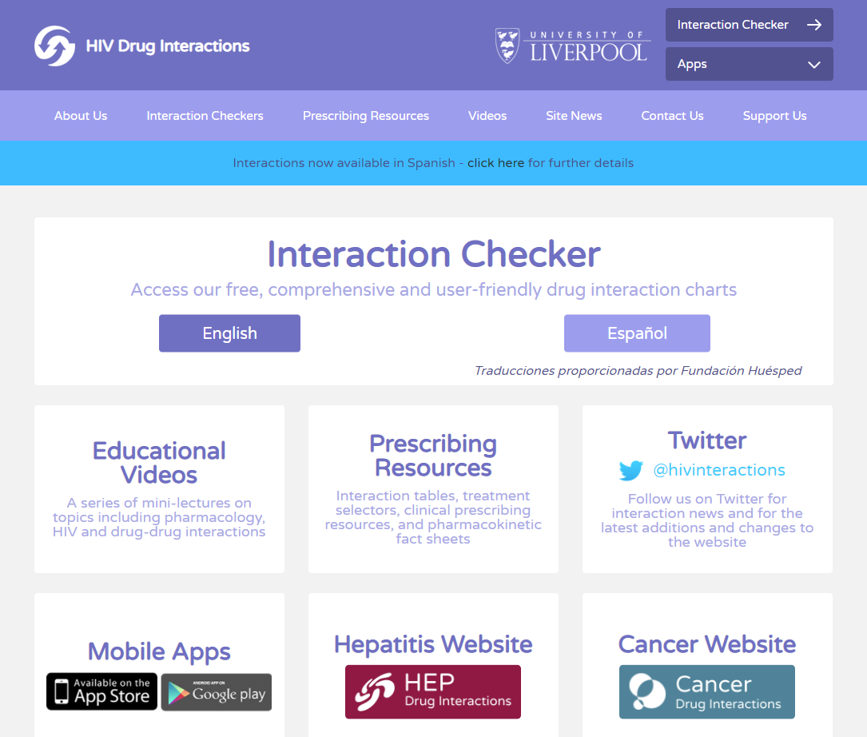
www.hiv-druginteractions.org

Slide 18
References
HIV Guidelines: Drug-Drug Interactions https://clinicalinfo.hiv.gov/en/guidelines/adult-and-adolescent-arv/overview?view=full
Liverpool HIV Interactions www.hiv-druginteractions.org
Clinical Pharmacology (subscription required) www.clinicalkey.com/pharmacology/

Slide 19
Resources
National Clinician Consultation Center http://nccc.ucsf.edu/
HIV Management
Perinatal HIV
HIV PrEP
HIV PEP line
HCV Management
Substance Use Management
Present case on ECHO http://echo.unm.edu hivecho@salud.unm.edu
AETC National HIV Curriculum https://aidsetc.org/nhc
Hepatitis C Online https://www.hepatitisc.uw.edu/
AETC National Coordinating Resource Center https://targethiv.org/library/aetc-national-coordinating-resource-center-0
Additional trainings scaetcecho@salud.unm.edu
www.scaetc.org
Notes:
Find additional TeleECHO sessions in your area: https://echo.unm.edu/locations-2/echo-hubs-superhubs-united-states/
https://hsc.unm.edu/echo/get-involved/join-an-echo/
IDEA Platform: Infectious Diseases Education & Assessment. https://idea.medicine.uw.edu/
AETC National HIV Curriculum: 6 core modules for self study; regularly updated; CME, CNE
Hepatitis C Online Curriculum: https://www.hepatitisc.uw.edu/
Hepatitis B Online Curriculum: https://www.hepatitisb.uw.edu/
National STD Curriculum: https://www.std.uw.edu/

