Slide 1
Mind the Clap: A Resurgence of Disseminated Gonococcal Infection?
Eric Tang, MD, MPH
Clinical Faculty | California Prevention Training Center
Arizona 2021 HIV/STI/TB Clinical Update | April 13, 2021

Slide 2

Roadmap
Gonorrhea Overview
  Screening
  Treatment *UPDATE*
  Clinical Manifestations
Disseminated Gonococcal Infection
  Diagnosis
  Treatment
What Clinicians Can Do
  Additional Management Considerations
Resources

Slide 3
Disclosure Information
I have no relevant financial relationships with an entity producing, marketing, re-selling, or distributing health care goods or services consumed by, or used on patients
Any mention of commercial companies is not an endorsement and is for informational purposes only

Slide 4
Disclaimer
“This presentation is supported by the Health Resources and Services Administration (HRSA) of the U.S. Department of Health and Human Services (HHS) as part of an award totaling $3,278,366. The contents are those of the author(s) and do not necessarily represent the official views of, nor an endorsement, by HRSA, HHS or the U.S. Government.”
The views and opinions expressed in this presentation are not necessarily those of the Pacific AIDS Education and Training Centers (PAETC), the Regents of the University of California or its San Francisco campus (UCSF or collectively, University) nor of our funder the Health Resources and Services Administration (HRSA). Neither PAETC, University, HRSA nor any of their officers, board members, agents, employees, students or volunteers make any warranty, express or implied, including the warranties of merchantability and fitness for a particular purpose; nor assume any legal liability or responsibility for the accuracy, completeness or usefulness of information [,apparatus, product] or process assessed or described; nor represent that its use would not infringe privately owned rights.

Slide 5
Gonorrhea Overview

Slide 6
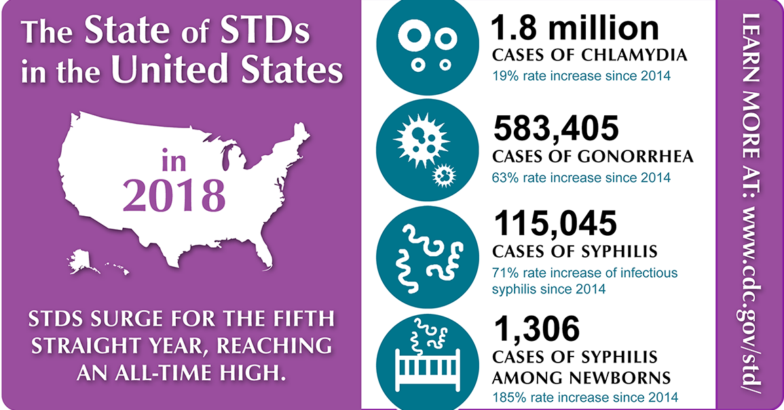
The State of STDs in the United States

Slide 7
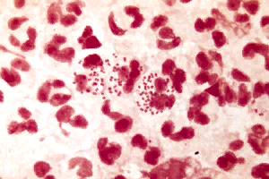
Neisseria gonorrhea (GC)
GC is the second most common bacterial STD
Transmission
  During vaginal, anal, or oral sex
  During delivery by infected mother
Causes a range of clinical syndromes
  Typically asymptomatic in women until complications (e.g., PID) develop
  In men, urethral infections usually symptomatic, but extragenital infections are mostly asymptomatic
Incidence highest among adolescents and young adults

Slide 8
Screening for Gonorrhea
(and Chlamydia)

Slide 9
Clinical scenario
27-year-old man presents to your clinic for routine visit. He has no symptoms but requests STI testing.
Any additional information you want to know?
Last tested for STIs 6 months ago; HIV negative; has sex with men, says he is “versatile” and last had sex with a man 3 weeks ago and had both oral and anal sex
In addition to HIV and syphilis testing, what other tests should you perform?
A. Urine Chlamydia/Gonorrhea
B. Pharyngeal Gonorrhea
C. Rectal Chlamydia/Gonorrhea
D. All of the above
E. None of the above

Slide 10
Clinical scenario Continued
27-year-old man presents to your clinic for routine visit. He has no symptoms but requests STI testing.
Any additional information you want to know?
Last tested for STIs 6 months ago; HIV negative; has sex with men, says he is “versatile” and last had sex with a man 3 weeks ago and had both oral and anal sex
In addition to HIV and syphilis testing, what other tests should you perform?
A. Urine Chlamydia/Gonorrhea
B. Pharyngeal Gonorrhea
C. Rectal Chlamydia/Gonorrhea
D. All of the above
E. None of the above

Slide 11
Who Should be Screened for CT/GC?
Females
< 25 annually, 25+ if at risk
MSM(W)
At least annually
MSW
High prevalence settings
Pregnant <25, if at risk
Exposed sites: genital, rectal, throat
HIV +
At least annually
Patients on PrEP
Post-Tx
All patients, 3 months after treatment
All exposed sites
Every 3 months
CDC 2015 STD Treatment Guidelines

Slide 12
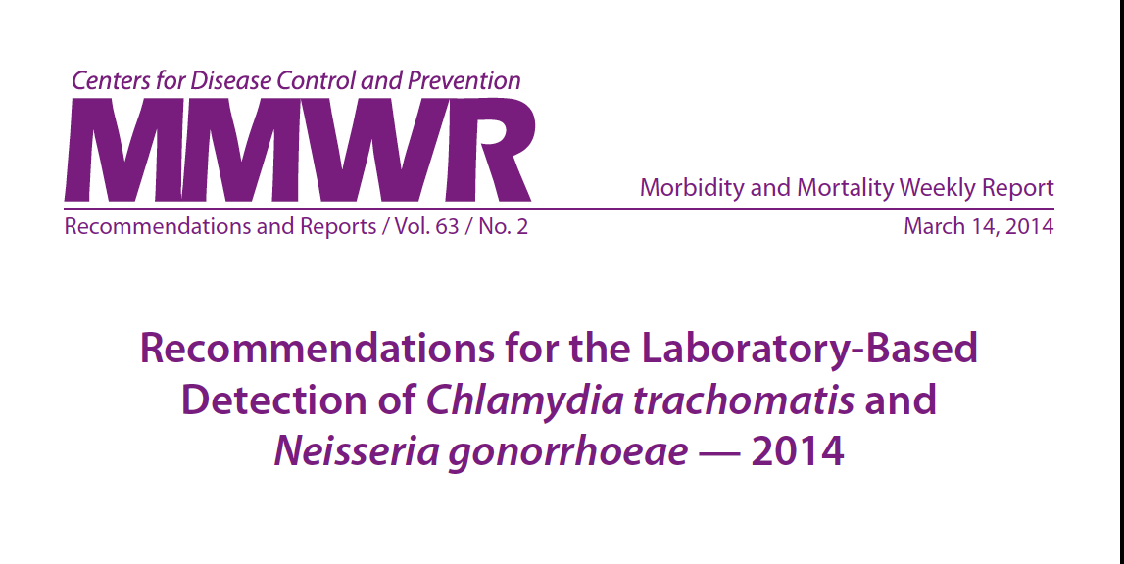
CDC Testing Recommendations
Nucleic Acid Amplification Tests (NAATs) recommended over culture
  Both symptomatic and asymptomatic
  Urogenital, pharyngeal & rectal sites
Optimal specimen types:
  First catch urine for men
  Vaginal swabs for women
Papp, 2014 - MMWR

Slide 13
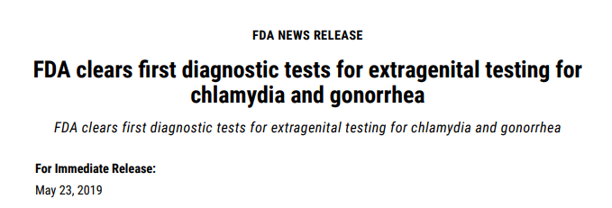
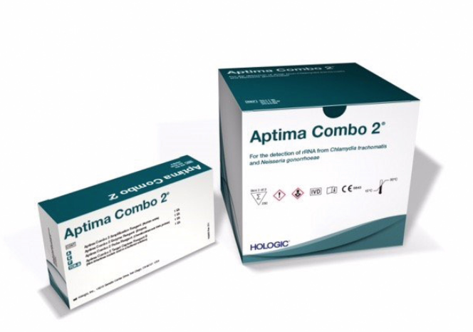
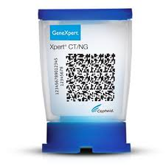
Nucleic Acid Amplification Test (NAAT)
FDA-cleared tests for oropharyngeal and rectal specimens
  Aptima Combo 2 Assay*
  Xpert CT/NG*
  Many labs have validated their own tests for extragenital testing, including for self-collected specimens
*Company and test names are provided for informational purposes only and do not imply endorsement.

Slide 14
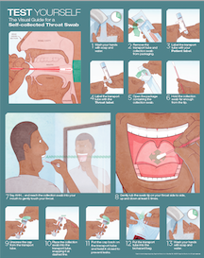
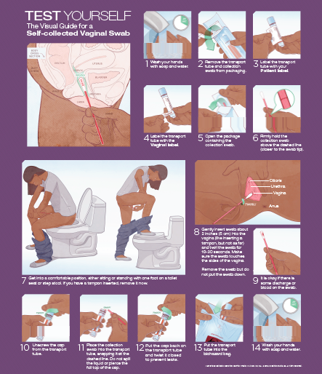
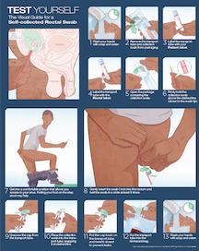
Self-collected STI Testing
Self-collected swabs accurate and acceptable
Similar performance to provider-collected specimens
Can be performed at lab along with blood draw/urine collection or in the exam room before/after the provider visit
May save the provider time
May save patient an office visit

Slide 15

CDC Extragenital Screening Recommendations
Sexually active MSM (HIV+ or HIV-)
  Oral GC and Rectal GC/CT (in addition to urogenital GC/CT)
  For reported exposure, regardless of condom use during exposure
Women and MSW
  “Less clear” but can be considered in any individual reporting exposure
  If GC is positive at urogenital/rectal site, recommend asking about oral exposure
    If reported, tx with regimen with acceptable efficacy against pharyngeal GC
Transgender Men and Women
  Assess STD risk based of current anatomy and sexual behavior
CDC 2015 STD Treatment Guidelines

Slide 16
(Uncomplicated) Gonorrhea Treatment

Slide 17
Case 1:
27 year-old, HIV-negative MSM sees you for routine STD screening. You test him for HIV, syphilis, and oropharyngeal, rectal, and urine GC/CT with NAAT. Pharyngeal GC NAAT is positive and the rest of his lab results are negative.
Which of the following should you use to treat him?
A. Ceftriaxone 250mg IM x 1
B. Azithromycin 1g IM x 1
C. Doxycycline 100mg BID PO x 7 days
D. Both A & C
E. Ceftriaxone 500mg IM x 1

Slide 18
Case 1 continued:
27 year-old, HIV-negative MSM sees you for routine STD screening. You test him for HIV, syphilis, and oropharyngeal, rectal, and urine GC/CT with NAAT. Pharyngeal GC NAAT is positive and the rest of his lab results are negative.
Which of the following should you use to treat him?
A. Ceftriaxone 250mg IM x 1 → Requires hire dose
B. Azithromycin 1g IM x 1 → No longer recommended for uncomplicated gonorrhea treatment
C. Doxycycline 100mg BID PO x 7 days → Used to treat chlamydia
D. Both A & C → No longer recommended for treatment of uncomplicated gonorrhea
E. Ceftriaxone 500mg IM x 1

Slide 19
Updated CDC GC Treatment Guidelines
Link to CDC MMWR for Updated Treatment Guidelines for Gonococal Infection
  Released December 2020
  Recommend monotherapy with ceftriaxone at a higher dose
  No longer recommending dual treatment with azithromycin

Slide 20


*New* Gonorrhea Treatment Guidelines for uncomplicated infections
However, if chlamydia has not been excluded, treat for chlamydia with:
Ceftriaxone 500 mg IM x 1
for persons weighing <150kg*
Doxycycline 100 mg PO BID x 7 days
*For persons weighing ≥ 150kg, 1 g of IM ceftriaxone should be administered
For pregnancy, allergy, or concern for non-adherence, 1g PO azithromycin x 1 can be used
New, higher dose ceftriaxone monotherapy
No longer recommending dual therapy with azithromycin
Update to CDC’s Treatment Guidelines for Gonococcal infection, 2020; MMWR

Slide 21
*New* Alternative Gonorrhea Treatment for uncomplicated infections of the cervix, urethra, and rectum if ceftriaxone is not available:
However, if chlamydia has not been excluded, treat for chlamydia with:
Doxycycline 100 mg PO BID x 7 days
Cefixime 800 mg PO x 1
For pregnancy, allergy, or concern for non-adherence, 1g PO azithromycin x 1 can be used
Cephalosporin allergy: Gentamicin 240 mg IM + azithromycin 2 g PO
No reliable alternative treatments are available for pharyngeal gonorrhea
  Get Test-of-Cure at 7-14 days post treatment for pharyngeal gonorrhea
Update to CDC’s Treatment Guidelines for Gonococcal infection, 2020; MMWR

Slide 22
Why the change in GC treatment recommendation?
Antimicrobial stewardship
  Increasing azithromycin resistance in Streptococcus pneumoniae, M. genitalium, Shigella, and Campylobacter
Pharmacokinetic and pharmacodynamic considerations
  A 250mg ceftriaxone dose does not reliably achieve adequate levels for an extended duration
Changes in azithromycin susceptibility
  Azithromycin MIC for GC isolates has steadily increased
  Ceftriaxone and cefixime MICs for GC has stabilized
Update to CDC’s Treatment Guidelines for Gonococcal infection, 2020; MMWR

Slide 23
Clinical Manifestations of Gonorrhea

Slide 24
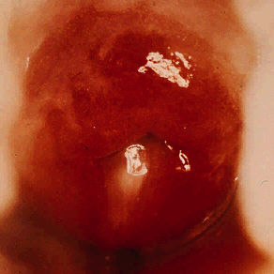
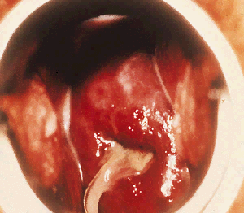
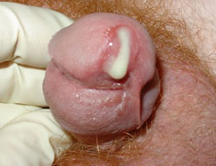
CERVICITIS, URETHRITIS
STD Atlas, 1997

Slide 25
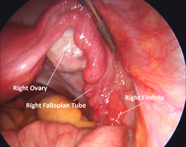
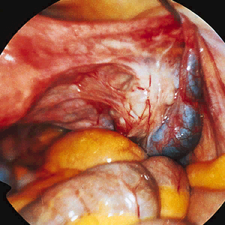
NORMAL TUBES/OVARIES AND PELVIC INFLAMMATORY DISEASE
STD Atlas, 1997

Slide 26
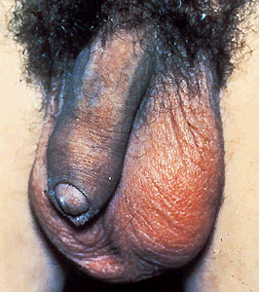
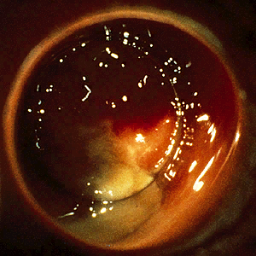
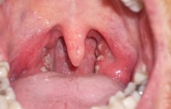
PHARYNGITIS, EPIDIDYMITIS, AND PROCTITIS
STD Atlas, 1997

Slide 27
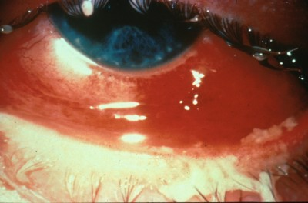
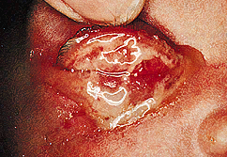
CONJUNCTIVITIS
STD Atlas, 1997

Slide 28
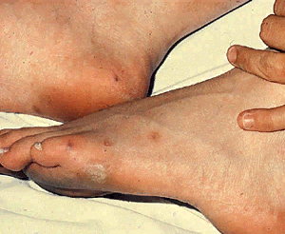
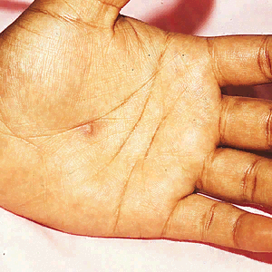
DISSEMINATED GONOCOCCAL INFECTION
STD Atlas, 1997

Slide 29
Case 2: 20-year-old woman presents with a rash…
Physical exam: erythematous pustules on the wrist and fingers, also visualized on her trunk, scalp, and both ankles. Mild swelling and pain with passive motion in the right ankle, and tenosynovitis involving the tendons of both ankles, but no appreciative joint effusions.
To make the diagnosis of DGI, at what anatomic sites should diagnostic tests be performed?
A. Blood (i.e. blood cultures)
B. Genital (genital NAAT and culture, if available)
C. Skin lesion (culture)
D. All of the above
Rash on arms, legs, trunk, and scalp for one day
Generalized muscle aches, fever, and pain in both ankles
2 weeks prior – vaginal sex with new partner without barrier protection
Denies vaginal discharge or pain on urination
Link to New England Journal of Medicine

Slide 30
Case 2 Continued: 20-year-old woman presents with a rash…
Physical exam: erythematous pustules on the wrist and fingers, also visualized on her trunk, scalp, and both ankles. Mild swelling and pain with passive motion in the right ankle, and tenosynovitis involving the tendons of both ankles, but no appreciative joint effusions.
To make the diagnosis of DGI, at what anatomic sites should diagnostic tests be performed?
A. Blood (i.e. blood cultures)
B. Genital (genital NAAT and culture, if available)
C. Skin lesion (culture)
D. All of the above
Rash on arms, legs, trunk, and scalp for one day
Generalized muscle aches, fever, and pain in both ankles
2 weeks prior – vaginal sex with new partner without barrier protection
Denies vaginal discharge or pain on urination
Link to New England Journal of Medicine

Slide 31
Case 2 blood culture: 20-year-old woman presents with a rash…
Rash on arms, legs, trunk, and scalp for one day
Generalized muscle aches, fever, and pain in both ankles
2 weeks prior – vaginal sex with new partner without barrier protection
Denies vaginal discharge or pain on urination
Link to New England Journal of Medicine

Slide 32
Disseminated Gonococcal Infection (DGI)

Slide 33
Epidemiology and Predisposing Factors
Considered to be a rare complication
  Estimated 0.5–3% of untreated gonococcal infections
Host factors: female, recent menstruation, pregnancy, terminal complement deficiency
  Eculizumab
    Monoclonal C5 antibody approved for diseases associated with dysregulation of complement activation (e.g., aplastic anemia, paroxysmal nocturnal hemoglobinuria)
    Several DGI case reports among patients treated with eculizumab
    8 cases per ongoing analysis of FDA adverse event reporting system
Gleesing 2012; Hublikar S,2014; Khandelwal, 2017; Crew, 2019

Slide 34
Epidemiology and Predisposing Factors: Microbial
Microbial factors
  Historically virulence factors and growth factors associated with serum resistance and increased propensity to cause DGI
    PorB1A
  DGI suspected to result from multifactorial process in which certain bacterial traits are probably necessary, but not sufficient (i.e., there are strains that cause DGI in some individuals, but are found circulating among individuals with uncomplicated gonorrhea)

Slide 35
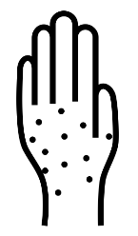


Disseminated Gonococcal Infection (DGI) Clinical Manifestations
N. gonorrhoeae invades bloodstream and
spreads to distant sites in the body
Clinical manifestations
  Fever, petechial/pustular skin lesions,
  polyarthralgias, tenosynovitis, septic arthritis
  Endocarditis, meningitis, osteomyelitis

Slide 36
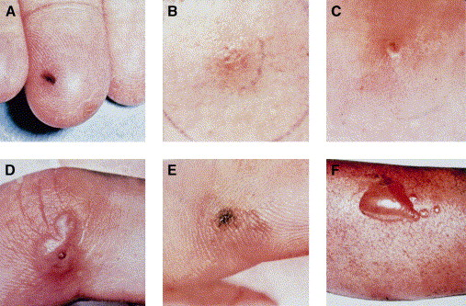
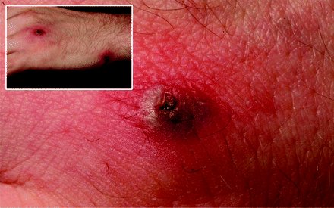
Clinical Manifestations
“Arthritis-dermatitis syndrome”
  Historically most common presentation
  Polyarthralgias and tenosynovitis
    Wrist, MCP joints, ankle
    Migratory, asymmetric polyarthralgia
  Skin lesions – mostly on extremities
  Fever, chills, malaise
  “Bacteremic stage” – bacteremia in up to 50% of cases
Photos: KK Holmes et al. Ann Intern Med 1971; CDC Public Health Image Library

Slide 37

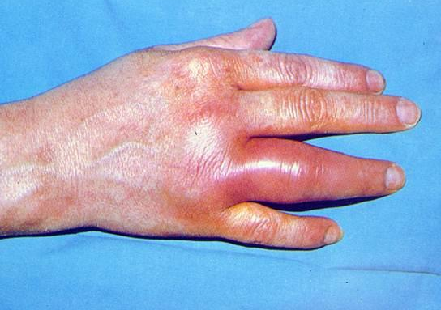
Clinical Manifestations Continued
Septic (purulent) arthritis
  Historically less than 50%
  of DGI cases
  Monoarticular or oligoarticular
  Knees, wrists, ankles
  Direct extension can result
  in osteomyelitis (rare)
Photos: CDC Public Health Image Library; HS Lambert et al, Slide Atlas of Infectious Diseases: Disseminated Infections, 1982.

Slide 38


Making the Diagnosis of DGI
Specimen collection
  Mucosal sites (urogenital, pharyngeal, rectal)
  Disseminated sites (e.g., skin, synovial fluid, blood, or cerebrospinal fluid)
Nucleic acid amplification testing (NAAT)
Culture
Culture

Slide 39
Making the Diagnosis of DGI Continued
Specimen collection
  Mucosal sites (urogenital, pharyngeal, rectal)
  Disseminated sites (e.g., skin, synovial fluid, blood, or cerebrospinal fluid)
Usually
clinical diagnosis
Nucleic acid amplification testing (NAAT)
Culture
Culture

Slide 40
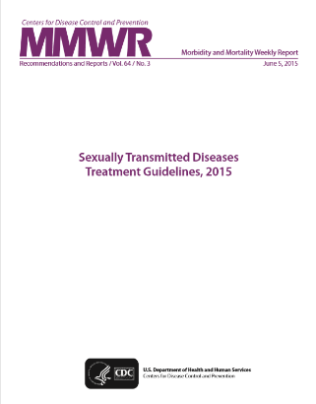
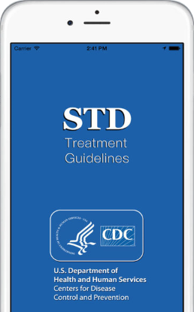
DGI Management and Treatment
Consult CDC STD Treatment Guidelines
Hospitalization and consultation with Infectious Disease specialist
Antimicrobial treatment per CDC STD Treatment Guidelines
Antimicrobial susceptibility testing (AST) on ALL isolates
Link to CDC's STD Website

Slide 41
DGI Management and Treatment Continued
Consult CDC STD Treatment Guidelines
2021 CDC STD Treatment Guidelines Coming Soon…
Hospitalization and consultation with Infectious Disease specialist
Antimicrobial treatment per CDC STD Treatment Guidelines
Antimicrobial susceptibility testing (AST) on ALL isolates
Link to CDC's STD Website

Slide 42
DGI Treatment

Slide 43
Case 2 : Treatment of DGI
What is the recommended treatment regimen for DGI arthritis and arthritis-dermatitis syndrome?
  A. Ceftriaxone 250mg IM/IV q24h + Azithromycin 1g PO
  B. Ceftriaxone 500mg IM/IV q24h
  C. Ceftriaxone 1g IM/IV q24h + Azithromycin 1g PO
  D. Ceftriaxone 1g IM/IV q24h
  E. Ceftriaxone 1-2g IV q12-24h + Azithromycin 1g PO

Slide 44
Case 2 continued: Treatment of DGI
What is the recommended treatment regimen for DGI arthritis and arthritis-dermatitis syndrome?
  A. Ceftriaxone 250mg IM/IV q24h + Azithromycin 1g PO
  B. Ceftriaxone 500mg IM/IV q24h
  C. Ceftriaxone 1g IM/IV q24h + Azithromycin 1g PO
  D. Ceftriaxone 1g IM/IV q24h
  E. Ceftriaxone 1-2g IV q12-24h + Azithromycin 1g PO

Slide 45
Case 2 note: Treatment of DGI
What is the recommended treatment regimen for DGI arthritis and arthritis-dermatitis syndrome?
  A. Ceftriaxone 250mg IM/IV q24h + Azithromycin 1g PO → CTX dose to low
  B. Ceftriaxone 500mg IM/IV q24h → CTX dose to low
  C. Ceftriaxone 1g IM/IV q24h + Azithromycin 1g PO
  D. Ceftriaxone 1g IM/IV q24h → azithromycin still in 2015 recommendations
  E. Ceftriaxone 1-2g IV q12-24h + Azithromycin 1g PO → Tx for DGI endocarditis or meningitis
  Note: Ceftriaxone 1g IM/IV q24h alone may be the recommended regimen once the 2021 CDC STI Treatment Guidelines are released

Slide 46
Treatment of Arthritis and Arthritis-Dermatitis Syndrome
Recommended Regimen
Ceftriaxone 1 g IM or IV every 24 hours
PLUS*
Azithromycin 1 g orally in a single dose
Alternative Regimens
Cefotaxime OR Ceftizoxime 1 g IV every 8 hours
PLUS*
Azithromycin 1 g orally in a single dose
When treating for the arthritis-dermatitis syndrome, the provider can switch to an oral agent guided by antimicrobial susceptibility testing 24–48 hours after substantial clinical improvement, for a total treatment course of at least 7 days.
*Per CDC 2015 STD Treatment Guidelines; azithromycin may be dropped in the updated CDC 2021 STI Treatment Guidelines

Slide 47
Treatment of Gonococcal Meningitis and Endocarditis
Recommended Regimen
Ceftriaxone 1–2 g IV every 12–24 hours
PLUS*
Azithromycin 1 g orally in a single dose
The duration of treatment of DGI has not been systematically studied and should be determined in consultation with an infectious-disease specialist.
Guided by the results of antimicrobial susceptibility testing. Pending antimicrobial susceptibility results, treatment decisions should be made on the basis of clinical presentation.
Therapy for meningitis should be continued for 10–14 days.
Therapy for endocarditis should be administered for at least 4 weeks.
*Per CDC 2015 STD Treatment Guidelines; azithromycin may be dropped in the updated CDC 2021 STI Treatment Guidelines

Slide 48
Increase in DGI Cases in the United States?

Slide 49
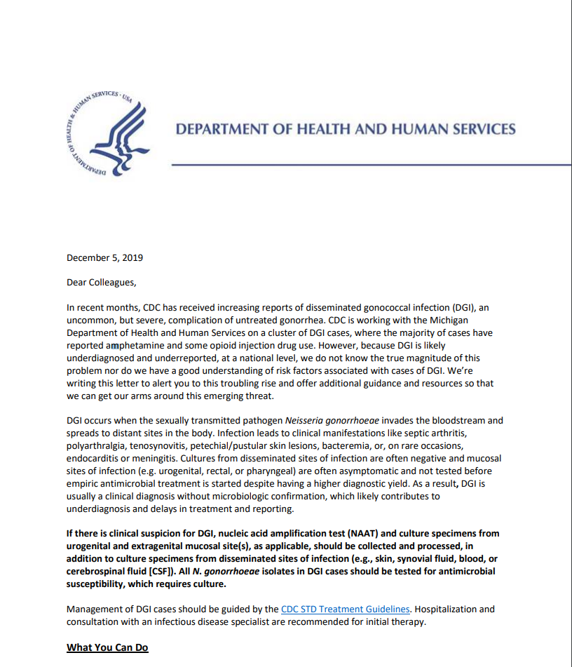
CDC DGI Dear Colleague Letter
Released December 5, 2019
CDC reports increase of DGI in Michigan
Majority of cases reported amphetamine and some opioid injection use
Link to CDC DGI Dear Colleague Letter

Slide 50
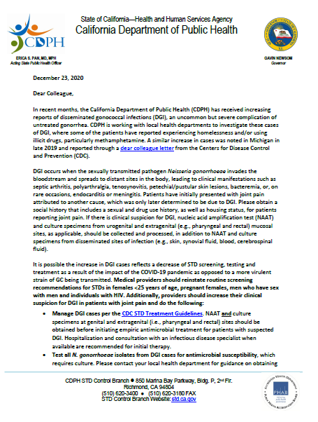
California Department of Public Health DGI Dear Colleague Letter
Released letter for CA clinicians on December 23, 2020
Increase in cases noted among patients who reported experiencing homelessness and/or illicit drugs, particularly methamphetamine
Link to California Department of Public Health Dear Colleague Letter

Slide 51
What can clinicians do?

Slide 52
Provider Recommendation #1
Providers should reinstate routine screening for STDs among:
  Individuals using illicit drugs, particularly (meth)amphetamine/IV drugs
  Individuals experiencing homelessness
Females
< 25 annually, 25+ if at risk
MSM(W)
At least annually
High prevalence settings (or at high risk)
Pregnant <25, if at risk
Exposed sites: genital, rectal, throat
HIV +
At least annually
Patients on PrEP
Post-Tx
All patients, 3 months after treatment
All exposed sites
Every 3 months
MSW

Slide 53
Provider Recommendation #2
Providers should increase their clinical suspicion for DGI in patients with joint pain
  Expand differential dx beyond osteoarthritis, joint sprain, and gout
  Explore nature of joint pain (is it migratory?)
  Ask about rash and conduct skin exam, with attention to hands and feet
  Ask about urogenital (as well as rectal, pharyngeal) symptoms
  Take a social history - sexual history, drug use, and housing status
  Aspirate joint if there is an effusion

Slide 54
Provider Recommendation #3
Manage DGI cases per the CDC STD Treatment Guidelines
  Before initiating empiric antibiotic tx for suspected DGI, obtain:
    Blood cultures as well as cultures from synovial fluid/skin pustules (if applicable)
    NAAT and culture (if available) at genital AND extragenital sites (pharyngeal and rectal)
  Hospitalized and consultation with an infectious disease specialist when available are recommended for initial therapy
  Clinical consultation for DGI management is also available through the STD Clinical Consultation Network (Link to STD Clinical Consultation Network)

Slide 55
Provider Recommendation #4
Test all GC isolates from DGI cases for antimicrobial susceptibility
  Antimicrobial susceptibility requires CULTURE
    Please contact your local health department for guidance on obtaining culture if not available at your site
    Some public health and commercial labs also provide GC culture +/- antimicrobial susceptibility
      Mayo Clinic and CDC can also perform GC susceptibility testing

Slide 56
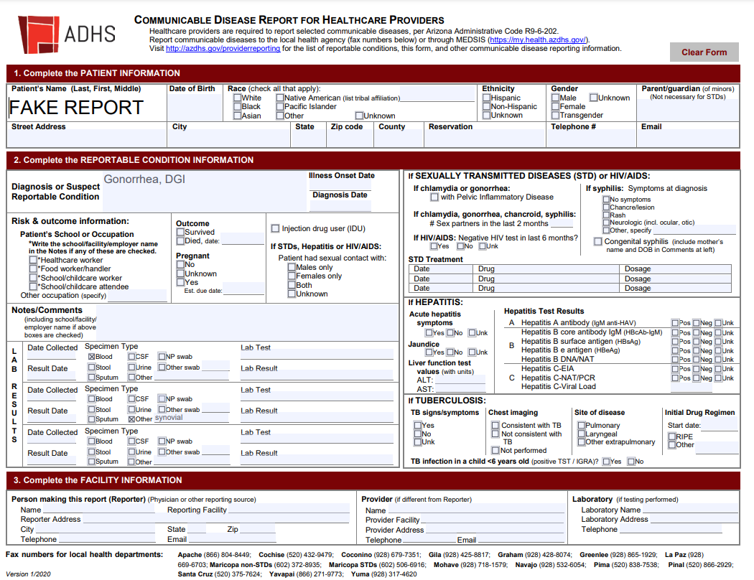
Provider Recommendation #5
Report all laboratory confirmed and clinically suspected cases of DGI to the local health department within 24 hours of identification

Slide 57
Additional Management

Slide 58
Additional management of DGI/GC
If dx with gonorrhea, test for HIV, syphilis, and chlamydia (CT)
Offer HIV Preexposure Prophylaxis (PrEP) – indications include:
  Man who has sex with men (MSM) with GC (or CT or syphilis) diagnosed or reported in the past 6 months
  Any woman or man with GC (or syphilis) diagnosed/reported in the past 6 months

Slide 59
Additional management of DGI/GC Continued
Treat partners
  Recent sex partners within the 60 days preceding onset of symptoms or diagnosis of DGI/GC should be referred for evaluation, testing, and presumptive treatment
  Gonococcal infection frequently is asymptomatic in sex partners of persons who have DGI
  Test for GC/CT at all sites of exposure
  To avoid reinfection, sex partners should abstain from unprotected sex for 7 days after they and their sexual partner(s) have completed treatment and after resolution of symptoms, if present.

Slide 60
Expedited Partner Therapy (EPT)
The practice of treating the partners of patients for STDs without performing a physical exam
Permissible by law in AZ for contacts of reportable communicable diseases (i.e., GC, CT)
Can be used when provider cannot confidently ensure all patient’s sex partners from the prior 60 days will be treated
Prevents reinfection, transmission, and cost savings relative to clinic visits
All dispensed drugs (including those dispensed for EPT) require the following:
  The dispensing doctor’s name, address, and telephone number
  The date the drug is dispensed
  The patient’s name
  The name and strength of the drug, directions for its use, and any cautionary statements

Slide 61
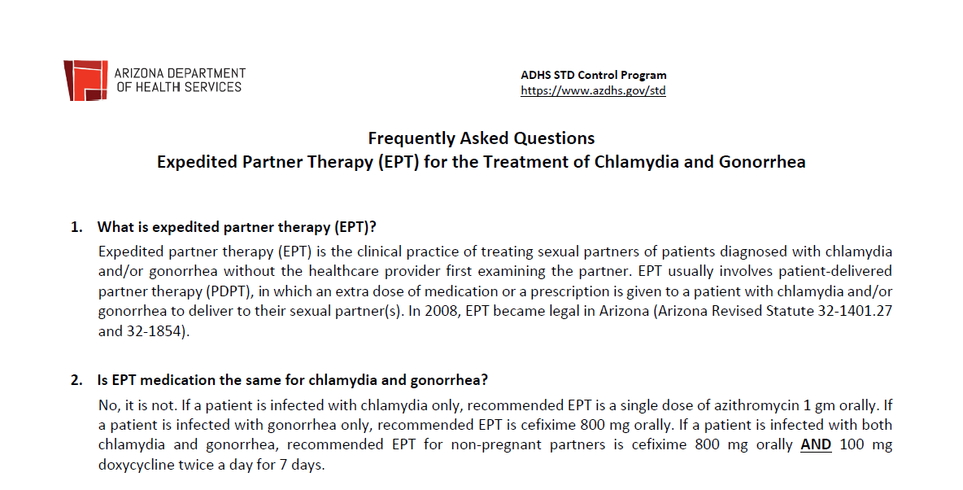
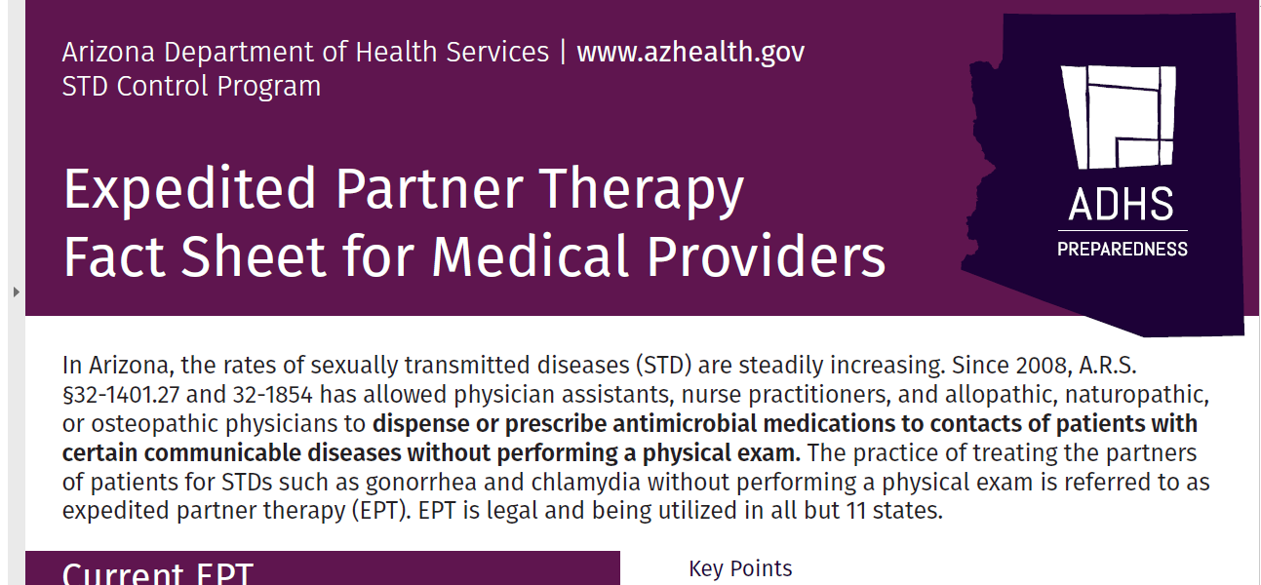
EPT Recommendations
  For Gonorrhea: Cefixime 800mg x 1
  When chlamydia cannot be excluded:
    Add Doxycycline 100mg BID x 7 days
    Alternative (e.g., in case of pregnancy or concern for compliance, allergy): Azithromycin 1g PO x 1
  Providing meds better than Rx if possible
  Should be accompanied by instructions/warnings
    e.g., allergies; need for in-person evaluation, particularly women who are pregnant and/or with symptoms of pelvic inflammatory disease
Link to AzDHS EPT FAQ for Medical Professionals
Link to AzDHS EPT Fact Sheet for Physicians

Slide 62

Link to Tellyourpartner.org

Slide 63

Take Home Points
Reinstate routine STD screening
Treat uncomplicated GC with ceftriaxone 500 mg IM monotherapy
DGI is increasing in the US – increase your clinical suspicion for DGI for patients with joint pain
Obtain NAAT and culture specimens at all exposed anatomic sites for patients with suspected DGI
Report GC/DGI cases to your local health department
Treat partners and if needed, by expedited partner therapy

Slide 64
Resources

Slide 65
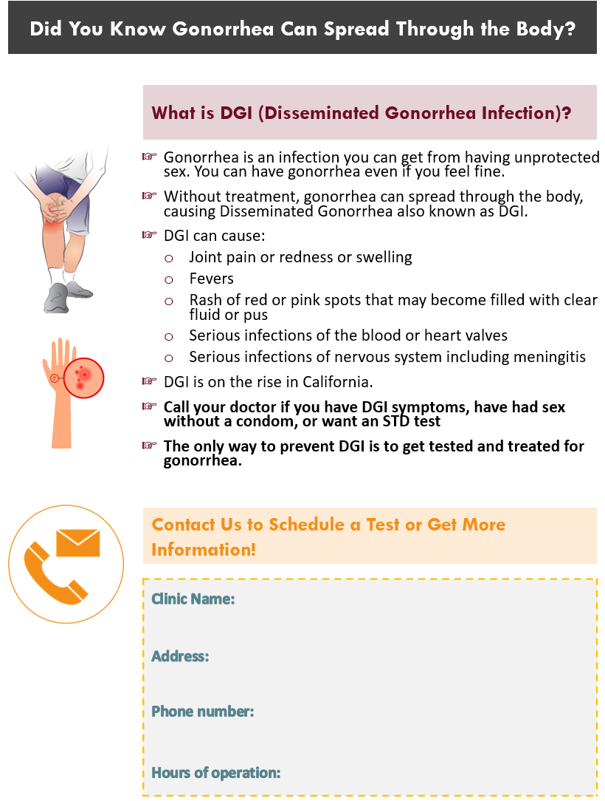
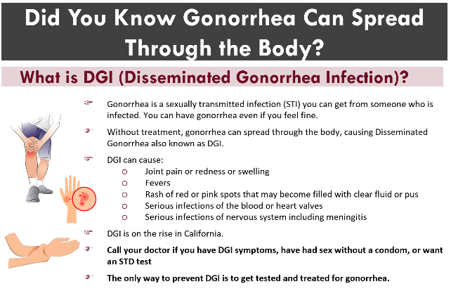
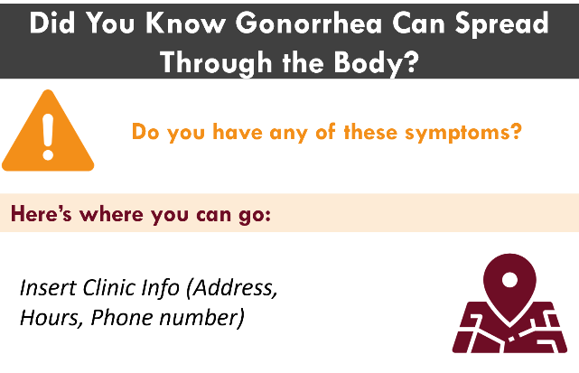
Additional DGI resources
DGI FAQ for Medical Providers
Patient education flyers/cards for clinics
Link to DGI FAQ for Medical Providers
Flyer also available in Spanish! If interested in these resources, contact lizzete.alvarado@cdph.ca.gov

Slide 66
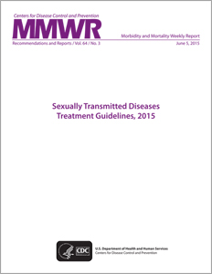




MORE Clinical Guidelines and Electronic Consultation
CDC STD Treatment
Guidelines App
Available now, free
Search for “STD TX”
STD Clinical
Consultation Network
Link to STD Clinical Care Network
Link to CDC STD Treatment Guidelines

Slide 67
Additional Resources with Links
Link to CDC 2020 Update to Treatment for Gonococcal Infections
Link to CDC DGI Case Reporting form
Link to Dear Colleague Letter: STD Care and Prevention Guidance During Disruption of Clinical Services due to the COVID-19 pandemic (April 6, 2020)
Link to Transportation of Specimens for Culture of Neisseria gonorrhoeae
Link to Recommendations for the Laboratory-Based Detection of C. trachomatis and N. gonorrhoeae – 2014

Slide 68
Thank you
Contact information: Eric.Tang@cdph.ca.gov
Acknowledgements:
Kathleen Jacobson
Lizzete Alvarado
Kelly Johnson
Rosalyn Plotzker
Ina Park
Nicole Burghardt
Denise Gilson
Ryan Murphy
Edwin Lopez
Lupe Espain
Bryan Hughes
Tazima Jenkins-Barnes
Hillary Berman-Watson
Laura Quilter
Brian Raphael
Jim Kent
William Nettleton
Justin Holderman
Alison Ridpath
Becca Scranton
Nessa Meshkaty
MelissaLee Barger
Will Geisler
Stephanie Cohen
Julie Dombrowski

Slide 69
Extra Slides

Slide 70
CDC 2015 STD Treatment Guidelines Chlamydia Treatment
Recommended first-line treatment:
Azithromycin 1 g PO
in a single dose
Doxycycline 100mg PO BID x 7 days
OR
Single dose regimen
Can be directly observed
Use when non-adherence is a concern
Contraindicated in pregnancy
CDC 2015 STD Treatment Guidelines

Slide 71
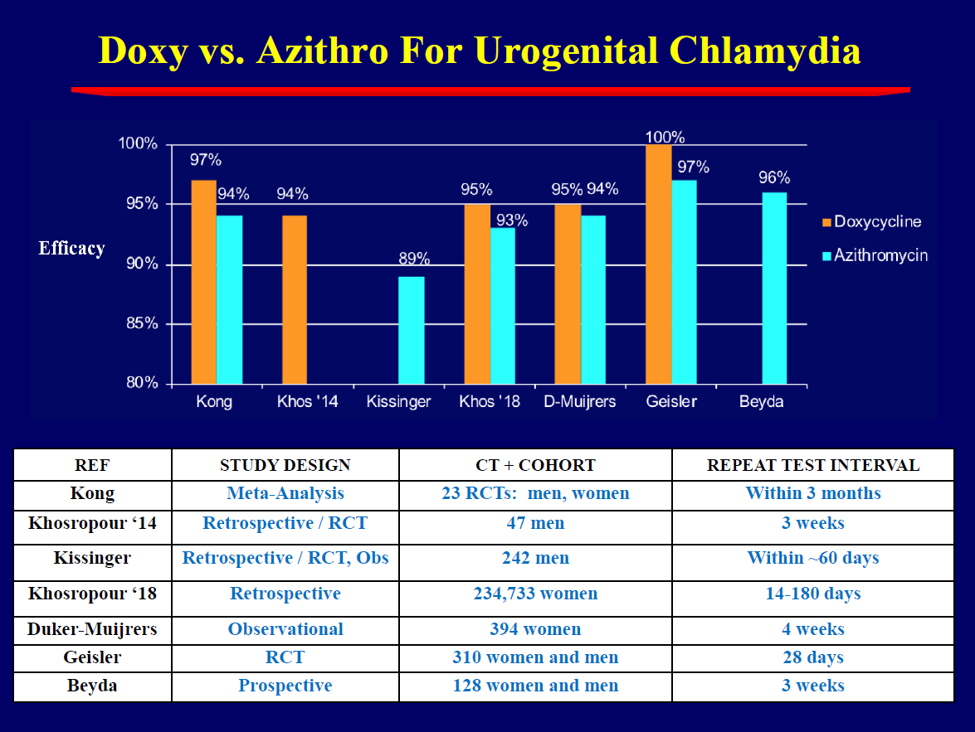
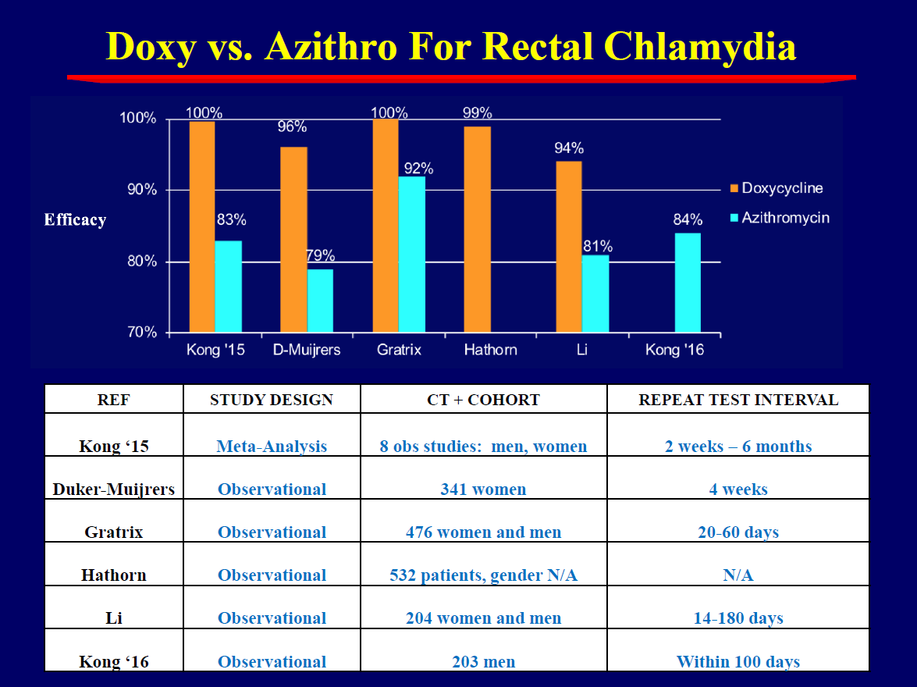
Evidence supporting doxycycline better than azithromycin for CT?
Slides courtesy of Will Geisler

Slide 72






A Randomized Trial of Azithromycin vs. Doxycycline for the Treatment of Rectal Chlamydia in Men who Have Sex with Men
(DMID Protocol 17-0092)
Julie Dombrowski, Michael R. Wierzbicki, Lori Newman, Jonathan Powell, Ashley Miller, Dwyn Dithmer, Olusegun Soge, Kenneth H. Mayer
2020 STD Prevention Conference

Slide 73
Objectives:
Placebo controlled RCT comparing:
  Azithromycin 1g x 1 vs doxycycline 100mg BID x 7d for rectal CT
Primary outcome: microbiologic cure at 4 weeks
Secondary outcomes: microbiologic cure at 2w; effect of LGV on cure
Participants: MSM testing NAAT(+) for rectal CT at two STI clinics in Seattle and Boston, with no or low-level symptoms (itch, irritation)
Dombrowski et al, STD Prevention Conf 2020

Slide 74
Microbiologic Cure at Four Weeks, by Treatment Group
Conclusion:
Doxycycline 100mg BID x 7d substantially better than azithromycin 1g x1 for rectal CT in MSM
% with Negative NAAT at 4 weeks
n=70/70
n=48/65
n=80/88
n=63/89
n=46/46
n=37/48
Absolute Difference
26%
(95% CI: 16-36%)
p<0.001
20%
(95% CI: 9-31%)
p<0.001
23%
(95% CI: 11-37%)
p<0.001
Dombrowski et al, STD Prevention Conf 2020

Slide 75
CT Treatment – CDC 2015 STD Treatment Guidelines
*Recommended first-line treatment:
Azithromycin 1 g PO
in a single dose
Doxycycline 100mg or PO BID x 7 days
OR
Single dose regimen
Can be directly observed
Use when non-adherence is a concern
Contraindicated in pregnancy
Better for rectal infections; underdiagnosed/tx in females?
*Per CDC 2015 STD Treatment Guidelines; doxycycline may be first-line tx, with azithromycin as alternative tx in the updated CDC 2021 STI Treatment Guidelines

