Slide 1
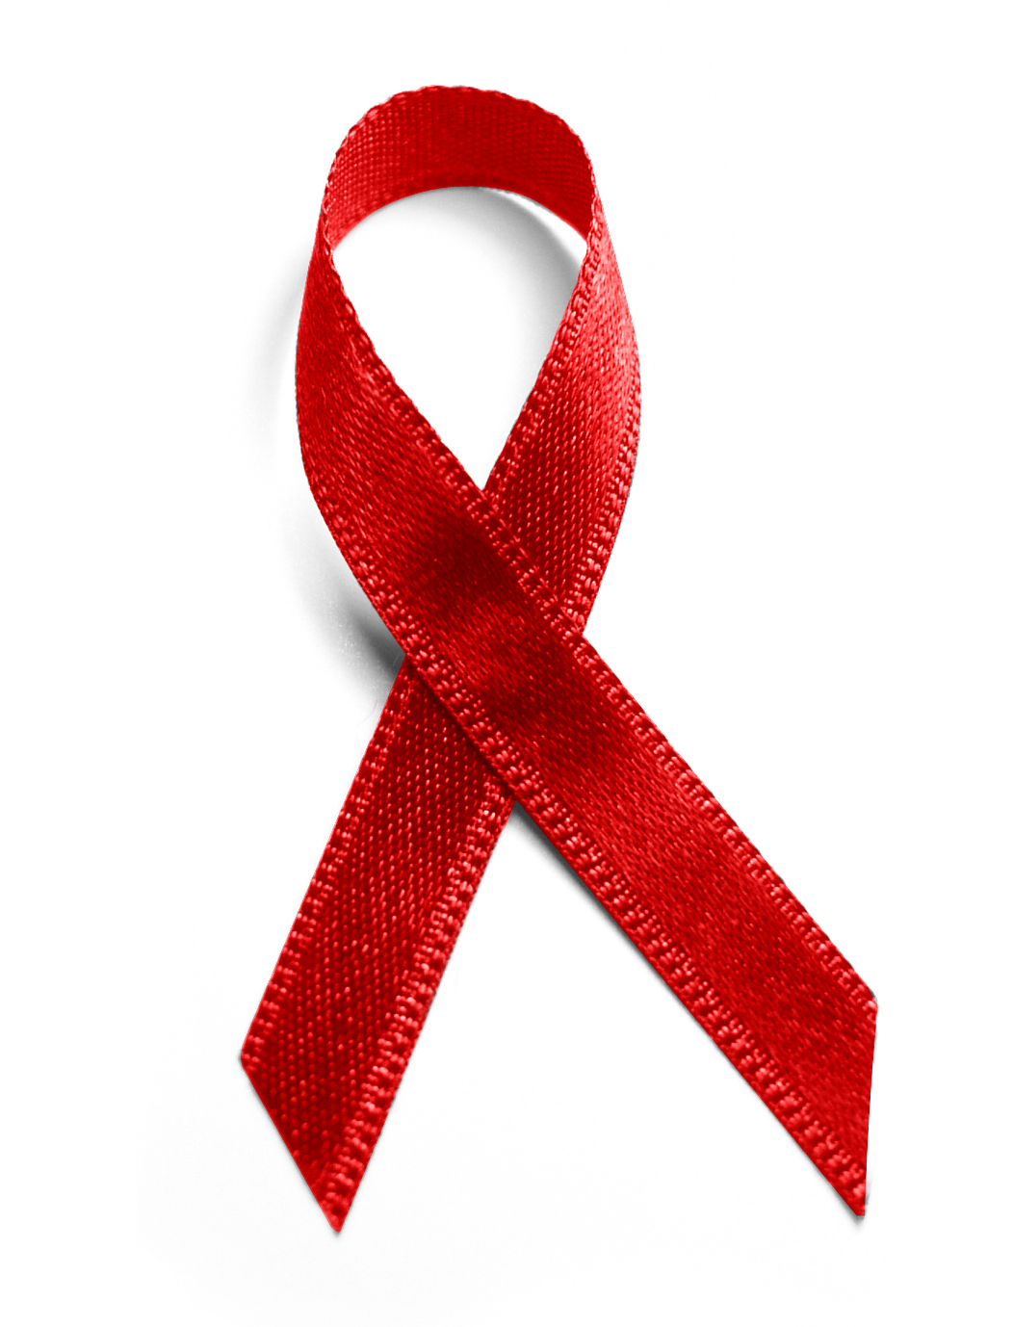
HIV Transmission PrEP/nPEP
Mark Schweizer, DDS MPH
Director Infection Prevention Progrmas
Nova Southeastern University College of Dental Medicine
Dental Director South Florida Southeast AIDS Education and Training Center

Slide 2
Disclosures
The activity planners and speakers do not have any financial relationships with commercial entities to disclose.
The speakers will not discuss any off-label use or investigational product during the program.
This slide set has been peer-reviewed to ensure that there are no conflicts of interest represented in the presentation
Special thanks to Dr. Elizabeth Sherman from the South Florida AETC for her contributions to this presentation

Slide 3
objectives
Explain the current demographics of HIV and the disparities in race/ethnicity.
Discuss the modes of transmission of HIV
Understand the significance of the HIV Care Continuum
Discuss and understand the role and methods of using PrEP in HIV prevention
Discuss and understand the role of nPEP in potential exposures to HIV

Slide 4
HIV in the United States
In 2018, an estimated 38,000 people were diagnosed with HIV infection in the United States.
About 700,000 people have died from HIV and about 13,000 additional lives are lost each year.
More than 1.2 million people in the US are living with HIV, and 1 in 7 or 15% of them don’t know it.
Over the last decade, the annual number of new HIV diagnoses declined 19%.
Gay and bisexual men accounted for an estimated 83% (29,418) of HIV diagnoses among males and 67% of all diagnoses.
Black/African American gay and bisexual men accounted for the largest number of estimated HIV diagnoses (11,201), followed by white gay and bisexual men (9,008).
http://www.cdc.gov/hiv/statistics/overview/ataglance.html

Slide 5
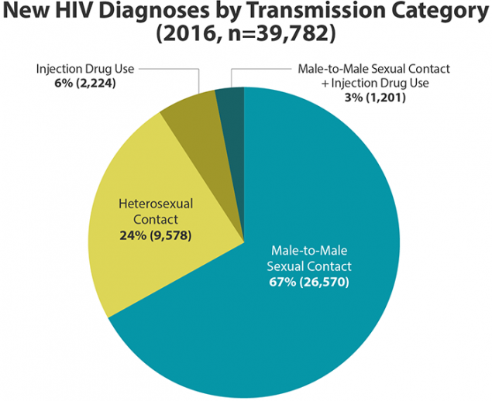

Slide 6
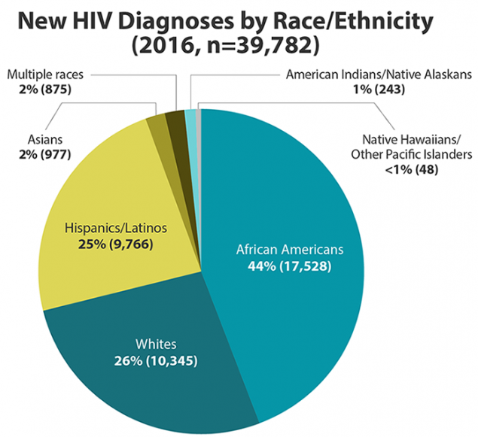

Slide 7
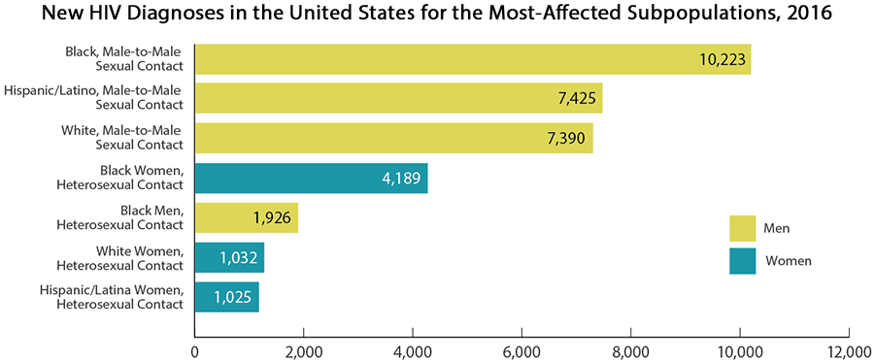
6,721 people died from HIV and AIDS in 2014. HIV remains a significant cause of death for certain populations. In 2014, it was the 8th leading cause of death for those aged 25-34 and 9th for those aged 35-44.

Slide 8
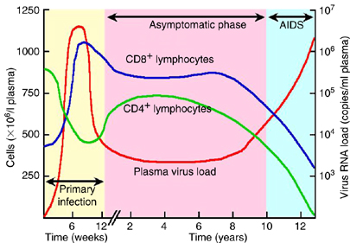
Typical Course of an HIV
Infected Individual - Untreated
Munier ML and Kelleher AD. Immunol Cell Biol. 2007 Jan;85(1):6-15. Epub 2006 Dec 5.
Notes:
Without treatment, HIV advances in stages. The three stages of HIV infection are (1) acute infection (2) clinical latency and (3) AIDS

Slide 9
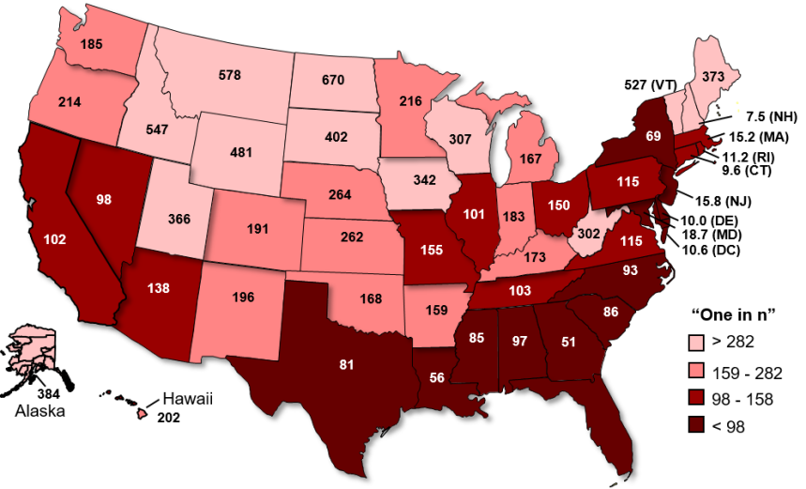
Estimating the Lifetime Risk of HIV Diagnosis in the U.S
Lifetime risk of Acquiring HIV
Male: 1 in 68
Female: 1 in 253
Lifetime Risk of an HIV
Diagnosis by US State
Lifetime risk for Men
AA 1 in 22
Hispanic/Latinos 1 in 51
Caucasians: 1 in 140
Lifetime risk for Women
AA 1 in 54
Hispanic/Latinos 1 in 256
Caucasians: 1 in 941
Ann Epidemiol. 2017 Apr;27(4):238-243 doi:10.1016/j.annepidem.2017.02.003. Epub 2017 Feb 21

Slide 10
Modes of Transmission
Only certain body fluids—blood, semen (cum), pre-seminal fluid (pre-cum), rectal fluids, vaginal fluids, and breast milk—from a person who has HIV can transmit HIV. These fluids must come in contact with a mucous membrane or damaged tissue or be directly injected into the bloodstream (from a needle or syringe) for transmission to occur. Mucous membranes are found inside the rectum, vagina, penis, and mouth.
In the United States, HIV is spread mainly by
Having anal or vaginal sex with someone who has HIV without using a condom or taking medicines to prevent or treat HIV.
For the HIV-negative partner, receptive anal sex (bottoming) is the highest-risk sexual behavior, but you can also get HIV from insertive anal sex (topping).
Either partner can get HIV through vaginal sex, though it is less risky for getting HIV than receptive anal sex.

Slide 11
Modes of Transmission
Sharing needles or syringes, rinse water, or other equipment (works) used to prepare drugs for injection with someone who has HIV.
Less commonly, HIV may be spread
From mother to child during pregnancy, birth, or breastfeeding. Although the risk can be high if a mother is living with HIV and not taking medicine, recommendations to test all pregnant women for HIV and start HIV treatment immediately have lowered the number of babies who are born with HIV.
By being stuck with an HIV-contaminated needle or other sharp object. This is a risk mainly for health care workers.
Having another sexually transmitted disease (STD) can increase the risk of getting or transmitting HIV.

Slide 12
Modes of Transmission/Health Care Workers
The average risk of HIV infection after a needle stick or cut
exposure to HlV-infected blood is 0.3% (i.e., three-tenths of one
percent, or about 1 in 300). Stated another way, 99.7% of
needle stick/cut exposures do not lead to infection.
The risk after exposure of the eye, nose, or mouth to HIV-infected
blood is estimated to be, on average, 0.1% (1 in 1,000).
The risk after exposure of non-intact skin to HlV-infected blood is
estimated to be less than 0.1%. A small amount of blood on intact skin probably poses no risk at all. There have been no documented cases of HIV transmission due to an exposure involving a small amount of blood on intact skin (a few drops of blood on skin for a short period of time).
There is only a single documented risk of occupational exposure since 1999 and no reported dental exposure since 1998.

Slide 13
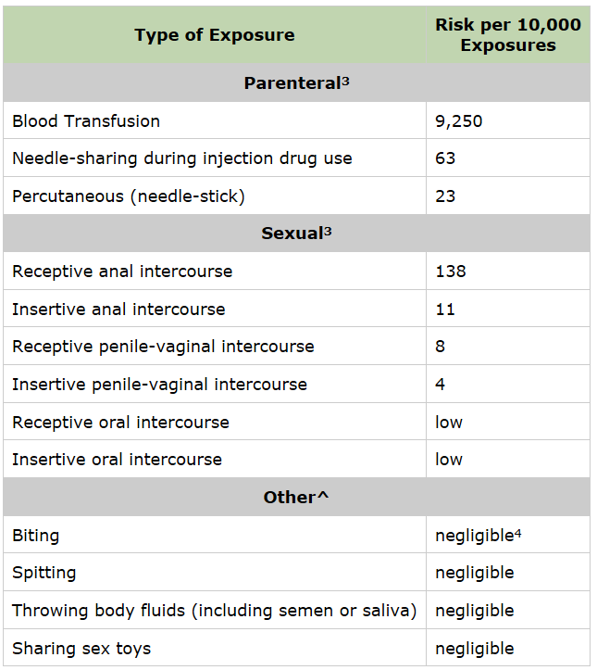
Estimated Per-Act Probability of Acquiring HIV from an Infected Source
http://www.cdc.gov/hiv/policies/law/risk.html

Slide 14
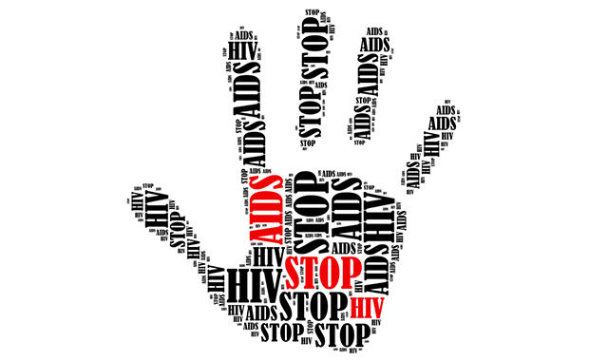
Prevention of Transmission of HIV/AIDS
Sexual
Abstinence
Barriers: condoms etc.
HIV treatment
Blood products
Testing for HIV
Discriminating use
Standard precautions
Needle exchange
Mother to Child
Anti-HIV treatment of mother
Preventative treatment of newborn
Avoidance of breastfeeding

Slide 15
Notes:
The key is that the patient needs to achieve and maintain viral suppression VL <200
Time to viral suppression, most people will achieve an undetectable VL within 6 months of starting ART
-need to have regular VL testing
Adherence is very important and the good adherence is the best way to maintain an undetectable viral load
Don’t stop meds because VL will risk quickly
The most important study is the PARTNER study published in 2016. This is an international study.

Slide 16
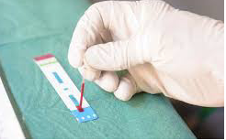
How Do We Test For HIV Infection?
HIV Antigen/Antibody Test (4th generation testing)
Can detect acute HIV infection
HIV Antibody Test (3rd generation)
Rapid HIV Test
Blood or sputum
Requires confirmation
HIV viral load
Can detect acute HIV infection

Slide 17
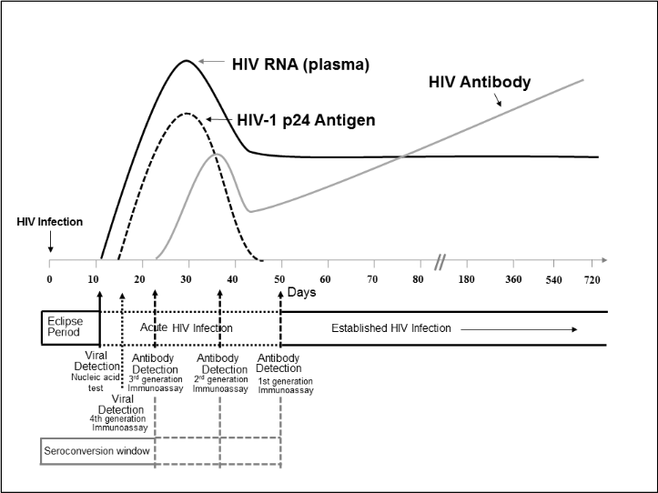
Sequence of Appearance of Lab Markers of HIV-1 Infection
Branson BM, et al. Laboratory Testing for the Diagnosis of HIV Infection: Updated Recommendations. CDC.gov. June 27, 2014.
Available at http://stacks.cdc.gov/view/cdc/23446..
Notes:
Lab markers of HIV-1 infection appear at different time points. Our ability to diagnose HIV infection depends on the diagnostic assay used the time from HIV infection. The HIV viral load becomes positive in 10-15 days from infection. The p24 antigen, a viral core protein that appears in the blood as the viral RNA rises following HIV infection, becomes positive at 15 to 20 days. Therefore, for patients in whom a diagnosis of acute HIV infection is being considered, ordering both an HIV viral load as well as 4th generation AG/Ab test may increase detection of acute infection.

Slide 18
HIV Infection: Screening Summary of Recommendations and Evidence – June 2019
Population | Recommendation-Grade A
Adolescents and Adults 15-64 Years Old | The United States Preventive Services Task Force (USPSTF) recommends that clinicians screen for HIV infection in adolescents and adults aged 15 to 65 years. Younger adolescents and older adults who are at increased risk should also be screened.
Pregnant Women | The USPSTF recommends that clinicians screen all pregnant women for HIV, including those who present in labor who are untested and whose HIV status is unknown.
https://www.uspreventiveservicestaskforce.org/Page/Name/uspstf-a-and-b-recommendations/ accessed 8-6-19

Slide 19
What happens if the test is positive?
Positive rapid tests require confirmation
Results should be communicated confidentially through personal contact
Provide counseling
HIV is a manageable disease
Discuss HIV risk reduction
Discuss ways to handle the emotional consequences of a positive result
Inform the patient that they might be contacted by health department staff
Notes:
If the HIV test is negative, results can be provided to the patient without direct personal contact between the patient and health-care provider. People known to be a high risk for HIV infection should be advised of recommendations for retesting and should be offered prevention counseling or be referred for prevention counseling.
In the event of a positive HIV test result, the healthcare provider, counselor or other skilled staff should provide results in a confidential manner. If an interpreter is needed for communication with a patient, that patient’s family or friends should not be used as interpreters to disclose HIV-positive test results.
If the test is positive, the patient should be notified in a confidential manner by the healthcare provider, nurse, counselor or other trained staff. The department of health can assist with locating and informing patients of their results in the event of testing in the emergency room or other facility from which the patient has been discharged prior to the results of the test being available. People receiving a positive HIV test result, should be encouraged to disclose their HIV status to spouses, current sex partners and previous sex partners and recommend that these partners be tested for HIV infection
Inform the patient that they might be contacted by health department staff
While a rapid test result is more than 99% accurate, supplemental testing is still needed for confirmation. In the event of a positive rapid test, disclose results in a private area and stress that the preliminary positive result needs to be confirmed with another test. Order a confirmatory HIV test and if acute HIV is suspected, order a viral load test. For all patients with a positive test, reassure the patient that he or she isn’t alone and medical care, emotional support and other services are available. Link the patient to HIV primary care either through HIV providers you know in your community or contact the Florida Department of Health in your area for assistance finding HIV providers.

Slide 20
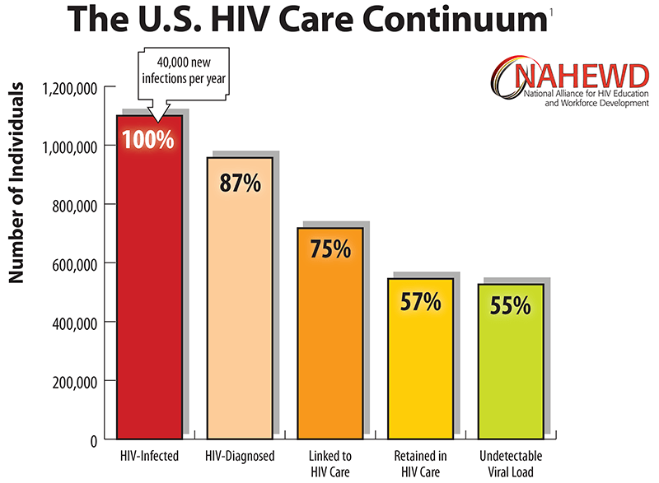

Slide 21
What is PrEP?

Slide 22
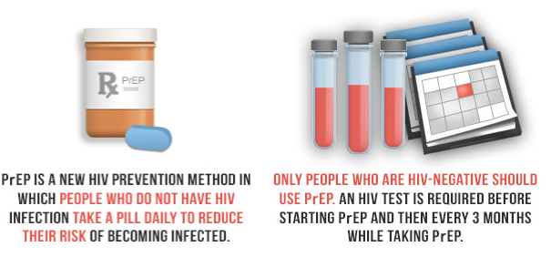
What is PrEP?
PrEP stands for Pre-Exposure Prophylaxis
PrEP is intended to prevent a person from becoming HIV infected if exposure to the virus occurs.
http://aids.gov/hiv-aids-basics/prevention/reduce-your-risk/pre-exposure-prophylaxis/
http://www.TDF/FTCpreprems.com/online-training

Slide 23
Four Scenarios of the Potential Impact of Expanded HIV Testing, Treatment and PrEP in the United States, 2015 ̶ 2020
New Infections
HIV Infections prevented due to expanded testing and treatment
HIV Infections prevents due to PrEP (assumes PrEP use among
high=risk populations = 40% MSM; 10% PWID; 10% HET)
Infections prevented through PrEP
Infections prevented through PrEP
Infections prevented through PrEP
Infections prevents through testing and treatment
Infections prevents through testing and treatment
Total number of new HIV infections
2015 through 2020
Projected new
infections by 2020
at current testing
and treatment rates
If PrEP use increases
among high-risk
populations at
current testing
and treatment rates
If 85% of people diagnosed are linked to care, 60% achieve viral suppression,
plus PrEP use
Achieving NHAS goals – if 85% of people diagnosed are linked to care, 80% achieve viral suppression, plus PrEP use
Source: Centers for Disease Control and Prevention
http://www.cdc.gov/nchhstp/newsroom/images/2016/croi_croi_four_scenarios_graph.jpg
Notes:
PWID: persons who inject drugs
HET: heterosexual

Slide 24
Antiretrovirals Used in HIV Prevention: The Foundation for PrEP
Prevention of mother-to-child transmission (PMTCT)
Antiretrovirals given to the mother during pregnancy, labor, and delivery and to the infant postpartum^{[1]}
PMTCT has virtually eliminated perinatal HIV infection in the US and other developed countries
Post-exposure prophylaxis (PEP) has been used for many years for occupational and non-occupational exposures
Antiretrovirals given within 72 hours of a known or suspected HIV exposure (for example, needle stick injury, rape)
Modified from Clinical Care Options: clinicaloptions.com/hiv
DHHS. Perinatal Guidelines. 2016

Slide 25
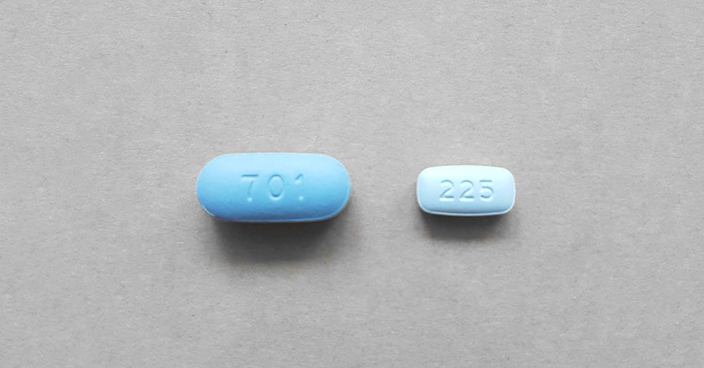
PrEP – Key Points
The approved medication is a combination of nucleos(t)ide reverse transcriptase inhibitors (NRTIs)
emtricitabine 200 mg (FTC) & tenofovir disoproxil fumarate 300 mg (TDF)
FDA approved for men & women in 2004 to treat HIV and in 2012 for PrEP
emtricitabine 200 mg & tenofovir alafenamide 25 mg (F/TAF)
FDA approved for men and transgender women who have sex with men in 2019
Both work by inhibiting HIV from replicating when it enters the body
This keeps HIV from establishing itself in the body permanently
(FTC/TDF)
(F/TAF)
Tablet not shown at actual size
Image credit: http://www.wallstreetotc.com/hiv-prevention-drug-TDF/FTC/220671/
Image credit: https://www.pan.org.au/blog/2018/11/23/descovy-as-prep

Slide 26
PrEP – Key Points (continued)
TDF/FTC or F/TAF for PrEP is one component of a comprehensive prevention strategy that includes:
Safer sex practices
Consistent use of condoms
Sexually Transmitted Disease (STD) screening
Not sharing needles or equipment
Cleaning “works”
Motivational interviewing directed at behavioral change.

Slide 27
Who Should Be Offered PrEP?
Any person at risk of acquiring HIV infection:
Recent infection of STI
History of multiple sex partners
History of inconsistent or no condom use
In a relationship with a person living with HIV
In a high HIV prevalence area or network
Commercial sex worker
Sharing needles or injection equipment
HIV-positive injecting partner
Center for Disease Control and Prevention Guidelines 2017
www.cdc.gov/hiv/pdf/guidelines/PrEPguidelines2017.pdf

Slide 28
Prescribing and Monitoring
Clinical follow-up
Every 3 months
4th generation Ag/Ab HIV testing; assess for signs symptoms of acute HIV infection; assess STI symptoms
Pregnancy testing for women who may become pregnant and offer contraception if at risk of becoming pregnant
Assess side effects, adherence, and HIV acquisition risk behaviors
Counsel regarding adherence and risk reduction
Consider STI testing—see next slides
Every 6 months
Estimated creatinine clearance
STI testing
Every 12 months evaluate need to continue PrEP
Notes:
There is clinical benefit to screening for STI every THREE months

Slide 29
Considerations When Prescribing
TDF/FTC and F/TAF are part of a comprehensive prevention plan to prevent HIV infection
Counsel patients on the importance of adherence to the prescribed medication regimen
TDF/FTC & F/TAF effectiveness is strongly correlated with consistent adherence
TDF/FTC requires 7 days for adequate rectal tissue levels & 20 days for blood and vaginal tissue protection
F/TAF lacks data for protection in vaginal tissue or for IDU – not recommended in such patients
Modified from http://www.TDF/FTCpreprems.com/online-training

Slide 30
PrEP and STIs
STARK Project, NYC Golub CROI 2016 #869
280 participants
21% had STI in 6 months prior to starting PrEP
13% at 3 months and 15% at 9 months after starting PrEP had positive STI screen
Conclusion: more frequent testing, particularly with STI hx

Slide 31
Warnings, Precautions, and Adverse Events
Renal Impairment
New onset/worsening renal impairment (including acute renal failure and Fanconi syndrome) TDF/FTC > F/TAF
Estimated creatinine clearance (eCrCl) should be assessed prior to starting PrEP medication
TDF/FTC for PrEP should not be used if CrCl is < 60 mL/min; < 30 mL/min for F/TAF
If a patient is at risk for renal impairment, then CrCl, serum phosphorus, urine glucose, and urine protein should be monitored before and during PrEP medication use
http://www.TDF/FTCpreprems.com/online-training

Slide 32
Warnings, Precautions, and Adverse Events (continued)
Bone Density
Changes in bone mineral density (BMD) and mineralization problems have been noted in those taking TDF/FTC > F/TAF
Assess BMD in patients with history of pathologic fractures and/or risk for osteoporosis or bone loss
Monitor for persistent and/or worsening bone pain, fractures, and/or muscle weakness
http://www.TDF/FTCpreprems.com/online-training

Slide 33
Women and Barriers to PrEP
Women’s lack of knowledge about PrEP, HIV-related health literacy, and HIV risk perception
Challenges identifying women who might benefit from HIV prevention with PrEP and assessing women’s risk of acquiring HIV
Healthcare provider bias based on a woman’s race, social class, or sexual behavior that might hinder effective communication about HIV risk and PrEP
High costs associated with PrEP
Lack of resources and infrastructure to provide PrEP for women in settings and venues they frequently use for healthcare
www.cdc.gov/hiv/pdf/group/gender/women/cdc-hiv-women-and-PrEP-discussion-series.pdf

Slide 34
PrEP Help Lines
For PrEP advice and inquiries, please call the PrEP line:
(855) 448-7737
or
(855) HIV-PrEP
Monday through Friday, 11 a.m. – 6 p.m. EST
Provides free, expert advice about PrEP to clinicians across the country

Slide 35
What is nPEP?
Non-occupational Post-exposure Prophylaxis (nPEP) is intended to prevent HIV infection.
Administered no later than 72 hours following an exposure.
Modified from http://aids.gov/hiv-aids-basics/prevention/reduce-your-risk/pre-exposure-prophylaxis, http://www.centerforaids.org/nPEP.html
Image credit: http://kliniknasontan.blogspot.com/?view=classic

Slide 36
Consider nPEP When:
Anyone who has had unprotected sex with a substantial risk for HIV exposure
Anyone who share injection needles or drug paraphernalia with someone else who may have a risk for HIV
Anyone who is a victim of sexual assault
The source is known to be HIV-positive and the exposure presents a substantial risk for transmission
Notes:
Substantial risk include:
Exposure of vagina, rectum, eye, mouth, or other mucous membranes, nonintact skin; with blood, semen, vaginal secretions, breast milk, or body fluids that are visibly contaminated with blood.

Slide 37
Preferred HIV nPEP Regimen
Recommended Regimen for HIV nPEP
Tenofovir DF 300 mg + Emtricitabine 200 mg taken once daily for 28 days
PLUS
*Dolutegravir 50 mg PO taken once daily with or without food for 28 days
OR
Raltegravir 400 mg PO twice daily with or without food for 28 days
*Do not use in women with pregnancy potential or on inadequate birth control or in 1st trimester of pregnancy
Alternative: Tenofovir DF 300 mg + Emtricitabine 200 mg with Darunavir 800 mg and
Ritonavir 100 mg all taken once daily with food
CrCl < 60 mL/min Zidovudine and Lamivudine (with both doses adjusted to degree of renal function) with Raltegravir 400 mg twice daily or Dolutegravir 50 mg once daily
nPEP must be started within 72 hours of exposure
Pregnancy is not a contraindication for nPEP
https://www.cdc.gov/hiv/pdf/programresources/cdc-hiv-npep-guidelines.pdf
Notes:
Page 30 of https://www.cdc.gov/hiv/pdf/programresources/cdc-hiv-npep-guidelines.pdf

Slide 38
 | Baseline only for Source | Baseline Exposed person | WK 1 | Wk 4 | Wk 12 | Wk 24
Clinic Visit | ✓ | ✓ | ✓ (or call) | ✓ | ✓ | ✓
Pregnancy Test | ✓ | ✓ |  | ✓
ALT, AST, Creatine (Can do a CMP) | ✓ | ✓ |  | ✓
HIV Ag/Ab Test (4th Generation) and Rapid HIV if available | ✓ | ✓ |  | ✓ | ✓ | ✓
Syphilis* | ✓ | ✓ |  | ✓ |  | ✓
Gonorrhea-chlamydia (all sites as appropriate) | ✓ | ✓ |  | ✓ |  | ✓
Hep B & C | ✓ | ✓ |  |  |  | ✓ (only if coinfected with Hep C)
*If infected and treated, repeat at 6 months. If not presumptively treated at baseline or is symptomatic, repeat at 4 weeks.
**If susceptible at baseline, repeat at 6 months
Notes:
Talking points:
Pregnancy is not a contraindication for nPEP
A rapid HIV test should be done at baseline if available
A urine NAAT for GC/CT should be collect as well as a swab from all sites that have been expose during sex such as Vagina, oral, and or anus.
Hep B serology, including: Hep B surface antigen, Hep B surface antibody, Hep B core antibody
HIV testing at 24 weeks is only needed if the exposed person acquired Hep C during the original exposure; Delayed HIV seroconversion has been seen in persons who simultaneously acquire HIV and Hep C infection

Slide 39
Considerations for All Patients Treated with nPEP
Use starter packs (if available)
Clinicians not experienced using ART should consult with HIV-care specialist*
However, this should not delay treatment
Facilitate adherence
Monitor for signs and symptoms associated with acute infection
*Post-Exposure Prophylaxis (PEP) Hotline
National HIV/AIDS Clinicians’ Consultation Center (NCCC):
Call for a Phone Consultation (888) 448-4911
9 a.m. – 2 a.m. EST, Seven days a week
Centers for Disease Control and Prevention, U.S Department of Health and Human Services, (2016)
Notes:
For Florida providers, you can contact the Walgreens Specialty pharmacy supervisor in your area. They will consider starting a specialty nPEP and PrEP service in your area. Then any provider can submit prescriptions for PrEP or for nPEP and they will fill and complete and follow-up the patient assistance program requirements. Pts will not have to wait on their drug. They will get it on arrival.
John Begert john.begert@walgreens.com 954-706-6657 FLL/Daytona/FtMyers
Rona Saunders rona.saunders@walgreens.com 786-510-3229 South Florida
Nancy Tishler nancy.tishler@walgreens.com 727-776-7988 Tampa Bay/Orlando
David Hayes david.hayes@walgreens.com 904-295-4695 North Florida
George Kress george.kress@walgreens.com 954-540-9323 HIV Pharmacist Lead State of Florida

Slide 40
Considerations for All Patients Treated with nPEP (continued)
Follow up HIV test 4th generation antibody/antigen at 4-6 weeks and 3 months
Follow up HIV test 4th generation antibody/antigen at 6 months (if person acquired Hep C during the original exposure; Delayed HIV seroconversion has been seen in persons who simultaneously acquire HIV and Hep C infection)
HIV PCR/RNA viral load testing if signs/symptoms of acute HIV infection occur
If positive HIV viral load – draw HIV-1 genotype and begin combination antiretroviral therapy (ART) by accessing a Test and Treat program, if Test and Treat program is not available start ART as soon as possible
HIV prevention and risk reduction counseling
Consider appropriateness for PrEP and plan to start PrEP at the finish of nPEP to avoid any break in protection
Centers for Disease Control and Prevention, U.S Department of Health and Human Services, (2016)
Lifson, A. R., et al., (2017, April 24). Improved quality of life with immediate versus deferred initiation of antiretroviral therapy in early asymptomatic HIV infection. AIDS, 31(7), 953-963.

Slide 41
Patient Assistance for nPEP: When the Patient has Insurance
Patient Advocate Foundation (PAF) Co-Pay Relief:
If the patient has health insurance and the insurance covers medications for which patient needs assistance
PAF CareLine 800-532-5274
Gilead’s Co-Pay Coupon Program:
If the patient has commercial insurance, he/she may contact or be referred to Gilead’s Co-Pay Coupon Program
1-877-505-6986
The patient is given an authorization number to present with the prescription and other insurance at the pharmacy

Slide 42
New Approaches and Developments for PrEP

Slide 43
Notes:
The key is that the patient needs to achieve and maintain viral suppression VL <200
Time to viral suppression, most people will achieve an undetectable VL within 6 months of starting ART
-need to have regular VL testing
Adherence is very important and the good adherence is the best way to maintain an undetectable viral load
Don’t stop meds because VL will risk quickly
The most important study is the PARTNER study published in 2016. This is an international study.

Slide 44
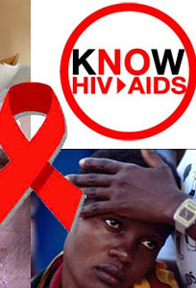
Thank you
We are available for clinical consultations and trainings

