Slide 1
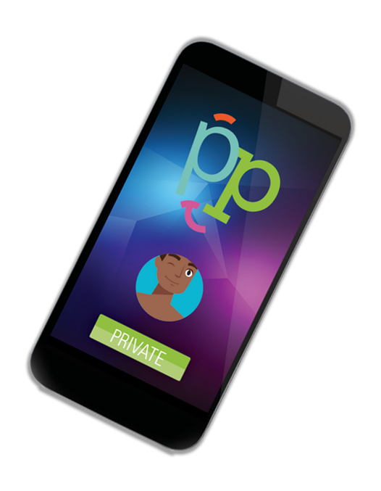
Positive Peers: A nationwide app connecting young people with HIV to each other & retaining them in care
Jennifer McMillen Smith, MSSA, LISW-S
Project Director
The MetroHealth System, Cleveland, OH

Slide 2
Faculty Disclosure
This program is supported by the Health Resources and Services Administration (HRSA) of the U.S. Department of Health and Human Services (HHS) under grant number U1OHA30535 as part of an award totaling $4.2m. The contents are those of the author(s) and do not necessarily represent the official views of, nor an endorsement, by HRSA, HHS, or the U.S. Government. For more information, please visit HRSA.gov.
“Funding for this presentation was made possible by cooperative agreement U1OHA30535 from the Health Resources and Services Administration HIV/AIDS Bureau. The views expressed do not necessarily reflect the official policies of the Department of Health and Human Services nor does mention of trade names, commercial practices, or organizations imply endorsement by the U.S. Government. Any trade/brand names for products mentioned during this presentation are for training and identification purposes only.”

Slide 3
Educational Need/Practice Gap
The younger a person is, the less likely they are retained in HIV care and achieving sustained viral suppression. Nationwide in 2019, just 63% of people in the youngest age range, 13-24, were virally suppressed.
CDC. Monitoring selected national HIV prevention and care objectives by using HIV surveillance data—United States and 6 dependent areas, 2019. HIV Surveillance Supplemental Report 2021;26(2).

Slide 4
Young people living with HIV (YPLWH) are very likely to be at the intersection of multiple marginalized identities (LGBTQIA) and disenfranchised communities (BIPOC) – and often experience compounding stigma, isolation and social drivers of health-related barriers to HIV care, overall health and longevity.
Reisner SL, Jadwin-Cakmak L, White Hughto JM, Martinez M, Salomon L, Harper GW. Characterizing the HIV prevention and care continua in a sample of transgender youth in the US. AIDS Behav 2017 Dec;21(12):3312-3327 [doi:10.1007/s10461-017-1938-8]
Senn TE, Braksmayer A, Coury-Doniger P, Urban MA, Rossi A, Carey MP, Development and preliminary pilot testing of a peer support text messaging intervention for HIV-infected black men who have sex with men. J Acquir Immune Defic Syndr 2017 Feb 01;74(Suppl 2):S121-S127 [doi: 10.1097/QAI.0000000000001241]

Slide 5
Objectives
Upon completion of this activity, participants will be able to:
Identify unique challenges of achieving sustained viral suppression faced by young people living with HIV.
Recognize the Positive Peers App mHealth intervention as a tool to decrease stigma perception and increase retention in care.
Use Affordance Theory to conceptualize human interaction with and via mHealth technology.

Slide 6
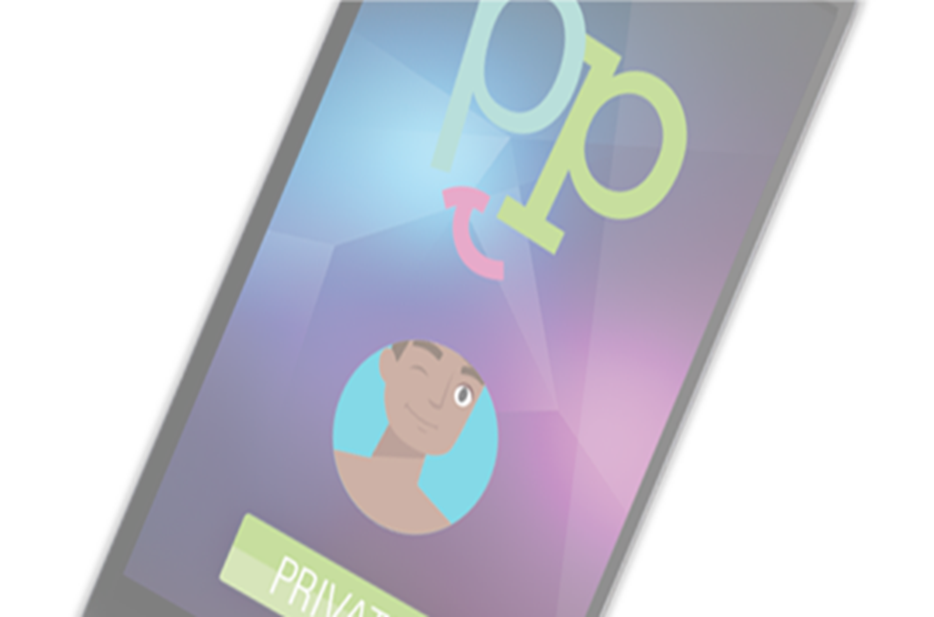
Expected Outcome
Consider recommending Positive Peers for YPWH so they can connect with peers and maximize chances for retention in care & viral suppression.

Slide 7
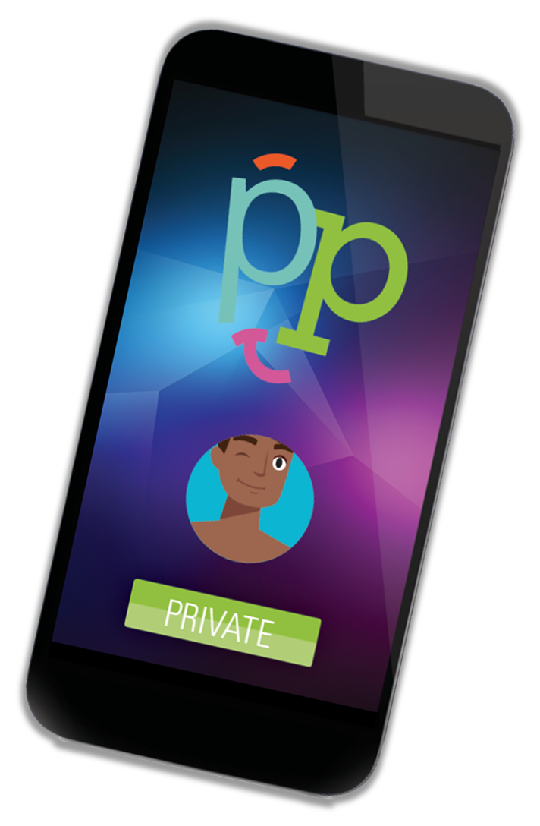
Intervention Overview
Positive Peers is an app with companion social media and a website that aims to engage young people in HIV care and connect them to a private, stigma-free, supportive community of peers from all over the US positivepeers.org @PositivePeers4U

Slide 8
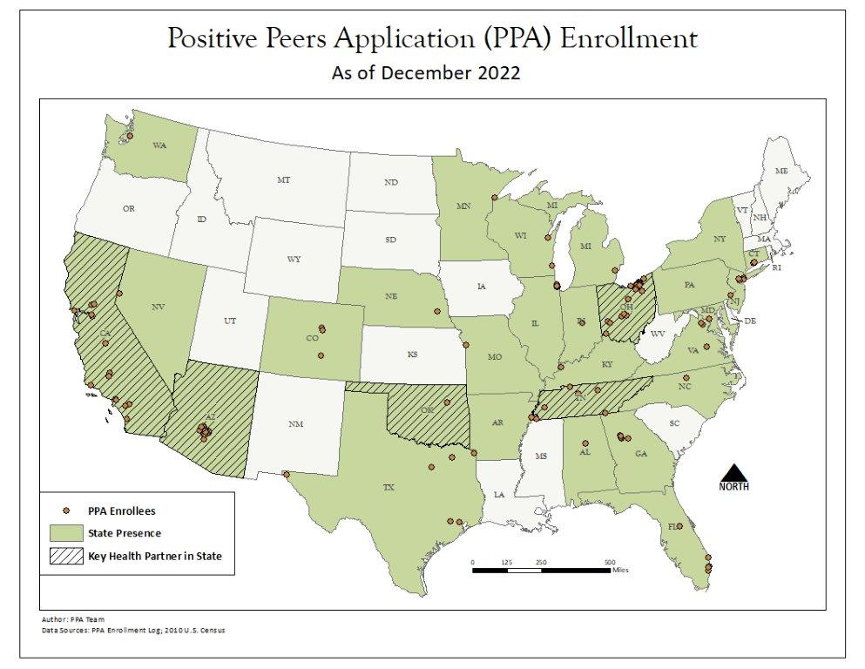
Demographic Overview
Positive Peers is always free for young people with HIV and has users from all over the United States

Slide 9
What are the top 2 ways you usually use your favorite social app?
Connect with family and friends
Meet new people
For News / current events
To Learn things
Be aware of the cool things going on in my area (cultural events, new restaurants, etc)
Following the latest trends and celebrities
Watch funny videos
View other peoples’ drama / lurk / troll

Slide 10
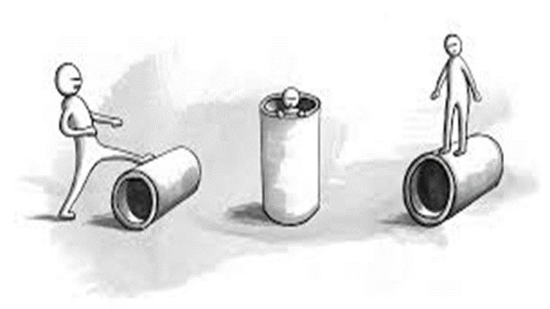
Media Affordance Theory
Positive Peers is based on Media Affordance Theory
Affordances are features of user/technology interaction that offer gratification of perceived needs
Affordances emerge from interaction with technologies (Leonardi, 2011)
Experimentation and adaptation shape user’s perceptions of how technology can work for them
Relational actions occur among users with technologies (Leonardi & Barley, 2008; Faraj & Azad, 2012)

Slide 11
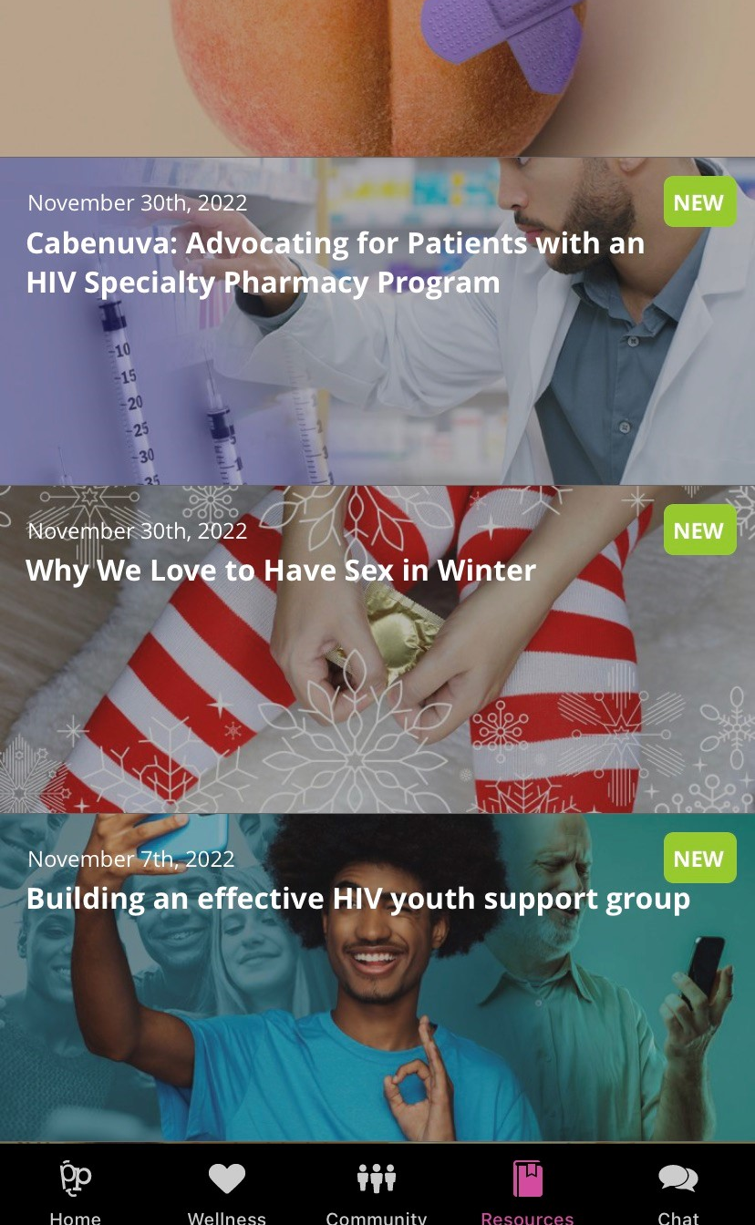
Positive Peers Provides:
Accurate, easy-to-understand HIV health and wellness education information in 300+ articles written at a 6th grade level
Medical News Today named Positive Peers one of the top 10 best blogs on HIV/AIDS in 2018
MyTherapy listed Positive Peers among the top 10 Best HIV and AIDS Blogs in 2019
FeedSpot named Positive Peers one of the Top 50 HIV Blogs, Websites and Influencers in 2019 and 2020
Verywell Health named Positive Peers one of the 7 Best HIV Support Groups of 2021
WebMD lists Positive Peers as a support app for PWH

Slide 12
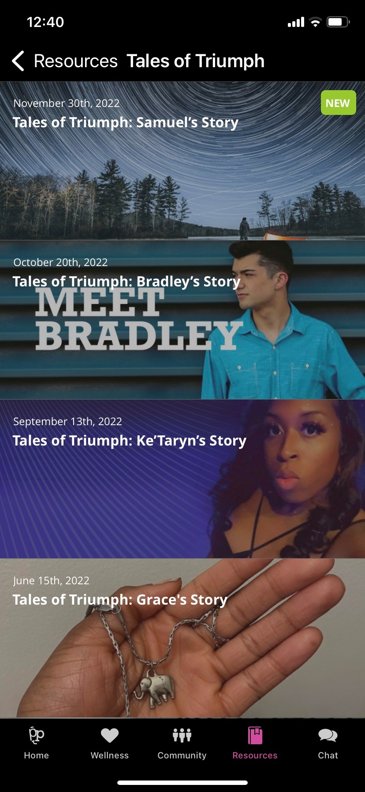
Tales of Triumph
Personal stories of real young people living with HIV

Slide 13
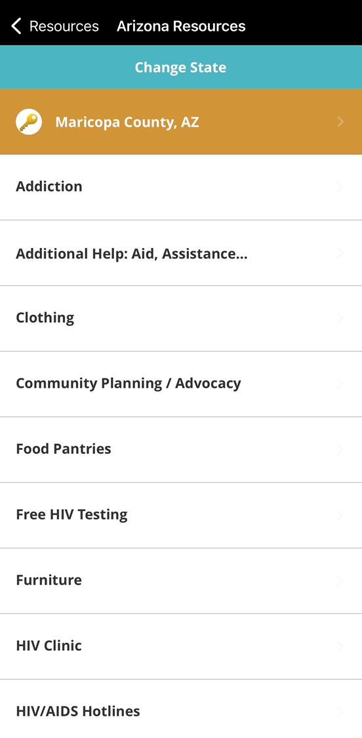
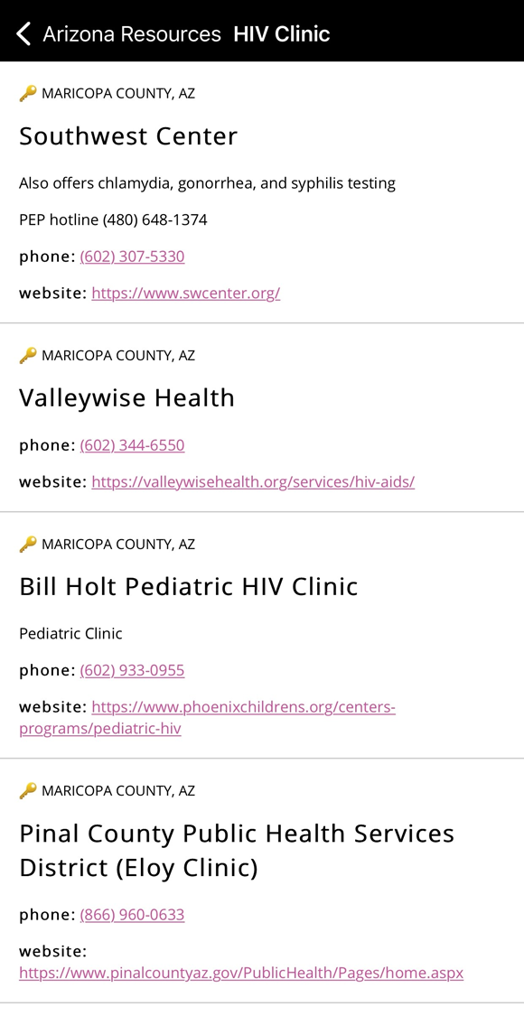
Resources
Positive Peers provides curated community resources that can be customized and maintained by Key Health Partners

Slide 14
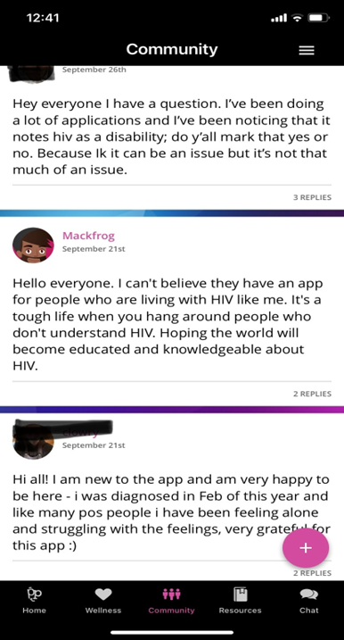
Community Connection
Positive Peers Provides:
Human connection in a virtual space through social networking in a community conversation and private chats

Slide 15
Community
Similar to posting on Facebook or an online forum
Everyone can see and reply to posts
Admins can add in links to external or in-app content
Everyone can use emojis ☺ and GIFs
Participants cannot upload and share pictures or videos

Slide 16
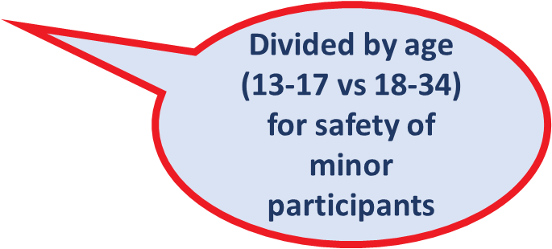
Chat
App 2.0 upgrade includes extra admin features in chat – all users in that geographic area are listed for easy one-click messaging by admins
Users and Key Health Partner admins can message one another
Similar to direct messaging (DMs) on Instagram

Slide 17
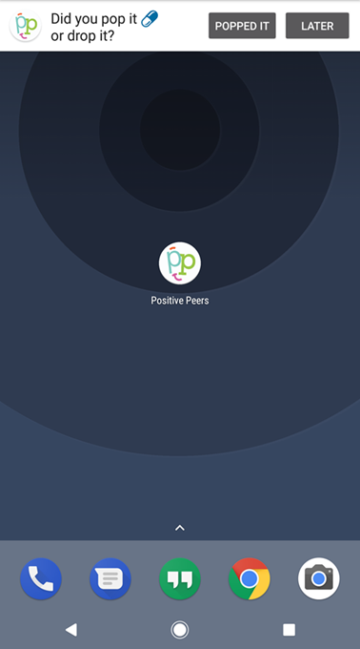
Health Management Tools
Positive Peers Provides health management tools, such as our customized medication reminder

Slide 18
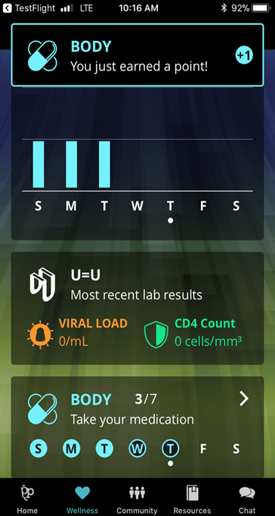
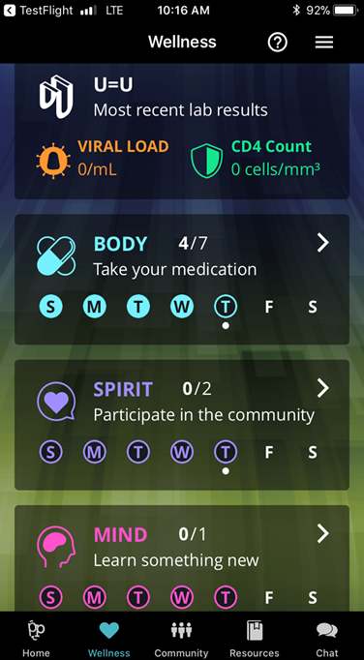
Wellness Tracker
Positive Peers Provides:
A Wellness Tracker where users can accumulate daily points in mind, body, and spirit

Slide 19
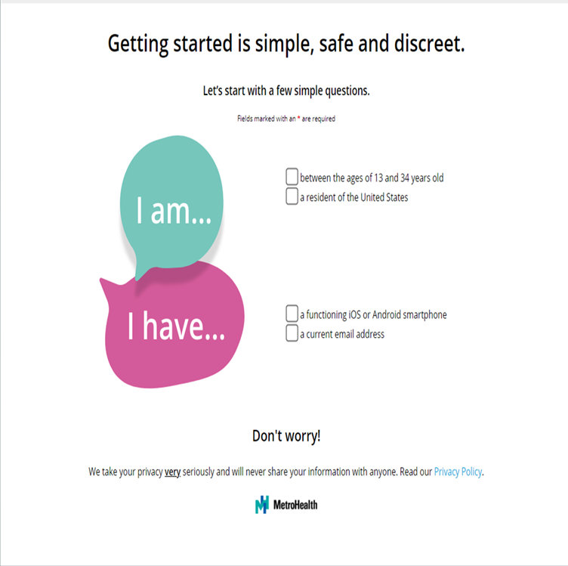
Enrollment
Positive Peers Provides:
FREE and easy online enrollment
Option to upload proof of age and status or choose to allow Key Health Partner to verify eligibility

Slide 20
Intervention Successes
After initial SPNS grant period ended and Positive Peers was well received, MetroHealth used local and internal resources to fund a scale-up strategy to bring the app to all eligible young people with HIV in the US for FREE
As of the end of 2022, there are app users from 25 different states, and we have Key Health Partnerships in 5 different states:
Maricopa County Ryan White, AZ
Sacramento County Ryan White, CA
Tennessee Department of Health, TN
Equitas Health, an ASO in OH
Oklahoma State Department of Health, OK

Slide 21
Published Outcomes – JMIR 2022
Positive Peers app use and viral suppression
One year after enrollment in the study, app users on average experienced more optimal health outcomes than the comparison group
App users overall were 1.66 times more likely to attend office visits than those who did not use the app
The youngest group, ages 13-24, were 2.85 times more likely to obtain HIV laboratory tests and were 4.22 times more likely to achieve HIV viral suppression than the comparison group

Slide 22
Published Outcomes – HPP 2020
Positive Peers app use and stigma
Black participants reported less stigma than other participants both at baseline and over time (Specific stigma measures included: overall stigma, personal stigma, disclosure stigma, self image stigma, and perceived public attitudes)
Overall stigma and public attitudes stigma lessened for all participants over all time points
Participants who were under 25 years old reported less disclosure stigma over time (p=.06; p=.03)
Participants who were 30 years and older reported less public attitudes stigma over time (p=.01)
There is a trending inverse relationship for broad use of the app and disclosure stigma (p =.09)

Slide 23
Positive Peers App Benefits
Meet young people where they are
Young people see their phones and social media as their most important means of communicating and socializing. Positive Peers is a way to meet them where they are.
Young people often change their addresses, phone numbers, and even email addresses. They typically do not change social media handles—so once a person is registered for Positive Peers, you have another way to reach them and (re)engage them in care if needed.
Promotional materials and training
Spread awareness of the app within your community with available posters, marketing handouts, promotional pins, and stickers provided by the interventionist.
Receive virtual training, upon request, to better understand the features and administration of the app.

Slide 24
Positive Peers App Benefits (continued)
Admin access
A mutually agreed-upon staff member will have admin access to interact directly with users in your geo-location
Post and reply to all Positive Peers users within the community forum
Send private chats & push notifications
Provide regional content for your community
Curate a regional calendar for local events
Add your community resources
Share success stories about your local young people with HIV (YPWH) in Tales of Triumph
Local, aggregate data
Get data about local YPWH from optional baseline surveys

Slide 25
References
The Positive Peers Monograph and Implementation Manual located under the SPNS Social Media Initiative Demonstration Site website (Target HIV): Click on this link and scroll down to “Positive Peers Application (PPA) - Mobile App”: https://targethiv.org/library/spns-social-media-initiative-demonstration-site-resources
“Positive Peers”: Function and Content Development of a Mobile App for Engaging and Retaining Young Adults in HIV Care:
https://formative.jmir.org/2020/1/e13495/
Positive Peers Mobile Application Reduces Stigma Perception Among Young People Living With HIV:
https://journals.sagepub.com/doi/pdf/10.1177/1524839920936244
The Use of Positive Peers Mobile App to Improve Clinical Outcomes for Young People With HIV: Prospective Observational Cohort Comparison:
https://mhealth.jmir.org/2022/9/e37868/

Slide 26
Q & A
PI: Ann K. Avery, MD
aavery@metrohealth.org
Project Director: Jen McMillen Smith, MSSA, LISW-S
jmsmith@metrohealth.org
Visit & Follow: positivepeers.org @PositivePeers4U

Slide 27
AETC Program
National Centers and National HIV Curriculum
National Coordinating Resource Center serves as the central web based
repository for AETC Program training and capacity building resources; its
website includes a free virtual library with training and technical assistance
materials, a program directory, and a calendar of trainings and other events.
Learn more: https ://aidsetc.org
National Clinician Consultation Center provides free, peer to peer,
expert advice for health professionals on HIV prevention, care, and treatment
and related topics. Learn more: https ://nccc.ucsf.edu
National HIV Curriculum provides ongoing, up to date HIV training and
information for health professionals through a free, web based curriculum;
also provides free CME credits, CNE contact hours, CE contact hours, and
maintenance of certification credits. Learn more: www.hiv.uw.edu

