Slide 1
Neurocognitive Screening in HIV
Alex Young PsyD
Notes:
Version date_05 2023

Slide 2
Conflict of Interest Disclosure Statement
The presenter has no conflicts to declare.
This program is supported by the Health Resources and Services Administration (HRSA) of the U.S. Department of Health and Human Services (HHS) as part of an award totaling $3,132,205, with 0% financed with non-governmental sources. The contents are those of the author(s) and do not necessarily represent the official views of, nor does mention of trade names, commercial practices, or organizations imply an endorsement by HRSA, HHS, or the U.S. Government. For more information, please visit HRSA.gov. Any trade/brand names for products mentioned during this presentation are for training and identification purposes only.

Slide 3
Learning Objectives
Discuss HIV and its effects on cognitive processes.
Assist learners in conceptualizing when to engage in neurocognitive screening.
Learn about various brief memory screeners that may be helpful neurocognitive impairment.

Slide 4
HIV effects on cognition
HIV can cause premature aging of the brain and create cognitive decline. Longitudinal studies have shown that over time patients can develop issues with memory and cognitive functioning.
Important factors to keep in mind include medication adherence, drug usage, and other health factors such as heart disease.

Slide 5
HIV effects on cognition
HAND otherwise know as ”HIV associated neurocognitive disorder” exists on a spectrum that provides some guidance for staging cognitive decline.
Mild with no functional associated neurocognitive impairment (ANI)
Cognitive difficulties with mild functional impairment Motor Neuron Disease (MND)
Dementia with significant functional impairment HIV Associated Disorder (HAD)
HAND occurs in 30-50% of patients over their lifetime.

Slide 6
Screening for HAND
Screening suggestions vary by study and country. One study recommended that screening within six months of diagnosis, before ART initiation, every 6–12 months if there is a high risk, every 12–24 months if there is low risk, and immediately if there is any clinical deterioration.

Slide 7
Asymptomatic Neurocognitive Impairment (ANI)
ANI accounts for 70% of all HAND cases
Characteristics include impairment on neurocognitive testing without daily functioning difficulties
There is controversy as to the usage of ANI and its possible distress for patients.

Slide 8
Asymptomatic Neurocognitive Impairment (ANI)
Some studies have shown that ANI can be an archaic title based on previous damage caused by HIV that is non-progressive. However, other studies suggest that those with ANI may progress to functional worsening compared to those without
Its important to assess how patients are reporting symptoms of cognitive decline such as self-report, observation, or professional assessment
Regardless patients with ANI are 3x more likely to develop everyday difficulties compared to health peers

Slide 9
Other considerations
Starting Antiretroviral therapy (ART) as soon as possible
Remaining undetectable
ART toxicity
Comorbid health conditions
Access to healthcare
Minority populations
Other medications
Diphenhydramine
Topiramate
Hydroxyzine

Slide 10
A focus on Latin communities
Latin communities make up 14% of the US population, but 18% of persons living with HIV (PWH) in the US
Another point of information suggests 18% and 26% respectively
Latinos are more likely to be diagnosed with late- stage HIV compared to peers
These diagnoses were more like to be discovered during inpatient visits to hospitals

Slide 11
A focus on Latin communities
Years life lost after HIV diagnosis were greater in Latino patients than non-Hispanic black or white peers
Interestingly Latino men rather than women are more likely to be diagnosed later with infection
Possibly due to other female-focused visits such as routine gynecologic exams
Lastly subgroups of the Latin population vary in their healthcare presentation

Slide 12
Testing Instruments
IHDS-International HIV Dementia Scale
MoCA-Montreal Cognitive Assessment
MMSE- Mini Mental Status Exam
SLUMS- The Saint Louis University Mental Status Exam
BOMC- Blessed Orientation Memory Concentration
Mini-Cog

Slide 13
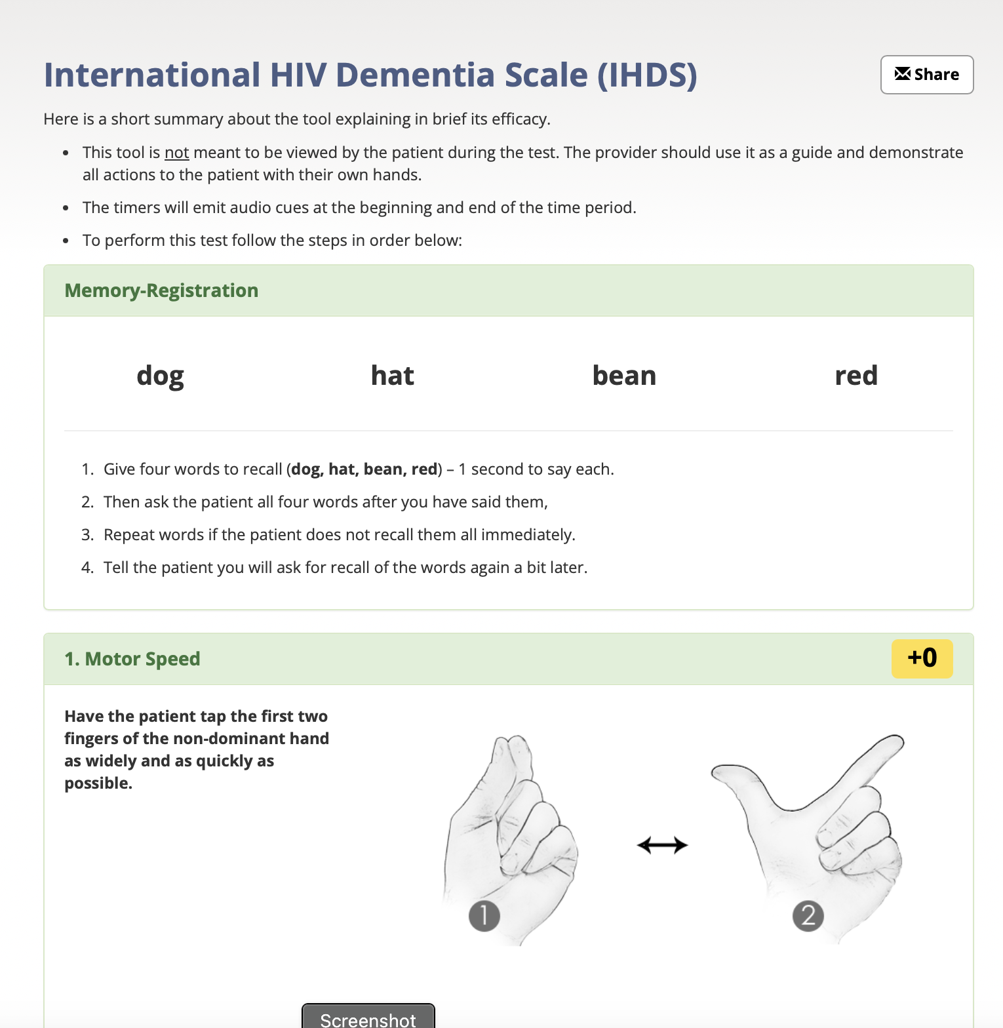
IHDS
IHDS and HDS are specific memory screeners for cognitive decline in persons with HIV
However, research suggests that it is not reliable and is a poor predictor
This is especially true for persons with low to mild cognitive impairment
https://www.hiv.uw.edu/page/mental-health-screening/ihds

Slide 14
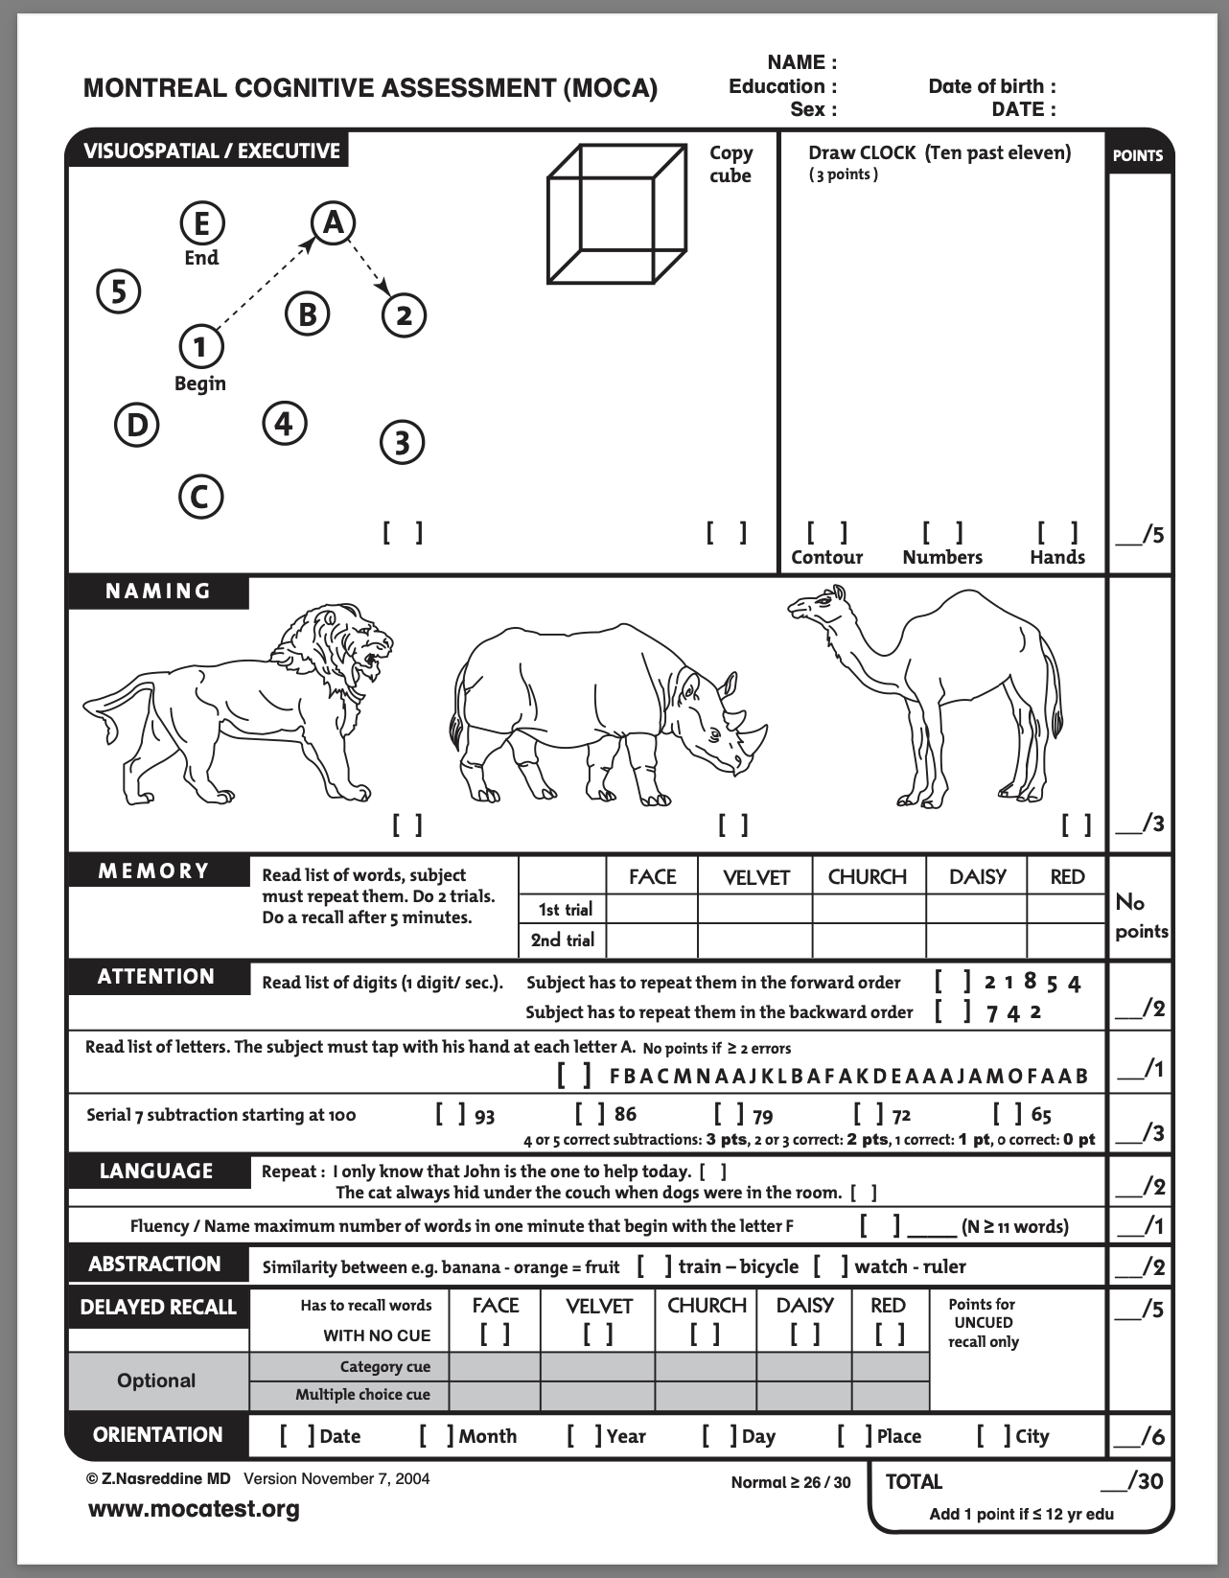
MoCA
Research suggests that the MoCA is a reasonable measure to use for individuals with suspected cognitive impairment from HIV
However, the score should be lowered from 26 to 23
This lowering can reduce false positives and improve accuracy
Any score equal to or greater than 26 is considered “normal”
Recommended to be combined with other measures

Slide 15
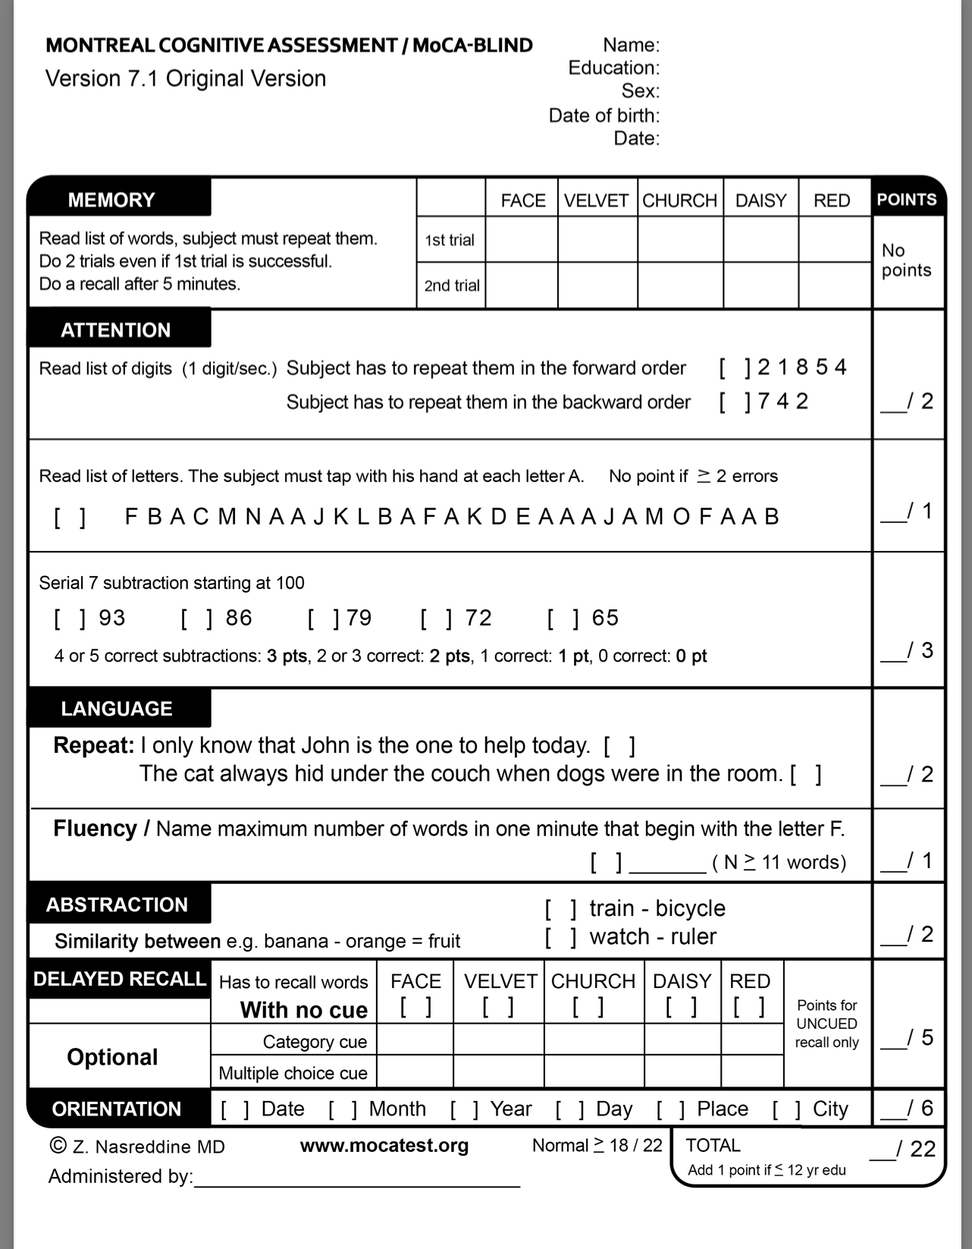
MoCA-Blind

Slide 16
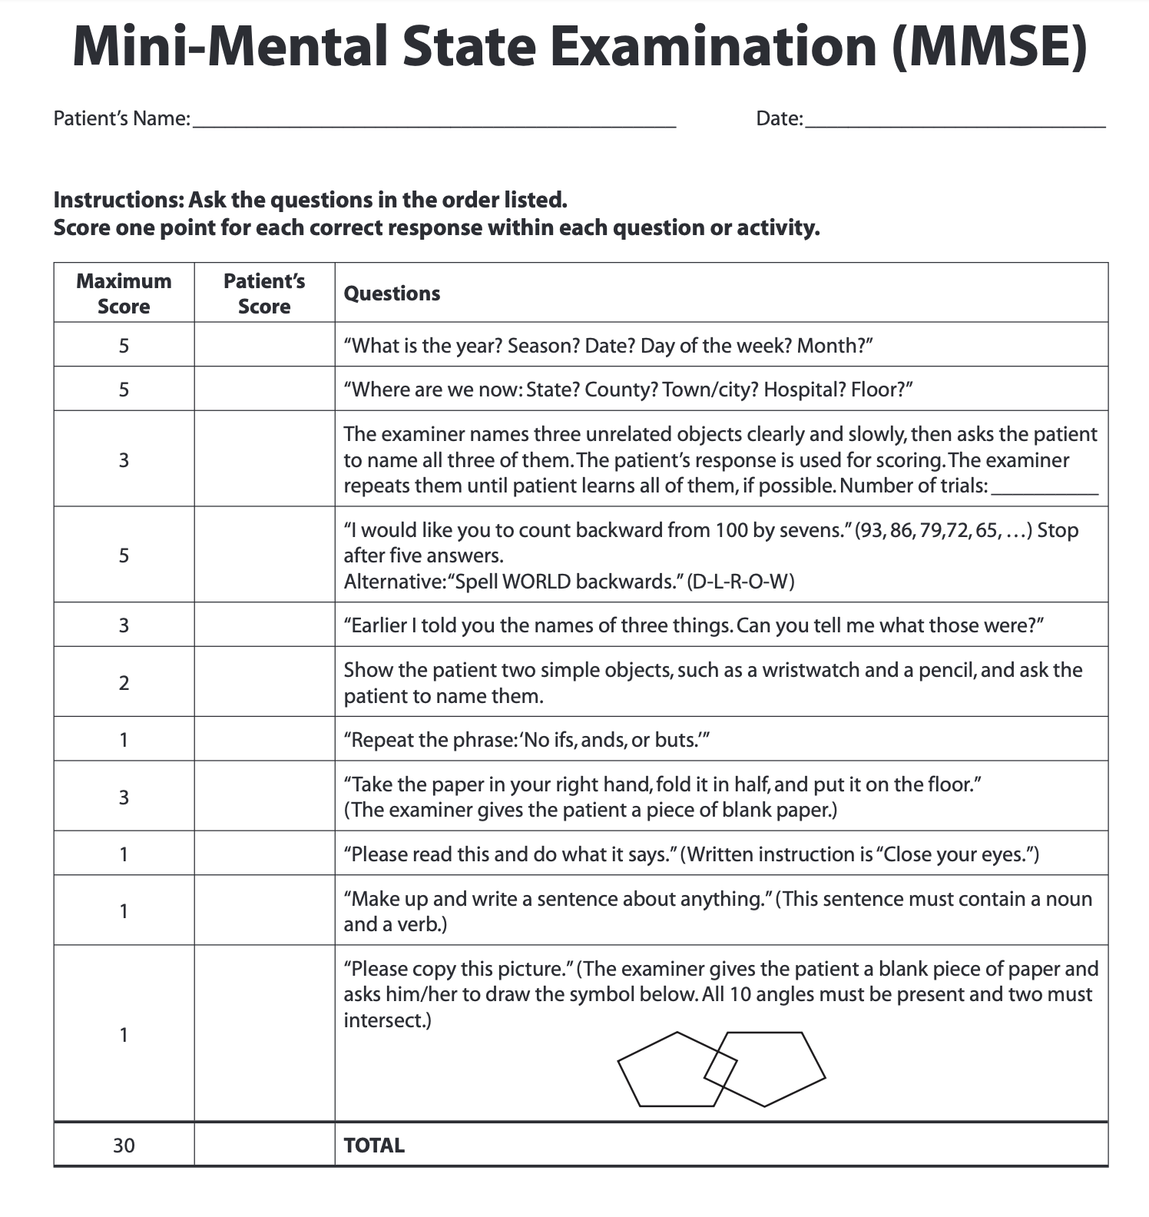
MMSE
Research suggests that overall, the MMSE is not a superior tool for the identification of HAND
In some studies, it produced similar findings to that of the IHDS and HDS
Some studies have suggested that educational level may play a role in false positives
Scores below 25 are considered “abnormal”
Notes:
The greater the education level the lower this performs due to compensation.

Slide 17
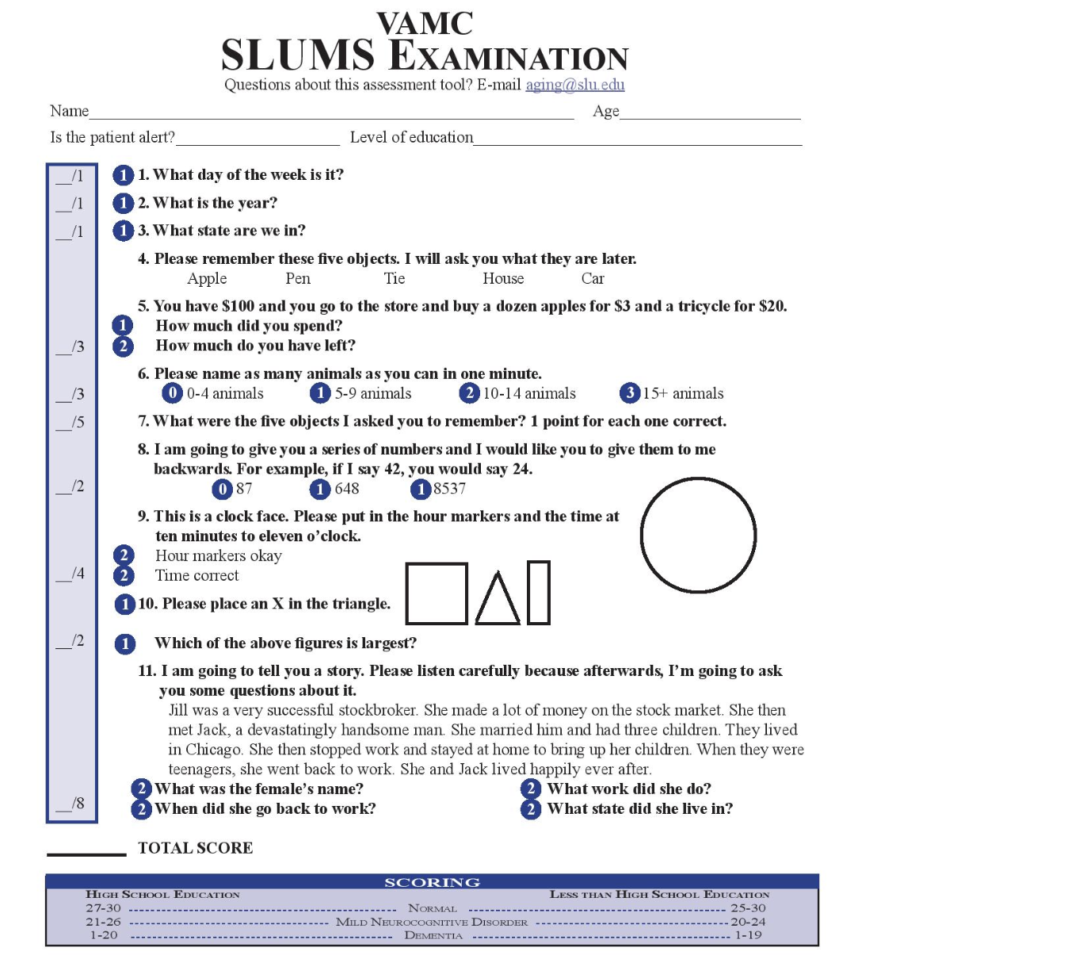
SLUMS
There is little to no research on the use of the SLUMS with HIV related cognitive impairment
Q1-Q3: Attention, immediate recall, and orientation
Q4 and Q7: Delayed recall with interference
Q5: Numeric calculation and registration
Q6: Memory: immediate recall with interference (time constraint)
Q8: Registration and digit span
Q9: Visual spatial
Q10: Visual spatial and executive function
Q11: Executive function plus extrapolation
Notes:
Comes in a variety of languages.
Does have a higher-level questions compared to alternatives

Slide 18
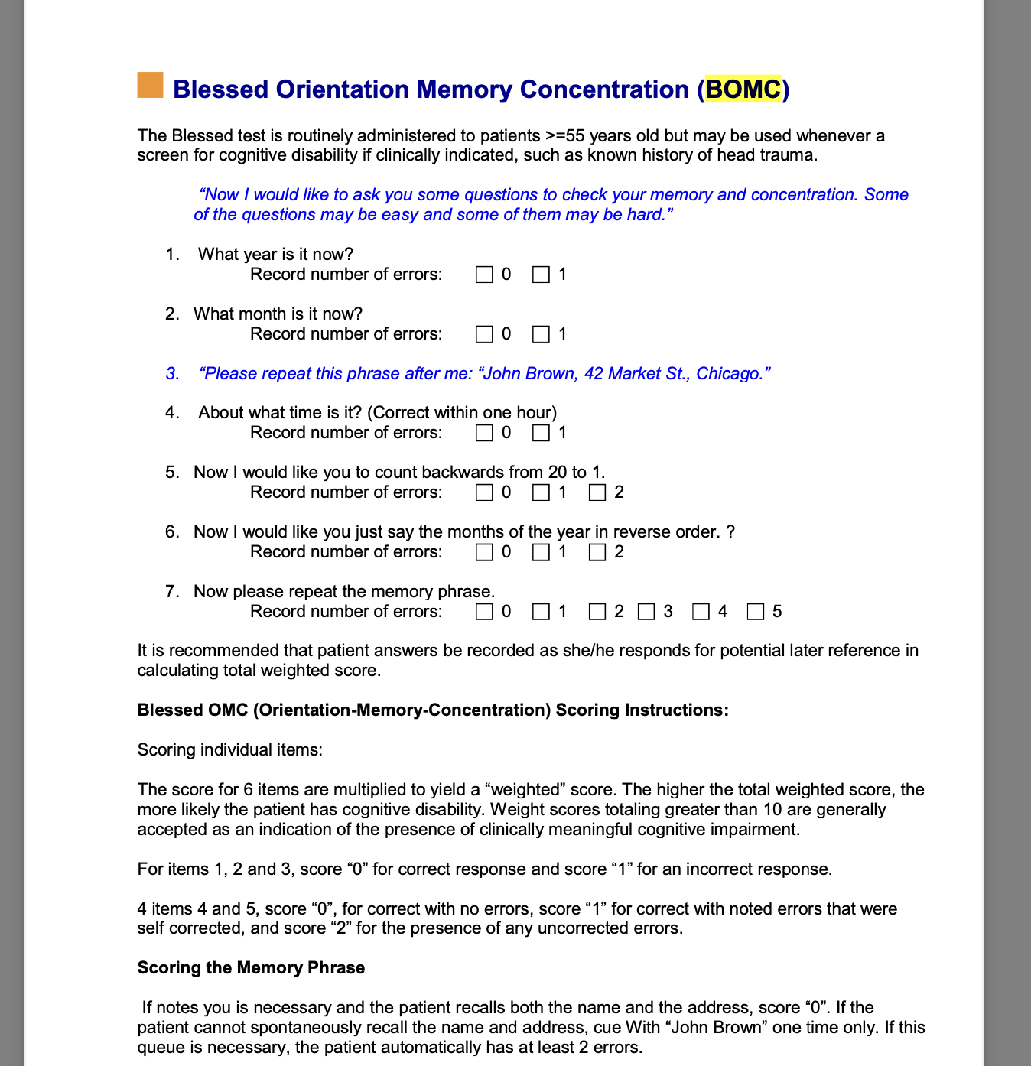
BOMC
Score max is 28
4 or under is normal
10 or more is consistent with dementia
Primarily used for older adults greater than 55
Quick and dirty memory test
Not good on its own
Can create false positives

Slide 19
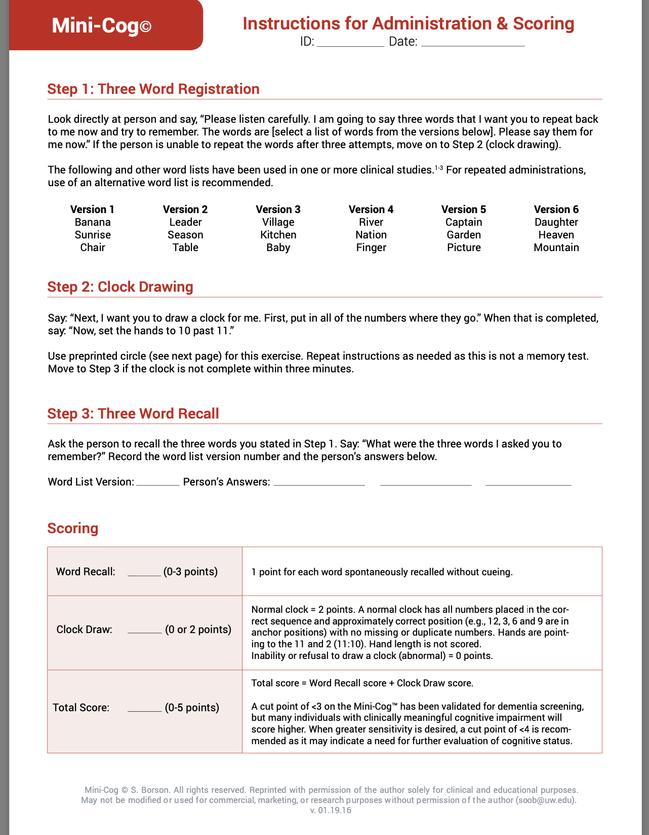
Mini-Cog
Little to no research involving the Mini-Cog and HIV populations
However, this simple 3 item test has a 76% specificity and an 89% of detecting dementia
Has a lower educational threshold, but due to its briefness may not be able to identify milder symptoms
Should be used with another measure

Slide 20
Conclusion
Brief neurocognitive screening should be a regular occurrence for individual living with HIV
This screening is even more important for older individuals
Other factors such as depression, anxiety, substance use disorder, and medication usage can alter the results of these screeners
Memory Screeners should be used in tandem with each other to ensure that false positives and false negatives are not missed
HAND is common occurrence for those living with HIV with ANI being the most common

Slide 21
Resources
National Clinician Consultation Center http://nccc.ucsf.edu/
HIV Management
Perinatal HIV
HIV PrEP
HIV PEP line
HCV Management
Substance Use Management
Present case on ECHO https://hsc.unm.edu/scaetc/programs-services/echo.html
AETC National HIV Curriculum https://aidsetc.org/nhc
AETC National Coordinating Resource Center https://targethiv.org/library/aetc-national-coordinating-resource-center-0
Additional trainings scaetcecho@salud.unm.edu
www.scaetc.org
Notes:
Find an HIV-related topic TeleECHO in your area: https://echo.unm.edu/locations-2/echo-hubs-superhubs-united-states/
IDEA Platform: Infectious Diseases Education & Assessment. https://idea.medicine.uw.edu/
AETC National HIV Curriculum: 6 core modules for self study; regularly updated; CME, CNE
Hepatitis C Online Curriculum: https://www.hepatitisc.uw.edu/
Hepatitis B Online Curriculum: https://www.hepatitisb.uw.edu/
National STD Curriculum: https://www.std.uw.edu/

Slide 22
SCAETC Social Media

Slide 23
References
Chen, N. E., Gallant, J. E., & Page, K. R. (2012). A systematic review of HIV/AIDS survival and delayed diagnosis among Hispanics in the United States. Journal of Immigrant and Minority Health, 14, 65-81.
Cohen, R. A., Seider, T. R., & Navia, B. (2015). HIV effects on age-associated neurocognitive dysfunction: premature cognitive aging or neurodegenerative disease?. Alzheimer's research & therapy, 7(1), 1-10.
Grant, I., Franklin, D. R., Deutsch, R., Woods, S. P., Vaida, F., Ellis, R. J., ... & CHARTER Group. (2014). Asymptomatic HIV-associated neurocognitive impairment increases risk for symptomatic decline. Neurology, 82(23), 2055-2062.
Heaton, R. K., Franklin Jr, D. R., Deutsch, R., Letendre, S., Ellis, R. J., Casaletto, K., ... & Teshome, M. (2015). Neurocognitive change in the era of HIV combination antiretroviral therapy: the longitudinal CHARTER study. Clinical Infectious Diseases, 60(3), 473-480.
Rosca, E. C., Albarqouni, L., & Simu, M. (2019). Montreal cognitive assessment (MoCA) for HIV-associated neurocognitive disorders. Neuropsychology Review, 29(3), 313-327.
Lyon, M. E., McCarter, R., & D'Angelo, L. J. (2009). Detecting HIV associated neurocognitive disorders in adolescents: what is the best screening tool?. Journal of adolescent health, 44(2), 133-135.
Skinner, S., Adewale, A. J., DeBlock, L., Gill, M. J., & Power, C. (2009). Neurocognitive screening tools in HIV/AIDS: comparative performance among patients exposed to antiretroviral therapy. HIV medicine, 10(4), 246-252.
Ances, B. M., & Ellis, R. J. (2007, February). Dementia and neurocognitive disorders due to HIV-1 infection. In Seminars in neurology (Vol. 27, No. 01, pp. 086-092). Copyright© 2007 by Thieme Medical Publishers, Inc., 333 Seventh Avenue, New York, NY 10001, USA..
Falk, N., Cole, A., & Meredith, T. J. (2018). Evaluation of suspected dementia. American family physician, 97(6), 398-405.
Rosca, E. C., Tadger, P., Cornea, A., Tudor, R., Oancea, C., & Simu, M. (2021). International HIV dementia scale for HIV-associated neurocognitive disorders: a systematic review and meta-analysis. Diagnostics, 11(6), 1124.

