Slide 1
HIV Prevention Update
Carly Floyd, PharmD, PhC, AAHIVP, CDCES, TTS
Clinical Director, NM and El Paso Partner Site (UNM-AETC)
South Central AIDS Education and Training Center
Notes:
Version date_05/2023
Target participants: Pharmacists and Technicians

Slide 2
Conflict of Interest Disclosure Statement
Speaker has nothing to disclose
This program is supported by the Health Resources and Services Administration (HRSA) of the U.S. Department of Health and Human Services (HHS) as part of an award totaling $3,132,205, with 0% financed with non-governmental sources. The contents are those of the author(s) and do not necessarily represent the official views of, nor does mention of trade names, commercial practices, or organizations imply an endorsement by HRSA, HHS, or the U.S. Government. For more information, please visit HRSA.gov. Any trade/brand names for products mentioned during this presentation are for training and identification purposes only.

Slide 3
Use of Trade/Brand Names
This program is supported by the Health Resources and Services Administration (HRSA) of the U.S. Department of Health and Human Services (HHS) as part of an award totaling $3,132,205, with 0% financed with non-governmental sources.
The views expressed do not necessarily reflect the official policies of the Department of Health and Human Services, nor does mention of trade names, commercial practices, or organizations imply endorsement by the U.S. Government. Any trade/brand names for products mentioned during this presentation are for training and identification purposes only.
Notes:
NOTE: THIS SLIDE MUST BE INCLUDED IF TRADE AND/OR BRAND NAMES FOR MEDICATIONS ARE USED IN THE PRESENTATION.
IT MAY BE DELETED IF THERE IS NO REFERENCE TO TRADE NAMES, INCLUDING PRESENTATIONS IN WHICH ONLY GENERIC MEDICATION NAMES ARE MENTIONED.
TRADE NAMES MUST BE PUT IN PARENTHESES AFTER THE GENERIC NAME THE FIRST TIME IT IS MENTIONED - E.G., FLUOXETINE (PROZAC). TRADE NAMES SHOULD ONLY BE MENTIONED FOR THE INITIAL REFERENCE AND THE GENERIC NAME ONLY SHOULD BE USED AFTER THAT. THIS APPLIES EQUALLY TO ALL MEDICATIONS OR PRODUCTS MENTIONED IN THIS PRESENTATION.

Slide 4
Paperwork- please fill out
This presentation is supported by UNM-AETC, a HRSA-funded Ryan White program
Forms help our program continue to get funding to educate New Mexico and El Paso, Texas

Slide 5
Learning Objectives - Pharmacists
Recognize the need for HIV prevention in the U.S. and New Mexico.
Identify appropriate candidates for HIV prevention medications.
Appropriately counsel on potential adverse reactions from the medications used for HIV prevention.

Slide 6
Learning Objectives - Technicians
Differentiate between true risks for HIV and misconceptions for HIV transmissions.
Recognize people who could benefit from HIV prevention medications.
Refer people to appropriate resources for HIV prevention.

Slide 7
Addressing Stigma
Stigma still exists
Essential to recognize and address
https://www.cdc.gov/stophivtogether/campaigns/hiv-stigma/index.html
Notes:
Assess audience composition (prior experience with full social history, HIV screening, PrEP, ART)
Healthcare providers can contribute to stigma and misinformation or can be part of the solution, depending on approach
Image: https://www.hiv.gov/hiv-basics/overview/making-a-difference/standing-up-to-stigma

Slide 8
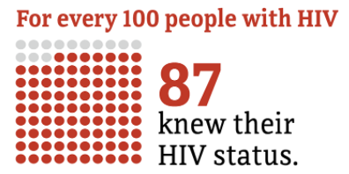
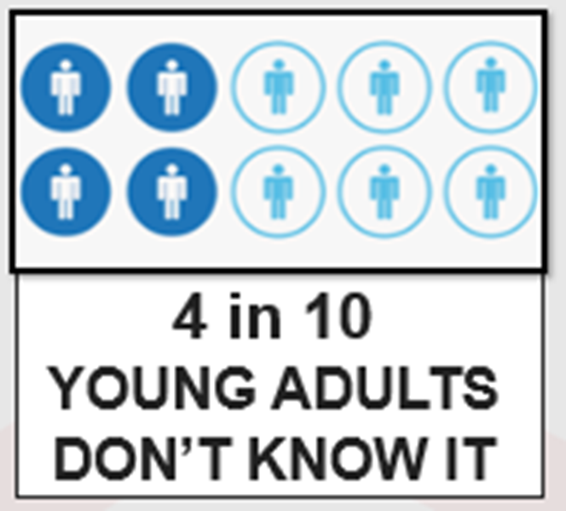
Not all People with HIV (PWH) know their status
1,189,700 PWH 2019
http://www.cdc.gov/hiv/statistics/overview/ataglance.html
Notes:
PWH= people with HIV
13% don’t know their status (1 in 7.5 don’t know it)
36,801 new hiv dx in US and dependent areas in 2019.
Of those, 69% gay and bisexual men, 23% heterosexual, 7% IDU
Number highest among 25-34yo
Transgender people: 2% MTF, 1% FTM
86% male
Rates of Diagnoses of HIV Infection among Adults and Adolescents, by Age at Diagnosis, 2008–2012—U.S. 50,000 new patients infected with HIV/yr.
CDC. MMWR 2015;64:657-662 (2012 data).
Estimated 1 in 8 HIV-infected women in the U.S. do not know their status
-13% general US population- 44% of 13-24yo do not know
http://www.cdc.gov/hiv/library/reports/surveillance/
NM: We have roughly 3,300 persons living with HIV. And average 131 new infections per year. 119 in 2012 – 142 in 2013 – 129 in 2014, 133 in 2015 – 134 in 2016
CDC. MMWR 2015;64:657-662 (2012 data).
Estimated 1 in 8 HIV-infected women in the U.S. do not know their status
-13% general US population- 44% of 13-24yo do not know
http://www.cdc.gov/hiv/library/reports/surveillance/

Slide 9
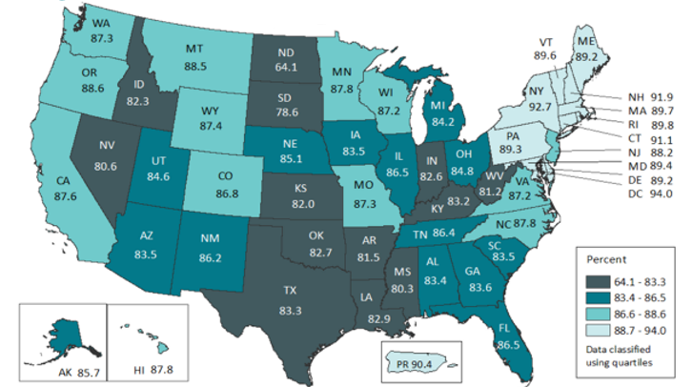
In U.S., 13% don’t know their status
In SCAETC region (NM, OK, TX, AR, LA)
17-20%
don’t know their status
Notes:
Estimated 13% of people in the US living with HIV infection are unaware of their diagnosis
Darker the color, the fewer the people with HIV have been diagnosed
HIV Screening is Important for Prevention & Treatment of HIV.
Those who don’t know their status thought to account for 30-50% of new infections (Marks, et al. 2006)

Slide 10
CDC http://www.cdc.gov/hiv/statistics/overview/ataglance.html

Slide 11
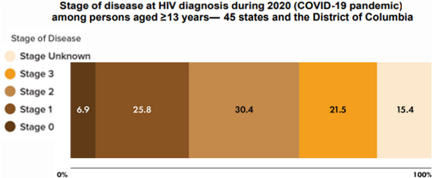
Late-stage diagnosis is associated with more morbidity and potential increased transmission
Late-stage diagnosis (2020)
Natural history of HIV: steady decline in CD4 count
Centers for Disease Control and Prevention. Monitoring selected national HIV prevention and care objectives by using HIV surveillance data United States and 6 dependent areas, 2020. HIV Surveillance Supplemental Report 2022;27(No. 3). http://www.cdc.gov/hiv/library/reports/hiv-surveillance.html. Published May 2022. Accessed 8/9/22
Notes:
2017 data
This means that patients have had undiagnosed HIV infections for about 10 years.
Stage 3 HIV: CD4<200 or CD4<14% or any CD4 with active opportunistic infection or malignancy
HIV Screening is Important for Treatment of HIV
21% new HIV diagnoses in the U.S. already have advanced disease (21% stage 3, 51% stage 2+3)
People who know they are infected can start HIV treatment
HIV treatment (HAART/ART) results in viral suppression and markedly reduced transmission¹⁻³
Studies show the benefit of ART on all people with HIV (PWH)^{4,5}
1. Cohen MS, et al. NEJM 2011;365:493-505. 2. Skarbinski J, et al. JAMA Intern Med 2015;175:588-96. 3. Rodger AJ et al. JAMA 2016;316(2):1-11. 4. Smith et al. JAIDS 2013; 63S2:S187-99. 5. Kitahata MM, et al. NEJM 2009;360:1815-26.

Slide 12
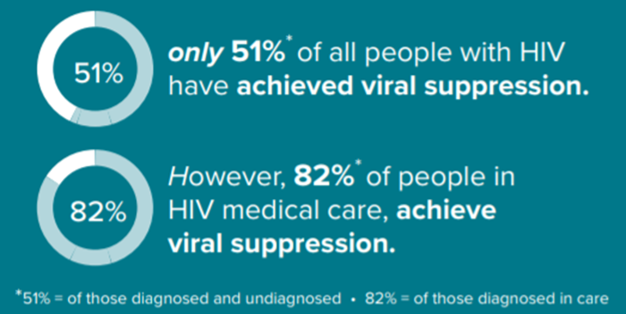
Linkage & Retention Are Key
https://www.cdc.gov/hiv/pdf/policies/cdc-hiv-prevention-and-care-outcomes.pdf

Slide 13
Treatment IS Prevention
Studies from 2008-2016 show zero linked HIV transmissions after >100,000 condomless sex acts
PWH had a durably undetectable viral load
Cohen, et al. NEJM 2011; 365: 493-505. Skarbinski J, et al. JAMA Intern Med 2015;175:588-96.
Bavinton BR, et al. Lancet HIV. 2018. IAS 2018 http://programme.aids2018.org/Abstract/Abstract/13470
Notes:
HPTN 052 was the randomized trial of starting people earlier vs later and showed very few—only 1—HIV transmission.
Three observational cohort studies were PARTNER, Opposites Attract, PARTNER 2. PARTNER had some heterosexual couples, and then the other 2 were all men who had sex with men. These are couples where one partner is positive and one is negative. The person who is positive is taking antiretroviral therapy. HIV-1 RNA to be and stay at < 200 copies/mL. In all 3 studies, there were very large numbers of condomless sex acts—more than 100,000—and there were no linked HIV transmissions, evidence that U = U means a lot.
The CDC and other multiple organizations have endorsed U = U and shows why it’s connected to rapid antiretroviral therapy—the sooner that you get your virus down to undetectable, the sooner you’re undetectable and you’re untransmittable.

Slide 14
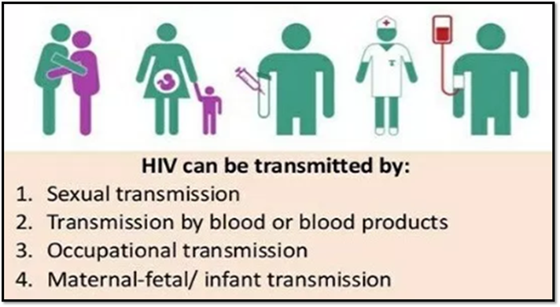
HIV Transmission Risk
https://www.cdc.gov/hiv/risk/estimates/riskbehaviors.html
Notes:
Potentially infectious: Blood, Breast milk, Tissue, Semen, Vaginal secretions
Visibly bloody fluids, Other bodily fluids (Cerebral spinal fluid, Synovial fluid, Pleural fluid, Pericardial fluid, Amniotic fluid)

Slide 15
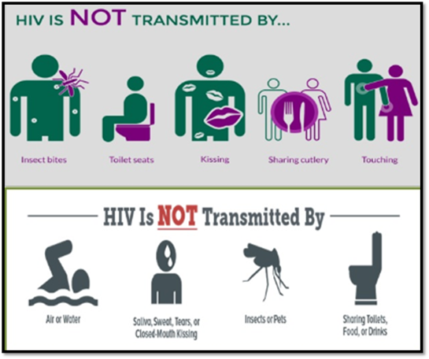
HIV Transmission Risk
Not infectious:
Urine
Saliva
Sweat
Tears
Nasal secretions
Sputum
Vomitus
Stool
https://www.cdc.gov/hiv/risk/estimates/riskbehaviors.html
Notes:
Status neutral approach.
Screen all patients for HIV and all those with history sexual activity for STIs.
Inform all patients about HIV transmission risk – for their own use, to help spread reliable information to communities, to reduce spread of misinformation, to reduce stigma

Slide 16
HIV Screening Guidelines
Screening As Prevention
CDC 2006
USPSTF 2013
Test all pts 13-64 yo
Test all pregnant women
Test all pts with TB or STI
Test high risk patients at least annually
Test all 15-65 yo
Test all pregnant women
Test <15 & >65 yo if at risk
Grade A recommendation
USPSTF=United States Preventative Services Task Force, TB = tuberculosis; STI = sexually transmitted infection, Branson, Bernard, et al. MMWR 2006;55(RR14):1-17. Moyer, Virginia et al. Annals of Internal Medicine. 2013
Notes:
Branson BM, et al. MMWR Recomm Rep. 2006;55(RR-14):1-17.
Thought that those who don’t know their status account for 50% of new infections (Marks, et al. 2006)
Verbal consent for testing (written consent no longer needed)

Slide 17
HIV Screening for Prevention
Knowing if one has HIV allows people to
Protect others from becoming infected
Make safer decisions about sex, needle use, & health care
People with HIV (PWH) who know their status avoid behaviors that spread infection
Those at high risk but test negative can start pre-exposure prophylaxis (PrEP)
Coates, et al JAMA 1987;258:1889. Doll et al. Health Psychol 1990;9:253-65. Fox, et al. AIDS 1987;1:241-6. Gibson, et al. AIDS and Behavior 1999;3:3-12. Rietmeijer, et al. AIDS 1996; 10:291-8. van Griensven et al. Am J Epidemiol 1989;129:596-603.

Slide 18
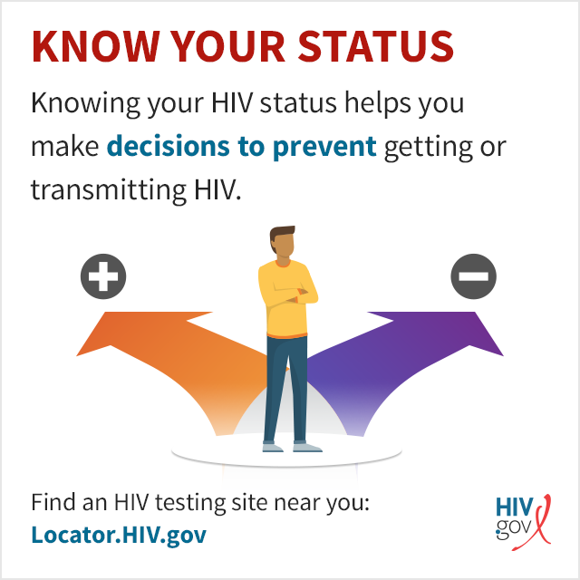
Status Neutral HIV Screening & Linkage to Care
Making HIV screening part of routine care helps ensure patients are screened, despite presumed risk, and helps reduce stigma
If HIV screen nonreactive/negative but continued exposure to HIV, linkage to HIV prevention (i.e. PEP, PrEP)
If HIV screen reactive/positive, linkage to HIV treatment (antiretroviral therapy & holistic care)
PEP=post-exposure prophylaxis, PrEP=pre-exposure prophylaxis
Notes:
HIV Screening is Important for Prevention
Knowing they have HIV allows people to
Protect others from becoming infected
Make safer decisions about sex, needle use, & their health care
PWH who know their status avoid behaviors that spread infection
Those at high risk but test negative can utilize prevention strategies
Coates, et al JAMA 1987;258:1889. Doll et al. Health Psychol 1990;9:253-65. Fox, et al. AIDS 1987;1:241-6. Gibson, et al. AIDS and Behavior 1999;3:3-12. Rietmeijer, et al. AIDS 1996; 10:291-8. van Griensven et al. Am J Epidemiol

Slide 19
Phase 1: reduce new infections by 75% in
5 years
Phase 2: Widely disseminate effort to reduce by 90% in the following 5 years
Phase 3: Intense case management to maintain the number of new infections at <3,000 per year
HIV.gov. About Ending the HIV Epidemic in the U.S. Overview.
Notes:
Ending the HIV Epidemic in the U.S. (EHE) is a bold plan announced in 2019 that aims to end the HIV epidemic in the United States by 2030.
There are 3 phases in the plan:
In its first phase, the initiative is focusing on areas where HIV transmission occurs most frequently, providing 57 geographic focus areas with an infusion of additional resources, expertise, and technology to develop and implement locally tailored EHE plans.
Phase 2: then expands the efforts to other parts of the US
Phase 3: includes efforts to help maintain the number of new infections at <3000 per year.
Over all GOAL:
The initiative seeks to reduce the number of new HIV infections in the United States by 75 percent by 2025, and then by at least 90 percent by 2030, for an estimated 250,000 total HIV infections averted.
https://www.hiv.gov/federal-response/ending-the-hiv-epidemic/overview

Slide 20
Reducing Acquisition of HIV
Increased testing & linkage to care
Delayed or fewer partners
Fewer activities with risk
Increased condom use
Empowerment & negotiation skills
Reducing alcohol & drug use
Reduce psychosocial barriers
Circumcision
Sexually Transmitted Infection (STI) treatment
HIV PEP & HIV PrEP

Slide 21
PEP vs. PrEP
post-exposure prophylaxis
Given after high-risk exposure to reduce risk of HIV infection
Start within 72 hours of exposure
28 day course of daily 3-drug regimen
pre-exposure prophylaxis
Daily regimen given before exposure to reduce risk of HIV infection
Start at least 7 days prior to exposure
Daily 2-drug regimen OR newly-approved q2 month injectable
https://www.cdc.gov/hiv/pdf/programresources/cdc-hiv-npep-guidelines.pdf
https://www.cdc.gov/hiv/pdf/risk/prep/cdc-hiv-prep-guidelines-2017.pdf
Notes:
PEP: Antiretroviral medication taken by someone who does NOT have HIV but who has had a potentially significant exposure in order to reduce the risk of infection with HIV
Taken daily for 28 days, started <72 hours after high risk activity (i.e. sexual activity, IDU) or unintentional exposure (i.e. occupational) with a known/potentially HIV-positive contact in order to reduce the risk of being infected with HIV. Occupational exposure: Needle stick, splash, bite. Non-occupational exposure: Unprotected sex, sexual assault, condom break, shared needles. Note: most pharmacies will dispense a 30d supply
PrEP: Antiretroviral medication taken by someone who does NOT have HIV in order to prevent infection with HIV. Taken daily before high risk activity (intercourse, IDU) with a known/potentially HIV-positive contact in order to reduce the risk of being infected with HIV.
https://www.cdc.gov/hiv/pdf/programresources/cdc-hiv-npep-guidelines.pdf
https://www.fda.gov/Drugs/DrugSafety/ucm608112.htm
https://www.cdc.gov/hiv/pdf/risk/prep/cdc-hiv-prep-guidelines-2017.pdf
https://www.cdc.gov/hiv/risk/prep/index.html
https://www.cdc.gov/hiv/guidelines/preventing.html

Slide 22
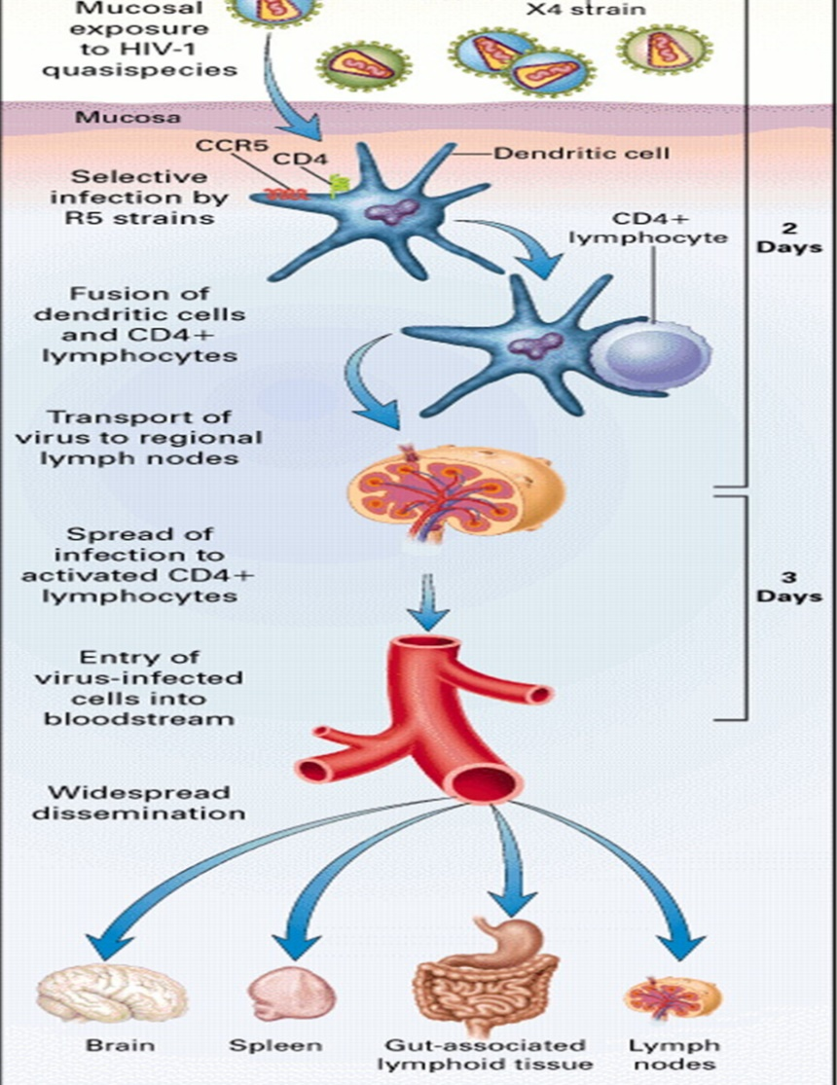
HIV Infection
PEP must be given <72 hours after exposure
PrEP requires therapeutic levels of drug at site of infection
Spira et al. J Exp Med 1996;183:215–25

Slide 23
Post-exposure prophylaxis (PEP)

Slide 24
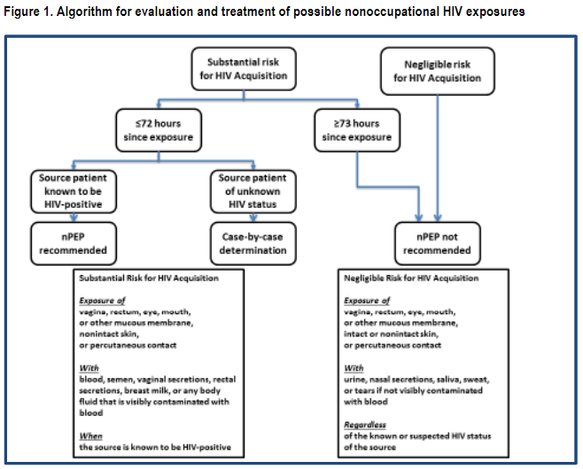
Updated guidelines for antiretroviral postexposure prophylaxis after sexual, injection drug use, or other nonoccupational exposure to HIV—United States, 2016

Slide 25
Substantial Risk of HIV Acquisition
Exposure to vagina, rectum, eye, mouth, or other mucous membrane, nonintact skin, or percutaneous contact
WITH
Blood
Semen
Vaginal secretions
Rectal secretions
Or any body fluid visibly contaminated with blood
From known source person with HIV
Updated guidelines for antiretroviral postexposure prophylaxis after sexual, injection drug use, or other nonoccupational exposure to HIV—United States, 2016

Slide 26
Negligible Risk of HIV Acquisition
Exposure to vagina, rectum, eye, mouth, or other mucous membrane, intact or nonintact skin, or percutaneous contact
WITH no visible blood contamination of
Urine
Nasal secretions
Saliva
Sweat
Tears
Regardless of whether source person is known or suspected to have HIV
Updated guidelines for antiretroviral postexposure prophylaxis after sexual, injection drug use, or other nonoccupational exposure to HIV—United States, 2016

Slide 27
What About Risks In Between?
Source HIV status unknown
Sexual assault
Substance use
Something outside of the boxes
If unclear, err on the side of higher risk,
especially if person wants PEP!

Slide 28
HIV Transmission Risk
Higher risk
Lower risk
receptive anal sex
per episode: 0.3 - 3%
needle sharing
per episode: 0.67%
oral sex
per episode: 0.06%
insertive sex
per episode 0.03 – 0.14%
1. Bell DM. Am J Med 1997;102(suppl5B):9--15. 2. Ippolito G et al. Arch Int Med 1993;153:1451--8. 3. Am J Epi 1999; 150:306-11.4. Am J Epi 1999;150:306-11.5. MMWR 47;RR-17, 1998.6. NEJM 336(15):1072-8. 7. Am J Epi 1999;150:306-11.8. Rothenberg RB et al. AIDS 1998;12:2095-2105.9. MMWR 47;RR-17, 1998.10. ACTG 076.

Slide 29
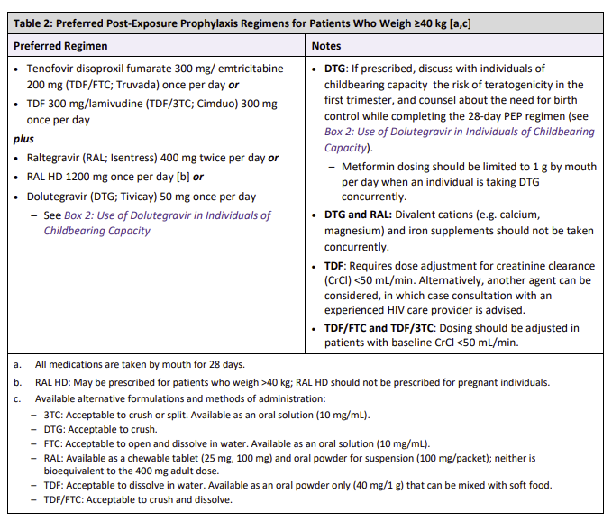
PEP: Adults
Start complete 3-drug regimen <72 hours from exposure
Side effects:
Mild nausea
Diarrhea
Headache
Insomnia (take in AM)
Table: NYDOH
https://www.cdc.gov/hiv/pdf/programresources/cdc-hiv-npep-guidelines.pdf; https://www.fda.gov/Drugs/DrugSafety/ucm608112.htm
https://www.hivguidelines.org/pep-for-hiv-prevention/pep/#tab_7_0
Notes:
Prescribe #30. Most pharmacies will not dispense a partial bottle of #28 due to cost.
AM=morning

Slide 30
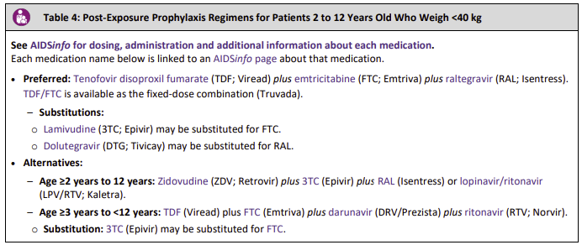
PEP: Children
Image: NYDOH
Table: NYDOH
https://www.hivguidelines.org/pep-for-hiv-prevention/pep/#tab_7_0

Slide 31
ART Guidelines: Initial Regimen
Current guidelines: 2 NRTI + INSTI
Alternates:
2 NRTIs + 3rd Class (INSTI, boosted-PI, or NNRTI)
1 NRTI + INSTI (Only 1 FDA-approved regimen)
https://www.iasusa.org/2018/07/24/antiretroviral-drugs-treatment-prevention-hiv-infection-adults-2018-recommendations-of-the-international-antiviral-society-usa-panel/
https://aidsinfo.nih.gov/guidelines/html/1/adult-and-adolescent-arv/0
NRTI = nucleoside reverse transcriptase inhibitor; INSTI = integrase strand transfer inhibitor; PI = protease inhibitor; NNRTI = non-nucleoside reverse transcriptase inhibitor
Notes:
DHHS Guidelines for the Use of Antiretroviral Agents in HIV-1 Infected Adults and Adolescents.
https://aidsinfo.nih.gov/guidelines/html/1/adult-and-adolescent-arv/0
Saag, Benson, Gandhi, et al, JAMA, 2018. 2018 Recommendations of the International Antiviral Society-USA Panel. Antiretroviral Drugs for Treatment and Prevention of HIV Infection in Adults. https://www.iasusa.org/2018/07/24/antiretroviral-drugs-treatment-prevention-hiv-infection-adults-2018-recommendations-of-the-international-antiviral-society-usa-panel/
Initial 2-drug regimens are only recommended in the rare situations in which a patient cannot take abacavir, TAF, or TDF

Slide 32
HIV PEP Follow Up
1 month
repeat HIV testing
assess medication adherence & tolerability
assess for transition to HIV PrEP if continued risk

Slide 33
NM Pharmacist PEP Prescriptive Authority
FREE classes quarterly through UNM-AETC
Next Friday, July 28th, 8:45am-12pm on Zoom- 3 hours CPE
Home study required for pharmacists (~12.5 hours)- complete prior to live course
CPhTs can attend and get 3 hours CPhT credit!
Email nmaetc@salud.unm.edu for more information

Slide 34
Pre-exposure prophylaxis (PrEP)

Slide 35
HIV PrEP Pre-Exposure Prophylaxis
Grade A Rec
FDA-approved daily oral formulations:
Tenofovir/Emtricitabine
1 tablet by mouth once a day
Prescribe for ≤ 90-day supply
Approved for adolescents & adults > 35kg (77 lb)*
*TDF/FTC FDA-approved indication in adults 7/2012 and for youth 5/2018
**TAF/FTC FDA-approved for PrEP (except receptive vaginal sex) 10/2019
USPSTF Grade A Recommendation, 6/2019
https://www.cdc.gov/hiv/guidelines/preventing.html
TDF/FTC=tenofovir disoproxil fumarate/emtricitabine (Truvada® or generic);
TAF/FTC=tenofovir alafenamide/emtricitabine (Descovy®)
Notes:
- USPSTF Prevention of HIV Infection: Preexposure Prophylaxis. 2019
https://www.uspreventiveservicestaskforce.org/Page/Document/RecommendationStatementFinal/prevention-of-human-immunodeficiency-virus-hiv-infection-pre-exposure-prophylaxis
- Max intracellular concentrations in blood after 20d of daily dosing, rectal tissue at 7d, cervicovaginal tissues at 20d. No data on penile tissue concentrations.
- TAF/FTC data presented at CROI 2019: Hare CB et al. The Phase 3 Discover Study: Daily F/TAF or F/TDF for HIV PrEP. CROI 2019 Abstract #104. www.croiconference.org Noninferiority to date (50%+ reached 96weeks; 90% reached >48wks).
TAF/FTC data presented at IAS 2019: Spinner, CD et al. DISCOVER study for HIV PrEP: F/TAF has a more rapid onset and longer sustained duration of HIV protection compared with F/TDF. Abstract 4898. programme.ias2019.org/abstract. Risk assessed from computer-aided self-interview, lab-assessed STIs. Adherence by pill count and self report and in subset measured by intracellular TFV-DP concentrations in PBMCs at week 4 and DBS q12wks. Week 4PBMC TFV-DP levels were 6.3 fold higher with F/TAF; 98% vs 65% above protective threshold. Median duration of protection after last dose at steady state was 60% longer for F/TAF.Low DBS TFV-DP levels (adherence<2 doses/week) associated with increase risk of HIV for F/TAF (OR29.4) and F/TDF (OR 13).
Additional agents and routes in clinical trials currently
10/2019 TAF/FTC FDA-approved https://www.gilead.com/~/media/Files/pdfs/medicines/hiv/descovy/descovy_pi.pdf

Slide 36
PrEP is Effective
Lessons learned from studies:
Safe, well tolerated (nausea)
Adherence is key
iPrEx study: 44% reduction in HIV
92% reduction in those with good adherence
PrEP as bridge to antiretroviral treatment (ART): 95% reduction
Important to screen & treat sexually transmitted infections (STIs)
Cost effective if used among high risk
Paltiel AD, et al. CID. 2009;48(6):806-815. Juusola JL, et al. Ann Intern Med. 2012;156(8):541-550. Schneider, et al. CID 2014;58:1027-34. Werner RN et al. PLoS ONE 2018. 13(12):e0208107. Traeger, M et al. JAMA 2019
Notes:
PrEP as bridge: PWH starting ART takes 1-3mo to get undetectable in most. During that time, HIV uninfected partner takes PrEP until PLWH has consistent undetectable HIV VL.
>15 trials published to date
Shorter duration of use, lower drug costs, improved adherence/efficacy would all shift balance in favor of PrEP (annual incidence >2%)
U.S. PrEP: Survey of ~80% of pharmacies. ~80,000 people on PrEP (800% increase since 2012). Mostly coastal cities. Little use in highest incidence areas: Southeast
Ipergay open-label extension: PrEP on demand offered to former placebo and active groups. 97% relative risk reduction (1 conversion in a non-adherent subject).
PrEP as bridge to ART: Kenya & Uganda. PrEP to HIV-negative partner for 6 mos while HIV+ partner starts ART. Seroconversion in 4 of 1000 couples, none felt to be failure of PrEP. 95% reduction vs. expected rate.
PARTNER: 0 linked infections out of 58,000 condomless sexual actives (gay and straight discordant couples)
ATN 113: Daily Oral TDF/FTC as PrEP for Adolescent MSM in US. Hosek S, et al. AIDS 2016. Abstract TUAX0104LB. Wk 48 outcomes: 3 seroconversions. All 3 had low TFV-DP drug levels at time of seroconversion. HIV incidence: 6.41/100 PY (95% CI: 4.9-25.8). Drop off in TFV-DP levels between Wk 12 and Wk 24 corresponded to reduced frequency of scheduled study visits (from every 4 wks to every 12 wks)
Werner RN et al. Incidence of STI in MSM and who are at substantial risk of HIV infection – a meta-analysis of data from trials and observational studies of PrEP. PLoS ONE 13(12):e0208107. 12/3/18.
Traeger, M et al. Association of HIV PrEP with incidence of STIs among individuals at high risk of HIV Infection. JAMA online 4/9/19. Australian study showed higher incidence of chlamydia and GC but no significant change in syphilis incidence.

Slide 37
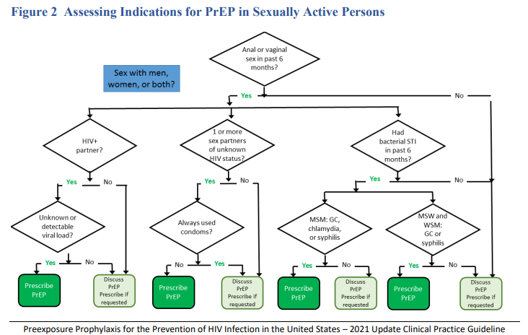
https://www.cdc.gov/hiv/pdf/risk/prep/cdc-hiv-prep-guidelines-2021.pdf
Notes:
PrEP in PWID: Any use of injection drugs (past 6 months)
AND
Any sharing of injection equipment OR participation in methadone, naloxone, or buprenorphine treatment program (past 6 months) OR risk of sexual acquisition
Additional consideration: transactional sex and high community and/or sexual network
The CDC has updated it’s webpage in regards to HIV prevention. For the first time the CDC has added percentages to various bio-medical HIV Prevention methods.
For Antiretroviral Therapy (ART)
For HIV-positive men and women, taking ART regularly greatly reduces the risk of HIV transmission to an HIV–negative partner. For persons who achieve and maintain viral suppression, there is effectively no risk of transmitting HIV to their HIV–negative sexual partner. This translates to an effectiveness estimate of 100% for taking ART regularly as prescribed and achieving and maintaining viral suppression. Effectiveness is lower, and there is a risk of transmitting HIV, when persons do not take ART as prescribed or stop taking ART, if viral suppression is not achieved, or if viral suppression is not maintained.
For PrEP
When taking PrEP daily or consistently (at least 4 times per week), the risk of acquiring HIV is reduced by about 99% among MSM. While daily use is recommended in the U.S., taking PrEP consistently (at least 4 times per week) appears to provide similar levels of protection among MSM. The effectiveness of oral PrEP is highly dependent on PrEP adherence. When taking oral PrEP daily or consistently, HIV acquisition is extremely rare and has not been observed in any of the studies described below. In clinical practice, a few cases of new HIV infections have been confirmed while HIV-negative individuals were on PrEP with verified adherence.
Persons Who Inject Drugs (PWIDs) face HIV risks from both injecting and sex behaviors. Studies on the effectiveness of PrEP when taken daily among PWID are limited. However, when taking PrEP consistently, the risk of acquiring HIV is reduced by an estimated 74 – 84% among PWID. These estimates are based on tenofovir alone and among a subset of PWID taking PrEP consistently, as verified by directly observed therapy or daily diary plus monthly pill count. The effectiveness of two-drug oral therapy has not been assessed among PWID but may be higher. The effectiveness of oral daily PrEP is highly dependent on PrEP adherence, with maximum effectiveness when taking PrEP daily and lower effectiveness when missing doses.

Slide 38
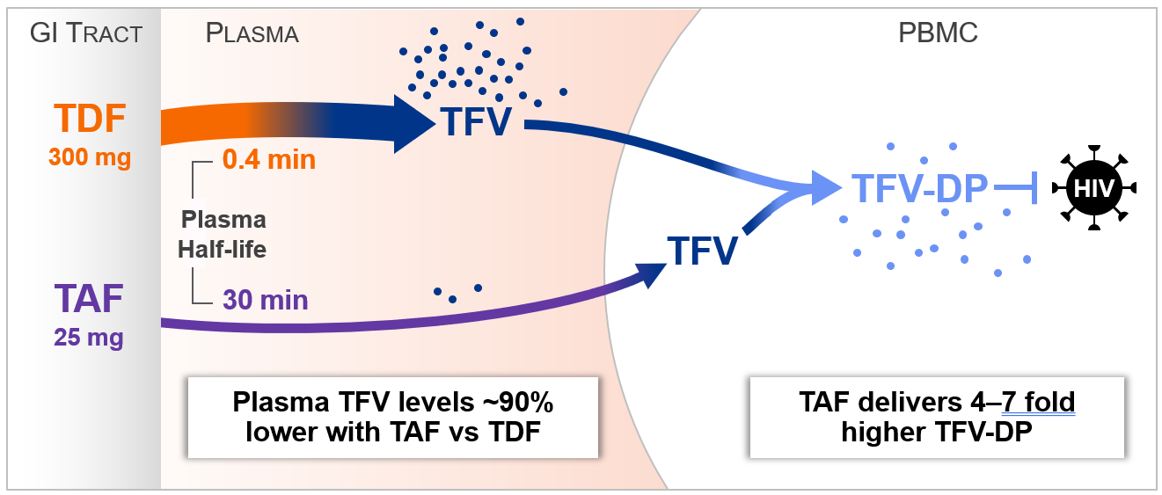
Tenofovir: Alafenamide (TAF) vs. Disoproxil Fumarate (TDF)
Spinner CD, et al. DISCOVER STUDY for HIV Pre-Exposure Prophylaxis: F/TAF has a more Rapid Onset and Longer Sustained Duration of HIV Protection Compared with F/TDF. 23July IAS 2019, Mexico City.

Slide 39
TAF vs. TDF
Descovy® (TAF/FTC)
Not indicated for receptive vaginal sex or injection drug use (IDU) alone
Less renal & bone toxicity
Can use if CrCl > 30 mL/min
Weight gain
1 - 1.7kg (TAF) vs. 0 - 0.5kg (TDF)
Smaller tablet
Truvada®* (TDF/FTC)
Use if receptive vaginal sex or if IDU is only risk factor (i.e., no sexual risk)
Potential renal & bone toxicity
Do not start if CrCl <60mL/min
Stop if CrCl drops to <50mL/min
Now generic* – cost-effective!
www.clinicalkey.com/pharmacology/

Slide 40
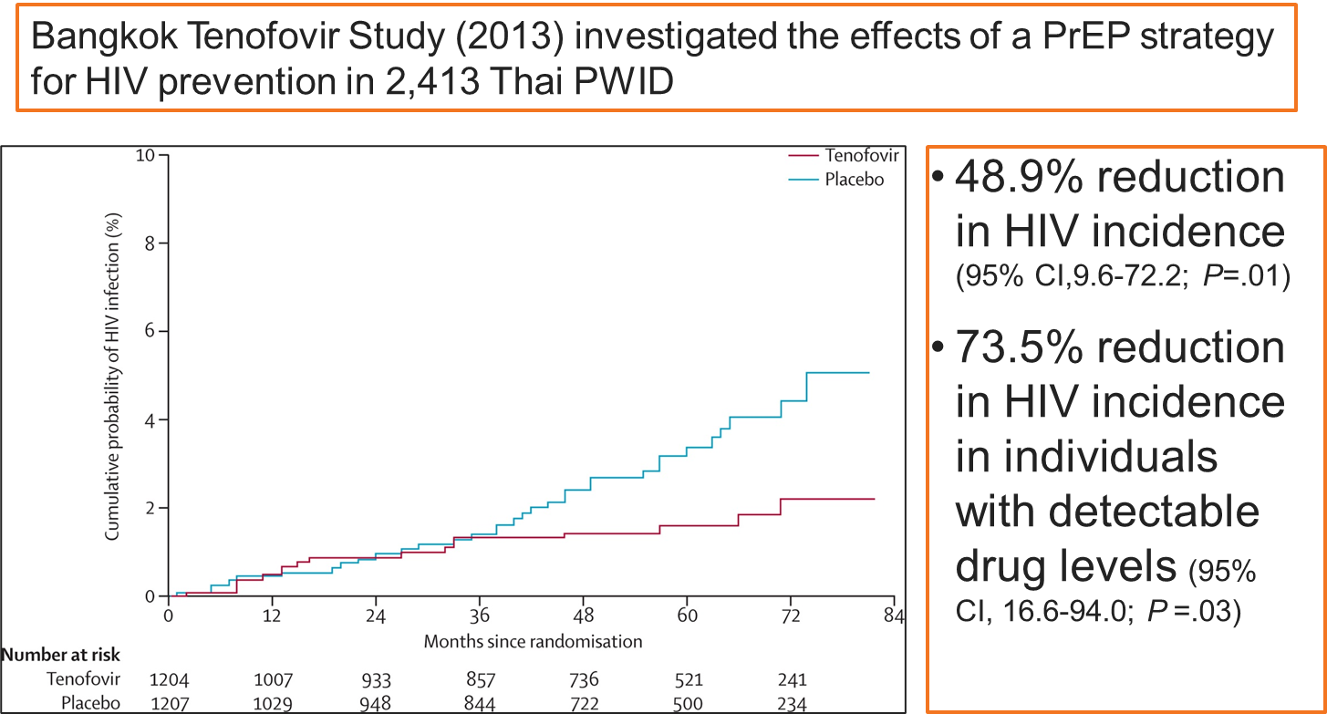
Clinical Study of PrEP in PWID
Kaplan-Meier Estimates of Time to HIV Infection in the Modified Intention-to-Treat Population
PWID = Persons who inject drugs
Choopanya K, et al. Lancet. 2013;381:2083-90.

Slide 41
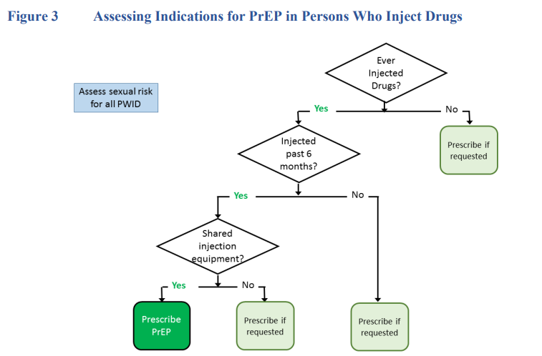
https://www.cdc.gov/hiv/pdf/risk/prep/cdc-hiv-prep-guidelines-2021.pdf

Slide 42
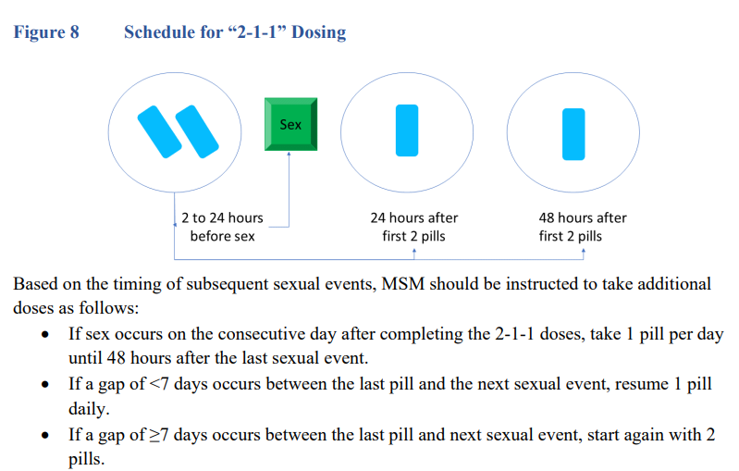
On Demand PrEP: 2-1-1
https://www.cdc.gov/hiv/pdf/risk/prep/cdc-hiv-prep-guidelines-2021.pdf
MSM=men who have sex with men
Notes:
https://apps.who.int/iris/rest/bitstreams/1239070/retrieve

Slide 43
Alternate Dosing of PrEP
IPERGAY and Prévenir studies demonstrated reduced risk of HIV infection in men who have sex with men (MSM) by 86% utilizing on-demand PrEP (2-1-1)
Used TDF/FTC
Not recommended in those with chronic hepatitis B, heterosexual men and women, transgender men and women and people who inject drugs
Off-label use
Saag. JAMA. 2018;320:379. Antoni, et al. IAS 2017. Molina JM et al. Lancet HIV. 2017;4(9):e402-410. Molina JM et al. 9th International AIDS Society Conference on HIV Science, 2017. Balavoine, S et al. . 9th International AIDS Society Conference on HIV Science, 2017. Swell WC et al. CROI 2020

Slide 44
Prescribing On Demand PrEP
Max 30 pills on rx- must have follow up and documentation of another negative HIV test
Sex <1x/week = sufficient supply for 7 intermittent events
Continue q3 month follow up visits for HIV and STI testing
Not indicated for anyone other than adult MSM
Only studied in this population
TAF not studied on-demand
https://www.cdc.gov/hiv/pdf/risk/prep/cdc-hiv-prep-guidelines-2021.pdf

Slide 45
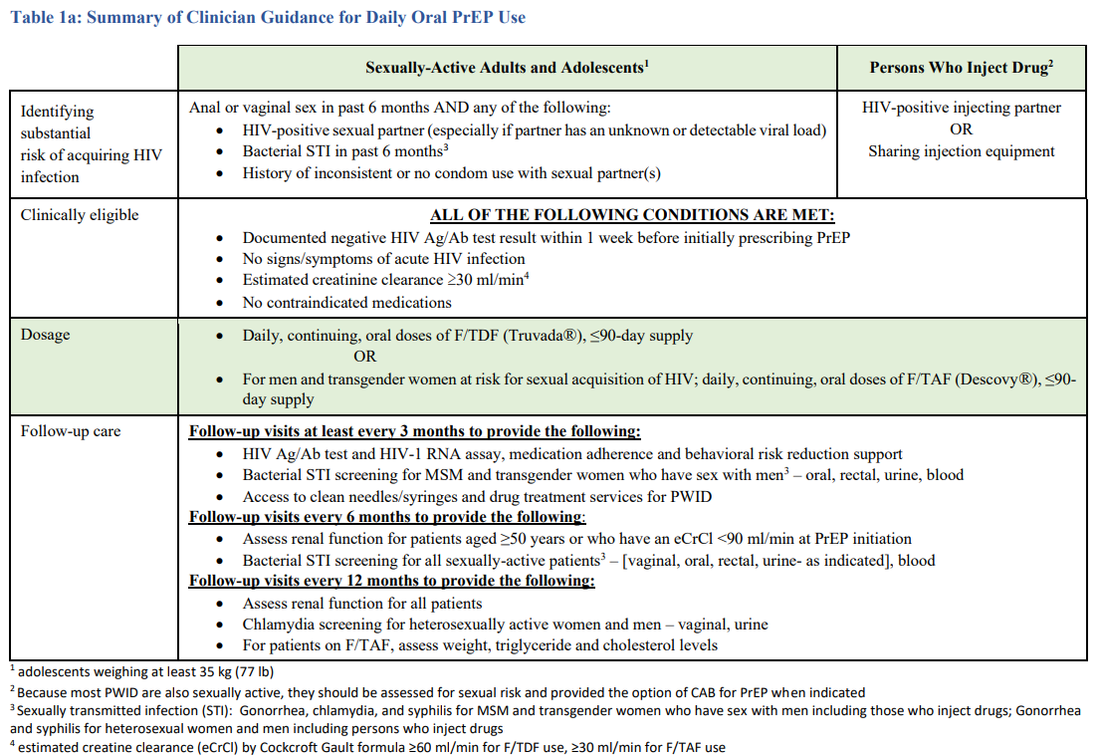
https://www.cdc.gov/hiv/pdf/risk/prep/cdc-hiv-prep-guidelines-2021.pdf
Notes:
PrEP in PWID: Any use of injection drugs (past 6 months)
AND
Any sharing of injection equipment OR participation in methadone, naloxone, or buprenorphine treatment program (past 6 months) OR risk of sexual acquisition
Additional consideration: transactional sex and high community and/or sexual network
The CDC has updated it’s webpage in regards to HIV prevention. For the first time the CDC has added percentages to various bio-medical HIV Prevention methods.
For Antiretroviral Therapy (ART)
For HIV-positive men and women, taking ART regularly greatly reduces the risk of HIV transmission to an HIV–negative partner. For persons who achieve and maintain viral suppression, there is effectively no risk of transmitting HIV to their HIV–negative sexual partner. This translates to an effectiveness estimate of 100% for taking ART regularly as prescribed and achieving and maintaining viral suppression. Effectiveness is lower, and there is a risk of transmitting HIV, when persons do not take ART as prescribed or stop taking ART, if viral suppression is not achieved, or if viral suppression is not maintained.
For PrEP
When taking PrEP daily or consistently (at least 4 times per week), the risk of acquiring HIV is reduced by about 99% among MSM. While daily use is recommended in the U.S., taking PrEP consistently (at least 4 times per week) appears to provide similar levels of protection among MSM. The effectiveness of oral PrEP is highly dependent on PrEP adherence. When taking oral PrEP daily or consistently, HIV acquisition is extremely rare and has not been observed in any of the studies described below. In clinical practice, a few cases of new HIV infections have been confirmed while HIV-negative individuals were on PrEP with verified adherence.
Persons Who Inject Drugs (PWIDs) face HIV risks from both injecting and sex behaviors. Studies on the effectiveness of PrEP when taken daily among PWID are limited. However, when taking PrEP consistently, the risk of acquiring HIV is reduced by an estimated 74 – 84% among PWID. These estimates are based on tenofovir alone and among a subset of PWID taking PrEP consistently, as verified by directly observed therapy or daily diary plus monthly pill count. The effectiveness of two-drug oral therapy has not been assessed among PWID but may be higher. The effectiveness of oral daily PrEP is highly dependent on PrEP adherence, with maximum effectiveness when taking PrEP daily and lower effectiveness when missing doses.

Slide 46
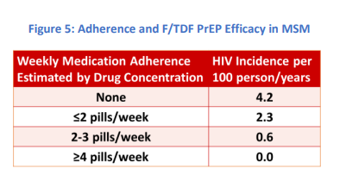
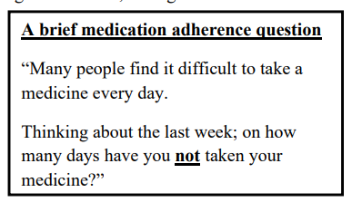
Daily PrEP Adherence
https://www.cdc.gov/hiv/pdf/risk/prep/cdc-hiv-prep-guidelines-2021.pdf

Slide 47
Injectable pREP

Slide 48
HIV PrEP Pre-Exposure Prophylaxis
FDA-approved long-acting injectable formulation:
Cabotegravir (Apretude®) 600mg/3mL every 2 months
Optional 30mg daily oral CAB 4-week lead-in
Approved for adolescents & adults > 35kg (77 lb)*
*Cabotegravir (CAB) FDA-approved indication for PrEP in 12/2021

Slide 49
Long-Acting Injectables (LAI)
Cabotegravir (CAB) LAI q8weeks for MSM and transwomen who have sex with men (TGWSM) at high risk for HIV
4,570 MSM & TGWSM (12%) double-blinded
LAI CAB HIV incidents = 13
Daily oral TDF/FTC HIV incidents = 39
66% fewer HIV infections in LAI CAB vs. TDF/FTC
Well-tolerated: injection site reactions (ISRs) = 2.2% discontinued
https://www.hptn.org/research/studies/hptn083

Slide 50
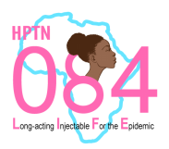
Long-Acting Injectables (LAI)
Cabotegravir (CAB) LAI q8weeks for sexually active cisgender women (not pregnant or breastfeeding, on contraception) at high risk for HIV
3,224 participants in Sub-Saharan Africa
LAI CAB HIV incidents = 4
Daily oral TDF/FTC HIV incidents = 36
89% fewer HIV infections in LAI CAB for cisgender women vs. TDF/FTC
Well-tolerated: ISRs – no discontinuations due to ISRs
https://www.084life.org/study-results/
Notes:
Cisgender= designated female at birth, identifies as female gender

Slide 51
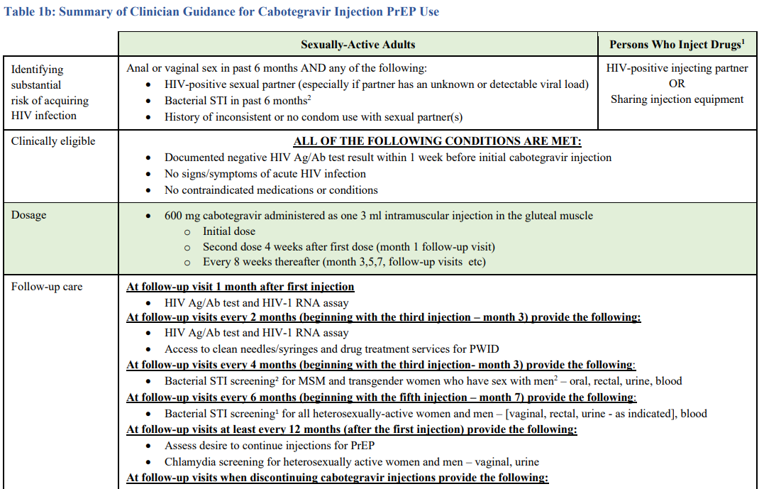
https://www.cdc.gov/hiv/pdf/risk/prep/cdc-hiv-prep-guidelines-2021.pdf

Slide 52
https://www.cdc.gov/hiv/pdf/risk/prep/cdc-hiv-prep-guidelines-2021.pdf

Slide 53
https://www.cdc.gov/hiv/pdf/risk/prep/cdc-hiv-prep-guidelines-2021.pdf

Slide 54
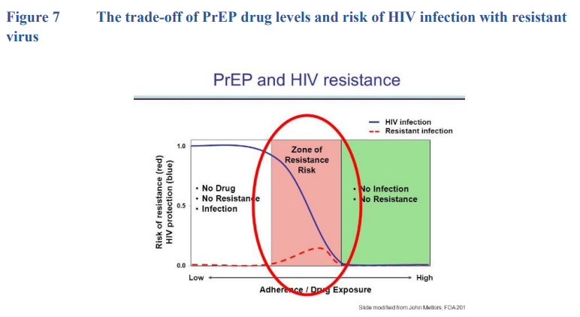
https://www.cdc.gov/hiv/pdf/risk/prep/cdc-hiv-prep-guidelines-2021.pdf

Slide 55
pREP access

Slide 56
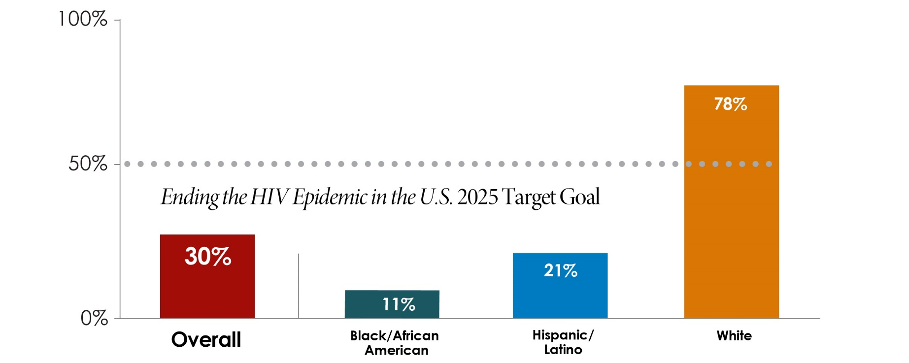
Notes:
People of color comprise a disproportionate number of new HIV infections in the US, yet have limited uptake of PrEP
PrEP has been most widely adopted by college educated, middle-aged, white gay men
Many LGBTQ+ community centers across the US are based in neighborhoods most popular for white gay men
If we look at it from a gender perspective, Men have at least 3x higher PrEP coverage than woman
Black heterosexual woman have higher rates of HIV acquisition than other women
CDC, 2016
Though 20% of the US population, Latinx people account for ¼ of new cases of HIV. Most of those diagnosed are men
Awareness of PrEP is low among Latinx individuals at risk, particularly MSM, posing challenges to adoption
Stigma or fear of being judged for one’s behaviors may serve as a barrier to PrEP adoption, as well as linguistic and economic access to resources in some regions

Slide 57
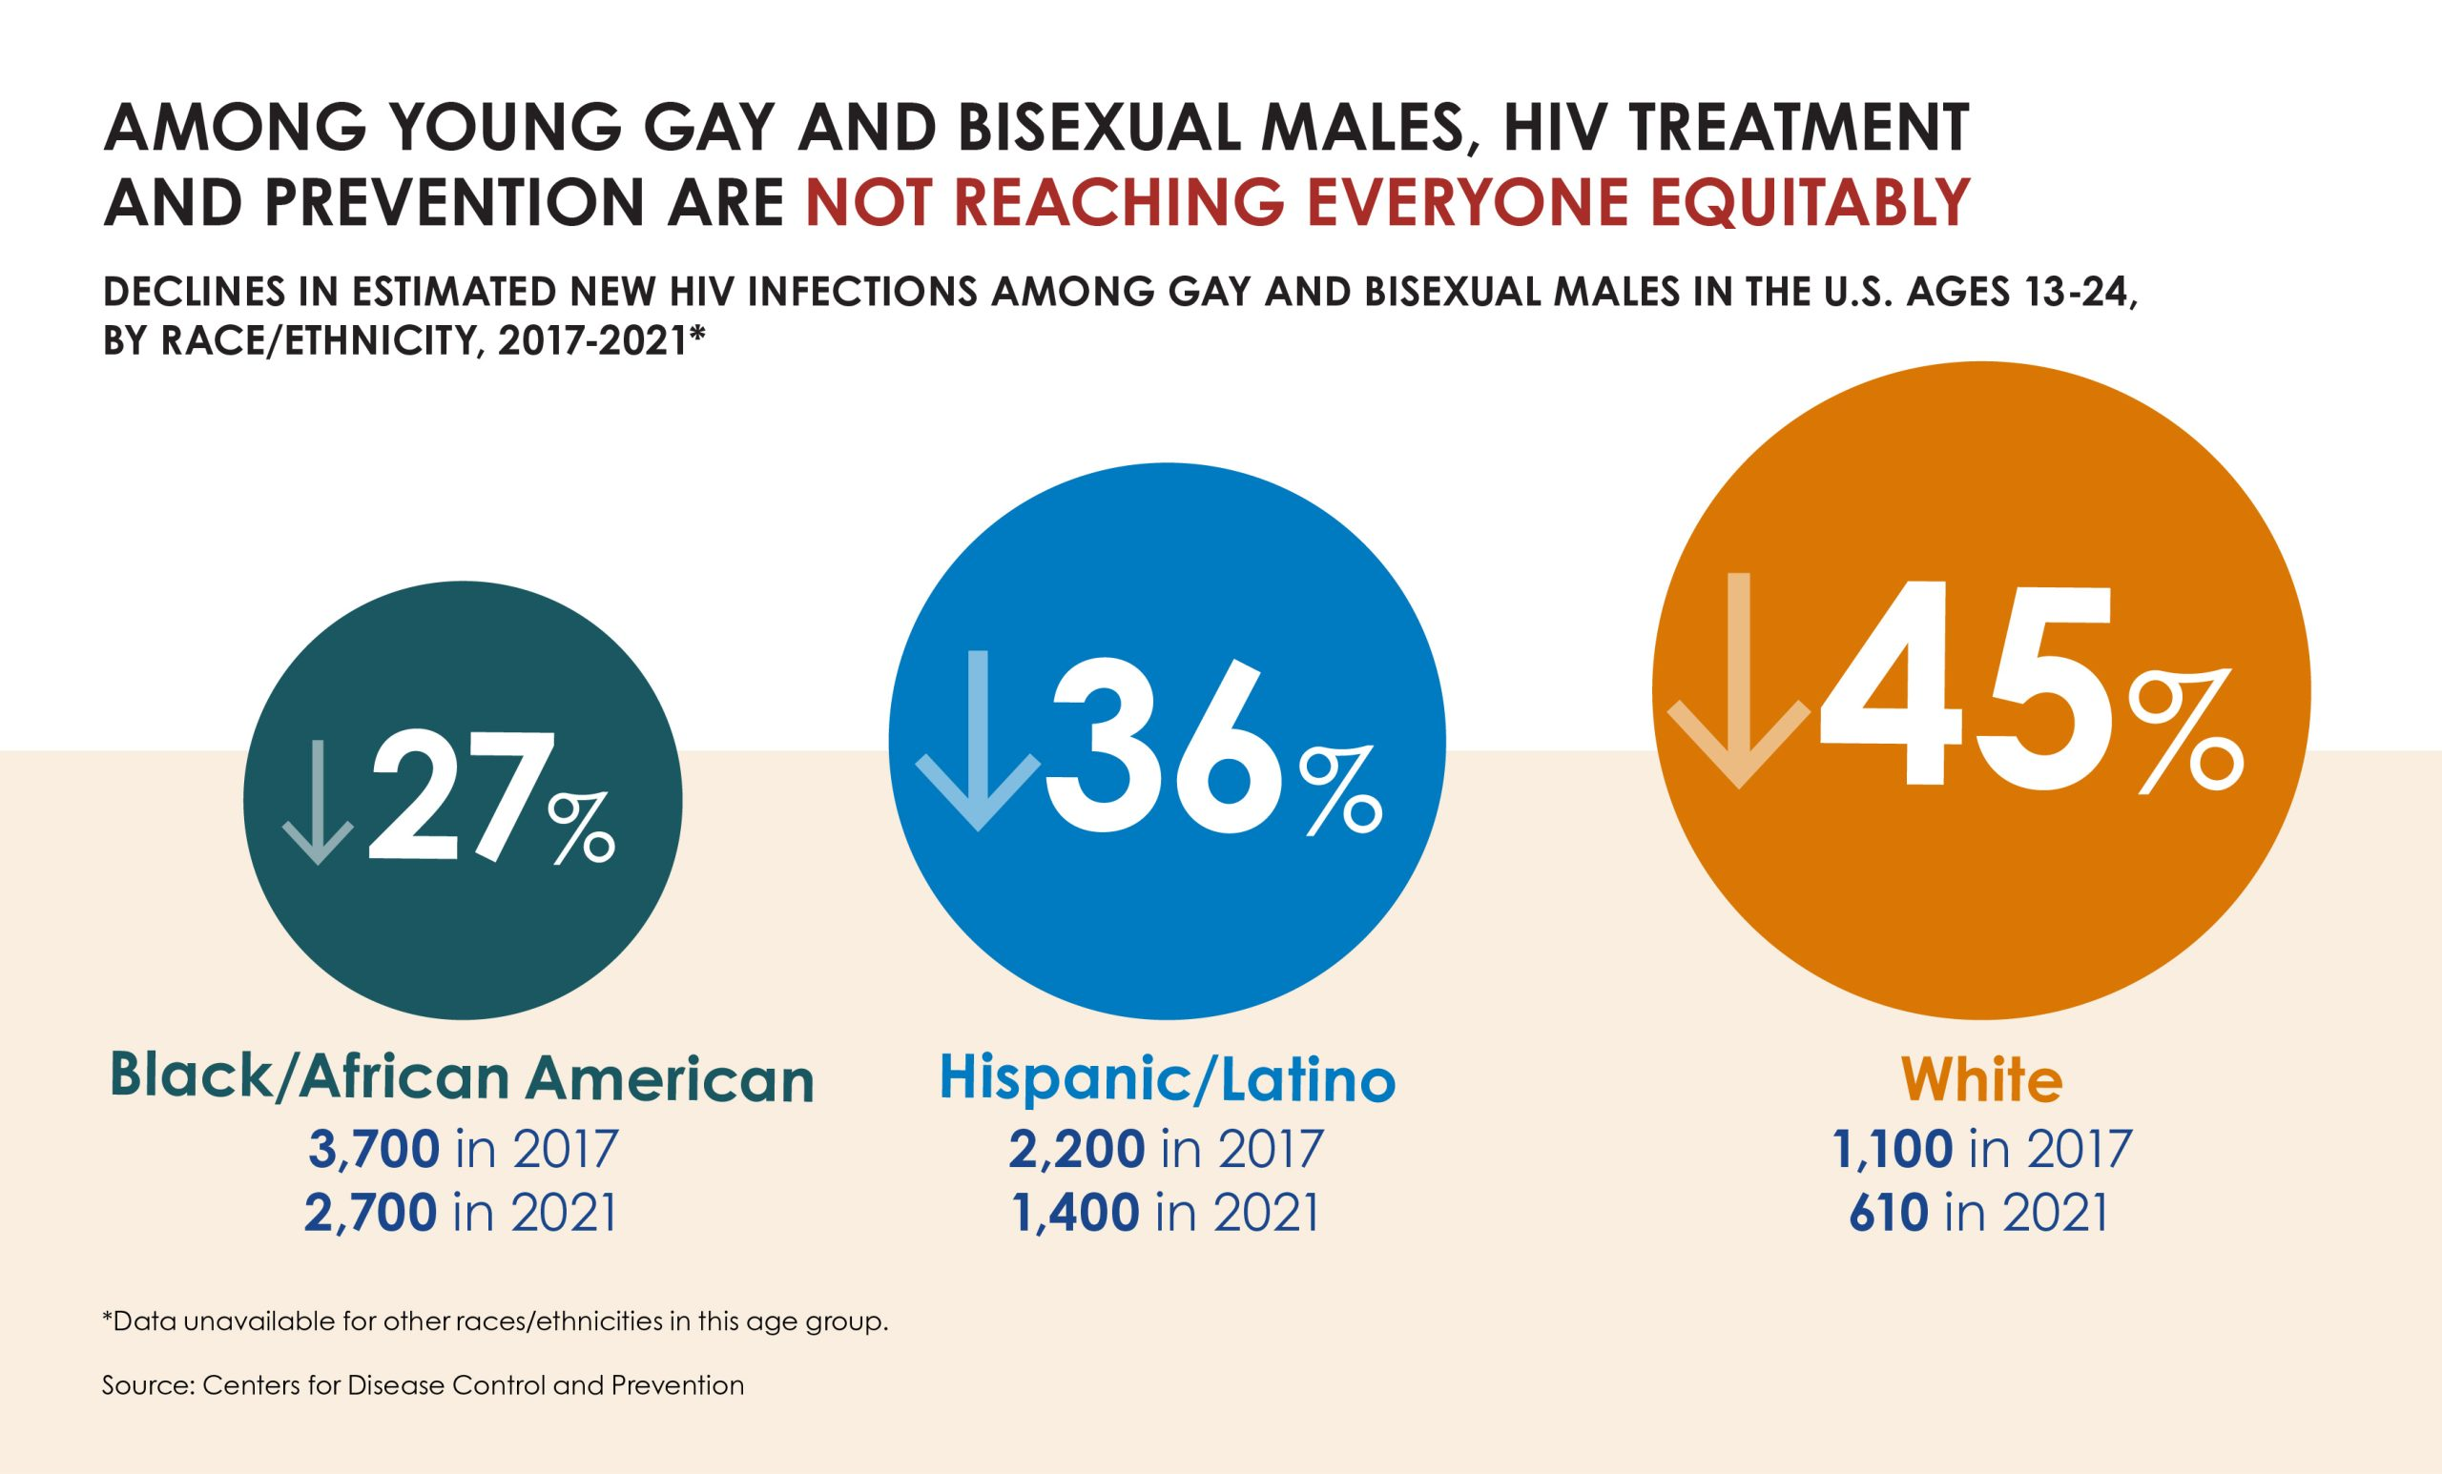
https://www.cdc.gov/nchhstp/newsroom/2023/2021-hiv-incidence.html

Slide 58
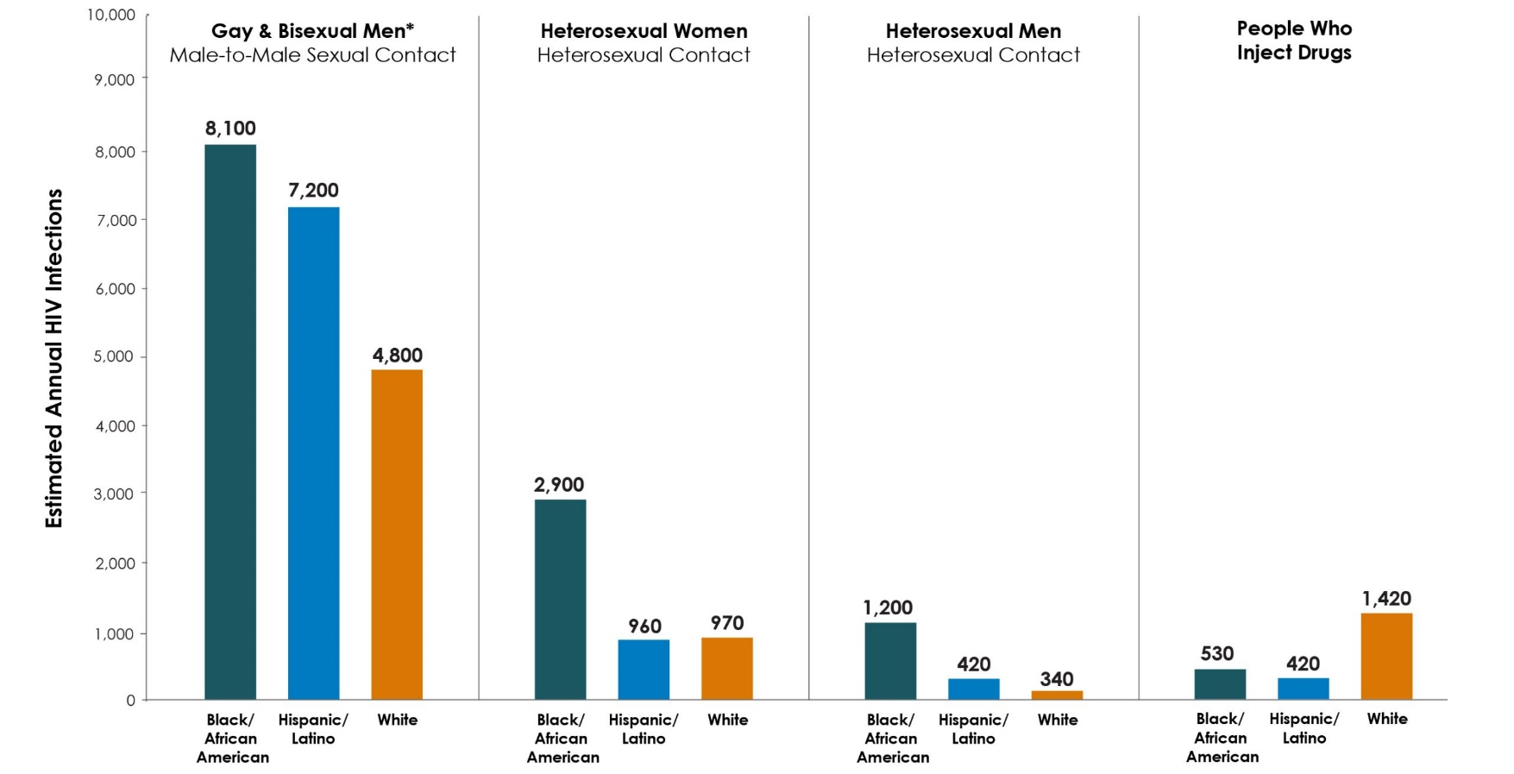
https://www.cdc.gov/nchhstp/newsroom/2023/2021-hiv-incidence.html

Slide 59
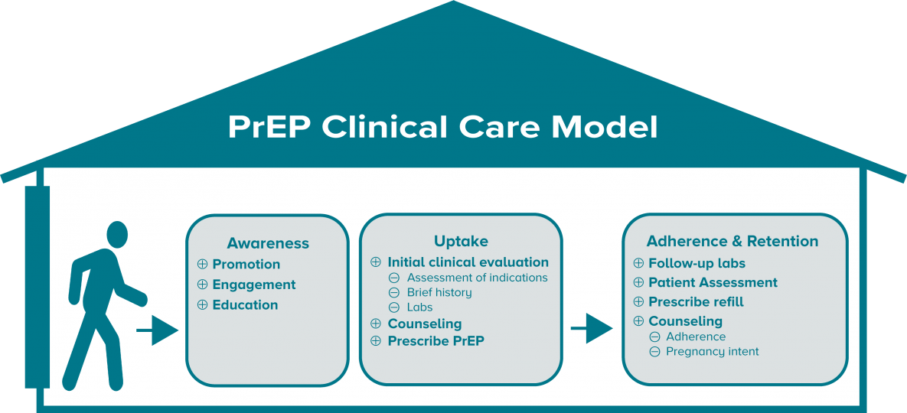
Need PrEP to Reach Most At Risk
Interventions to improve metrics at each step of PrEP Care Continuum could reduce disparities
https://www.cdc.gov/hiv/effective-interventions/prevent/prep/index.html

Slide 60
Coverage of PrEP
If insured, may require prior authorization
If large copay: (however, ACA implementation part 47 should = $0)
Copay cards for oral PrEP (Med D excluded): https://www.gileadadvancingaccess.com/copay-coupon-card
Patient Advocate Foundation (also for people with Med D): https://www.copays.org/diseases/hiv-aids-and-prevention
Good Days (also for people with Med D): https://www.mygooddays.org/patients/diseases-covered/hiv-aids-treatment-and-prevention
If uninsured:
Medication Assistance Program: 1-800-226-2056 https://advancingaccessconsent.iassist.com/
Ready Set PrEP: https://readysetprep.hiv.gov/
State PrEP Assistance Programs: https://nastad.org/prepcost-resources/prep-assistance-programs

Slide 61
Key Points
HIV prevention methods can be used in combination to reduce HIV
People on oral PrEP require screening every 3 months for adherence, HIV, toxicities, and STIs
People on injectable PrEP require screening every 2 months for HIV RNA, toxicities, and STIs
PrEP is effective at reducing HIV transmission but not enough people who could benefit have access

Slide 62
References
NM DOH reporting/partner tracing/linkage to care http://nmhivguide.org/
https://www.cdc.gov/hiv/basics/prep.html
https://aidsvu.org/preptoolkit2018/
https://primeinc.org/hiv?s=aetc
CDC 2021 PrEP Guidelines: https://www.cdc.gov/hiv/pdf/risk/prep/cdc-hiv-prep-guidelines-2021.pdf
USPSTF Preexposure Prophylaxis for the Prevention of HIV Infection. JAMA 2019;321(22):2203-2213.
Marrazzo et al., HIV Prevention in Clinical Care Settings 2014 Recommendations of the International Antiviral Society–USA Panel JAMA. July 2014;312(4):390.
Riddell, J et al. HIV Preexposure Prophylaxis: A Review. JAMA. 2018;319(12):1261-1268.
Saag, MS et al. Anitretroviral Drugs for Treatment and Prevention of HIV Infection in Adults: 2018 Recommendations of the IAS-USA Panel. JAMA. 2018;320(4):379-396.
Chen, Anders et al. Clinical Effectiveness and Cost-Effectiveness of HIV PrEP in MSM: Risk Calculators for Real-World Decision-Making. PLOS ONE. October 2014;9(10):e108742.
Katz, D et al. HIV Incidence among MSM after dx with STI. Sexually Transmitted Diseases. 2016;43(4):249-254.
Spinner CD, et al. DISCOVER STUDY for HIV Pre-Exposure Prophylaxis: F/TAF has a more Rapid Onset and Longer Sustained Duration of HIV Protection Compared with F/TDF. 23July IAS 2019, Mexico City.
Centers for Disease Control and Prevention. Core indicators for monitoring the Ending the HIV Epidemic initiative (preliminary data): National HIV Surveillance System data reported through June 2021; and preexposure prophylaxis (PrEP) data reported through March 2021. HIV Surveillance Data Tables 2021;2(No. 4). http://www.cdc.gov/hiv/library/reports/hiv-surveillance.html. Published October 2021. Accessed 5/29/23.

Slide 63
Resources
National Clinician Consultation Center http://nccc.ucsf.edu/
HIV Management
Perinatal HIV
HIV PrEP
HIV PEP line
HCV Management
Substance Use Management
Present on ECHO
https://hsc.unm.edu/scaetc/programs-services/echo.html​
AETC National HIV Curriculum https://aidsetc.org/nhc
AETC National Coordinating Resource Center https://targethiv.org/library/aetc-national-coordinating-resource-center-0
HIVMA Resource Directory https://www.hivma.org/globalassets/ektron-import/hivma/hivma-resource-directory.pdf
Additional trainings scaetcecho@salud.unm.edu
www.scaetc.org
Notes:
IDEA Platform: Infectious Diseases Education & Assessment. https://idea.medicine.uw.edu/
AETC National HIV Curriculum: 6 core modules for self study; regularly updated; CME, CNE
Hepatitis C Online Curriculum: https://www.hepatitisc.uw.edu/
Hepatitis B Online Curriculum: https://www.hepatitisb.uw.edu/
National STD Curriculum: https://www.std.uw.edu/

Slide 64
SCAETC Social Media

