Slide 1
Thomas Street Health Center Cultural Competence All-Staff Training Transgender & Gender Diverse Care 101 May 17, 2023 1:00 - 2:00 p.m.
Lis Shell, PhD, PA-C
Assistant Professor
Baylor College of Medicine/Thomas Street Health Center
Notes:
Version date_05 2024
Target Audience: NPs/PA, nurses, medical assistants, pharmacists, case managers, service linkage workers, front desk staff, pharmacists/pharmacy techs, lab personnel

Slide 2
Conflict of Interest Disclosure Statement
Speaker has nothing to disclose
This program is supported by the Health Resources and Services Administration (HRSA) of the U.S. Department of Health and Human Services (HHS) as part of an award totaling $3,132,205, with 0% financed with non-governmental sources. The contents are those of the author(s) and do not necessarily represent the official views of, nor does mention of trade names, commercial practices, or organizations imply an endorsement by HRSA, HHS, or the U.S. Government. For more information, please visit HRSA.gov. Any trade/brand names for products mentioned during this presentation are for training and identification purposes only.

Slide 3
Learning Objectives:
Learn how to apply inclusive language to transgender/gender diverse patients.
Build a safe and inclusive environment that is respectful of transgender/gender diverse patients.

Slide 4
What’s in the name?
LGBTQ+
Lesbian
Gay
Bisexual
Transgender/Gender Diverse (TGD)
Queer/Questioning
+ (Intersex, Two-spirit,
Ally, Asexual, Pansexual)

Slide 5
THE GENDERBREAD PERSON
https://www.itspronouncedmetrosexual.com

Slide 6
TRANSGENDER/gender diverse FLAG
Created by Monica Helms in 1999
First shown at the Pride Parade in Phoenix, Arizona in 2000

Slide 7
ANTI-TRANS BILLS IN THE U.S.
2023 anti-trans bills tracker: 533 bills in 49 states
54 passed
382 active
97 failed
https://translegislation.com/

Slide 8
TRANSGENDER/gender diverse PATIENT FACTS
55% have been denied surgical coverage
33% have reported negative experiences in healthcare
25% have experienced insurance issues
25% have been denied gender-affirming hormones
20% have experienced homelessness in their lifetime
19% have been denied healthcare
2015 U.S. Transgender Survey

Slide 9
transgender/gender diverse patients New hiv diagnosis
https://www.cdc.gov/hiv/library/reports/hiv-surveillance/vol-32/index.html

Slide 10
NEW HIV DIAGNOSIS BY AGE
References are included here
CDC AtlasPlus

Slide 11
NEW HIV DIAGNOSIS Among Transgender People by Race/Ethnicity in the US and Dependent Areas, 2019
https://www.cdc.gov/hiv/library/reports/hiv-surveillance/vol-32/index.html

Slide 12
NEW HIV DIAGNOSIS Among Transgender People by Region in the US and Dependent Areas, 2019
https://www.cdc.gov/hiv/library/reports/hiv-surveillance/vol-32/index.html

Slide 13
Barriers to care
Financial
Discrimination
Lack of cultural competence
Health systems
Socioeconomic

Slide 14
What patients have said
“I was flat out turned down by the primary care physician who had to give the go-ahead to give me a referral to an endocrinologist; I was just shut down. That was it, end of story.”
– Nonbinary person, 50s

Slide 15
WHAT DO PATIENTS WANT?
Patients want to come out to the staff and their healthcare provider, but wonder if it is safe
Patients want an environment inclusive of transgender/gender diverse people
Transgender/Gender diverse patients want to discuss their concerns

Slide 16
Photo by Bernard Spragg

Slide 17
Laying down
the foundation of trust
Creating a safe and welcoming environment
Use language that upholds the principles of safety, dignity and respect
Use appropriate pronouns and gender identity
Train all office staff, including call centers

Slide 18
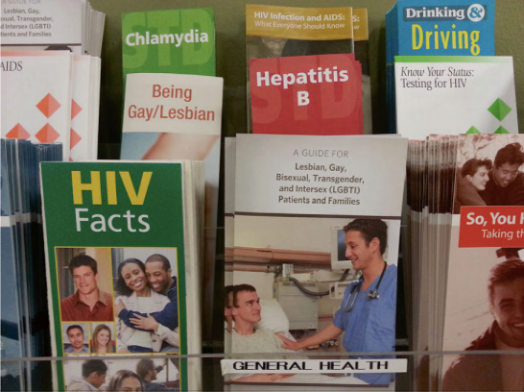
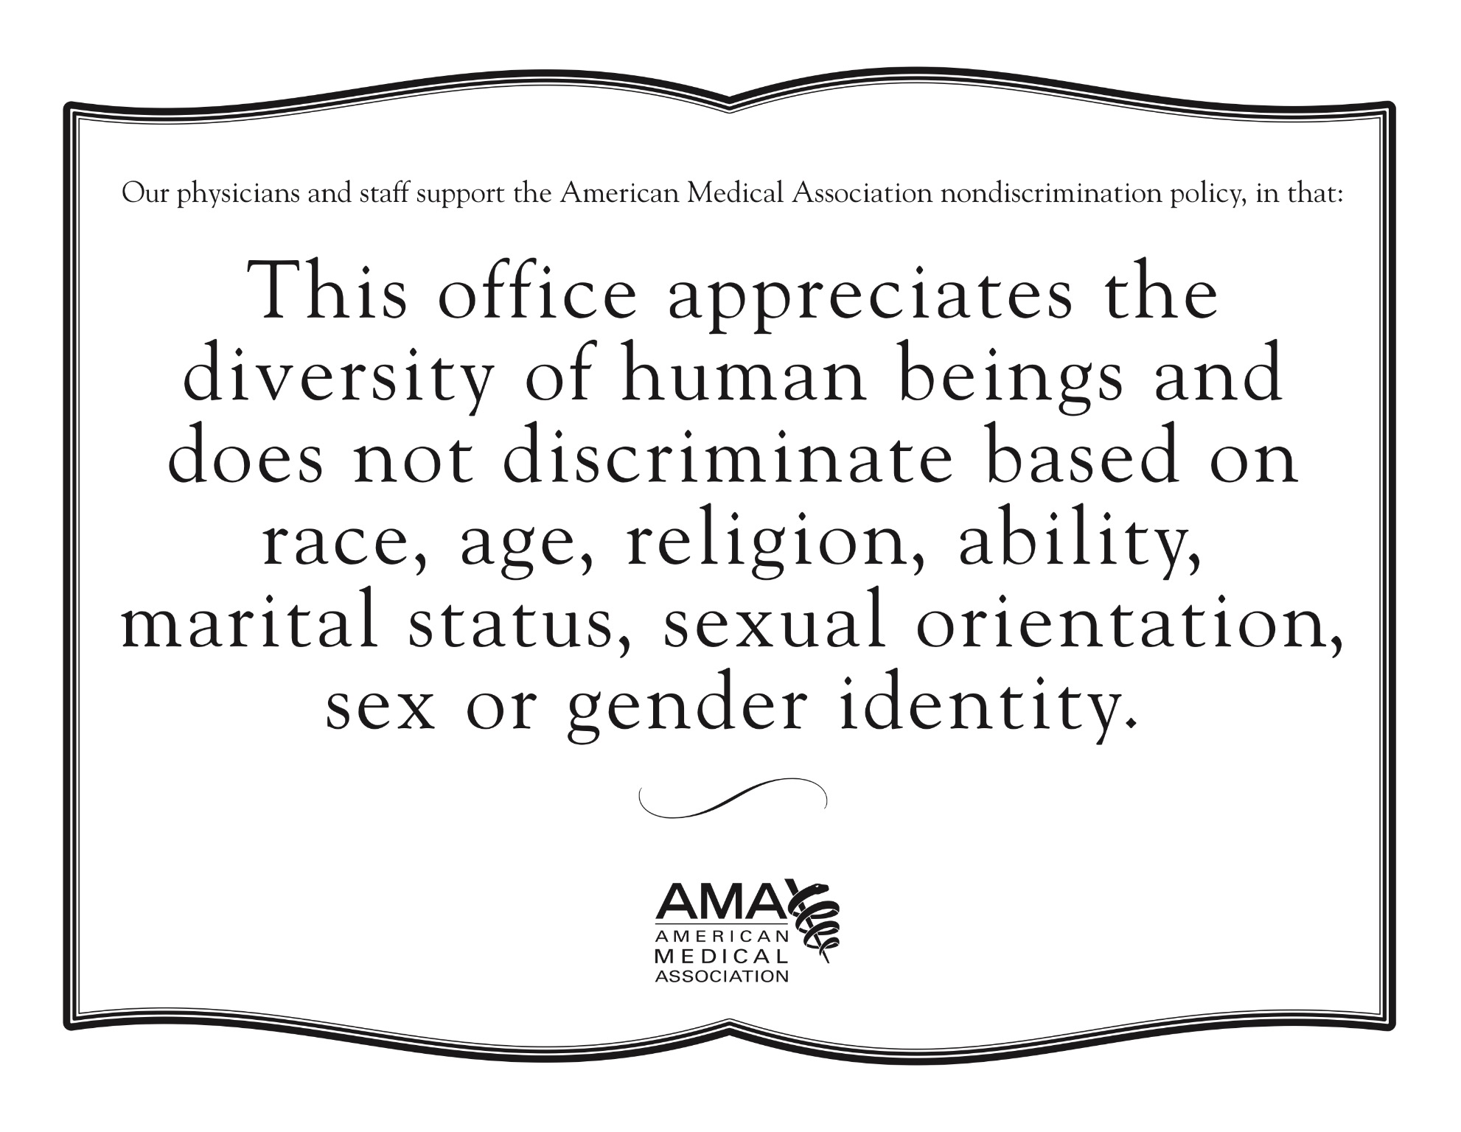
Inclusive clinical environment

Slide 19
Why is sex & gender identity important?
A woman is hospitalized with pneumonia and develops a fever

Slide 20
2-STEP GENDER IDENTITY & BIRTH SEX QUESTIONS
What is your current gender identity? (Check all that apply)
☐Male
☐Female
☐Transgender male/Trans man/ FTM
☐Transgender female/Trans woman/MTF
☐Genderqueer or diverse
☐Nonbinary
☐Two spirit
☐Other (please specify):____________________________
☐Decline to answer

Slide 21
2-STEP GENDER IDENTITY & BIRTH SEX QUESTIONS
What sex were you assigned at birth?
☐Male ☐Female ☐Decline to answer
Do you have a name you want to be called that is different from the name listed on your patient registration form? ______________________________________________________
What is/are your gender pronoun(s)? __________________________________________

Slide 22
Talking about gender identity
My name is Lis. I am a PA and my pronouns are she/her/hers.
What are your pronouns?
Have you had any gender-affirming surgeries?
What is your gender identity?
I have not heard of that gender identity before but I am interested to learn. Can you tell me more about it?
Is there anything about you that I should know for our conversation today?

Slide 23
Talking about gender identity
What name would you like me to use in my documentation for today's visit?
Have you ever gone by any other names?
I noticed in my chart review that you have started transitioning.
What can you tell me about your transition so far?
How has your transition been going?
What has your transition included up to now?

Slide 24
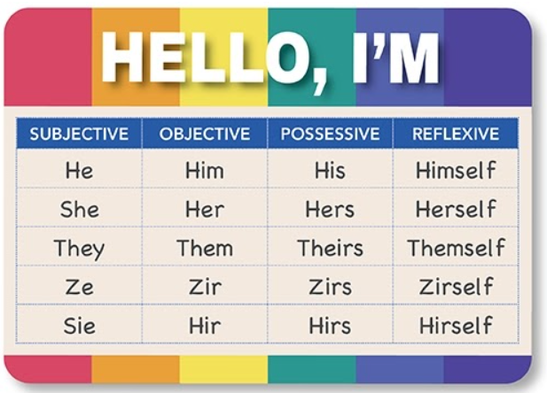
Pronouns: It matters

Slide 25
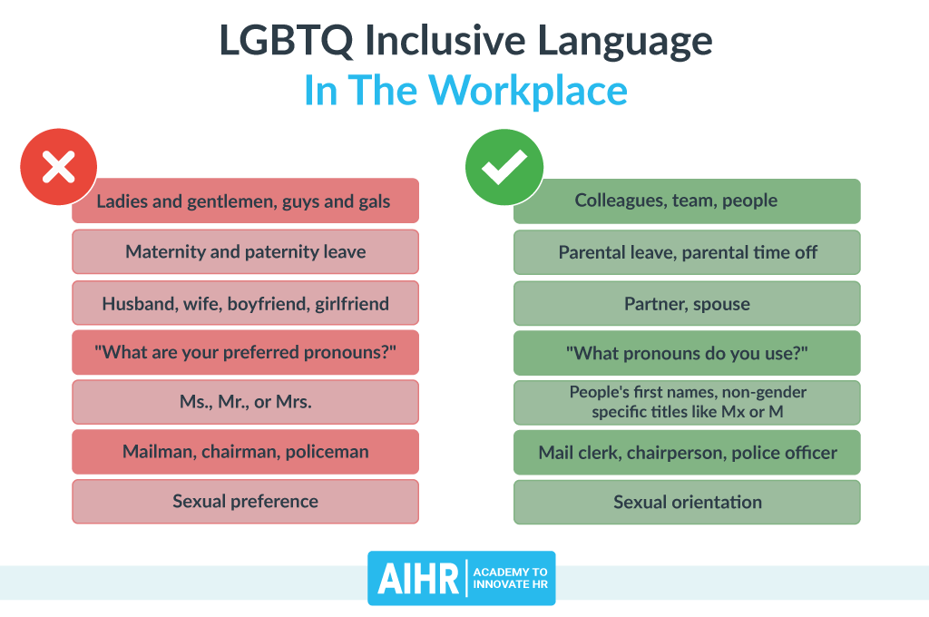
GENDER INCLUSIVE TERMS

Slide 26
Physical examination

Slide 27
anatomy
SAY | INSTEAD OF
UPPER BODY | BREAST/CHEST
EXTERNAL GENITALS | PENIS/VAGINA (VULVA)
EXTERNAL GONADS | TESTES/TESTICLES
INTERNAL GONADS | OVARIES

Slide 28
surgery
“For me to really to live my truth and live my identity, I had to have the surgery, which is why I went through it. It doesn’t mean [that others] have to, or that it will make you more or less of a woman because you have it. But for me to be comfortable, … that was a big part of it. And so, that’s why I felt I had to get it.” – Trans woman, early 40s

Slide 29
LANGUAGE TO AVOID
Hermaphrodite
Transvestite
Transsexual
Sex change/sex change operation
Gender Identity Disorder
Transgender as a noun
Transgender as a “lifestyle”
Tranny

Slide 30
7 ways to be a good trans ally
Use their desired pronouns & name at all times
Listen more; speak less
Educate yourself & others
Don’t be defensive
Ensure sensitivity in your questioning
Be inclusive
Don’t “out” anyone

Slide 31
The goal
“The staff and healthcare providers at Thomas Street were incredible and provided the kind of clinical environment that is welcoming, respectful and inclusive.”

Slide 32
The Montrose center
Trans*Fabulous Support Group
Thursdays
7 :00 PM - 8:30 PM

Slide 33
Gender infinity conference
Annual conference every October/November in the Houston area
www.genderinfinity.org

Slide 34
November 20th

Slide 35
Wrap-up
Don’t assume
Be empowering and inclusive
Respect diversity
Respect the right to bodily and mental integrity
Stay up-to-date

Slide 36
Additional information
http://www.transhealth.ucsf.edu/
http://www.lgbthealtheducation.org/
http://www.lgbthealtheducation.org/lgbt-education/lgbt-health-resources/
https://www.prideinpractice.org
http://www.transpeoplespeak.org/

Slide 38
SCAETC Social Media

Slide 39
Resources
National Clinician Consultation Center http://nccc.ucsf.edu/
HIV Management
Perinatal HIV
HIV PrEP
HIV PEP line
HCV Management
Substance Use Management
Present case on ECHO https://hsc.unm.edu/scaetc/programs-services/echo.html
AETC National HIV Curriculum https://aidsetc.org/nhc
AETC National Coordinating Resource Center https://targethiv.org/library/aetc-national-coordinating-resource-center-0
Additional trainings scaetcecho@salud.unm.edu
www.scaetc.org
Notes:
Find an HIV-related topic TeleECHO in your area: https://echo.unm.edu/locations-2/echo-hubs-superhubs-united-states/
IDEA Platform: Infectious Diseases Education & Assessment. https://idea.medicine.uw.edu/
AETC National HIV Curriculum: 6 core modules for self study; regularly updated; CME, CNE
Hepatitis C Online Curriculum: https://www.hepatitisc.uw.edu/
Hepatitis B Online Curriculum: https://www.hepatitisb.uw.edu/
National STD Curriculum: https://www.std.uw.edu/

