Slide 1
The Intersection of Public Health Prevention and Healthcare Systems: Ending HIV in Texas
Isabel Clark, MA, RD
HIV Prevention & Routine Screening in Healthcare Systems Consultant
Notes:
Version date_06 2023
UTMB HIV Annual Conference "HIV: Thriving in the New Normal"

Slide 2
Conflict of Interest Disclosure Statement
Speaker has nothing to disclose
This program is supported by the Health Resources and Services Administration (HRSA) of the U.S. Department of Health and Human Services (HHS) as part of an award totaling $3,132,205, with 0% financed with non-governmental sources. The views expressed do not necessarily reflect the official policies of the Department of Health and Human Services, nor does mention of trade names, commercial practices, or organizations imply endorsement by the U.S. Government.
Any trade/brand names for products mentioned during this presentation are for training and identification purposes only

Slide 3
Learning Objectives
Summarize events and public health legislation and policies that have influenced the HIV epidemic in Texas.
Discuss public health resources and the role of healthcare systems and providers in implementing HIV prevention models to end the HIV epidemic in Texas.
Discuss why the collaboration between public health and healthcare systems is essential in ending new HIV transmissions in Texas – the UTMB model.

Slide 4
Persons and Events, and Public Health Legislation and Policies that Have Influenced the HIV Epidemic in Texas

Slide 5
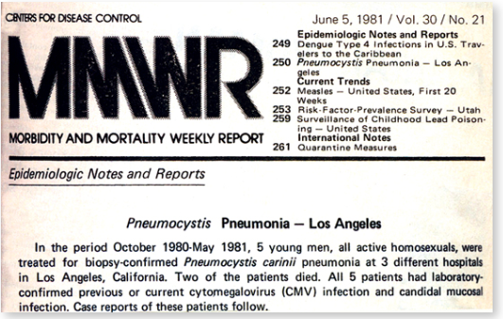
Over 40 years ago the MMWR published the first report of cases now identified as HIV/AIDS
July 3, 1981 – the MMWR reported cases of Kaposi Sarcoma and Pneumocystic Pneumonia (PCP) among homosexual men in CA and NYC.
Sep 24, 1982 – the CDC released the first case definition of AIDS—Acquired ImmunoDeficiency Syndrome.
May 1, 1987 – Virus that causes AIDS was named “Human Immunodeficiency Virus” or HIV.”
“A disease at least moderately predictive of a defect in cell-mediated immunity, occurring in a person with no known cause for diminished resistance to that disease.”
June 5, 1981 – 5 young gay men in Los Angeles were treated for biopsy-confirmed Pneumocystic pneumonia, and laboratory confirmed cytomegalovirus (CMV) infection and candida mucosal infection.
5

Slide 6
New HIV Diagnoses, People with HIV (PWH), and Deaths From All Causes Among People with HIV (PWH) in Texas (1981-2021)
2021 PWH 102,800
2021 New Dx 4,377
*There is a two-year lag in availability of complete death data
2021 Annual Report
TX HIV/STD Epidemiology & Surveillance Branch
6

Slide 7
Early Advances Timeline - Technology and Treatment
Technology
1985 – ELISA
1987 – Western Blot
1989 – 1st Algorithm
2010 – 4th gen. HIV-1/2 Abs, HIV-1 p24 Ag
2012 – 4th gen. Algorithm
(dx. Acute HIV)
Treatment
1987 – AZT - nucleoside reverse transcriptase inhibitor
– Am Med Assn Statement
– Universal Precautions
1990 – Care Act (RW Program)
1995 – Sequinavir – 1st protease
inhibiter Highly Active Antiretroviral Therapy (HAART)
1996 – Dr. David Ho “hit early, hit hard”
HAART new standard of care
2000 - Combivir, 1st fixed dose combination of Antiretroviral Therapy (ART) in one pill
7

Slide 8
1990 CARE ACT – Ryan White Program
He was 13 yo when diagnosed with six months to live. He lived five years longer than expected dying one month before his high school graduation.
Ryan became the national face of AIDS as he faced discrimination and fought for his right to attend school. When he was 16 yo he testified before the President’s Commission on AIDS.
On August 18th, 1990, Congress passed the Ryan White Comprehensive AIDS Resources Emergency (CARE) Act.
The Ryan White HIV/AIDS Program (RWHAP) helps low-income people with HIV and provides:
Medical care
Medications
Essential support services to help them stay in care.
More than 50% of people with HIV – over a half million people – receive services through the RWHAP each year.
12/6/1971 – 4/8/1990
Ryan White was one of the first children and hemophiliacs to be diagnosed with AIDS on 12/27/1984.
8

Slide 9
HRSA/RW Program & HUD/HOPWA
HRSA/RW Program — 5 Funded Parts
A – Medical & support services to Cities/Counties most severely affected by HIV – EMA*, TGA*
B – All 50 states, DC, Puerto Rico, U.S. Virgin Islands, and six U.S. territories administer Part B services
- To Improve the quality of and access to HIV health care and support services. [Tx DSHS /AAs]
- ADAP [Tx DSHS + SPAP]
C – Local community-based groups
- Provide outpatient ambulatory health services & support for people with HIV.
- Help for community-based groups to strengthen their capacity to deliver high-quality HIV care.
D – Family-centered care and access to primary medical care services for women, infants, children, and youth with HIV.
F – AETC, Special Projects, Dental, Minority AIDS Initiative
HOPWA – HUD
DSHS HIV/STD Prevention and Care Unit administers HOPWA, which is funded by annual formula grants from the U.S. Department of Housing and Urban Development (HUD):
Housing assistance and supportive services to help low-income persons living with HIV and their households establish or maintain affordable and stable housing,
Reduce PWH risk of homelessness, and
Improve access to health care and supportive services.
[*EMA - Eligible Metropolitan Areas (Hou/Harris Co & Dallas/Dallas Co) & TGA - Transitional Grant Areas (FW/Tarrant, SA/Bexar, Aus/Travis)
9
Notes:
South Texas Development Council, Laredo - UTMB-Galv
The Resource Group/Houston – Smart Health/Beaumont and East Texas

Slide 10
Landmark Recommendations CDC/MMWR, USPSTF, Texas Law
Pregnant Women
1985 – offer women at high-risk counseling and voluntary HIV testing.
1995 - universal counseling and voluntary HIV testing of all pregnant women and treatment for those living with HIV.
2001 – strengthened the recommendations and revised guidelines to emphasize HIV testing as a routine part of prenatal care.
Universal Screening for HIV
2006 – CDC Revised recommendation* for HIV testing of adults, adolescent, and pregnant women in health care settings as a standard of care, unless the patient opts-out.
Goal: To remove the barriers of previous recommendations, which included:
Separate written, signed consent.
Pre-test counseling.
*Targeted risk-based testing was missing many PWH (missed opportunities). In 2006 25% of PWH had not been diagnosed (13% in 2019). Goal - ID PWH earlier in the disease process to improve outcomes.
10

Slide 11
Missed Opportunities
Persons participate in healthcare, but many have never been tested for HIV.
6
Persons living with HIV are unaware of their HIV diagnosis due to:
They may not believe they are at risk and or are unaware of the risks of HIV transmission.
They distrust or are suspicious of healthcare.
They lack access to healthcare.
The adoption of the USPSTF or CDC routine HIV screening recommendations were for all healthcare organizations and medical providers to address these cases.
* Memorial Herman TMC-ED testing program in 2010 – 1 patient diagnosed with HIV had had 48 previous ED visits but was never tested for HIV. All previous ED visit complaints could have been symptoms of undiagnosed HIV. NOTE – EDs have proved to be the most successful testing sites, being the safety net for persons unaware of their health conditions including HIV.
11

Slide 12
Landmark Recommendations CDC, USPSTF, Texas Law
Screening for HIV
1996 – All persons with no identified risk*. Grade C
Routine counseling & screening for all persons at increased risk for HIV, including pregnant women and infants born to high-risk mothers. Grade A
2013 – Screening for Human Immunodeficiency Virus (HIV ) – adolescents & adults aged 15-65 (younger adolescents and older adults who are at high*), and all pregnant women and at labor & delivery, if status is unknown. Grade A
2019 – REVISED – Screening may not be necessary for persons who have not been at increased risk since last test. Grade A
Preventing HIV Infections: PrEP
2016 – clinicians should prescribe PrEP with effective anti-retroviral therapy to persons at increased risk of HIV acquisition, after the clinician and patient have discussed PrEP and patient agrees. Grade A
December 22, 2022 – Draft Evidence Review to include new formulations - PENDING
2016 _ Prevention Action Campaign launched the U = U Campaign promoting the benefits of ART and maintenance in care and sustaining viral suppression, i.e., undetectable.
*Men who have Sex with Men (MSM), condomless sex, multiple partners, Intravenous Drug Users (IDU)
12

Slide 13
Minor Consent - Texas Family Code Section §32.003
General and Informed Consent - Texas Health and Safety Code §81.105 & §81.106
Pregnancy – Texas Health and Safety Code §81.090
Confidentiality - Texas Health and Safety Code Sections §81.046, §81.103, and §81.106(b)
Delivering positive test results - Texas Health and Safety Code §81.109
Partner Services – Texas Health and Safety Code Section §81.051
Reporting HIV test results to appropriate local/regional health authority - Texas Health and Safety Code §81.041, §81.042, §81.043, & §81.044 and Texas Administrative Code §97.131 - §97.134
13

Slide 14
Public health resources and the role of healthcare systems and providers in implementing HIV prevention models to end the HIV epidemic in Texas

Slide 15
Initiatives to End the HIV Epidemic in the US
A network to end the global HIV epidemic
2014 Fast Track Cities 90-90-90 Goals
90% of all individuals with HIV have been diagnosed and know their status,
90% diagnosed with HIV are on treatment, and
90% on treatment achieve sustained viral suppression – U = U
The Paris Declaration on Fast-Track Cities was launched on World AIDS Day in 2014 and pledged to attain and surpass the Joint United Nations Programme on HIV/AIDS (UNAIDS) 90-90-90 targets by 2020 on a trajectory towards ending urban HIV epidemics.
2021-2026 UN Global AIDS Strategy → increased targets from 90% to 95%, added a 4th recommendation for 95% of PWH be on combination HIV prevention therapy, and a call for ZERO stigma and discrimination.
Today the FTC network includes over 300 cities and municipalities worldwide. Texas FTCs include Houston/Harris Co., Dallas/Dallas Co., San Antonio/Bexar Co., Austin/Travis Co.
15

Slide 16
Initiatives to End the HIV Epidemic in the US
The broad, overarching national plan that extends across federal departments encompassing the entire nation.
NHAS Goals include:
Prevent new HIV infections. By 2030 reduce new HIV infections to 10%.
Improve HIV-related health outcomes.
Reduce HIV-related disparities and health inequities.
Achieve integrated, coordinated efforts that address the HIV epidemic among all partners and interested parties.
In Texas, avg 4,300-4,400 new dx annually; 10% goal ≈ 430-440 new cases.
16
Notes:
≈

Slide 17
Initiatives to End the HIV Epidemic (EHE) in the US
EHE is complementary to National HIV/AIDS Strategy (NHAS) and shares the common goal of reducing new HIV transmissions in the US by 75% by 2025 and 90% by 2030.
Leading component & funding source of the work is DHHS & HRSA/RW Program.
CDC – PS20-2010 funding - “Integrated HIV Programs for Health Departments to Support EHE in the United States.”
17

Slide 18
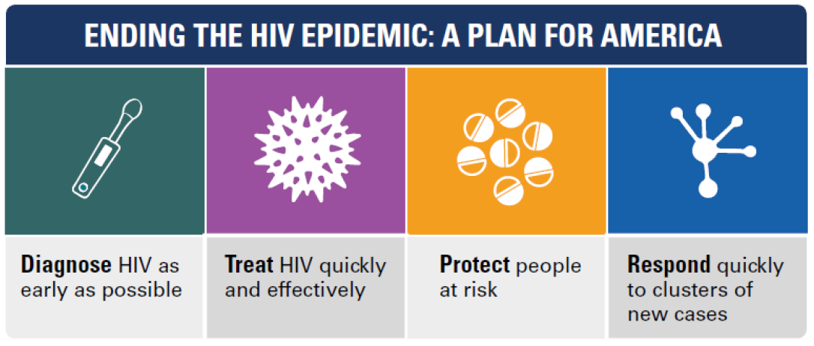
ID Acute HIV Rapid Start/ART PrEP/nPEP Surveillance
Reporting/DIS

Slide 19
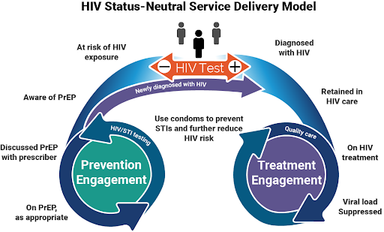
Source: HIV Prevention: A toolkit for care teams. Austin Fast Track Cities Prevention Workgroup, Jan 2023

Slide 20
Key Partnerships to End the Epidemic
PWH or persons vulnerable to acquiring HIV
Access medical services – diagnosis, treatment & care, referrals to other services.
Healthcare Providers - meet your patients where they are.
Approach your patients with cultural humility, avoid stigma and bias.
Local Clinics and Healthcare Facilities
Adopt policies and procedures to offer services to prevent and diagnose HIV and other STIs.
Partner with City, County, Tribal, & State Health Departments and other agencies.**
** CDC, HRSA, IHS, NIH, OASH, SAMHSA
Other Partners include: Advocates, Professional Associations, Providers of Medication-Assisted Treatment for Opioid Use Disorder, Community and Faith-Based Organizations and Academic and Research Institutions
20

Slide 21
Stigma Impacts Health Outcomes
Some PROVIDERS have said –
“My patients don’t have HIV”.
“That’s the work for Public Health”. “Send them to the STD clinic or the Health Department”.
Some Providers believe:
Patients will opt-out.
Testing is too time consuming.
I don’t want to bill patients for a test they didn’t request.
Some PATIENTS –
Won’t disclose their risk behaviors or HIV status for fear of stigma and/or provider bias, based on previous experience or experiences shared by others.
21

Slide 22
Role of Health Systems
Leadership and Clinicians -
Champion for HIV prevention programs and policies.
Diagnose – Implement prevention services, e.g., sexual health assessments at intake [new patients and annually] to NORMALIZE sexual health and prevention screenings in addition to routine testing.
Treat – Rapid ART, PrEP and patient education.
Rapid response to new outbreaks – partner with your local health authority.
22

Slide 23
Healthcare Systems HIV Prevention Programs Best Practices
Implement Prevention Programs and Designate Leadership to Oversee Prevention Teams:
Policies
IT/Billing
Lab
CQI
Education
✪ Delegate staff to manage & track program activities 
23

Slide 24
The UTMB Model
Public Health and Healthcare Systems Collaborations are Vital to
Ending the HIV Epidemic in Texas

Slide 25
Challenges of Prevention Screening Programs in Healthcare Systems
Most healthcare systems experience challenges when implementing new programs including:
Leadership support
Clinician Buy-in
Funding
Developing systems & streamlining processes
25

Slide 26
UTMB Model Routine HIV Screening Address the Challenges
Leadership support -
Institutional leadership: President of UTMB - Dr. Ben Raimer; CMO – Dr. Sharma; Dir. HIV Programs - Dr. Keiser.
Departmental leadership: Medical Dir. of ED - Dr. Rumph; CMIO-IT/EPIC – Dr. Clark.
Clinicians – Stigma/Bias
Conveyed a clear message indicating leadership support.
Educated clinicians and support staff on the CDC & USPSTF recommendations on routine screening.
26

Slide 27
UTMB Model Routine HIV Screening Address the Challenges
Resources/Funding/Support –
Texas Dept of State Health Services, CDC Prevention Grant; Ryan White Program; Galveston County Public Health Dept – Surveillance & Public Health Follow-up Team/DIS.
Developed Systems & Streamlined Processes –
The streamlined processes and robust system for rapid notification & linkage to care justified routine screening and eliminated the burden of ED physicians from ordering the test & delivering positive test results to patients.
Strong collaborations and open channels of communication among the HIV routine screening program, the AIDS Education and Training Center Program, the Ryan White Program, Division of Infectious Disease, the Emergency Department, and Galveston County Health District.
26

Slide 28
UTMB Streamlining processes
Consent
Patients are informed of HIV screening according to Texas law.
Ordering the Test
Standing delegation orders per Dr. Rumph, Med Dir. of ED (ED physicians are not required to order the test, per SDO nurses can order the test).
The test is automatically ordered through EPIC for patients aged 18-64 when blood work is needed (unless provider cancels the order).
27

Slide 29
UTMB Streamlining processes
Patient Results Notification/EPIC Model
Galveston County Health District (GCHD) has partial access to UTMB EPIC system. The district is notified timely with each confirmed positive case.
Both the UTMB Testing/Linkage to the Care (T&LC) Coordinator of the HIV Routine Screening Program and the Ryan White Case Managers are notified simultaneously via EPIC.
GCHD DIS notify patients diagnosed with HIV in the ED.
UTBM T&LC Coordinator contacts patients after being notified by GCHD to schedule an appointment with an ID physician within seven days, in most cases.
Trainings and Education
Webinars on routine HIV screening systems at other EDs in Texas are shared across UTMB campus.
Short videos for clinicians at educational events.
27

Slide 30
Education and Trainings
New Employee Orientation - overview of HIV and the need for opt-out routine screening programs.
Orientation session for new employees.
Resource materials including a concise educational package and recorded webinars.
Trainings for Program Staff:
Admissions/Intake, Med Techs, Nursing, Providers, Lab, Social Workers/Case Management.
STIGMA –
Driving forces of HIV.
Affects all healthcare services and outcomes.
28

Slide 31
Best Practices
Increase awareness
ID Champions to promote the RS Program and answer staff questions to share w/team.
Clinicians & Staff – offer on-going trainings, videos, webinars, and program testing reports.
Regularly report/share progress with leadership and staff.
Keep it Simple – Focus on Systems Change to complement processes and stress the education of personnel to avoid the impact of bias.
29

Slide 32
Public Health Prevention Efforts and Healthcare Systems Will Help End the HIV Epidemic
Opt Out HIV screening is universally recommended and supported by the CDC, the U.S. Preventative Services Task Force (USPSTF), Texas Law, the Dept State Health Services, and other Public Health organizations and agencies.
Routinizing HIV screening as a standard of care:
Contributes to reduced stigma associated with HIV and other STIs.
Expands awareness and opportunities for broader access to testing.
Earlier identification of individuals with HIV results in improved health outcomes including slower clinical progression and reduced mortality.
Opportunities to discuss sexual health and introduce PrEP to individuals engaging in high-risk activity (Status Neutral Model).
For those diagnosed with HIV or at risk of acquiring HIV, a strong, engaged, and compassionate HIV healthcare system is waiting to partner with them!
30

Slide 33
Ending the HIV Epidemic: Looking Forward
TX Legislative Session
HB 2235 & 3377
Universal screening
Testing technology –
Revised algorithm, 5th Gen
Rapid POC viral load
Medications –
Widespread injectables
Long-acting implants to treat and prevent HIV
A Cure
Non-vaccine approaches to block HIV transmission including the pre-exposure prophylaxis Cabotegravir.
Engineered potent antibodies that neutralize divergent strains of HIV.
Bi-specific monoclonal antibodies – potential immuno-therapies for HIV treatment, and
Engineered antibodies to purge the viral latent reservoir as a part of the international HIV cure effort.

Slide 34
Thank you!
Isabel Clark, MA, RD
HIV Prevention & Routine Screening Program Consultant

Slide 35
SCAETC Social Media
Notes:
Find an HIV-related topic TeleECHO in your area: https://echo.unm.edu/locations-2/echo-hubs-superhubs-united-states/
IDEA Platform: Infectious Diseases Education & Assessment. https://idea.medicine.uw.edu/
AETC National HIV Curriculum: 6 core modules for self study; regularly updated; CME, CNE
Hepatitis C Online Curriculum: https://www.hepatitisc.uw.edu/
Hepatitis B Online Curriculum: https://www.hepatitisb.uw.edu/
National STD Curriculum: https://www.std.uw.edu/

Slide 36
Resources
National Clinician Consultation Center http://nccc.ucsf.edu/
HIV Management
Perinatal HIV
HIV PrEP
HIV PEP line
HCV Management
Substance Use Management
Present case on ECHO hivecho@salud.unm.edu
AETC National HIV Curriculum https://aidsetc.org/nhc
AETC National Coordinating Resource Center https://targethiv.org/library/aetc-national-coordinating-resource-center-0
Additional trainings scaetcecho@salud.unm.edu
www.scaetc.org
Notes:
Find an HIV-related topic TeleECHO in your area: https://echo.unm.edu/locations-2/echo-hubs-superhubs-united-states/
IDEA Platform: Infectious Diseases Education & Assessment. https://idea.medicine.uw.edu/
AETC National HIV Curriculum: 6 core modules for self study; regularly updated; CME, CNE
Hepatitis C Online Curriculum: https://www.hepatitisc.uw.edu/
Hepatitis B Online Curriculum: https://www.hepatitisb.uw.edu/
National STD Curriculum: https://www.std.uw.edu/

