Slide 1
Power of Nutrition in HIV and Insulin Resistant Disorders
Madhuri M. Vasudevan, MD, MPH
Endocrinology, Diabetes and Metabolism
Baylor College of Medicine
Michael E. DeBakey VA Medical Center
Notes:
version date_04 2023

Slide 2
Presenter Profile
Madhuri M. Vasudevan, MD, MPH is Assistant Professor at Baylor College of Medicine and Director of the Diabetes Program at the Michael E. DeBakey VA Medical. Her clinical interests include innovations in specialty care delivery, insulin pump and sensor therapy, and patient safety. She created the first and model electronic consultation service and initiated the dedicated insulin pump clinic. She gained recognition for her niche in insulin pumps and sensors and was nominated to lead VA endocrinologist across southwestern United States. She serves as Physician Champion of MOVE! weight management program. She is an invited speaker at local and national conferences and has been published in peer reviewed journals. Dr. Vasudevan’s professional goals include delivery of high-quality evidence-based diabetes and endocrinology care, integrating innovations in clinical care delivery and developing a comprehensive, multidisciplinary, device-driven diabetes program. She is committed to cultivating a program to meet the growing needs of veterans with general endocrine disorders. Dr. Vasudevan is the recipient of the Rose Norton Fulbright Award for Excellence in Teaching and Evaluation, the Star Award for Clinical Excellence, and Women of Excellence Award at Baylor College of Medicine.

Slide 3
Conflict of Interest Disclosure Statement
Speaker has nothing to disclose
This program is supported by the Health Resources and Services Administration (HRSA) of the U.S. Department of Health and Human Services (HHS) as part of an award totaling $3,132,205, with 0% financed with non-governmental sources. The contents are those of the author(s) and do not necessarily represent the official views of, nor does mention of trade names, commercial practices, or organizations imply an endorsement by HRSA, HHS, or the U.S. Government. For more information, please visit HRSA.gov. Any trade/brand names for products mentioned during this presentation are for training and identification purposes only.

Slide 4
Learning Objectives
Recognize the role of nutrition in optimizing care in patients with HIV
Identify the relationship between specific nutrients and HIV immunity, infectivity, transmissibility
Recognize role of nutrition counseling in management of cardiometabolic diseases in people with HIV (PWH)
Incorporate counseling strategies into patient education on healthy nutrition and importance of micronutrient surveillance

Slide 5
Background
Sustainable Development Goals – commitment to end the HIV epidemic by 2030
37 million people living with HIV
Increased risk of Type 2 Diabetes (2DM), cardiometabolic disorders
Nutrition-related issues 50% or more of risk factors for mortality in US and globally
Comprehensive approach including nutritional interventions maximize benefit of Antiretroviral Therapy (ART) in preventing HIV disease progression and other adverse outcomes
JAMA. 2017;317(9):912–924.
Notes:
In 1981, the Centers for Disease Control and Prevention published case studies on an immune dysfunction that was later recognized as the Acquired Immune Deficiency Syndrome (AIDS), and the causal linkage to infection with the human immunodeficiency virus (HIV) was established a few years hence. The world continues to lose more than a million lives every year to this epidemic, and nearly two million were infected with HIV in the last year alone. Though a vaccine or cure is still elusive, considerable progress in terms of a decline in mortality due to AIDS has been achieved through the increasing availability and coverage of antiretroviral treatment (ART).
The new Sustainable Development Goals, adopted by countries of the United Nations in 2015, include a commitment to end the AIDS epidemic by 2030. Considerable emphasis on prevention of new infections and treatment of those living with HIV will be needed to make this goal achievable. With nearly 37 million people now living with HIV, it is a communicable disease that behaves like a noncommunicable disease (NCD). For example, HIV infection is associated with increased risk for type 2 diabetes mellitus, independent of other risk factors such as age, sex, ethnic origin, sexual orientation, family history of NCDs, smoking, illicit drug use, or heavy alcohol use. People living with HIV (PLHIV) may now spend decades of their lives infected and have an increased burden of other complications, including dyslipidemias and cardiometabolic outcomes.
We believe that a comprehensive approach that includes nutritional interventions is likely to maximize the benefit of antiretroviral therapy in preventing HIV disease progression and other adverse outcomes in HIV-infected men and women. Nutrition is a modifiable risk factor that has been acknowledged to be one of the most cost-effective approaches for intervention in a number of health outcomes by forums such as the Copenhagen Consensus; for example, recent analyses in JAMA have suggested that nutrition-related issues constitute 50% or more of the risk factors for mortality both in the United States and globally.

Slide 6
Vitamin Supplementation
Improve host immune response and post-treatment status
Enhance quality of life for PWH
Vitamins A, B-complex, C, D, E modulate pathogenesis of HIV infection and stage three HIV progression
Excretion of nutrients is higher in PWH for a multitude of reasons – contributing to vitamin deficient states
Summary of literature on the unique role each of these vitamins play in PWH
Vaccine, 29(13), 2429–36
Notes:
Nutrition in the form of vitamin supplementation has been shown to improve host immune response and post-treatment status. Additionally, vitamin supplementation enhances the quality of life for those battling HIV-associated morbidities, both physically in terms of improved body mass index (BMI) and immune markers and psychologically by improving symptoms of depression. Nutritional status and micronutrients, particularly vitamin A, as well as B-complex, C, D, and E vitamins, modulate the pathogenesis of HIV infection and AIDS progression in infected adults, pregnant or postpartum women, and children. Including vitamin A as an adjuvant in HIV vaccines for HIV transgenic rat models (Yu and Vajdy, 2011) has also shown promising results. What is yet to be determined is the particular combination of supplement composition and dosage for each target population that will yield the greatest prevention and treatment benefits; evidence from observational studies and randomized controlled trials is contradictory. This chapter presents an overview of recent studies that have focused on nutrition, with an emphasis on vitamin A, in individuals with HIV/AIDS.

Slide 7
Vitamin A
Retinoid compounds all-trans retinol biological activity
Maintains epithelial integrity in the respiratory and gastrointestinal (GI) tracts
Prevention of night blindness
Beta-carotene (precursor of Vitamin A)
Maintain immune response, antioxidant benefits
Deficiency associated with increased risk of
Measles, diarrheal infections, blindness, anemia
Increase natural killer function in vitro, stimulate phagocytosis
Notes:
Nutrients, especially vitamins, have a profound impact on immunity and HIV infection progression and can help support host recovery from side effects of ART. The most studied of the vitamins, vitamin A, impacts HIV disease outcomes and transmission, but supplementation can also be detrimental in certain populations. Vitamin A is a family of retinoid compounds with all-trans-retinol biologic activity (Villamor et al., 2005). In the body, vitamin A is important for the maintenance of the integrity of the epithelium in the respiratory and gastrointestinal tracts, as well as in the prevention of night blindness. Night blindness is the world’s foremost cause of preventable blindness in children (Villamor and Fawzi, 2005; Katona and Katona-Apte, 2008). Vitamin A has received much attention and focus in the arena of infectious diseases, particularly after Scrimshaw observed that “no nutritional deficiency is more consistently synergistic with infectious disease than that of vitamin A” (Scrimshaw et al., 1968, p. 94). Increased prevalence of measles, diarrheal infections, blindness, and anemia has been linked to low vitamin A status (Semba, 1994; Villamor and Fawzi, 2005; Katona and Katona-Apte, 2008).
Immunologically, vitamin A has been shown to increase natural killer cell function in vitro and to stimulate phagocytosis (Kaio et al., 2013). β-Carotene, a precursor of vitamin A, has been shown to maintain the immune response and can also act as an antioxidant (Baeten et al., 2007). The retinoic acid receptor (RAR) supports robust antibody responses by promoting T-helper type 2 cells (Th₂) and Th₁₇, as well as regulatory T-cell (T_{reg}) development and responses (Mora et al., 2008; Reilly et al., 2012). The Th₂ cytokines interleukin-4 (IL-4), IL-5, and IL-10 are associated with strong antibody production, eosinophil activation, and inhibition of several macrophage functions (a phagocyte-independent protective response) (Mora et al., 2008; Reilly et al., 2012). Retinoic acid can also inhibit B-cell apMoptosis and modulate antigen presentation on dendritic cells (Mora et al., 2008). Deficiency has been associated with abnormalities in T-cell subsets such as the selective loss of CD4⁺ helper T cells from lymph nodes, thymus, and spleen (Srinivas and Dias, 2008) and associated decreases in the Th₂ antibodies IgE, IgG1, and IgA (Long et al., 2010). In a mouse model, vitamin A deficiency resulted in a reduction of Th₂ cells; vitamin A supplementation reversed the defect (Mora et al., 2008; Motswagole et al., 2013).
The relationship between nutritional status and infection, particularly HIV, is locked in a vicious cycle (Scrimshaw et al., 1968): HIV/AIDS lowers appetite and impairs the absorption, utilization, and excretion of nutrients; in turn, lowered nutritional status increases infection susceptibility (WHO, 2003; Evans et al., 2013). Co-morbidities—such as increased diarrheal and respiratory diseases in the case of HIV—result in further malnourishment (Katona and Katona-Apte, 2008). Vitamin A, in particular, has been shown to modulate immune function and HIV pathogenesis.
There is evidence in the literature demonstrating that HIV infection impairs nutrient metabolism (Kassu et al., 2007; Katona and Katona-Apte, 2008; Buccigrossi et al., 2011; Evans et al., 2013). HIV infection is initiated on the intestinal mucosal surface and induces infiltration of the gut mucosa, causing the release of T cells, damage to the intestinal wall, and epithelial apoptosis (Epple et al., 2010). The mechanisms of impaired absorption are not well characterized, but increased permeability due to altered intestinal mucosal architecture was seen in human mucosa specimens in vitro in a recent study (Buccigrossi et al., 2011). HIV-1 transactivator factor, a viral factor referred to as Tat, induced an enterotoxic effect on intestinal epithelial cells that may explain the diarrhea that often occurs with HIV infection. Tat also caused oxidative stress followed by apoptosis of enterocytes. These effects were prevented by the administration of the antioxidant N-acetyl-cysteine. In HIV-positive patients not taking ART, chronic oxidative stress causes perturbations of the antioxidant defense system, which may be explained by the role of Tat in HIV enteropathy.
Nutrient utilization and requirements are altered during HIV infection. Increased inflammation and increased oxidation of retinol, a form of vitamin A, result in increased tissue retinol requirements (Neves et al., 2006). However, with severe protein malnutrition and lower levels of retinolbinding protein (RBP), less retinol is mobilized from hepatic stores (possibly as a result of the acute phase response). Fever, which often occurs in HIV, also increases energy and micronutrient requirements (Katona and Katona-Apte, 2008). Excretion of nutrients is heightened during HIV infection, resulting in poorer nutritional status. Several studies have shown that HIV infection-associated fever diminishes the ability of the proximal tubules of the kidneys to absorb low-molecular-weight proteins such as RBP, leading to its loss—and thus that of retinol—in a 1:1 retinol:RBP ratio in the urine, a condition known as febrile proteinuria (Neves et al., 2006; Kassu et al., 2007; Srinivas and Dias, 2008). This loss further exacerbates nutrient deficiency.
Anorexia, induced by both the HIV infection and ART therapy for it, is a major factor in HIV/ AIDS-related wasting and malnutrition. Lack of appetite is caused by multiple factors—including nausea and vomiting, difficulty swallowing (dysphagia) or painful swallowing (odynophagia), as well as esophageal candidiasis, a common opportunistic fungal infection affecting HIV patients (Neves et al., 2006; Mda et al., 2010; Evans et al., 2013). Additionally, mental status can impact dietary intake, as observed among HIV-infected adults with depression (Purnomo et al., 2012). One trial found that micronutrient supplementation improves appetite, indicating that vitamin and/ or mineral supplementation may play a role in regulating hunger levels (Mda et al., 2010). In agreement with this finding, another study showed associations between the low ingestion of retinoids and carotenoid precursors with dietary distortion and anorexia (Neves et al., 2006). As a result, wasting, protein depletion, micronutrient deficiencies, and reduction in body cell mass are found in untreated HIV/AIDS patients (Katona and Katona-Apte, 2008). As an adjunct to ART therapy, nutrition interventions can improve appetite and help replenish some of the extra vitamins that are lost, improving quality of life and, potentially, adherence to ART.
Dietary vitamin A may be obtained as retinyl palmitate from animal sources or in the form of pro-vitamin A (including the carotenoids β-carotene, α-carotene, and γ-carotene and the xanthophyll β-Cryptoxanthin) from plant sources, such as dark leafy greens and orange-colored vegetables (Solomons, 2012). Because animal-sourced foods are less common in resource-poor regions, and carotenoids are not as effective in boosting vitamin A status (based on an intestinal carotenoid-to-retinol conversion ratio of 12:1), vitamin A deficiency (defined as less than 0.70 μmol/L or less than 20 μg/dL serum retinol) is a major problem in many areas of the world (WHO, 2009), especially in HIV-infected persons (Nunnari et al., 2012). In 122 countries, vitamin A deficiency affects 250 million children, raising the risk of night blindness and infection of HIV (WHO, 2009, 2014a).
It is well established that vitamin A supplementation improves growth and reduces morbidity in HIV-infected children (Villamor et al., 2002; Ndeezi et al., 2010; Kaio et al., 2013). Adults also benefit from supplementation of vitamin A, including decreased mortality in advanced AIDS patients (Austin et al., 2006). However, vitamin A supplementation is not recommended for pregnant women or lactating mothers, despite findings from observational studies showing that low vitamin A status increases the risk of mother-to-child transmission (MTCT). Supplementation can also increase the risk of MTCT (Fawzi et al., 2002). One mechanism to explain this counterintuitive finding is that vitamin A supplementation appears to cause increased viral shedding in breast milk and higher prevalence of mastitis, leading to vertical transmission from mother to breastfeeding infant (Baeten et al., 2002; Kantarci et al., 2007; Villamor et al., 2010). Additionally, the HIV genome contains retinoic acid receptors, by which vitamin A may stimulate transcription and replication of the virus. Vitamin A may also increase the expression of CCR5 receptors on monocytes/macrophages, which would increase the susceptibility of cells to HIV infection (Webb et al., 2011). The findings from cross-sectional studies may be explained by the acute phase response, a process that causes the body to blockade nutrients (such as vitamin A and iron) deep in storage tissue to hypothetically prevent the utilization of nutrients by pathogens (Zvandasara et al., 2006). Additionally, inflammatory cytokines such as interleukin-2 (IL-2), IL-6, IL-10, and TNF-α stimulate the movement and storage of iron into macrophages during the acute phase response (WHO and CDC, 2007). The resulting effect is lowered retinol-binding protein levels, and thus lower serum retinol status, which would explain why low vitamin A status is found among HIV patients and also found to increase transmission from mother to child (Mehta and Fawzi, 2007).
In the following sections, laboratory studies, animal studies, observational studies, randomized controlled trials, and vitamin A interactions with ART are discussed. The primary exposure is vitamin A status or an intervention with vitamin A, and the outcomes include various HIV-related symptoms and co-morbidities.

Slide 8
Retinoic Acid
Increased uptake of gut hormone receptors
Promote TH2 cell-differentiation
Blocks differentiation of TH17 cells
Nat Rev Immunol. 2008 September ; 8(9): 685–698
Notes:
In addition to upregulating the expression of gut-homing receptors, retinoic acid has also been reported to promote T-helper-2 (TH2)-cell differentiation. Moreover, retinoic acid blocks the differentiation of T helper 17 (TH17) cells and induces forkhead box protein 3 (FOXP3)+regulatory T (TReg) cells in the presence of transforming growth factor-β (TGFβ) by reciprocally downregulating receptor-related orphan receptor-γt (RORγt) and inducing FOXP3 expression in T cells, respectively. Retinoic acid also enhances the TGFβ-driven induction of TReg cells and induces gut-homing receptor expression in both naturally occurring and induced TReg cells. TH17-cell differentiation requires TGFβ, interleukin-6 (IL-6), IL-23 and, in humans, IL-1β. b | B cells activated in non-mucosal lymphoid tissues, such as peripheral lymph nodes and spleen, mostly become IgG+ antibody-secreting cells (ASCs) and home to the bone marrow and sites of inflammation. By contrast, B cells activated in mucosal-associated lymphoid tissues (MALT) give rise to IgA+ ASCs. In MALT (including the gut-associated lymphoid tissue; GALT), TGFβ and CD40 ligand (CD40L) are essential for the generation of T-cell-dependent IgA responses, whereas BAFF (B-cell-activating factor) and APRIL (a proliferation-inducing ligand) are important for T-cell-independent IgA responses. APRIL is induced by Toll-like receptor (TLR) signals, commensal flora and thymic stromal lymphopoietin (TSLP). Inducible nitric oxide synthase (iNOS), which is also upregulated by TLR signals and commensal flora, produces nitric oxide (NO), allows proper TGFβ signalling and induces the production of APRIL and BAFF by dendritic cells. Thus, iNOS and NO are essential for both T-cell-dependent and -independent IgA responses. In the GALT, retinoic acid might contribute directly to the differentiation of T-cell-independent (and probably also T-cell-dependent) IgA+ ASCs. In addition, retinoic acid might contribute indirectly to T-celldependent and -independent IgA responses by inducing iNOS expression

Slide 9
Retinoic Acid
Inducible Nitric Oxide Synthase (iNOS and NO) are essential for T-cell dependent and independent IgA responses
Retinoic Acid induces iNOS expression, supporting antioxidant/immunity
Nat Rev Immunol. 2008 September ; 8(9): 685–698
Notes:
In addition to upregulating the expression of gut-homing receptors, retinoic acid has also been reported to promote T-helper-2 (TH2)-cell differentiation. Moreover, retinoic acid blocks the differentiation of T helper 17 (TH17) cells and induces forkhead box protein 3 (FOXP3)+regulatory T (TReg) cells in the presence of transforming growth factor-β (TGFβ) by reciprocally downregulating receptor-related orphan receptor-γt (RORγt) and inducing FOXP3 expression in T cells, respectively. Retinoic acid also enhances the TGFβ-driven induction of TReg cells and induces gut-homing receptor expression in both naturally occurring and induced TReg cells. TH17-cell differentiation requires TGFβ, interleukin-6 (IL-6), IL-23 and, in humans, IL-1β. b | B cells activated in non-mucosal lymphoid tissues, such as peripheral lymph nodes and spleen, mostly become IgG+ antibody-secreting cells (ASCs) and home to the bone marrow and sites of inflammation. By contrast, B cells activated in mucosal-associated lymphoid tissues (MALT) give rise to IgA+ ASCs. In MALT (including the gut-associated lymphoid tissue; GALT), TGFβ and CD40 ligand (CD40L) are essential for the generation of T-cell-dependent IgA responses, whereas BAFF (B-cell-activating factor) and APRIL (a proliferation-inducing ligand) are important for T-cell-independent IgA responses. APRIL is induced by Toll-like receptor (TLR) signals, commensal flora and thymic stromal lymphopoietin (TSLP). Inducible nitric oxide synthase (iNOS), which is also upregulated by TLR signals and commensal flora, produces nitric oxide (NO), allows proper TGFβ signalling and induces the production of APRIL and BAFF by dendritic cells. Thus, iNOS and NO are essential for both T-cell-dependent and -independent IgA responses. In the GALT, retinoic acid might contribute directly to the differentiation of T-cell-independent (and probably also T-cell-dependent) IgA+ ASCs. In addition, retinoic acid might contribute indirectly to T-celldependent and -independent IgA responses by inducing iNOS expression

Slide 10
Vitamin A: Utilization
Impaired in HIV infection: Increased inflammation / oxidation of retinol
Severe protein malnutrition and lower retinol binding protein, less retinol mobilized from hepatic stores
HIV-associated fever diminishes proximal tubule absorption of low molecular weight proteins, such as Retinol-binding proteins (RBP) –leading to 1:1 retinol: RBP in the urine – febrile proteinuria
Supplementation improves growth and reduces morbidity in children with HIV
Nutrition, 22(5), 483–9, Pediatrics, 109(1), e6
Notes:
Nutrient utilization and requirements are altered during HIV infection. Increased inflammation and increased oxidation of retinol, a form of vitamin A, result in increased tissue retinol requirements (Neves et al., 2006). However, with severe protein malnutrition and lower levels of retinolbinding protein (RBP), less retinol is mobilized from hepatic stores (possibly as a result of the acute phase response). Fever, which often occurs in HIV, also increases energy and micronutrient requirements (Katona and Katona-Apte, 2008). Excretion of nutrients is heightened during HIV infection, resulting in poorer nutritional status. Several studies have shown that HIV infection-associated fever diminishes the ability of the proximal tubules of the kidneys to absorb low-molecular-weight proteins such as RBP, leading to its loss—and thus that of retinol—in a 1:1 retinol:RBP ratio in the urine, a condition known as febrile proteinuria (Neves et al., 2006; Kassu et al., 2007; Srinivas and Dias, 2008). This loss further exacerbates nutrient deficiency.

Slide 11
Vitamin A: Challenges
Not recommended for pregnant women or lactating mothers – increased risk of mother to child transmission (MTCT)
Potential to increase viral shedding in breast milk
Higher prevalence of mastitis- vertical transmission from mother to breast/chest feeding infant
HIV genome contains retinoic acid receptors – if stimulated with vitamin A, may increase transcription and replication of the virus
AIDS, 16(14), 1935–44
Notes:
It is well established that vitamin A supplementation improves growth and reduces morbidity in HIV-infected children (Villamor et al., 2002; Ndeezi et al., 2010; Kaio et al., 2013). Adults also benefit from supplementation of vitamin A, including decreased mortality in advanced AIDS patients (Austin et al., 2006). However, vitamin A supplementation is not recommended for pregnant women or lactating mothers, despite findings from observational studies showing that low vitamin A status increases the risk of mother-to-child transmission (MTCT). Supplementation can also increase the risk of MTCT (Fawzi et al., 2002). One mechanism to explain this counterintuitive finding is that vitamin A supplementation appears to cause increased viral shedding in breast milk and higher prevalence of mastitis, leading to vertical transmission from mother to breastfeeding infant (Baeten et al., 2002; Kantarci et al., 2007; Villamor et al., 2010). Additionally, the HIV genome contains retinoic acid receptors, by which vitamin A may stimulate transcription and replication of the virus. Vitamin A may also increase the expression of CCR5 receptors on monocytes/macrophages, which would increase the susceptibility of cells to HIV infection (Webb et al., 2011). The findings from cross-sectional studies may be explained by the acute phase response, a process that causes the body to blockade nutrients (such as vitamin A and iron) deep in storage tissue to hypothetically prevent the utilization of nutrients by pathogens (Zvandasara et al., 2006). Additionally, inflammatory cytokines such as interleukin-2 (IL-2), IL-6, IL-10, and TNF-α stimulate the movement and storage of iron into macrophages during the acute phase response (WHO and CDC, 2007). The resulting effect is lowered retinol-binding protein levels, and thus lower serum retinol status, which would explain why low vitamin A status is found among HIV patients and also found to increase transmission from mother to child (Mehta and Fawzi, 2007).

Slide 12
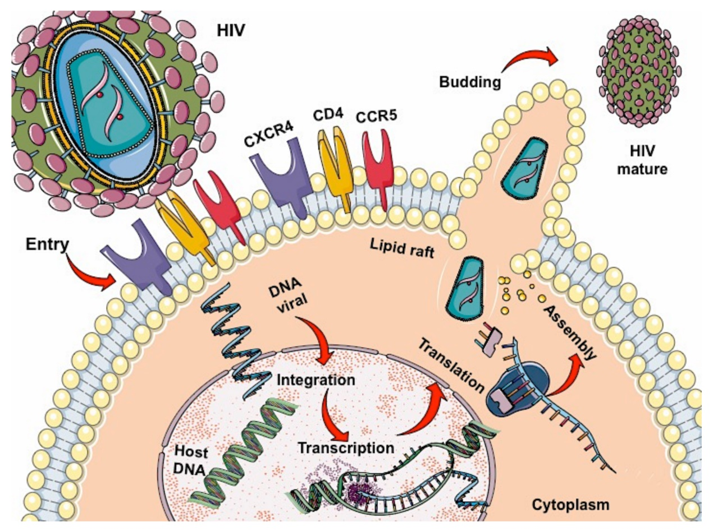
Vitamin A increases lymphoid cell differentiation, which leads to an increase in Chemokine Receptor type 5 (CCR5) receptors
CCR5 receptors essential for attachment of HIV to the lymphocytes
Increased CCR5 receptors may increase HIV replication
Vitam Horm. 2007;75:355-83
Notes:
Finally, vitamin A is known to increase lymphoid cell differentiation, which leads to an increase in CCR5 receptors. These receptors are essential for attachment of HIV to the lymphocytes and therefore, an increase in their number is likely to increase HIV replication.
Vitam Horm. 2007;75:355-83

Slide 13
Vitamin A: WHO Recommendations
Supplementation not recommended for newborns or infants up to 5 months, unless >1% prevalence of Vitamin A deficiency and night blindness (Vitamin A 100,000 IU x1)
Children, 1-5 years: 200,000 IU every 4-6 months
Pregnancy: NOT RECOMMENDED, unless >5% prevalence night blindness
No consensus among non-pregnant, adults with HIV
WHO (2011a). Guideline: Neonatal Vitamin A Supplementation. New York: World Health Organization
Notes:
Vitamin A supplementation is not recommended for newborns and infants up to 5 months of age (WHO, 2011a,b). In locales where night blindness prevalence is >1% among children 12 to 24 months of age or where vitamin A deficiency (serum retinol < 0.70 μmol) is > 20% among children 6 to 59 months of age, WHO recommends that infants 6 to 11 months of age, including those who are HIV positive, receive one dose of vitamin A (100,000 IU or 300 mg RE) in an oral liquid, oil-based preparation of retinyl palmitate or retinyl acetate (WHO, 2011c).
For children 12 to 59 months of age, including HIV-positive individuals, WHO recommends 200,000 IU (60 mg RE) of vitamin A every four to six months (WHO, 2011c).
For pregnant women, it is not recommended that they receive routine vitamin A supplementation to prevent maternal and infant morbidity and mortality, as vitamin A is a known teratogen. However, in settings where night blindness > 5% in pregnant women or in children 24 to 59 months of age, vitamin A supplementation is recommended during pregnancy to prevent night blindness (WHO, 2011d).
WHO does not recommend that HIV-positive pregnant women receive vitamin A supplementation for reducing the risk of mother-to-child transmission (MTCT) of HIV (WHO, 2011e). Several studies have shown an increased risk for MTCT when vitamin A is administered, as discussed in this chapter and in Mehta and Fawzi’s review (2007).
Vitamin A supplementation is not recommended for postpartum women for the prevention of maternal and infant morbidity and mortality (WHO, 2011f). Again, studies have shown that vitamin A supplementation increases the risk of HIV transmission from mothers to their babies via horizontal transmission (i.e., through breastfeeding).

Slide 14
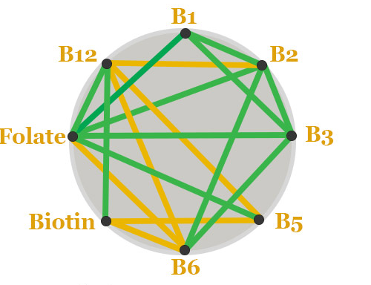
B Vitamins
Water-soluble micronutrients required for cell metabolism
Cofactors in Anacardic Acid (AA), Fatty Acid (FA), sugar metabolism
Synthesis and methylation of DNA
Required for de novo purine biosynthesis of S-adenosyl methionine – universal methyl donor that is required for > 100 methylation processes
Required during periods of rapid growth and development
Nutrition and HIV: Epidemiological Evidence to Public Health. 2018 May 15
Notes:
Nutrition and HIV: Epidemiological Evidence to Public Health.
Show detailsMehta S, Finkelstein JL, editors.
New York (NY): CRC Press; 2018 May 15
B-vitamins are a class of water-soluble micronutrients that are required for cell metabolism. These include thiamin (vitamin B₁), riboflavin (vitamin B₂), niacin (vitamin B₃), pantothenic acid (vitamin B₅), pyridoxine (vitamin B₆), biotin (vitamin B₇), folate (vitamin B₉), and vitamin B₁₂. B-vitamins serve as cofactors in the metabolism of amino acids, fatty acids, and sugars, as well as the synthesis and methylation of DNA (McCormick et al., 1999; Powers, 2003; Kamanna and Kashyap, 2008; Stover, 2009; Allen, 2012; Combs, Jr., 2012). In particular, folate, vitamin B₆, and vitamin B₁₂ are required in one-carbon metabolism, including de novo purine biosynthesis and production of S-adenosyl methionine, the universal methyl donor required in over 100 methylation processes (Stover, 2009; Finkelstein et al., 2015). Requirements for B-vitamins are increased during periods of rapid growth and development, including during pregnancy and early childhood (Stover, 2009; Finkelstein et al., 2015).
B-vitamins and Immune Function
B-vitamins are required for innate and adaptive immunity and the maintenance of processes underlying immune function. For example, folate, vitamin B₆, and vitamin B₁₂ are important for lymphocyte maturation and proliferation, T-cell cytotoxicity, and protection against oxidative stress (Dhur et al., 1991; Gay and Meydani, 2001). In observational studies among patients with megaloblastic anemia, intramuscular vitamin B₁₂ injections restored CD8 T-cell counts, total leukocyte counts, and natural killer cell activity (Tamura et al., 1999; Erkurt et al., 2008), and folic acid supplementation improved cell-mediated immunity (Gross et al., 1975). Another study found that increased dietary intake of vitamin B₆ was associated with elevated lymphocyte proliferation (Kwak et al., 2002). During elevated interferon-gamma (IFN-γ) activity, riboflavin and vitamin B₆ may be depleted, given the role of these nutrients as cofactors for tryptophan catabolism, a metabolic process that is increased during IFN-γ-mediated immune activity (Christensen et al., 2012; Theofylaktopoulou et al., 2014). Few studies have been conducted to investigate the associations of other B-vitamins and immune function.

Slide 15
B Vitamins and Immunity
Innate and adaptive immunity
Lymphocyte maturation, proliferation, T-cell cytotoxicity, protection against oxidative stress
Repletion restores Cluster of Differentiation 8 (CD8) T cell counts, Total leukocyte counts, Natural Killer (NK) cell activity
Nutrition and HIV: Epidemiological Evidence to Public Health. 2018 May 15
Notes:
B-vitamins and Immune Function
B-vitamins are required for innate and adaptive immunity and the maintenance of processes underlying immune function. For example, folate, vitamin B₆, and vitamin B₁₂ are important for lymphocyte maturation and proliferation, T-cell cytotoxicity, and protection against oxidative stress (Dhur et al., 1991; Gay and Meydani, 2001). In observational studies among patients with megaloblastic anemia, intramuscular vitamin B₁₂ injections restored CD8 T-cell counts, total leukocyte counts, and natural killer cell activity (Tamura et al., 1999; Erkurt et al., 2008), and folic acid supplementation improved cell-mediated immunity (Gross et al., 1975). Another study found that increased dietary intake of vitamin B₆ was associated with elevated lymphocyte proliferation (Kwak et al., 2002). During elevated interferon-gamma (IFN-γ) activity, riboflavin and vitamin B₆ may be depleted, given the role of these nutrients as cofactors for tryptophan catabolism, a metabolic process that is increased during IFN-γ-mediated immune activity (Christensen et al., 2012; Theofylaktopoulou et al., 2014). Few studies have been conducted to investigate the associations of other B-vitamins and immune function.

Slide 16
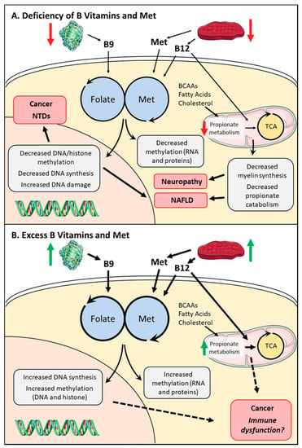
B Vitamin Deficiency
Decrease in one-carbon metabolism output, leading to decreased DNA synthesis, increased genomic instability, and decreased methylation potential.
Neural tube defects (NTDs), non-alcoholic fatty liver disease
Nutrients 2020, 12(9), 2867
Notes:
Systemic effects of altered micronutrients in one-carbon metabolism. (A) Reduced folate, methionine, or B12 can cause a decrease in one-carbon metabolism output, leading to decreased DNA synthesis, increased genomic instability, and decreased methylation potential. This can promote the development of neural tube defects (NTDs), non-alcoholic fatty liver disease (NAFLD), and cancer (specifically colorectal cancer). Reduced B12 also decreases activity of the propionate catabolic pathway through decreased methylmalonyl-CoA mutase (MUT) enzymatic activity, leading to decreased myelin synthesis, increased cellular stress, and disrupted tricarboxylic acid (TCA) cycling. These factors influence the development of neuropathies and promote NAFLD. (B) Effects of excess folate, methionine, and B12 are less understood, but increases can promote cell proliferation and can increase SAM (S-adenosylmethionine) levels, which allow cells to maintain their methylated states. This could lead to the development of cancers as maintenance of methylation is important for some malignancies. Excessive folate also disrupts normal hematopoiesis, possibly through increased one-carbon metabolism.

Slide 17
B Vitamin Excess
Promote cell proliferation
Allows cells to maintain methylated states
May increase development of cancers
Disrupts hematopoiesis
Nutrients 2020, 12(9), 2867
Notes:
Systemic effects of altered micronutrients in one-carbon metabolism. (A) Reduced folate, methionine, or B12 can cause a decrease in one-carbon metabolism output, leading to decreased DNA synthesis, increased genomic instability, and decreased methylation potential. This can promote the development of neural tube defects (NTDs), non-alcoholic fatty liver disease (NAFLD), and cancer (specifically colorectal cancer). Reduced B12 also decreases activity of the propionate catabolic pathway through decreased methylmalonyl-CoA mutase (MUT) enzymatic activity, leading to decreased myelin synthesis, increased cellular stress, and disrupted tricarboxylic acid (TCA) cycling. These factors influence the development of neuropathies and promote NAFLD. (B) Effects of excess folate, methionine, and B12 are less understood, but increases can promote cell proliferation and can increase SAM (S-adenosylmethionine) levels, which allow cells to maintain their methylated states. This could lead to the development of cancers as maintenance of methylation is important for some malignancies. Excessive folate also disrupts normal hematopoiesis, possibly through increased one-carbon metabolism.

Slide 18
B Vitamins and HIV Related Outcomes
B Vitamin Supplementation in combination with other vitamins and minerals – improved HIV related outcomes
Decrease the risk of HIV disease progression and AIDS- related deaths
Increased Cluster of Differentiation 4 (CD4) counts in pregnant and non-pregnant women with HIV
Reduced the risk of HIV-related opportunistic infections, weight loss, anemia
New England Journal of Medicine, 351(1), 23–32
Notes:
Micronutrient supplementation with B-vitamins in combination with other vitamins and minerals has been associated with improved HIV-related outcomes in several randomized trials. B-vitamin supplementation decreased the risks of HIV disease progression and AIDS-related death (Jiamton et al., 2003; Fawzi et al., 2004b) and increased CD4 T-cell counts (Fawzi et al., 1998; Baum et al., 2013) in randomized trials in both pregnant and non-pregnant HIV-infected women. Daily supplementation with B-vitamins also reduced the risk of HIV-related opportunistic infections, weight loss, and anemia in trials in HIV-infected pregnant women (Villamor et al., 2005b; Fawzi et al., 2007; Villamor et al., 2008; Olofin et al., 2014).

Slide 19
Heart Positive Study
Against a background of low saturated fat diet and regular exercise, niacin increased High Density Lipoprotein-Cholesterol (HDL-C) and fenofibrate decreased triglycerides in a multiethnic population of patients with HIV dyslipidemia on ART
Combination therapy produced lowest ratio of total cholesterol to HDL-C, a measure highly correlated to cardiovascular risk
Balasubramanyuam et al. J Clin Endocrinol Metab. 2011 Jul; 96(7): 2236–2247.
Notes:
A combination of fenofibrate and niacin with low-saturated-fat D/E is effective and safe in increasing HDL-C, decreasing non-HDL-C and hypertriglyceridemia, and ameliorating hypoadiponectinemia in patients with HIV/ART-associated dyslipidemia
The Heart Positive study demonstrated that, against a background of a low-saturated-fat diet and regular exercise, niacin increased HDL-C and fenofibrate decreased triglycerides in a multiethnic group of dyslipidemic HIV patients on ART. These drugs were selected, despite their overlapping lipid-lowering effects, for their ability to target distinct kinetic defects in HIV patients. A combination of the two was most effective in lowering triglycerides (−52% compared with usual care), increasing HDL-C (+12%), and lowering non-HDL-C (−18.5%). Indeed, postintervention mean levels for the group that received both drugs were in the normal range for triglycerides and HDL-C. Combination therapy also produced the lowest ratio of total cholesterol to HDL-C, a measure highly correlated with cardiovascular risk (24).
B-vitamin deficiencies are prevalent in HIV-infected individuals and have been associated with increased risk of adverse health outcomes. Randomized trials to date have demonstrated a consistent benefit of B-vitamin supplementation on HIV disease progression and HIV-related health outcomes in ART-nai’ve populations. Current evidence supports the use of B-vitamin supplementation at the single RDA level for HIV-infected individuals. There is, however, more limited evidence of the additional benefit of higher dose B-vitamin supplementation compared to the single RDA level. Improved dietary intake of B-vitamins using food fortification and dietary diversification approaches is needed, particularly in resource-limited settings where the burden of B-vitamin deficiencies is high.
Extended-release niacin has demonstrated consistent benefits for lipid profiles and dyslipidemia in HIV-infected adults who are stable on ART. ER-niacin therapy is a feasible method to maintain a normal lipid profile for HIV-infected individuals on ART. However, findings regarding the potential effects on insulin resistance and elevated blood glucose concentrations warrant caution, and individuals must be carefully monitored for insulin resistance and diabetes.

Slide 20
B Vitamin Recommendations
B Vitamin deficiencies highly prevalent in PWH and associated with adverse health outcomes
Randomized Control Trials (RCT) consistent benefit of B vitamin supplementation on HIV disease progression, health outcomes in ART-naïve populations
Literature supports B vitamin supplementation at the single Recommended Dietary Allowance (RDA) for PWH
Food fortification and dietary diversification is needed
Niacin consistently demonstrates benefits for lipid profiles and dyslipidemia on stable ART
Nutrition and HIV: Epidemiological Evidence to Public Health. 2018 May 15
Notes:
B-vitamin deficiencies are prevalent in HIV-infected individuals and have been associated with increased risk of adverse health outcomes. Randomized trials to date have demonstrated a consistent benefit of B-vitamin supplementation on HIV disease progression and HIV-related health outcomes in ART-nai’ve populations. Current evidence supports the use of B-vitamin supplementation at the single RDA level for HIV-infected individuals. There is, however, more limited evidence of the additional benefit of higher dose B-vitamin supplementation compared to the single RDA level. Improved dietary intake of B-vitamins using food fortification and dietary diversification approaches is needed, particularly in resource-limited settings where the burden of B-vitamin deficiencies is high.
Extended-release niacin has demonstrated consistent benefits for lipid profiles and dyslipidemia in HIV-infected adults who are stable on ART. ER-niacin therapy is a feasible method to maintain a normal lipid profile for HIV-infected individuals on ART. However, findings regarding the potential effects on insulin resistance and elevated blood glucose concentrations warrant caution, and individuals must be carefully monitored for insulin resistance and diabetes.

Slide 21
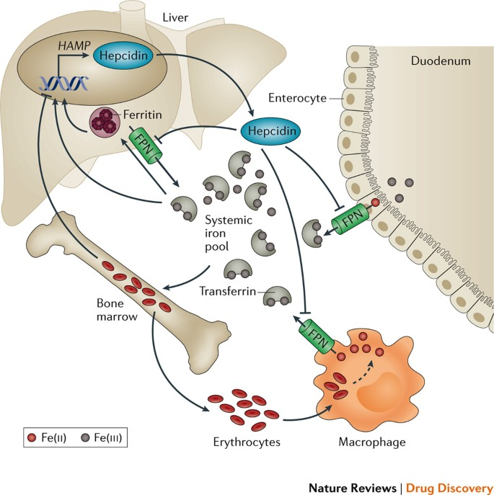
Iron
Trace element
Essential physiological and cellular pathways
Oxygen transport
Oxidative energy production
Cell proliferation and immune function
Bactericidal and T-cell function
Blood Reviews, 31(4), 225–33.
Notes:
Iron is a trace element required for essential physiological and cellular pathways in all life forms, including oxygen transport to tissues via hemoglobin, oxidative energy production, cell proliferation, and immune function (Camaschella, 2017). Iron is required for pathogen growth and is a key micronutrient in the context of immune function, with bidirectional associations between iron status and infection. Iron deficiency has been associated with impaired immune function, bactericidal macrophage activity, and T-cell function (Jonker and van Hensbroek, 2014). However, because pathogens also require iron for survival, host sequestration of iron is a defense mechanism and part of the innate immune response, and it has been associated with lower incidence of bacterial and viral infections (Murray et al., 1978; Weinberg, 1996; Berlim and Abeche, 2001). Findings from these studies have led to the use of iron deprivation to target some infections, such as Mycobacterium tuberculosis (Gomes, 1999; Pal et al., 2015).
Iron and HIV
As with many infections, the associations between iron and HIV are complex and bidirectional. Whereas iron deficiency and anemia are common in HIV-infected individuals, higher iron status has also been associated with increased HIV infection and replication (Traore and Meyer, 2004; Chang et al., 2015). Based on evidence that HIV utilizes iron to replicate, iron deprivation has been proposed as a potential strategy to target HIV-associated bacterial infections, as well as the course of HIV infection itself (Boelaert et al., 1996).

Slide 22
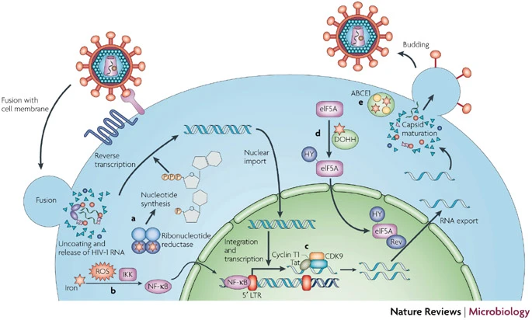
Iron and HIV
Higher iron status associated with increased HIV infection and replication
Nature Reviews Microbiology volume 6, pages 541–552 (2008)

Slide 23
Iron Deficiency Anemia (IDA) in PWH
Most common micronutrient deficiency
Results in poor health outcomes, impaired development, increased susceptibility to infections
Anemia is one of the most common conditions in PWH (42.5-73%)
IDA associated adverse health outcomes in PWH including lower CD4, increase HIV progression, increased risk of OI, poorer prognosis, and HIV mortality
BMC Blood Disorders, 9, 5; Nutrition and HIV: Epidemiological Evidence to Public Health. 2018 May 15
Notes:
Anemia and Iron Deficiency Have Been Associated with Adverse Health Outcomes in HIV-Infected Individuals
Iron deficiency has been associated with adverse health outcomes in HIV-infected populations, ncluding lower CD4 T-cell counts, increased HIV disease progression, and increased risk of opportunistic infections (Gordeuk et al., 2001; Malvoisin et al., 2014). Anemia has also been associated with poorer prognoses in HIV-infected patients, including lower CD4 T-cell counts (Antelman et al., 2000; Eley et al., 2002; Salome and Grotto, 2002; Dikshit et al., 2009; Chatterjee et al., 2010; Finkelstein et al., 2012; Petraro et al., 2013; Shen et al., 2013) and HIV-related mortality (O’Brien et al., 2005; Finkelstein et al., 2012; Shen et al., 2013; Porter et al., 2015). For example, in a study of HIV-infected patients in Mskutfi, Nigeria, 55.2% of patients with lower CD4 T-cell counts (<200 cells/mm³) were anemic compared to 32.5% of patients with higher CD4 T-cell count (>200 cells/mm³) (Ogbe et al., 2012).
Nutrition and HIV: Epidemiological Evidence to Public Health. 2018 May 15

Slide 24
Elevated Iron in PWH
Excess iron (ferritin) associated with adverse health outcomes.
Ferritin > 200 ug/dL in women and > 300 ug/dL in men associated with lower CD4 counts and greater prevalence of Stage 3 HIV/AIDS – observational outcome
Iron is required for survival by both the host and the virus
Controversy whether iron supplementation is safe in PWH
No randomized trials have been done to assess adverse effects of iron supplementation
International Journal of STD & AIDS, 26(6), 393–7
Notes:
Elevated Iron Status
In contrast, elevated iron status (e.g., serum ferritin) has also been associated with adverse health outcomes in observational studies in HIV-infected populations. For example, in a study among 571 asymptomatic HIV-infected patients in Spain (86.2% on ART and 36.3% diagnosed with AIDS), iron overload (i.e., serum ferritin > 200 μg/L in women and > 300 μg/L in men) was associated with lower CD4 T-cell counts (<350 cells/μL) and greater prevalence of AIDS cases (with iron overload, 49.2% diagnosed with AIDS; without iron overload, 34.6%; p = 0.02) (Lopez-Calderon et al., 2015). Among 168 HIV-infected individuals in Spain, individuals with lower CD4 T-cell counts (<300 x 10⁶/L) had significantly higher ferritin levels compared to those with higher CD4 T-cell counts (mean, 330 vs. 261-418 μg/L; p < 0.001) (Riera et al., 1994). Observational studies have also noted associations between higher serum ferritin concentrations and increased HIV disease progression (Tohill et al., 2007; Rawat et al., 2009), lower CD4 T-cell counts (Dikshit et al., 2009), and higher HIV RNA viral load (Friis et al., 2003). However, some of these studies did not assess or adjust for inflammation, such as C-reactive protein (CRP), which constrains the interpretation of findings.
Iron supplementation in the Context of HIV: A Double-Edged Sword?
Iron is required for survival by both the host and virus, and iron supplementation is the standard of care for prevention and treatment of anemia (WHO, 2012). However, associations between elevated iron stores and increased HIV disease progression and mortality raise concern regarding the safety and efficacy of iron supplementation in the context of HIV, particularly in iron-replete individuals. Iron may be a “double-edged sword”—that is, because HIV also utilizes iron for growth and replication, iron interventions (i.e., additional iron in circulation) may be harmful in the context of HIV infection (Sunder-Plassmann et al., 1999; Clark and Semba, 2001; Gordeuk et al., 2001).

Slide 25
Iron Recommendations for PWH
Cochrane Systematic Review:
Iron supplementation in children may be considered as RCT have demonstrated protective effect in reducing progression to stage three HIV
Further research is indicated to assess in adults and pregnant women populations of PWH
Further research indicated to assess proper dosage and timing of iron supplementation
Balasubramanyuam et al. J Clin Endocrinol Metab. 2011 Jul; 96(7): 2236–2247.
Notes:
RCT=randomized controlled trial
The most recent Cochrane Systematic Review (Adetifa et al., 2009) concluded that there was weak evidence from observational studies and expert opinions that iron supplementation should be provided to HIV-infected children. Since then, one randomized trial in anemic HIV-infected children has been conducted (Esan et al., 2013). Iron supplementation was found to protect against the progression to AIDS in children and, therefore, may be recommended in children; however, further research is needed to assess whether this recommendation would apply to adults and pregnant women living with HIV, as well as to populations living in areas where other infections, such as TB, are endemic. No randomized trial has observed a relationship between iron supplementation and incidence of TB in an HIV-infected population. Further research is also needed to assess the proper dosage and timing of iron supplementation that would reduce anemia and not result in adverse HIV-related health outcomes.

Slide 26
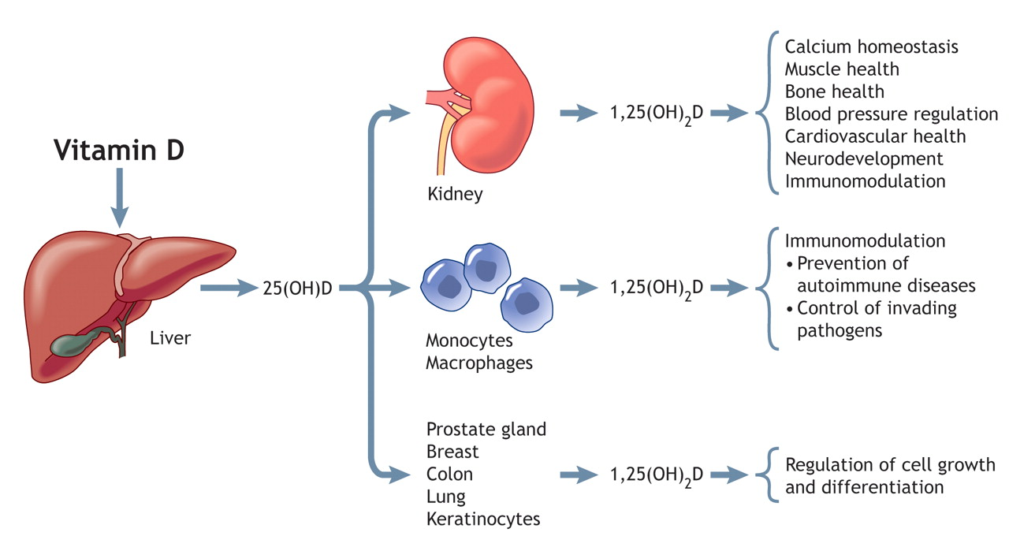
Vitamin D
CMAJ April 25, 2006 174 (9) 1287-1290
Notes:
In 1981, rare opportunistic infections (Kaposi’s sarcoma and Pneumocystis carinii pneumonia) were reported as clinical cases (Gottlieb et al., 1981) and later identified as acquired immunodeficiency syndrome (AIDS). Worldwide, 39 million deaths are cumulatively related to AIDS (UNAIDS, 2014), and 36.9 million individuals were living with HIV in 2014 (UNAIDS, 2015). Despite substantial progress, including increased global access to antiretroviral therapy (ART), the burden of disease from HIV disproportionately affects individuals in low- and middle-income countries (United Nations, 2015). The remaining major challenges in HIV prevention and treatments have heightened interest in the roles of treatment adjuncts, such as micronutrient supplementation. In certain resource-limited settings with higher prevalence of HIV, individuals often face the additional challenges of malnutrition (including vitamin D deficiency) and food insecurity (United Nations, 2015).
Suboptimal vitamin D status is considered by some as the most common medical condition globally (Holick, 2010); however, estimates of deficiency prevalence range widely (6 to 100%) among individuals living with HIV (Orkin et al., 2014). Aside from the established role of vitamin D in skeletal health, the immunomodulatory effects of vitamin D have more recently been recognized (Cantorna et al., 2004; Baeke et al., 2010; Cantorna, 2010; Hewison, 2012; Prietl et al., 2013). In the early 1980s, studies identified a nuclear receptor in immune cells (including lymphocytes and monocytes) (Bhalla et al., 1983; Provvedini et al., 1983), which binds specifically to the biologically active vitamin D metabolite. Furthermore, other key laboratory findings (Wang et al., 2004; Liu et al., 2006, 2007; Adams and Hewison, 2008) corroborated the dynamic interaction between vitamin D and the human host response against infectious diseases.
Separately, other studies have provided mechanisms of how certain ART pharmacokinetics could result in vitamin D deficiency (Dao et al., 2011; Yin and Stein, 2011). One non-nucleoside analog reverse transcriptase inhibitor (efavirenz [EFV]) induces cytochrome P450 enzymes (Vrouenraets et al., 2007), including CYP24 (Landriscina et al., 2008). CYP24A1 is a key enzyme in vitamin D metabolism that degrades the physiologically active vitamin D metabolite 1,25(OH)₂D to 24,25(OH)₂D (Jones et al., 2012). Over the past two decades, a number of published case reports have documented a link between vitamin D status and patients with HIV/AIDS on ART (Playford et al., 2001; Gyllensten et al., 2006; Kumar et al., 2012).
Preliminary evidence supports the complex associations between vitamin D and HIV (including host immunity and treatments); however, a number of research gaps remain. Therefore, our objective was to review current evidence of the bidirectional linkages between vitamin D and HIV/AIDS, including clinical health outcomes and ART treatments.
CMAJ April 25, 2006 174 (9) 1287-1290

Slide 27
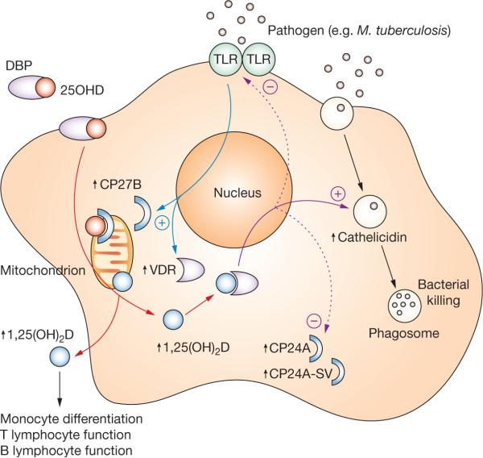
Vitamin D Immune Function
Immunomodulatory effects recognized – nuclear receptor in lymphocytes and monocyte function
Dynamic interaction between Vitamin D and human host response against infectious diseases
Nat Clin Pract Endocrinol Metab. 2008 Feb; 4(2): 80–90.
Notes:
Estimated prevalence of Vitamin D deficiency in HIV 6-100%
Nat Clin Pract Endocrinol Metab. 2008 Feb; 4(2): 80–90.
Suboptimal vitamin D status is considered by some as the most common medical condition globally (Holick, 2010); however, estimates of deficiency prevalence range widely (6 to 100%) among individuals living with HIV (Orkin et al., 2014). Aside from the established role of vitamin D in skeletal health, the immunomodulatory effects of vitamin D have more recently been recognized (Cantorna et al., 2004; Baeke et al., 2010; Cantorna, 2010; Hewison, 2012; Prietl et al., 2013). In the early 1980s, studies identified a nuclear receptor in immune cells (including lymphocytes and monocytes) (Bhalla et al., 1983; Provvedini et al., 1983), which binds specifically to the biologically active vitamin D metabolite. Furthermore, other key laboratory findings (Wang et al., 2004; Liu et al., 2006, 2007; Adams and Hewison, 2008) corroborated the dynamic interaction between vitamin D and the human host response against infectious diseases.
Separately, other studies have provided mechanisms of how certain ART pharmacokinetics could result in vitamin D deficiency (Dao et al., 2011; Yin and Stein, 2011). One non-nucleoside analog reverse transcriptase inhibitor (efavirenz [EFV]) induces cytochrome P450 enzymes (Vrouenraets et al., 2007), including CYP24 (Landriscina et al., 2008). CYP24A1 is a key enzyme in vitamin D metabolism that degrades the physiologically active vitamin D metabolite 1,25(OH)₂D to 24,25(OH)₂D (Jones et al., 2012). Over the past two decades, a number of published case reports have documented a link between vitamin D status and patients with HIV/AIDS on ART (Playford et al., 2001; Gyllensten et al., 2006; Kumar et al., 2012).
Preliminary evidence supports the complex associations between vitamin D and HIV (including host immunity and treatments); however, a number of research gaps remain. Therefore, our objective was to review current evidence of the bidirectional linkages between vitamin D and HIV/AIDS, including clinical health outcomes and ART treatments.
CMAJ April 25, 2006 174 (9) 1287-1290

Slide 28
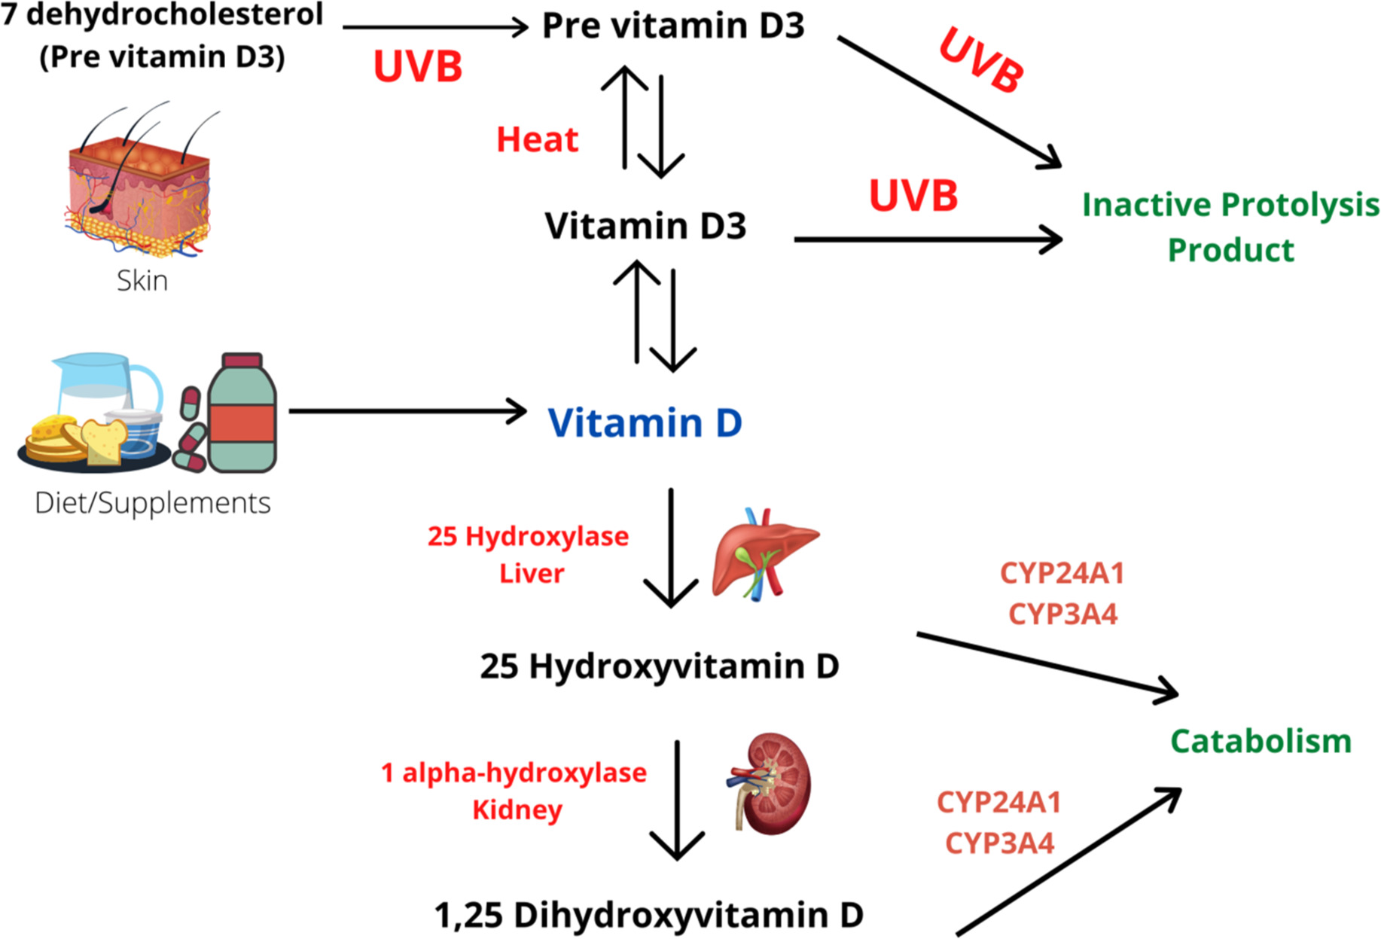
Vitamin D and HIV
Estimated prevalence of Vitamin D deficiency in HIV 6-100%
ART may contribute to accelerated catabolism of Vit D (acceleration of CYP24A1 pathway)
Published case reports linking Vitamin D and PWH on ART
Food and Science Nutrition. V 10 (10). 3230-3240
Notes:
Separately, other studies have provided mechanisms of how certain ART pharmacokinetics could result in vitamin D deficiency (Dao et al., 2011; Yin and Stein, 2011). One non-nucleoside analog reverse transcriptase inhibitor (efavirenz [EFV]) induces cytochrome P450 enzymes (Vrouenraets et al., 2007), including CYP24 (Landriscina et al., 2008). CYP24A1 is a key enzyme in vitamin D metabolism that degrades the physiologically active vitamin D metabolite 1,25(OH)₂D to 24,25(OH)₂D (Jones et al., 2012). Over the past two decades, a number of published case reports have documented a link between vitamin D status and patients with HIV/AIDS on ART (Playford et al., 2001; Gyllensten et al., 2006; Kumar et al., 2012).
Preliminary evidence supports the complex associations between vitamin D and HIV (including host immunity and treatments); however, a number of research gaps remain. Therefore, our objective was to review current evidence of the bidirectional linkages between vitamin D and HIV/AIDS, including clinical health outcomes and ART treatments.
CMAJ April 25, 2006 174 (9) 1287-1290
Food and Science Nutrition. V 10 (10). 3230-3240

Slide 29
Vitamin D and HIV
Inhibition of HIV viral replication
Vitamin D (VD) receptor associated with indicators of HIV (Long Terminal Repeat (LTR) activation)
Increased HIV disease progression with VDR genotypes and Vitamin D deficiency
Not all findings consistent
RCTs: positive outcome with bone health outcomes
Limited longitudinal studies Vitamin D on HIV
No international recommendations on Vitamin D status or supplementation
Nutrition and HIV: Epidemiological Evidence to Public Health. 2018 May 15

Slide 30
Learning Objectives
Recognize the role of nutrition in optimizing care in patients with HIV
Identify the relationship between specific nutrients and HIV immunity, infectivity, transmissibility
Recognize role of nutrition counseling in management of cardiometabolic diseases in people with HIV
Incorporate counseling strategies into patient education on healthy nutrition and importance of micronutrient surveillance

Slide 31
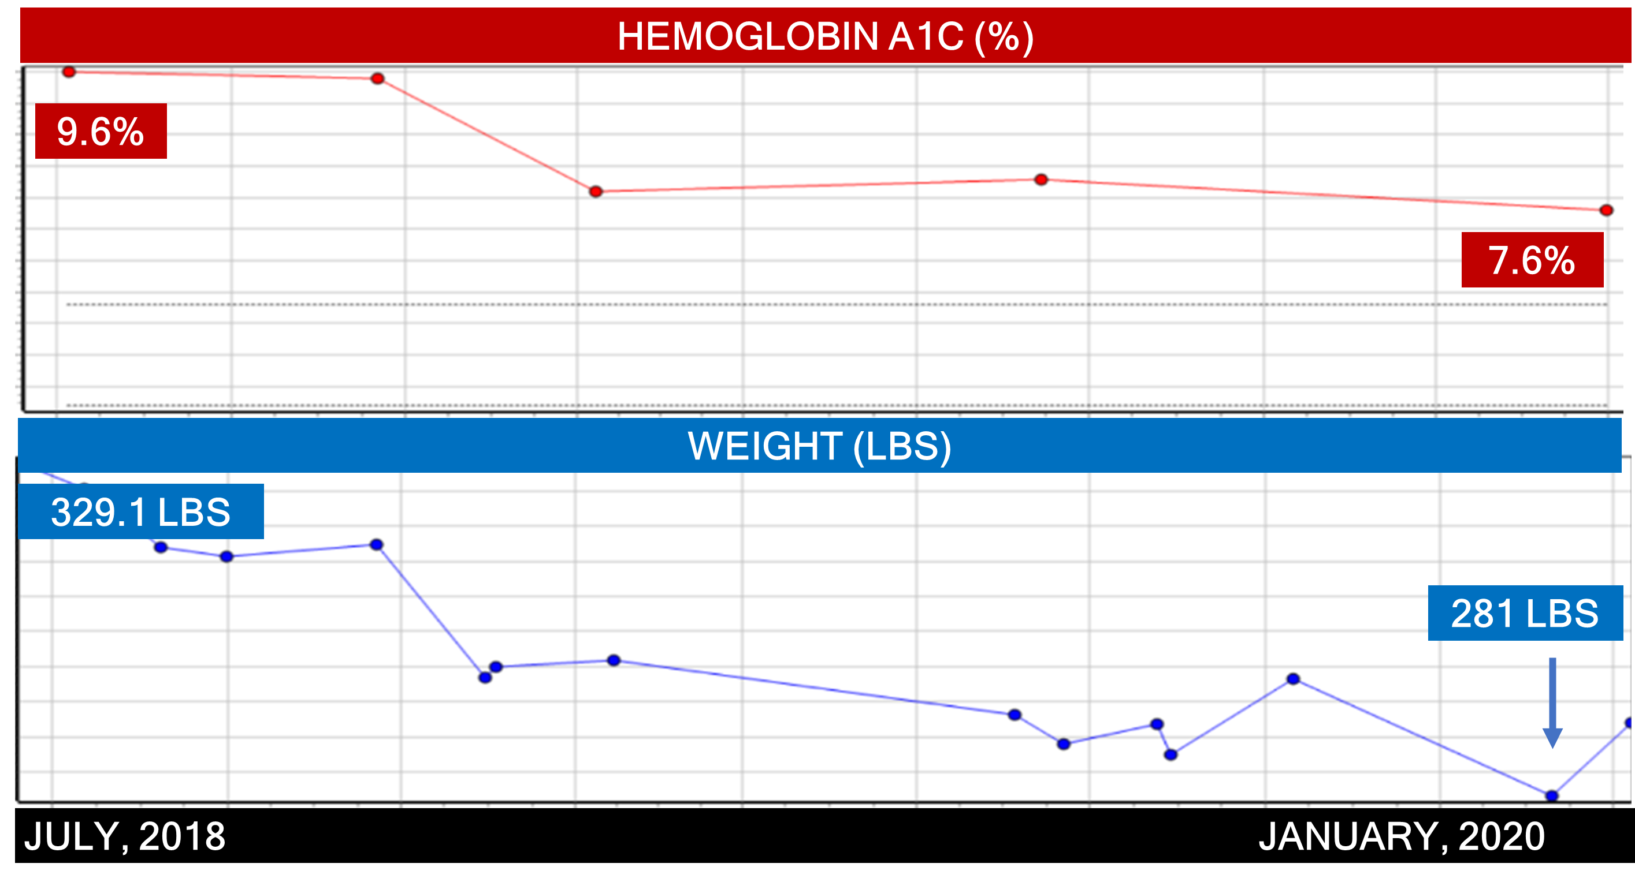
Nutrition Counseling Cardiometabolic Disease
Provider directed counseling on low inflammatory nutrition strategies
Reduced insulin requirements
Improved glycemic control
Notes:
Image source: presenter

Slide 32
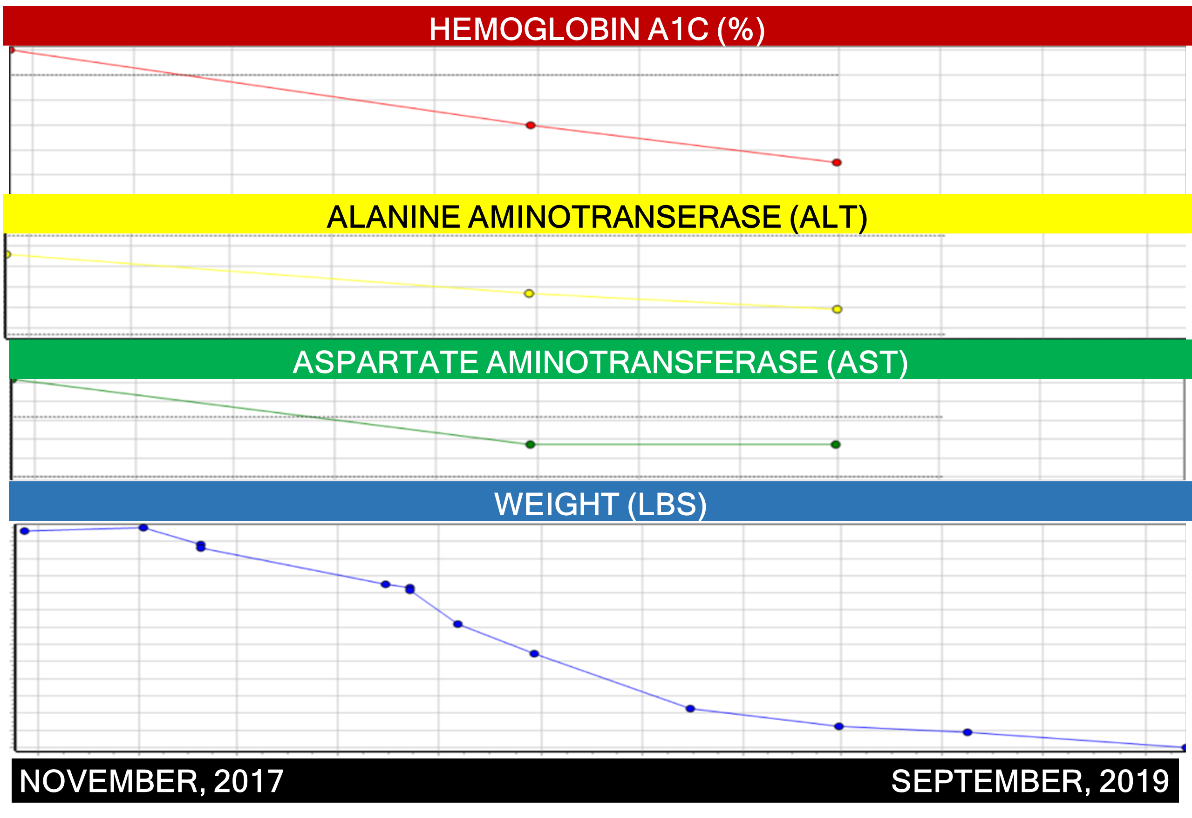
Nutrition Counseling Cardiometabolic Disease
Provider directed counseling
Resolution of fatty liver
Improved glycemic control
Significant weight loss
Resolution of neuropathic pain
Notes:
Image source: presenter

Slide 33
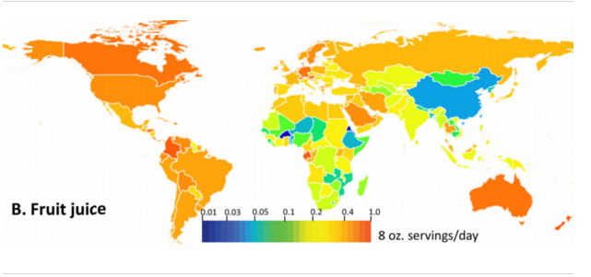
Sugar Sweetened Beverages
PLOS ONE 14(3): e0214344.

Slide 34
Sugar Sweetened Beverages: Clinical Outcomes
Obesity | # Studies | Incidence | Relative Risk | Dose Dependent RR | Linear
Sugar Concentrated | 7 | 11,821/56,579 20% | 1.2 | 1.12 | +
T2 Diabetes Mellitus | # Studies | Incidence | Relative Risk | Dose Dependent RR | Linear
Sugar Concentrated | 19 | 34,788/1,010,392 3.4% | 1.27 | 1.19 | +
Hypertension | # Studies | Incidence | Relative Risk | Dose Dependent RR | Linear
Sugar Concentrated | 7 | 80,605/302,156 25.8% | 1.13 | 1.1 | +
All Cause Mortality | # Studies | Incidence | Relative Risk | Dose Dependent RR | Linear
Sugar Concentrated | 10 | 467,841/1,125,834 41.5% | 1.10 | 1.04 | +
European Journal of Epidemiology (2020) 35:655–671 https://doi.org/10.1007/s10654-020-00655-y

Slide 35
Artificially Sweetened Beverages: Clinical Outcomes
Obesity | # Studies | Incidence | Relative Risk | Dose Dependent RR | Linear
Artificially Sweetened | 6 | 5,960/26,551 22% | 1.39 | 1.21 | +
T2 Diabetes Mellitus | # Studies | Incidence | Relative Risk3.6% | Dose Dependent RR | Linear
Artificially Sweetened | 13 | 23,845/660,732 3.6% | 1.2 | 1.15 | +
Hypertension | # Studies | Incidence | Relative Risk | Dose Dependent RR | Linear
Artificially Sweetened | 6 | 78,767/296,762 26.5% | 1.13 | 1.08 | x
All Cause Mortality | # Studies | Incidence | Relative Risk | Dose Dependent RR | Linear
Artificially Sweetened | 4 | 104,520/665,221 15.7% | 1.15 | 1.06 | x
European Journal of Epidemiology (2020) 35:655–671 https://doi.org/10.1007/s10654-020-00655-y

Slide 36
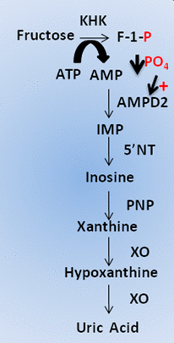
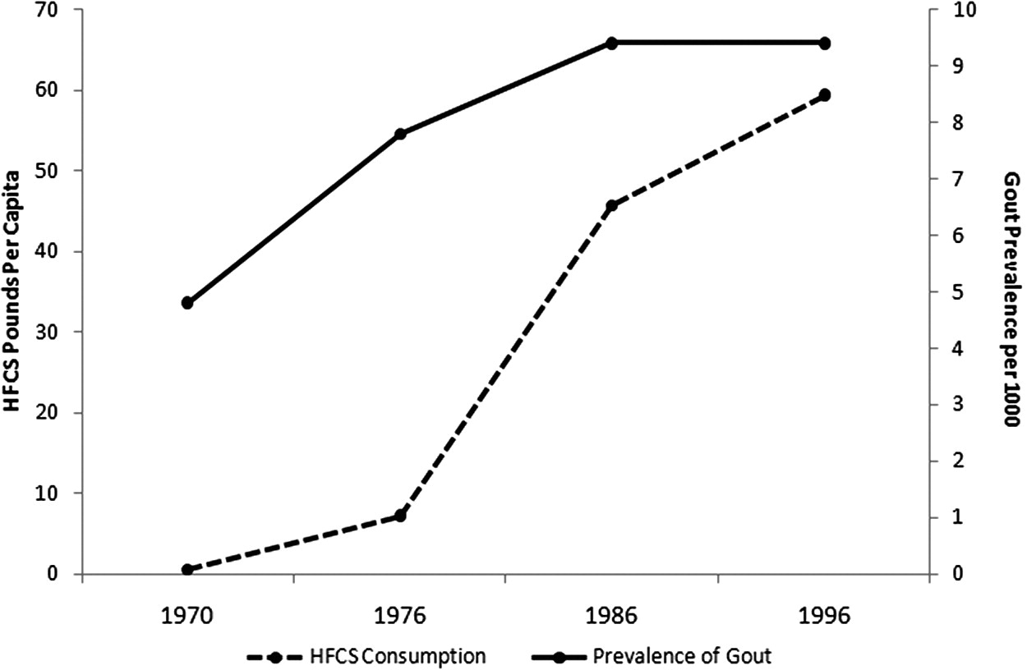
Fructose and Uric Acid
Semin Nephrol. 2011 Sep;31(5):410-9.
Seminars in Nephrology, Sept 2011. 31 (5) P410-419
Diabetes 2013 Oct; 62(10): 3307-3315.

Slide 37
Uric Acid and HIV
Metabolic syndrome and increased serum uric acid levels are prevalent conditions in PWH receiving treatment
Metabolic syndrome significantly affects uric acid levels in PWH receiving treatment
The negative association between uric acid levels and endothelial function is attenuated by the metabolic syndrome
Atherosclerosis. Volume 272: 101-107
Notes:
Metabolic syndrome and increased serum uric acid levels are prevalent conditions in treated HIV patients.
Metabolic syndrome significantly affects uric acid levels in treated HIV infected patients.
The negative association between uric acid levels and endothelial function is attenuated by the metabolic syndrome.
The association between uricemia and FMD is independent of the metabolic syndrome only for elevated uric acid levels. Atherosclerosis
Atheroscloerosis. V 272. 101-107

Slide 38
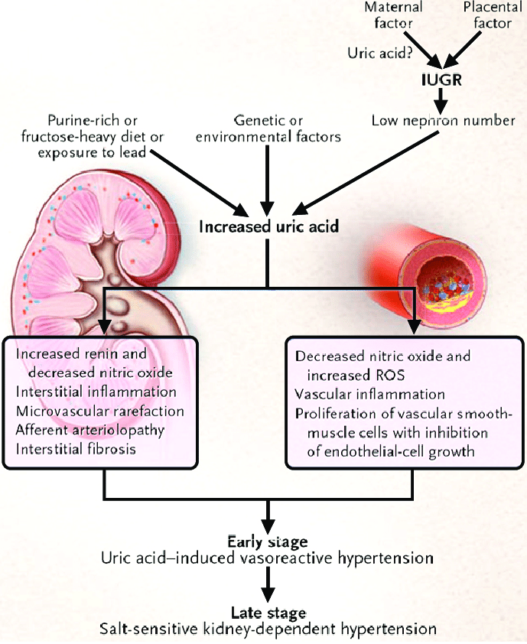
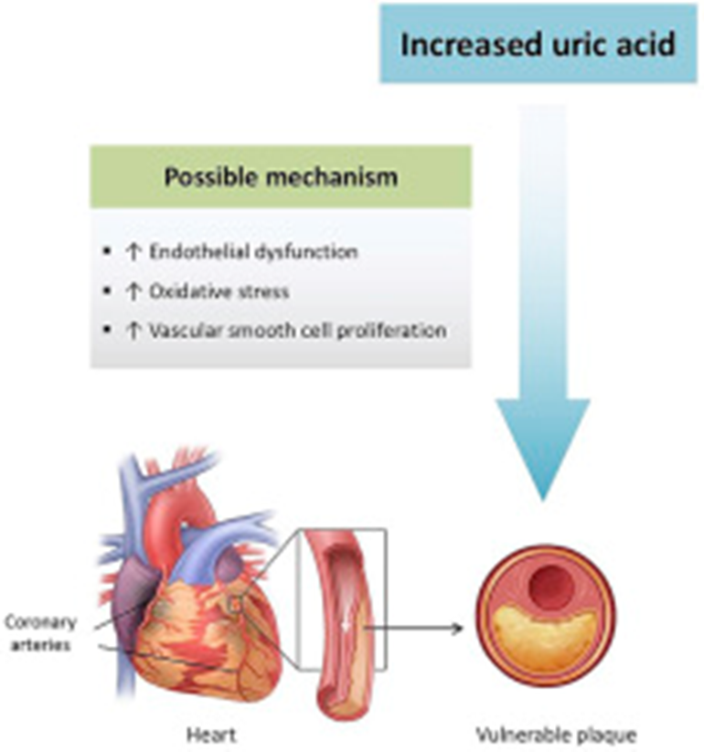
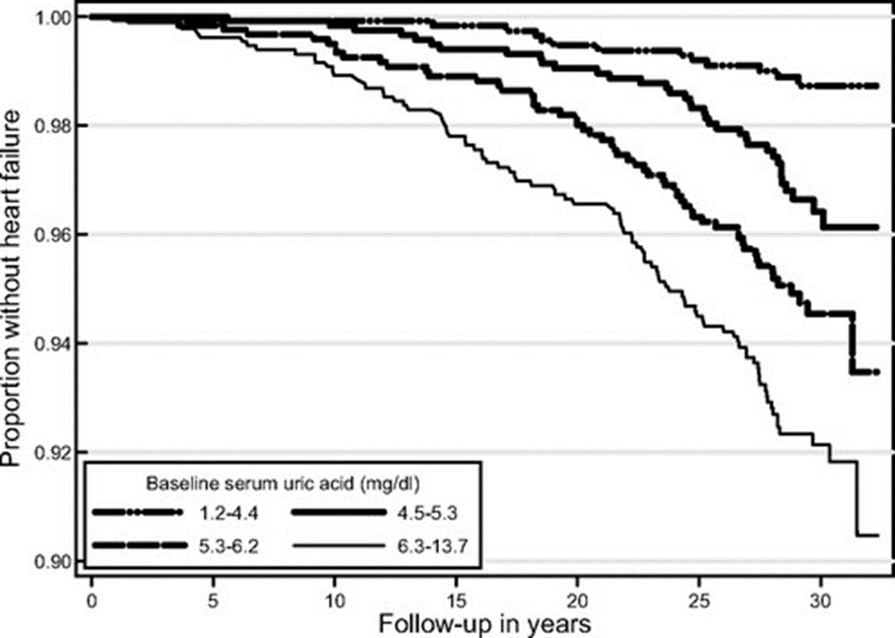
Clinical Hypertension. V 26. Article no. 13 (2020), Lim et al. Atherosclerosis, Sept 2019. 288:112-117; Circulation 2009. 2:556-562
Notes:
Clinical Hypertension. V 26. Article no. 13 (2020)

Slide 39
Red Meat and Processed Meat
Cancer: Carcinogenicity of the consumption of red meat and processed meat (who.int)
Notes:
Cancer: Carcinogenicity of the consumption of red meat and processed meat (who.int)

Slide 40
Food Preparation and Inflammation
J Hepatol. 2018 Jun;68(6):1239-1246.

Slide 41
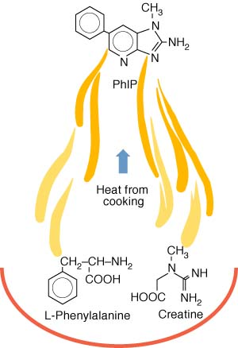
HCA and PAH- carcinogenic potential
More than 90% of our exposure to Heterocyclic Amine (HCA) and Polycyclic Aromatic Hydrocarbons (PAH) come from cooked foods
Grilled meats/fish
Processed carbohydrates
Fats/oils
Take home message:
Reduce (or eliminate) meat and fish consumption
Don’t fry, grill, char, burn food…EVER
Avoid cooking at high temperatures
Increase the amount of fresh, uncooked foods
https://www.precisionnutrition.com/all-about-cooking-carcinogens

Slide 42
Learning Objectives
Recognize the role of nutrition in optimizing care in patients with HIV
Identify the relationship between specific nutrients and HIV immunity, infectivity, transmissibility
Recognize role of nutrition counseling in management of cardiometabolic diseases in people with HIV
Incorporate counseling strategies into patient education on healthy nutrition and importance of micronutrient surveillance

Slide 43
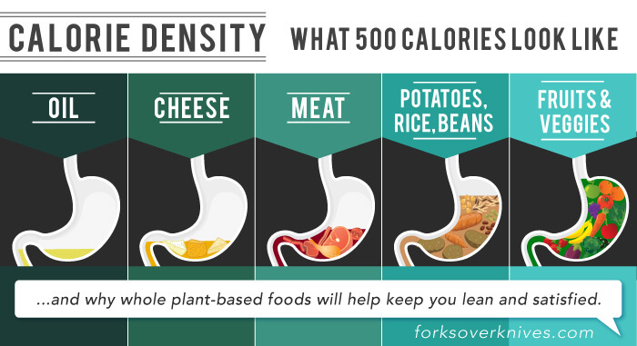
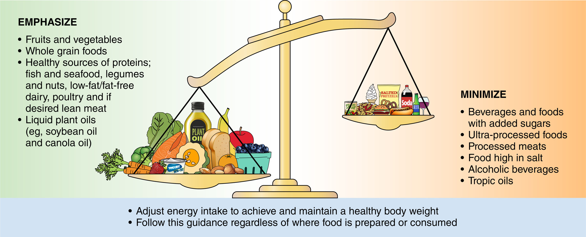
Counseling Strategies
AMERICAN HEART ASSOCIATION
NUTRITION UPDATE 2021
Pictures are worth 1000 words!
forksoverknives.com; Circulation. Vol144, Issue 23, 7 December 2021; Pages e472-e487
Notes:
forksoverknives.com

Slide 44
Questions?

Slide 46
SCAETC Social Media

Slide 47
Resources
National Clinician Consultation Center http://nccc.ucsf.edu/
HIV Management
Perinatal HIV
HIV PrEP
HIV PEP line
HCV Management
Substance Use Management
Present case on ECHO hivecho@salud.unm.edu
AETC National HIV Curriculum https://aidsetc.org/nhc
AETC National Coordinating Resource Center https://targethiv.org/library/aetc-national-coordinating-resource-center-0
Additional trainings scaetcecho@salud.unm.edu
www.scaetc.org
Notes:
Find an HIV-related topic TeleECHO in your area: https://echo.unm.edu/locations-2/echo-hubs-superhubs-united-states/
IDEA Platform: Infectious Diseases Education & Assessment. https://idea.medicine.uw.edu/
AETC National HIV Curriculum: 6 core modules for self study; regularly updated; CME, CNE
Hepatitis C Online Curriculum: https://www.hepatitisc.uw.edu/
Hepatitis B Online Curriculum: https://www.hepatitisb.uw.edu/
National STD Curriculum: https://www.std.uw.edu/

