Slide 1
PrEParation 101: Preparing Providers for PrEP Sustainability in Primary Health Care
Dr. Edna Lampkin, B.S., Pham D
Friday May 26th, 2023

Slide 2
Disclosures
This program is supported by the Health Resources and Services Administration (HRSA) of the U.S. Department of Health and Human Services (HHS) under grant number U1OHA30535 as part of an award totaling $4.2m. The contents are those of the author(s) and do not necessarily represent the official views of, nor an endorsement, by HRSA, HHS, or the U.S. Government. For more information, please visit HRSA.gov.
“Funding for this presentation was made possible by cooperative agreement U1OHA30535 from the Health Resources and Services Administration HIV/AIDS Bureau. The views expressed do not necessarily reflect the official policies of the Department of Health and Human Services nor does mention of trade names, commercial practices, or organizations imply endorsement by the U.S. Government. Any trade/brand names for products mentioned during this presentation are for training and identification purposes only.”
This content is owned by the AETC, and is protected by copyright laws. Reproduction or distribution of the content without written permission of the sponsor is prohibited, and may result in legal action.

Slide 3
AETC Program National Centers and HIV Curriculum
National Coordinating Resource Center – serves as the central web –based repository for AETC Program training and capacity building resources; its website includes a free virtual library with training and technical assistance materials, a program directory, and a calendar of trainings and other events. Learn more: https://aidsetc.org/
National Clinician Consultation Center – provides free, peer-to-peer, expert advice for health professionals on HIV prevention, care, and treatment and related topics. Learn more: https://nccc/ucsf.edu
National HIV Curriculum – provides ongoing, up –to-date HIV training and information for health professionals through a free, web –based curriculum; also provides free CME credits, CNE contact hours, CE contact hours, and maintenance of certification credits. Learn more: www.hiv.uw.edu

Slide 4
Goals and Objectives
Goal: Stimulate discussion, develop new perspectives, and support peer to peer learning
Learning Objectives:
Increase knowledge by defining PrEP & describe efficacies of various PrEP dosage forms.
Provide a list of barriers to PrEP implementation including cost of PrEP services & medications.
Increase understanding by summarizing methods to identify PrEP eligible populations.
Notes:
SAY: For our webinar today our goal is to stimulate discussion, develop new perspectives, and support peer to peer learning.
To achieve this goal, our learning objectives are:
Increase knowledge by defining on PrEP and describe efficacies of various PrEP dosage forms.
Provide a list of barriers to PrEP implantation including cost of PrEP services & medications.
Increase understanding by summarizing methods to identify PrEP eligible populations.

Slide 5
Define PrEP (Pre-Exposure Prophylaxis)

Slide 6
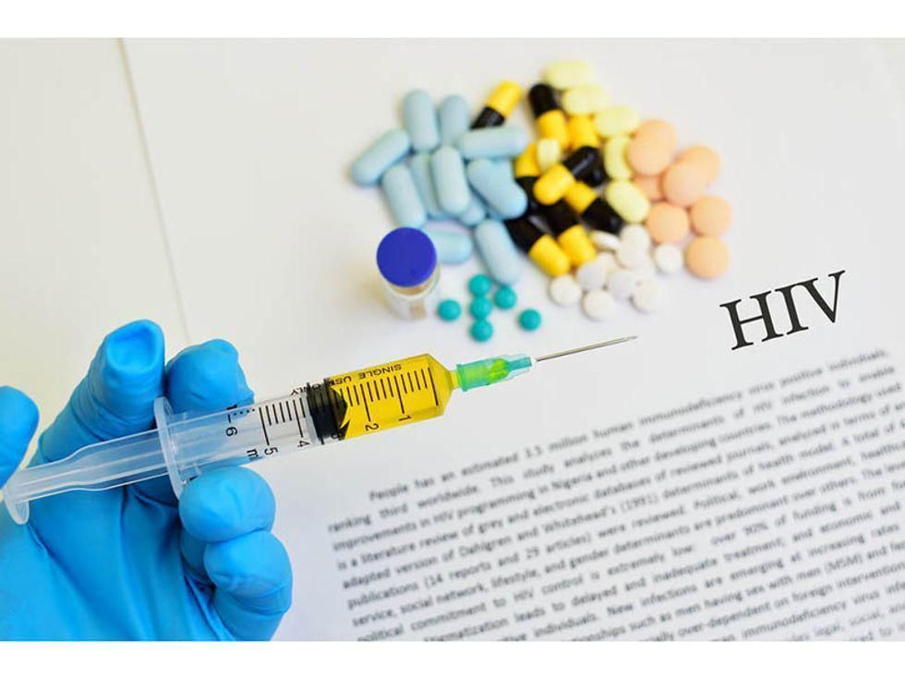
The Purpose of Clinicians understanding HIV Prevention
This training is designed to help any provider interested in supporting people who want access to HIV Pre-Exposure Prophylaxis, commonly known as PrEP.
Access to PrEP is a key component of Ending the HIV Epidemic in the U.S. indicators.
PrEP is a powerful tool for protecting patients at risk for HIV.
Let’s explore how to prescribe HIV prevention in your practice to help keep your patients healthy.
PrEP drugs stock image: https://www.comhs.org/about-us/newsroom/health-library/2021/08/05/two-prep-meds-work-equally-well-one-is-much-cheaper
Notes:
Purpose:
-Access to PrEP is a key component of Ending the HIV Epidemic. It is encouraged to seek funding opportunities with local health authorities and some community-based organizations to promote PrEP use and assist with PrEP navigation services.
-This training is designed to help anyone interested in supporting people who want access to HIV Pre-Exposure Prophylaxis, commonly known as PrEP, including health providers and people working to end HIV in Mississippi. Whether you’re are a pharmacist considering prescribing PrEP to customers or a prevention specialist helping community members navigate medical care or insurance systems,
we have compiled the basic information and resources you need to answer people’s questions, help them find a provider, and figure out how to access the right medications.
-Read further for brief information on what PrEP is, who it is for, information on statutory and regulatory requirements regarding its use, information on insurance and patient assistance options.

Slide 7
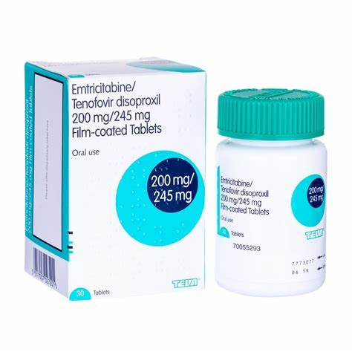
What is PrEP?
PrEP, or pre-exposure prophylaxis, is a once daily medicine that can reduce a person’s risk of contracting HIV from sex or injection drug usage.
PrEP can prevent HIV replication and spread through the body.
Only condoms protect against other STIs like syphilis and gonorrhea.
Notes:
Pre-exposure prophylaxis (or PrEP) is a medication that if taken daily can reduce the chances of HIV infection by more than 90%. When used in conjunction with condoms, the odds of HIV infection are reduced even further.
PrEP is a safe and effective way for persons who are at high-risk for acquiring HIV but do not have HIV to prevent HIV infection by taking a pill orally every day.
Apreptude is a new long-acting injectable suspension recently approved Dec 2021

Slide 8
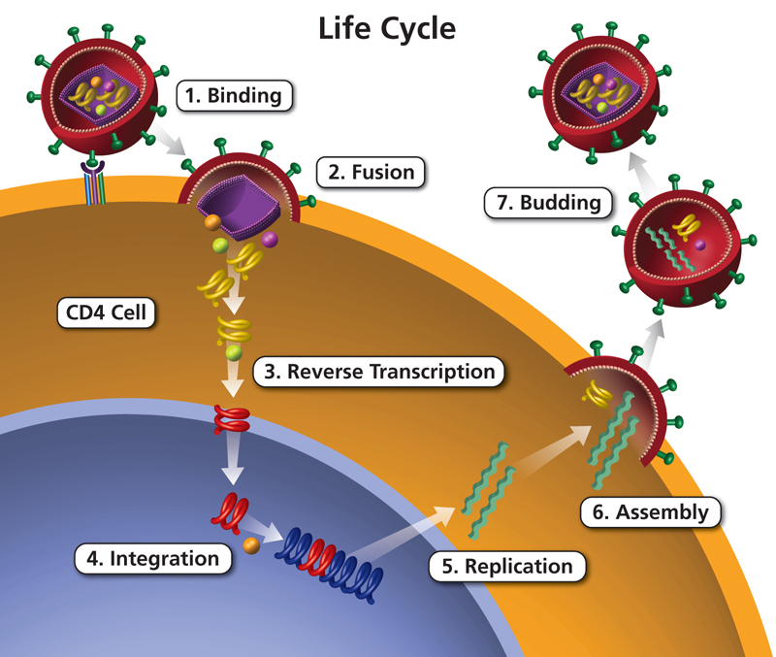
How Does PrEP Work?
PrEP is comprised of several medications, that block an enzyme called HIV reverse transcriptase.
HIV uses this enzyme to make new copies of HIV, so PrEP prevents HIV from multiplying in the body.
PrEP
Notes:
PrEP medications work together to block a portion of the HIV life cycle; reverse transcription. This portion of the life cycle is how the HIV virus uses the CD4 cells to make additional copies of HIV leading to acquisition for persons that are HIV negative or an increase in viral load for persons living with HIV.
Essentially, a person who does not have HIV takes enough antiretrovirals (ARVs) for there to be high levels of the drugs in their body before any exposure to HIV. If exposure occurs, the ARVs stop the virus from entering the cells of the person and replicating. This prevents HIV from establishing itself and the person remains HIV negative

Slide 9
Who is PrEP for?
Is PrEP safe?
PrEP is for anyone who is HIV negative and may be at increased vulnerability for acquiring HIV.
Certain medications may be recommended based on personal factors.
Ideally, a qualified provider will discuss a patient’s specific medical history and life circumstances to determine which medication is right for them.
According to the CDC, PrEP is both safe and effective in lowering a person’s risk of acquiring HIV.
While some people experience side effects like diarrhea, nausea, headache, fatigue, and stomach pain; these side effects usually go away with time.
Notes:
Who is PrEP for?
--PrEP is for anyone who is HIV negative and may be at increased vulnerability for acquiring HIV.
--Certain medications may be recommended based on personal factors; ideally a qualified provider will discuss a patient’s specific medical history and life circumstances to determine which medication is right for them.
Is PrEP safe?
--According to the CDC, PrEP is both safe and effective in lowering a person’s risk of acquiring HIV.
--While some people experience side effects like diarrhea, nausea, headache, fatigue, and stomach pain, these side effects usually go away with time.
>Patients experiencing side effects should notify their provider right away so they can discuss strategies to mitigate them and so they can be monitored.
>In rare instances people may not be able to get past side effects and PrEP may not be an option for them at this time. In these cases, discussing harm reduction strategies is advised. For more information on side effects, check out: https://prepdaily.org/what-are-the- side-effects-of-prep/.

Slide 10
Describe the efficacy of various PrEP dosage forms.

Slide 11
Available PrEP Medications
Oral Tablets
Emtricitabine-tenofovir (TDF)
Emtricitabine-tenofovir alafen
Intramuscular Injection (ER)
Brand Name: Cabotegravir
Descovy Truvada Image: https://www.statnews.com/2020/02/26/newest-prep-pill-hiv-prevention-fuel-progress-or-profits/
transgender men (anal receptive & vaginal receptive) AWP $4,440.00
Apreptude image: https://pragnews.com/hiv-prevention-injection-apretude-gets-fdas-approval/
Notes:
>Truvada- first drug approved for PrEP use July 16, 2012 in cis gender men, transgender women, cis gender women (anal receptive and vaginal receptive sex)
>Descovy- approved for PrEP use October 3, 2019 ONLY in cis gender men and transgender women (anal receptive sex ONLY)
>Apreptude is a new long-acting injectable suspension recently approved for PrEP use Dec 20, 2021 in cis gender men, transgender women, cis gender women AND transgender men (anal receptive & vaginal receptive) AWP $4,440.00
Apreptude image: https://pragnews.com/hiv-prevention-injection-apretude-gets-fdas-approval/
Descovy Truvada Image: https://www.statnews.com/2020/02/26/newest-prep-pill-hiv-prevention-fuel-progress-or-profits/

Slide 12
TRUVADA (F/TDF):Emtricitabine 200mg/Tenofovir Disoproxil Fumarate 300mg_{1,8}
Truvada is the first drug approved for PrEP use on July 16, 2012, in the following populations:
*High-risk adults and adolescents weighing at least 35 kg.
Injectable drug users
Cis-gender men
Transgender women
Cis-gender women
anal receptive and vaginal receptive sex
Notes:
Image from “Trump Administration Sues Gilead Over Truvada PReP for HIV Prevention” by Mark Terry, Nov 07, 2019. Image by Michael Moloney/Shutterstock. Accessed on 3/30/22 via: https://www.biospace.com/article/trump-administration-sues-gilead-over-hiv-drug/
35 kg= 77 lbs

Slide 13
DESCOVY (F/TAF) Emtricitabine 200mg/Tenofovir Alafenamide 25 mg_{1,8}
Descovy is the second drug approved for PrEP use on October 3, 2019, in the following populations:
*High-risk adult and adolescent MEN weighing at least 35 kg.
Cis-gender men ONLY
Transgender women ONLY
anal receptive sex
Notes:
35 kg= 77 lbs
Image by Tony Webster, Mar 14, 2020. Accessed on 3/30/22 via: https://www.flickr.com/photos/diversey/49765063118

Slide 14
Emtricitabine-tenofovir | VS. | Emtricitabine-tenofovir alafen
Daily use & PrEP 2-1-1 |  | Daily use
Effective in “everyone”, including IV drug users |  | Effective ONLY in cis gender men & transgender women
Taken WITH food |  | Taken WITH or WITHOUT food
Weight & Cholesterol- slight weight loss & slight LDL increase |  | Weight & Cholesterol- slight weight gain & slight LDL increase
Bone- avoid use with Osteoporosis |  | Bone- safer to use with Osteoporosis
Renal- avoid use in patients with pre-existing kidney conditions low CrCl family Hx of kidney Dz |  | Renal- safer to use with monitoring in pre-existing kidney conditions low CrCl family Hx of kidney Dz
TRUVADA | ART options
if resistance to 3TC/FTC but no INSTI resistance | Boosted PI + 2 NRTIs (at least 1 active) DTG + 2 NRTIs (include at least 1 active) Boosted PI + INSTI
if EVG or RAL resistance +/- 3TC/FTC resistance | Boosted PI + 2 NRTIs (at least 1 active) DTG BID (if HIV is sensitive to DTG) + 2 active NRTIs DTG BID (if HIV is sensitive to DTG) + boosted PI (BIC not recommended – no data)
Notes:
Image from “Which PrEP medication is best for me?: ” San Francisco Aids Foundation. Accessed ON 3/30/22 via https://www.sfaf.org/wp-content/uploads/resources/PrEP-2019-Descovy-Truvada-Comparison-Flyer-8x11-FINAL.pdf

Slide 15
Cabotegravir
Cabotegravir is the first long-acting injectable suspension recently approved for PrEP use on December 20, 2021, in the following populations:
*High-risk adults and adolescents weighing at least 35 kg.
Cis-gender men
Transgender women
Cis-gender women
anal receptive and vaginal receptive sex
Notes:
Image from NPR Medical Treatments: “A new injection to prevent HIV, rather than pills, is a game-changer, scientists say”. Deepa Shivaram, Dec 23, 2021. Accessed on 3/30/22 via https://www.npr.org/2021/12/23/1067366345/hiv-aids-injection-fda-approval-cabotegravir-apretude-prep
“Apretude (Cabotegravir)- The Official Patient Website”. Viiv Healthcare, Feb 2022. Accessed 3/30/22 via https://apretude.com/?gclid=Cj0KCQjw_4-SBhCgARIsAAlegrU0sR0dAPlKLgRCedvIzwBEZ9brAM-9cowdoO5d-W64SiOTPqFUyKYaAqJnEALw_wcB&gclsrc=aw.d\

Slide 16
Cabotegravir
Administered intramuscularly EVERY OTHER MONTH by a healthcare professional AFTER
2 initiation injections have been administered 1 month apart for 2 consecutive months
Has NOT been studied for use in injectable drug users
Notes:
Image taken from “Apretude (Cabotegravir)- The Official Patient Website”. Viiv Healthcare, Feb 2022. Accessed 3/30/22 via https://apretude.com/?gclid=Cj0KCQjw_4-SBhCgARIsAAlegrU0sR0dAPlKLgRCedvIzwBEZ9brAM-9cowdoO5d-W64SiOTPqFUyKYaAqJnEALw_wcB&gclsrc=aw.d\

Slide 17
PrEP Efficacy₁
Studies have shown that oral PrEP reduces the risk of contracting HIV via sexual transmission by about 99% when taken appropriately.
Oral PrEP reduces the risk of contracting HIV via injectable drug usage by at least 74% when taken appropriately.
Truvada & Descovy- > 99% effective when taken properly.
Notes:
“PrEP: Pre-Exposure Prophylaxis”. Centers for Disease Control and Prevention (CDC), May 13, 2021. Accessed 3/30/22 via https://www.cdc.gov/hiv/basics/prep.html

Slide 18
PrEP Efficacy Statistics₁
Cabptegravir- when administered properly:
Cis-gender men and transgender women
69% lower risk of infection compared to Truvada
HIV transmissions occurred 3x’s less often compared to Truvada
Cis-gender women
90% lower risk of infection compared to Truvada
HIV transmissions occurred 12 x’s less often compared to Truvada
Notes:
“PrEP: Pre-Exposure Prophylaxis”. Centers for Disease Control and Prevention (CDC), May 13, 2021. Accessed 3/30/22 via https://www.cdc.gov/hiv/basics/prep.html
“Apretude (Cabotegravir)- The Official Patient Website”. Viiv Healthcare, Feb 2022. Accessed 3/30/22 via https://apretude.com/?gclid=Cj0KCQjw_4-SBhCgARIsAAlegrU0sR0dAPlKLgRCedvIzwBEZ9brAM-9cowdoO5d-W64SiOTPqFUyKYaAqJnEALw_wcB&gclsrc=aw.d\

Slide 19
Provide a list of barriers to PrEP implementation including cost of PrEP services & medications.

Slide 20
Common Myths About PrEP # 1 of 5
Myth #1: I don’t have insurance so I can’t afford PrEP.
FALSE!
Fortunately, there is an option to access the PrEP medication at an affordable cost even if you don’t have insurance coverage.
Ready, Set, PrEP is a program that makes PrEP medication available at no cost specifically for those that do not have health insurance coverage for prescription drugs.
You can find out more about eligibility by visiting their website at: https://readysetprep.hiv.gov/.
Enrollment option(s)
Notes:
Myth #1: I don’t have insurance so I can’t afford PrEP.
FALSE!
Fortunately, there is an option to access the PrEP medication at an affordable cost even if you don’t have insurance coverage. Ready, Set, PrEP is a program that makes PrEP medication available at no cost specifically for those that do not have health insurance coverage for prescription drugs. You can find out more about eligibility by visiting their website at: https://readysetprep.hiv.gov/.

Slide 21
Common Myths About PrEP # 2 of 5
Myth #2: I have insurance, but I won’t be able to afford the copays for the medication or all the other lab tests and ongoing medical visits.
FALSE!
Thanks to the US Preventive Services Task Force (USPSTF) and the Affordable Care Act (ACA), insurance plans are now required to cover the cost of PrEP medications and the medical visits and labs associated with PrEP at no cost to the patient!
What this means is that your visits and prescriptions should be covered in full, with no copays to you.
Notes:
Myth #2: I have insurance, but I won’t be able to afford the copays for the medication or all the other lab tests and ongoing medical visits.
FALSE!
-Thanks to the US Preventive Services Task Force (USPSTF) and the Affordable Care Act (ACA), insurance plans are now required to cover the cost of PrEP medications and the medical visits and labs associated with PrEP at no cost to the patient!
--What this means is that your visits and prescriptions should be covered in full, with no copays to you.
If your insurance plan is exempt from USPSTF and ACA requirements, consider seeking services from a community clinic such as an FQHC or Planned Parenthood. This requirement is new as of late 2021, so if you tried to get PrEP previously and were faced with large copays or other expenses, try again! You can also contact a PrEP navigator who is trained to assist with insurance and coverage challenges.

Slide 22
Common Myths About PrEP # 3 of 5
Myth #3: I want to get PrEP, but I am concerned that if I do, my medical chart will make it look like I participate in behaviors that put me at increased risk of HIV.
FALSE!
There are many reasons why someone might want to use PrEP.
Encourage your patients to be forthcoming with you about their health and wellness.
It may be useful to seek out a healthcare provider locally who is knowledgeable about LGBTQ health and/or HIV or a LGBTQ-friendly clinic.
Notes:
Myth #3: I want to get PrEP, but I am concerned that if I do, my medical chart will make it look like I participate in behaviors that put me at increased risk of HIV.
FALSE!
There are many reasons why someone might want to use PrEP.
Be forthcoming with your provider about your health and wellness – or find a provider with whom you can talk freely about behaviors or circumstances that may have increased your chances of contracting HIV.
Anything you disclose to your provider is confidential. It may be useful to seek out a healthcare provider who is knowledgeable about LGBTQ health and/or HIV or a LGBTQ-friendly clinic such as Planned Parenthood.

Slide 23
Common Myths About PrEP # 4 of 5
Myth #5: I don’t currently have legal documentation to reside in the US, so I can’t qualify for assistance to get PrEP.
FALSE!
There are several patient assistance programs through the manufacturers: Gilead’s Advancing Access Program, or publicly funded assistance programs such as Ready, Set, PrEP.
Ready, Set, PrEP is a program that provides free access to PrEP medications to thousands of people living in the United States, including tribal lands and territories.
Ready, Set, PrEP is specifically for people who don’t have health insurance coverage. Please note that Ready, Set, PrEP covers the cost of the medication but does not cover the cost of labs or office visits.
Notes:
Myth #4: I don’t currently have legal documentation to reside in the US and so I can’t qualify for assistance to get PrEP.
FALSE!
-Ready, Set, PrEP is a program that provides free access to PrEP medications to thousands of people living in the United States, including tribal lands and territories.
-Ready, Set, PrEP is specifically for people who don’t have health insurance coverage. Please note that Ready, Set, PrEP covers the cost of medication but does not cover the cost of labs or office visits.

Slide 24
Common Myths About PrEP # 5 of 5
Myth #5: I already started PrEP but stopped taking it and it won’t be authorized again.
FALSE!
Plans and insurers cannot restrict the number of times an individual may start PrEP.
Notes:
Myth #5: I already started PrEP but stopped taking it and it won’t be authorized again.
FALSE! Plans and insurers cannot restrict the number of times an individual may start PrEP.

Slide 25
Summarize methods to identify PrEP eligible populations

Slide 26
CDC Comprehensive guidelines for prescribing PrEP
Assess your patients to identify candidates for PrEP
Prescribe PrEP to anyone who asks for it, including sexually active adults and adolescents who do not report HIV risk factors.
Whether or not a patient asks for PrEP, it is important to take a sexual and substance use history.
This information is essential to understand each patient’s risk of acquiring HIV, if PrEP might be right for them, and what other risk-reduction services should be offered.

Slide 27
Offering PrEP to Sexually Active Adults and Adolescents

Slide 28
Baseline assessments required for individuals beginning PrEP
Before prescribing PrEP, perform the required baseline assessments.
HIV Testing
STI Testing
Kidney Function
HBV (Hepatitis B Virus) Serology
Lipid Profile
Notes:
Baseline assessments required for individuals beginning PrEP
Before prescribing PrEP, perform the required baseline assessments.
-HIV Testing
--HIV testing is required to confirm that patients do not have HIV when they start taking PrEP. Required testing differs for people who have or do not have recent antiretroviral PrEP or post-exposure prophylaxis (PEP) use. Recent use is defined as taking oral PrEP in the last 3 months or receiving a CAB injection in the last 12 months.
-STI Testing
--Tests to screen for chlamydia, gonorrhea, and syphilis are recommended for all sexually active adults before starting oral or injectable PrEP.
-Kidney Function
--Oral PrEP. For patients taking F/TDF or F/TAF as PrEP, assess kidney function before starting PrEP.
--Injectable PrEP. For patients taking CAB, kidney assessments are not needed.
-HBV (Hep. B Virus) Serology
--Emtricitabine and tenofovir can be used to treat active hepatitis B virus (HBV) infection. However, in people with active HBV, stopping these medicines can result in a rebound of HBV replication leading to liver damage. HBV infection is not a contraindication to PrEP, but all people considered for oral PrEP with F/TDF or F/TAF must be screened for HBV. Patients with active HBV infection should be educated about the risks of stopping oral PrEP without appropriate follow-up so that if they stop using oral PrEP, their liver function can be closely monitored for reactivation of HBV replication.
-Lipid Profile
--For patients taking F/TAF as oral PrEP, assess cholesterol and triglyceride levels before starting PrEP.

Slide 29
QUESTIONS & FEEDBACK?
We value your feedback!

Slide 30
References
1. “PrEP: Pre-Exposure Prophylaxis”. Centers for Disease Control and Prevention (CDC), May 13, 2021. Accessed 3/30/22 via https://www.cdc.gov/hiv/basics/prep.html
2. “HIV Treatment”. The Sexperts. May 22, 2020. Image accessed 3/30/22 via https://sexinfoonline.com/hiv-treatment/
3. “View The Map: Rates of Persons Using PrEP, 2019”. AIDSVu. Accessed 3/30/22 via https://map.aidsvu.org/map?maptype=county&datatype=PrEP&ratescases=rates&filters=overall&overlays=&area=All&basemap=cjjopfjjb03ag2rpnrv3w5k62&year=2019&countytype=all
4. “Two PrEP Meds Work Equally Well One Is Much Cheaper”, Health Day, Aug 5, 2021. Accessed 3/30/22 via: https://www.comhs.org/about-us/newsroom/health-library/2021/08/05/two-prep-meds-work-equally-well-one-is-much-cheaper

Slide 31
References
5. “Will the newest pill for HIV prevention fuel progress — or profits?”, Douglas Krakower, Kenneth Katz and Julia L. Marcus, Feb 26, 2020. Accessed 3/30/22 via https://www.statnews.com/2020/02/26/newest-prep-pill-hiv-prevention-fuel-progress-or-profits/
6.“BREAKING: HIV prevention injection Apretude gets FDA’s approval”, Digital desk, Jan 8, 2022. Accessed 3/30/22 via https://pragnews.com/hiv-prevention-injection-apretude-gets-fdas-approval/
7. HIV Prevention Certified Provider Certification Program: “HIV Prevention: Epidemiology, Interventions and Strategies” and “HIV Testing and Assessing Risk for Short Behavioral Intervention and Referral”. Jonathan Appelbaum. Mar 21, 2022. Accessed 5/4/22 via https://ehealthhiv.org/my/
8. “Trump Administration Sues Gilead Over Truvada PReP for HIV Prevention”, Mark Terry, Nov 07, 2019. Image by Michael Moloney/Shutterstock. Accessed 3/30/22 via: https://www.biospace.com/article/trump-administration-sues-gilead-over-hiv-drug/

Slide 32
References
9. “Which PrEP medication is best for me?”, San Francisco Aids Foundation. Accessed 3/30/22 via https://www.sfaf.org/wp-content/uploads/resources/PrEP-2019-Descovy-Truvada-Comparison-Flyer-8x11-FINAL.pdf
10. San Francisco AIDS Foundation: “Q&A PrEP 2-1-1”. Jul 9, 2019. Accessed 3/31/22 via https://www.sfaf.org/resource-library/qa-prep-2-1-1-for-anal-sex/
11. “Apretude (Cabotegravir)- The Official Patient Website”, Viiv Healthcare, Feb 2022. Accessed 3/30/22 via https://apretude.com/?gclid=Cj0KCQjw_4-SBhCgARIsAAlegrU0sR0dAPlKLgRCedvIzwBEZ9brAM-9cowdoO5d-W64SiOTPqFUyKYaAqJnEALw_wcB&gclsrc=aw.d\
12. US Public Health Service: PREEXPOSURE PROPHYLAXIS FOR THE PREVENTION OF HIV INFECTION IN THE UNITED STATES – 2021 UPDATE A CLINICAL PRACTICE GUIDELINE. Accessed on Mar 30, 2022 via https://www.cdc.gov/hiv/pdf/risk/prep/cdc-hiv-prep-guidelines-2021.pdf

Slide 33
References
13. “Barriers to the Wider Use of Pre-exposure Prophylaxis in the United States: A Narrative Review”. Kenneth H. Mayer, Allison Agwu, & David Malebranche. Mar 30 2020. Accessed 3/30/22 via https://link.springer.com/article/10.1007/s12325-020-01295-0.
14. “A Frontline Provider Training on PrEP Research, Care, and Navigation”. PleasePrEPme.org. Accessed 3/30/22 via https://www.pleaseprepme.org/PrEPNavTraining
15. “An ‘HIV status neutral’ Paradigm Shift”. Camille Arkell, Nov 4, 2019. Accessed 3/30/22 via https://blog.catie.ca/2019/11/04/an-hiv-status-neutral-paradigm-shift/
16. “What Is Your Status?”. HIV Advocates. 2022. Accessed 3/30/22 via http://www.hivadvocates.org/news-stories/karl-schmid-u-u-and-the-campaign-for-access-education

