Slide 1
What Everyone Needs to Know to Reduce HIV Stigma!
Joyce Roundtree-McCoy
June 27, 2023

Slide 2
Disclosures

Slide 3
Learning Objectives
By the end of this session, you will be able to…
Define HIV and AIDS.
Differentiate between the myths and facts about HIV.
Define and discuss HIV stigma which can lead to HIV discrimination.
Explain how to reduce HIV stigma.
Develop your own action plan to reduce HIV stigma in your community and workplace.
Articulate what will motivate you to be committed to reducing HIV stigma in your community and workplace.

Slide 4
What Are HIV and AIDS?
HIV stands for Human Immunodeficiency Virus.
HIV attacks the immune system.
HIV can lead to AIDS (Acquired Immunodeficiency Syndrome).
AIDS diagnosis…
Opportunistic infection OR
CD4 cell count less than 200
Currently no cure for HIV or AIDS exists.
HIV can be controlled with proper medical care.
The goal of HIV care & treatment is for PWH to reach viral suppression.

Slide 5
How Is HIV Transmitted?
Through oral, anal, or vaginal sex with someone who has HIV.
By sharing needles, syringes, or other drug injection equipment (e.g., cookers) with someone who has HIV.
From a mother to her baby during pregnancy, birth, or breastfeeding.
Less common because of advances in HIV prevention and treatment.

Slide 6
Blood
Semen (cum)
Pre-seminal fluid (pre-cum)
Rectal fluids
Vaginal fluids
Breast milk
What Body Fluids Transmit HIV?
Reference: https://www.cdc.gov/hiv/basics/transmission.html

Slide 7
About HIV

Slide 8
HIV Can Be Transmitted By Or Through…
MYTH or FACT?
Mosquitoes, ticks, or other insects
Oral sex with a person who has HIV
Saliva, tears, or sweat
Closed-mouth or “social” kissing
Other sexual activities that don’t involve exchange of body fluids (e.g., touching)
Touching surfaces
The air
Hugging or shaking hands
Sharing toilets or dishes
Breastfeeding by a mother with HIV
Blood transfusions and organ transplants

Slide 9
How Can HIV Be Prevented?
Tools & Strategies
Practice abstinence (not have sex)
Do not share needles
Use latex condoms the right way every time you have sex
Medications
Pre-exposure Prophylaxis (PrEP)
Post-exposure Prophylaxis (PEP)
Is testing a way to prevent HIV?

Slide 10
HIV STIGMA CAN LEAD TO HIV DISCRIMINATION

Slide 11
What Is HIV Stigma?
Negative attitudes and beliefs about people with HIV.
The prejudice that comes with labeling an individual as part of a group that is believed to be socially unacceptable.
Examples
Believing that only certain groups of people can contract HIV.
Making moral judgments about people who take steps to prevent HIV transmission.
Feeling that people deserve to get HIV because of their choices.

Slide 12
What Is HIV Discrimination?
The act of treating people with HIV differently than those without HIV.
Examples
A health care professional refusing to provide care or services to a person with HIV.
Refusing casual contact with someone diagnosed with HIV.
Socially isolating a member of a community because he or she is a person with HIV.
Referring to people as infected or Positives.

Slide 13
What are the Effects of HIV Stigma & Discrimination?
Diminished emotional well-being and mental health.
Internalized stigma leading to a negative self-image.
Fear of HIV status being revealed.
“Internalized stigma” or self-stigma.
Shame, fear of disclosure, isolation, & despair
Hinders testing & treatment

Slide 14
What Causes HIV Stigma?
Fear of HIV.
Misconceptions or myths about how HIV is transmitted.
Lack of information and awareness combined with outdated beliefs.
Negative value judgements about people with HIV.

Slide 15
What Can Be Done About HIV Stigma?
Learn about HIV.
“Heal thyself before healing others.” ~African Proverb
Talk about HIV.
Helps to normalize the subject.
Provides opportunities to correct misconceptions.
Avoid unacceptable “stigma language.” [Let’s Stop HIV Together stigma language guide]
Take action! Develop and activate your very own action plan.

Slide 16
SCENARIO #1: Discrimination In the Workplace due to HIV stigma
A friend at work remarks to you that another co-worker shouldn’t be participating in the office potluck because he has HIV.
How would you respond to your co-worker(s)?
What behavior would you model in this situation?

Slide 17
Scenario #1 Debrief
Respond to your friend’s misconception kindly by explaining the facts.
“You don’t need to worry. You can’t contract HIV from eating food handled by a person with HIV.”
Help your friend as well as other co-workers understand that refusing casual contact with someone with HIV is a form of stigma.
Model positive behavior by eating the food your co-worker with HIV brings to the potluck.
Have lunch together regularly and check in with your co-worker to ensure he isn’t feeling isolated.

Slide 18
SCENARIO #2: Discrimination In THE FAMILY
due to HIV stigma
You arrive to a family reunion picnic with your sister who recently shared with the family that she was diagnosed with HIV. As you say hello and hug family members, a cousin hesitates to greet your sister, asking, “I’m not going to get it am I?”
How would you respond to your cousin?
What behavior would you model in this situation?

Slide 19
Scenario #2 Debrief
Model positive behavior by hugging your sister. Make sure she’s okay.
Share HIV basics, including facts about how HIV is transmitted.
“I’m not sure if you know, but HIV is not spread by hugging, shaking hands, or socially kissing someone who has HIV. HIV can’t survive outside the body.”
Offer to have a conversation with your cousin and answer any other questions she might have about HIV.
Follow up with her later via an email or text that links to educational resources.

Slide 20
SCENARIO #3: Discrimination Against a Person with HIV in the Clinic or Community Health Center due to HIV Stigma
You and a co-worker are at the registration desk in the clinic when a person with HIV says he has an appointment with Dr. Joe Smith. Dr. Smith is known to only take care of people with HIV. The co-worker turns to you and whispers, “I’m not touching anything he touches and gives us, so you check him in. I’m not doing it!” She then walks away from the registration desk. Though she whispered, the expression on the client’s face and what he says to you indicate that he is hurt and angry because he had heard her.
How would you respond to the person with HIV?
What behavior would you model in this situation?
How would you deal with the co-worker’s behavior?

Slide 21
Scenario #3 Debrief
Respond to the client by apologizing and informing him that you and the health center do not tolerate stigma and ask if he still wants to see the doctor.
“I’m so sorry. I want you to know that type of behavior is not tolerated here. I will be sharing that with my supervisor, and if you want to speak with our compliance officer, I can contact her to come speak with you right now or after you see the doctor. You are important to us here, and we want to make sure that you know that as well as feel comfortable and confident when you come here to get the care and treatment that you and everyone deserve.”
Model positive behavior by handing him a pen and the forms to complete and by receiving these and other necessary items like his identification and insurance cards from him when he provides them to you.
After registering the client, quickly review your policies to see how you are to handle the situation and follow those procedures.

Slide 22
Scenario #3 Debrief continued
Inform your supervisor of the situation.
If the co-worker returns to the desk, using a professional tone, share with her some basic facts about HIV such as how it is transmitted.
“I’m not sure if you know this, but HIV is not spread by touching something that’s been touched by someone who has HIV because HIV can’t survive outside the body. Also, the client heard what you whispered to me, and he was very upset. The type of behavior you displayed today promotes stigma and is not tolerated here. It’s not tolerated because stigmatizing remarks can make our clients not want to come here or go anywhere to get the treatment and care they need and deserve.”
Offer to have a conversation and answer other questions she might have later. Also, consider following up with her later with an email or text that links her to educational resources.
Consider following up with your supervisor later in the same week to see if someone has and/or will reach out to the client.

Slide 23
SCENARIO #4: Discrimination In the COMMUNITY due to HIV stigma
During your weekly basketball league game, the subject comes up of a team member sharing on Facebook that he was going to get an HIV test. This individual is absent from the game this day. Several negative and judgmental comments are being expressed by your fellow teammates.
How would you respond to your fellow teammates?
What behavior can you model in the near future or share that you’ve already done in this situation?

Slide 24
Scenario #4 Debrief
Share the last time you were tested for HIV and ask them if they have thought about getting tested, too. Explain that HIV testing is a normal and routine part of health care and knowing your status is important because it helps keep you healthy.
Explain to the team that they are contributing to HIV stigma when making judgements about people who take steps to prevent HIV transmission. Let them know that these types of stigmatizing remarks can lead people to being afraid of what people will say and less likely to get tested for HIV.

Slide 26
Learning Objectives Review
By the end of this session, you will be able to…
Define HIV and AIDS.
Differentiate between the myths and facts about HIV.
Define and discuss HIV stigma which can lead to HIV discrimination.
Explain how to reduce HIV stigma.
Develop your own action plan to reduce HIV stigma in your community and workplace.
Articulate what will motivate you to be committed to reducing HIV stigma in your community and workplace.

Slide 27
References
A Guide to Talking About HIV
https://www.cdc.gov/stophivtogether/library/stop-hiv-stigma/fact-sheets/cdc-lsht-stigma-factsheet-language-guide.pdf
Let’s Stop HIV Together
https://www.cdc.gov/stophivtogether/hiv-stigma/ways-to-stop.html#Stigma-Language-Guide
HIV Basics
https://www.cdc.gov/hiv/basics/index.html

Slide 28
AETC Program – National Centers and National HIV Curriculum

Slide 29
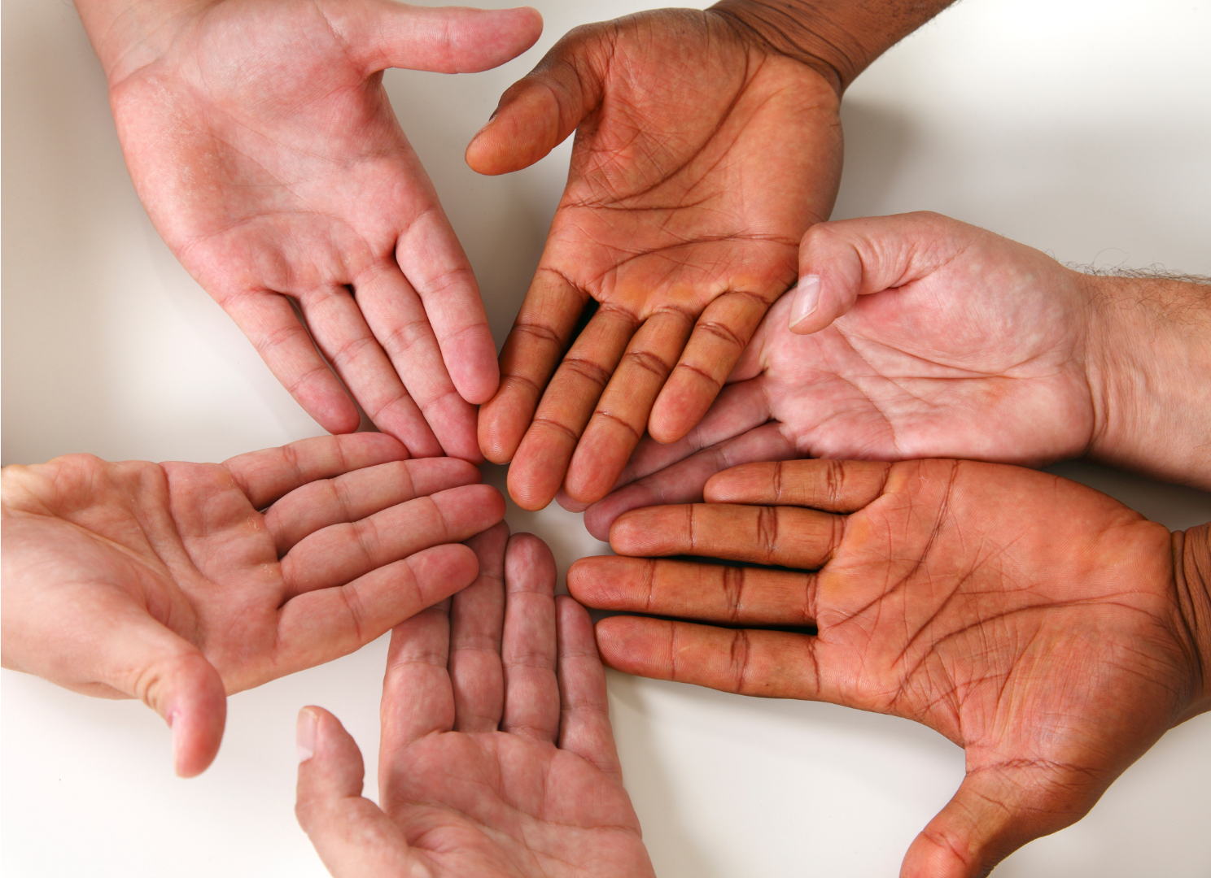

Slide 30
Joyce Roundtree-McCoy, M.Ed.
Thank You!
What Everyone Needs to Know
to Reduce HIV Stigma!
Founder/Consultant
Just the Right Motivation Consulting, LLC
662.723.3027
jrmccoy@jrmconsultingllc.org

