Slide 1
Basics of HIV Virology and Immunology, and the Relevance to Clinical Practice
Dr. Nathan Erdmann MD, PhD Associate Professor Infectious Diseases, Department of Medicine

Slide 2
Disclosures
This program is supported by the Health Resources and Services Administration (HRSA) of the U.S. Department of Health and Human Services (HHS) under grant number U1OHA30535 as part of an award totaling $4.2m. The contents are those of the author(s) and do not necessarily represent the official views of, nor an endorsement, by HRSA, HHS, or the U.S. Government. For more information, please visit HRSA.gov.
“Funding for this presentation was made possible by cooperative agreement U1OHA30535 from the Health Resources and Services Administration HIV/AIDS Bureau. The views expressed do not necessarily reflect the official policies of the Department of Health and Human Services nor does mention of trade names, commercial practices, or organizations imply endorsement by the U.S. Government. Any trade/brand names for products mentioned during this presentation are for training and identification purposes only.”
This content is owned by the AETC, and is protected by copyright laws. Reproduction or distribution of the content without written permission of the sponsor is prohibited, and may result in legal action.

Slide 3
Disclosures
Intellectual Property (IP), “Human neutralizing antibodies against SARS CoV-2/COVID-19” licensed to the Platform Corp
Perspectum Scientific Advisory Board

Slide 4
AETC Program National Centers and HIV Curriculum
National Coordinating Resource Center – serves as the central web –based repository for AETC Program training and capacity building resources; its website includes a free virtual library with training and technical assistance materials, a program directory, and a calendar of trainings and other events. Learn more: https://aidsetc.org/
National Clinician Consultation Center – provides free, peer-to-peer, expert advice for health professionals on HIV prevention, care, and treatment and related topics. Learn more: https://nccc/ucsf.edu
National HIV Curriculum – provides ongoing, up –to-date HIV training and information for health professionals through a free, web –based curriculum; also provides free CME credits, CNE contact hours, CE contact hours, and maintenance of certification credits. Learn more: www.hiv.uw.edu

Slide 5
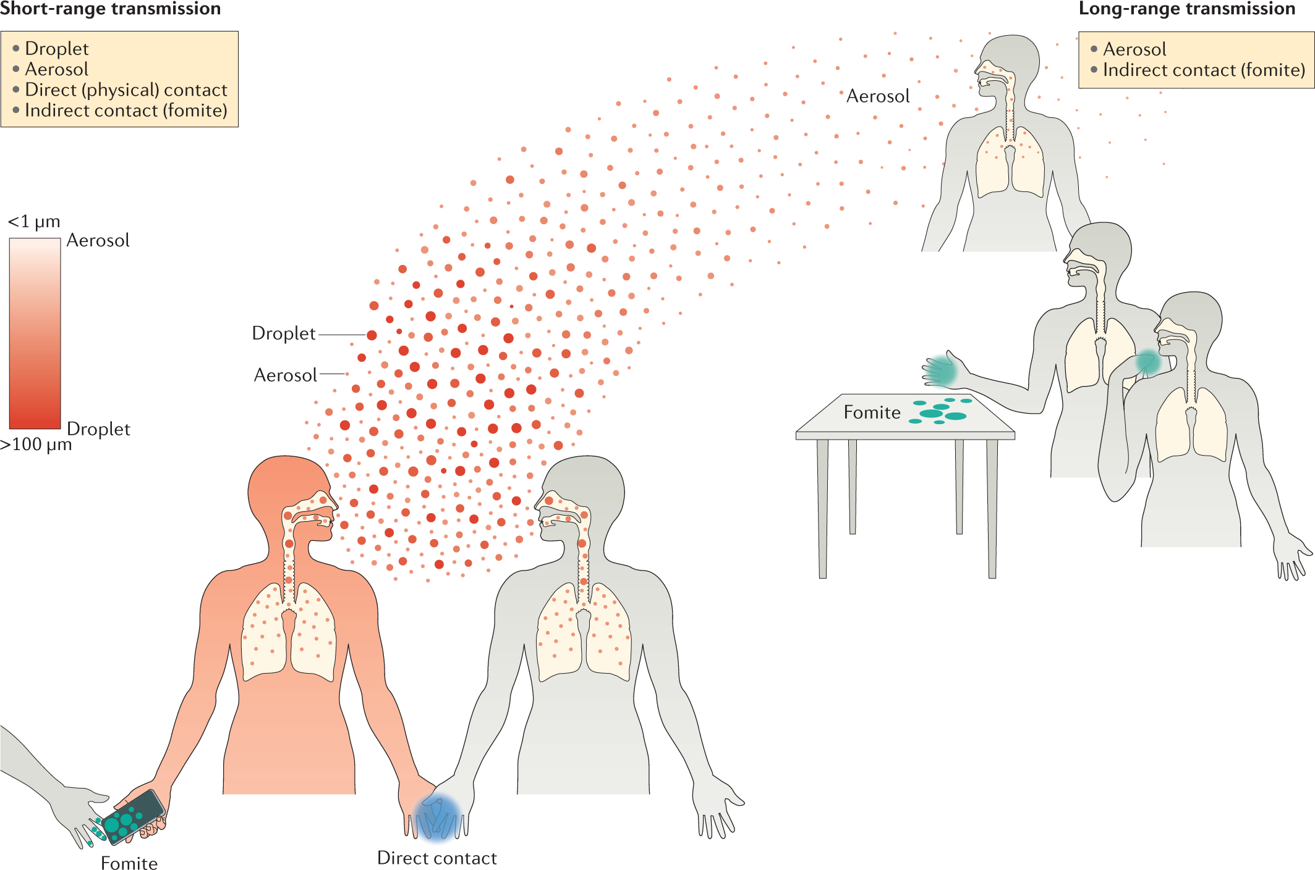
In order to initiate infection, virions must first bind to cells. Binding occurs between ligands on the surface of the virion (viral attachment proteins) and receptors on the plasma membrane of the cell

Slide 6
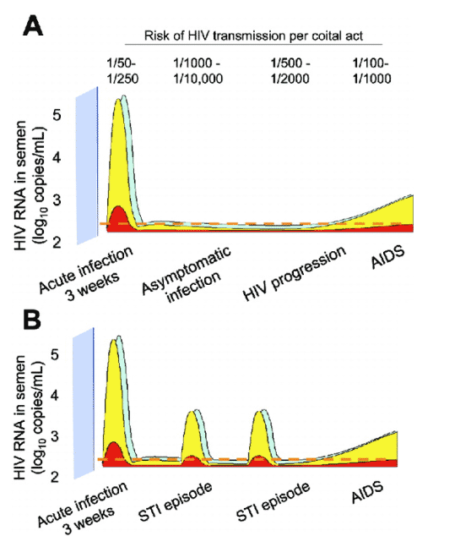
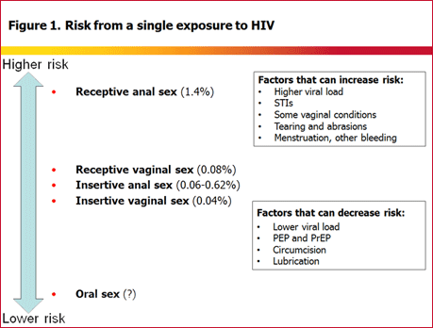
HIV Transmission

Slide 7
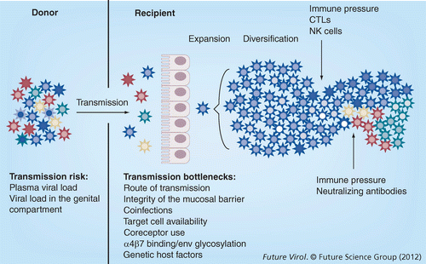
Transmission and Proliferation

Slide 8
Transmission and Proliferation
Mucosal Exposure
Kahn and Walker, 1998

Slide 9
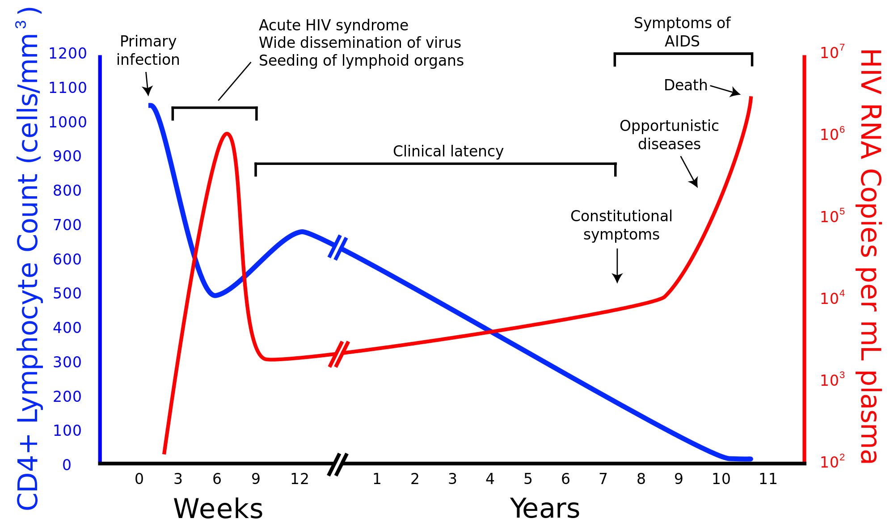

Slide 10
Acute Viral Dynamics
Influenza
Measles

Slide 12
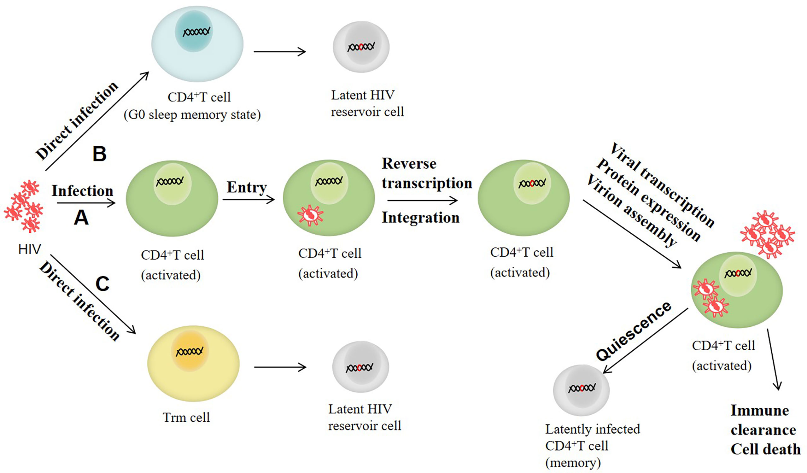
HIV Latency
Extensive and persistent reservoir is primary barrier to sterilizing cure

Slide 13
Mississippi Baby
Born to an HIV-positive mother who had not received any treatment during pregnancy
Treatment initiated within 30 hours
Family stopped antiretroviral therapy at 18 months
Remained off the drugs for the next 27 months with no signs of the virus
Presented back and tested for HIV every 6–8 weeks with no evidence of persistent infection
Months later found to have rebound viremia
Sequence of the virus matched that taken from the girl’s mother two years earlier

Slide 14
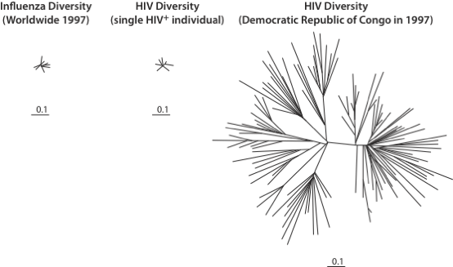
Viral Diversity and Implications for prophylactic vaccination strategies

Slide 15
Case – Outpatient HIV Clinic
41y/o WM presents for follow-up after initial presentation 9 months ago. At that time, patient had an acute presentation for PJP and AIDS with viral load of 500k and CD4 of 31.
He was started on TMP- SMX, reports excellent adherence, CD4 has improved to 144
Exam - benign
Notes:
Zack in for Merck 0518 eary study drug discontinuation visit. Pt with virologic failure on study drug. Discontinued study drug 6/1/15 and started Prezcobix + Truvada 6/2/15. States loose stool 6/2/15 through 6/4/15 now resolved. No other health complaints. Labs drawn per protocol. No further study visits. Pt to see PMP in July per patient.
MERCK 292-0518 : A Phase III Multicenter, Double-blind, Randomized, Active Comparator-Controlled Clinical Trial to Evaluate the Safety and Efficacy of Reformulated Raltegravir 1200 mg Once Daily Versus Raltegravir 400mg Twice Daily, Each in Combination with TRUVADA in Treatment-Naïve HIV1 Infected Subjects
Zack on Merck 0518 ART naive study. At last study visit (wk 24) performed on 3/20/15 his HIV-1 VL was 159. Pt has not reached undetectable since starting ART. Pt's PMP made aware. Per protocol virologic failure confirmation visit required. Pt in for visit today. Labs drawn per protocol. Pending lab results. RTC for f/u study visit 6/12/15.
MERCK 292-0518 : A Phase III Multicenter, Double-blind, Randomized, Active Comparator-Controlled Clinical Trial to Evaluate the Safety and Efficacy of Reformulated Raltegravir 1200 mg Once Daily Versus Raltegravir 400mg Twice Daily, Each in Combination with TRUVADA in Treatment-Naïve HIV1 Infected Subjects

Slide 16
Background
HIV Disease
Relevant Histories
HIV viral load 134
Viral load max - 500k copies/mL
CD4 cell count - 144, 11%
CD4 nadir - 31 cells/mm^3
Normal renal and liver labs
Medical - tobacco
Family - noncontributory
Psychosocial – monogamous partner, works as EMT
Meds – Emtricitabine/ tenofovor disoproxil fumarate

Slide 17
Timeline
500,000
109
25,000
434
39
134
Patient is feeling much better, has started to gain weight, but is concerned about his labs
Viral load since presentation:

Slide 18
Follow-up and Outcomes
Events
Patient with persistent viremia despite apparent good adherence and clinical response
What is most likely cause of the laboratory abnormality
What is the role for changing or enhancing regimen
Notes:
Diagnostic assessment (information about diagnostic methods and reasoning)

Slide 19
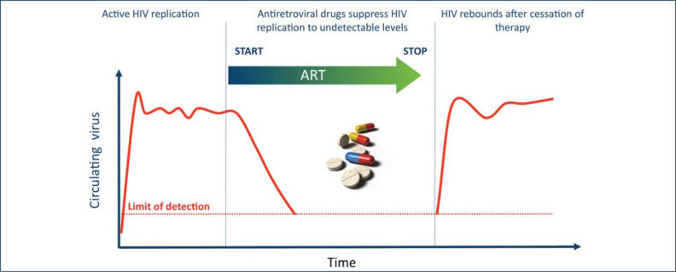

Slide 20
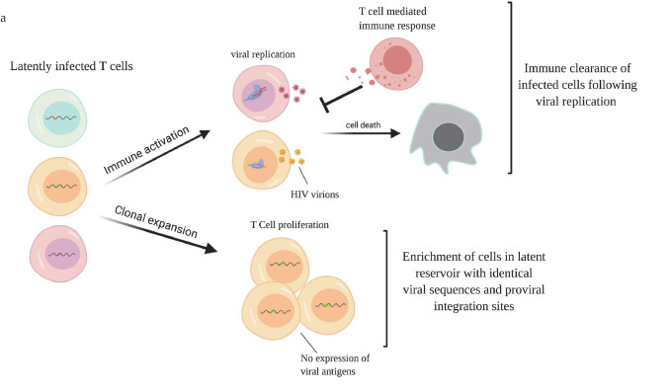
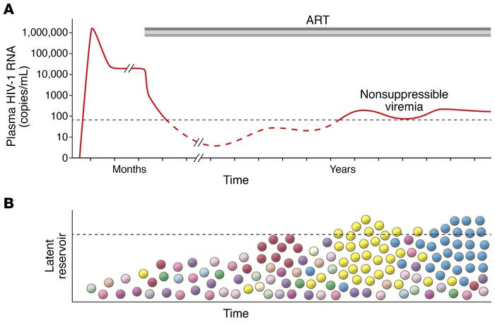
Siliciano 2020

Slide 22
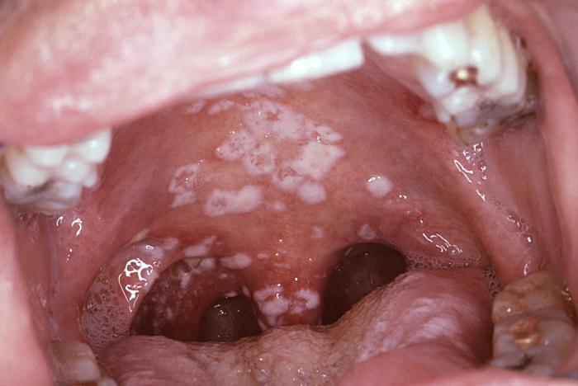
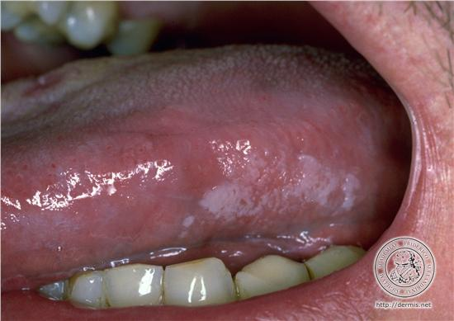
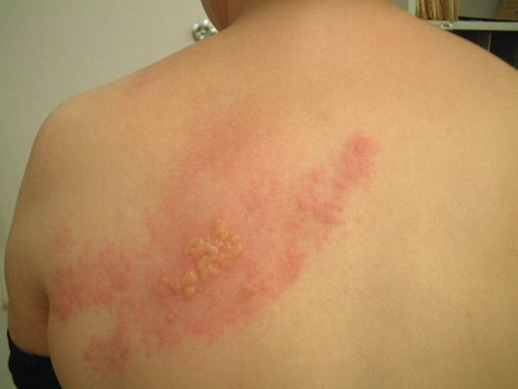
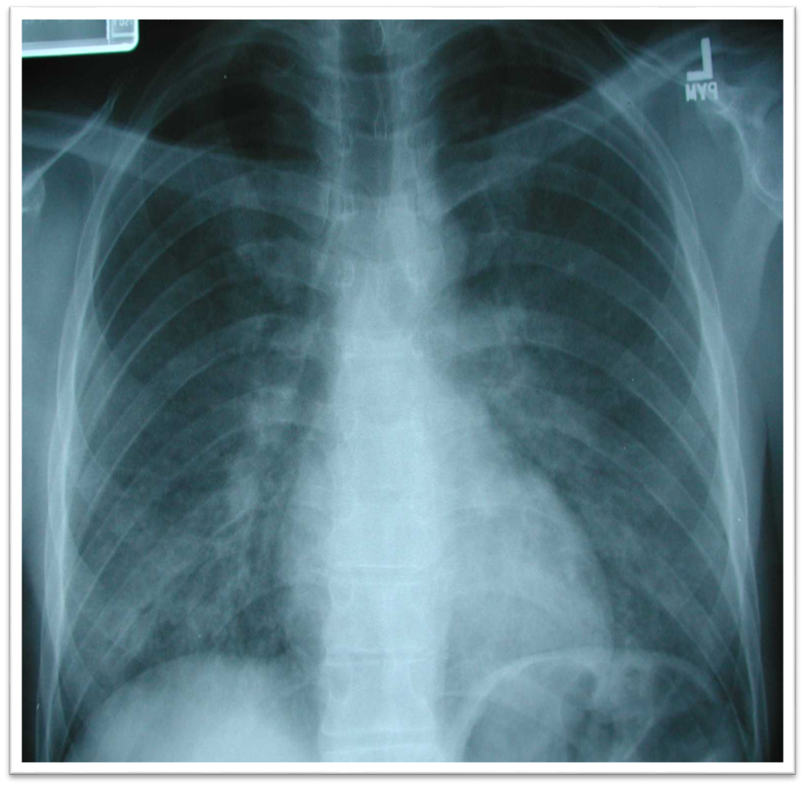
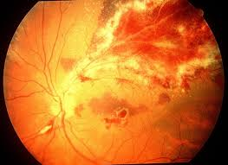
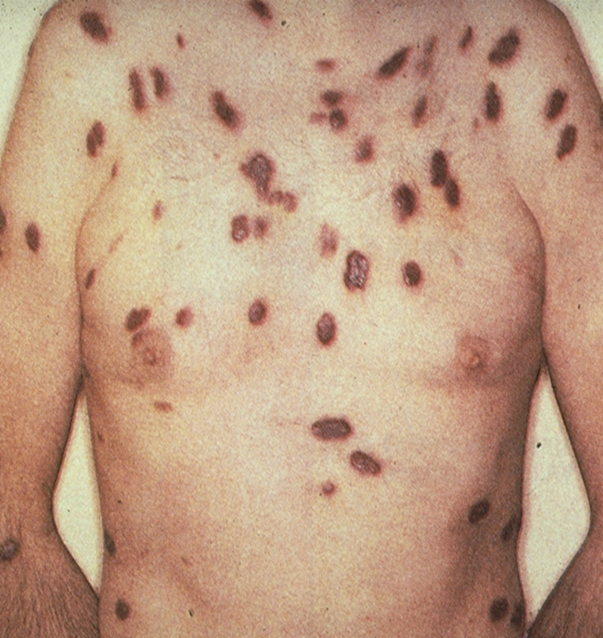
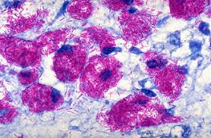
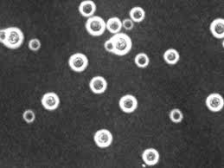
HIV progression leads to collapse of immune function that directly correlates with decline in CD4 T cell populations

Slide 23
Distribution of CD4+ Lymphocyte Counts at Diagnosis of Opportunistic Infection
CD4 Count | % PCP Diagnosis
≥ 300 | 5.5%
200 – 299 | 5.6%
50 – 199 | 34.5%
0 – 49 | 54.4%

Slide 24
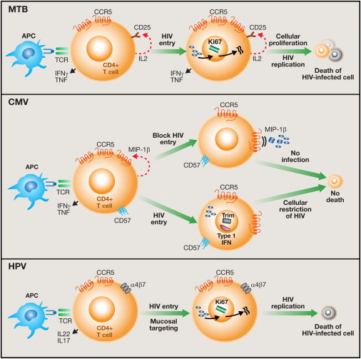
T Cell Susceptibility to HIV Influences Outcome of Opportunistic Infections

