Slide 1
Non-Viral Liver Diseases to Address in Persons with HIV
Caroline Miller, PA-C
HIV PA Resident
University of Kentucky

Slide 2
AETC Program National Centers and HIV Curriculum
National Coordinating Resource Center – serves as the central web –based repository for AETC Program training and capacity building resources; its website includes a free virtual library with training and technical assistance materials, a program directory, and a calendar of trainings and other events. Learn more: https://aidsetc.org/
National Clinician Consultation Center – provides free, peer-to-peer, expert advice for health professionals on HIV prevention, care, and treatment and related topics. Learn more: https://nccc/ucsf.edu
National HIV Curriculum – provides ongoing, up –to-date HIV training and information for health professionals through a free, web –based curriculum; also provides free CME credits, CNE contact hours, CE contact hours, and maintenance of certification credits. Learn more: www.hiv.uw.edu

Slide 3
Faculty Disclosure
This program is supported by the Health Resources and Services Administration (HRSA) of the U.S. Department of Health and Human Services (HHS) under grant number U1OHA30535 as part of an award totaling $4.2m. The contents are those of the author(s) and do not necessarily represent the official views of, nor an endorsement, by HRSA, HHS, or the U.S. Government. For more information, please visit HRSA.gov.
“Funding for this presentation was made possible by cooperative agreement U1OHA30535 from the Health Resources and Services Administration HIV/AIDS Bureau. The views expressed do not necessarily reflect the official policies of the Department of Health and Human Services nor does mention of trade names, commercial practices, or organizations imply endorsement by the U.S. Government. Any trade/brand names for products mentioned during this presentation are for training and identification purposes only.”

Slide 4
Educational Need/Practice Gap
Need to address non-viral liver disease as a serious cause of non-AIDS related deaths in PWH

Slide 5
Objectives
Upon completion of this educational activity, you will be able to:
Recall differential diagnosis for abnormal liver function tests in the absence of viral causes.
Describe the progression of Non-Alcoholic Fatty Liver disease (NAFLD) and identify treatment options.
Explain the relationship between alcohol and liver disease in people with HIV.

Slide 6
Expected Outcome
Knowledge to interpret liver function tests and resources to help patients improve outcomes
Understanding of non-viral causes of abnormal liver function

Slide 7
Why is Liver Disease Important?
With effective antiretroviral treatment, the life expectancy for people with HIV (PWH) is now approaching that seen in the general population
Liver disease is the second leading cause of non-AIDS related deaths:
Non-AIDS defining cancers – 15%
Liver disease – 13%
Cardiovascular disease – 11%
Smith CJ, et al.; D:A:D Study Group. Trends in underlying causes of death in people with HIV from 1999 to 2011 (D:A:D): a multicohort collaboration. Lancet. 2014 Jul 19;384(9939):241-8. doi: 10.1016/S0140-6736(14)60604-8. PMID: 25042234.

Slide 8
Causes of Liver Disease in PWH
Pre-ART
Post- ART
Viral Hepatitis
Opportunistic infections
Neoplasm
Alcohol Related Liver Disease
Alcohol Related Liver Disease*
Viral Hepatitis
Nonalcoholic fatty liver disease*
ART toxicity
Drug induced liver injury (non-ART)
Notes:
INSTI – weight gain
NRTI – toxicity
Multi-class – metabolic

Slide 9
Liver Testing
Liver Injury
Liver function
Alanine aminotransferase (ALT)
Aspartate aminotransferase (AST)
Alkaline phosphatase
Total Bilirubin
Albumin
PT/INR

Slide 10
Hepatocellular Causes of Liver Injury
Elevation | Common causes | HIV-related
Mild (<100 U/L) | Chronic viral hepatitis Alcohol Nonalcoholic fatty liver disease Wilson’s Disease | ART toxicity Opportunistic infections
Moderate (100-300 U/L) | Same as above | Same as above
Severe (>1000 U/L) | Drug induced liver injury Acute viral hepatitis Autoimmune hepatitis
Hepatocellular (ALT, AST)
Sanchez J, Corey K. Interpretation of abnormal liver chemistries in the hospitalized patient. Clin Liv Dis. 2016;7:132–4.

Slide 11
Cholestatic Causes of Liver Injury
Elevation | Common Causes | HIV-related
Low (<40 U/L) | Wilson’s Disease
Mild elevation | Biliary obstruction | Opportunistic infections
Moderate elevation (<4 times upper limit of normal) | Primary biliary cholangitis | Mycobacterium tuberculosis Opportunistic infections
Severe elevation (>1000 U/L) | Malignancy | Mycobacterium Avium Complex Kaposi’s Sarcoma AIDS Cholangiopathy Non-Hodgkin’s lymphoma
Alemu BT, Troy SB, Beydoun HA, Akpinar-Elci M, Cunningham TD. Determinants of Elevated Alkaline Phosphatase in Patients Infected with HIV. South Med J. 2016 Aug;109(8):487-91. doi: 10.14423/SMJ.0000000000000500. PMID: 27490660.

Slide 12
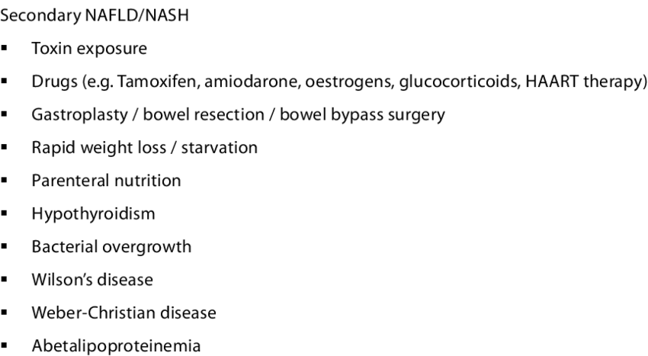
Nonalcoholic Fatty Liver Disease (NAFLD)
Accumulation of fat in the liver without excessive alcohol
Daily recommendations for alcohol consumption:
Men: 2 drinks or less
Women: 1 drink or less
Absence of secondary cause of hepatic steatosis
Tan, Hui-Hui & Chang, Jason. (2010). Non-Alcoholic Fatty Liver Disease. Proceedings of Singapore Healthcare. 19. 36-50. 10.1177/201010581001900106.

Slide 13
Comorbidities associated with NAFLD
Obesity
Diabetes Mellitus
Hypertension
Dyslipidemia
CVD
CKD
Lake JE, et al. Expert Panel Review on Nonalcoholic Fatty Liver Disease in Persons With Human Immunodeficiency Virus. Clin Gastroenterol Hepatol. 2022 Feb;20(2):256-268. doi: 10.1016/j.cgh.2020.10.018. Epub 2020 Oct 16. PMID: 33069882; PMCID: PMC9069630.

Slide 14
Progression of NAFLD
Nonalcoholic fatty liver
Non-alcoholic steatohepatitis (NASH
Fibrosis
Sven M. Francque, et al. Non-alcoholic fatty liver disease: A patient guideline,
JHEP Reports,Volume 3, Issue 5,2021,100322,ISSN 2589-5559,https://doi.org/10.1016/j.jhepr.2021.100322.
Notes:
Nonalcoholic fatty liver: only liver fat accumulation without liver cell damage or inflammation
Non-alcoholic steatohepatitis (NASH): accumulation of fat in liver cells with cell damage and inflammation
Fibrosis: scar tissue that develops when the liver is damaged and inflamed

Slide 15
Published Studies of NAFLD Epidemiology in PWH
Study |  | Participants | NAFLD prevalence
Hadigan, 2007 | Cross-sectional, single center | N = 33; 73% male, 21% HCV+, 85% on ART | 42%
Guaraldi, 2008 | Cross-sectional, single center | N = 225, 72% male, 100% on ART | 37% (44% men, 19% women)
Crum-cianflone, 2009 | Cross-sectional, single center | N = 216, 94% male; 65% on ART | 31%
Perazzo, 2018 | Cross-sectional, single center | N = 395, 40% male | 35%; 9% fibrosis
Pembroke, 2017 | Cross-sectional, singe center | N = 726, 23% HCV+, 3% HBV+; 75% male, 92% on ART | 36% steatosis, 29% fibrosis
Lake, JE. 2020
Notes:
Data reports prevalence rates greater than 30% by imaging or biopsy with frequent short term progression of disease in the subset of longitudinal studies

Slide 16
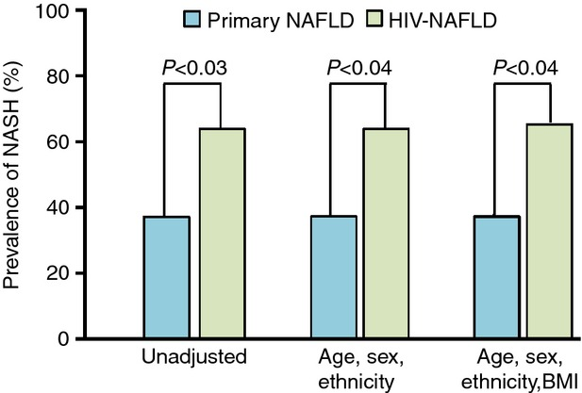
Prevalence of NASH in PWH
Cross-sectional case control study done at University of California San Diego compared consecutive liver biopsies over 13 year period
Enrolled PLWH with biopsy-proven NAFLD (N=33) and age-sex matched PWoH with biopsy-proven NAFLD (N=33)
Prevalence of NASH:
63.6% in PLWH
36.4% in PWoH
Vodkin I., Valasek M.A., Bettencourt R., et. al.: Clinical, biochemical and histological differences between HIV-associated NAFLD and primary NAFLD: a case–control study. Aliment Pharmacol Ther 2015; 41: pp. 368-378.
Notes:
This study is a cross-sectional case control study comparing histological samples of patients with HIV associated NAFLD vs patient with primary NAFLD. Performed at UC san diego over 13 year period with consectutive liver biopsies

Slide 17
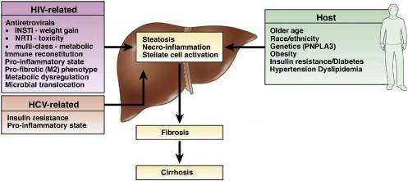
Pathophysiology in PWH

Slide 18
Diagnostic modalities, non-invasive
Imaging | Strengths/limitations
Ultrasound | Semi-quantitative assessment; mild/moderate/severe Low sensitivity with less severe steatosis
FIB-4 | No added cost; not accurate in <35 yr Lower rule-out threshold among high-risk individuals (first line assessment)
MRI-proton density fat fraction | Most sensitive across spectrum of steatosis; costly
Fibroscan (vibration-controlled elastography) | Can be used to rule out advanced fibrosis; may be useful in identifying disease progression
Magnetic Resonance Elastography (MRE) | More sensitive for fibrosis stage > 2; most accurate noninvasive, imaging based biomarker of fibrosis

Slide 19
What can we do?
Prevention & Treatment:
Reducing or eliminating alcohol ingestion
Reducing weight in people with high BMI values
Updating vaccines as needed to prevent other forms of liver disease live HBV or Hepatitis A virus
Sherman, Kenneth E, and David L Thomas. HIV and Liver Disease: A Comprehensive Update, vol. 30, no. 4, 2022.
Notes:
Reducing weight: weight loss of 10% or more of total body weight is associated with NASH resolution in 90% of patients and a 1 stage fibrosis reduction in 45% after 1 year

Slide 20
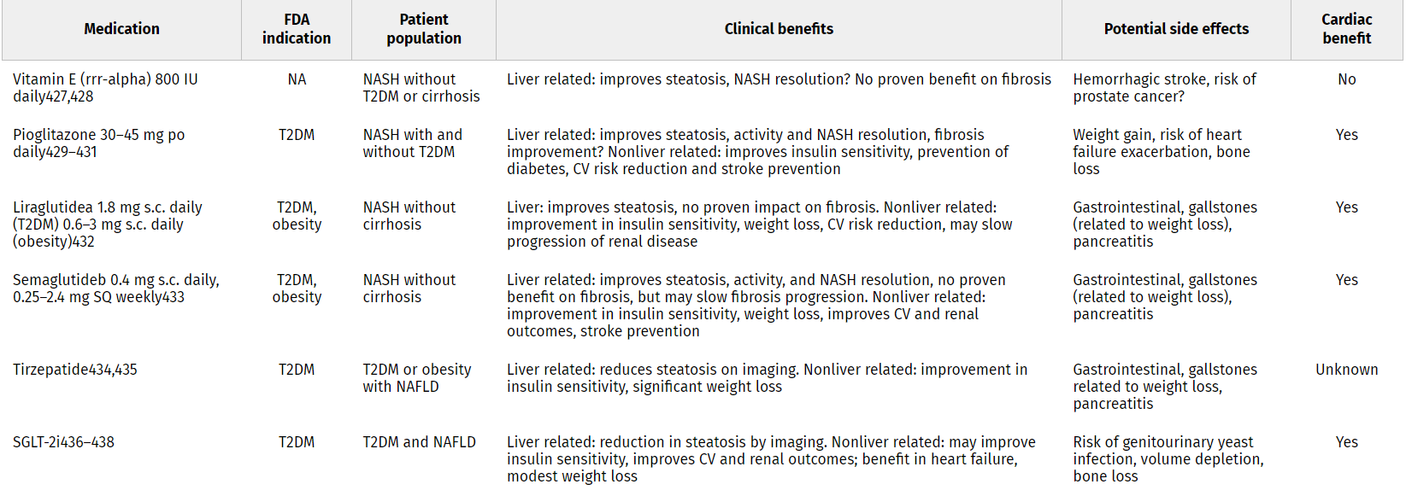
Medications for Patients with NAFLD
Available medications with demonstrable histological benefit in patients with biopsy-confirmed NASH. None of the medications are approved for treatment of NASH but can be used in carefully selected individuals with NASH and comorbid conditions such as diabetes and obesity or for off-label use.
Rinella, Mary E.1; Neuschwander-Tetri, Brent A.2; Siddiqui, Mohammad Shadab3; Abdelmalek, Manal F.4; Caldwell, Stephen5; Barb, Diana6; Kleiner, David E.7; Loomba, Rohit8. AASLD Practice Guidance on the clinical assessment and management of nonalcoholic fatty liver disease. Hepatology 77(5):p 1797-1835, May 2023. | DOI: 10.1097/HEP.0000000000000323

Slide 21
Alcohol Guidelines
NIAAA’s definition of “heavy drinking”
Men:
>4 drinks per day
>14 standard drinks per week
Women:
>3 drinks per day
>7 standard drinks per week
Patients with chronic liver disease: unknown amount of what is considered “safe” (highest risk of injury)

Slide 22
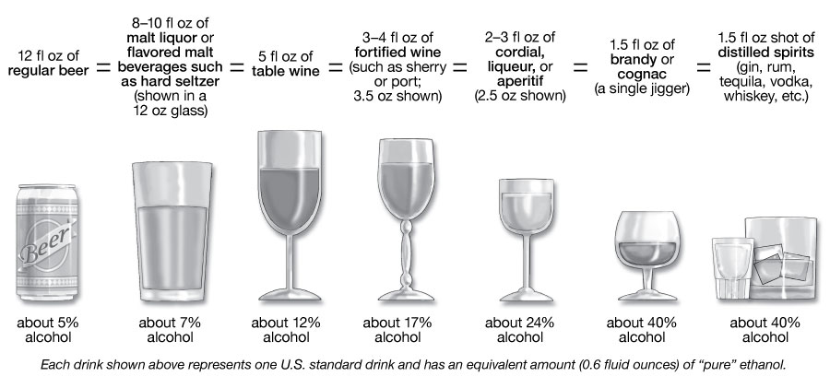
Examples of One Standard Drink
https://www.niaaa.nih.gov/alcohols-effects-health/overview-alcohol-consumption/what-standard-drink

Slide 23
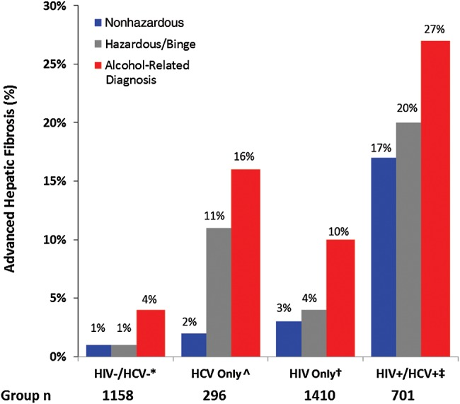
Alcohol and Liver Disease in PWH
Cross-sectional study through Veterans Aging Cohort Study who reported alcohol consumption at enrollment
Prevalence of advanced hepatic fibrosis increased as the category of alcohol use increased
Lim, Joseph K, et al. “Relationship between Alcohol Use Categories and Noninvasive Markers of Advanced Hepatic Fibrosis in HIV-Infected, Chronic Hepatitis C Virus-Infected, and Uninfected Patients.” Clinical Infectious Diseases : An Official Publication of the Infectious Diseases Society of America, May 2014, www.ncbi.nlm.nih.gov/pmc/articles/PMC4001286/.
Notes:
Nonhazardous = audit score < 4
Hazardous/binge = audit-c score > 4 or report of consumption of >6 drinks on any 1 occasion in the past year
Alcohol-related diagnosis = ICD 9 diagnosis for alcohol dependence/abuse recorded between 12 months before and 6 months after enrollment

Slide 24
Study, continued
Study found that:
Advanced fibrosis was more prevalent among HIV-infected than uninfected
210/9.9% vs 61/4.2%; P <.001
Increased category of alcohol use is associated with higher risk of advanced hepatic fibrosis
In each category of alcohol use, advanced hepatic fibrosis was more common in persons infected with HIV or chronic HCV than among uninfected persons

Slide 25
How to help
Counsel patients on decreasing alcohol use/stopping altogether
Helping patients find a rehabilitation center or outpatient recovery center that align with their goals
Medications
Naltrexone/vivitrol
Acamprosate
Notes:
Naltrexone/vivitrol: once daily medication or once monthly injection; cannot be used in patients with opioid use disorder or prescribed chronic opioids
Acamprosate: TID dosing makes it hard for patients to consistently take

Slide 26
Drug-Induced Liver Injury (DILI)
Common cause of acute liver injury in the US
Types of DILI:
Intrinsic
Examples: acetaminophen (most common), nicotinic acid, aspirin, cocaine, methotrexate
Idiosyncratic
Examples: isoniazid, amoxicillin/clavulanic acid, macrolides, fluoroquinolones, diclofenac
Indirect
Examples: high dose corticosteroids, antineoplastic agents
Drug-Induced Liver Injury (DILI). Council for International Organizations of Medical Sciences. Geneva 2020.
Notes:
Intrinsic – caused by drugs or chemicals that have direct and predictable toxicity on the liver; dose dependent
Idiosyncratic – induce liver damage in an unpredictable pattern; independent of dose, route, or duration of exposure
Indirect – unintended liver injury associated with known actions of a drug

Slide 27
Diagnosis of DILI
Liver testing: any one listed in the absence of competing etiology –
ALT > 5 x upper limit of normal
Alkaline Phosphatase > 2 x upper limit of normal
ALT > 3 x upper limit of normal + total bilirubin > 2 x upper limit of normal
Diagnosis of Exclusion:
History
Negative hepatitis tests
Absence of alcoholism, shock, autoimmune source
Imaging studies of liver/biliary tree

Slide 28
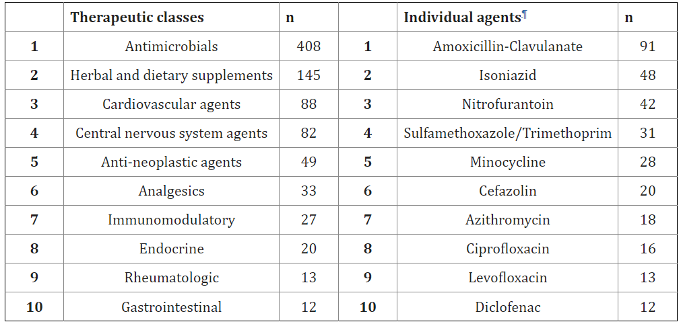
Top therapeutic classes and individual agents to cause DILI
Chalasani N, et al; United States Drug Induced Liver Injury Network. Features and Outcomes of 899 Patients With Drug-Induced Liver Injury: The DILIN Prospective Study. Gastroenterology. 2015 Jun;148(7):1340-52.e7. doi: 10.1053/j.gastro.2015.03.006. Epub 2015 Mar 6. PMID: 25754159; PMCID: PMC4446235.

Slide 29
Herbal and Dietary Supplements
Increasing cause of liver injury
In previously mentioned study, herbal and dietary supplements were 2nd most common group but rarely the specific agent implicated more than once
Body building and weight loss supplements rising
Can also cause interactions with ART

Slide 30
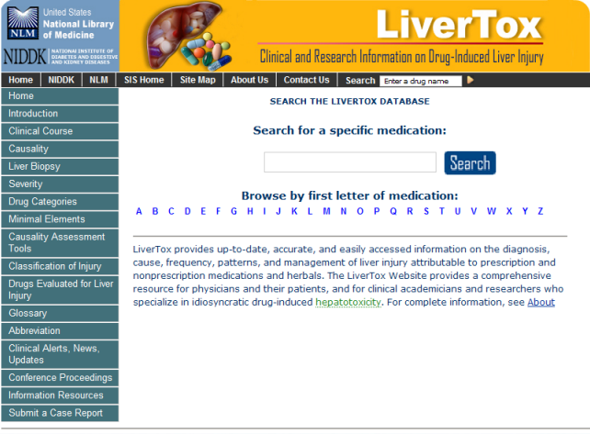
Take away
Always ask patients what supplements they are taking
Can search those supplements on Livertox.nih.gov
Monitor patients on common antimicrobials associated with DILI

Slide 31
Q&A

Slide 32
AETC Program
National Centers and National HIV Curriculum
National Coordinating Resource Center serves as the central web based
repository for AETC Program training and capacity building resources; its
website includes a free virtual library with training and technical assistance
materials, a program directory, and a calendar of trainings and other events.
Learn more: https ://aidsetc.org
National Clinician Consultation Center provides free, peer to peer,
expert advice for health professionals on HIV prevention, care, and treatment
and related topics. Learn more: https ://nccc.ucsf.edu
National HIV Curriculum provides ongoing, up to date HIV training and
information for health professionals through a free, web based curriculum;
also provides free CME credits, CNE contact hours, CE contact hours, and
maintenance of certification credits. Learn more: www.hiv.uw.edu

