Slide 1
Updates in HIV Treatment and Prevention
Donald Hong, MD
Washington University in St. Louis School of Medicine
St. Louis STI/HIV Prevention Training Center

Slide 2
Disclaimer
This presentation was supported by the Health Resources and Services Administration (HRSA) of the U.S. Department of Health and Human Services (HHS) as part of an award totaling $4,067,580 with no percentage financed with nongovernmental sources. The contents are those of the author and do not necessarily represent the official views of, nor an endorsement, by HRSA, HHS or the U.S. Government.
Notes:
Simone

Slide 3
Drug Disclaimer
Funding for this presentation was made possible by grants 4910, 4920, 4925, and 4915 from the Health Resources and Services Administration’s HIV/AIDS Bureau. The views expressed do not necessarily reflect the official policies of the Department of Health and Human Services nor does mention of trade names, commercial practices, or organizations imply endorsement by the U.S. Government. Any trade/brand names for products mentioned during this presentation are for training and identification purposes only.

Slide 4
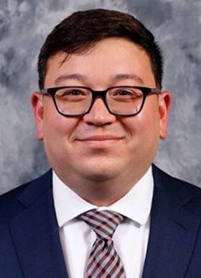
Presenter
Donald Hong, MD
Washington University in St. Louis School of Medicine
St. Louis STI/HIV Prevention Training Center
Notes:
Both

Slide 5
Objectives
HIV surveillance data
HIV treatment
Injectable Cabenuva
New ART agents
HIV prevention
2021 Guideline Update
Injectable PrEP
LEVI syndrome
DoxyPEP

Slide 6
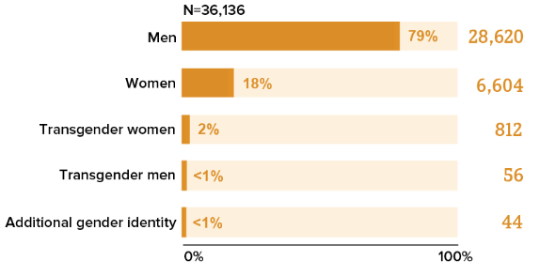
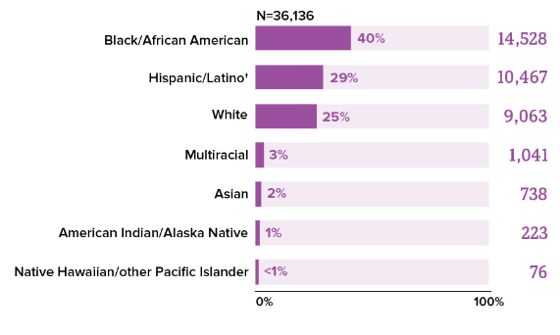
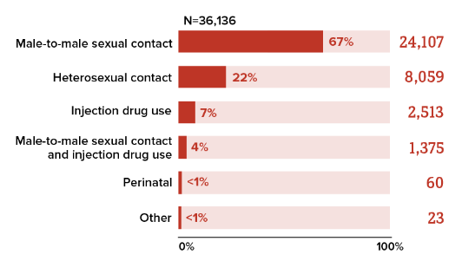
HIV within the United States
In 2021, approximately 1.2 million people in US living with HIV
87% were aware of their HIV status
36,136 new diagnosis of HIV in 2021
CDC. Diagnoses of HIV Infection in the United States and Dependent Areas, 2021. HIV Surveillance Report 2023.

Slide 7
HIV Treatment

Slide 8
IM Cabotegravir/Rilpivirine (Cabenuva)
Cabenuva is a complete regimen for the treatment of HIV-1 that can be given as a q2 month IM injection
Currently approved for those who are virologically suppressed on stable ART regimen with no hx of treatment failure and no known resistance to cabotegravir or rilpivirine
ATLAS and FLAIR studies showed Cabenuva to be non-inferior to standard ART regimen

Slide 9
IM Cabotegravir/Rilpivirine (Cabenuva)
SOLAR: Randomized switch trial of CAB/RPV-LA vs BIC/TAF/FTC
Phase 3b randomized, open-label non-inferiority study to assess switching virologically suppressed adults to Cabenuva vs continuing Biktarvy
Ramgopal M, et al. CROI 2023; Seattle, WA; February 19-22, 2023. Abst. 191.

Slide 10
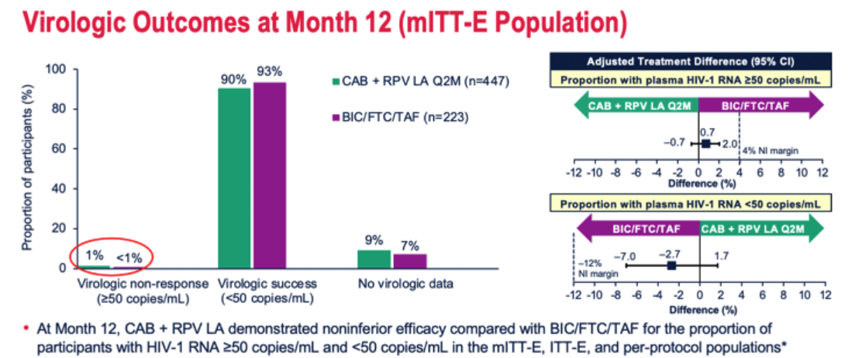
SOLAR Study
At month 12, CAB/RPV-LA was shown to be non-inferior to BIC/TAF/FTC
90% of participants in LA arm preferred LA after switch from PO
Ramgopal M, et al. CROI 2023; Seattle, WA; February 19-22, 2023. Abst. 191.

Slide 11
Ibalizumab (IBA)
Ibalizumab (Trogarzo) is a long acting monoclonal antibody that functions as a post-attachment inhibitor
Works by binding CD4 extracellular domain 2
Binding prevents a necessary conformational changes in the CD4–HIV envelope glycoprotein (gp120) complex required for viral entry
Acts on both CCR5 and CXCR4 tropic strains
FDA approved for heavily-treatment experienced adults w/ multidrug resistant HIV experiencing treatment failure on current regimen
Dosing
Single loading dose of 2000mg given over 30 minutes
Maintenance dose is 800mg given over 15 minutes every 2 weeks

Slide 12
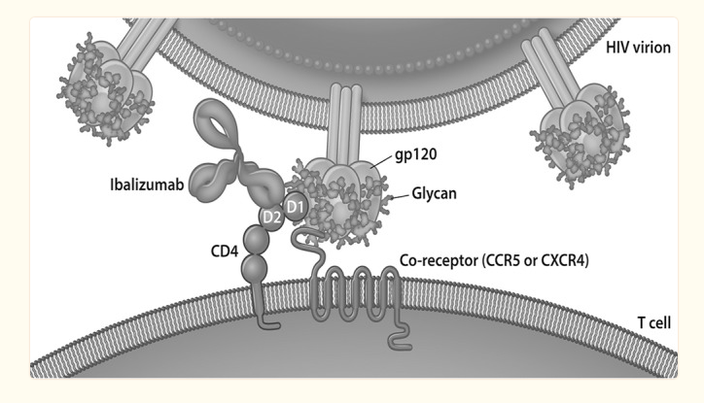
Ibalizumab Mechanism of Action
Beccari et al. Antimicrobial Agents and Chemotherapy. 2019

Slide 13
Ibalizumab (IBA)
In Phase 3 study, 40 adults with MDR HIV-1 with viral load >1000 copies were given loading dose and then maintenance dose every 14 days though week 25
Combined with optimized background regimen with at least one fully active agent
Mean baseline viral load was 4.5 log₁₀ copies/mL
At week 25, patients had mean decrease of 1.6 log₁₀ copies/mL
43% had viral load <50 copies/mL
50% had viral load <200 copies/mL
Emu B et al. NEJM 2018

Slide 14
Ibalizumab (IBA)
In the 48 week continuation study of phase 3 trial, patients continued to receive IBA 800mg every 2 weeks to complete 48 weeks
Of those that continued into 48 week follow up, 59% had viral load <50 copies/mL and 63% had viral load <200 copies/mL
All patients who had viral load <50 copies/mL at week 24 were able to maintain their viral suppression through week 48
Emu B et al. OFID 2017

Slide 15
Fostemsavir (FTR)
Fostemsavir (Rukobia) is a prodrug that is metabolized into the active metabolite temsavir
First in class attachment inhibitor which binds directly to viral envelope glycoprotein gp120
Binds near the CD4 binding site of gp120
Binding locks gp120 into closed state, which blocks the conformational change necessary for interaction with CD4 on cells, which prevents attachment and viral entry into T cells
Tropism has no effect on action
Dosing: One 600mg tablet twice daily

Slide 16
Fostemsavir Mechanism of Action
Kozal et al. NEJM. 2020

Slide 17
Fostemsavir (FTR)
BRIGHTE trial – phase 3 trial enrolling patient with MDR HIV-1 infection
First cohort – patients with at least one fully active ART agent randomized in 3:1 ratio to either receive fostemsavir 600mg BID or placebo in addition to failing regimen for 8 days, followed by open label fostemsavir plus optimized background therapy
Second cohort – patients with no active ART options given open label fostemsavir plus optimized background therapy
At day 8, mean decrease in HIV-1 RNA was 0.79 log10 copies/mL in fostemsavir group vs 0.17 log10 copies/mL in placebo
At week 48, 54% of patients in randomized cohort and 38% in non-randomized cohort had HIV-1 RNA level <40 copies/mL
Mean increase in CD4 of 139 in randomized cohort and 64 in non-randomized cohort
Kozal et al. NEJM. 2020

Slide 18
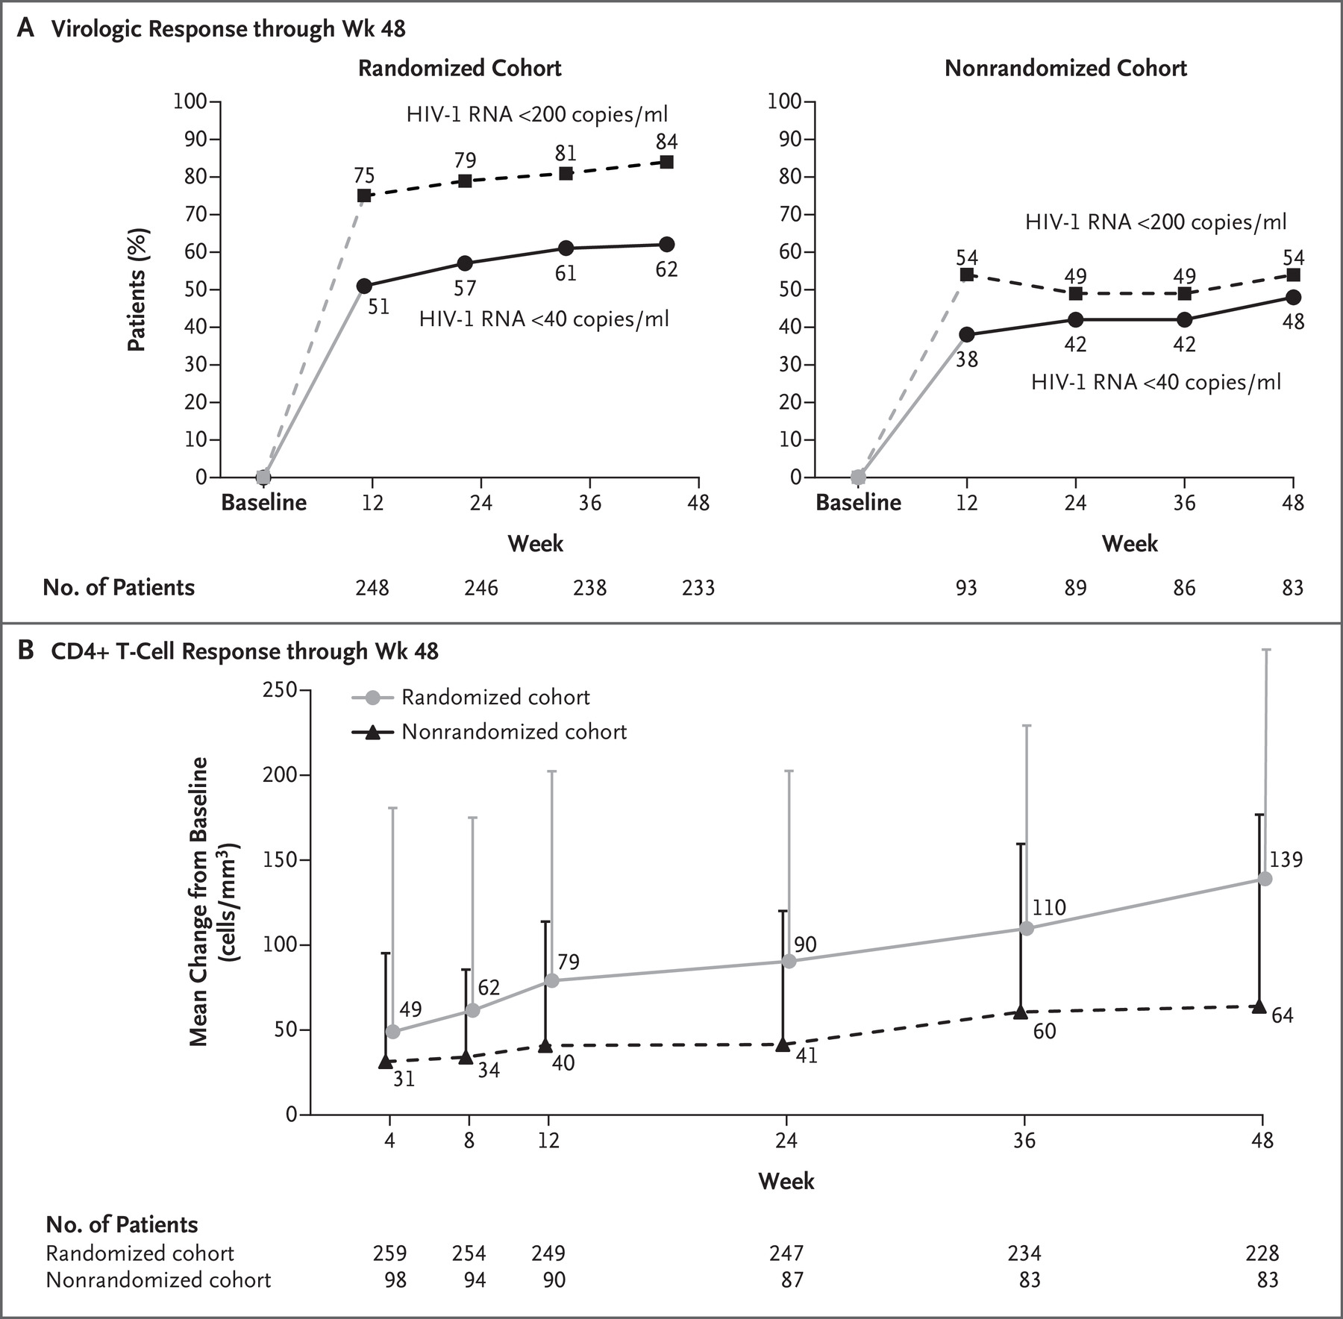
Fostemsavir (FTR)
Kozal et al. NEJM. 2020

Slide 19
Fostemsavir (FTR)
BRIGHTE trial – released planned 96 week interim analysis
In the randomized cohort, viral suppression (HIV RNA <40 copies) increased from 54% at week 24 to 60% at week 96
Mean CD4 count increase was 205 cells from baseline to week 96
In the non-randomized cohort, viral suppression remained at 37% in both weeks 24 and 96
Mean CD4 count increase was 119 cells from baseline to week 96
Lataillade M et al. Lancet HIV 2020

Slide 20
Lenacapavir (LEN)
First in class capsid inhibitor
Functions both in early and late states of HIV life cycle
Inhibits capsid mediated nuclear uptake of preintegration complexes
Inhibits virion production
Additional benefit is the long-acting injectable formulation
Given as a q6 month subQ injection
Oral formulation only used for initial lead in
Dosing
2 options for initiation dosing
Option 1: Day 1 - 927mg SubQ injection + 600mg PO; Day 2 – 600mg PO
Option 2: Day 1 – 600mg PO; Day 2 – 600mg PO; Day 8 – 300mg PO; Day 15 – 927mg SubQ injection
Maintenance dosing: 927mg SubQ injection every 26 weeks

Slide 21
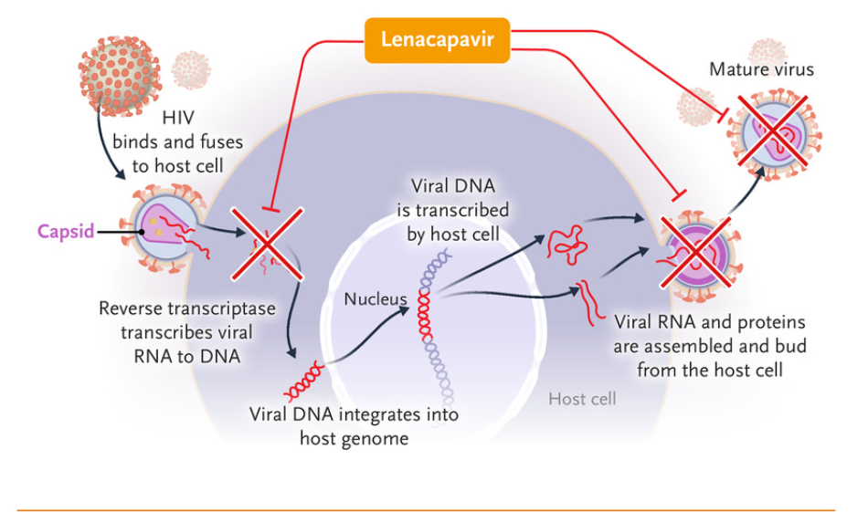
Lenacapavir (LEN)
Segal-Maurer et al. NEJM. 2022

Slide 22
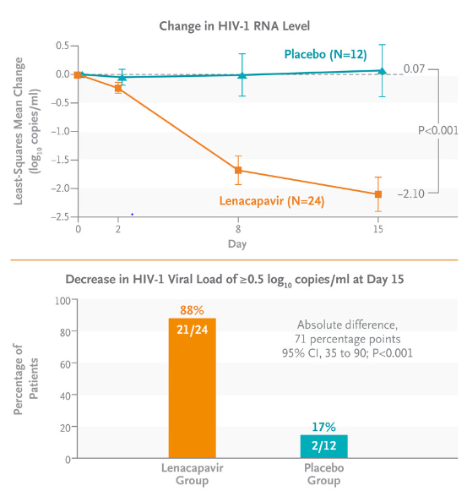
Lenacapavir (LEN)
CAPELLA trial – Phase 3 trial enrolling patients with MDR HIV-1 infection w/ resistance to at least 2 ART from 3 of 4 main classes
Randomized to receive oral lenacapavir or placebo + optimized background therapy through day 15 followed by subQ lenacapavir every 6 months
Decrease of at least 0.5 log10 copies/mL in viral load by day 15 seen in 88% of lenacapavir group vs 17% in placebo group
At week 26, viral load of <50 copies/mL seen in 81% of participants
Segal-Maurer et al. NEJM. 2022

Slide 23
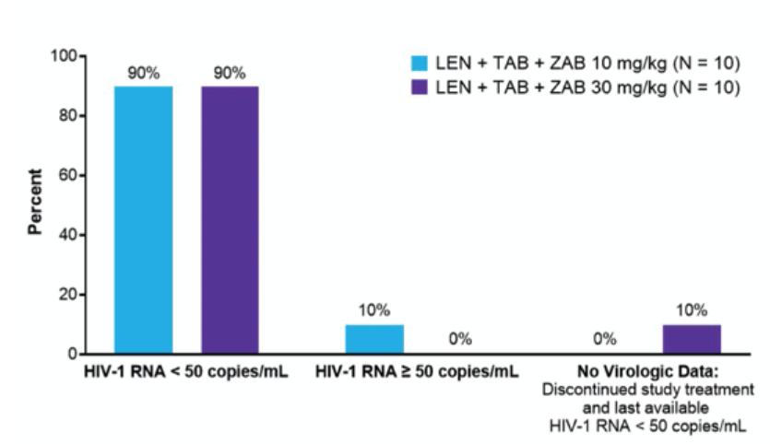
Lenacapavir (LEN)
Study to assess the effectiveness of long-acting lenacapavir with 2 additional long-acting agents
Teropavimab (TAB) – binds CD4 binding site of gp 120
Zinlirvimab (ZAB) – binds V3 domain of gp120
18/20 participants maintained suppression for 26 weeks after single administration of study regimen
This combination may in the future offer a fully active regimen that would only need to be administered twice yearly
Eron et al. CROI 2023; Seattle WA; Feb 19-22, 2023. Abst. 193

Slide 24
Islatravir
First in class nucleoside reverse transcriptase translocation inhibitor (NRTTI)
Multiple mechanisms of action
High affinity binding for reverse transcriptase leading to ability to block translocation leading to immediate chain termination
If translocation still occurs, delayed chain termination due to islatravir incorporation leading to steric interactions and mismatched primers unable to be extended
Initially investigated as both HIV treatment given daily or weekly and for HIV PrEP given monthly
Unfortunately, clinical development was paused in 12/2021 due to reduced lymphocyte counts in ongoing trials
Clinical development for treatment of HIV-1 has resumed
Development for monthly PrEP has been discontinued

Slide 25
Islatravir
Squires et al. presented at CROI 2023 the Effect of Islatravir on Total Lymphocyte and Lymphocyte Subset Counts
Found that decreases in mean total lymphocyte count and CD4+ counts occurred in dose-dependent manner
Greater increases in weekly (20mg) and monthly (60mg) doses when compared to daily (0.75mg) dose
Among those that discontinued in PrEP studies, total lymphocyte counts returned to levels similar to control group
In daily dosing study combined with doravirine, lymphocyte counts stabilized between weeks 48 and 72
No noted increases in infection
Squires et al. CROI 2023; Seattle, WA; February 19-22, 2023. Abst. 192

Slide 26
HIV Prevention

Slide 27
HIV Pre-exposure Prophylaxis
New USPHS PrEP guidelines released in 2021
Increased and simplified the indications
Increased access to PrEP
More options for PrEP (TAF/FTC & Cabotegravir)
Laboratory testing changes

Slide 28
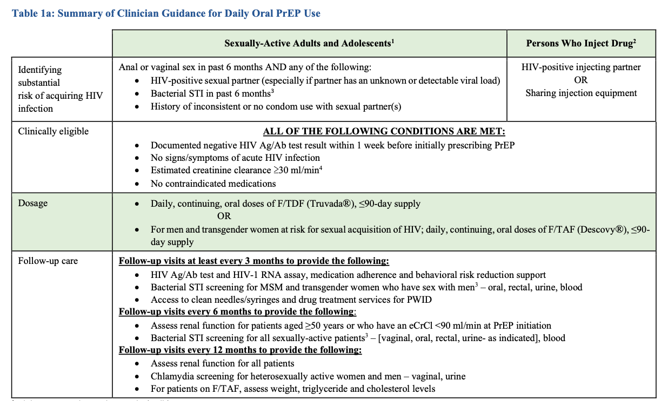
More PrEP Indications
“Added recommendation to inform all sexually active adults and adolescents about PrEP”
Simplified indications for PrEP for all sexually active persons and PWID
Centers for Disease Control and Prevention: US Public Health Service: Preexposure prophylaxis for
the prevention of HIV infection in the United States—2021 Update: a clinical practice guideline.

Slide 29
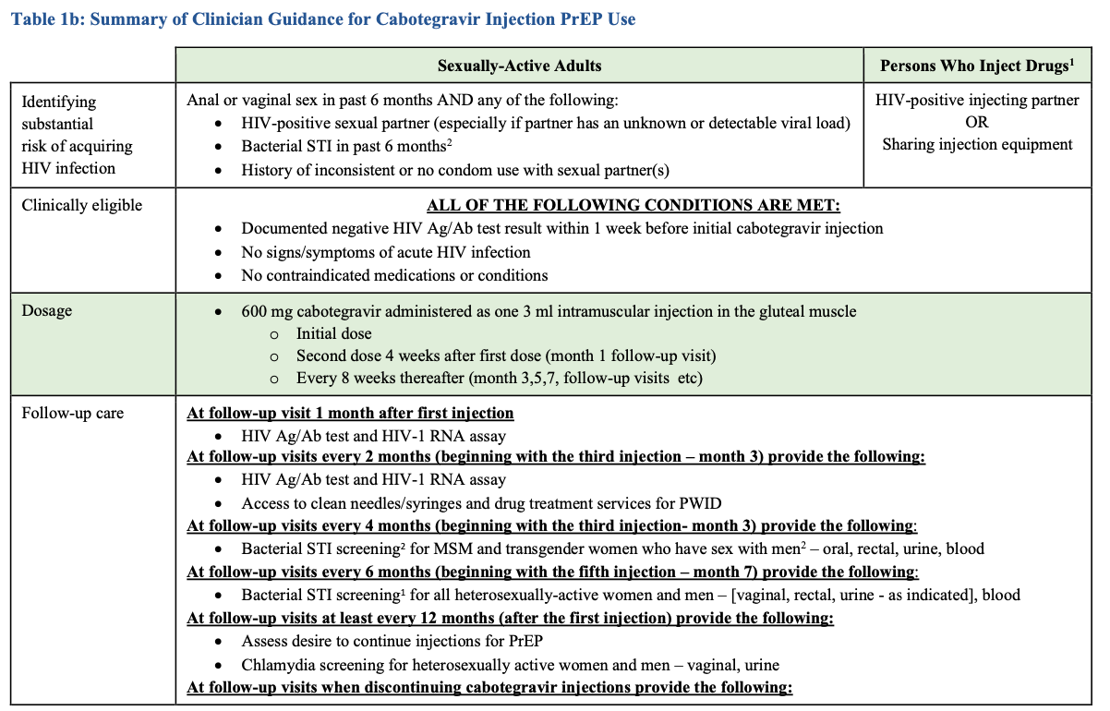
Cabotegravir
Centers for Disease Control and Prevention: US Public Health Service: Preexposure prophylaxis for
the prevention of HIV infection in the United States—2021 Update: a clinical practice guideline.

Slide 30
Cabotegravir IM for PrEP
HPTN 083 study
Randomized double-blind non inferiority trial comparing long-acting injectable cabotegravir vs TDF/FTC for HIV PrEP in MSM and TGW
CAB-LA found to be superior to daily oral TDF/FTC in prevention of HIV infection in MSM and TGW
HPTN 084
Randomized double blind superiority trial comparing long-acting injectable cabotegravir vs TDF FTC for HIV PrEP in women
CAB-LA found to be superior to daily oral TDF/FTC in prevention of HIV infection in cis-gender women

Slide 31
Long-acting Early Viral Inhibition (LEVI) Syndrome
HIV acquired while on CAB-LA is rare but when occurs may be clinically silent and difficult to diagnose
HIV rapid tests and 4th gen Ag/Ab tests failed to detect HIV infection in setting of CAB-LA
Viral suppression and delayed/diminished Ab expression can persist for months after infection
Delayed diagnosis may lead to:
Unnecessary CAB-LA dosing
Delayed ART initiation
Emergence of INSTI resistance
In HPTN 083, detection of infection was delayed in ~50% infections that occurred in CAB arm
Rarely observed if infection occurred >6 months from CAB injection
Eshleman S, et al. CROI 2023; Seattle, WA; February 19-22, 2023. Abst. 160.

Slide 32
Long-acting Early Viral Inhibition (LEVI) Syndrome
Eshleman S, et al. CROI 2023; Seattle, WA; February 19-22, 2023. Abst. 160.

Slide 33
Long-acting Early Viral Inhibition (LEVI) Syndrome
Eshleman S, et al. CROI 2023; Seattle, WA; February 19-22, 2023. Abst. 160.

Slide 34
Long-acting Early Viral Inhibition (LEVI) Syndrome
Eshleman S, et al. CROI 2023; Seattle, WA; February 19-22, 2023. Abst. 160.

Slide 35
Long-acting Early Viral Inhibition (LEVI) Syndrome
Eshleman S, et al. CROI 2023; Seattle, WA; February 19-22, 2023. Abst. 160.

Slide 36
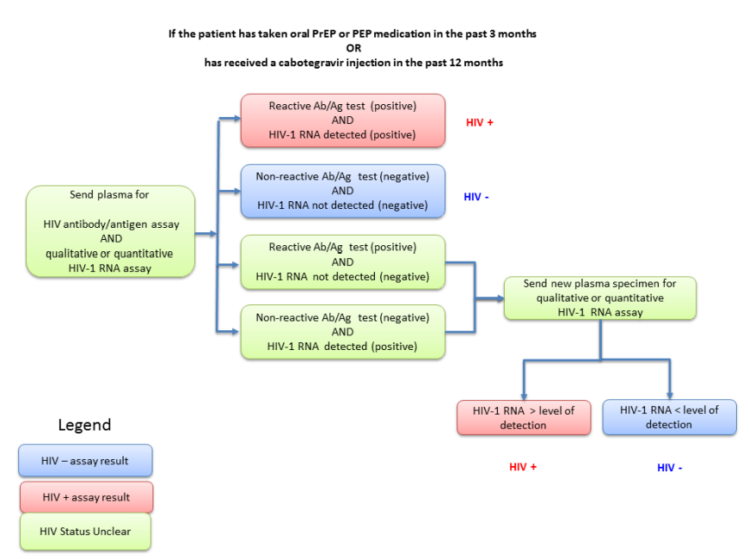
CDC HIV Testing Recommendations for PrEP
HIV-1 RNA testing now recommended for routine screening of HIV infection during the use of oral and long-acting injectable PrEP
Q3months for PO
Q2months for LA injectable
Centers for Disease Control and Prevention: US Public Health Service: Preexposure prophylaxis for
the prevention of HIV infection in the United States—2021 Update: a clinical practice guideline.

Slide 37
Doxy PEP for STI Prevention
Randomized open-label trial for MSM/TGW with HIV or on PrEP living in San Francisco and Seattle with gonorrhea, chlamydia, or early syphilis w/in past year
Randomized 2:1 to doxy 200mg up to 72hrs following condomless sex vs no doxy
STI testing at enrollment, quarterly, and when symptomatic
Primary Endpoint: At least one incident STI (GC/CT/syphilis) during a follow-up quarter
Quarterly STI reduction of 62% in PLWH and 66% in those on PrEP
Luetkemeyer A et al. AIDS 2022; Montreal, Can; July 29 – August 2, 2022

Slide 38
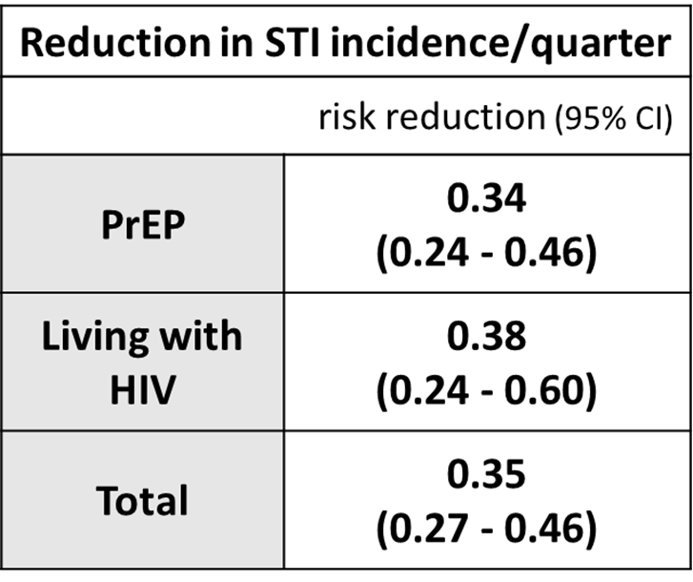
Doxy PEP for STI Prevention
Luetkemeyer A et al. AIDS 2022; Montreal, Can; July 29 – August 2, 2022

Slide 39
DoxyPEP Resistance
N. Gonorrhoeae
56 GC cultures able to be evaluated
Similar doxy resistance at baseline and on doxyPEP
18-20% low level resistance
6-10% high level resistance
Staph aureus
14% decrease in colonization in doxyPEP arm
Low overall doxy resistance with 8% increase in resistance in doxyPEP arm
Overall no marked increase in doxycycline resistance
Luetkemeyer A, et al. CROI 2023; Seattle, WA; February 19-22, 2023. Abst. 120

Slide 40
ANRS 174 DOXYVAC
Randomized, open-label factorial design trial to compare doxycycline post-exposure prophylaxis or no PEP (2:1); and 2 shots of meningococcal B vaccine (Bexsero) or no vaccine (1:1).
Enrolled MSM on PrEP with bacterial STI in past year
Primary efficacy endpoints:
DoxyPEP: time to first episode of syphilis or chlamydia
MenB vaccine: time to first episode of gonorrhea (1 month after 2nd injection)
Tested for gonorrhea and chlamydia at baseline, every 3 months, and when symptomatic
Tested for syphilis at baseline and every 3 months
Molina JM, et al. CROI 2023; Seattle, WA; February 19-22, 2023. Abst. 119

Slide 41
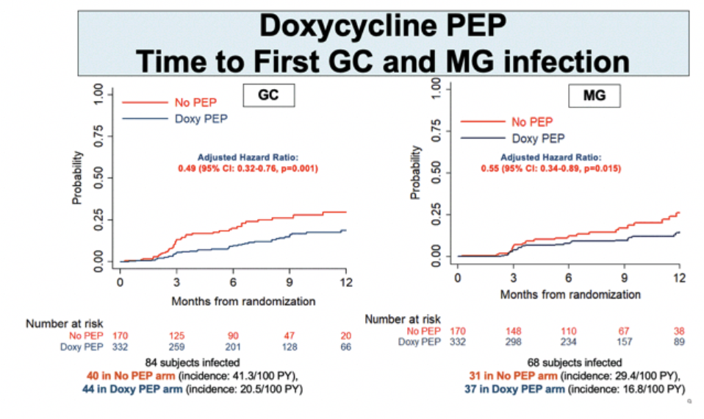
ANRS 174 DOXYVAC
Molina JM, et al. CROI 2023; Seattle, WA; February 19-22, 2023. Abst. 119

Slide 42
DoxyPEP CDC Guidance
CDC STI Treatment Guidelines

Slide 45
MATEC Resources
National Clinician Consultation Center http://nccc.ucsf.edu/
HIV Management
Perinatal HIV
HIV PrEP
HIV PEP line
HCV Management
Substance Use Management
AETC National HIV Curriculum https://aidsetc.org/nhc
AETC National HIV-HCV Curriculum https://aidsetc.org/hivhcv
Hepatitis C Online https://www.hepatitisc.uw.edu
AETC National Coordinating Resource Center https://aidsetc.org/
Additional Trainings https://matec.info

