Slide 1
Project ECHO® - UNM
HIV ECHO
Meningitis in People with HIV
Michelle Iandiorio, MD
Professor, UNMHSC SOM Dept of IM, Div of ID
Clinical Director, SCAETC
Notes:
Version_ 08 2023
Target trainees: interprofessional members of the healthcare team

Slide 2
Conflict of Interest Disclosure Statement
Speaker has nothing to disclose.
This presentation was reviewed by UNMHSC and SCAETC faculty to ensure it meets Continuing Education guidelines.
This program is supported by the Health Resources and Services Administration (HRSA) of the U.S. Department of Health and Human Services (HHS) as part of an award totaling $4,205,743 with 0% financed with non-governmental sources. The contents are those of the author(s) and do not necessarily represent the official views of, nor does mention of trade names, commercial practices, or organizations imply an endorsement by HRSA, HHS, or the U.S. Government. For more information, please visit HRSA.gov. Any trade/brand names for products mentioned during this presentation are for training and identification purposes only.

Slide 3
Unconscious Bias Disclosure
SCAETC recognizes that language is constantly evolving, and while we make every effort to avoid bias and stigmatizing terms, we acknowledge that unintentional lapses may occur in our presentations.
We value your feedback and encourage you to share any concerns related to language, images, or concepts that may be offensive or stigmatizing.
Your input will help us refine and improve our presentations, ensuring they remain inclusive and respectful to participants.

Slide 4
Learning Objectives
List strategies that reduce the risk of meningitis in people with HIV (PWH).
Recognize the clinical symptoms of meningitis in people with HIV and the various presentation including acute, subacute, and chronic.
Identify which patients with HIV and meningitis should delay initiation of antiretroviral therapy (ART).

Slide 5
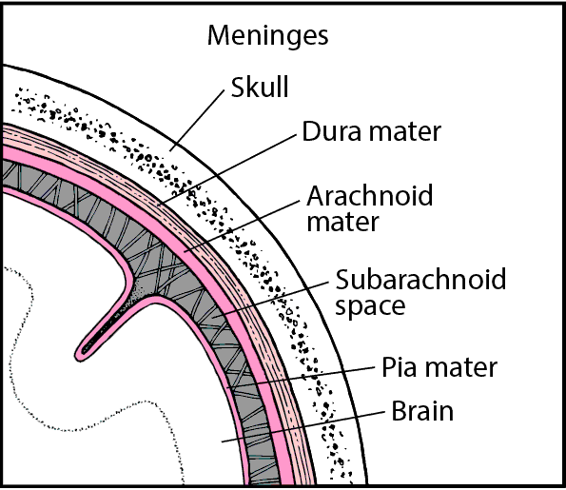
Meningitis in People with HIV
Vulnerability to various opportunistic infections is largely dictated by the degree to T cell-mediated immunosuppression
Treatment of HIV-associated central nervous system (CNS) infections can pose challenges, including the development of an immune reconstitution inflammatory syndrome (IRIS)
HIV-associated CNS infections can include meningitis, encephalitis, meningoencephalitis
Meningitis = inflammation of the layers of tissue that cover the brain and spinal cord (meninges) and of the fluid-filled space between the meninges (subarachnoid space)
Image: https://www.merckmanuals.com/

Slide 6
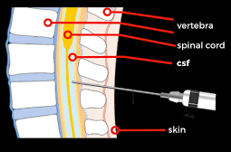
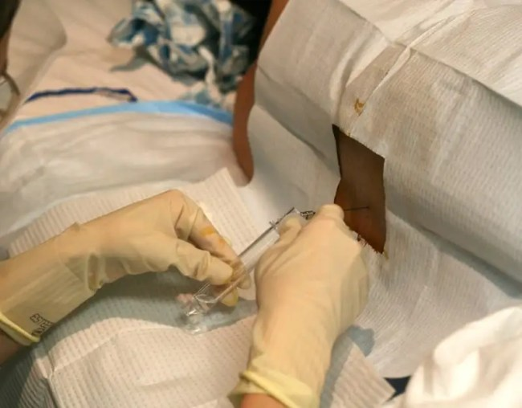
Diagnosis of Meningitis
Clinical symptoms: headache, fever, photophobia (sensitivity to light), nuchal rigidity (stiff neck)
Lumbar puncture to collect cerebrospinal fluid (CSF)
Cell count with differential
Glucose, Total Protein
Stains, Cultures
Polymerase Chain Reaction
(PCR), antigen, antibody tests
Imaging
MRI with contrast: inflammation of meninges, complications
Image: https://dontforgetthebubbles.com/
Image: https://www.aliem.com/tips-for-interpreting-the-csf-opening-pressure/
Notes:
PCR= polymerase chain reaction; type of nucleic acid amplification test
CNS infection can cause increased intracranial pressure and herniation
Lumbar puncture
LP without CT is safe if no papilledema, localizing signs, or signs of increased pressure
Contraindications: signs of increased intracranial pressure (risk of herniation), localizing neurologic signs, signifant coagulopathy, lumbar soft tissue infection

Slide 7
Meningitis in the setting of Acute Retroviral Syndrome
Onset of symptoms 1-6 weeks after exposure with HIV
Early surge of HIV viral load & drop of cluster of differentiation 4 (CD4) cells
Symptoms related to immune response & coincide with viral load
Mild nonspecific viral illness: fever, pharyngitis, myalgia, rash, cervical lymphadenopathy, headache and diarrhea
Less common are aseptic meningitis, facial palsy, acute inflammatory demyelinating polyradiculoneuropathy (AIDP)
Symptoms generally resolves within few days but can last few weeks
Treatment: antiretroviral therapy (ART)
Niu, MT et al. JID 1993;168:1490-1501.
Notes:
Niu, MT et al. JID 1993;168:1490-1501. Headache 32%, neuropathy 6%, encephalopathy 6%
Guillain-Barre = acute idiopathic polyradiculoneuritis; acute inflammatory demyelinating polyradiculoneuropathy (AIDP)

Slide 8
Meningitis in PWH
Typical Acute Bacterial Meningitis
Acute, severe symptoms
More common in PWH
Streptococcus pneumonia, Neisseria meningitides, Hemophilus influenza, Listeria monocytogenes
Treatment: intravenous antibiotics x 10 days
Dexamethasone prior to antibiotics
Prevention: vaccination
Viral/”Aseptic” Meningitis
Subacute, milder symptoms
Viral: i.e., Enterovirus, HSV
Often self-limited, benign
Most etiologies do not have antimicrobial therapy
Chronic Meningitis
Symptoms weeks to months
Fungal, Mycobacterial, atypical bacteria
Van Veen, KEB et al. Journal of Infection. 2016;72:362-368.
Notes:
Development of bacterial meningitis progresses through the following five related steps: (1) bacterial colonization of the nasopharynx, (2) mucosal invasion and penetration into the bloodstream, (3) intravascular multiplication and entrance through the blood–brain barrier usually via the choroid plexus, (4) generation of inflammation within the subarachnoid space, and (5) induction of neuronal and auditory cell damage
Complications: bacteremia, seizures, brain herniation, cranial nerve damage,
Dexamethasone PRIOR to initial antibiotics reduced morbidity and mortality
Most effective in Strep pneumo
Less deafness for children with H. influenzae
Apparent treatment effect ceased to be significant after adjustment for multiple comparisons so true positive effect unclear (Lancet Neuro 2010; 9(3):254-63.
In resource poor settings with high HIV infection rates, RCTs showed no effect of dexamethasone.
2013 Cochrane review showed beneficial effect of corticosteroids in patients with community-acquired bacterial meningitis
Droplet precautions for 1st 24hrs after beginning appropriate antibiotic therapy
Post-exposure prophylaxis only for close contacts: household members, day care center contacts, those with direct contact to oral secretions; rifampin bid x 2 days or ciprofloxacin x 1.
HSV=herpes simplex virus; HSV-2 can cause meningitis

Slide 9
Neurosyphilis Meningitis
Clinical manifestations of neurosyphilis may be more common in PWH
Diagnosis: clinical symptoms + serum T.pallidum antibody reactive with elevated RPR titer and abnormal CSF
CSF: elevated mononuclear cells, elevated protein, +/- VDRL
Treatment: penicillin G 20mu IV CI daily x 10-14d
No delay in antiretroviral therapy (ART) recommended
May consider repeat CSF analysis in 6 months to document improvement in CSF WBC
https://clinicalinfo.hiv.gov/en/guidelines/hiv-clinical-guidelines-adult-and-adolescent-opportunistic-infections/
Notes:
Treatment: penicillin G 18-24mu IV CI daily x 10-14d

Slide 10
Cryptococcal Meningitis
Leading CNS opportunistic infection in PWH
Fungal infection caused by Cryptococcus neoformans or Cryptococcus gattii
Subacute symptoms over 2-4 week period
Classic meningeal signs occur in only ¼ of patients
CD4 usually <100cells/mm³ but can be >200
Positive serum cryptococcal antigen sensitive and specific
Acute mortality correlated with CSF fungal burden, altered mental status at presentation, and rate of infection clearance
Elevated CSF pressure present in 50-75% pts
Bowen, LN, et al. Nat Rev Neurol. 2016; 12(11):662-674.
Notes:
Accounts for 15-20% of deaths attributed to HIV-associated opportunistic infections
Mortality can reach 70%
cryptococcus= ubiquitous environmental yeast found in soil and bird droppings
Infection typically acquired through inhalation of spores
Initial infection can lead to primary pulmonary infection, latent infection (asymptomatic cryptococcal antigenemia), or disseminated infection with a predilection for the CNS
In setting of HIV, cryptococcal meningitis inflammatory response in CSF is weaker, fungal burdens are larger, and number of mass lesions is lower
OP >47cmH20 associated with development of papilloedema
Elevated CSF confers poor prognosis

Slide 11
Cryptococcal Meningitis Treatment
Antifungal therapy
Induction: amphotericin B + flucytosine x 2 weeks
Consolidation: high-dose fluconazole x 8 weeks
Maintenance: low-dose fluconazole for at least a year; CD4>100, HIV VL UD
Serial lumbar punctures
Relieve intracranial hypertension required in those with elevated opening pressures
Some will require shunt
Guidelines recommend delay 4-6 weeks to start ART
Clearance of cryptococcus relies on robust CD4+ cell responses and production for cytokines (IFN-gamma) secreted by type 1 T helper cell response
Immune reconstitution from HIV antiretroviral therapy (ART) important but can be associated with complications
https://clinicalinfo.hiv.gov/en/guidelines/hiv-clinical-guidelines-adult-and-adolescent-opportunistic-infections/
Notes:
Bowen, LN, et al. Nat Rev Neurol. 2016; 12(11):662-674. 1. Boulware DR et al. NEJM 2014;370(26):2487-2498. 2. Beardsley J et al. NEJM 2016;374(6): 542-554.
Paradoxical cryptococcal IRIS reported in 10-45% ART-naïve PWH with cryptococcal meningitis with 60% occuring within first month of ART; ; more common in pts who fail to mount an initial pleocytosis (<25cells, protein, inf gamma responses at diagnosis)
Manifestations of cryptococcal IRIS: clinically worse after initial period of stabilization of improvement on therapy; MRI: leptomeningeal enhancement
Guidelines recommend delay 4-6 weeks to start ART, especially in those with elevated ICP and low CSF TNC
Less risk when ART started after CNS cultures negative
COAT trial- Boulware et al,- Cryptococcal Optimal Antiretroviral timing trial determined the optimal timing of ART initiation to be >5 weeks following initiation of CM antifungal treatment, this delay allows time for CD4 T‐cell count restoration and re‐establishment of the Th1 and Th2/17 balance, which is thought to be the immune response needed for fungal clearance. RCT 3 sites n Africa compared pts with cryp meningitis who started ART within 1-2 weeks (median 8d) after dx iwith meningitis with pts for whom ART delayed for 4-6 wks (median 35d) after dx. ; ampho B + fluconazole for induction’; a significantly greater in crease in 6-mo mortality occurred in early ART group than in delayed ART group (45% vs 30%, P-0.3); increase most pronounced during first 8 to 30d of study. Difference in mortality between early ART group and delayed ART group even greater among individuals with CSF WBC<5. Excess deaths in early ART group likely attributable to paradoxical IRIS>
Chang et al- study found that patients with cryptococcal meningitis who were CSF culture-negative at the initiation of ART had a greater than 60% reduction in risk of clinical deterioration than those who were culture-positive and that those with sterile CSF had a greater than 60% reduction in risk of IRIS than those without sterile CSF.
Balasko A et al. HIV Med. 2019;20(1):1-10. Shedding light on IRIS: from pathophysiology to treatment of crypt. Menin and IRIS in HIV. Immune response Th2/Th17 rather than Th1, leading to inefficient fungal clearance at the time of ART initiation and subsequent over-exaggeration fo the Th1 response and life-threatening IRIS development. Tx include corticosteroids, thalidomide (TNF-alpha cytokine antagonist).
Eshun-Wilson, et al. Cochrane Database Syst Rev. 2018. Early vs delayed ART in PLWH with cryptococcal meningitis. Review for low and middle-income countries. Unable to pool results. Possible bias due to selective outcome reporting. Evidence is low certainty that higher mortality risk related to cr men-IRIS.
While other TNF‐α antagonists are applied in noninfectious settings (e.g. rheumatoid arthritis), such as infliximab, the only TNF‐α antagonist applied in the HIV‐CM setting is thalidomide; thalidomide has been proved to be safe in immunocompromised HIV‐infected patients. Clinically, thalidomide has been proven effective in HIV‐infected patients experiencing IRIS following ART initiation 46. Two HIV‐infected patients with CM and one HIV/TB‐coinfected patient showed rapid clinical remission and were able to stop corticosteroid treatment following treatment with thalidomide, allowing successful IRIS resolution. Another two HIV‐CM IRIS patients treated with thalidomide showed dramatic improvement. Further, thalidomide was used successfully to treat CM‐related IRIS in an immunocompetent individual who was clinically deteriorating with an elevated ICP, despite corticosteroid use
INSHI definition of cryptococcal IRIS includes the antecedent criteria of cryptococcal infection that has improved with antifungal treatment and the clinical criteria of clinical deterioration within 12 months of starting ART, with the development of meningitis, intracranial lesions, skin lesions, pulmonary nodules, or lymphadenopathy. Nonadherence to ART and other diagnoses, including other infections or malignancies, must be excluded
Zolopa 2009¹ Delay of ART initiation 14d. Safe.
Makadzange 2010² Delay of ART initiation 72hr vs 10 weeks. Early therapy had worse outcomes but suboptimal tx (fluconazole only, older ART)

Slide 12
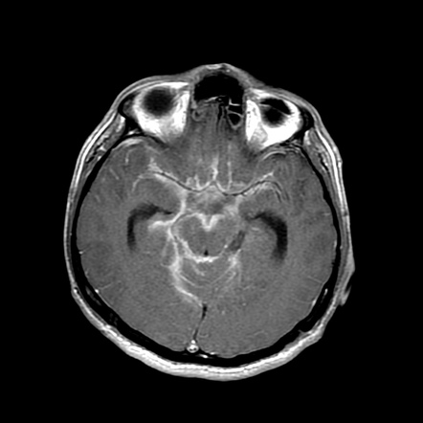
Tuberculosis Meningitis
Presentation of tuberculosis is influenced by the degree of immunodeficiency
PWH CD4>200 presents similarly to those without HIV
Meningitis, and other extrapulmonary TB, is more common in PWH with CD4<200
IGRA may be reactive or indeterminant
Chest imaging may be abnormal
Brain MRI with contrast: prominent leptomeningeal and basal cistern enhancement, ventricular dilation due to hydrocephalus, infarction
Image: https://radiopaedia.org/
https://clinicalinfo.hiv.gov/en/guidelines/hiv-clinical-guidelines-adult-and-adolescent-opportunistic-infections/
Notes:
Steroids also used in TB pericardium.
About 50% those with TB-IRIS meningitis will develop IRIS (Chang et al)
Study in Vietnam¹: No delay vs 2mo delay; Overall mortality 58%, severe adverse events 90% (may not be generalizable)
IDSACDC/ATS guidelines recommend pts with TB meningitis should not start ART before 8 weeks of TB tx is completed, regardless of CD4 count
Many experts recommend that PWH with TB meningitis, ART should be initiation within first 2-8 wks after starting anti-TB, opting for first 2 weeks in those with CD4 <50 in settings where close monitoring oof drug-related toxicities and CNS adverse events is feasible.
1. Torok ME et al. CID 2011;52(11):1374-83 2. http://aidsinfo.nih.gov/contentfiles/lvguidelines/adult_oi.pdf 3. Thwaites GE et al. NEJM 2004;351(17):1741-1751. 4. Pepper DJ et al. CID 2009;48(11):e96-07. 5. Meintjes G et al. AIDS 2010;24(15):2381-2390. 6. Manea E et al. Pneumologia 2015;64(4):32-6.

Slide 13
Tuberculosis Meningitis
CSF AFB culture and PCR
Treat with combination therapy x 9-12 months
Adjunctive corticosteroid improves survival for PWH with CNS tuberculosis
Dexamethasone taper over 12 weeks
Delay start of ART
Delay for 8-12 weeks
Some experts recommend earlier treatment, opting for first 2 weeks in those with CD4 <50 in settings where close monitoring of drug-related toxicities and CNS adverse events is feasible
https://clinicalinfo.hiv.gov/en/guidelines/hiv-clinical-guidelines-adult-and-adolescent-opportunistic-infections/
Notes:
About 50% those with TB-IRIS meningitis will develop IRIS (Chang et al)
Study in Vietnam¹: No delay vs 2mo delay; Overall mortality 58%, severe adverse events 90% (may not be generalizable)
IDSACDC/ATS guidelines recommend pts with TB meningitis should not start ART before 8 weeks of TB tx is completed, regardless of CD4 count
Many experts recommend that PWH with TB meningitis, ART should be initiation within first 2-8 wks after starting anti-TB, opting for first 2 weeks in those with CD4 <50 in settings where close monitoring oof drug-related toxicities and CNS adverse events is feasible.
1. Torok ME et al. CID 2011;52(11):1374-83 2. http://aidsinfo.nih.gov/contentfiles/lvguidelines/adult_oi.pdf 3. Thwaites GE et al. NEJM 2004;351(17):1741-1751. 4. Pepper DJ et al. CID 2009;48(11):e96-07. 5. Meintjes G et al. AIDS 2010;24(15):2381-2390. 6. Manea E et al. Pneumologia 2015;64(4):32-6.

Slide 14
Coccidioidomycosis Meningitis
Caused by dimorphic fungus found in endemic regions: Coccidioides immitis and Coccidioides posadasii
Risk increased and severity in PWH with CD4<250cells/mm³ and viremia
Headache, progressive lethargy
Coccidioidomycosis IgM & IgG enzyme immunoassay (EIA)
If reactive, antibody assays by immunodiffusion and by complement fixation should be obtained to firm result and for follow-up
Coccidioidomycosis antigen or PCR of CSF, CSF fungal cultures
https://clinicalinfo.hiv.gov/en/guidelines/hiv-clinical-guidelines-adult-and-adolescent-opportunistic-infections/
Notes:
Dimophic fungi that live in soil in endemic regions (U.S.= lower San Joaquin Valley and other arid regions in southern California, much of Arizona, southern Utah Nevada and NM, western TX, easter Washington)
Takes several weeks for antibodies to develop so serologies can be negative in early infection
Coccidiodomycosis antigen in CSF has very high sensitivity and specificity
Note that cocci PCR is commercially available but no FDA-approved nor testing in PWH

Slide 15
Coccidioidomycosis Meningitis
Treatment: fluconazole 400-800mg qday; lifelong suppressive therapy
Monitor for development of hydrocephalus as CSF shunting may be required
Monitor Cocci complement fixation antibody titer to assess response to therapy q12weeks
IRIS rare so delay in initiation of ART is not recommended
Although some experts suggest 4–6-week delay in those with CD4<100
Primary antifungal prophylaxis for those with negative serologic tests for Cocci is not recommended
Consider annual serologic testing for those who live in endemic areas and CD4<250
https://clinicalinfo.hiv.gov/en/guidelines/hiv-clinical-guidelines-adult-and-adolescent-opportunistic-infections/
Notes:
Intrathecal amphoteric B is used in refractory cases
Amphotericin B during first trimester pregnancy
Cocci complement fixation (CF) abx titer more than twofold rise suggests recurrence or worsening of clinical diseases and should prompt reassessment of management

Slide 16
References
Panel on Opportunistic Infections in HIV-Infected Adults and Adolescents. http://aidsinfo.nih.gov/contentfiles/lvguidelines/adult_oi.pdf
Bowen, LN, et al. HIV-associated opportunistic CNS infections: pathophysiology, diagnosis, and treatment. Nat Rev Neurol. 2016; 12(11):662-674.
Zolopa, A et al. Early Antiretroviral Therapy Reduces AIDS Progression/Death in Individuals with Acute Opportunistic Infections: A Multicenter Randomized Strategy Trial (ACTG A5164 study). PLoS ONE. 2009;4(5):e5575.
Meya D et al. The immunopathogenesis of cryptococcal IRIS: understanding a conundrum. Curr Opin Infect Dis 2016;29:10-22.

Slide 17
Resources
National Clinician Consultation Center http://nccc.ucsf.edu/
HIV Management
Perinatal HIV
HIV PrEP
HIV PEP line
HCV Management
Substance Use Management
Present case on ECHO http://echo.unm.edu hivecho@salud.unm.edu
AETC National HIV Curriculum https://aidsetc.org/nhc
AETC National Coordinating Resource Center https://targethiv.org/library/aetc-national-coordinating-resource-center-0
HIVMA Resource Directory https://www.hivma.org/globalassets/ektron-import/hivma/hivma-resource-directory.pdf
Additional trainings scaetcecho@salud.unm.edu
www.scaetc.org
Notes:
Find additional ECHO sessions in your area: https://echo.unm.edu/locations-2/echo-hubs-superhubs-united-states/
https://hsc.unm.edu/echo/get-involved/join-an-echo/
IDEA Platform: Infectious Diseases Education & Assessment. https://idea.medicine.uw.edu/
AETC National HIV Curriculum: 6 core modules for self study; regularly updated; CME, CNE
Hepatitis C Online Curriculum: https://www.hepatitisc.uw.edu/
Hepatitis B Online Curriculum: https://www.hepatitisb.uw.edu/
National STD Curriculum: https://www.std.uw.edu/

Slide 18
South Central AIDS Education & Training Center

