Slide 1
HIV and Aging
Michelle Lewis, PharmD, BCPS, AAHIVP
Clinical Associate Professor
Co-Clinical Director SCAETC at OUHSC
Notes:
Version date_11/2023
Target participants: Physicians

Slide 2
Conflict of Interest Disclosure Statement
Presenter has no relevant financial relationships or affiliations with commercial interests to disclose
This program is supported by the Health Resources and Services Administration (HRSA) of the U.S. Department of Health and Human Services (HHS) as part of an award totaling $4,205,743 with 0% financed with non-governmental sources. The contents are those of the author(s) and do not necessarily represent the official views of, nor does mention of trade names, commercial practices, or organizations imply an endorsement by HRSA, HHS, or the U.S. Government. For more information, please visit HRSA.gov. Any trade/brand names for products mentioned during this presentation are for training and identification purposes only.

Slide 3
Use of Trade/Brand Names
This program is supported by the Health Resources and Services Administration (HRSA) of the U.S. Department of Health and Human Services (HHS) as part of an award totaling $4,205,743, with 0% financed with non-governmental sources.
The views expressed do not necessarily reflect the official policies of the Department of Health and Human Services, nor does mention of trade names, commercial practices, or organizations imply endorsement by the U.S. Government.
Any trade/brand names for products mentioned during this presentation are for training and identification purposes only.
Notes:
NOTE: THIS SLIDE MUST BE INCLUDED IF TRADE AND/OR BRAND NAMES FOR MEDICATIONS ARE USED IN THE PRESENTATION.
IT MAY BE DELETED IF THERE IS NO REFERENCE TO TRADE NAMES, INCLUDING PRESENTATIONS IN WHICH ONLY GENERIC MEDICATION NAMES ARE MENTIONED.
TRADE NAMES MUST BE PUT IN PARENTHESES AFTER THE GENERIC NAME THE FIRST TIME IT IS MENTIONED - E.G., FLUOXETINE (PROZAC). TRADE NAMES SHOULD ONLY BE MENTIONED FOR THE INITIAL REFERENCE AND THE GENERIC NAME ONLY SHOULD BE USED AFTER THAT. THIS APPLIES EQUALLY TO ALL MEDICATIONS OR PRODUCTS MENTIONED IN THIS PRESENTATION.

Slide 4
Unconscious Bias Disclosure
SCAETC recognizes that language is constantly evolving, and while we make every effort to avoid bias and stigmatizing terms, we acknowledge that unintentional lapses may occur in our presentations.
We value your feedback and encourage you to share any concerns related to language, images, or concepts that may be offensive or stigmatizing.
Your input will help us refine and improve our presentations, ensuring they remain inclusive and respectful to participants.

Slide 5
Learning Objectives
Compare estimated life expectancy for a person with HIV (PWH) in the early epidemic to now.
Describe the epidemiology of the HIV epidemic based on people over 50 years of age.
Analyze the aging process with HIV as it affects occurrence of comorbidities.

Slide 6
Introduction

Slide 7
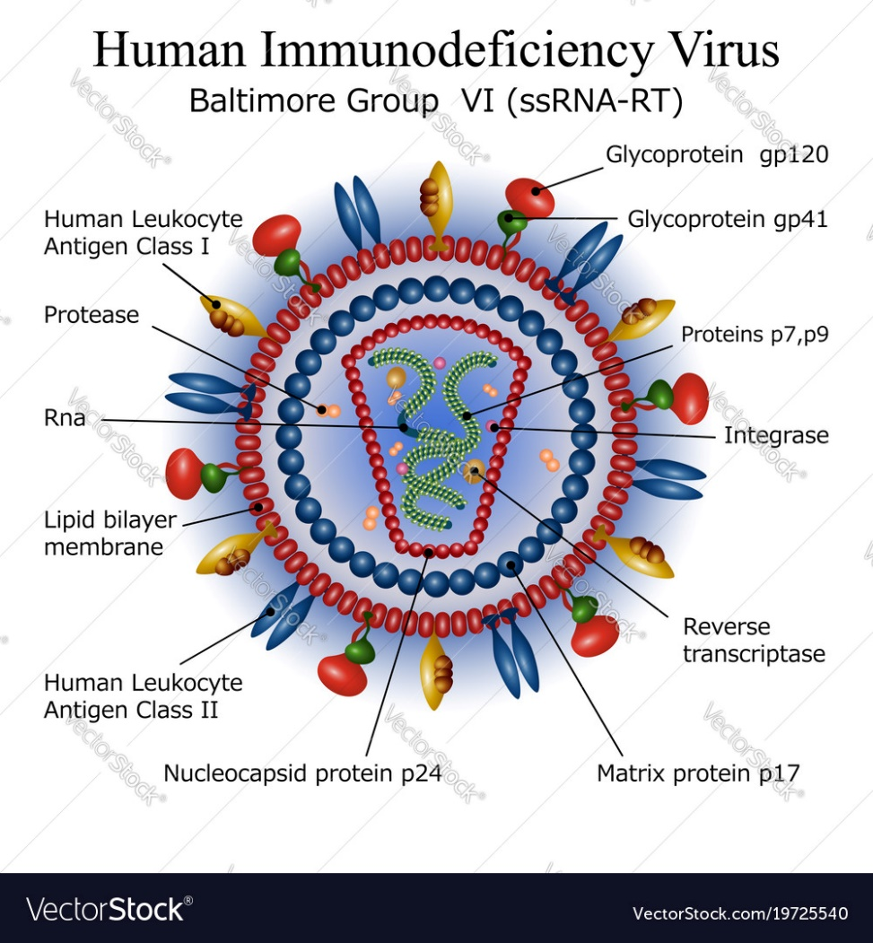
Human Immunodeficiency Virus (HIV)
HIV: single-stranded RNA virus that infects (CD4)-receptor positive cells
HIV infection: a person having a chronic infection caused by HIV
Stage 3 HIV/ AIDS (Acquired Immunodeficiency Syndrome): clinical diagnosis indicating advanced stage HIV infection
https://www.hiv.gov/hiv-basics/overview/about-hiv-and-aids/what-are-hiv-and-aids
https://www.vectorstock.com/royalty-free-vector/diagram-of-hiv-virus-particle-structure-vector-19725540
Notes:
AIDS - persons with a depleted immune system and at risk for opportunistic infections

Slide 8
Disease Progression Markers
CD4 cell count
Measure of immunodeficiency from HIV
Normal range: 500-1500 cells/µL
Determines stage of HIV (Stage 1 CD4>500)
HIV RNA
Measure of viral activity – how busy is the virus making copies of itself
Correlates with how quickly the immune system may be depleted
Used to determine response to antiretroviral therapy (controlled versus uncontrolled)

Slide 9
HIV Natural History
Primary infection
1200
1100
1000
900
800
700
600
500
400
300
200
100
0
Possible acute HIV syndrome
Wide dissemination of virus
Seeding of lymphoid organs
Death
Opportunistic diseases
Clinical latency
1:512
1:256
1:128
1:64
1:32
1:16
1.8
1.4
1.2
0
CD4 T Cells/mm³
Constitutional symptoms
Plasma Viremia Titer
0
3
6
9
12
1
2
3
4
5
6
7
8
9
10
11
Weeks
Years
Adapted from Ann Intern Med 1996;124:654
Notes:
Adapted from Ann Intern Med 1996;124:654
More importantly is this, the clinical process.

Slide 10
LIFE Expectancy

Slide 11
Survival With HIV/AIDS: The Way It Was
The first 505 patients with AIDS in San Francisco
Median survival: 11 months overall, 9 months in those with an Opportunistic Infection (OI)
Prospective cohort of 2,647 men with HIV in Baltimore, Chicago, Los Angeles, and Pittsburgh
Median survival time following AIDS onset
11.6 months in 1984-1985
19.5 months in 1988-1989
17.2 months in 1990-1991
The main impact was use of Trimethoprim/Sulfamethoxazole to prevent Pneumocystis pneumonia
Bacchetti et al. J Infect Dis. 1988;157(5):1044-7
Jacobson et al Am J Epidemiol. 1993;138(11):952-64
Notes:
Bacchetti et al. J Infect Dis. 1988;157(5):1044-7
Jacobson et al Am J Epidemiol. 1993;138(11):952-64
Trimethoprim/Sulfamethoxazole (TMP/SMX)= Bactrim

Slide 12
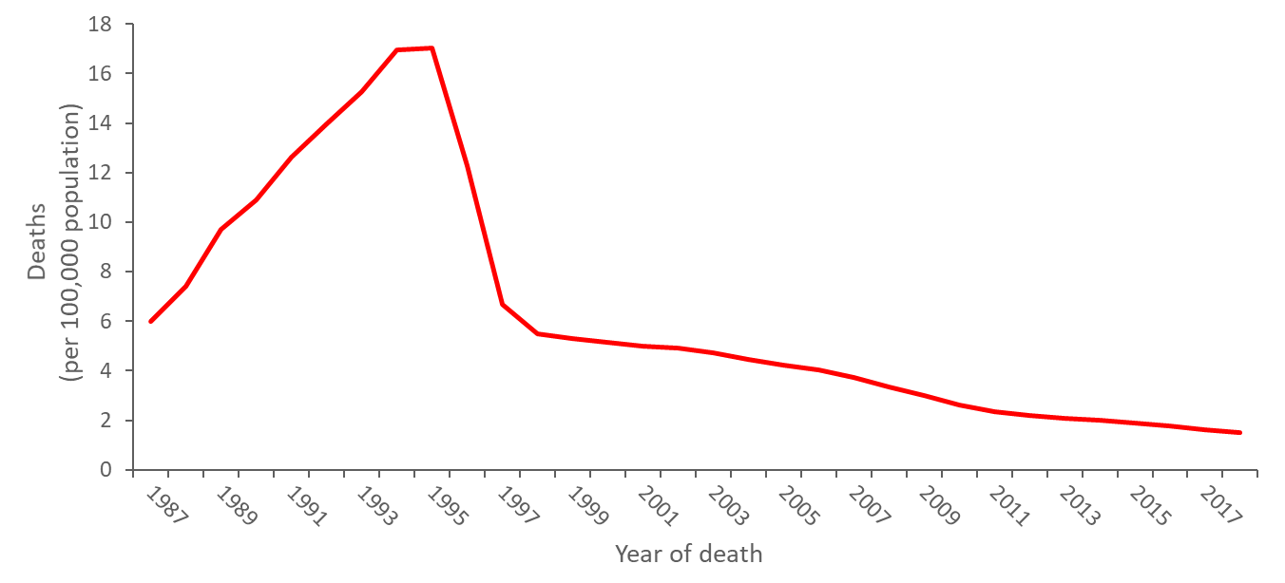
Annual age-adjusted rates of death with HIV infection as the underlying cause, 1987−2018, United States
https://www.cdc.gov/hiv/pdf/library/slidesets/cdc-hiv-surveillance-mortality-2018.pdf
Notes:
https://www.cdc.gov/hiv/pdf/library/slidesets/cdc-hiv-surveillance-mortality-2018.pdf

Slide 13
Life Expectancy 2000-2007
Illustration from National HIV Curriculum – www.hiv.uw.edu
Samji H, Cescon A, Hogg RS, et al. Closing the gap: increases in life expectancy among treated HIV-positive individuals in the United States and Canada. PLoS One. 2013;8:e81355.
Notes:
North American AIDS Cohort Collaboration on Research and Design (NA-ACCORD)
Cohort analysis
Approximately 23,000 individuals contributing 82,000 person-years with 1600 deaths
Life expectancy increased from 36.1 to 51.4 from 2002 to 2007.
Life expectancy was lower for individuals with a history of injection drug use, non-whites, and in patient with baeline CD4 counts <350 cells/mm3.

Slide 14
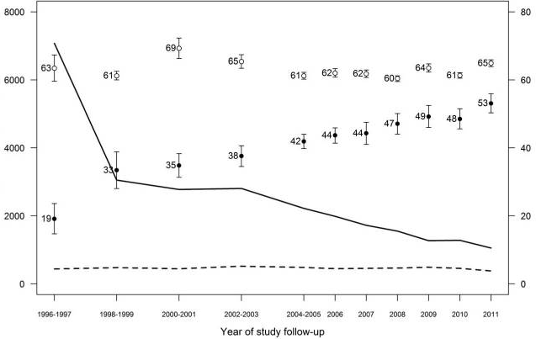
Life Expectancy 1996 to 2011
HIV^{neg}
HIV^{neg}
Deaths per 10⁵ person-years
Life expectancy at age 20
HIV^{pos}
HIV^{pos}
Marcus J, et al. Narrowing the gap in life expectancy between HIV-infected and HIV-uninfected individuals with access to care. JAIDS. 2016;73(1):39-46
Notes:
Marcus et al., J Acquir Immune Defic Syndr. 2016
Sep 1;73(1):39-46.
Study conducted on a population of patietns erroled in Kaiser-Permanente care between 1996 and 2011. Enrolled 24,768 people with HIV and 257,600 HIV negative controls.
Left side looks at deaths
Right side looks at life expectancy at age 20
The bottom illustrates the time point

Slide 15
Life Expectancy after 2015
https://www.thelancet.com/journals/lanhiv/article/PIIS2352-3018%2823%2900028-0/fulltext
Trickey A, et al. Life expectancy after 2015 of adults with HIV on long-term antiretroviral therapy in Europe and North America: a collaborative analysis of cohort studies. Lancet HIV. 2023;10(5):E295-E307
Notes:
Most recently a cohort analysis was published earlier this year looking at life expectancy after 2015.
This study found that life expectancy significantly increased across all groups, but for those with higher CD4 counts (>500) the difference between HIV infected and HIV uninfected was much smaller
Women with HIV >500
on ART at start of followup (2015) was 5.6 years shorter
started AR after 2015 was 3.8 years shorter
Men with HIV >500
on ART at start of followup (2015) was 2.7 year shorter
started ART after 2015 was 1.5 years shorter
For those with low CD4 cell counts 1 year after starting ART, estimated life expectancy could be up to 30 years lower than the general population.

Slide 16
Summary
Antiretroviral therapy (ART) significantly increases life expectancy in person with HIV infection
People who start ART with higher CD4 counts (>500) have significantly increased life expectancy over those who start with low CD4 counts
Getting people diagnosed early in infection and on ART will ultimately contribute to increased life expectancy

Slide 17
Epidemiology

Slide 18
Persons Living with HIV in the US
Graph from National HIV Curriculum – www.hiv.uw.edu
Centers for Disease Control and Prevention. Estimated HIV Incidence and Prevalence in the United States, 2017–2021. HIV Surveillance Supplemental Report. 2023;28(3). Published May 2023
Notes:
Estimate of diagnosed and undiagnosed HIV

Slide 19
Persons with HIV by Age – US 2021
Graph from National HIV Curriculum – www.hiv.uw.edu
Centers for Disease Control and Prevention. Estimated HIV Incidence and Prevalence in the United States, 2017–2021. HIV Surveillance Supplemental Report. 2023;28(3). Published May 2023

Slide 20
HIV prevalence in the US in 2021
Graph from National HIV Curriculum – www.hiv.uw.edu
Centers for Disease Control and Prevention. Diagnoses of HIV infection in the United States and dependent areas, 2021. HIV Surveillance Report, 2021; vol. 34. Published May 2023.
Notes:
Diagnosed HIV
The percentage of people >50 living with HIV has steadily increased over time since the introduction of effective therapy
2018 – 50.6%

Slide 21
New HIV Diagnosis - US
Graph from National HIV Curriculum – www.hiv.uw.edu
Centers for Disease Control and Prevention. Diagnoses of HIV infection in the United States and dependent areas, 2021. HIV Surveillance Report, 2021; vol. 34. Published May 2023.

Slide 22
New HIV Diagnosis by Age – US 2021
≥ 50 = 16%
Graph from National HIV Curriculum – www.hiv.uw.edu
Centers for Disease Control and Prevention. Diagnoses of HIV infection in the United States and dependent areas, 2021. HIV Surveillance Report, 2021; vol. 34. Published May 2023.
Notes:
People over 50 are also diagnosed with HIV infection for the first time.
This 16% has remained constant over past years

Slide 23
HIV Staging at Diagnosis
Illustration from National HIV Curriculum – www.hiv.uw.edu
Centers for Disease Control and Prevention. Revised surveillance case definition for HIV infection—United States, 2014. MMWR Recomm Rep. 2014;63(RR-03):1-10.

Slide 24
HIV Staging at Diagnosis
Illustration from National HIV Curriculum – www.hiv.uw.edu
Adapted from Ann Intern Med 1996;124:654
Centers for Disease Control and Prevention. Revised surveillance case definition for HIV infection—United States, 2014. MMWR Recomm Rep. 2014;63(RR-03):1-10.

Slide 25
Late Diagnosis
Graph from National HIV Curriculum – www.hiv.uw.edu
Centers for Disease Control and Prevention. Monitoring Selected National HIV Prevention and Care Objectives by Using HIV Surveillance Data United States and 6 Dependent Areas, 2021. HIV Surveillance Supplemental Report. 2023;28(No. 4). Published May 2023.
Notes:
This late diagnosis means that they have lower CD4 counts. This has implications on response to therapy and life expectancy as we have already discussed.

Slide 26
Global Trend for People with HIV >50
Autenrieth C, et al. Global and regional trends of people living with HIV aged 50 and over: Estimates and projections for 2000-2020. PLoS ONE. 2018;13(11):e0207005

Slide 27
Aging with HIV

Slide 28
Aging Process
Impact of HIV in aging is not entirely understood
Studies show persons with HIV have an increased risk of age-related medical comorbidities
Studies also show that these comorbidities likely have an earlier onset in persons with HIV
Accelerated versus accentuated aging
Budak J. HIV in Older Adults. National HIV Curriculum. Available at: https://www.hiv.uw.edu/go/key-populations/hiv-older-patients/core-concept/all. Updated August 2023

Slide 29
Accelerated vs Accentuated
Illustration from National HIV Curriculum – www.hiv.uw.edu
https://www.hiv.uw.edu/go/key-populations/hiv-older-patients/core-concept/all
Source: image based on model from: Pathai S, Bajillan H, Landay AL, High KP. Is HIV a model of accelerated or accentuated aging? J Gerontol A Biol Sci Med Sci. 2014;69:833-42.
Notes:
Accelerated – an age-related comorditity would occur at an earlier age in persons with HIV compared to those without HIV

Slide 30
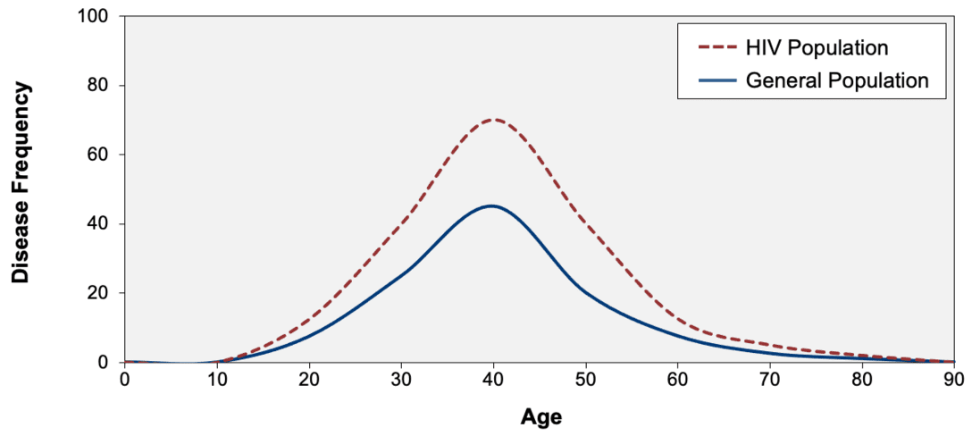
Accelerated vs Accentuated
Illustration from National HIV Curriculum – www.hiv.uw.edu
https://www.hiv.uw.edu/go/key-populations/hiv-older-patients/core-concept/all
Source: image based on model from: Pathai S, Bajillan H, Landay AL, High KP. Is HIV a model of accelerated or accentuated aging? J Gerontol A Biol Sci Med Sci. 2014;69:833-42.
Notes:
Accentuated aging – an age-related comorbidity would occur more commonly at all ages in persons with HIV compared to those without HIV

Slide 31
Accelerated and Accentuated
Illustration from National HIV Curriculum – www.hiv.uw.edu
https://www.hiv.uw.edu/go/key-populations/hiv-older-patients/core-concept/all
Source: image based on model from: Pathai S, Bajillan H, Landay AL, High KP. Is HIV a model of accelerated or accentuated aging? J Gerontol A Biol Sci Med Sci. 2014;69:833-42.
Notes:
It is possible that both of these models are occurring simultaneously where conditions would occur at an earlier age and at a higher rate.

Slide 32
Accelerated vs Accentuated
Accelerated
Studies have found that adults with HIV have immune profiles that mimic those found in older adults without HIV
HIV-related immune dysfunction and chronic inflammation cause earlier aging of the immune system
This is more pronounced in patient with detectable HIV RNA, but still persists even in patients with optimally treated HIV
Accentuated
Studies show adults with HIV are at increased risk of comorbidities, but these conditions occur at similar ages in adults with and without HIV
Budak J. HIV in Older Adults. National HIV Curriculum. Available at: https://www.hiv.uw.edu/go/key-populations/hiv-older-patients/core-concept/all. Updated August 2023

Slide 33
Chronic disease onset among people living with HIV in a large private insurance claims dataset
Evaluated the magnitude of association of HIV infection on developing chronic conditions.
Controlled for:
Demographics
Behavioral risk factors
Chronic comorbidities
Compared chronic disease risks between those with HIV and those without HIV for:
Diabetes
Hypertension
Stroke
Cancers
Lung diseases
Cardiovascular diseases
Cognitive impairment
Yang H,et al. Chronic Disease Onset Among People Living with HIV and AIDS in a Large Private Insurance Claims Dataset. Scientific Reports volume 9, article number 18514 (2019)

Slide 34
Chronic disease onset among people living with HIV in a large private insurance claims dataset
Interval | Diabetes | Hypertension | Stroke | Cancer | Lung Disease | Cardiovascular Disease | Cognitive Impairment/ Dementia
2-year | 1.30 | 1.13 | 1.28 | 1.44 | 1.26 | 1.30 | 1.66
 | (1.19–1.42) | (1.06–1.20) | (1.16–1.40) | (1.31–1.58) | (1.19–1.34) | (1.20–1.40) | (1.48–1.86)
5-year | 1.44 | 1.22 | 1.43 | 1.44 | 1.25 | 1.38 | 1.56
 | (1.33–1.57) | (1.13–1.31) | (1.30–1.57) | (1.31–1.58) | (1.17–1.34) | (1.28–1.49) | (1.40–1.72)
10-year | 1.45 | 1.36 | 1.45 | 1.37 | 1.33 | 1.37 | 1.73
 | (1.24–1.70) | (1.17–1.58) | (1.22–1.73) | (1.15–1.64) | (1.16–1.52) | (1.19–1.58) | (1.44–2.08)
Conclusions
HIV status is significantly associated with higher levels for all chronic illnesses examined
Yang H,et al. Chronic Disease Onset Among People Living with HIV and AIDS in a Large Private Insurance Claims Dataset. Scientific Reports volume 9, article number 18514 (2019)

Slide 35
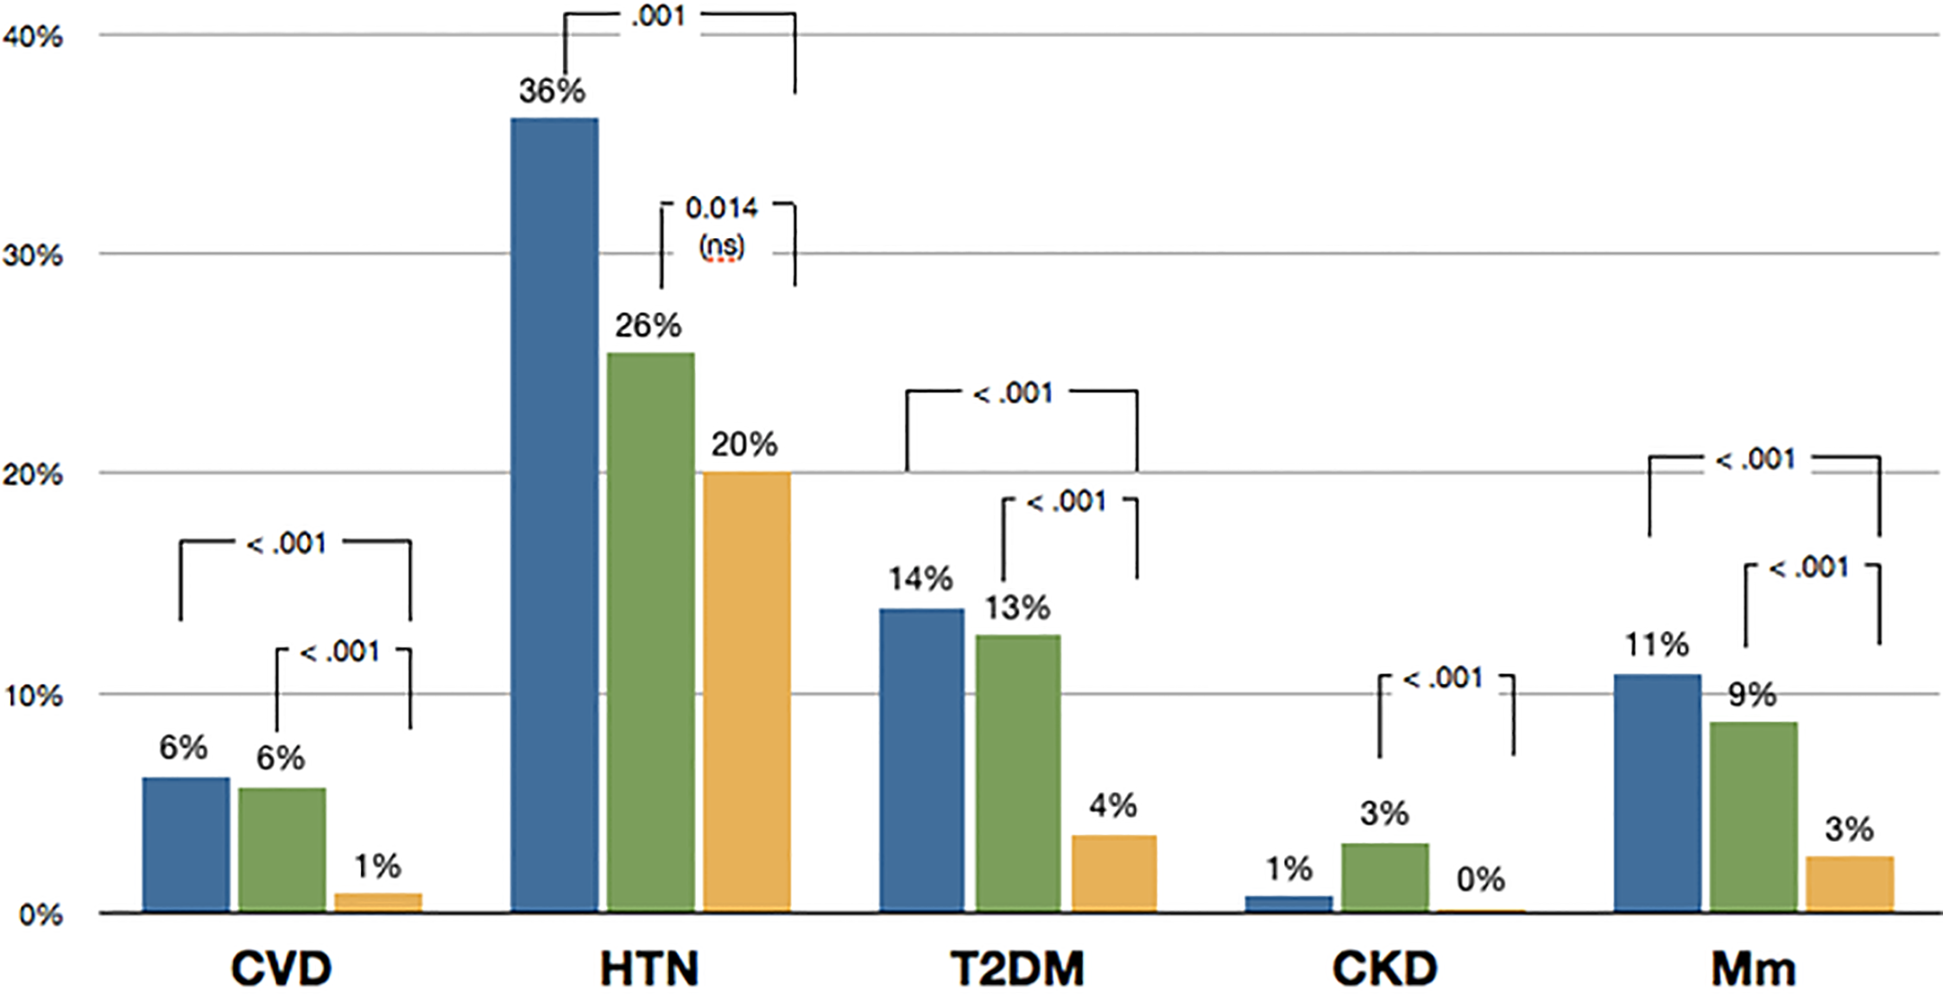
Prevalence of medical co-morbidities in Italian age-matched cohorts of PWH on ART and those without HIV
PWH ≥20.6 yrs (n= 404)
PWH <11.3 yrs (n= 404)
People without HIV (n= 2424)
Prevalence's of Co- and Multi-morbidities (Mm)
https://journals.plos.org/plosone/article?id=10.1371/journal.pone.0118531
Guaraldi G, et al. Aging with HIV vs HIV Seroconversion at Older Age: A Diverse Population with Distinct Comorbidity Profiles. PLOS ONE. 2015;10(4);e0118531
Notes:
PWH=people with HIV
ART=antiretroviral therapy
CVD=cardiovascular disease
HTN=hypertension
T2DM=type 2 diabetes mellitus
CKD=chronic kidney disease
Mm=multi-morbidities

Slide 36
Common Comorbidities
Cancer
Non-AIDS related malignancies
Cardiovascular disease
Diabetes mellitus
Osteoporosis
Liver disease
Renal disease
Testosterone deficiency
Frailty
Budak J. HIV in Older Adults. National HIV Curriculum. Available at: https://www.hiv.uw.edu/go/key-populations/hiv-older-patients/core-concept/all. Updated August 2023

Slide 37
Treatment Considerations

Slide 38
Antiretroviral Therapy (ART)
Department of Health and Human Services (DHHS) guidelines recommend ART for all persons with HIV regardless of CD4 count or age
Same HIV treatment regimens are recommended for older adults as younger adults living with HIV
ART improves outcomes in all people with HIV
ART prevents transmission of HIV
Budak J. HIV in Older Adults. National HIV Curriculum. Available at: https://www.hiv.uw.edu/go/key-populations/hiv-older-patients/core-concept/all. Updated August 2023

Slide 39
Considerations
ART should be selected based on characteristics of each patient taking into account
Comorbidities
Access/cost
Adherence
Adverse effect profile
Drug interaction potential
Budak J. HIV in Older Adults. National HIV Curriculum. Available at: https://www.hiv.uw.edu/go/key-populations/hiv-older-patients/core-concept/all. Updated August 2023

Slide 40
Response
Virologic response
Equivalent virologic responses when compared to younger persons with HIV
Immunologic response
Less robust CD4 cell count responses compared to younger persons with HIV
Budak J. HIV in Older Adults. National HIV Curriculum. Available at: https://www.hiv.uw.edu/go/key-populations/hiv-older-patients/core-concept/all. Updated August 2023

Slide 41
Neurocognitive Disorder

Slide 42
HIV-Associated Neurocognitive Disorder (HAND)
Spectrum of dysfunction from mild impairment to severe dementia
Asymptomatic neurocognitive impairment (ANI)
Mild neurocognitive disorder (MND)
HIV-associated dementia (HAD)
Cognitive impairment must be acquired
Rule out treatable causes of memory impairment such as thyroid disease, B12 deficiency, medication side effects, syphilis, depression, and other illness
Estimated to occur in 14-28% of the population in higher-income countries with access to ART
Much higher rates in countries with poor ART access
Alford K, Vera J. Cognitive Impairment in people living with HIV in the ART era: A Review. Brit Med Bull. 2018:127(1):55-68.
Notes:
DHHS guidelines updated HIV and the older person with special admonition to realize that patients with HAND may have poorer adherence and overall Health outcomes
Heaton RK, Clifford DB, Franklin DR Jr, et al. HIV-associated neurocognitive disorders persist in the era of potent antiretroviral therapy: CHARTER Study. Neurology. 2010;75:2087-96.

Slide 43
HIV-Associated Neurocognitive Disorder (HAND)
Early infection of the Central Nervous System (CNS) is believed to contribute to development of HAND
Serve as ongoing reservoir for replication
Diagnosed using neuropsychological testing and functional status assessments
No definitive marker for diagnosis
No specific treatment
ART is the only method to prevent or delay progression, but it is ineffective in some patients
Effects survival, quality of life and everyday functioning
Alford K, Vera J. Cognitive Impairment in people living with HIV in the ART era: A Review. Brit Med Bull. 2018:127(1):55-68.

Slide 44
Summary
HIV treatment has become very effective
Patients are living long healthy lives
Unfortunately, people with HIV continue to have more health problems than those without HIV as they age
Providers need to implement preventative health interventions early
Care coordination is important for older people with HIV to address complex comorbidities, medication use, and possible neurocognitive issues
Notes:
-seen frequently (every 1-3 months)

Slide 45
State of Aging with HIV
When asked to describe aging with HIV in one work, more than 50% chose “challenging,” followed by the descriptors “difficult” and “complicated”
HealthHIV. Third Annual State of Aging with HIV National Survey. Available at: https://healthhiv.org/stateof/agingwithhiv/

Slide 46
References
Fauci A, et al. Immunopathogenic Mechanisms of HIV infection. Ann Intern Med. 1996;124(7):654-663. doi.org/10.7326/0003-4819-124-7-199604010-00006
Bacchetti P, et al. Survival Patterns of the First 500 Patients with AIDS in San Francisco. J Infect Dis. 1988;157(5):1044-7. doi.org/10.1093/infdis/157.5.1044
Jacobson L, et al. Changes in Survival after Acquired Immunodeficiency Syndrome (AIDS): 1984-1991. Am J Epidemiol. 1993;138(11):952-64. doi.org/10.1093/oxfordjournals.aje.a116815
Center for Disease Control and Prevention. HIV Mortality 2018 slide set. Available at: https://www.cdc.gov/hiv/pdf/library/slidesets/cdc-hiv-surveillance-mortality-2018.pdf
Samji H, Cescon A, Hogg RS, et al. Closing the gap: increases in life expectancy among treated HIV-positive individuals in the United States and Canada. PLoS One. 2013;8:e81355. doi.org/10.1371/journal.pone.0081355
Marcus J, et al. Narrowing the gap in life expectancy between HIV-infected and HIV-uninfected individuals with access to care. JAIDS. 2016;73(1):39-46. doi.org/10. 1097/QAI.0000000000001014

Slide 47
References
Trickey A, et al. Life expectancy after 2015 of adults with HIV on long-term antiretroviral therapy in Europe and North America: a collaborative analysis of cohort studies. Lancet HIV. 2023;10(5):E295-E307. doi.org/10.1016/ S2352-3018(23)00028-0
Centers for Disease Control and Prevention. Estimated HIV Incidence and Prevalence in the United States, 2017–2021. HIV Surveillance Supplemental Report. 2023;28(3). Published May 2023
Centers for Disease Control and Prevention. Diagnoses of HIV infection in the United States and dependent areas, 2021. HIV Surveillance Report, 2021; vol. 34. Published May 2023.
Centers for Disease Control and Prevention. Revised surveillance case definition for HIV infection—United States, 2014. MMWR Recomm Rep. 2014;63(RR-03):1-10.
Centers for Disease Control and Prevention. Monitoring Selected National HIV Prevention and Care Objectives by Using HIV Surveillance Data United States and 6 Dependent Areas, 2021. HIV Surveillance Supplemental Report. 2023;28(No. 4). Published May 2023.
Autenrieth C, et al. Global and regional trends of people living with HIV aged 50 and over: Estimates and projections for 2000-2020. PLoS ONE. 2018;13(11):e0207005. doi.org/10.1371/journal.pone.0207005

Slide 48
References
Budak J. HIV in Older Adults. National HIV Curriculum. Available at: https://www.hiv.uw.edu/go/key-populations/hiv-older-patients/core-concept/all. Updated August 2023
Pathai S, et al. Is HIV a model of accelerated or accentuated aging? J Gerontol A Biol Sci Med Sci. 2014;69:833-42. doi.org/10.1093/gerona/glt168
Yang H,et al. Chronic Disease Onset Among People Living with HIV and AIDS in a Large Private Insurance Claims Dataset. Scientific Reports volume 9, article number 18514 (2019). doi.org/10.1038/s41598-019-54969-3
Guaraldi G, et al. Aging with HIV vs HIV Seroconversion at Older Age: A Diverse Population with Distinct Comorbidity Profiles. PLOS ONE. 2015;10(4);e0118531. doi.org/10.1371/journal.pone.0118531
Alford K, Vera J. Cognitive Impairment in people living with HIV in the ART era: A Review. Brit Med Bull. 2018:127(1):55-68. doi.org/10.1093/bmb/ldy019
HealthHIV. Third Annual State of Aging with HIV National Survey. Available at: https://healthhiv.org/stateof/agingwithhiv/
https://www.hiv.gov/hiv-basics/overview/about-hiv-and-aids/what-are-hiv-and-aids
https://www.vectorstock.com/royalty-free-vector/diagram-of-hiv-virus-particle-structure-vector-19725540

Slide 49
Resources
National Clinician Consultation Center http://nccc.ucsf.edu/
HIV Management
Perinatal HIV
HIV PrEP
HIV PEP line
HCV Management
Substance Use Management
Present on ECHO
https://hsc.unm.edu/scaetc/programs-services/echo.html​
AETC National HIV Curriculum https://aidsetc.org/nhc
AETC National Coordinating Resource Center https://targethiv.org/library/aetc-national-coordinating-resource-center-0
HIVMA Resource Directory https://www.hivma.org/globalassets/ektron-import/hivma/hivma-resource-directory.pdf
Additional trainings scaetcecho@salud.unm.edu
www.scaetc.org
Notes:
IDEA Platform: Infectious Diseases Education & Assessment. https://idea.medicine.uw.edu/
AETC National HIV Curriculum: 6 core modules for self study; regularly updated; CME, CNE
Hepatitis C Online Curriculum: https://www.hepatitisc.uw.edu/
Hepatitis B Online Curriculum: https://www.hepatitisb.uw.edu/
National STD Curriculum: https://www.std.uw.edu/

Slide 50
SCAETC Social Media

