Slide 1
Youth And HIV Prevention
Tat Yau, MD, MPH
LSU Infectious Diseases
tyau@lsuhsc.edu
Notes:
Version date_04 2023

Slide 2
Conflict of Interest Disclosure Statement
I, Tat W Yau, have no conflict of interest to disclose.

Slide 3
Use of Trade/Brand Names
This program is supported by the Health Resources and Services Administration (HRSA) of the U.S. Department of Health and Human Services (HHS) as part of an award totaling $3,132,205, with 0% financed with non-governmental sources.
The views expressed do not necessarily reflect the official policies of the Department of Health and Human Services, nor does mention of trade names, commercial practices, or organizations imply endorsement by the U.S. Government. Any trade/brand names for products mentioned during this presentation are for training and identification purposes only.
Notes:
NOTE: THIS SLIDE MUST BE INCLUDED IF TRADE AND/OR BRAND NAMES FOR MEDICATIONS ARE USED IN THE PRESENTATION.
IT MAY BE DELETED IF THERE IS NO REFERENCE TO TRADE NAMES, INCLUDING PRESENTATIONS IN WHICH ONLY GENERIC MEDICATION NAMES ARE MENTIONED.
TRADE NAMES MUST BE PUT IN PARENTHESES AFTER THE GENERIC NAME THE FIRST TIME IT IS MENTIONED - E.G., FLUOXETINE (PROZAC). TRADE NAMES SHOULD ONLY BE MENTIONED FOR THE INITIAL REFERENCE AND THE GENERIC NAME ONLY SHOULD BE USED AFTER THAT. THIS APPLIES EQUALLY TO ALL MEDICATIONS OR PRODUCTS MENTIONED IN THIS PRESENTATION.

Slide 4
Learning Objectives
Identify risk factors for human immunodeficiency virus (HIV) infection for adolescent and young adults (AYA).
Discuss approaches to assess sexual health and other social history of AYA.
Initiate and manage preexposure prophylaxis for youth at higher risk for HIV acquisition.

Slide 5
HIV in the United States
37,000 new diagnosis in 2019
  21% were youth aged 13 to 24 years
30,365 new diagnosis in 2020
  20% were youth aged 13 to 24 years
  57% aged 13 to 34 years
  Data may be affected by COVID-19 pandemic
https://www.cdc.gov/hiv/statistics/overview/index.html

Slide 6
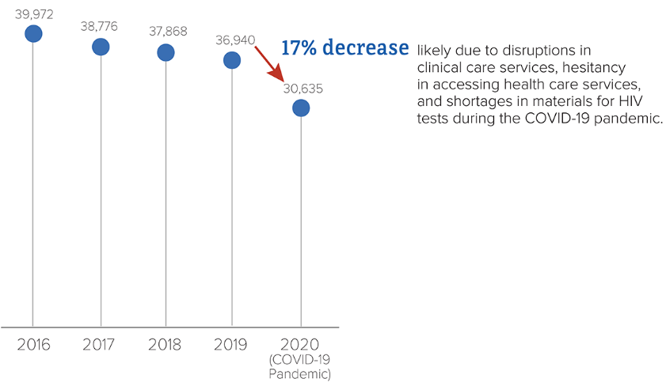
HIV diagnoses in the U.S. are declining
https://www.cdc.gov/hiv/library/reports/hiv-surveillance.html
Notes:
Centers for Disease Control and Prevention. HIV Surveillance Report, 2020; vol. 33. https://www.cdc.gov/hiv/library/reports/hiv-surveillance.html. Published May 2022. Accessed March 10, 2022.

Slide 7
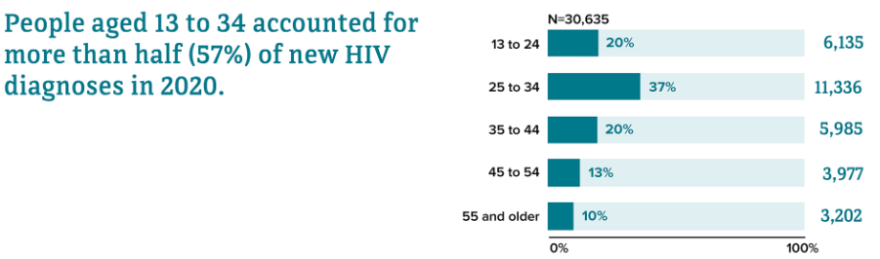
New HIV Diagnoses by Age
https://www.cdc.gov/hiv/library/reports/hiv-surveillance.html
Notes:
Centers for Disease Control and Prevention. HIV Surveillance Report, 2020; vol. 33. https://www.cdc.gov/hiv/library/reports/hiv-surveillance.html. Published May 2022. Accessed March 10, 2022.

Slide 8
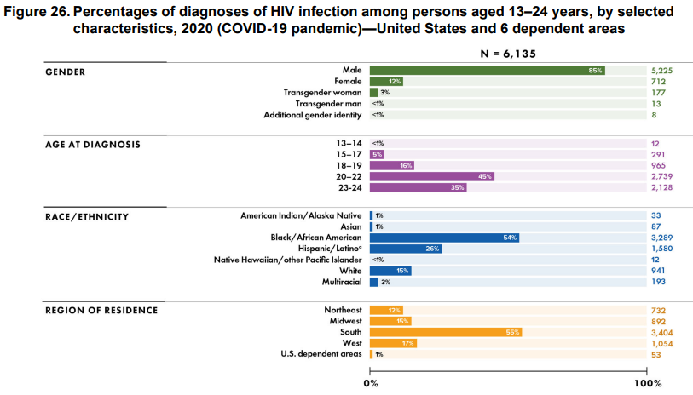
https://www.cdc.gov/hiv/library/reports/hiv-surveillance.html
Notes:
Centers for Disease Control and Prevention. HIV Surveillance Report, 2020; vol. 33. https://www.cdc.gov/hiv/library/reports/hiv-surveillance.html. Published May 2022. Accessed March 10, 2022.

Slide 9
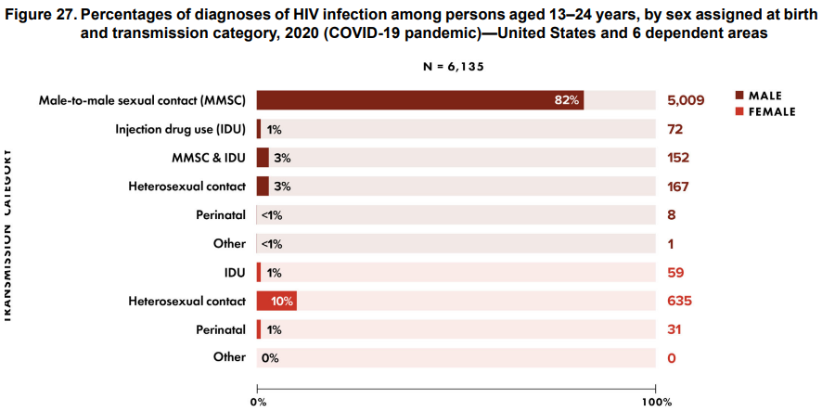
https://www.cdc.gov/hiv/library/reports/hiv-surveillance.html
Notes:
Centers for Disease Control and Prevention. HIV Surveillance Report, 2020; vol. 33. https://www.cdc.gov/hiv/library/reports/hiv-surveillance.html. Published May 2022. Accessed March 10, 2022.

Slide 10
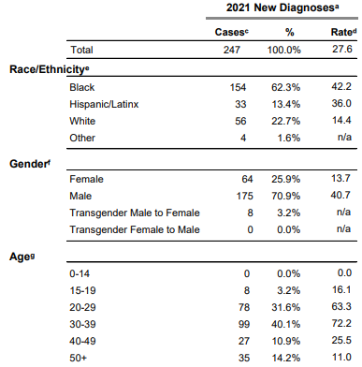
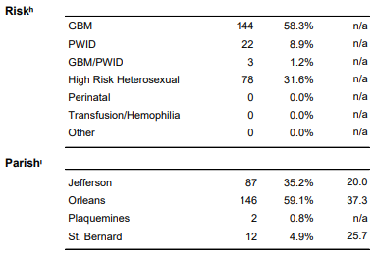
Regional Data – New Orleans 2021
https://ldh.la.gov/news/6720.
Notes:
Louisiana Department of Health. Region 1 (New Orleans) Data Tables – 2021. https://ldh.la.gov/news/6720. Published February 2023. Accessed March 10, 2022.

Slide 11
Youth At Higher Risk
Least likely to aware of HIV infection
  4 in 7 people not aware of infection
Less likely to be linked to care
Less likely to retain in care
Less likely to have viral suppression
  Estimated suppression rate of 30%
  54% of Louisiana youth living with HIV are virally suppressed
Brundrett, 2022

Slide 12
Persistent Disparities
Race/Ethnicity
Gender/Sexual Orientation
Geography
Brundrett, 2022

Slide 13
Strategies to HIV Prevention
Testing for HIV and sexually transmitted infections
Safe sex practice (condoms)
Needle exchange programs for people who inject drugs
Preexposure prophylaxis
Brundrett, 2022

Slide 14
“Getting Into Adolescent Heads”
HEADSS assessment:
  Home
  Education, Employment
  Activities
  Diet, Drugs (tobacco, vape, alcohol, recreational drugs)
  Suicidality/Depression
  Sexuality
  Safety (injury, violence)
Challenges
  Confidentiality
  Legal barriers to medical care
Goldenring and Rosen, 2008

Slide 15
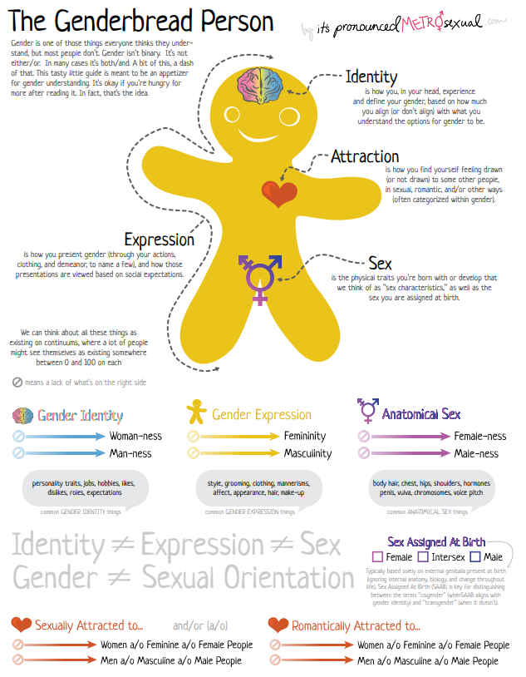
https://www.genderbread.org/resource/genderbread-person-v4-0

Slide 16
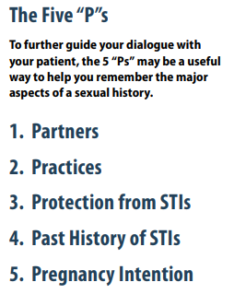
Guidance in Taking Sexual History
https://www.cdc.gov/std/treatment/SexualHistory.pdf

Slide 17
Preexposure Prophylaxis (PrEP)
Previous 2017 Guidance:
Men who have Sex With Men (MSM)
  Sexual partner with HIV
  Recent bacterial Sexually Transmitted Infections (STI)
  High number of sexual partners
  History of inconsistent condom use
  Commercial sex work
Heterosexual women/men
  Same as MSM, plus in high HIV prevalence area/network
People Who Inject Drugs (PWID)
  Injecting partner with HIV
  Sharing injection equipment
2021 Update:
Sexually active adults and adolescents who had anal or vaginal sex in the past 6 months AND any of the following:
  Sexual partner with HIV
  Bacterial STI in past 6 months
  History of inconsistent/no condom use with sexual partner(s)
PWID
  Injection partner with HIV OR sharing injecting equipment
https://www.cdc.gov/hiv/pdf/risk/prep/cdc-hiv-prep-guidelines-2021.pdf

Slide 18
PrEP Medications
Daily oral medications:
  Emtricitabine 200 mg/Tenofovir alafenamide 25 mg (Descovy®) oral daily
    Male, transgender women
  Emtricitabine 200 mg/Tenofovir disoproxil fumarate 300 mg (Truvada® or generic) oral daily
    Cisgender women, receptive vaginal intercourse, injection drug use
Cabotegravir 600 mg (Apretude®) intramuscular injection
  FDA approval in December 2021

Slide 19
PrEP Guideline - Youth
United States Preventative Task Force (USPSTF) recommends (grade “A”) that all adolescents (age ≥15 years) be screened for HIV
Clinicians should explicitly discuss any limits of confidentiality based on these local laws, regulations and policies and what methods will be used to assure confidentiality is maintained to the extent permitted
https://www.hivlawandpolicy.org/states
Notes:
As of 2020, all jurisdictions have laws that explicitly allow a minor of a particular age by state to:
Give informed consent to receive STI diagnosis and treatment, and/or prevention
Give informed consent to HIV testing, treatment, and/or prophylaxis, including pre-exposure prophylaxis (PrEP), or
Give informed consent to general health care, services, or procedures
All states and the District of Columbia permit minors to consent for testing and treatment of sexually transmitted infections without parenteral consent and many explicitly designate HIV as a sexually transmitted infection in the law with respect to parental consent
From a practical standpoint, it may be difficult for a minor to maintain the confidentiality since many states allow medical providers to disclose the minor’s treatment information to the parents and billing services often include information in the explanation of benefits and specific charges

Slide 20
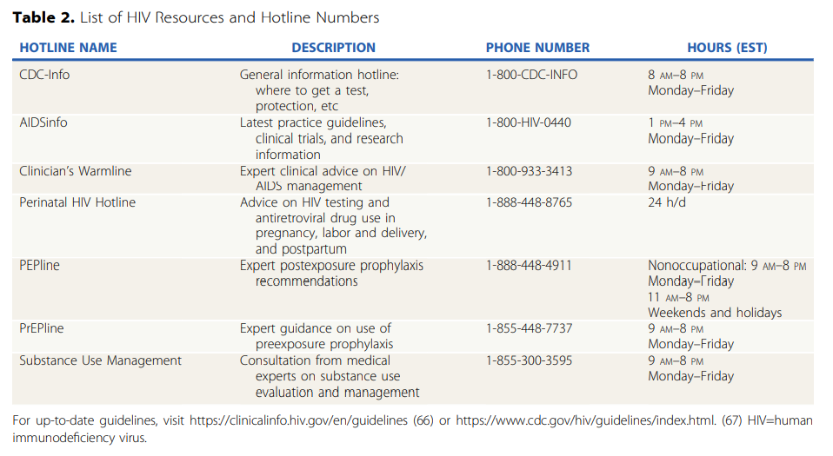

Slide 21
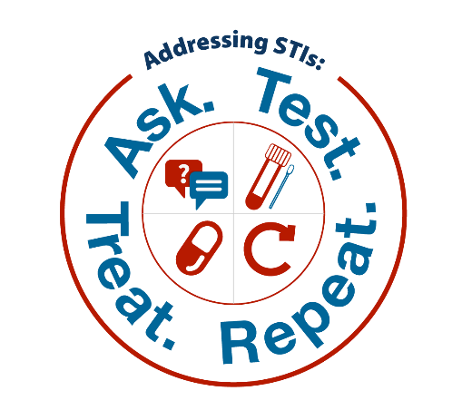
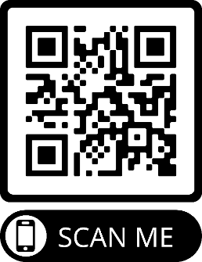
The Rutgers School of Nursing conducted a multi-year evaluative study, funded by the Health Resources and Services Administration HIV/AIDS Bureau and Bureau of Primary Health Care, on the implementation of evidence-based interventions to improve routine screening, testing, and treatment of common bacterial sexually transmitted infections (STIs) in HIV primary care clinics.
What's Included in Your Toolkit?
Materials detailing the interventions
Questions used in the self-administered sexual history
Tools for making a clinic space welcoming to LGBTQ+ clients
Tips for success to consider during implementation
Resources to give to clients to encourage follow-up visits

Slide 22
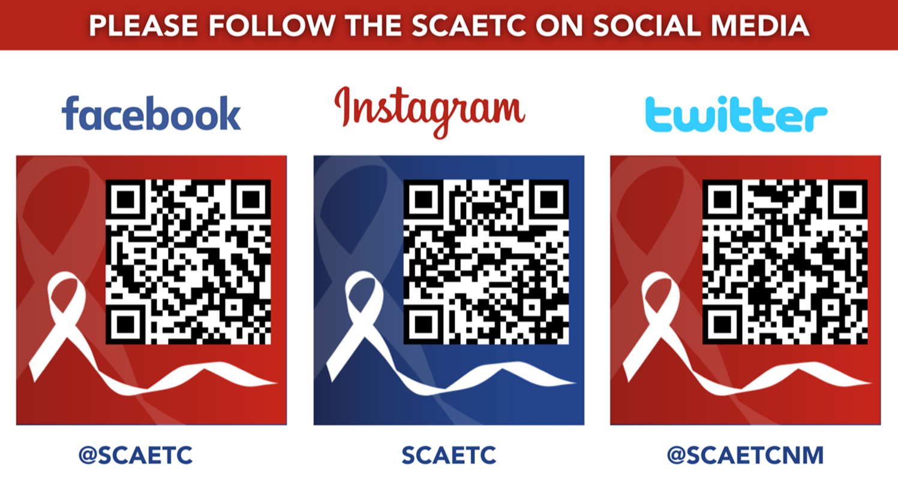
SCAETC Social Media Workgroup

Slide 23
Resources
National Clinician Consultation Center http://nccc.ucsf.edu/
  HIV Management
  Perinatal HIV
  HIV PrEP
  HIV PEP line
  HCV Management
  Substance Use Management
Present case on ECHO hivecho@salud.unm.edu https://hsc.unm.edu/scaetc/programs-services/echo.html
AETC National HIV Curriculum https://aidsetc.org/nhc
AETC National Coordinating Resource Center https://targethiv.org/library/aetc-national-coordinating-resource-center-0
HIVMA Resource Directory https://www.hivma.org/globalassets/ektron-import/hivma/hivma-resource-directory.pdf
Additional trainings SCAETC scaetcecho@salud.unm.edu www.SCAETC.org
Notes:
Find an HIV-related topic TeleECHO in your area: https://echo.unm.edu/locations-2/echo-hubs-superhubs-united-states/
IDEA Platform: Infectious Diseases Education & Assessment. https://idea.medicine.uw.edu/
AETC National HIV Curriculum: 6 core modules for self study; regularly updated; CME, CNE
Hepatitis C Online Curriculum: https://www.hepatitisc.uw.edu/
Hepatitis B Online Curriculum: https://www.hepatitisb.uw.edu/
National STD Curriculum: https://www.std.uw.edu/

Slide 24
If you are interested in other training opportunities, contact:
Dana Gray, SCAETC Program Director
LSU Health – New Orleans, School of Public Health
dgray@lsuhsc.edu or (504) 568-5647
Visit us at: https://hsc.unm.edu/scaetc/
or
https://sph.lsuhsc.edu/service/south-central-aetc/scaetc-events/

Slide 25
References
Brundrett ME. Human Immunodeficiency Virus Preexposure Prophylaxis in Adolescents and Young Adults. Pediatr Rev. 2022 Jan 1;43(1):28-36. doi: 10.1542/pir.2020-002048. PMID: 34970687.
Centers for Disease Control and Prevention. HIV Surveillance Report, 2020; vol. 33. https://www.cdc.gov/hiv/library/reports/hiv-surveillance.html. Published May 2022. Accessed March 10, 2022.
Centers for Disease Control and Prevention. Preexposure Prophylaxis For The Prevention Of HIV Infection In The United States – 2021 Update. 2021. https://www.cdc.gov/hiv/pdf/risk/prep/cdc-hiv-prep-guidelines-2021.pdf. Accessed March 10, 2022.
Emmanuel PJ, Mansfield J, Siberry GK. Human Immunodeficiency Virus Infection: An Update for Pediatricians. Pediatr Rev. 2022 Jun 1;43(6):335-346. doi: 10.1542/pir.2020-001644. PMID: 35641447.

Slide 26
References
Goldenring, J. Rosen, D. Getting into adolescent heads: An essential update. Contemporary Pediatrics. 2008.
Louisiana Department of Health. Region 1 (New Orleans) Data Tables – 2021. https://ldh.la.gov/news/6720. Published February 2023. Accessed March 10, 2022.
Katzenellenbogen, R. HEADSS: The “Review of Systems” for Adolescents. Virtual Mentor. 2005;7(3):231-233. doi: 10.1001/virtualmentor.2005.7.3.cprl1-0503.
Reno, H. Park, I. Workowski, K. Machefsky, A. Bachmann, L. A Guide to Taking a Sexual History. Centers for Disease Control and Prevention. 2022.
https://www.cdc.gov/hiv/policies/law/states/minors.html

