Slide 1
Disclosing HIV to Children/Adolescents
Chris Sinnock, LCSW & Megan Wilkins, PhD
St. Jude Children’s Research Hospital
( 1 )

Slide 2
Question for polling
Have you had experience disclosing HIV to a child/adolescent?
If so, how many sessions did it take to complete the disclosure?
1
2
3
more than 3
Show results?

Slide 3
Learning Objectives
Learner will be able to define types of disclosure of illness status to youth with HIV.
Learner will be able to discuss stages of disclosure of HIV status to youth.
Learner will be able to list special circumstances for consideration during process of disclosure of HIV to youth.
( 3 )

Slide 4
Disclosures of Conflicts of Interest
The presenters have no conflicts of interest disclosures.
This program is supported by the Health Resources and Services Administration (HRSA) of the U.S. Department of Health and Human Services (HHS) under grant number U1OHA30535 as part of an award totaling $4.2m. The contents are those of the author(s) and do not necessarily represent the official views of, nor an endorsement, by HRSA, HHS, or the U.S. Government. For more information, please visit HRSA.gov.
“Funding for this presentation was made possible by cooperative agreement U1OHA30535 from the Health Resources and Services Administration HIV/AIDS Bureau. The views expressed do not necessarily reflect the official policies of the Department of Health and Human Services nor does mention of trade names, commercial practices, or organizations imply endorsement by the U.S. Government. Any trade/brand names for products mentioned during this presentation are for training and identification purposes only.”
( 4 )
Notes:
The HRSA disclosures must remain as part of our grant requirements.

Slide 5
Disclosure Definitions
Full disclosure: Use of the words “HIV” or “AIDS” when explaining the diagnosis
Partial disclosure: Providing information about the disease process without using the words “HIV” or “AIDS”
Non-disclosure: No information; avoid explanation of reasons for taking medications and having frequent medical visits
Inadvertent disclosure: Overhearing diagnosis unintentionally during discussions between family members, medical team, etc.; reading about diagnosis after learning name of medication, etc.

Slide 6
American Academy of Pediatrics (1999)
Consider the child’s age, psychosocial maturity, family dynamics, and clinical context
Encourages the disclosure of HIV status to school-aged children over several visits
Recommends that adolescents know their HIV status
Generally consistent with WHO recommendation that youth with HIV know their status by 6-12 years of age (WHO, 2011)

Slide 7
Provider Barriers to Disclosure to Youth
Fear of negative outcomes
Lack of resources to disclose
Feel unprepared to have discussion
Caregiver resistance
Photo by Pixabay: https://www.pexels.com/photo/architecture-art-artwork-bench-206784/
Notes:
Initial sadness; less prevalent 1 week after disclosure event

Slide 8
Caregiver Concerns
Child’s maturity to manage secrecy due to stigma
Fear they may tell others
Psychological impact on the child (i.e., depression);
fear of stigma
Parental guilt regarding transmission
Child may become angry at the parent
Potential discussion about parent’s substance use,
sexual behaviors, etc.
Photo by Ketut Subiyanto: https://www.pexels.com/photo/photo-of-woman-sitting-on-couch-while-hugging-her-child-4473625/

Slide 9
Benefits of Disclosure
Maintain relationship with youth
Honest communication
Information is youth’s right and allows them to protect self/others
Improved health outcomes:
Long-term adherence (Bikaako-Kajura et al., 2006 & Cluver et al, 2015)
Viral suppression (Ferris et al, 2007) and
Retention in care (Arrive et al, 2012)

Slide 10
Disclosure of Diagnosis: Process vs. Event
Process can incorporate developmental changes over time regarding concepts related to diagnosis and illness
Build on information already presented
Allows for follow up with family to monitor response
Event implies a singular, one-time disclosure
Photo by Miguel Á. Padriñán: https://www.pexels.com/photo/photo-of-golden-cogwheel-on-black-background-3785926/

Slide 11
St. Jude Children’s Research Hospital Model
Includes the facilitation of the disclosure process with the assistance of a Child Life Specialist or Social Worker
Includes education of the caregiver regarding the process, assessment and intervention of parental concerns, and implementation of the process with the child in the caregiver’s presence
(Cantrell et al., 2013)

Slide 12
Initial Assessment
Individualized approach
Establish a timeline and clarify goals with the caregiver
Discuss caregiver or medical team concerns
Provide education regarding the process and stages
Show materials, give examples
Encourage reinforcement of education by caregiver
Photo by Antoni Shkraba: https://www.pexels.com/photo/woman-in-a-psychotherapy-session-7579190/

Slide 13
Staged Approach to Disclosure
Stages of disclosure
Breaks out topics and groups information together to present to family
Allows step-by-step process and emphasizes process approach to disclosure

Slide 14
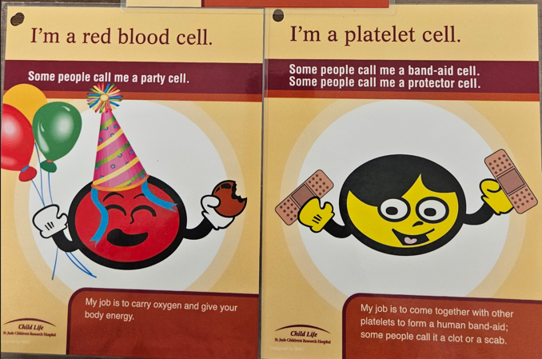
Stage 1: Blood Cells
White blood cells: “fighter cells”
Red blood cells: “party cells”
Platelets: “Band-Aid cells”
Child Life, St. Jude Children’s Research Hospital

Slide 15
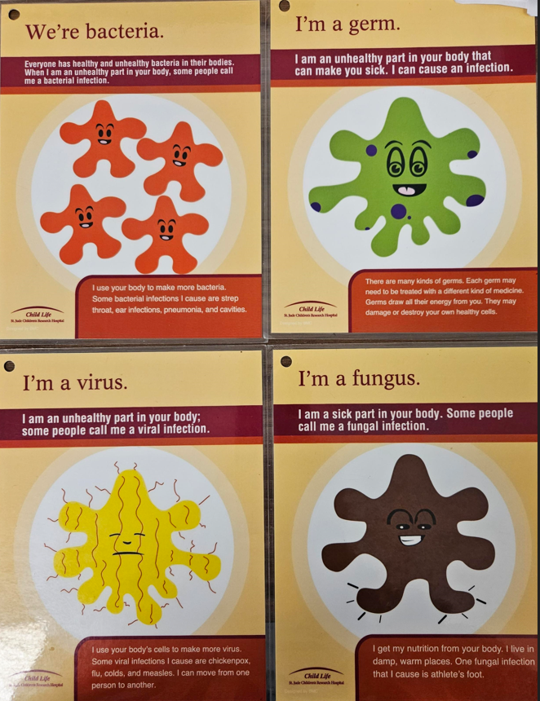
Stage 2: Germs and Infection
Bacteria
Viruses
Fungi
Child Life, St. Jude Children’s Research Hospital

Slide 16
Stage 3: Medications
Medications that “keep white blood cells strong”
Name(s) of medication
Photo by Anna Shvets: https://www.pexels.com/photo/tablets-on-pink-surface-3683044/

Slide 17
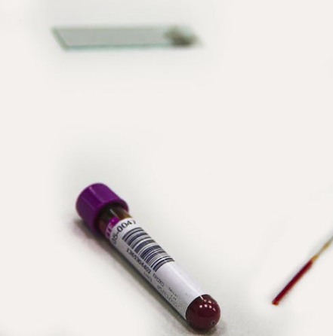
Stage 4: White Blood Cells
Types of WBCs (emphasizing lymphocytes)
Role of CD4 cells
Photo by roberto carrafa: https://www.pexels.com/photo/purple-and-white-plastic-bottle-3908178/

Slide 18
Interim Assessment (with Caregiver)
Review the timeline for full disclosure
Discuss caregiver concerns & relevant legal issues if applicable
Review the positive impact of disclosure for children
Photo by Polina Tankilevitch: https://www.pexels.com/photo/a-woman-having-a-therapy-session-with-a-psychologist-5234573/

Slide 19
Stage 5: Unhealthy Part
Introduction of child’s blood as unhealthy
Need for medications to help WBCs function better
Similar to “partial disclosure”
Allows for assessment of child’s reaction
Photo by Gustavo Fring: https://www.pexels.com/photo/photo-of-a-girl-looking-at-a-card-with-her-parents-7447259/

Slide 20
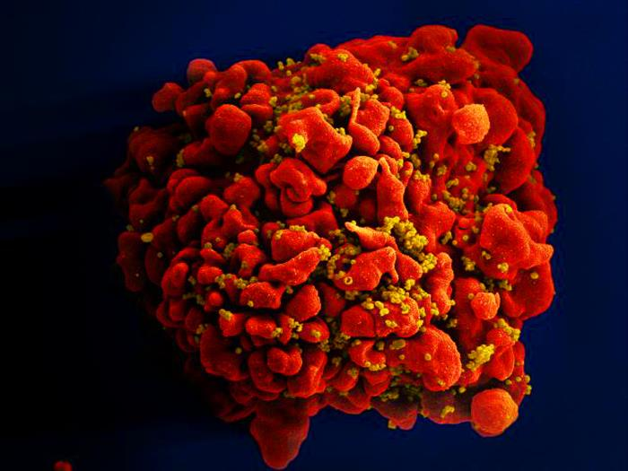
Stage 6: Virus
Unhealthy part that impacts WBCs is a virus
Review past concepts regarding blood cells and germs; how virus fits in
Introduce the concepts of viral load (amount of virus) and CD4 count
Teaching examples
NIAID: https://phil.cdc.gov/Details.aspx?pid=18143

Slide 21
Stage 7: More Virus
Stages 7- 9 completed at a
single visit
Born with a virus
Parent’s HIV infection
Photo by Daniel Reche: https://www.pexels.com/photo/person-s-tummy-and-hand-1556671/

Slide 22
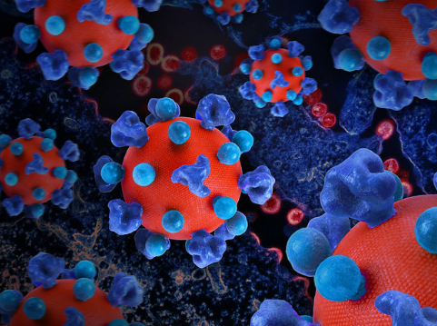
Stage 8: HIV
Review of past concepts
Inquire about the child’s awareness
of the name of the virus
Name of the diagnosis is “HIV”
https://www.flickr.com/photos/niaid/52536527476/

Slide 23
Stage 9: Privacy and Confidentiality
People who are HIV aware; people who are HIV unaware
Negative response by those who are unaware/uneducated
Identification of people with whom the child can discuss HIV
“inner circle”
Photo by Yaroslav Shuraev: https://www.pexels.com/photo/person-whispering-near-the-woman-s-ear-5085562/

Slide 24
Reassessment
Follow up regarding acquired knowledge
Explore emotional reaction; provide support and referrals as needed
Parent and child/adolescent
Reassessment should occur routinely over time

Slide 25
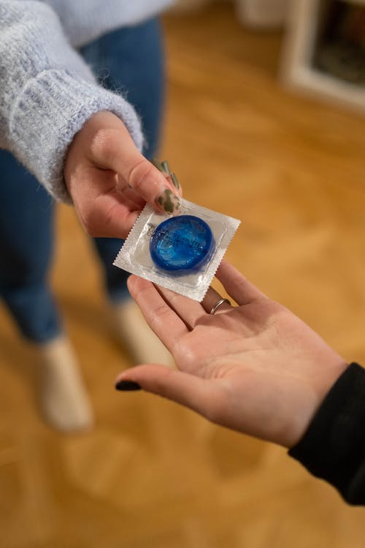
Stage 10: Transmission
Modes of transmission
Prepares for future prevention of sexual transmission
Photo by cotton-bro studio: https://www.pexels.com/photo/handing-out-blue-condom-6473745/

Slide 26
Summary
Disclosure should be a process, not a single event
Coping with provider and caregiver hesitation
Staged approach; led by caregiver input
Preparation is key
Resources to support

Slide 27
Resources
Research developed comic for educational purposes (publicly available):
https://phacsstudy.org/cms_uploads/Health%20Education%20and%20Communication%20Documents/What_is_HIV.pdf
Wright et al., 2017 – includes list of resources – peer-reviewed and not

Slide 28
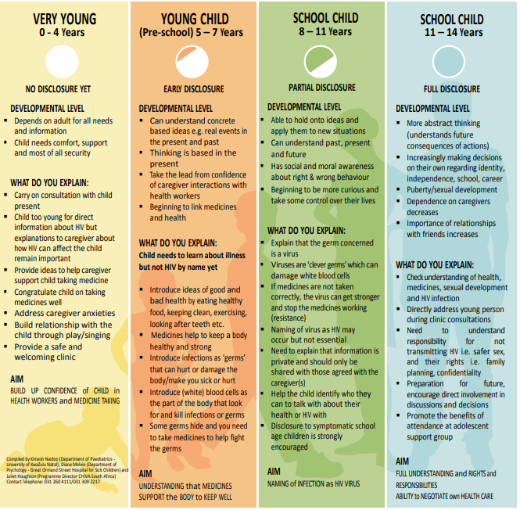
Example Resource
https://www0.sun.ac.za/southtosouth/toolkits/peads/Paediatric%20HIV%20Care%20and%20Treatment%20Toolkit.pdf

Slide 29
Thank You! Questions?
( 29 )

Slide 30
References
American Academy of Pediatrics, Committee on Pediatric AIDS. (1999). Disclosure of illness status to children and adolescents with HIV infection. Pediatrics, 103, 164-166.
Cantrell, K., Patel, N., Mandrell, B., & Grissom, S. (2013). Pediatric HIV disclosure: a process-oriented framework. AIDS Education and Prevention, 25(4), 302-314.
World Health Organization. (2011). Guideline on HIV disclosure counseling for children up to 12 years of age.
Vreeman RC, Nyandiko WM, Ayaya SO, Walumbe EG, Marrero DG, Inui TS. The perceived impact of disclosure of pediatric HIV status on pediatric antiretroviral therapy adherence, child well-being, and social relationships in a resource-limited setting. AIDS Patient Care STDS. 2010 Oct;24(10):639-49. doi: 10.1089/apc.2010.0079. PMID: 20836704; PMCID: PMC4696428.
Bikaako-Kajura W, Luyirika E, Purcell DW, Downing J, Kaharuza F, Mermin J, Malamba S, Bunnell R. Disclosure of HIV status and adherence to daily drug regimens among HIV-infected children in Uganda. AIDS Behav. 2006 Jul;10(4 Suppl):S85-93. doi: 10.1007/s10461-006-9141-3. PMID: 16791525.
Cluver LD, Hodes RJ, Toska E, Kidia KK, Orkin FM, Sherr L, Meinck F. 'HIV is like a tsotsi. ARVs are your guns': associations between HIV-disclosure and adherence to antiretroviral treatment among adolescents in South Africa. AIDS. 2015 Jun;29 Suppl 1:S57-65. doi: 10.1097/QAD.0000000000000695. PMID: 26049539.
Arrivé E, Dicko F, Amghar H, Aka AE, Dior H, Bouah B, et al. (2012) HIV Status Disclosure and Retention in Care in HIV-Infected Adolescents on Antiretroviral Therapy (ART) in West Africa. PLoS ONE 7(3): e33690. https://doi.org/10.1371/journal.pone.0033690
Ferris M, Burau K, Schweitzer AM, Mihale S, Murray N, Preda A, Ross M, Kline M. The influence of disclosure of HIV diagnosis on time to disease progression in a cohort of Romanian children and teens. AIDS Care. 2007 Oct;19(9):1088-94. doi: 10.1080/09540120701367124. PMID: 18058392.

Slide 31
AETC Program National Centers and HIV Curriculum
National Coordinating Resource Center – serves as the central web –based repository for AETC Program training and capacity building resources; its website includes a free virtual library with training and technical assistance materials, a program directory, and a calendar of trainings and other events. Learn more: https://aidsetc.org/
National Clinical Consultation Center – provides free, peer-to-peer, expert advice for health professionals on HIV prevention, care, and treatment and related topics. Learn more: https://nccc/ucsf.edu
National HIV Curriculum – provides ongoing, up –to-date HIV training and information for health professionals through a free, web –based curriculum; also provides free CME credits, CNE contact hours, CE contact hours, and maintenance of certification credits. Learn more: www.hiv.uw.edu
( 31 )
Notes:
This slide must remain as part of our funding requirements.

