Slide 1
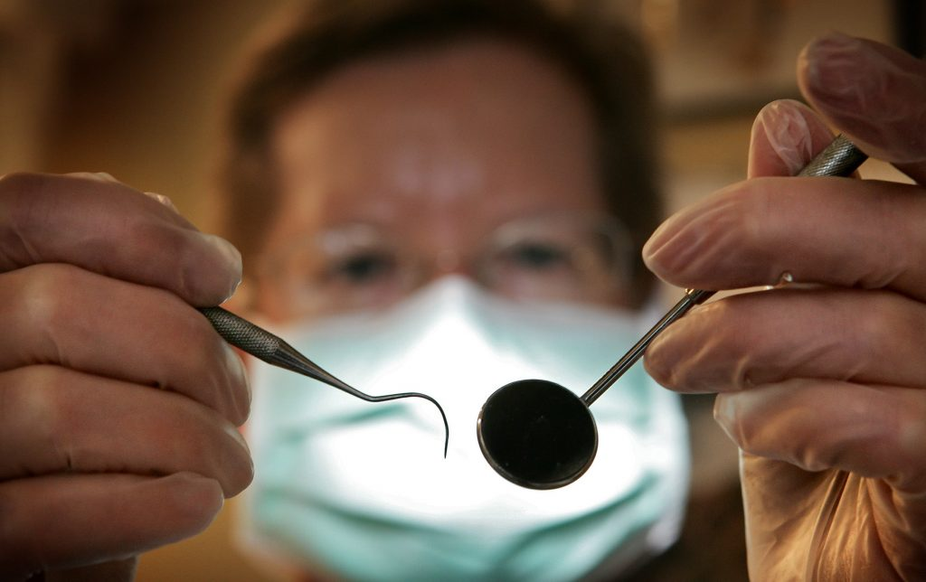
HIV and Oral Health 2023
Mark Schweizer, DDS MPH
Assistant Dean Community Programs and Public Health
Dental Director Southeast AETC
Nova southeastern University College of Dental Medicine

Slide 2
Faculty Disclosure
This program is supported by the Health Resources and Services Administration (HRSA) of the U.S. Department of Health and Human Services (HHS) under grant number U1OHA30535 as part of an award totaling $4.2m. The contents are those of the author(s) and do not necessarily represent the official views of, nor an endorsement, by HRSA, HHS, or the U.S. Government. For more information, please visit HRSA.gov.
“Funding for this presentation was made possible by cooperative agreement U1OHA30535 from the Health Resources and Services Administration HIV/AIDS Bureau. The views expressed do not necessarily reflect the official policies of the Department of Health and Human Services nor does mention of trade names, commercial practices, or organizations imply endorsement by the U.S. Government. Any trade/brand names for products mentioned during this presentation are for training and identification purposes only.”

Slide 3
Objectives
Explain the current discrepancies in oral health care.
Recognize the most commons comorbidities associated with oral health.
Describe the difference in HIV outcomes by geographic region and race/ethnicity.
Describe the frequency of oral lesions and the importance of recognizing oral lesions .
Explain how interprofessional practice can affect health outcomes.
List and explain oral health opportunities in interprofessional care.
Identify methods to screen patients for oral health care.
Demonstrate the steps in an intraoral extraoral exam.
Diagnose common oral lesions in patients with HIV.

Slide 4
Educational Need/Practice Gap
Gap =Engaging all patients in oral health care
Need = Improvement in health outcomes for patients engaged in oral health

Slide 5
Oral health: A window to your overall health
Your oral health is more important than you might realize. Learn how the health of your mouth, teeth and gums can affect your general health.
Like other areas of the body, your mouth teems with bacteria — mostly harmless. But your mouth is the entry point to your digestive and respiratory tracts, and some of these bacteria can cause disease.
Normally the body's natural defenses and good oral health care, such as daily brushing and flossing, keep bacteria under control. However, without proper oral hygiene, bacteria can reach levels that might lead to oral infections, such as tooth decay and gum disease.

Slide 6
Oral Health Care Access
Less than one half of the population gains access to the oral health care system
Major Oral Health Problems include dental caries, Periodontal Disease and Oral Cancer
Notes:
Good oral health is essential to overall health and well-being, but oral health problems are common. More than 4 in 5 people have had at least one cavity by age 34, and more than 2 in 5 adults have had mouth pain in the past year.1
And yet less than half of the population uses the oral health care system.2 Many common oral health problems like tooth decay, gum disease, and jaw disorders are preventable with regular oral care. But many people who need this care face barriers, which means they aren’t able to get the care they need.
The majority of oral health conditions are: dental caries (tooth decay), periodontal diseases, oral cancers, oral manifestations of HIV, oro-dental trauma, cleft lip and palate, and noma (severe gangrenous disease starting in the mouth mostly affecting children). Most oral health conditions are largely preventable and can be treated in their early stages. Oral health disparities refers to the existence of differences in the incidence, prevalence, mortality, and burden of oral diseases and other adverse health conditions, as well as the use of health care services, among specific population groups in the United States. Existence of disparities in oral health status, accessing and using the oral health care delivery system, and receiving treatment depending on gender, race or ethnicity, education, income, disability, geographic location, and sexual orientation have been documented.

Slide 7
Disparities
Oral Health Disparities in Adults Aged 65 or Older
Edentulism (complete tooth loss). Seventeen percent of older adults have lost all their teeth. Low-income older adults, those with less than a high school education, or those who are current smokers are more than 3 times as likely to have lost all of their teeth as adults with higher incomes, more than a high school education, or who have never smoked.
Disparities in Oral Cancer and Gum Disease
Adults and oral cancer. Head and neck cancers are more than twice as common among men as women.¹¹ The 5-year survival rate for oral pharyngeal (throat) cancers is lower among Black men (41%) than White men (62%).¹
Adults and gum (periodontal) disease. Forty-two percent of adults have some form of gum disease. Among adults aged 65 and older, the rate of gum disease increases to 60%.
Severe gum disease is most common among adults aged 65 or older, Mexican American and non-Hispanic Black adults, and people who smoke.
This Photo by Unknown Author is licensed under CC BY
Notes:
The nation’s oral health has greatly improved since the 1960s, but not all Americans have equal access to these improvements.¹ Some racial/ethnic and socioeconomic groups have worse oral health² as a result of the social determinants of health—conditions in the places where people are born, live, learn, work, and play.^{3, 4} For example, some groups of people:
Can’t afford to pay out of pocket for dental care, do not have private or public dental insurance, or can’t get time off from work to get to dental care.¹
Live in communities where they don’t have access to fluoridated water and school sealant programs, healthy foods, and public transportation to get to dental appointments.¹
Regular preventive dental care is essential for good oral health so one can find problems earlier when they are easier to treat, but many don’t get the care they need. More people are unable to afford dental care than other types of health care.⁵ In 2015, the percentage of people in the United States with no dental insurance was 29% overall and 62% for older adults.⁶ Traditional Medicare does not cover routine dental care, therefore many lose their benefits upon retirement.
In addition, many low-income adults do not have public dental insurance. Medicaid programs are not required to provide dental benefits to adult enrollees, so dental coverage varies widely from state to state. Currently, 15 states provide no coverage or only emergency coverage.⁷
Among working-age US adults, over 40% of low-income and non-Hispanic Black adults have untreated tooth decay.⁸ Untreated oral disease has a large impact on quality of life and productivity:
Over 34 million school hours were lost in the United States in 2008 because of unplanned urgent dental care.⁹
Over $45 billion is lost in productivity in the United States each year because of untreated oral disease.¹⁰
Nearly 18% of all working-age adults, and 29% of those with lower incomes, report that the appearance of their mouth and teeth affects their ability to interview for a job.¹¹

Slide 8
Solutions
Medicaid Expansion
Increase in Medicaid reimbursement rates
Expansions of dental benefits under the Affordable Care Act
Student Loan Forgiveness Program

Slide 9
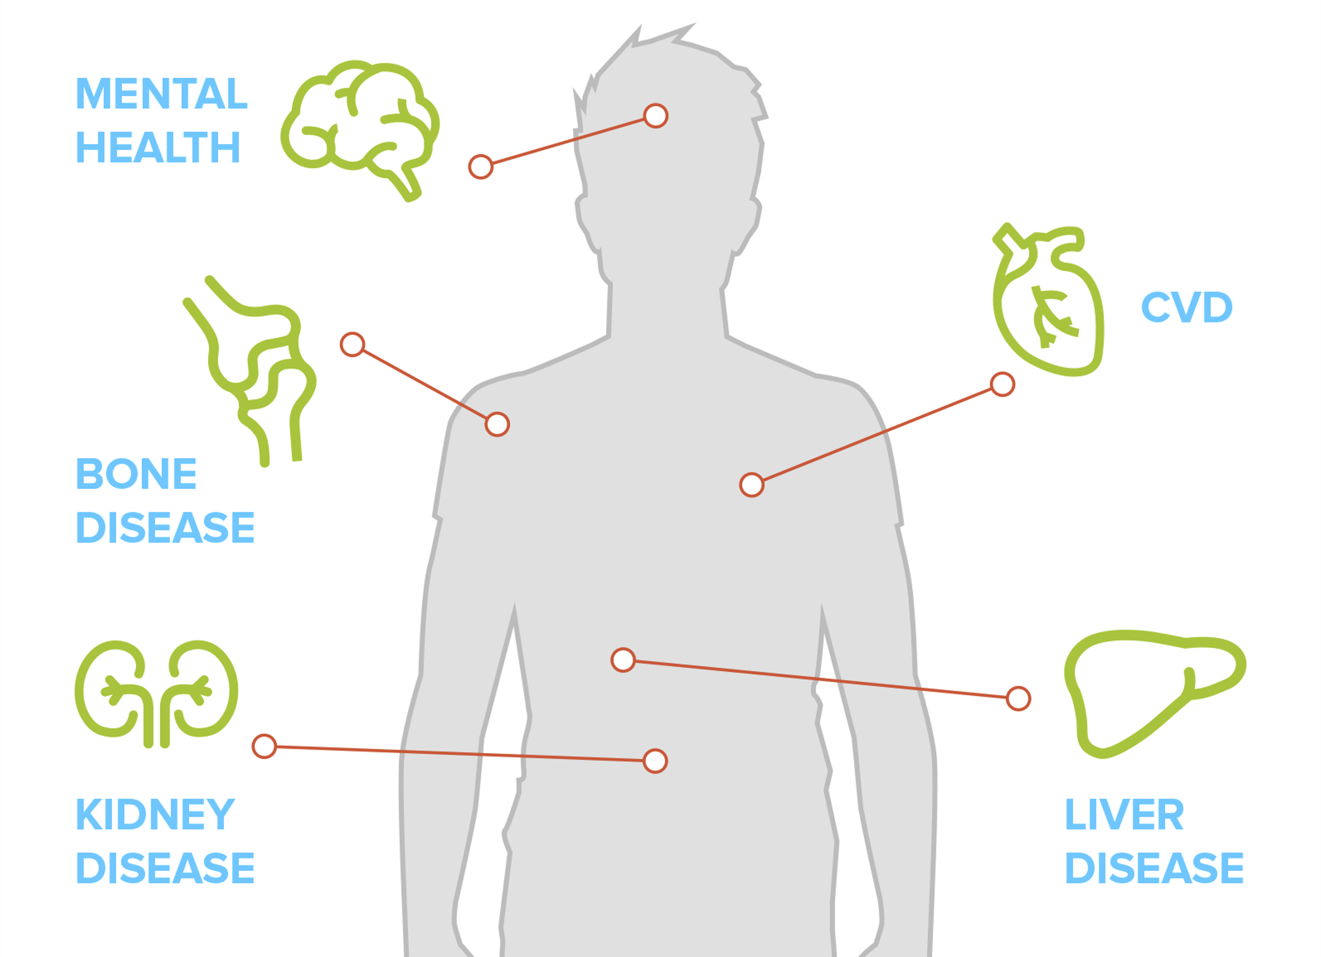
Common Comorbidities in Patients with Poor Oral Health Care
Cardiovascular Disease
Kidney Disease
Neurocognitive
Hepatic Function
Bone Disorders
Diabetes
Notes:
What conditions can be linked to oral health?
Your oral health might contribute to various diseases and conditions, including:
Endocarditis. This infection of the inner lining of your heart chambers or valves (endocardium) typically occurs when bacteria or other germs from another part of your body, such as your mouth, spread through your bloodstream and attach to certain areas in your heart.
Cardiovascular disease. Although the connection is not fully understood, some research suggests that heart disease, clogged arteries and stroke might be linked to the inflammation and infections that oral bacteria can cause.
Pregnancy and birth complications. Periodontitis has been linked to premature birth and low birth weight.
Pneumonia. Certain bacteria in your mouth can be pulled into your lungs, causing pneumonia and other respiratory diseases.
Certain conditions also might affect your oral health, including:
Diabetes. By reducing the body's resistance to infection, diabetes puts your gums at risk. Gum disease appears to be more frequent and severe among people who have diabetes.
Research shows that people who have gum disease have a harder time controlling their blood sugar levels. Regular periodontal care can improve diabetes control.
HIV/AIDS. Oral problems, such as painful mucosal lesions, are common in people who have HIV/AIDS.
Osteoporosis. This bone-weakening disease is linked with periodontal bone loss and tooth loss. Certain drugs used to treat osteoporosis carry a small risk of damage to the bones of the jaw.
Alzheimer's disease. Worsening oral health is seen as Alzheimer's disease progresses.
Other conditions that might be linked to oral health include eating disorders, rheumatoid arthritis, certain cancers and an immune system disorder that causes dry mouth (Sjogren's syndrome).
Tell your dentist about the medications you take and about changes in your overall health, especially if you've recently been ill or you have a chronic condition, such as diabetes.

Slide 10
HIV Where are we?

Slide 11
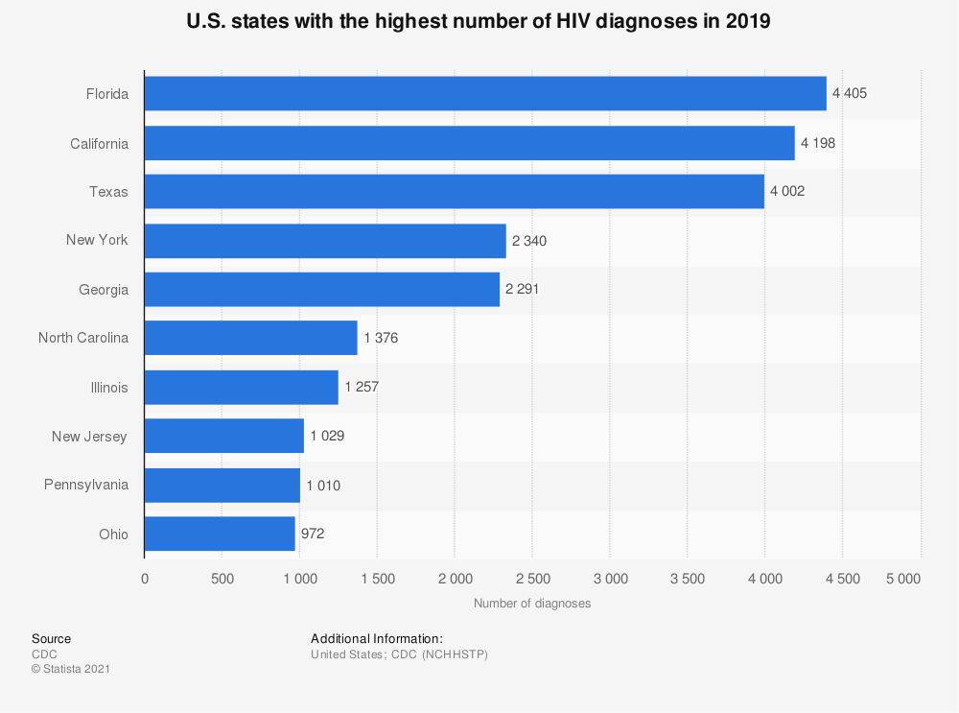

Slide 12
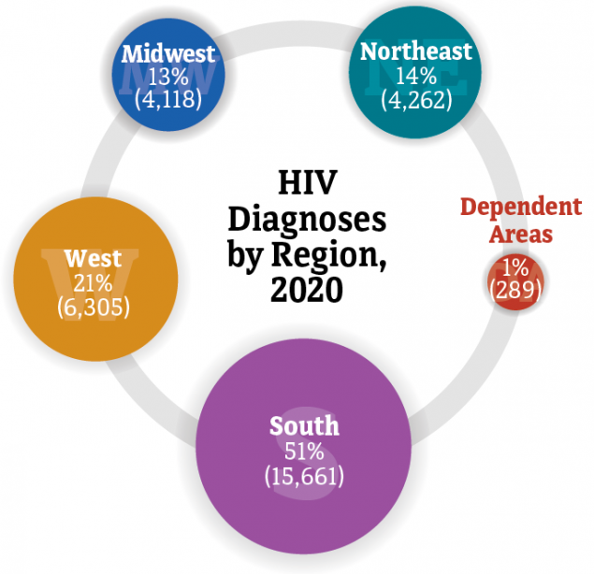

Slide 13
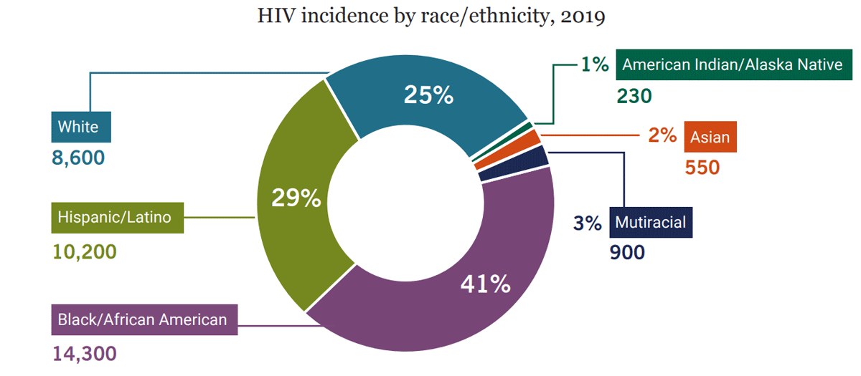

Slide 14
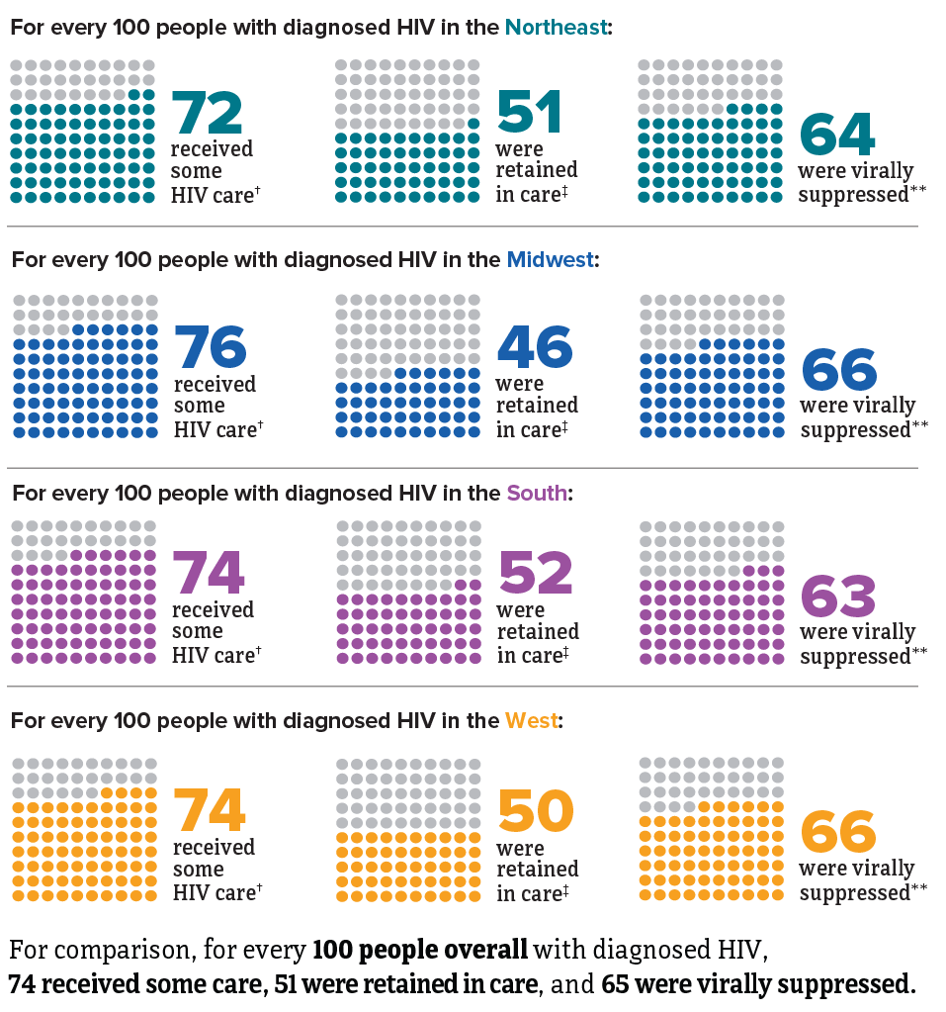
Notes:
64% virally suppressed after one year of art, 62% after two years and 59% after three years

Slide 15
Oral Health HIV Care Continuum
Retention in Care and Viral Suppression

Slide 16
Retained in Care
Notes:
RIC: 1.8% DECREASE

Slide 17
Virally Suppressed
Notes:
RIC: 1.8% DECREASE

Slide 18
Oral Health and HIV
32-46 percent of PLWHA will have at least one major HIV-related oral health problem.
58-68 percent PLWHA do not receive regular health care.
Barriers PLWHA face in receiving oral health care include lack of insurance, limited incomes, lack of providers, stigma, and limited awareness.
Poor oral health can impede food intake and nutrition, leading to poor absorption of HIV medications and leaving PLWHA susceptible to progression of their disease.⁴
HIV medications have side effects such as dry mouth, which predisposes PLWHA to dental decay, periodontal disease, and fungal infections.

Slide 19
Oral Manifestations of HIV
Significance of Oral Manifestations
First sign of clinical disease
Signify disease progression
Signify possible ART failure
Effects on medication adherence and nutrition

Slide 20
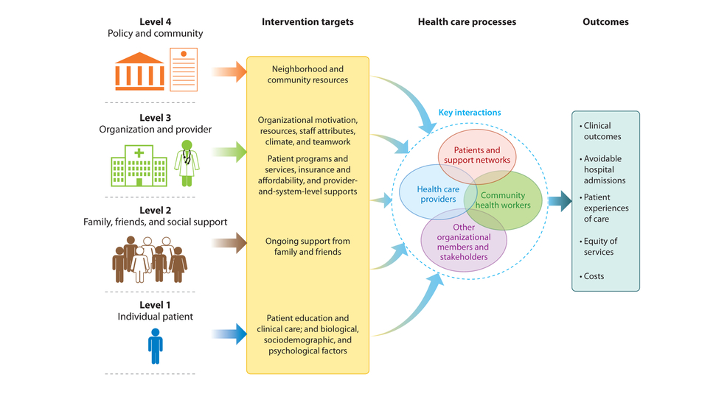
This conceptual model, factors that influence disparities in access to care and quality of health care services, by level, was created from the analysis of findings from systematic reviews of cardiovascular disease and cancer disparities (115). Figure adapted from Reference 115 with permission.
Purnell TS, Calhoun EA, Golden SH, Halladay JR, Krok-Schoen JL, et al. 2016. Achieving health equity: closing the gaps in health care disparities, interventions, and research. Health Aff. 35(8):1410–15
Notes:
What can we do and what factors affect engagement in oral health care and improves outcomes

Slide 21
Interprofessional Practice
Recommendations for an Interprofessional Practice Model
Apply oral health core clinical competencies within primary care practices to increase oral health care access for safety net populations in the United States.
Develop infrastructure that is interoperable and accessible across clinical settings and enhances adoption of the oral health core clinical competencies. The defined, essential elements of the oral health core clinical competencies should be used to inform decision making and measure health outcomes.
Modify payment policies to efficiently address the costs of implementing oral health competencies and provide incentives to health care systems and practitioners.
Execute programs to develop and evaluate implementation strategies of the oral health core clinical competencies into primary care practice.
US DHHS (Dep. Health Hum. Serv.). 2014. Integration of oral health and primary care practice. US DHHS, Health Res. Serv. Admin., Rockville, MD:
https://www.hrsa.gov/sites/default/files/hrsa/oralhealth/integrationoforalhealth.pdf
Notes:
The Health Resources and Services Administration (HRSA) synthesized recommendations and considered expert and professional opinions expressed during the Integration of Oral Health Care and Primary Care Practice meetings. The following recommendations serve as guiding principles and provide a framework for the design of a competency-based, interprofessional practice model to integrate oral health and primary care.

Slide 22
Strategies for Integrating Oral Health and Primary Care

Slide 23
Oral Health Care Opportunities
Unique Relationship
Frequency of Visits
Integration of Oral Health and Oral Health
Bi-directional referrals
Educational Opportunities

Slide 24
Expected Outcome
Engage all patients in oral heath care and include referral and follow-up

Slide 25
How to Screen for Oral Health Issues
When is the last time you saw a dentist and was it for routine or emergency care?
2. Do you have any pain, swelling, sores, swelling, lesions, bleeding, pus, or any problems in your mouth currently? How long have they been present?
3. Have you had a fever?
Swelling, Fever, Pus or Bleeding, and Pain that keeps that patient up at night are all indications for immediate dental care.

Slide 26
How to Screen for Oral Health Issues
Intra Oral Extraoral Exam
INSERT VIDEO

Slide 27
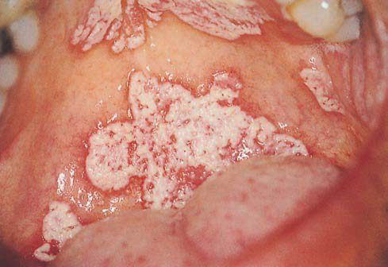
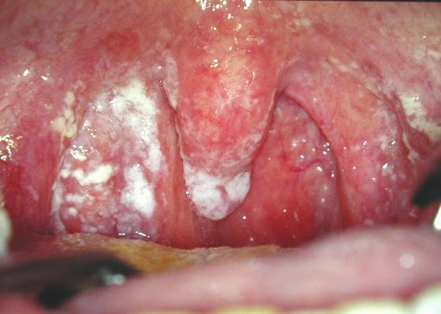
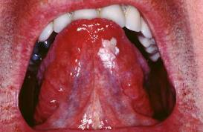
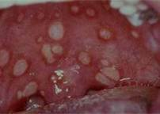
Candidiasis
Oral Hairy Leukoplakia Herpetic Lesions
All photos courtesy of Dr. Mark Schweizer

Slide 28
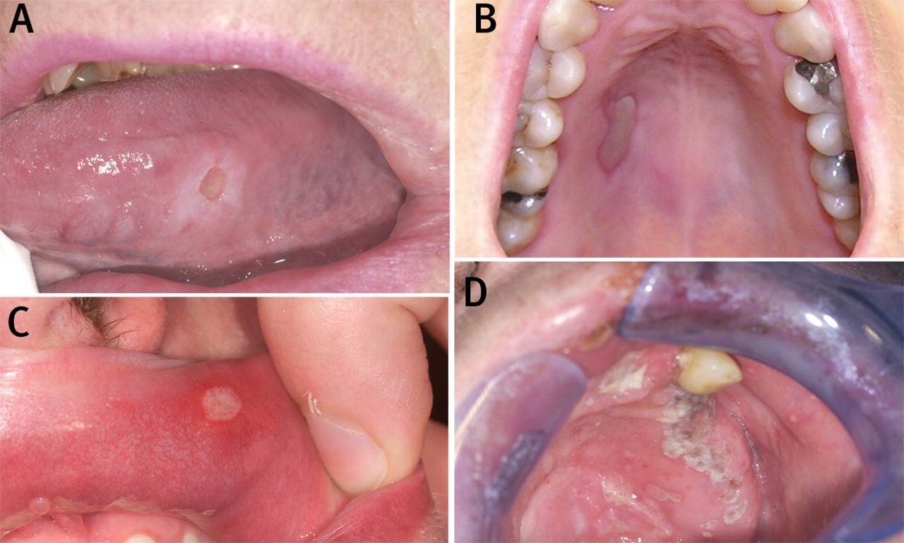
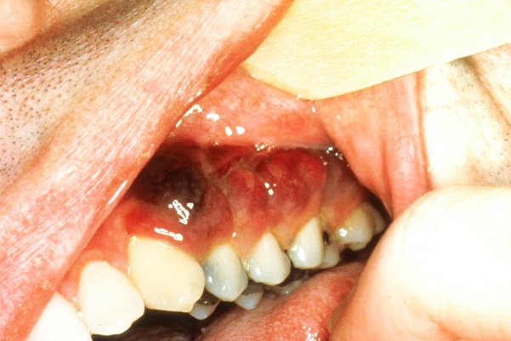
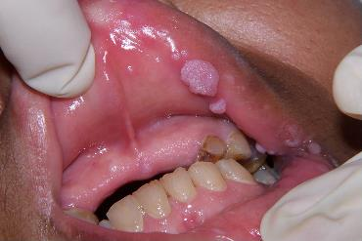
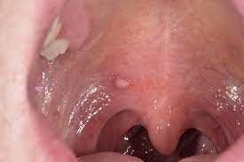
Aphthous Ulcers Kaposi's Sarcoma
HPV (Human Papilloma Virus)
All photos courtesy of Dr. Mark Schweizer

Slide 31
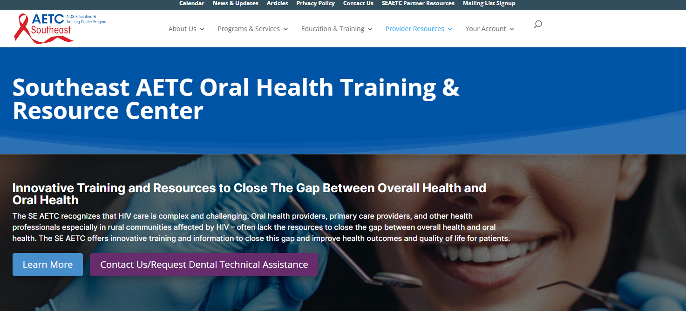
https://www.seaetc.com/oral-health-and-resources-training-center/

Slide 32
AETC Program
National Centers and National HIV Curriculum
National Coordinating Resource Center serves as the central web based
repository for AETC Program training and capacity building resources; its
website includes a free virtual library with training and technical assistance
materials, a program directory, and a calendar of trainings and other events.
Learn more: https ://aidsetc.org
National Clinician Consultation Center provides free, peer to peer,
expert advice for health professionals on HIV prevention, care, and treatment
and related topics. Learn more: https ://nccc.ucsf.edu
National HIV Curriculum provides ongoing, up to date HIV training and
information for health professionals through a free, web-based curriculum;
also provides free CME credits, CNE contact hours, CE contact hours, and
maintenance of certification credits. Learn more: www.hiv.uw.edu

Slide 33
Q&A

Slide 34
References
CDC.gov
Purnell Purnell TS, Calhoun EA, Golden SH, Halladay JR, Krok-Schoen JL, et al. 2016. Achieving health equity: closing the gaps in health care disparities, interventions, and research. Health Aff. 35(8):1410–15.
Defining Comorbidity: Implications for Understanding Health and Health Services, Valderas, Starfield, Salisbury, Roland, FMedSci , Ann Fam Med 2017 Jul; 7(4): 357–363.
Vujicic M, Buchmueller T, Klein R. Dental care presents the highest level of financial barriers, compared to other types of health care services. Health Affairs. 2016;35(12):2176–21
Manski RJ, Rohde F. Dental Services: Use, Expenses, Source of Payment, Coverage and Procedure Type, 1996–2015pdf iconexternal icon. Research Findings No. 38. Agency for Healthcare Research and Quality, US Dept of Health and Human Services; 2017.
Centers for Disease Control and Prevention. Oral Health Surveillance Report: Trends in Dental Caries and Sealants, Tooth Retention, and Edentulism, United States, 1999–2004 to 2011–2016. US Dept of Health and Human Services; 2019.
Griffin SO, Thornton-Evans G, Wei L, Griffin PM. Disparities in dental use and untreated caries prevalence by income. JDR Clin Trans Res. 2020:2380084420934746. doi:10.1177/2380084420934746
Cancer Facts and Figures 2017external icon. American Cancer Society; 2017.

Slide 35
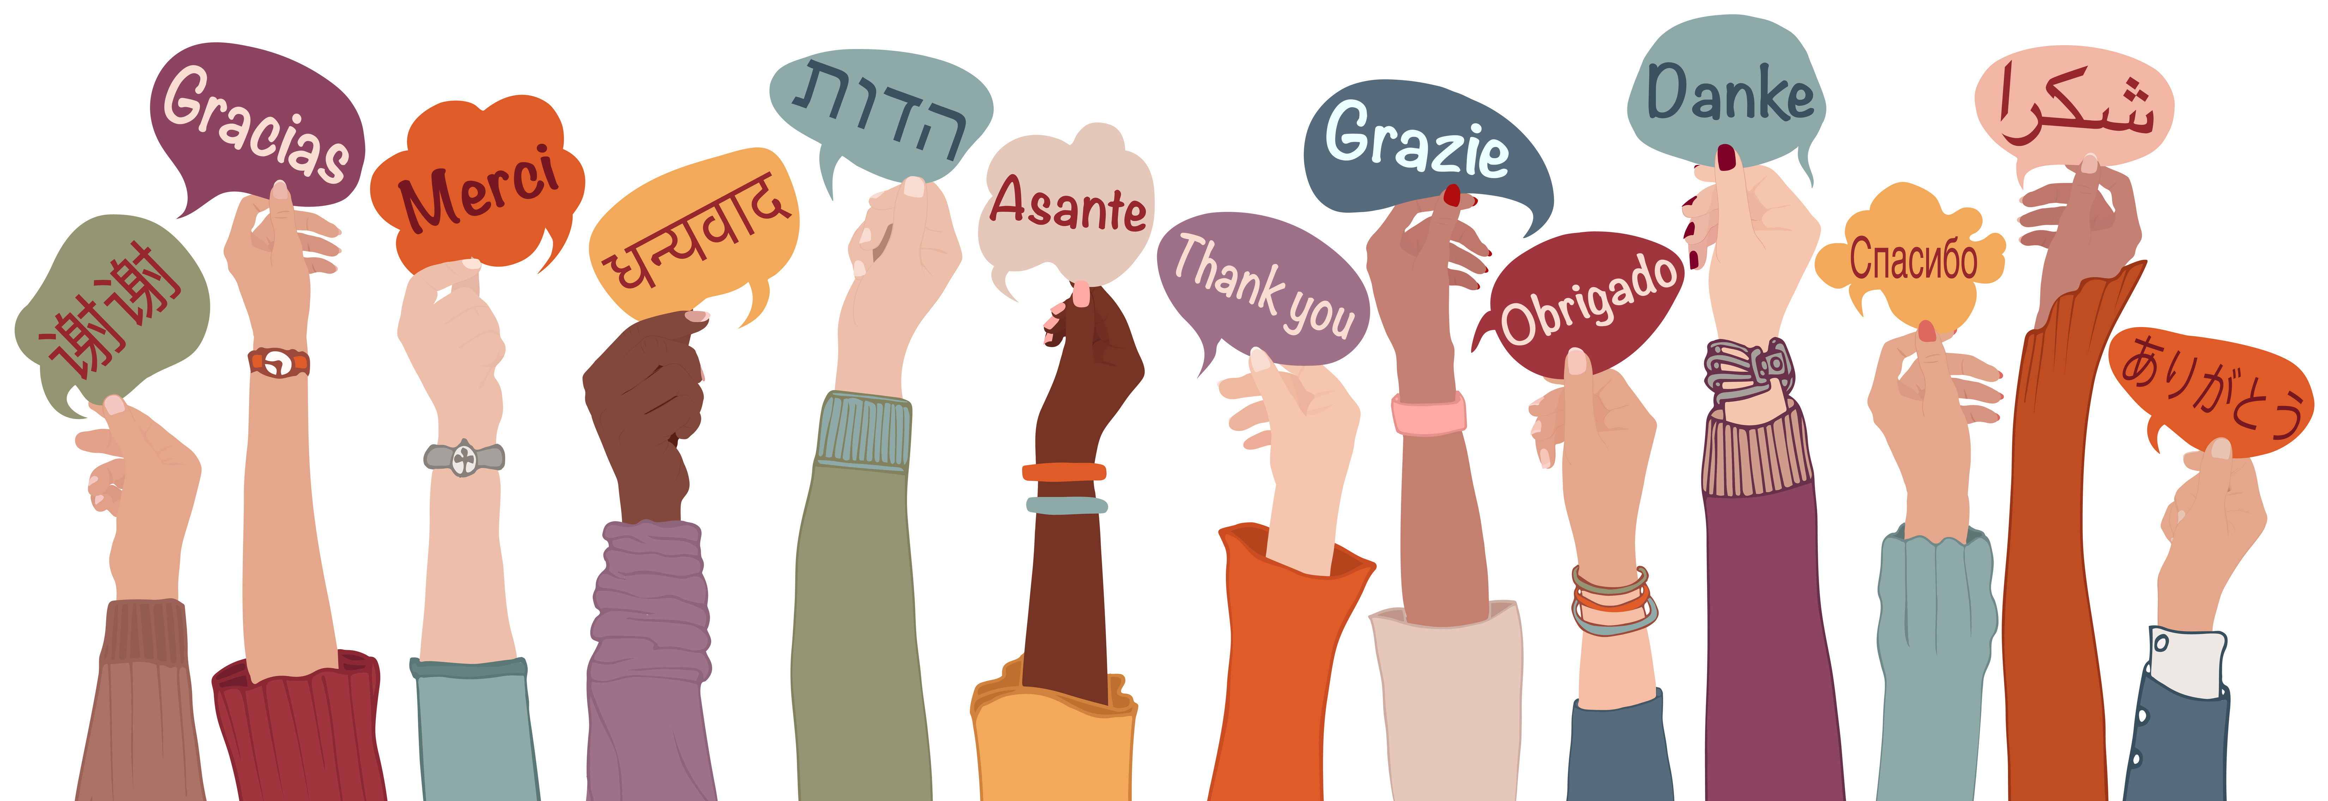
Thank you for your attenDing!

