Slide 1
HIV PrEP and DoxyPEP
Louie Mar Gangcuangco, MD, MSc, AAHIVS
Assistant Professor of Medicine, Hawaii Center for AIDS
John A Burns School of Medicine, University of Hawaii at Manoa
April 9, 2024

Slide 2
Disclaimer
The views and opinions expressed in this presentation are not necessarily those of the Pacific AIDS Education & Training Center (Pacific AETC) or its eight local partner sites in HRSA Region 9, the Regents of the University of California or its San Francisco campus (UCSF or collectively, University) nor of our funder the Health Resources and Services Administration (HRSA). Neither Pacific AETC, University, HRSA nor any of their officers, board members, agents, employees, students, or volunteers make any warranty, express or implied, including the warranties of merchantability and fitness for a particular purpose; nor assume any legal liability or responsibility for the accuracy, completeness or usefulness of information, product or process assessed or described; nor represent that its use would not infringe privately owned rights.
​
HRSA Acknowledgement Statement​ The Pacific AETC is supported by the Health Resources and Services Administration (HRSA) of the U.S. Department of Health and Human Services (HHS) as part of an award totaling $4,377,449. The contents are those of the author(s) and do not necessarily represent the official views of, nor an endorsement, by HRSA, HHS, or the U.S. Government. For more information, please visit HRSA.gov.
​
Trade Name Disclosure Statement​ Funding for this presentation was made possible by 5 U1OHA29292‐08‐00 from the Human Resources and Services Administration HIV/AIDS Bureau. The views expressed do not necessarily reflect the official policies of the Department of Health and Human Services nor does mention of trade names, commercial practices, or organizations imply endorsement by the U.S. Government. Any trade/brand names for products mentioned during this presentation are for training and identification purposes only.

Slide 3
Learning Objectives
At the completion of this presentation, participants will be able to:
Describe the indications and contraindications on the use of the different types of HIV pre-exposure prophylaxis
Discuss the potential use of doxycycline as post-exposure prophylaxis for bacterial sexually transmitted infections (STI)
Identify various barriers and challenges to the uptake of HIV and STI prevention strategies

Slide 4
Human Immunodeficiency Virus (HIV)
HIV causes Acquired Immune Deficiency Syndrome (AIDS)
HIV attacks the immune system, making it difficult for the body to fight infections
Without treatment, People with HIV (PWH) will develop AIDS
Treatment greatly delays disease progression and prevents HIV transmission
Notes:
Starting with the basics
Here, you see an illustration of the Human Immunodeficiency Virus, HIV.
This is the virus that causes AIDS, the Acquired Immune Deficiency Syndrome. You might hear people use the term “Advanced HIV” because the term AIDS is being used less and less these days in medical settings.
Without treatment, HIV breaks down the immune systems and leaves it unable to fight infections.
With consistent treatment, however, someone newly diagnosed with HIV should expect to never be given an AIDS diagnosis nor even to transmit the virus to their sexual partners.
A really important teaching point to keep in mind when working with clients is that HIV and AIDS are not the same thing. HIV is the virus. AIDS is the disease state that happens over a number of years if HIV is left untreated. AIDS or Advanced HIV, is the a clinical definition of what happens when HIV goes untreated.
In my work, I find that it can give people a sense of control over their diagnosis as HIV+ to know that by taking medications to treat HIV, they are proactively keeping themselves healthy, keeping Advanced HIV at bay, and they are protecting their sex partners. My taking medications, they are taking action to keep themselves healthy…taking control and exerting their power over the diagnosis.
So, in respect to the question of why should someone get tested? Well, to know their status and if HIV-, take the proper steps to protect themselves from getting HIV such as taking PrEP, using condoms, or other prevention methods. And if HIV+, to engage in medical care and get on treatment to maintain their long-term health and protect their partners.

Slide 5
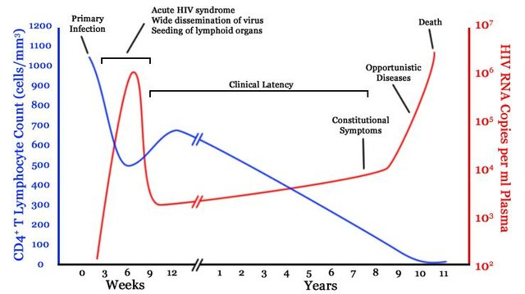
Natural History of untreated HIV infection
Popoola and Awodele. Afr. J. Med. med. Sci. (2016) 45, 5 - 21
Notes:
This is a figure presenting the natural history of untreated HIV infection. The blue line shows the level of CD4 T lymphocytes while the red line shows the HIV viral load. HIV is a virus that destroys the immune system, primarily infecting CD4 lymphocytes. During the first few years of HIV infection, the body is able to control the virus but after several years, the CD4 lymphocytes get depleted and viral load increases significantly. At this point, the patient would be susceptible to various bacterial, viral, and fungal infections.

Slide 6
HIV Statistics
At year-end 2021, an estimated 1.2 million people in the United States aged 13 and older had HIV in the U.S.
Estimated new HIV infections in the U.S.: 32,100
Lifetime treatment cost of an HIV infection is currently estimated at $379,668 in 2010 dollars.
World Health Organization & CDC data

Slide 7
How is HIV transmitted?
Transmitted via certain body fluid(s)
Blood
Semen
Vaginal Secretions
Breast Milk
These body fluids enter into the body via…
Mucous Membrane in Anus or Vagina
Blood-to-Blood (IV drug use)
Perinatal (In utero, during birth, breastfeeding)
Notes:
HIV is spread most commonly through unprotected sex with an infected partner. The virus can enter the body through the lining of the vagina, vulva, penis, or the rectum, during high-risk sex.
When I say “high risk” I want you to not only consider sex without a barrier (e.g. condom) but also without PrEP or without the PWH having an undetectable viral load.
HIV is also spread through contact with infected blood, especially among injecting drug users who share contaminated needles and other drug paraphernalia.
Women can transmit HIV to their babies during pregnancy, birth and via breastfeeding

Slide 8
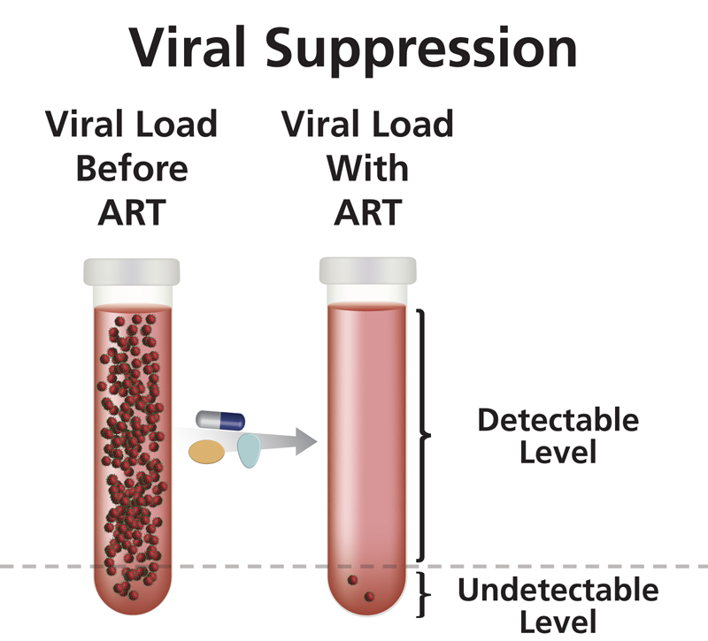
Antiretroviral Treatment (ART) (1)
Clinical Goals
Reduce viral load as much as possible for as long as possible
Increase CD4 cell count
Ensure medication adherence to preserve ART options
Preserve quality of life
Reduce HIV transmission
https://clinicalinfo.hiv.gov/en/glossary/viral-suppression
U=U Undetectable = Untransmittable
Notes:
Once linked to care, medical clinicians will do a full panel of baseline labs and then start patients on Antiretroviral Treatment or ART with the clinical goals of:
Reducing HIV viral load to undetectable and keeping it that way
Increasing CD4 cell count and maintaining it in the normal range between 500 and 1600
Ensuring ART adherence on simple first line regimens such as one-pill-once-a-day meds
Preserving a patient’s quality of life
And reducing HIV transmission
Just to re-emphasize, a really empowering point for PWH is that when someone achieves an undetectable viral load and sustains it for longer than six months, research has shown that they cannot transmit HIV to their sexual partners.

Slide 9
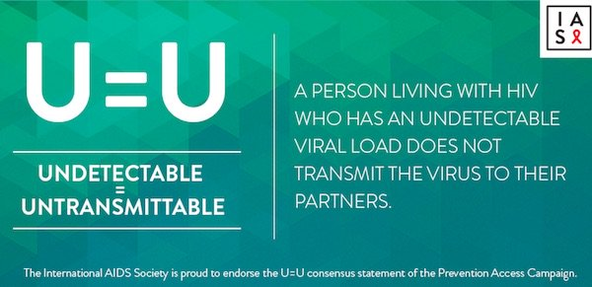
Antiretroviral Treatment (ART) (2)
https://aidsinfo.nih.gov/understanding-hiv-aids/glossary/876/undetectable-viral-load

Slide 10
HIV Prevention Strategies
There have been many claims for two abstinence strategies:
ABC (abstinence, be faithful, correct & consist use of condoms) and
ABCDE (adds don’t share needles/do drugs and education/early detection) strategies.
However, research shows that abstinence and abstinence only programs have inconsistent findings and may have little or no effect on risk of HIV infections (Chin et al., 2021 and Underhill et al., 2007).
Notes:
Underhill 2007 is a systematic review of the literature focusing on high income countries.

Slide 11
Effectiveness of condoms in preventing HIV transmission
HIV seroconversion studies suggests that condoms are 90 to 95% effective when used consistently
Consistent condom users are 10 to 20 times less likely to become infected when exposed to the virus than are inconsistent or non-users.
(Pinkerton & Abramson 1997)
Condom in jeans pocket with red awareness ribbon for aids and hiv, close up by Marco Verch under Creative Commons 2.0

Slide 12
Reasons for not using condoms consistently
Trust in one’s sexual partner (34.4%)
Condoms are perceived primarily as a birth control measure rather than a barrier against STI’s
Diminished pleasure (32%)
Purchasing condoms in small towns can be embarrassing
Unavailability (23.4%)
Purchasing condoms is associated with premarital sex or infidelity
Gangcuangco, et al. 2013
Lucea, et al. 2013
Limited by factors including allergic reactions to the latex used in most condoms, and the perception of inconvenience and diminished sexual pleasure.
Mnyika, et al. 1995

Slide 13
Internal condoms (formerly, ‘female condoms’)
A study among commercial sex workers (CSW) in Mpumulanga Province, South Africa showed:
The program would distribute 6000 female condoms annually at a cost of $4002 and would avert 5.9 HIV, 38 syphilis, and 33 gonorrhea cases. (Marseille et al., 2001)

Slide 14
Circumcision and HIV prevention
Results of three randomized controlled trials (RCT) showing that male circumcision reduces the risk of HIV acquisition by approximately 60%.
(Weiss et al., 2008)
Sharma et al., 2021
Notes:
Figure: HIV transmission in the inner foreskin. (a) The inability of cell-free HIV to translocate efficiently most of it becomes degraded. (b) The inefficient translocation of HIV. (c) The efficient translocation of HIV when there is a formation of apical viral synapses between cells highly infected with HIV and dendrites of Langerhans cells.

Slide 15
Pre-exposure prophylaxis (PrEP)
PrEP is an HIV prevention method in which people who do NOT have HIV take HIV medicine to reduce their risk of getting HIV.
“20220627_Morristown-017” by John O’Boyle is licensed by CC BY-NC-ND 2.0 cropped from original

Slide 16
Deciding to take PrEP
Anal or vaginal sex in the past 6 months and
have a sexual partner with HIV (especially if the partner has an unknown or detectable viral load),
have not consistently used a condom,
have been diagnosed with a sexually transmitted disease in the past 6 months.
Centers for Disease Control & Prevention. Available at https://www.cdc.gov/hiv/basics/prep/prep-decision.html Accessed Feb 2024

Slide 17
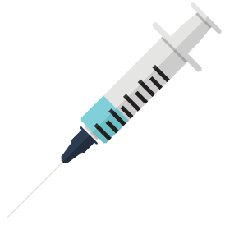
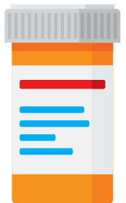
Deciding to take PrEP [1]
You inject drugs and you
have an injection partner with HIV, or
share needles, syringes, or other drug injection equipment
You have been prescribed PEP (post-exposure prophylaxis) and you
report continued risk behavior, or
have used multiple courses of PEP.
Centers for Disease Control & Prevention. Available at https://www.cdc.gov/hiv/basics/prep/prep-decision.html Accessed Feb 2024

Slide 18
How effective is PrEP?
PrEP reduces the risk of getting HIV from sex by about 99% when taken as prescribed.
Although there is less information about how effective PrEP pills are among people who inject drugs, we know that PrEP pills reduce the risk of getting HIV by at least 74% when taken as prescribed. Currently, PrEP shots are not recommended for people who inject drugs.
PrEP is less effective when not taken as prescribed.
CDC. https://www.cdc.gov/hiv/basics/prep/prep-decision.html Accessed April 2023

Slide 19
How long does PrEP take to work?
For receptive anal sex (bottoming), PrEP pills reach maximum protection from HIV at about 7 days of daily use.
For receptive vaginal sex and injection drug use, PrEP pills reach maximum protection at about 21 days of daily use.
No data are available for PrEP pill effectiveness for insertive anal sex (topping) or insertive vaginal sex.
We don’t know how long it takes for PrEP shots to reach maximum protection during sex.
CDC. https://www.cdc.gov/hiv/basics/prep/prep-decision.html Accessed April 2023

Slide 20
Which medication should I prescribe for PrEP?
TDF/FTC – tenofovir disoproxil fumarate/emtricitabine
TAF/FTC – Tonofovir Alafenamide/emtricitabine
https://twitter.com/JuliaLMarcus/status/1181218839343828999/photo/1 Twitter post 10/7/2019 by Julia L Marcus
cropped from original

Slide 21
IPERGAY: sex-driven PrEP
The protocol (2-1-1) was found to provide an 86% reduction in HIV. (Molina et al. 2015)
However, 2-1-1 is not FDA approved, but listed in several guidelines, including WHO and IAS-USA.
Slide from presentation of Efficacy of “On Demand” PrEP The ANRS IPERGAY Trial published by Philippa Webster 2015 https://slideplayer.com/slide/12806523/ Cropped from original

Slide 22
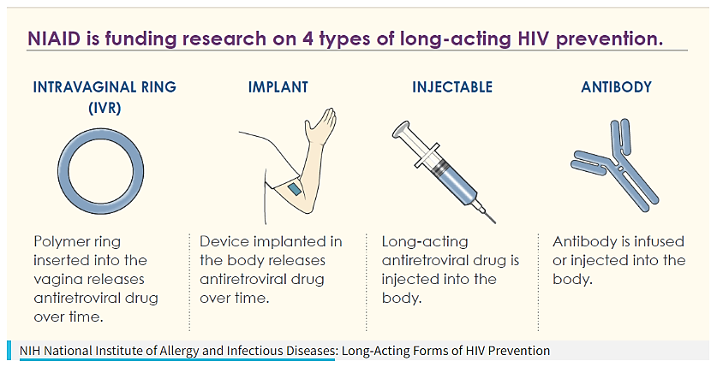
Long-acting HIV Prevention tools
“Long-Acting Forms of HIV Prevention Infographic” NIAID (CC BY 2.0) Cropped from the original; red box added.
Studies have shown that PrEP is much less effective if it is not taken consistently, and that taking a daily pill can be challenging for some people.
Researchers are working to create new HIV prevention tools that do not require taking a daily pill.
Notes:
Link: https://www.hiv.gov/hiv-basics/hiv-prevention/potential-future-options/long-acting-prep/

Slide 23
Cabotegravir injections (1)
Recommended dosing schedule (direct to injection) for pre-exposure prophylaxis in adults and adolescents weighing at least 35 kg:
Intramuscular (gluteal) initiation injection (month 1 and month 2) | Intramuscular (gluteal) continuation injection (month 4 and every 2 months onward)
600 mg (3 mL) | 600 mg (3 mL)
Individuals may be given a cabotegravir injection up to 7 days before or after the date the individual is scheduled to receive the injections (both initiation and continuation).
FDA. Available at https://www.accessdata.fda.gov/drugsatfda_docs/label/2021/215499s000lbl.pdf Accessed April 2023

Slide 24
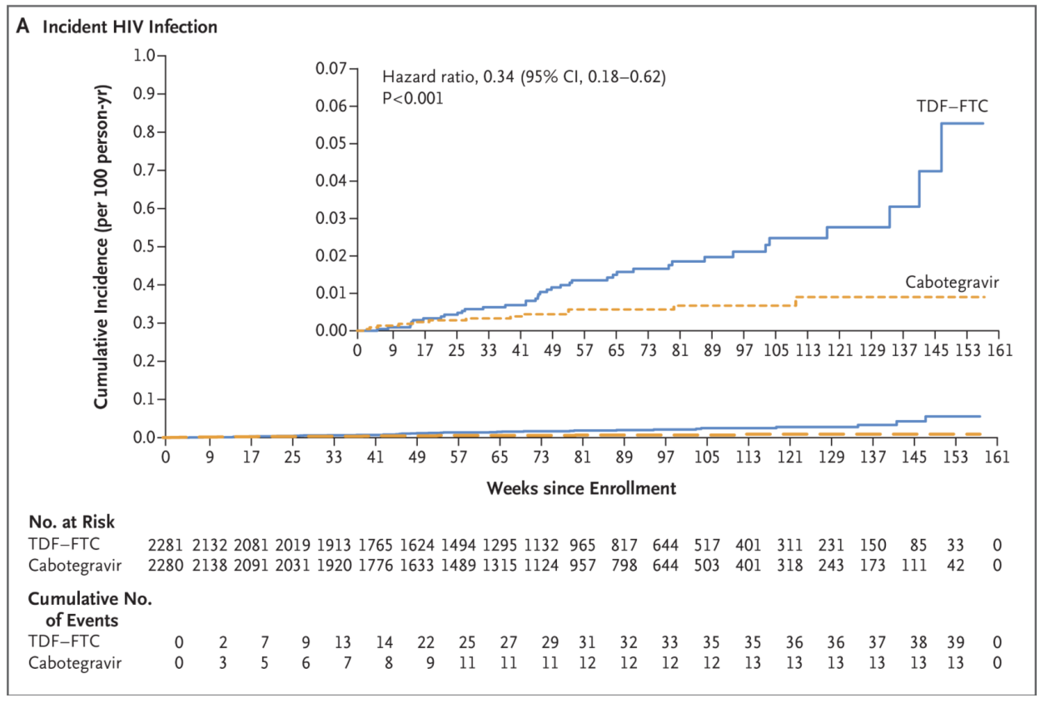
Cabotegravir for HIV Prevention in Cisgender Men and Transgender Women (HPTN 083)
Landovitz et al. 2021

Slide 25
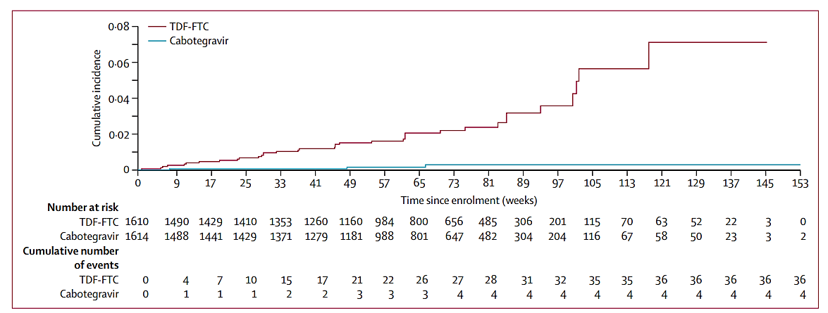
Cabotegravir for the prevention of HIV-1 in women (HPTN 084)
Delany-Moretlwe et al 2022

Slide 26
Cabotegravir injections (2)
WARNING: there is a risk of drug resistance with the use of cabotegravir for HIV-1 for PrEP in people with undiagnosed HIV-1 infection.
Individuals must be tested for HIV prior to initiating cabotegravir (either injected or oral) and with each subsequent injection.
Do not use cabotegravir for HIV PrEP unless negative infection status is confirmed.
If an antigen/antibody-specific test is used and provides negative results, then such negative results should be confirmed using an RNA-specific assay.
People who become infected with HIV while receiving cabotegravir for PrEP must transition to a complete HIV treatment regimen.
FDA. Available at https://www.accessdata.fda.gov/drugsatfda_docs/label/2021/215499s000lbl.pdf Accessed April 2023

Slide 27
Potential risk of HIV resistance with cabotegravir injections
Test before each injection to confirm HIV-1 negative status using a test approved or cleared by the FDA for the diagnosis of acute or primary HIV-1 infection.
If an antigen/antibody-specific test is used and provides negative results, then such negative results should be confirmed using an RNA-specific assay.
Individuals who are confirmed to have HIV-1 infection must transition to a complete HIV-1 treatment regimen.

Slide 28
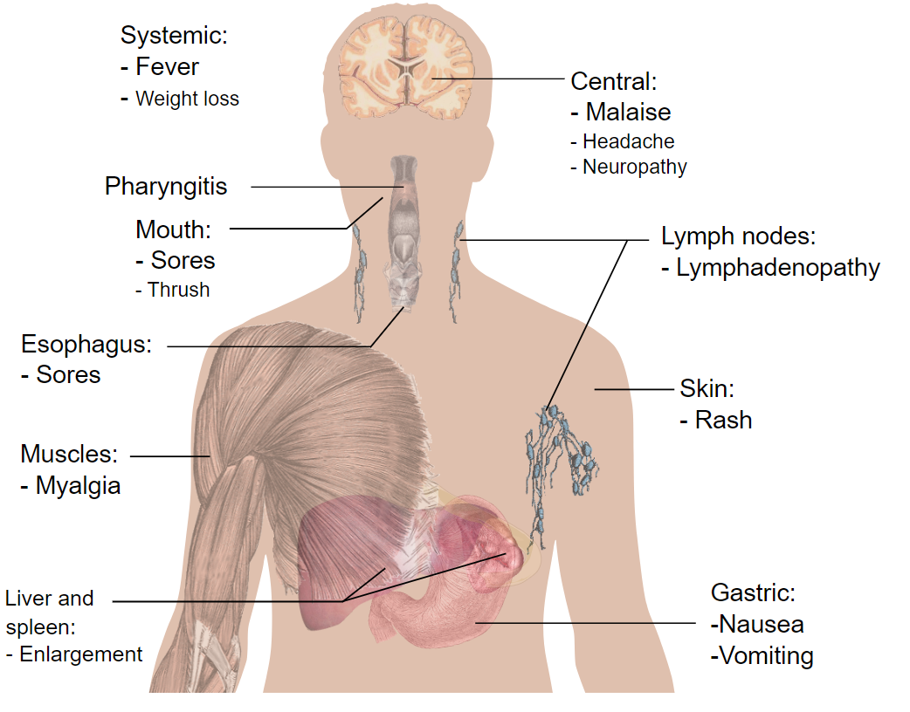
Initiating PrEP
Assess for possible acute HIV infection
Check for HIV RNA (viral load)
Mikael Häggström, Main Symptoms of Acute HIV Infection. Public Domain.

Slide 29
Acute HIV Syndrome
Common Symptoms fever, fatigue, and rash
Less Common Symptoms headache, swollen lymph glands, sore throat, feeling achy, nausea, vomiting, diarrhea, and night sweats
Similar to other illnesses (e.g. flu, COVID-19)
Only experienced by about ½ of the people newly infected
Only an HIV test can diagnose HIV
Notes:
Some people, during seroconversion, experience something called Acute HIV Syndrome
You’ll see the common and less common symptoms listed here on the screen
Only about half of the people newly infected with HIV have this experience and it mimics other illnesses
Of course, you can’t tell someone has HIV just by looking at them or by an anecdotal symptom review. The only way to know is to get a test
As a side note: There are many people infected with HIV who are not aware of it—1 out of 7 nationally* (155,000 per 2016 estimates)
Research has shown that PWH who are not diagnosed and in care are linked to 9/10 new HIV transmissions so knowing your status matters not only to the individual but also to the community

Slide 30
Initiating PrEP: Baseline Labs
HIV screening
antigen/antibody and HIV RNA testing should be performed if the patient received oral PrEP within the last three months or long-acting injectable PrEP within the prior 12 months
Basic Metabolic Panel (eGFR)
Pregnancy test
Although the oral agents used for PrEP (TDF, TAF, and emtricitabine) are felt to be safe for use in pregnancy, only TDF-FTC is recommended
Hepatitis B and Hepatitis C
Other tests
Lipid panel if considering TAF-FTC
Consider Dexa scan for those at risk for osteoporosis

Slide 31
HIV Seroconversion Window Period
Different types of tests diagnose HIV at different intervals post-infection
Antibody tests – as early as 3 weeks; most by 12 weeks via oral fluid or blood
Antigen test – as early as 2 weeks; most by 6 weeks via blood
Viral Detection – as early as 7 days; up to 28 days via blood
Notes:
The HIV Seroconversiton Window Period is the time between when an HIV infection occurs and when that infection shows up on a test.
Different types of tests diagnose HIV at different intervals after an infection occurs.
Additionally, everyone’s bodies produce the markers some of these tests are looking for at different times so we cannot say with 100% precision when each test is going to diagnose HIV
Antibody tests via saliva or blood, may pick up an HIV+ result as early as three (3) weeks after infection
Antigen blood tests can give results as early as two (2) weeks after infection
Viral Detection—done through a Nucleic Acid Amplification Test which examines the actual virus in the blood—can diagnose HIV as early as seven (7) days after an infection
Of course, these are the earliest times that a certain test can detect HIV infection and in many instances, they require longer to pick up a positive result if there is one.
So, because the virus can be present in someone’s body but not register on a test—that is, they are in the Window Period—we ask them to get another HIV test after a prescribed duration of time

Slide 32
Considerations when Selecting PrEP
 | Benefits | Risks/Considerations
TDF-FTC (Truvada) | Well tolerated Most studied regimen Used for all populations | Can result in decreased eGFR Truvada not for use as PrEP in persons with eGFR<60 Can result in bone mineral density loss Risk of HBV flare if discontinued
TAF-FTC (Descovy) | Well tolerated Less bone and renal toxicity compared with TDF | Higher rates of mild triglyceride elevations and weight gain Not to be used if risk is mainly vaginal (frontal) sex or inject drugs Risk of HBV flare if discontinued
Cabotegravir injection (Apretude) | Well tolerated Every other month injection Clinical trials appear to show greater efficacy than TDF-FTC | Long half life. Oral agent required when discontinuing cabotegravir LA Future HIV treatment options may be limited if HIV acquired while on cabotegravir Logistics Injection site reactions No studies in PWID Limited pregnancy data

Slide 33
Routine Monitoring [1]
In general, prescribe no more than a 90-day supply of oral PrEP, renewable only after HIV testing confirms that patient remains HIV uninfected

Slide 34
Routine Monitoring [2]
What to monitor | Frequency for oral PrEP | Frequency for cabotegravir injectable
HIV test | Every 3 months | Every 2 months
Adherence, side effects, risk-reduction and counseling | Every 3 months | Every 2 months
Test for STIs | Every 3 to 6 months | Every 4 to 6 months
Serum creatinine | At risk for renal disease: every 6 months All others: every 12 months | Routine monitoring not needed
HCV testing | MSM, Transgender women, PWID: every 12 months | MSM, Transgender women, PWID: every 12 months
Lipids & weight | Persons on TAF-FTC: every 12 months | Routine monitoring not needed

Slide 35
Common ICD-10 Diagnoses for PrEP Visits
Encounter for HIV pre-exposure prophylaxis [Z29.81]
Encounter for long-term (current) drug use [Z79.899]
High risk sexual behavior [Z72.52]
Contact with and (suspected) exposure to HIV [Z20.6]
Contact with and (suspected) exposure to infections with a predominantly sexual mode of transmission [Z20.2]

Slide 36
Case 1:
A 25-year-old cisgender woman is in the clinic today for a routine annual exam.
She states that she is in an open relationship with her boyfriend, engaging with multiple sex partners with inconsistent condom use.
Her boyfriend has HIV and has undetectable HIV RNA.
She has no other medical conditions. She inquires about PrEP to prevent HIV.
What is the best response?
PrEP is not indicated because your boyfriend has undetectable HIV viral load.
PrEP is indicated and may help in the prevention of HIV
PrEP is indicated and can also prevent sexually transmitted infections
PrEP is not indicated for cisgender women

Slide 37
Case 1 [continued]:
The patient would like to start taking PrEP.
What PrEP options could be offered to your patient who is a cisgender woman?
Emtricitabine-tenofovir disoproxil fumarate
Emtricitabine-tenofovir alafenamide
Cabotegravir injection
Any of the above
A or C only
Notes:
Answer: E. A or C only

Slide 38
Sexually Transmitted Infections & PrEP
Reports of increased sexually transmitted infection among PrEP users
PrEP users' perception of decreased risk of HIV acquisition may lead them to engage in overall riskier sexual practices and increase their chances of acquiring sexually transmitted infections (STIs). (Blumenthal, et al. 2014)
PrEP should therefore be used in combination with other education and other prevention measures against STIs. (Barreiro 2018)

Slide 39
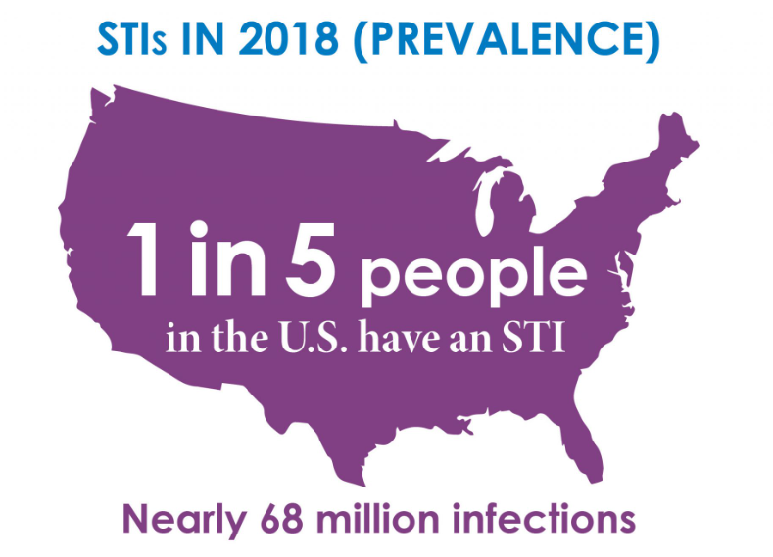
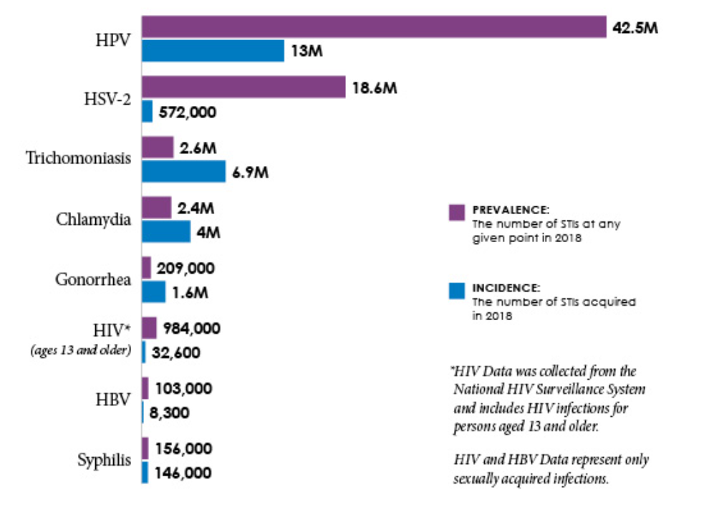
High Rates of Sexually Transmitted Infection in the U.S.
CDC. NCHHSTP Newsroom Accessed Feb 2024.

Slide 40
CDC’s 2022 STI Surveillance Report: Incident Cases of Syphilis is on the Rise
CDC. Sexually Transmitted Infections Surveillance 2022. Accessed Feb 2024
Notes:
Sexually Transmitted Infections Surveillance, 2022 provides the most current and complete data for nationally notifiable STIs for federally funded control programs. CDC’s annual report underscores that STIs must be a public health priority. In 2022, more than 2.5 million cases of syphilis, gonorrhea, and chlamydia were reported in the United States. The most alarming concerns center around the syphilis and congenital syphilis epidemics, signaling an urgent need for swift innovation and collaboration from all STI prevention partners. In addition to the syphilis epidemic worsening, reported gonorrhea cases declined for the first time in at least a decade while reported chlamydia cases were level. CDC will continue to examine this finding closely and look to 2023 data for better understanding, but recognize this finding may be a cause for an even closer look at public health efforts and redoubled prevention strategies. As STI services and related resources continue to rebound from the U.S. COVID-19 pandemic and mpox outbreak, we must act now to mobilize and execute a whole-of-nation approach if we hope to turn the tide.

Slide 41
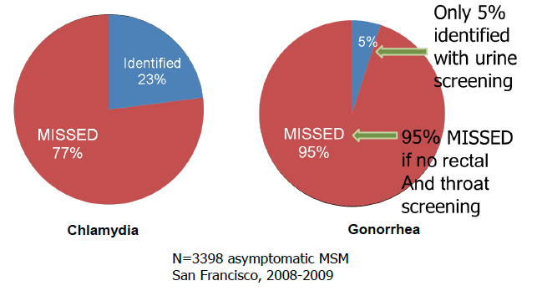
Sexually transmitted infections can be missed if just screening urine
Marcus, et al. Sex Transm Dis. 2011; 38:922-4.

Slide 42
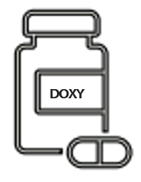
Doxycycline as post-exposure prophylaxis for sexually transmitted infections in MSM and transgender women
DoxyPEP Interim Guidance
Take two 100mg doxycycline (total of 200mg) within 24 hours, but no later than 72 hours after condomless sex (oral, anal, vaginal).
For MSM or transgender women with at least 1 bacterial STI in the past 12 months.
Maximum 200mg doxycycline every 24 hours.
Highleyman L. AIDSMap. Oct 11, 2023

Slide 43
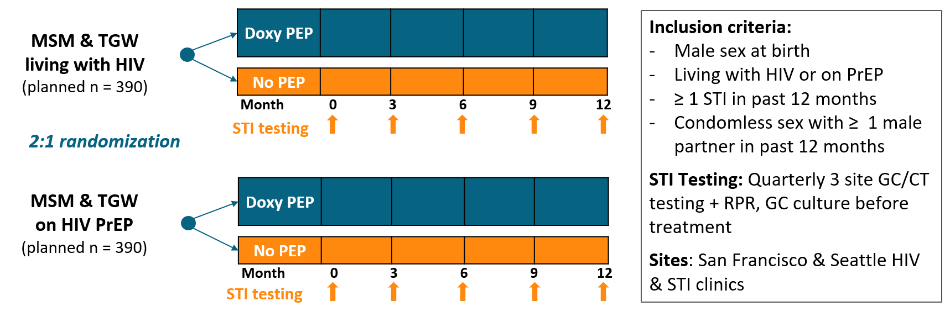
DoxyPEP Study Design
Luetkemeyer AF, et al. N Engl J Med . 2023 Apr 6;388(14):1296-1306.
Image from the presentation by Luetkemeyer AF, et al. AIDS2022 (Montreal, Canada)

Slide 44
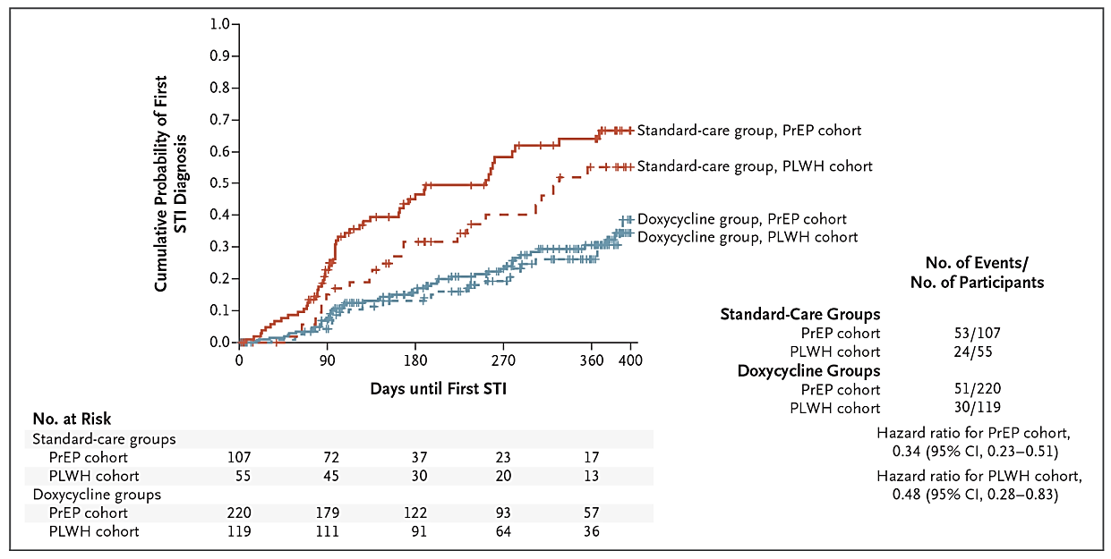
Combined incidence of gonorrhea, chlamydia, and syphilis was lower by 2/3 with DoxyPEP vs standard care
Luetkemeyer AF, et al. N Engl J Med . 2023 Apr 6;388(14):1296-1306.

Slide 45
DoxyPEP: Adherence and Safety
86% of participants reported taking doxy-PEP consistently (always or often).
The median number of doxycycline doses taken was estimated to be 4.0 doses (interquartile range, 1.0 to 10.0).
One grade 2 laboratory abnormality (transaminitis) and five grade 3 adverse events (three diarrheal events and two headaches or migraines) occurred that were possibly or probably related to doxycycline.
Five grade 3 adverse events and no serious adverse events were attributed to doxycycline.
No serious adverse events.
Luetkemeyer AF, et al. N Engl J Med . 2023 Apr 6;388(14):1296-1306.

Slide 46
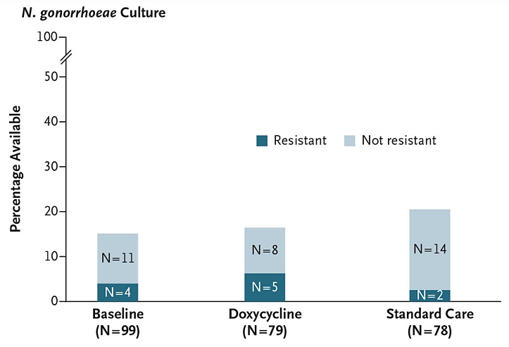
DoxyPEP: Risk of Antimicrobial Resistance
Of the participants with gonorrhea culture available, tetracycline-resistant gonorrhea occurred in 5 of 13 in the doxycycline groups and 2 of 16 in the standard-care groups.
Luetkemeyer AF, et al. N Engl J Med . 2023 Apr 6;388(14):1296-1306.
Notes:
Of the participants with gonorrhea culture available, tetracycline-resistant gonorrhea occurred in 5 of 13 in the doxycycline groups and 2 of 16 in the standard-care groups.

Slide 47
Case 2:
A 40-year-old male comes to the clinic for rectal discomfort. He admits to engaging in unprotected sex with both males and females and engages as a anal intercourse.
His last sexual contact was 2 weeks ago. He has no other known medical issues.
What lab tests would you order?

Slide 48
Case 2 [continued]:
Labs:
HIV antigen/antibody test: negative
Urine NAAT: negative
Rectal swab (NAAT): +gonorrhea
You administer ceftriaxone intramuscular injection for gonorrhea.
Aside from counseling on safe sexual practices, based on current evidence and guidance, which of the following should be offered?
PrEP
Doxy-PEP
Both PrEP and Doxy PEP
None of the above

Slide 49
Case 2 [continued]
Patient would like to proceed with DoxyPEP.
He inquires what is the correct way to take Doxy PEP.
What is the best response?
Take doxycycline 100mg by mouth two times a day for 7 days
Take doxycycline 100mg once within 24 to 72 hours after condomless sex
Take 2 capsules of doxycycline 100mg (total of 200mg) once within 24 to 72 hours after condomless sex (oral, anal, vaginal).
Take doxycycline 100mg by mouth two times a day for 2 weeks

Slide 50
Summary
Pre-exposure prophylaxis is the use of antiretrovirals to prevent HIV acquisition among people who are HIV-seronegative but at risk for HIV infection
Different types of PrEP include emtricitabine-TDF, emtricitabine-TAF, and cabotegravir injection
Doxycycline 200mg taken within 72 hours after condomless sex reduces the risk of incident chlamydia, gonorrhea, and syphilis in cisgender MSM and transgender women who have sex with men.
Cultural, behavioral, and economic factors affect the uptake of HIV prevention efforts

Slide 51
References (1)
Underhill, K, et al. (2007). Sexual abstinence only programmes to prevent HIV infection in high income countries: systematic review. BMJ 235, 348. https://doi.org/10.1136/bmj.39245.446586.BE
Chen, HB, et al. (2012). The Effectiveness of Group-Based Comprehensive Risk-Reduction and Abstinence Education Interventions to Prevent or Reduce the Risk of Adolescent Pregnancy, Human Immunodeficiency Virus, and Sexually Transmitted Infections: Two Systematic Reviews for the Guide to Community Preventive Services. Am J Prev Medicine 42(3), 272-294. https://doi.org/10.1016/j.amepre.2011.11.006
Pinkerton, SD, Abramson PR (1997). Effectiveness of condoms in preventing HIV transmission. Soc Sci Med 44(9): 1303-12. https://doi.org/10.1016/S0277-9536(96)00258-4
Gangcuangco LMA, et al. (2013). Prevalence and risk factors for HIV infection among men having sex with men in Metro Manila, Philippines. 44(5), 810-17. https://www.tm.mahidol.ac.th/seameo/journal-44-5-2013.html
Lucea MB, et al. (2013). The Context of Condom Use Among Young Adults in the Philippines: Implications for HIV Prevention. Health Care for Women International, 34:3-4, 227-248. https://doi.org/10.1080/07399332.2012.721414
Mnyika, KS, et al. (1995). Condom awareness and use in the Arusha and Kilimanjaro regions, Tanzania: A population based study. AIDS Educ Prev, 7(5) 403-414. https://pubmed.ncbi.nlm.nih.gov/8672393/
Marseille, E, Kahn, JG, Billinghurst, K, Saba J. (2001). Cost-effectiveness of the female condom in preventing HIV and STDs in commercial sex workers in rural South Africa. Soc Sci Med, 52(1), 135-148. https://doi.org/10.1016/S0277-9536(00)00282-3
Weiss, HA, et al. (2008). Male circumcision for HIV prevention: from evidence to action? AIDS 22(5):p 567-574. DOI: 10.1097/QAD.0b013e3282f3f406 https://journals.lww.com/aidsonline/Fulltext/2008/03120/Male_circumcision_for_HIV_prevention__from.2.aspx
Sharma, AL, et al. (2021). Circumcision as an Intervening Strategy against HIV Acquisition in the Male Genital Tract. Pathogens 10(7):806 https://doi.org/10.3390/pathogens10070806

Slide 52
References (2)
CDC. Deciding to take PrEP. https://www.cdc.gov/hiv/basics/prep/prep-decision.html Accessed April 2023
Molina JM, et al. (2015). On-Demand Preexposure Prophylaxis in Men at High Risk for HIV-1 Infection. N Engl J Med 2015 373:2237-2246. DOI: 10.1056/NEJMoa1506273 https://www.nejm.org/doi/full/10.1056/nejmoa1506273
HIV.gov. Drug Database: cabotegravir. https://clinicalinfo.hiv.gov/en/drugs/cabotegravir-1/patient. Accessed April 2023.
Landovitz RJ, et al. (2021). Cabotegravir for HIV Prevention in Cisgender Men and Transgender Women. N Engl J Med 385(7):595-608. https://www.nejm.org/doi/10.1056/NEJMoa2101016
Delany-Moretlwe S, et al. (2022). Cabotegravir for the prevention of HIV-1 in women: results from HPTN, a phase 3, randomized clinical trial. Lancet 399(10337):1779-1789. https://doi.org/10.1016/S0140-6736(22)00538-4
Preexposure Prophylaxis for the Prevention of HIV Infection in the United States – 2021 Update: A Clinical Practice Guideline. Centers for Disease Control and Prevention. https://www.cdc.gov/hiv/pdf/risk/prep/cdc-hiv-prep-guidelines-2021.pdf (Accessed on August 26, 2022).
Gandhi RT, Bedimo R, Hoy JF, et al. Antiretroviral drugs for treatment and prevention of HIV infection in adults: 2022 recommendations of the International Antiviral Society-USA Panel. JAMA 2023; 329:63
Consolidated Guidelines on HIV Prevention, Testing, Treatment, Service Delivery and Monitoring: Recommendations for a Public Health Approach. World Health Organization 2021. https://www.who.int/publications/i/item/9789240031593 (Accessed on May 24, 2022).
Blumenthal J, et al. (2014). Will Risk Compensation Accompany Pre-Exposure Prophylaxis for HIV? Virtual Mentor 16(11): 909-915. https://journalofethics.ama-assn.org/sites/journalofethics.ama-assn.org/files/2018-05/stas1-1411.pdf
Barreiro P. (2018). Sexually Transmitted Infections on the Rise in PrEP Users. AIDS Review 20(1):71. https://pubmed.ncbi.nlm.nih.gov/29628512/

Slide 53
Questions?
Presenters:
Louie Mar Gangcuangco, MD
louiemag@hawaii.edu
Dominic Chow, MD
dominicc@hawaii.edu

