Slide 1

Trauma Informed Care and Exams
HIV ECHO Clinic
Kate Stuenkel, MD
University of New Mexico Medical Group Truman Health Services
Albuquerque, NM
12 March 2024
Notes:
Version_ 02 2024
Target audience: clinical members of the healthcare team

Slide 2
Conflict of Interest Disclosure Statement
Speaker has nothing to disclose.
This presentation was reviewed by UNMHSC and SCAETC faculty to ensure it meets Continuing Education guidelines.
This program is supported by the Health Resources and Services Administration (HRSA) of the U.S. Department of Health and Human Services (HHS) as part of an award totaling $4,205,743 with 0% financed with non-governmental sources. The contents are those of the author(s) and do not necessarily represent the official views of, nor does mention of trade names, commercial practices, or organizations imply an endorsement by HRSA, HHS, or the U.S. Government. For more information, please visit HRSA.gov. Any trade/brand names for products mentioned during this presentation are for training and identification purposes only.

Slide 3
Unconscious Bias Disclosure
SCAETC recognizes that language is constantly evolving, and while we make every effort to avoid bias and stigmatizing terms, we acknowledge that unintentional lapses may occur in our presentations.
We value your feedback and encourage you to share any concerns related to language, images, or concepts that may be offensive or stigmatizing.
Your input will help us refine and improve our presentations, ensuring they remain inclusive and respectful to participants.

Slide 4
Learning Objectives
Review adverse childhood experiences (ACEs) / trauma definition
Identify what trauma may look like in a clinic setting
Compare how the LGBTQIA+ experience may be different compared to other experiences
Understand the “Universal Precautions” to use in your practice and options for a trauma-informed exam
LGBTQIA+ = Lesbian, Gay, Bisexual, Transgender, Queer, Intersex, Asexual, and other identities

Slide 5
Jack (part 1)
Jack is a 42-year-old trans man (AFAB, on testosterone, no gender affirming surgeries, pronouns he/him) with Stage 1 well-controlled HIV who is brought in by his partner for evaluation of several months of irregular frontal bleeding after having had no bleeding for a number of years. He has not had a pelvic exam in >10 years.
Question:
  What factors might explain Jack’s delay in seeking care?
AFAB = assigned female at birth

Slide 6
Definition of Trauma SAHMSA (2012)
“Trauma results from an event, series of events, or set of circumstances that is experienced by an individual as physically or emotionally harmful or threatening, and has lasting effects on the person’s functioning and physical, social, emotional, and spiritual wellbeing.”
https://store.samhsa.gov/sites/default/files/sma14-4816_litreview.pdf

Slide 7
Health Impact
Adverse Childhood Experiences (ACEs) Study conducted in 1997 – 17,500 middle class, predominantly white, medically insured Americans
  Assessed the relationship between trauma and health outcomes
Subsequent studies of ACEs have shown remarkably consistent results
Am J Prev Med 1998;14: 245-258
Notes:
ACE in PWH
Young-Wolff, KC. Adverse childhood experiences, mental health, substance use, and HIV-related outcomes among persons with HIV. 19 Mar 2019; 1241-1249. https://www.tandfonline.com/doi/full/10.1080/09540121.2019.1587372#:~:text=Sample%20characteristics%20of%20Persons%20with,adverse%20childhood%20experiences%20(ACEs).&text=ACES%20were%20highly%20prevalent%2C%20with,and%2023.3%25%20%E2%89%A55%20ACEs.

Slide 8
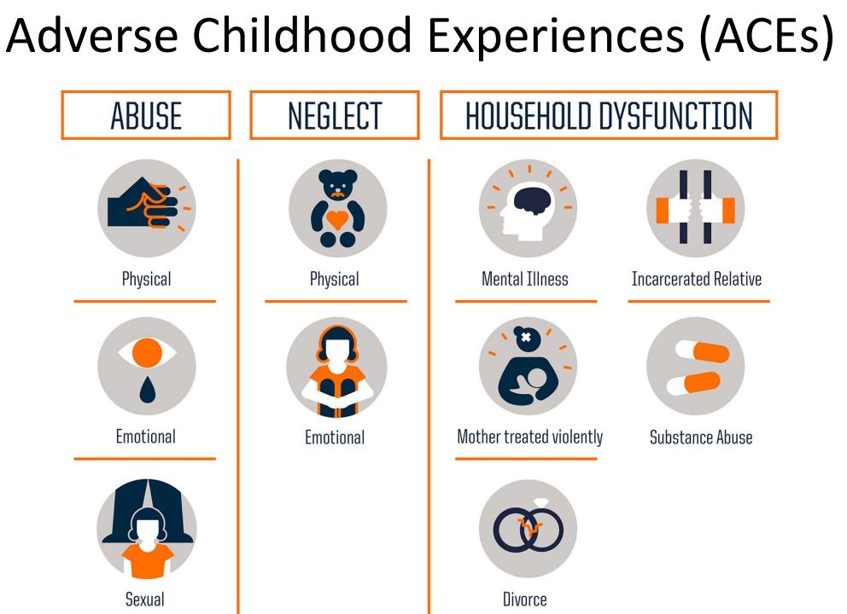
Image: https://cfka.org/aces-arent-wild-cards-speaker-series-on-adverse-childhood-experiences/

Slide 9
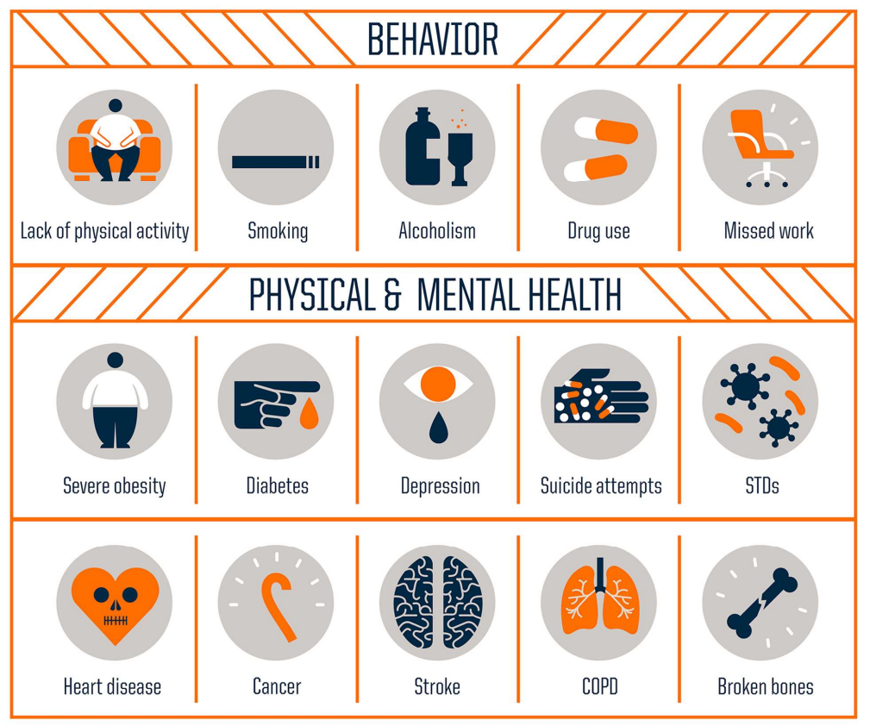
Image: Robert Wood Johnson Foundation; Source: CDC

Slide 10
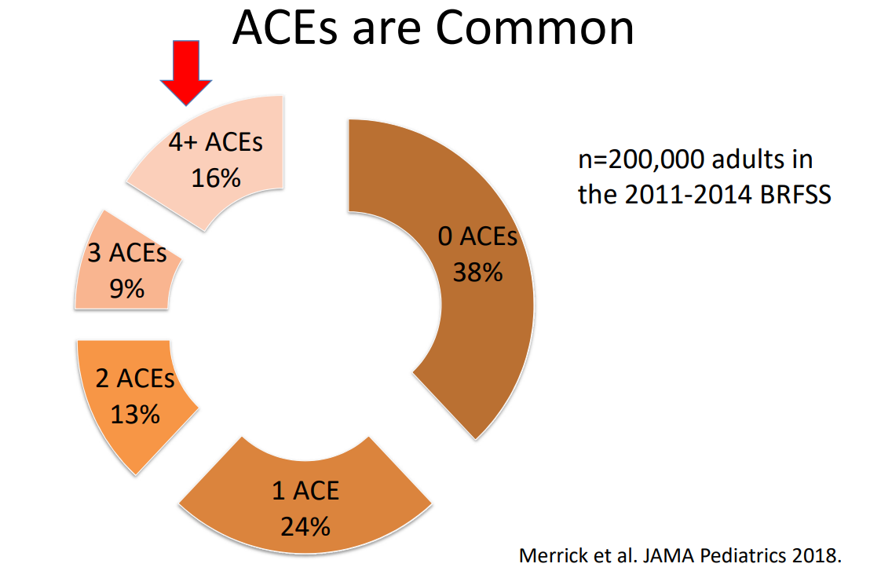
BRFSS = Behavioral Risk Factor Surveillance System

Slide 11
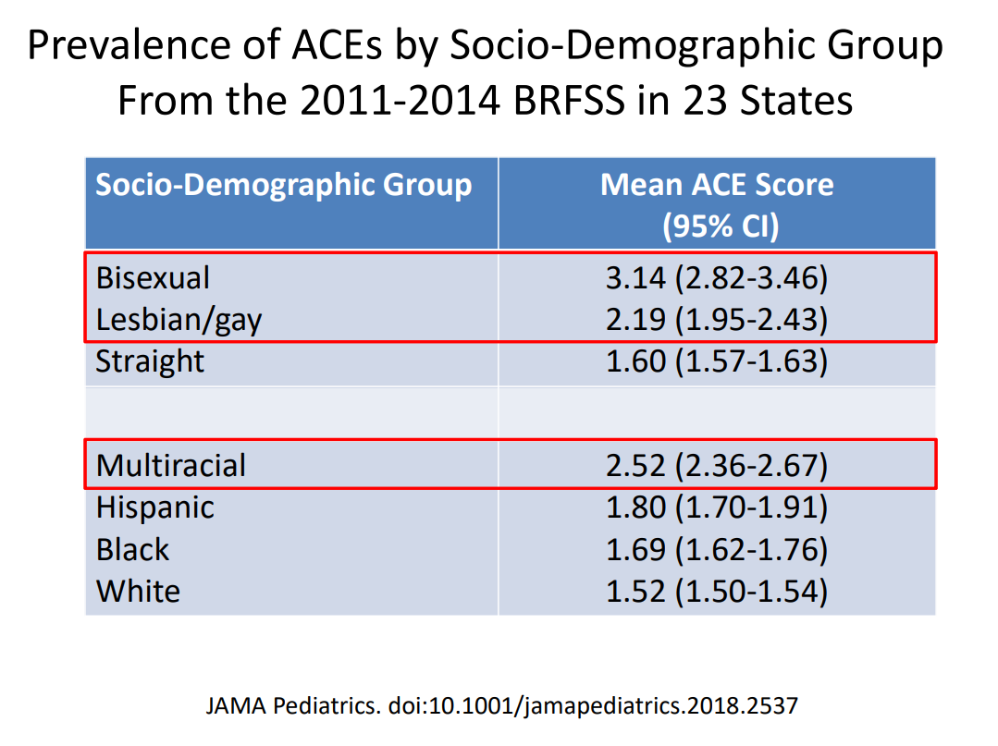

Slide 12
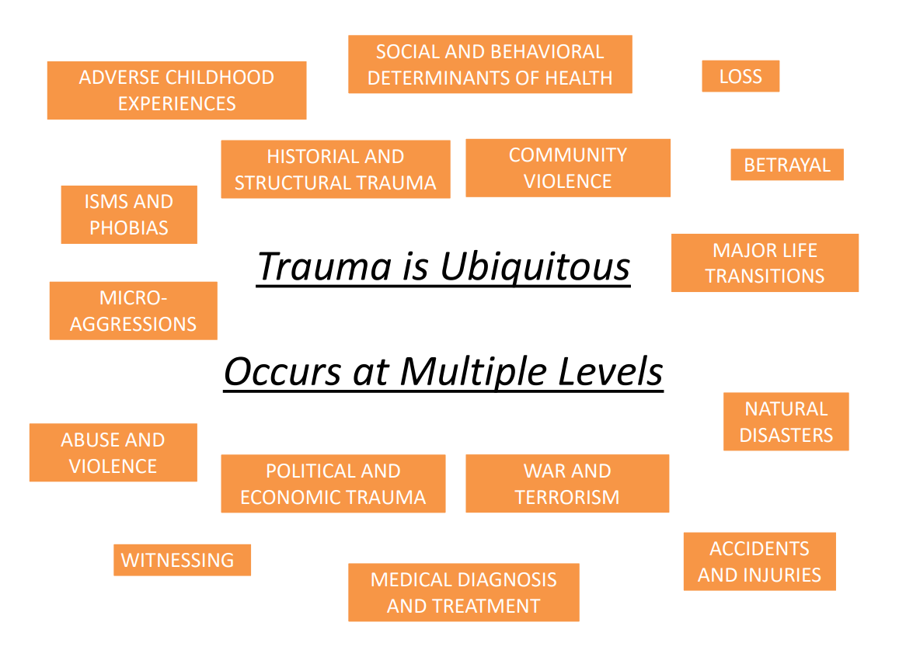
Trauma is Ubiquitous – Occurs at Multiple Levels

Slide 13
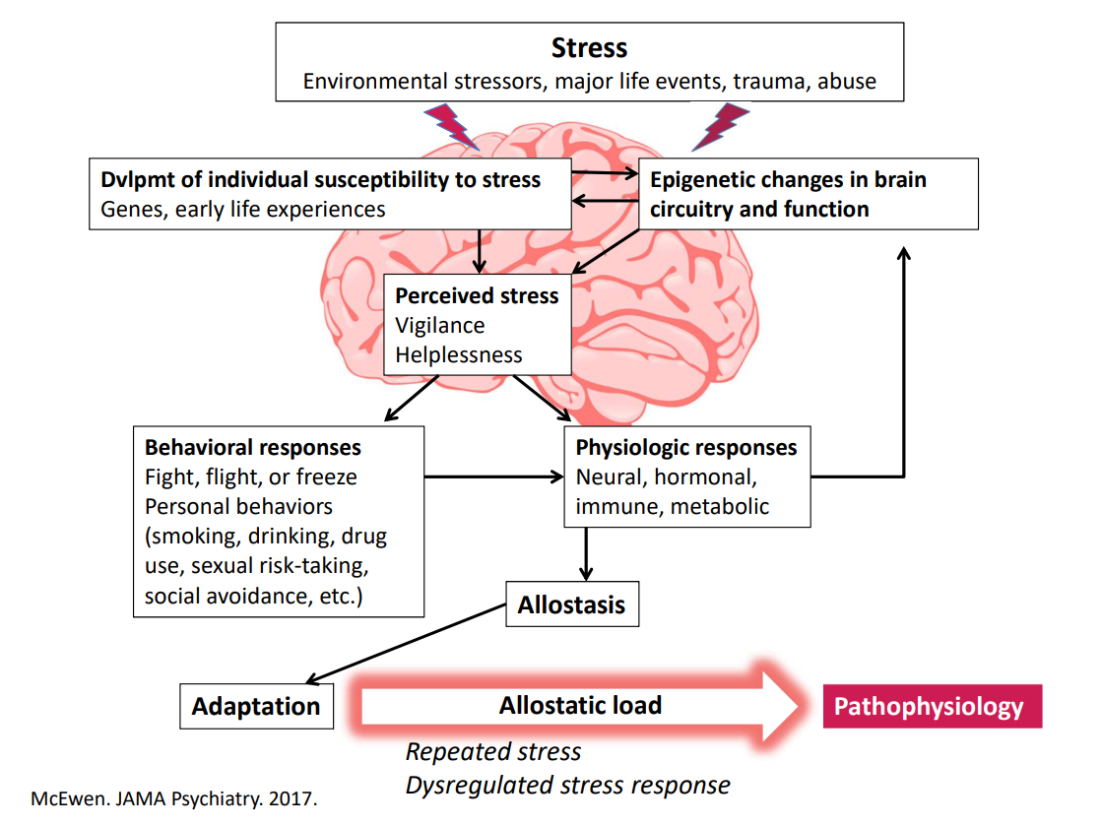

Slide 14
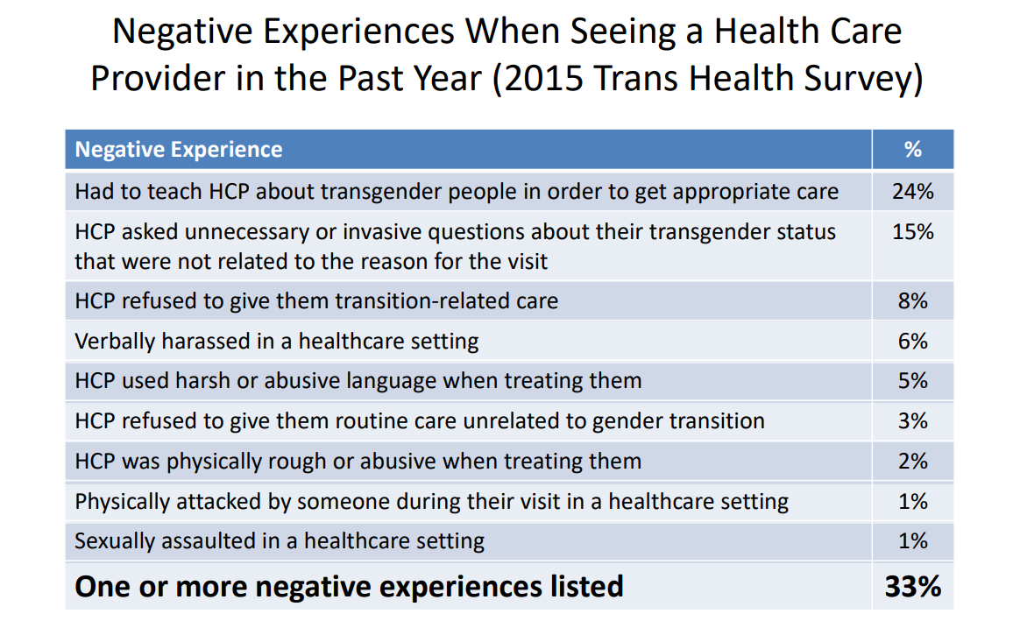
https://transequality.org/issues/us-transgender-survey

Slide 15
Higher Rates for LGBTQIA+ Communities
Bullying / harassment at school
Youth incarceration
Negative healthcare interactions
Trauma / ACEs
Social isolation
Unemployment
Uninsured
Living in poverty
Hate crimes
Internalized homophobia / transphobia

Slide 16
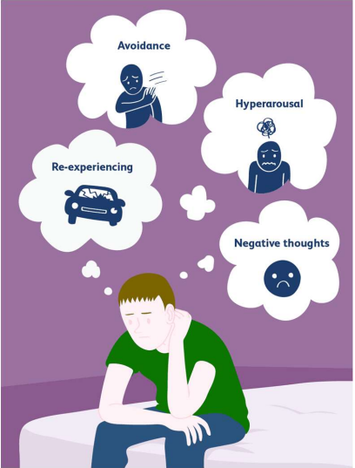
What is PTSD?
4 symptom clusters
Avoidance
Hyperarousal
Reexperiencing
Negative thoughts and emotions
Clinically significant distress and impairment
PTSD = post traumatic stress disorder
Image: https://drsamyaktiwari.com/services/treatment-of-post-traumatic-stress-disorder/

Slide 17
Jack (part 2)
After being discharged from the hospital, Jack’s friend took him to a local LGBTQ health center, where he started seeing a primary care provider experienced in caring for people with HIV and offering gender affirming care and a therapist specializing in trauma informed care. Jack also joined a transgender support group and started taking testosterone. One year later, he felt dramatically better and was starting to make plans for his future.
Question:
  What is trauma-informed care?

Slide 18
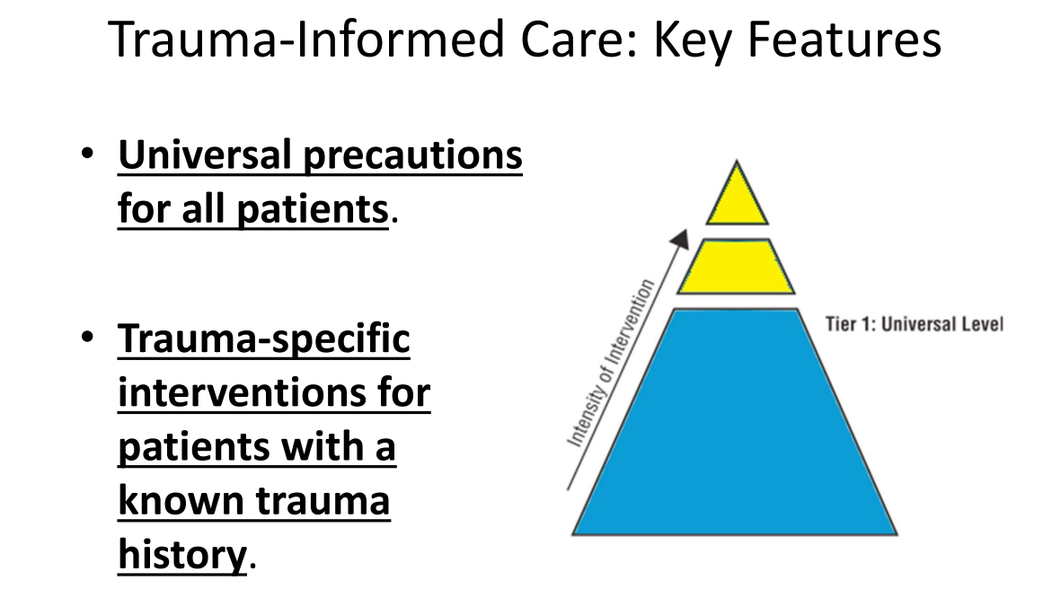
https://fenwayhealth.org/wp-content/uploads/Potter-SGM-Presentation.pdf

Slide 19
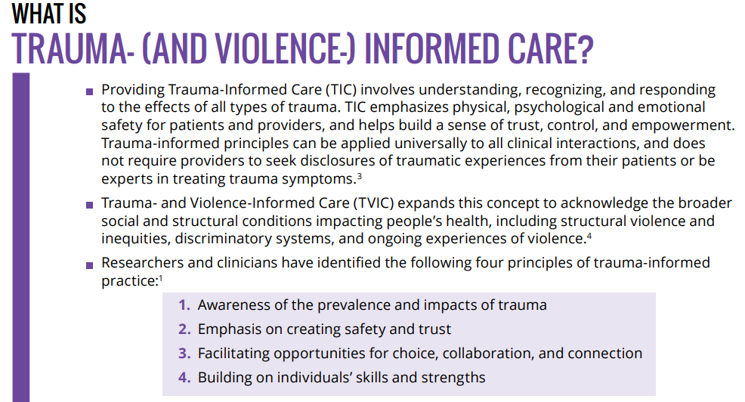
https://www.cpha.ca/sites/default/files/uploads/resources/stbbi/trauma-informed-exam-tool-e.pdf

Slide 20
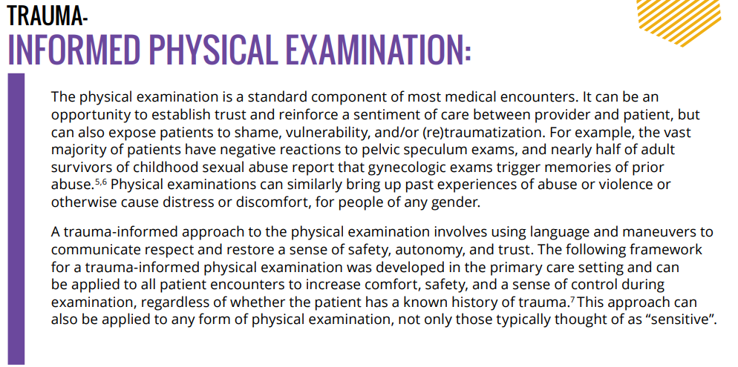
https://www.cpha.ca/sites/default/files/uploads/resources/stbbi/trauma-informed-exam-tool-e.pdf

Slide 21
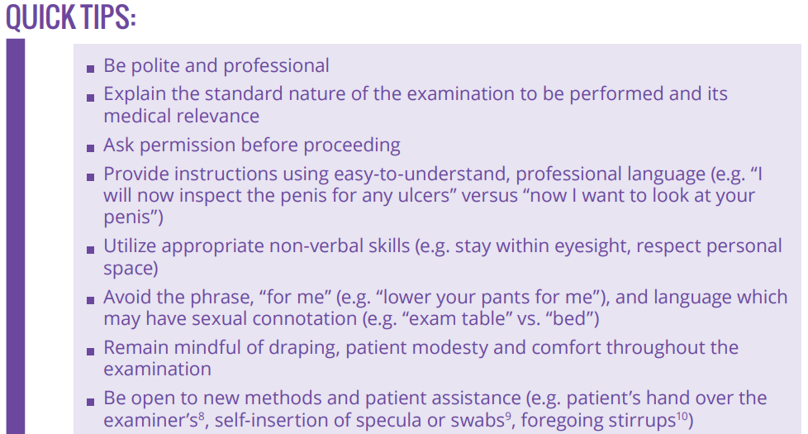
https://www.cpha.ca/sites/default/files/uploads/resources/stbbi/trauma-informed-exam-tool-e.pdf

Slide 22
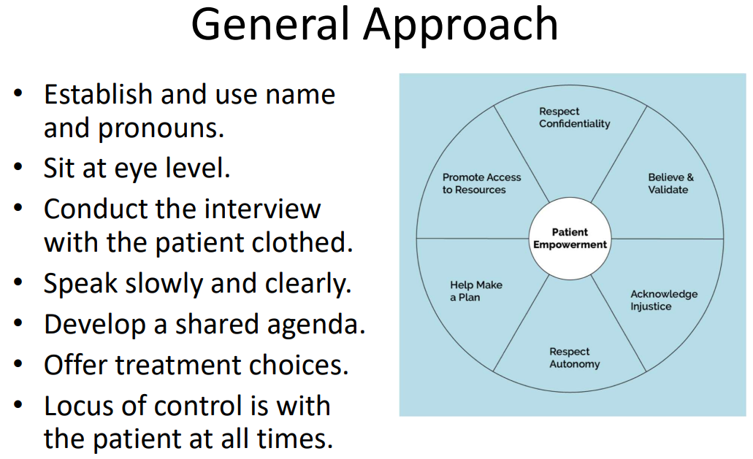
https://fenwayhealth.org/wp-content/uploads/Potter-SGM-Presentation.pdf

Slide 23
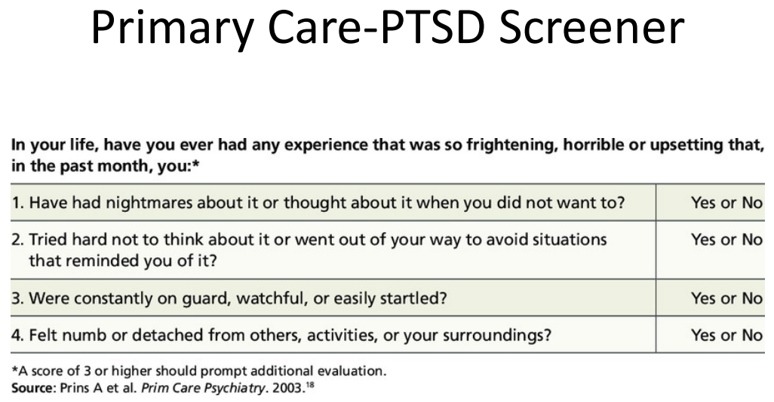

Slide 24
Jack (part 3)
Fast forward to 2024. Jack is now 42 years old and presents with several months of irregular frontal bleeding. His partner tells you she's been trying to convince him to come into the clinic, but "the last gyno exam he had was so bad, he is terrified."
Question:
  How would you proceed?

Slide 25
Remember
Any exam or procedure has the potential to be traumatizing (i.e. cervical lymph node exam)
This is more common with “vulnerable” (i.e., chest, genital, rectal exams)

Slide 26
Trans / Non-Binary / Intersex People
Prior exposure to traumatic/voyeuristic exams
Historical tendency to inappropriately gender certain exams (pelvic = “well-woman exam”)
Dysphoria during examination of body parts that are discordant with one’s gender
Dysphoria if provider uses triggering terms to describe body parts

Slide 27
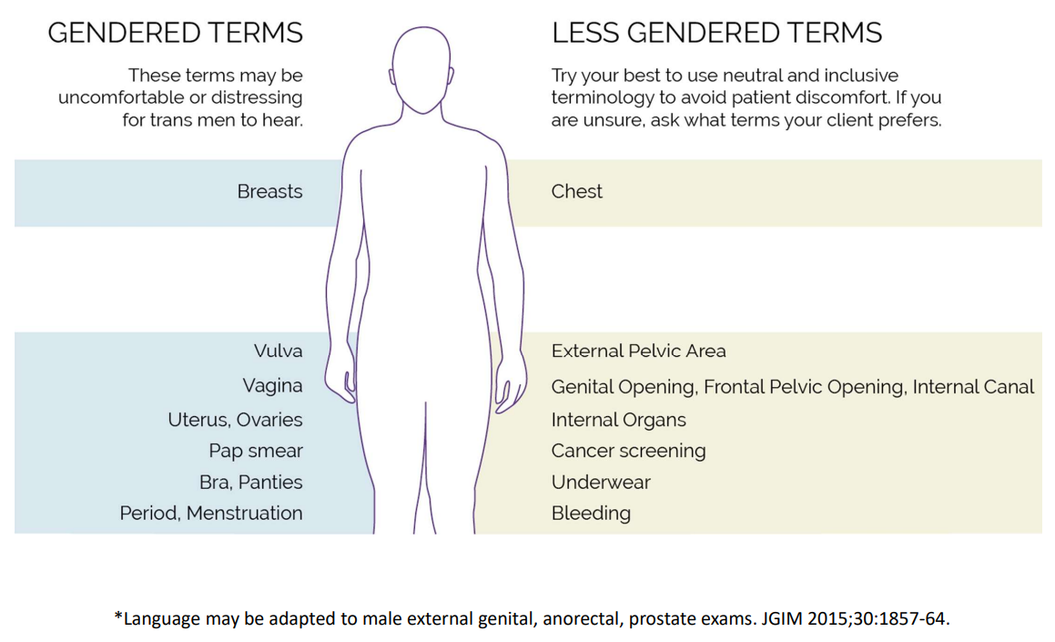

Slide 28
Evidence-Based Exams
Avoid exams that are not supported by reliable and consistent evidence (e.g., routine screening clinical breast exam, bimanual exam, testicular exam)
Consider less intrusive ways to obtain needed data (e.g., vaginal self-swab for gonorrhea/chlamydia)
Utilize shared decision-making in the face of uncertain evidence or conflicting guidelines

Slide 29
Before the Exam
Review the patient’s prior experiences with the exam
Explain the purpose and offer to talk through the steps of the exam
Ask what you can do to make the experience more comfortable
“You’re in control here. If you want me to stop at any point, please let me know.”

Slide 30
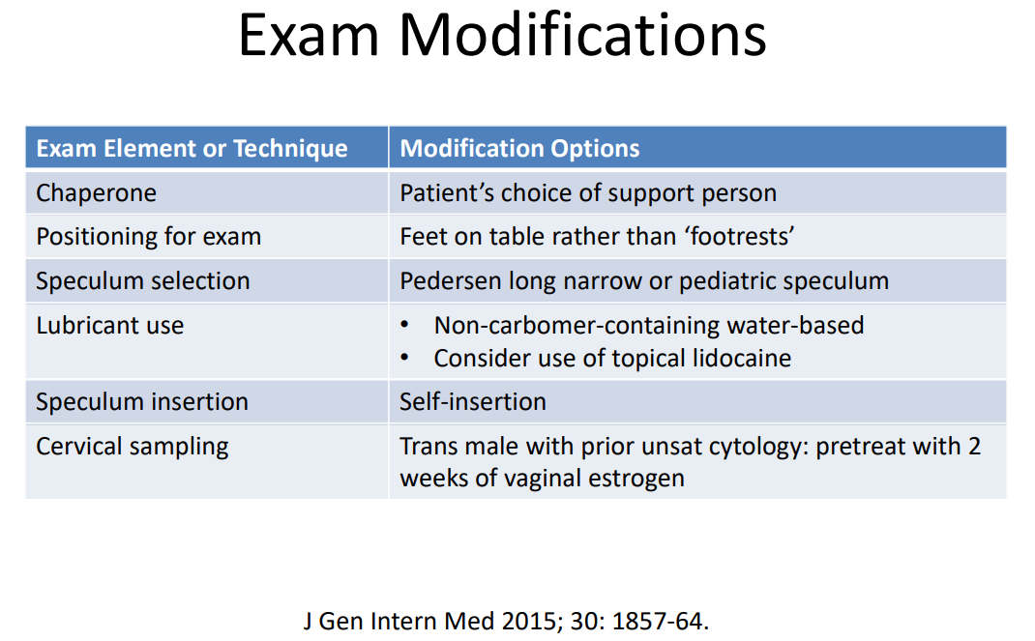

Slide 31
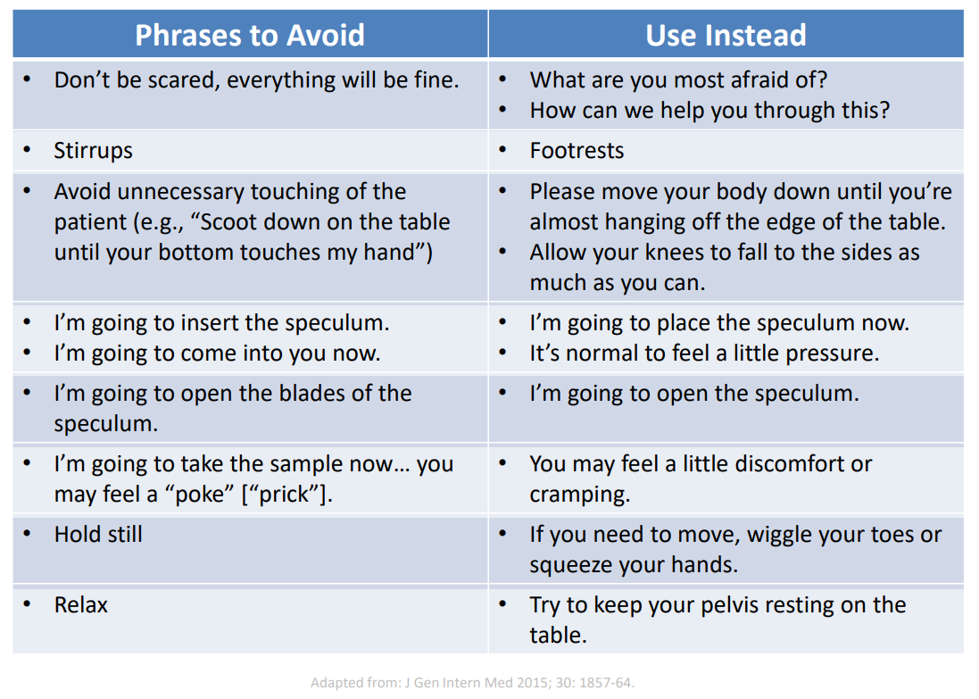

Adapted from: J Gen Intern Med 2015; 30: 1857-64

Slide 32
Trauma-Informed Care & Exams In Clinic
Pelvic exam, digital rectal exams, anal pap collection, STI symptom exam, cervical lymph node exam, inguinal lymph node exam
Speculum options
Gel - more is better, don’t call it “lube”
Topical lidocaine is available
Pronouns and names – in front of the patient, in documentation, when discussing patient with other staff
STI = sexually transmitted infections

Slide 33
Jack (part 4)
Jack agrees to be examined if his partner inserts the speculum and lidocaine gel is used to enhance comfort. The exam is unremarkable. Jack then agrees to a pelvic ultrasound that shows a thickened endometrial lining. After considering various options, Jack chooses to have a complete hysterectomy, which he had been thinking about for some time. He recovers well post-op. Pathology shows endometrial polyps. No further treatment is indicated.
Questions:
  What would you do if Jack becomes distressed during the exam?
  What additional resources can you provide to assist Jack’s ongoing trauma recovery?

Slide 34
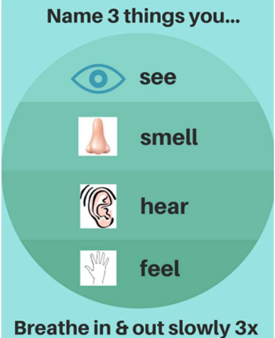
General DOs and DON’Ts
Do:
Stay calm
Stop the exam
Provide reassurance
Use grounding techniques
Make a self-care plan
Do not:
Engage in the trauma
Bombard with questions
Image: www.socialwork.career
Notes:
www.socialwork.career

Slide 35
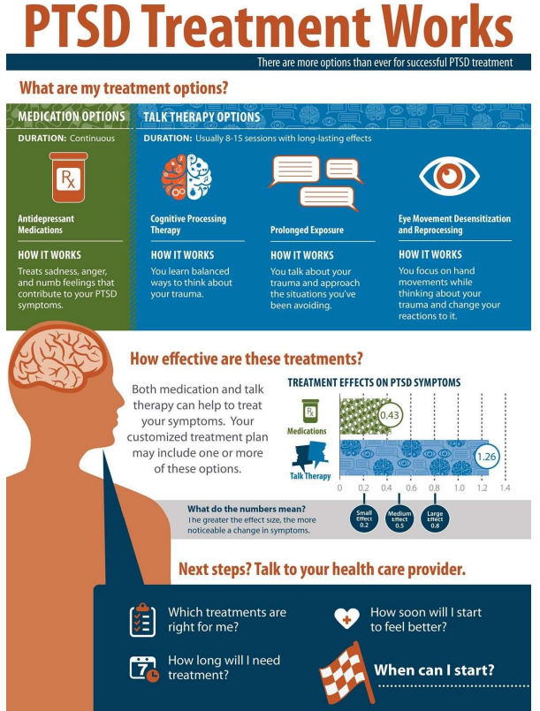
Image: www.PTSD.va.gov

Slide 36
References
Microsoft PowerPoint - SGM Minority Stress-TIC Talk FINAL 3-25-19 (fenwayhealth.org) by Jennifer Potter and Conall O’Cleirigh
trauma-informed-exam-tool-e.pdf (cpha.ca) Copyright © 2021 | Canadian Public Health Association
Eckstrand & Potter (eds.) Trauma, Resilience, and Health Promotion in LGBT Patients. Springer (2017).
VA/DoD PTSD Clinical Practice Guideline: https://www.healthquality.va.gov/guidelines/MH/ptsd/VADoDPTSDCPGClinicianSummaryFinal.pdf

Slide 37
Resources
National Clinician Consultation Center http://nccc.ucsf.edu/
  HIV Management
  Perinatal HIV
  HIV PrEP
  HIV PEP line
  HCV Management
  Substance Use Management
Present your case on ECHO
http://echo.unm.edu hivecho@salud.unm.edu
AETC National HIV Curriculum https://aidsetc.org/nhc
AETC National Coordinating Resource Center https://targethiv.org/library/aetc-national-coordinating-resource-center-0
HIVMA Resource Directory https://www.hivma.org/globalassets/ektron-import/hivma/hivma-resource-directory.pdf
Additional trainings scaetcecho@salud.unm.edu
Notes:
Find additional ECHO sessions in your area: https://echo.unm.edu/locations-2/echo-hubs-superhubs-united-states/
https://hsc.unm.edu/echo/get-involved/join-an-echo/
IDEA Platform: Infectious Diseases Education & Assessment. https://idea.medicine.uw.edu/
AETC National HIV Curriculum: 6 core modules for self study; regularly updated; CME, CNE
Hepatitis C Online Curriculum: https://www.hepatitisc.uw.edu/
Hepatitis B Online Curriculum: https://www.hepatitisb.uw.edu/
National STD Curriculum: https://www.std.uw.edu/

Slide 38
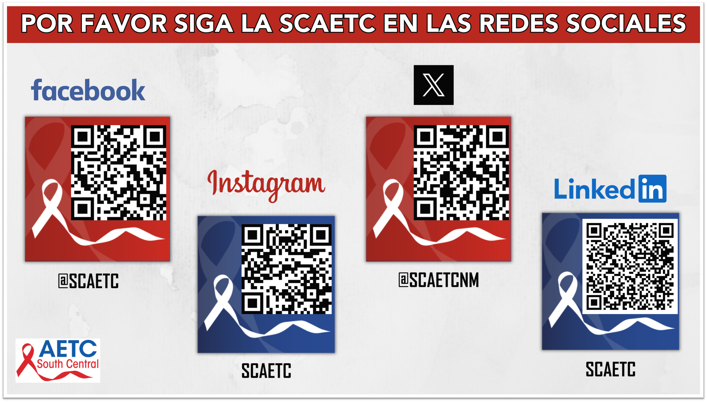
Notes:
Find an HIV-related topic TeleECHO in your area: https://echo.unm.edu/locations-2/echo-hubs-superhubs-united-states/
IDEA Platform: Infectious Diseases Education & Assessment. https://idea.medicine.uw.edu/
AETC National HIV Curriculum: 6 core modules for self study; regularly updated; CME, CNE
Hepatitis C Online Curriculum: https://www.hepatitisc.uw.edu/
Hepatitis B Online Curriculum: https://www.hepatitisb.uw.edu/
National STD Curriculum: https://www.std.uw.edu/

