Slide 1
Addressing HIV Myths in Rural Nevada
Victoria Young, MPH
Senior Program Manger
Pacific AETC-NV
University of Nevada, Reno School of Medicine
Ivy T. Spadone, MS, PA-C, AAHIVS
Assistant Professor
University of Nevada, Reno School of Medicine
Pacific AETC-NV Faculty

Slide 2
Disclaimer
The views and opinions expressed in this presentation are not necessarily those of the Pacific AIDS Education & Training Center (Pacific AETC) or its eight local partner sites in HRSA Region 9, the Regents of the University of California or its San Francisco campus (UCSF or collectively, University) nor of our funder the Health Resources and Services Administration (HRSA). Neither Pacific AETC, University, HRSA nor any of their officers, board members, agents, employees, students, or volunteers make any warranty, express or implied, including the warranties of merchantability and fitness for a particular purpose; nor assume any legal liability or responsibility for the accuracy, completeness or usefulness of information, product or process assessed or described; nor represent that its use would not infringe privately owned rights.
HRSA Acknowledgement Statement
The Pacific AETC is supported by the Health Resources and Services Administration (HRSA) of the U.S. Department of Health and Human Services (HHS) as part of an award totaling $3,887,700.00. The contents are those of the author(s) and do not necessarily represent the official views of, nor an endorsement, by HRSA, HHS, or the U.S. Government. For more information, please visit HRSA.gov.
Trade Name Disclosure Statement
Funding for this presentation was made possible by 5 U1OHA29292‐08‐00 from the Human Resources and Services Administration HIV/AIDS Bureau. The views expressed do not necessarily reflect the official policies of the Department of Health and Human Services nor does mention of trade names, commercial practices, or organizations imply endorsement by the U.S. Government. Any trade/brand names for products mentioned during this presentation are for training and identification purposes only.

Slide 3
Disclosures
All presenters of this continuing medical education activity have indicated that neither they nor their spouse/legally recognized domestic partner has any financial relationships with commercial interests related to the content of this activity.

Slide 4
Learning Objectives
At the completion of this presentation, participants will be able to:
Compare Nevada’s HIV Epidemiology data with other states
Discuss why HIV screening is important
Examine case presentation from rural Nevada
Describe HIV and STI resources for Nevada providers

Slide 5

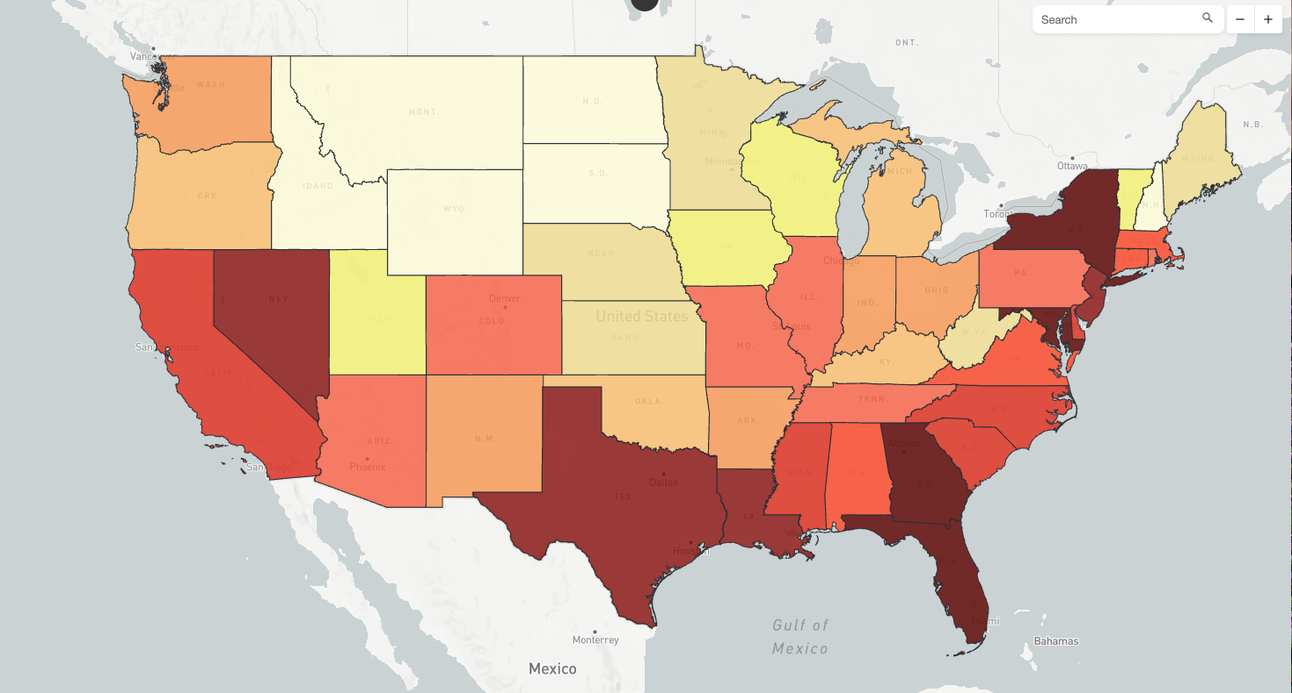
Myth: HIV is not a Problem in Nevada
Rate per 100,000
Prevalence Rates:
Georgia 657
Florida 625
Louisiana 559
Nevada 431
California 411
Texas 415
U.S. 305
2021
(CFAR, 2023)

Slide 6
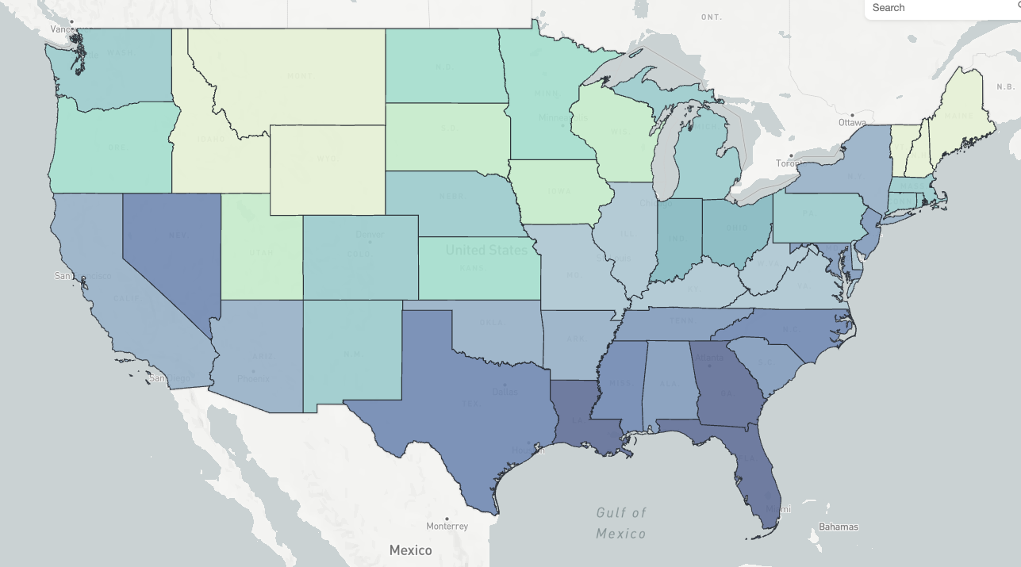
Myth: HIV is not a Nevada Problem
Rate per 100,000
New Diagnosis Rates:
Georgia 26
Florida 22
Louisiana 23
Nevada 19
Texas 18
California 13
U.S. 12
2021
(CFAR, 2023)

Slide 7
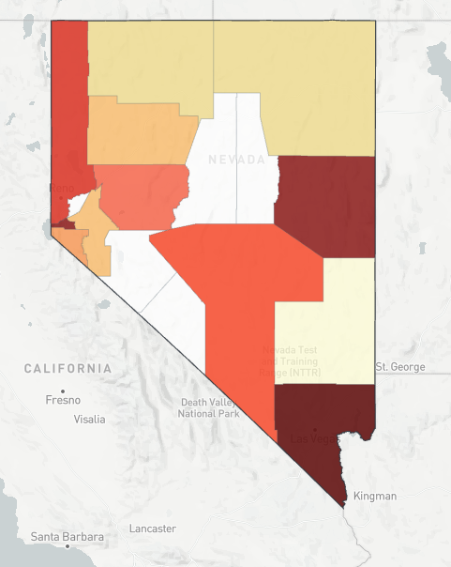
Closer Look at Nevada
2022 Nevada HIV Data:
13,299 people with HIV living in Nevada
535 New HIV Diagnoses
(CFAR, 2023), ( NV DPBH, 2023)

Slide 8
HIV Prevalence Rates 2018-2022
(NV DPBH, 2018-2022)

Slide 9
New HIV Diagnosis 2018-2022
(NV DPBH, 2018-2022)

Slide 10
New HIV Diagnosis by Sex, 2018-2022
(NV DPBH, 2018-2022)

Slide 11
New HIV Diagnosis by Age and Sex, 2022
(NV DPBH, 2018-2022)

Slide 12
HIV New Diagnosis by Race and Ethnicity,
2018-2022
(NV DPBH, 2018-2022)

Slide 13
Facility of Diagnosis for New Diagnosis, 2022
(NV DPBH, 2018-2022)

Slide 14
Transmission Category for New Diagnosis, 2022
(NV DPBH, 2018-2022)

Slide 15
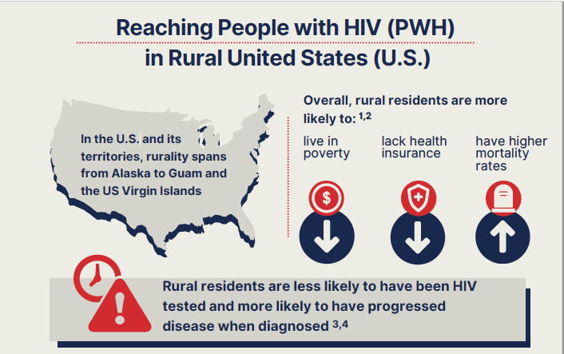
Reaching People with HIV in Rural U.S.
(AETC NCRC, 2024)

Slide 16
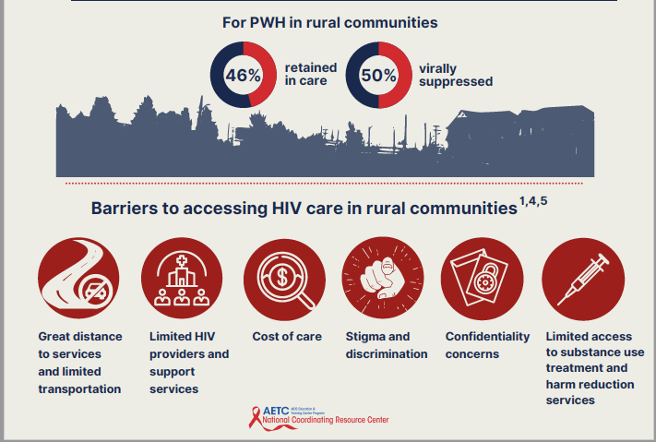
Barrier to accessing HIV Care in Rural Communities
(AETC NCRC, 2024)

Slide 17
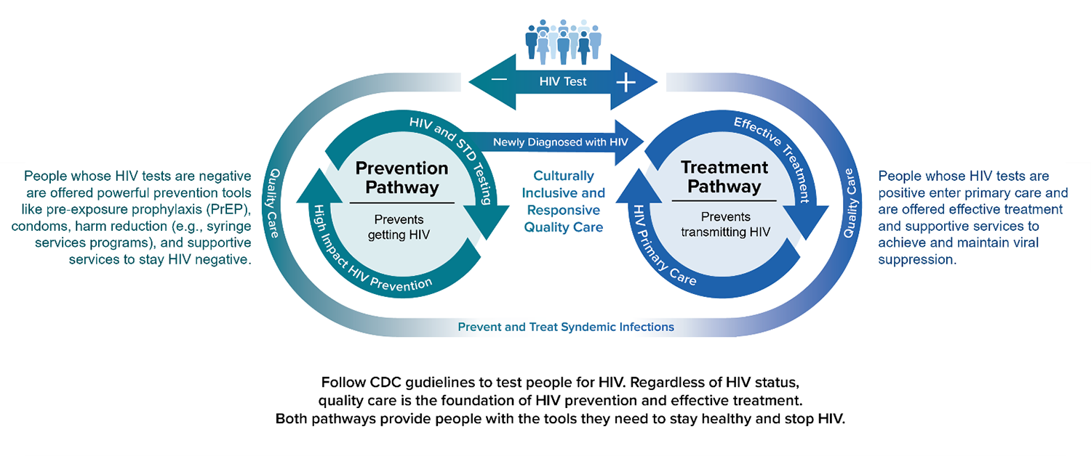
Why is HIV Screening Important?
Health care providers who routinely screen for HIV play a key role in improving outcomes at each step of the HIV prevention and care continuum.³ For patients with a negative HIV result, assess their needs and risk and link them to prevention tools, such as PrEP, condoms, and risk-reduction counseling.
(CDC, 2022)
Notes:
https://www.cdc.gov/hiv/clinicians/screening/patient-benefits.html#:~:text=Health%20care%20providers%20who%20routinely,HIV%20prevention%20and%20care%20continuum.&text=For%20patients%20with%20a%20negative,%2C%20and%20risk%2Dreduction%20counseling.

Slide 18
Screening for HIV Guidelines
At least once
ALL 13 to 64 years old (15 to 65 for USPSTF)
At least annually
ALL sexually active MSM (along with syphilis, gonorrhea, chlamydia screen)
Anyone who has unsafe sex or shares injection drug equipment (along with HCV screen)
(CDC, 2020) (USPSTF, 2022)

Slide 19
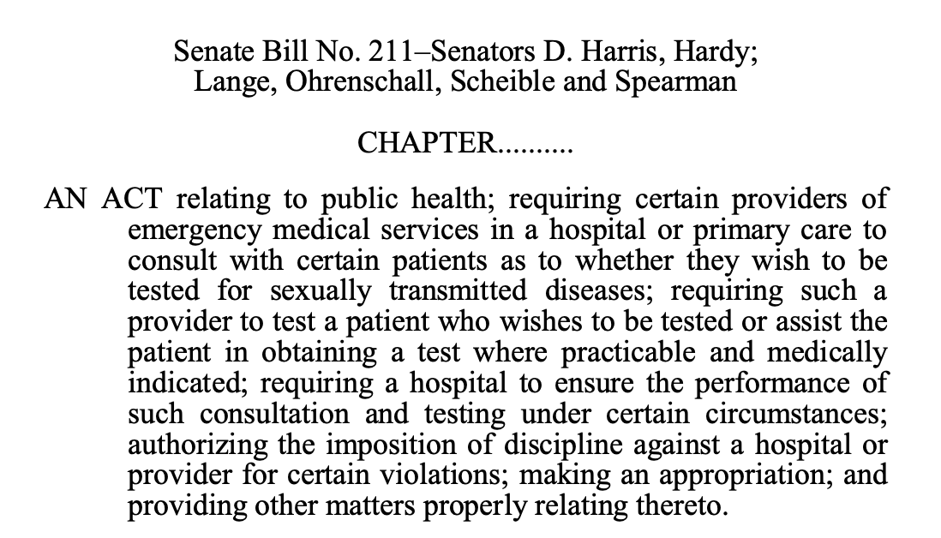
Nevada Senate Bill 211 (2021)
(NDPBH, 2021)

Slide 20
Myth: The numbers are so low that I won’t see anyone with HIV in my clinic.

Slide 21
Consider the case of Mr. S
62 y/o male seen as new patient in primary care s/p ER visit for an allergic reaction. Was cutting down trees in back yard, developed a rash on his arms and legs and angioedema in his left arm. Some shortness of breath, seen in ER. Given Claritin, Pepcid, dose of steroid. Told to establish primary care
Seen in PC office for first time one week after. Patient screened during social history for substance use. Patient states sober for about 5 years. But did use substances (IV) in the past. PC added HIV antibody test to lab work. Never been tested for HIV previously.

Slide 22
Mr. S:
HIV Ab: Positive
HIV Multispot: Positive
Hep A Ab, Total: Negative
Hep B surface Ag: Neg
Hep B core Ab: Pos
Hep B Surf Ab: <3.1
Hep C Ab: Neg
Absolute CD4: 30/2.7%
HIV-1 RNA by PCR:
234,000 copies/ml with
log10 5.369
RPR: 1:1
Lipids: C = 249, TG: 92, HDL: 56,LDL 177
CBC: normal
HIV Genosure: no identified mutations
ALT: 21
AST: 15
Creat: 1.17
QFN: Negative
GC/Chlamydia : neg

Slide 23
Myth: My patient have already been screened by other providers

Slide 24
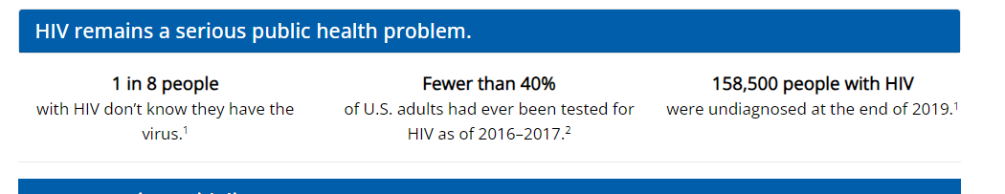
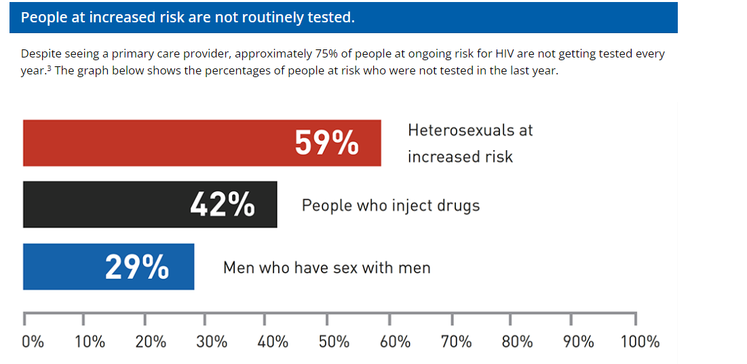
Why screen?
(CDC, 2023)
Notes:
24

Slide 25
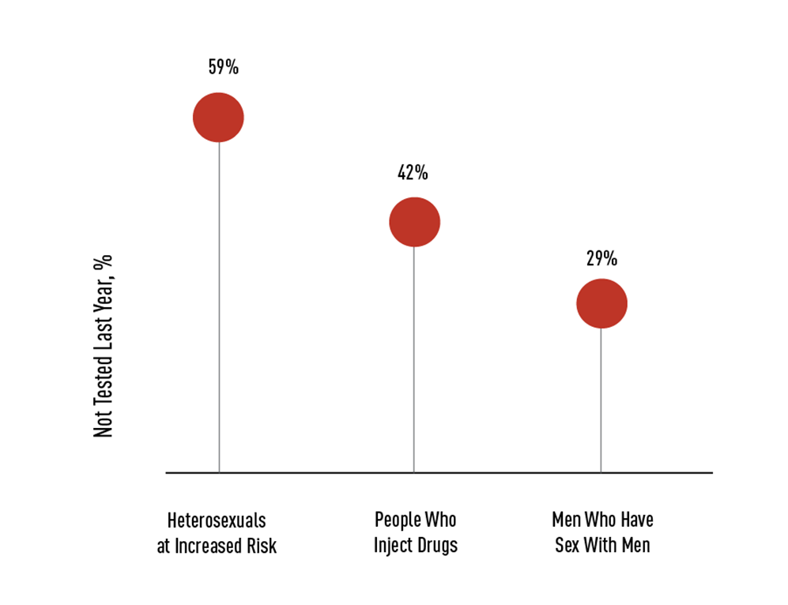
Missed Opportunities
Missed Opportunities for HIV Testing
7 out of 10 patients at risk for HIV who were not tested for HIV in the past year saw a primary care provider during that period
75%of those patients who saw their primary care provider were not offered a test
(CDC, 2022)

Slide 26
Myth: I don’t have the equipment to screen and it is too expensive

Slide 27
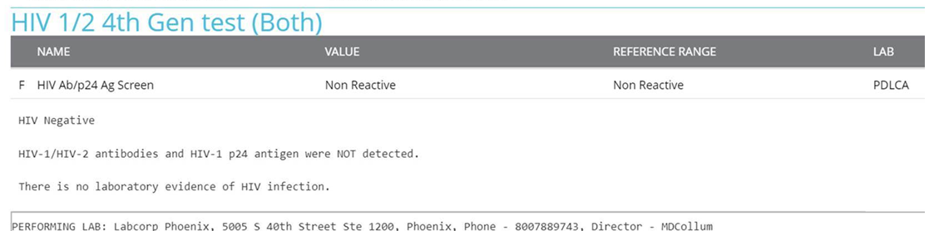
RAPID VS IN LAB TESTING (SCREENING)
Rapid tests:
    1 min, fingerstick—Ab test (INSTI)
    20 minutes, fingerstick– Ag and Ab test (Alere 4th gen)
Lab tests:
    Venipuncture
    24 hours
    enzyme linked immunoassay
    Ab test
(Spadone Image, 2022)

Slide 28
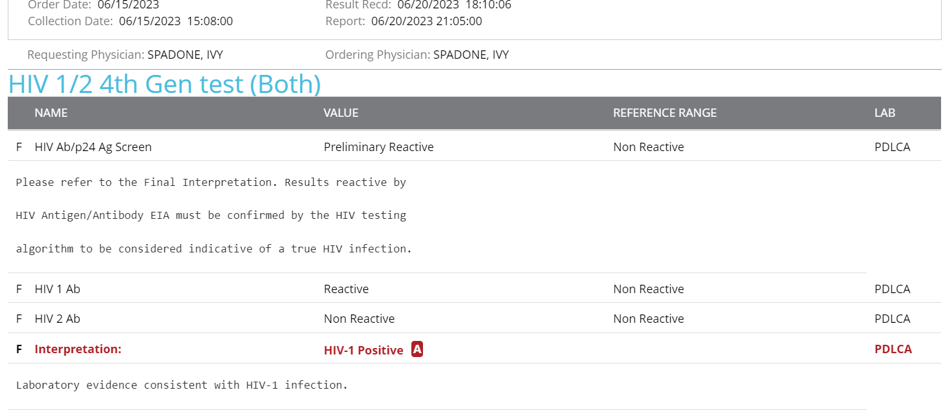
HIV confirmation:
(Spadone Image, 2022)

Slide 29
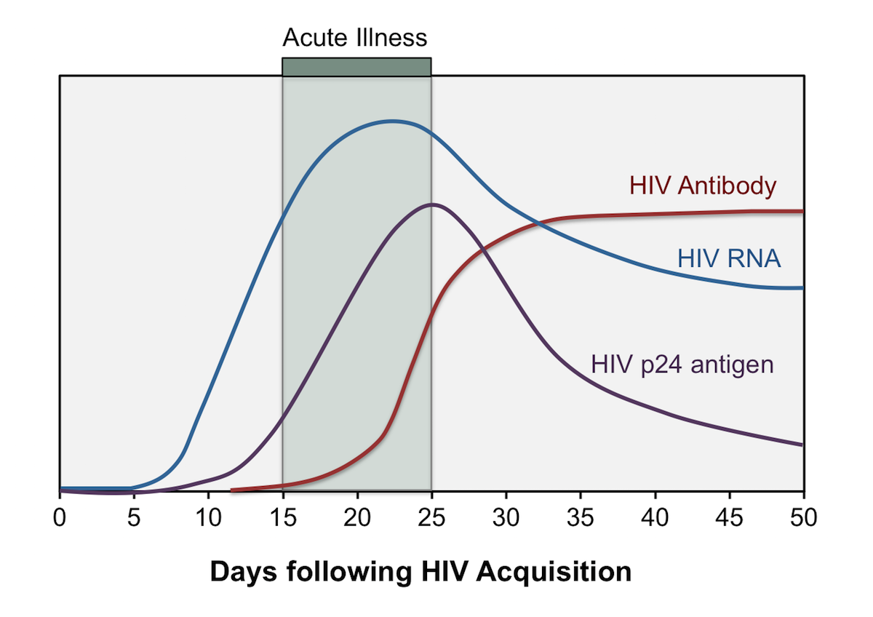
Which test to use?
Determination of which Ab test to use, based on patient’s history of exposure and symptoms at the time of testing
(CDC, 2022)

Slide 30
Myth: We really don’t have many cases of sexually transmitted infections in the rural areas

Slide 31
STI testing
Frequency dependent on risk
Sexual history: 5Ps
Partners
Practices
Prevention
Pregnancy
Previous STI
Multisite STI screening and testing– videos
https://preprx.ucsf.edu/self-swab-sti-testing
(CDC, 2022) (UCSF, 2023)

Slide 32

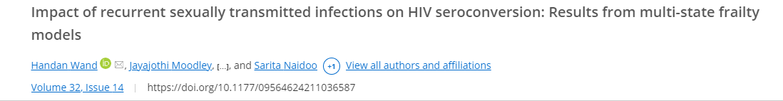
Journal articles
South Africa—epicenter of HIV epidemic
Study published in 2021
Highest burden of STIs
Studied cumulative impact of recurrent STIs on HIV seroconversion
Conclusion: recurrent STIs increases rates of HIV.
65% of HIV infections associated with recurrent STIs
(CDC, 2022)

Slide 33
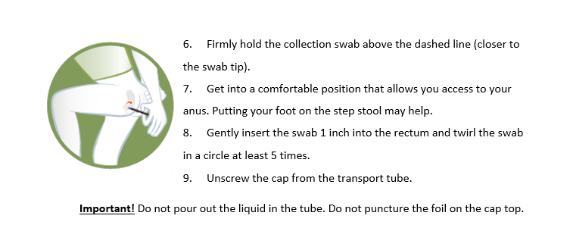
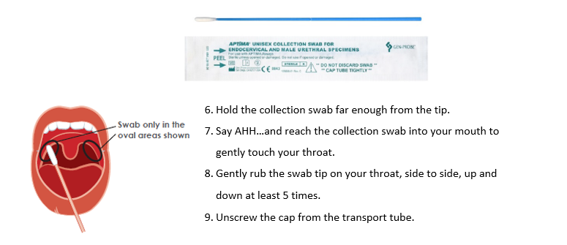
Collection Methods
Collection Methods
(CDC, 2022)
Notes:
Spanish and Chinese

Slide 34
Myth: There is no place for me to send a patient with HIV in Nevada

Slide 35


National HIV Curriculum
(National HIV Curriculum, 2024)
Notes:
National HIV Curriculum

Slide 36
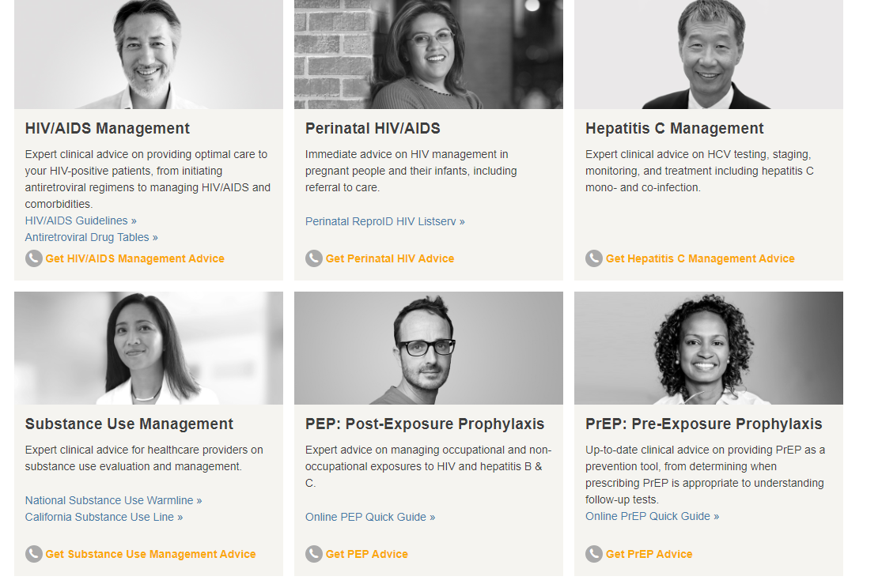
NATIONAL CLINICIAN CONSULTATION CENTER
(National Clinician Consultation Center, 2024)

Slide 37
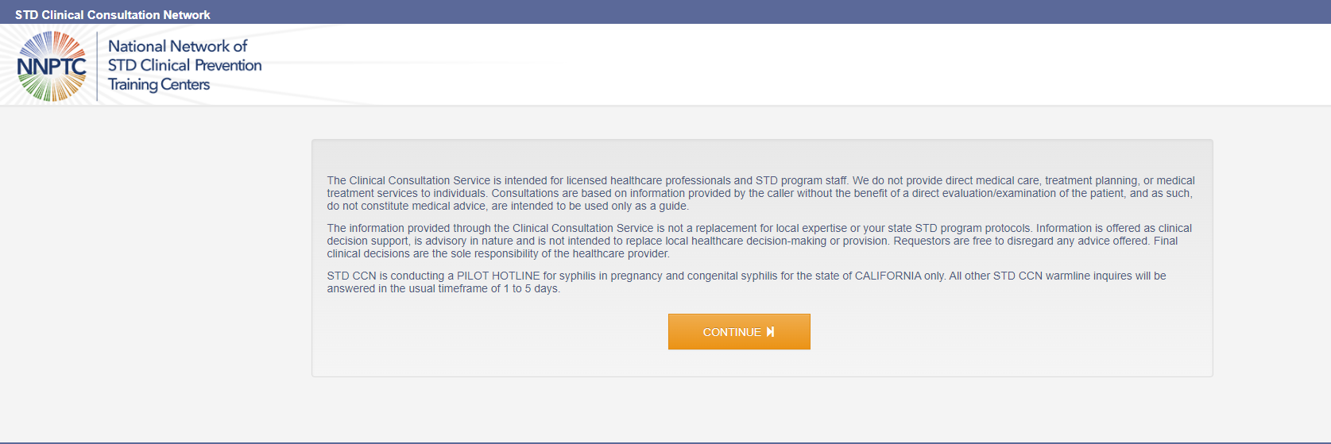
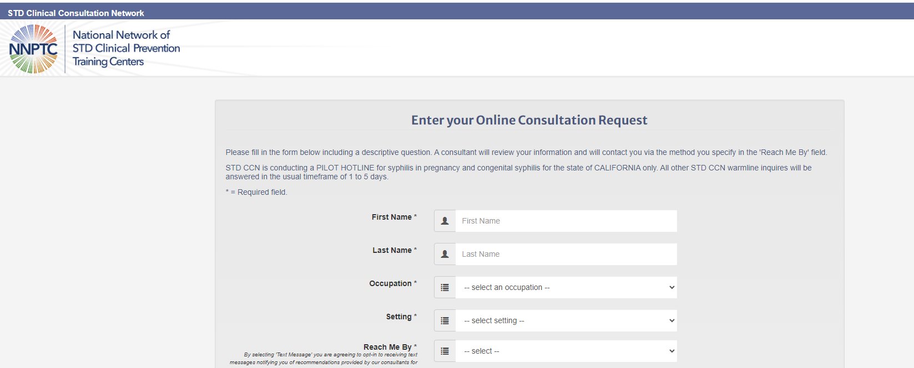
NNPTC
(National Network of STD Clinical Prevention and Training Center , 2024)

Slide 38
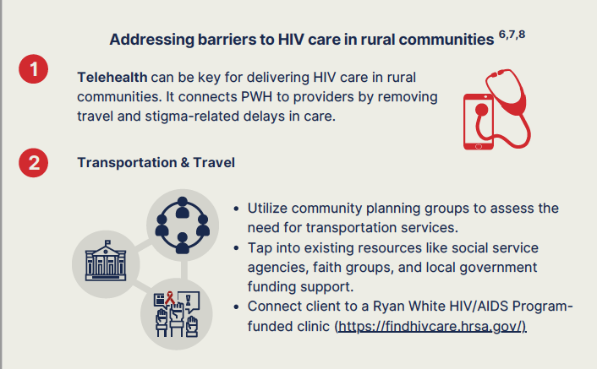
Addressing Barriers to Care in Rural Communities
(AETC NCRC, 2024)

Slide 39
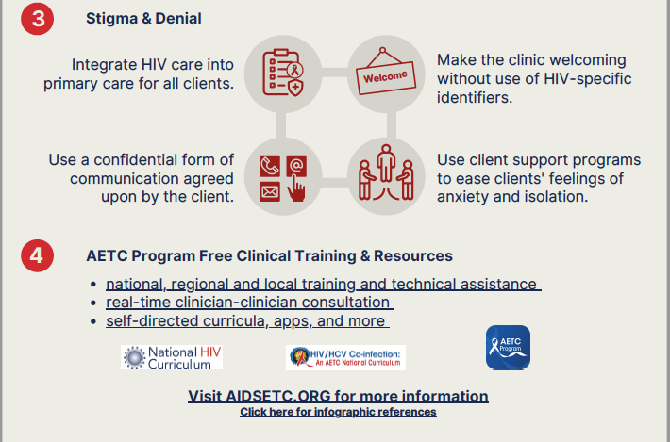
Addressing Stigma and Free Training
(AETC NCRC, 2024)

Slide 40
Statewide Resources
Rethink HIV - This great HIV resource for patient education https://www.rethinkhivnevada.org
Rethink Safe sex- This great STI resource for patient education https://www.rethinksafesexnv.org
Collect2Protect- At Home HIV, Gonorrhea, and Chlamydia testing with video and instructions in English and Spanish (free or low cost).
  https://www.southernnevadahealthdistrict.org/programs/collect-2-protect/
State of Nevada Website on HIV Treatment and Testing
  https://endhivnevada.org/testing-and-treatment/
Nevada Medicaid Covers Condoms with an RX

Slide 41
Northern Nevada Resources
Northern Nevada HOPES- HIV care and treatment
  https://www.nnhopes.org/hiv/
Change Point- Harm Reduction
  https://www.nnhopes.org/patients/services/change-point/
Carson City Health and Human Services
  https://www.gethealthycarsoncity.org/divisions/chronic-disease-prevention-health-promotion/hiv-aids-stds
Accept- HIV screening and support
  https://acceptonline.org/

Slide 42
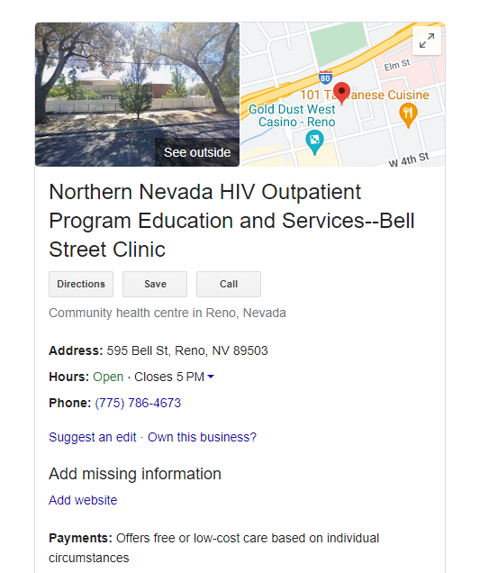
Northern Nevada HIV Outpatient Program Education and Services ( NNHOPES)
(NNHOPES, 2024)

Slide 43
Southern Nevada Resources
Southern Nevada Health District
  Sexual Health Clinic- HIV and STI screening
    https://www.southernnevadahealthdistrict.org/community-health-center/sexual-health-clinic/
  Empower Change- Rapid HIV Testing and Counseling Training Program
    https://impactchange.southernnevadahealthdistrict.org
UMC Wellness Center- resource HIV prevention and care
  https://www.umcsn.com/medical-services/hiv-aids-wellness-center
Impact Exchange – Harm reduction center
  https://www.harmreductioncenterlv.com/services
Community Outreach Medical Center - resource HIV prevention and care
  https://www.communityoutreachmedicalcenter.org
The Center-resource HIV prevention and care
  https://thecenterlv.org

Slide 44
Southern Nevada Resources continued
Rapid stART Response Team ( not just limited to Las Vegas!)
To link patients to care
  855-RAP1DNV (855-727-1368)
  Contact: Veronica Arana
  Phone: 702-400-7442
  Email: varana@thecenterlv.org

Slide 45

Questions
This Photo by Unknown Author is licensed under CC BY

Slide 46
References
State of NV, Office of HIV. Division of Public and Behavioral Health. 2018-2022 HIV Fast Facts. Las Vegas, Nevada. e1.0. July 2023
Office of State Epidemiology. Division of Public and Behavioral Health. Nevada Carson City, Nevada. November 2023.
Center for AIDS Research at Emory University. AIDSVu. 2023. Emory University’s Rollins School of Public Health
Center for Disease Control and Prevention, 2023. How Does Routine HIV Screening Benefit My Patients? Accessed March 2024 here.
Nevada Division of Public and Behavior Health. Senate Bill 211 Summary. Access March 2024 here.
Center for Disease Control and Prevention, 2023. Screening for HIV. Accessed March 2024 here.
AETC NCRC. Reaching People with HIV in Rural United States. 2021. Access March 2024 here
Images on slide 27, 28 owned by Ivy Spadone

