Slide 1
The Pacific AIDS Education & Training Center and HIV Medications Overview
Louie Mar Gangcuangco, MD, MSc, AAHIVS
Assistant Professor of Medicine, Hawaii Center for AIDS
John A Burns School of Medicine, University of Hawaii at Manoa
Principal Investigator, Pacific AIDS Education & Training Center –
Hawaii and US-affiliated Pacific Islands
April 4, 2024

Slide 2
Disclaimer
The views and opinions expressed in this presentation are not necessarily those of the Pacific AIDS Education & Training Center (Pacific AETC) or its eight local partner sites in HRSA Region 9, the Regents of the University of California or its San Francisco campus (UCSF or collectively, University) nor of our funder the Health Resources and Services Administration (HRSA). Neither Pacific AETC, University, HRSA nor any of their officers, board members, agents, employees, students, or volunteers make any warranty, express or implied, including the warranties of merchantability and fitness for a particular purpose; nor assume any legal liability or responsibility for the accuracy, completeness or usefulness of information, product or process assessed or described; nor represent that its use would not infringe privately owned rights.
​
HRSA Acknowledgement Statement​ The Pacific AETC is supported by the Health Resources and Services Administration (HRSA) of the U.S. Department of Health and Human Services (HHS) as part of an award totaling $4,377,449. The contents are those of the author(s) and do not necessarily represent the official views of, nor an endorsement, by HRSA, HHS, or the U.S. Government. For more information, please visit HRSA.gov.
​
Trade Name Disclosure Statement​ Funding for this presentation was made possible by 5 U1OHA29292‐08‐00 from the Human Resources and Services Administration HIV/AIDS Bureau. The views expressed do not necessarily reflect the official policies of the Department of Health and Human Services nor does mention of trade names, commercial practices, or organizations imply endorsement by the U.S. Government. Any trade/brand names for products mentioned during this presentation are for training and identification purposes only.

Slide 3
Objectives
Discuss the mission and vision of the Pacific AIDS Education and Training Center
Compare and contrast various antiretroviral therapy options when initiating treatment for people with HIV
Identify indications and contraindications to common antiretrovirals for HIV

Slide 4
About the Pacific AETC – HIAPI [1]
The Pacific AETC – Hawai`i & US-Affiliated Pacific Islands (HIAPI) provides HIV/AIDS capacity building, technical assistance, prevention education, and clinical training/consultation to health care providers, community health centers and care team staff throughout the State.

Slide 5
AETC Regions & Regional Offices
Notes:
The Pacific AIDS Education & Training Center (Pacific AETC) is a member of a national AIDS Education & Training Center network of eight regional and two national centers, covering all 50 states as well as US Territories and Jurisdictions

Slide 6
About the Pacific AETC – HIAPI [2]
Programs feature collaborations with community-based organizations and the private sector, which has enhanced linkage to care, reengagement in care and medication adherence activities.
For well over a decade, Pacific AETC-HIAPI has provided clinical education and training services to the resource challenged US Pacific Island Jurisdictions.

Slide 7
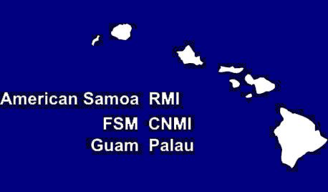
Regions Served by the Pacific AETC-HIAPI
State of Hawai‘i and US Pacific Island Jurisdictions:
American Samoa
Guam
Federated States of Micronesia (Chuuk, Kosrae, Pohnpei, Yap)
Commonwealth of the Northern Mariana Islands
Republic of Palau
Republic of the Marshall Islands

Slide 8
Pacific AETC HIAPI: Vision & Mission
Vision:
Attain health equity for all to end the HIV epidemic in Hawaiʻi and the Pacific.
Mission:
Empower and educate the health workforce to improve HIV health equity in Hawaiʻi and theUS-Affiliated Pacific.

Slide 9
Human Immunodeficiency Virus (HIV)
HIV causes Acquired Immune Deficiency Syndrome (AIDS)
HIV attacks the immune system, making it difficult for the body to fight infections
Without treatment, People with HIV (PWH) will develop AIDS
Treatment greatly delays disease progression and prevents HIV transmission
Notes:
Starting with the basics
Here, you see an illustration of the Human Immunodeficiency Virus, HIV.
This is the virus that causes AIDS, the Acquired Immune Deficiency Syndrome. You might hear people use the term “Advanced HIV” because the term AIDS is being used less and less these days in medical settings.
Without treatment, HIV breaks down the immune systems and leaves it unable to fight infections.
With consistent treatment, however, someone newly diagnosed with HIV should expect to never be given an AIDS diagnosis nor even to transmit the virus to their sexual partners.
A really important teaching point to keep in mind when working with clients is that HIV and AIDS are not the same thing. HIV is the virus. AIDS is the disease state that happens over a number of years if HIV is left untreated. AIDS or Advanced HIV, is the a clinical definition of what happens when HIV goes untreated.
In my work, I find that it can give people a sense of control over their diagnosis as HIV+ to know that by taking medications to treat HIV, they are proactively keeping themselves healthy, keeping Advanced HIV at bay, and they are protecting their sex partners. My taking medications, they are taking action to keep themselves healthy…taking control and exerting their power over the diagnosis.
So, in respect to the question of why should someone get tested? Well, to know their status and if HIV-, take the proper steps to protect themselves from getting HIV such as taking PrEP, using condoms, or other prevention methods. And if HIV+, to engage in medical care and get on treatment to maintain their long-term health and protect their partners.

Slide 10
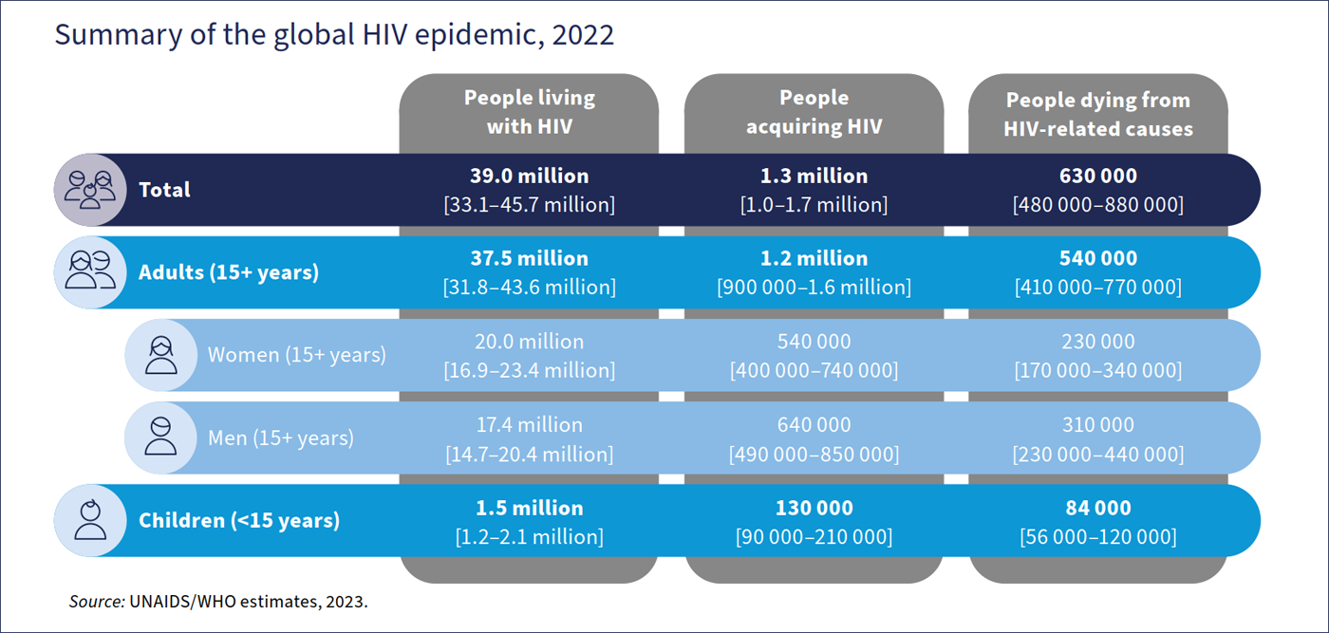
WHO HIV Epidemic 2023 estimates
World Health Organization. HIV data and statistics. Accessed Feb 19, 2024.

Slide 11
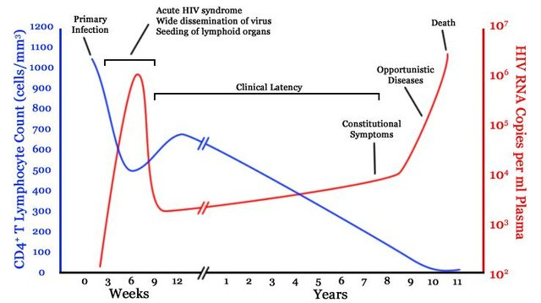
Natural History of untreated HIV infection
Popoola and Awodele. Afr. J. Med. med. Sci. (2016) 45, 5 - 21
Notes:
This is a figure presenting the natural history of untreated HIV infection. The blue line shows the level of CD4 T lymphocytes while the red line shows the HIV viral load. HIV is a virus that destroys the immune system, primarily infecting CD4 lymphocytes. During the first few years of HIV infection, the body is able to control the virus but after several years, the CD4 lymphocytes get depleted and viral load increases significantly. At this point, the patient would be susceptible to various bacterial, viral, and fungal infections.

Slide 12
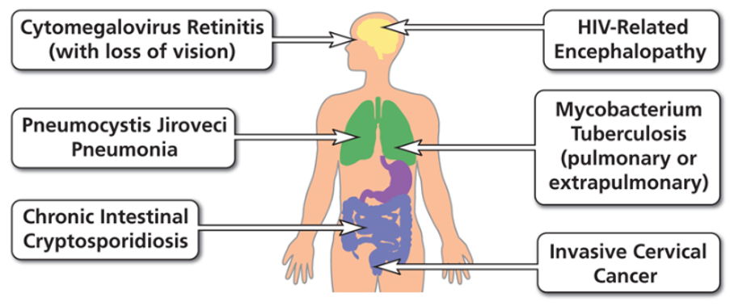
Examples of AIDS-Defining Conditions
https://aidsinfo.nih.gov/understanding-hiv-aids/glossary/784/aids-defining-condition

Slide 13
HIV Life Cycle
Notes:
This is a depiction of the HIV Life cycle from infection to the production of new virus. The cycle will be broken down into sections to describe the targets of HIV treatment.

Slide 14
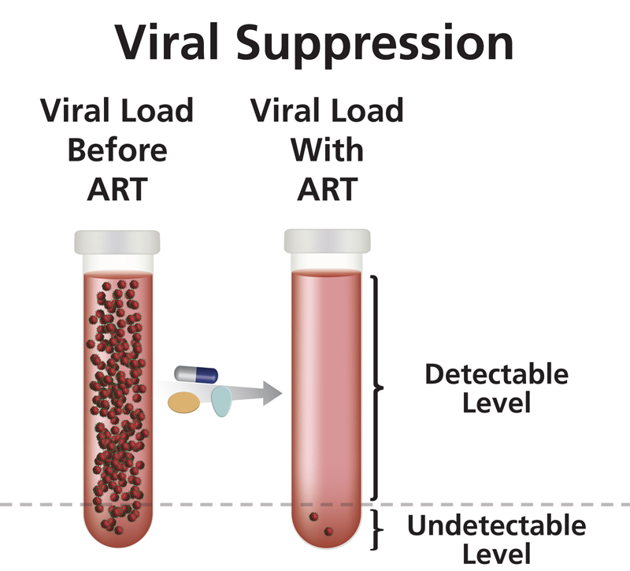
Antiretroviral Treatment (ART)
Clinical Goals
Reduce viral load as much as possible for as long as possible
Increase CD4 cell count
Ensure medication adherence to preserve ART options
Preserve quality of life
Reduce HIV transmission
https://clinicalinfo.hiv.gov/en/glossary/viral-suppression
U=U Undetectable = Untransmittable
Notes:
Once linked to care, medical clinicians will do a full panel of baseline labs and then start patients on Antiretroviral Treatment or ART with the clinical goals of:
Reducing HIV viral load to undetectable and keeping it that way
Increasing CD4 cell count and maintaining it in the normal range between 500 and 1600
Ensuring ART adherence on simple first line regimens such as one-pill-once-a-day meds
Preserving a patient’s quality of life
And reducing HIV transmission
Just to re-emphasize, a really empowering point for PWH is that when someone achieves an undetectable viral load and sustains it for longer than six months, research has shown that they cannot transmit HIV to their sexual partners.

Slide 15
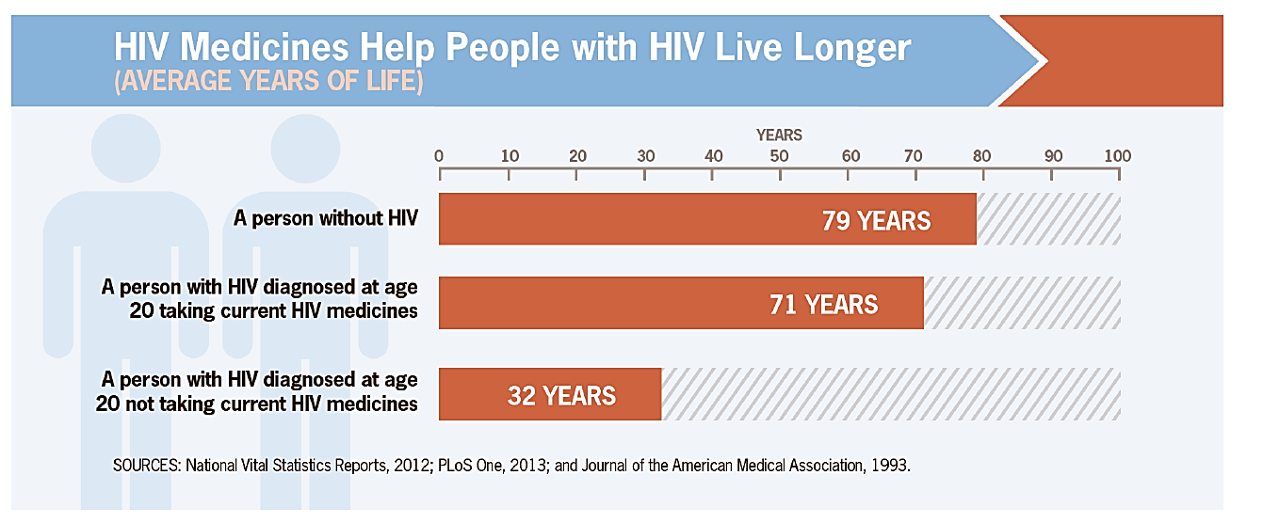
Effective Treatment Saves Lives
Infection is lifelong – HIV is treatable but not curable​

Slide 16
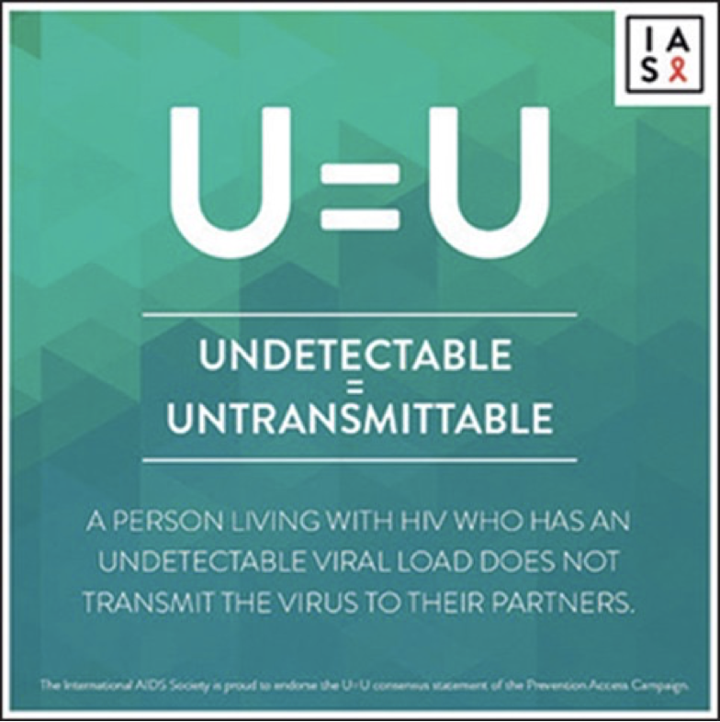
U=U and "Treatment as Prevention" has revolutionized HIV prevention and care
“HIV stigma is a public health crisis, and yet many people in positions of power are still sitting on their hands, overstating risk and not sharing this life changing information! We need people to move away from controlling people with HIV and toward trusting people with HIV.” (Bruce Richman, Prevention Access Campaign 2017)
Notes:
U=U and "Treatment as Prevention" has revolutionized HIV prevention and care

Slide 17
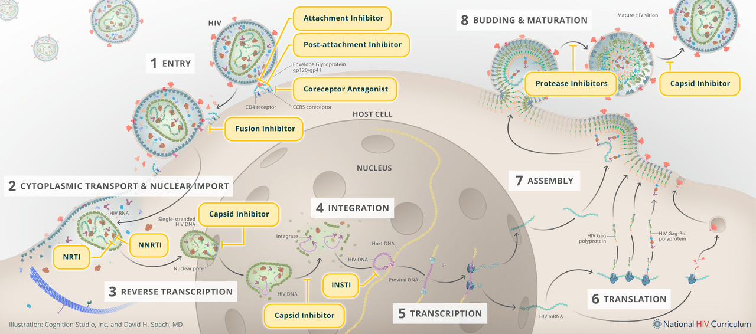
Site of Inhibitors of Viral Replication
Illustration: Cognition Studio, Inc. and David H. Spach, MD. Available at: https://www.hiv.uw.edu/go/antiretroviral-therapy/general-information/core-concept/all Accessed March 5, 2024.

Slide 18
Recommended Initial Regimens for Most People with HIV (in alphabetical order)
bictegravir/tenofovir alafenamide/emtricitabine (fixed-dose combination)
dolutegravir/abacavir/lamivudine (fixed-dose combination)
only for individuals who are HLA-B*5701 negative and without chronic hepatitis B virus (HBV) coinfection
dolutegravir + (tenofovir alafenamide or tenofovir disoproxil fumarate) + (emtricitabine or lamivudine)
dolutegravir/lamivudine (fixed-dose combination)
except for individuals with HIV RNA >500,000 copies/mL, HBV coinfection, or when ART is to be started before the results of HIV genotypic resistance testing for reverse transcriptase or HBV testing are available.
AIDS Panel on Antiretroviral Guidelines for Adults and Adolescents. Guidelines for the Use of Antiretroviral Agents in Adults and Adolescents with HIV. Department of Health and Human Services. Available at https://clinicalinfo.hiv.gov/en/guidelines/adult-and-adolescent-arv. Accessed December 2023
Notes:
Note: For people with a history of using cabotegravir as PrEP: INSTI genotypic resistance testing should be done before the start of ART. If treatment is begun prior to results of genotypic testing, the following regimen is recommended: Boosted darunavir plus (TAF or TDF) plus (FTC or 3TC) — pending the results of the genotype test (AIII)

Slide 19
Preferred Initial Regimens in Pregnancy who are Antiretroviral Naïve
Fixed dose combination: dolutegravir/abacavir/lamivudine
NOTE: only for HLA-B*5701 negative individuals
dolutegravir plus a preferred dual NRTI backbone:
TAF/FTC
TAF plus 3TC
TDF/FTC
TDF/3TC
Abbreviations: 3TC: lamivudine; FTC: emtricitabine; TAF: tenofovir alafenamide; TDF: tenofovir disoproxil fumarate
Other options may be appropriate
Panel on Treatment of HIV During Pregnancy and Prevention of Perinatal Transmission. Recommendations for the Use of Antiretroviral Drugs During Pregnancy and Interventions to Reduce Perinatal HIV Transmission in the United States. DHHS. Available at https://clinicalinfo.hiv.gov/en/guidelines/perinatal. Accessed Feb 26, 2024.

Slide 20
Pre-exposure prophylaxis (PrEP)
PrEP is an HIV prevention method in which people who do NOT have HIV take HIV medicine daily to reduce their risk of getting HIV.
“20220627_Morristown-017” by John O’Boyle is licensed by CC BY-NC-ND 2.0 cropped from original

Slide 21
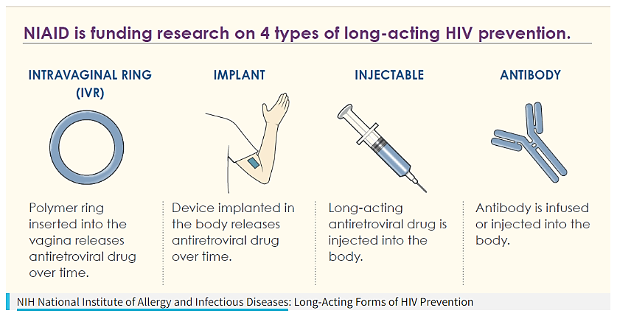
Long-acting HIV Prevention tools
“Long-Acting Forms of HIV Prevention Infographic” NIAID (CC BY 2.0) Cropped from the original; red box added.
Studies have shown that PrEP is much less effective if it is not taken consistently, and that taking a daily pill can be challenging for some people.
Researchers are working to create new HIV prevention tools that do not require taking a daily pill.
Notes:
Link: https://www.hiv.gov/hiv-basics/hiv-prevention/potential-future-options/long-acting-prep/

Slide 22
In Summary
The Pacific AETC – HIAPI provides HIV/AIDS capacity building, technical assistance, prevention education, and clinical training/consultation to health care providers, community health centers and care team staff throughout the State.
Advances in HIV antiretroviral therapy has allowed for people with HIV to have life expectancy similar to HIV-seronegative individuals.
Daily pills called PrEP (pre-exposure prophylaxis) are highly effective in preventing HIV acquisition

Slide 23
Questions?
Louie Mar Gangcuangco, MD
louiemag@hawaii.edu

