Slide 1
Let’s Talk About Sex
Sarah Waldman, MD
Division of Infectious Diseases, UC Davis
Central Valley AIDS Education & Training Center

Slide 2
Authors and Funders
This presentation was prepared by Sarah Waldman from the Central Valley office of the Pacific AETC in February 2020.
This presentation is supported by the Health Resources and Services Administration (HRSA) of the U.S. Department of Health and Human Services (HHS) under grant number # U1OHA29292-01-01 awarded to the Central Valley AETC. No percentage of this project was financed with non-governmental sources. This information or content and conclusions are those of the authors and should not be construed as the official position or policy of, nor should any endorsements be inferred by HRSA, HHS or the U. S. Government.

Slide 3
REGISTRATION LINK
http://bit.ly/elicareg
Notes:
Our goals today are:
Think about and test for…
HIV in the primary care setting, as well as…
Other sexually transmitted infections (STIs)
Understand current recommendations for STI screening in the general population and in higher risk individuals (MSM’s, transgender, etc…)
Review epidemiology and treatment of syphilis, gonorrhea and chlamydia
Understand the role of Pre-Exposure Prophylaxis (PrEP) and Post-Exposure Prophylaxis (PEP)
“PrEP” in high risk individuals

Slide 4
Our Goal Today…
Think about and test for…
HIV in the primary care setting, as well as…
Other sexually transmitted infections (STIs)
Understand current recommendations for STI screening in the general population and in higher risk individuals (MSM’s, transgender, etc…)
Review epidemiology and treatment of syphilis, gonorrhea and chlamydia
Understand the role of Pre-Exposure Prophylaxis (PrEP) and Post-Exposure Prophylaxis (PEP)
“PrEP” in high risk individuals

Slide 5
Myths and Truths About HIV
What are some myths that you’ve heard about HIV?
Where do you think these come from?

Slide 6
Truths About HIV
Can you name the 5 fluids that transmit HIV?
Notes:
Blood, semen, breast milk, vaginal and rectal fluids

Slide 7
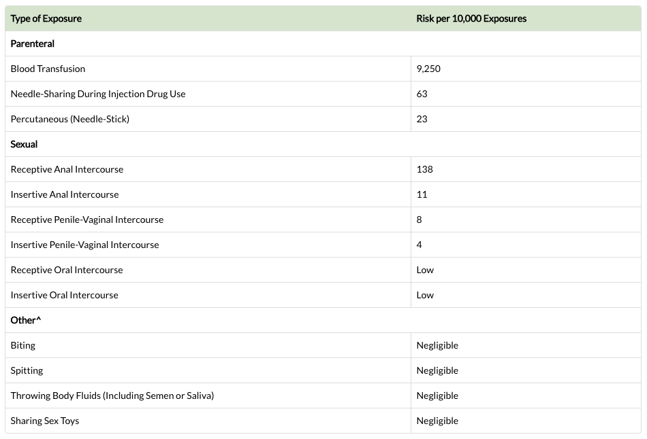
Patel P, Borkowf CB, Brooks JT. Et al. Estimating per-act HIV transmission risk: a systematic review. AIDS. 2014. doi: 10.1097/QAD.0000000000000298.
Pretty LA, Anderson GS, Sweet DJ. Human bites and the risk of human immunodeficiency virus transmission. Am J Forensic Med Pathol 1999;20(3):232-239.

Slide 8
EPIDEMIOLOGY

Slide 9
Estimated New HIV Infections in the US, by Age, 2018
Persons <25 and >50 years old make up nearly 37% of new HIV infections
21%
17%
Centers for Disease Control and Prevention. HIV Surveillance Report, 2018. rwww.cdc.gov/hiv/pdf/library/reports/surveillance/cdc-hiv-surveillance-report-2018-vol-30.pdf. Published June 2019. Accessed Feb 6, 2020.
Notes:
Of the 37,832 new HIV diagnoses in US and dependent areas in 2018
-21% aged 15-24 and 17% over 50 years old – both groups with innate challenges to test.
-Younger population can be resistant to testing, lack of self-awareness about risk and their own self-invincibility
-Providers often make assumptions about the lack of sexual risk in ppl with advanced age leading to undertesting and elevated rates of STI
-In 2018, 69% of new HIV infections were among gay, bisexual and men who have sex with men. 24% were among heterosexuals. 7% were among ppl who inject drugs.
-When breaking down the data to look at the most-affected subpopulations
-Black MSM had the most new infection at 9,499. The overall trend in this subpopulation was stable from the prior year.
-Next Hispanic/Latino MSM with 7,543 new infections – this subpopulation had increased 17% compared to prior year.
-Subsequent was White MSM 6,423 new infections – this subpopulation had decreased 19%
-Heterosexuals continue to be affected by HIV. In 2018, heterosexuals accounted for 24% of the 37,832 new HIV diagnoses. Heterosexual men accounted for 7% of total HIV diagnoses, while heterosexual woman accounted for 16% of new diagnoses. Both of those subpopulations had decreased between 20-30% from year prior.

Slide 10
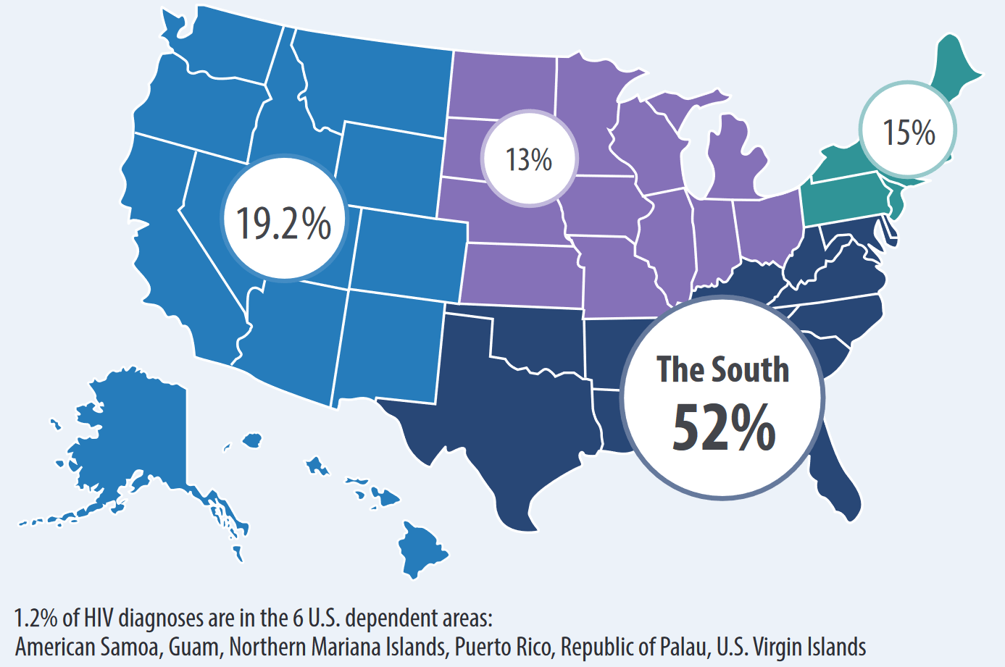
Percentage of New HIV Diagnoses in the U.S. and Dependent Areas by Region, 2018
Source: cdc.gov
Notes:
The rates of HIV and AIDS diagnoses are higher in the South.
The South generally is behind other regions in some key HIV prevention and care indicators, such as testing, linkage to care, retention in care and viral load suppression.
African Americans highest percentage of HIV diagnoses in the South, Northeast, and Midwest, and Hispanics/Latinos highest percentage in the West.
8 states have higher rates than California.

Slide 11
Chlamydia : 1.8 million cases. 19% rate increase since 2014
Gonorrhea: 583,405 cases. 63% rate increase since 2014
Syphilis*: 115,045 cases. 71% rate increase since 2014
* Includes primary, secondary, unknown duration and congenital
CDC 2018 Surveillance Data
Notes:
This is the 2018 CDC Surveillance Data.
-There were 1.8 million cases of chlamydia, which is a 19% increase in cases since 2014.
-There were approx 583K cases of gonorrhea, which is a 63% increase since 2014.
-Syphilis has been increasing dramatically. There were 35k primary and secondary cases of syphilis with 1,306 congenital cases. This is a 71% increase since 2014
-many reasons behind this. Regional outbreaks of syphilis, lack of testing availability, decreased public health funding into monitoring programs to name a few.

Slide 12
What’s New in the 2015 CDC STD Treatment Guidelines
STD testing in women
STD testing in pregnant women
STD testing in men
STD testing in men that have sex with men (MSM)
2020
2015
Barrow et al. Recommendations for Providing Quality Sexually Transmitted Diseases Clinical Services, 2020. MMWR Recomm Rep 2020;68(No. RR-5):1–20.
Centers for Disease Control and Prevention. Sexually Transmitted Diseases Treatment Guidelines, 2015. MMWR Recomm Rep 2015;64(No. RR-3): 1-137.
Notes:
2015 CDC STD Treatment Guidelines are the most up to date
Though there was Recommendations for Providing Quality STD Clinical Services Published on January 3, 2020.
These new recommendations discuss sexual history taking and physical examination, role of prevention, screening, partner services, evaluation of STD-related conditions, lab diagnosis and treatment.
The STD Quality Clinical Services Document focuses more on what services to have available and the STI Treatment Guidelines focuses on managing ppl with or at risk of infection.

Slide 13
STI TESTING IN WOMEN
Sexually Active adolescents & adults <25 years old
Routine chlamydia and gonorrhea screening
Others STIs and HIV based on risk (syphilis, HBV, HCV, cervical cancer, trichomoniasis, anal cancer)
Women 25 years of age and older
STI/HIV testing based on risk
Pregnant women
Chlamydia (<25 years of age or risk)
Gonorrhea (<25 years of age or risk)
HIV (opt out screening)
Syphilis serology
Hep B S Ag
Hep C (if high risk)
Notes:
For sexually active adolescents
- Recommend routine screening for Chlamydia and Gonorrhea on annual bases for females if <25yo.
For women >25 yo, testing for HIV and STD should be based on risk
Pregnant Woman
-all test for HIV as part of prenatal care, retesting 3rd trimester for those at high risk (HIV Ag/Ab combination 4th gen test)
-Testing pregnant women and treating those who are infected are vital not only to maintain the health of the woman, but to reduce perinatal transmission of HIV through available antiretroviral and obstetrical interventions.
-Rapid HIV screening for all women in labor with no documented HIV test.
-Serologic test for syphilis at first prenatal visit.
-Women who are at high risk for syphilis or live in areas of high syphilis morbidity should be screened again early in the third trimester (at approximately 28 weeks’ gestation) and at delivery.
- All pregnant women should be routinely tested for hepatitis B surface antigen (HBsAg) at the first prenatal visit even if they have been previously vaccinated or tested
-All pregnant women aged <25 years and older women at increased risk for infection (e.g., those who have a new sex partner, more than one sex partner, a sex partner with concurrent partners, or a sex partner who has a sexually transmitted infection) should be routinely screened for Chlamydia and Gonorrhea at the first prenatal visit.

Slide 14
STI TESTING IN MEN
Consider screening young men in high prevalence clinical settings or in populations with high burden of infection (e.g. MSM, transgender)
Large number or partners, inconsistent condom use, substance use, etc.
Notes:
The term “men who have sex with men” (MSM) describes a heterogeneous group of men who have varied behaviors, identities, and health-care needs
Some MSM are at high risk for HIV infection and other viral and bacterial STDs because MSM may practice anal sex, and the rectal mucosa is uniquely susceptible to certain STD pathogens.
In addition, multiple sex partners, substance use, and sexual network dynamics of MSM increase risk for HIV and STDs in this population.

Slide 15
STI TESTING IN MEN (MSM)
HIV
Syphilis
Urethral GC and CT
Rectal GC and CT (if RAI)
Pharyngeal GC (if oral sex)
HSV-2 serology (consider)
Hepatitis B (HBsAg, freq not specified)
Hepatitis C (HIV+MSM at least annually)
Anal Cancer in HIV+ MSM: Data insufficient to recommend routine screening, some centers perform anal Pap and HRA
* Annually, more frequent (3-6 months) if at high risk
Notes:
Recommends testing MSM annually for HIV, syphilis, urethral and rectal gonorrhea and chlmaydia if appropriate.
Evaluation for HSV-2 infection with type-specific serologic tests also can be considered if infection status is unknown in persons with previously undiagnosed genital tract infection.
Recommends testing all MSM for HBsAg to detect chronic HBV infection as well as testing for HCV. Recommends annually if HIV and MSM.
Data are insufficient to recommend routine anal-cancer screening with anal cytology in persons with HIV infection or HIV-negative MSM. More evidence is needed concerning the natural history of anal intraepithelial neoplasia, the best screening methods and target populations, safety of and response to treatments,
However, some clinical centers perform anal cytology to screen for anal cancer among high-risk populations (e.g., persons with HIV infection and MSM), followed by high-resolution anoscopy for those with abnormal cytologic results (e.g., ASC-US)

Slide 16
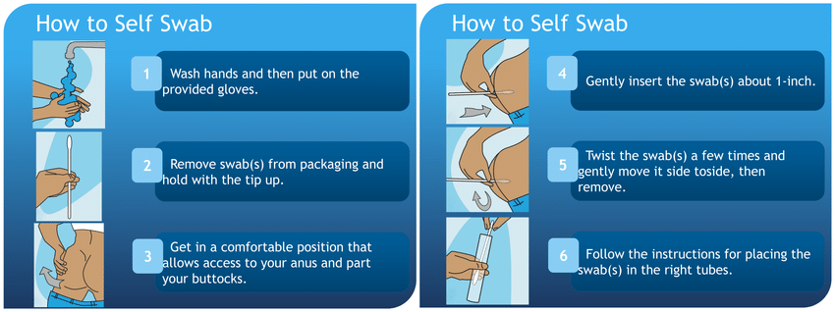
Ordering rectal and pharyngeal swabs for gonorrhea and chlamydia
CAN BE COLLECTED DURING THE VISIT OR CONSIDER SELF-COLLECTION
Notes:
Recommends testing MSM annually for HIV, syphilis, urethral and rectal gonorrhea and chlmaydia if appropriate.
Evaluation for HSV-2 infection with type-specific serologic tests also can be considered if infection status is unknown in persons with previously undiagnosed genital tract infection.
Recommends testing all MSM for HBsAg to detect chronic HBV infection as well as testing for HCV. Recommends annually if HIV and MSM.
Data are insufficient to recommend routine anal-cancer screening with anal cytology in persons with HIV infection or HIV-negative MSM. More evidence is needed concerning the natural history of anal intraepithelial neoplasia, the best screening methods and target populations, safety of and response to treatments,
However, some clinical centers perform anal cytology to screen for anal cancer among high-risk populations (e.g., persons with HIV infection and MSM), followed by high-resolution anoscopy for those with abnormal cytologic results (e.g., ASC-US)

Slide 17
CHLAMYDIA TREATMENT Uncomplicated Genital, Rectal, or Pharyngeal Infections
Recommended regimens (non-pregnant):
Azithromycin 1 g orally in a single dose
Doxycycline 100 mg orally twice daily for 7 days
Recommended regimens (pregnant*):
Azithromycin 1 g orally in a single dose
CDC 2015 STD Treatment Guidelines www.cdc.gov/std/treatment
Notes:
Alternatives for nonpregnant woman are erythromycin 500 mg orally QID for 7 days OR erythromycin ethylsuccinate 800 mg orally QID x 7D OR in levofloxacin 500 mg daily for 7 days OR ofloxacin 300 mg BID x7D
Pregnant woman alternatives in 2010 – included erythromycin and erythromycin ethylsuccinate as well as amoxicillin 500mg TID x 7D

Slide 18
GONORRHEA DUAL THERAPY Uncomplicated Genital, Rectal, or Pharyngeal Infections
Ceftriaxone 250 mg IM in a single dose
Azithromycin 1g orally
PLUS*
*Regardless of CT test result
Ceftriaxone and azithromycin administered on the same day
Preferably simultaneously and under direct observation
CDC 2015 STD Treatment Guidelines www.cdc.gov/std/treatment
Notes:
[Insert Lecture Name Here]
Slide 18
In 2007, emergence of fluoroquinolone-resistant N. gonorrhoeae in the United States prompted CDC to cease recommending fluoroquinolones for treatment of gonorrhea, leaving cephalosporins as the only remaining class of antimicrobials available for treatment of gonorrhea in the United States.
Reflecting concern about emerging gonococcal resistance, CDC’s 2010 STD treatment guidelines recommended dual therapy for gonorrhea with a cephalosporin plus either azithromycin or doxycycline, even if NAAT for C. trachomatis was negative at the time of treatment. However, during 2006–2011, the minimum concentrations of cefixime needed to inhibit in vitro growth of the N. gonorrhoeae strains circulating in the United States and many other countries increased, suggesting that the effectiveness of cefixime might be waning.
There have been reports of treatment failure with oral cephalosporins in many countries worldwide. U.S. gonococcal strains with elevated MICs to cefixime also are likely to be resistant to tetracyclines but susceptible to azithromycin, so that is why dual therapy is recommended.
If ceftriaxone is not available from 2010 guidelines
-cefixime 400 mg orally in a single dose PLUS azithromycin 1 g in a single
If cephalosporin allergy:
gemifloxacin 320 mg orally in a single dose PLUS azithromycin 2 g orally in a single dose OR gentamicin 240 mg IM single dose PLUS azithromycin 2 g orally in a single dose
-

Slide 19
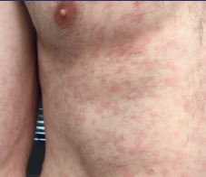
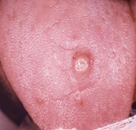
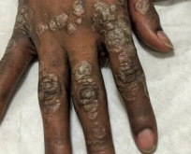
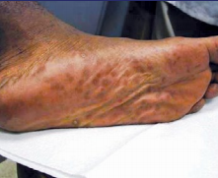
SYPHILIS TREATMENT
Incidence estimates: total ~100K new cases per year (incl P&S, unknown duration and congenital)
Diagnostic issues:
treponemal EIA (reverse sequence screening)
RPR-based algorithm
Primary, Secondary & Early Latent:
Benzathine penicillin G 2.4 million units IM in a single dose
Late Latent and Unknown Duration:
3 doses of 2.4 million units each at 1 week intervals
Neurosyphilis:
Aqueous Crystalline Penicillin G 18-24 million units IV daily administered as 3-4 million IV q 4 hr for 10 -14 d
Notes:
Traditional algorithm – RPR and if reactive confirm with treponemal testing and if reactive then consider syphilis infection
Reverse sequence screening – start with EIA typically (treponemal testing) and if reactive, then RPR, if nonreactive then would perform TPPA- which would suggest current untreated syphilis infection or previous treatment

Slide 20
HIV TESTING and PrEP

Slide 21
Why do we need to test everyone for HIV?
Approximately 14% of 1.1 million HIV-infected people do not know their status
Do not benefit from treatment
20-40% diagnosed within 1 year of AIDS diagnosis
People who are unaware of their infection account for:
70% of new sexually transmitted HIV infections
Most people who learn they are infected with HIV take steps to protect their partner
Source: Aidsvu.org/state/California
Notes:
Quicker diagnosis is associated with better outcomes and prevent new HIV infections

Slide 22
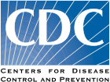
HIV Screening Recommendations
Screen all patients 13-64 years. Special groups: pregnancy, patients with STIs or TB Annual screenings in patients at high risk for HIV MSM, IDU, sex workers, sex partners of HIV+ individuals | Screen all patients 15 to 65 years.
Branson BM, et al. MMWR Recomm Rep. 2006;55(RR-14):1-17.
Notes:
Repeat Screening Recommended: Before beginning a new sexual relationship; When clinically indicated; After an occupational exposure

Slide 23
Most common HIV testing methods
HIV Ag/Ab combination test – screening test
HIV nucleic acid test (NAT) / viral load – diagnostic test
HIV 1/2 Antibody test – screening or confirmation test
If concern for acute HIV, order HIV NAT and HIV Ag/Ab

Slide 24
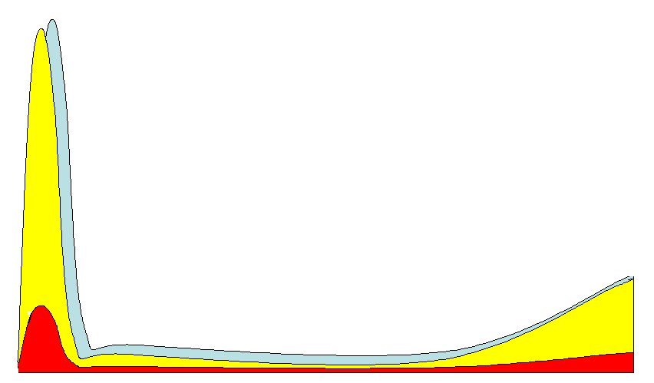
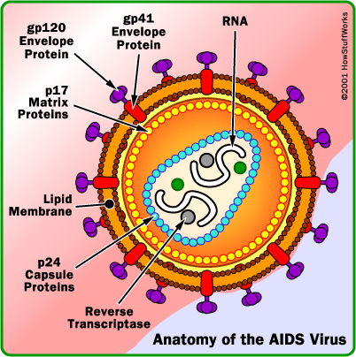
Acute Infection: Increased Risk of Sexual Transmission of HIV
1/30-
1/200
Virus 75-750 times more infectious
5
4
HIV RNA in Semen
(Log₁₀ copies/ml)
1/100-
1/1000
1/1000-
1/10,000
1/500-
1/2000
3
2
Acute Infection
6-12 wks
Asymptomatic
Infection
HIV Progression
AIDS
Cohen & Pilcher, J Infect Dis. 2005.
Notes:
--Virus more infectious during acute HIV infection.
--With each sexual act between heterosexual male and female, it is estimated that there is 1/30-1/200 probability of transmission.
--Most people 80-90% express fever like symptoms Also whole body rashes
--With previous testing algorithms, HIV infected individual might not test HIV positive (remember it is an antibody test)
--newer generations of HIV testing, you are able to diagnose acute HIV earlier.

Slide 25
Symptoms to Monitor for
Acute HIV Infection
Fever
Fatigue
Myalgia
Skin rash
Headache
Pharyngitis
Cervical Lymphadenopathy
Arthralgia
Night sweats
Diarrhea
Early diagnosis, linkage to care and initiation of ART
Reduces viremia
Decreases rate of viral mutation
Preserves immune function and slows progression of disease
Decreases severity of disease
Reduces HIV transmission
Notes:
These are the most common symptoms of acute HIV, with fever being the most common (75%), and diarrhea the least common on the list (27%).
You want to make the diagnosis as soon as possible in acute HIV infection as they are at increased risk of sexual transmission of HIV, you want to engage them in care and start them on therapy.

Slide 26
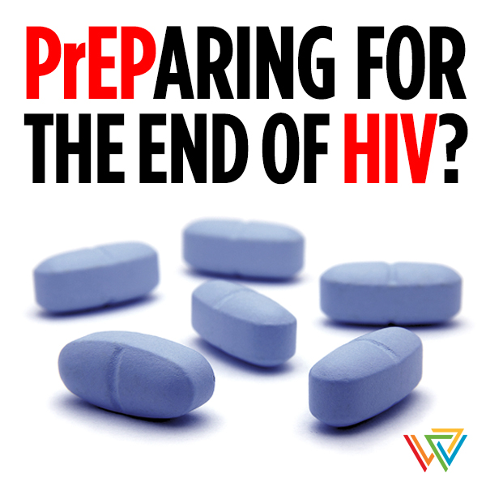

Slide 27
A QUICK POLL
Have you prescribed or discussed PrEP with a patient?

Slide 28
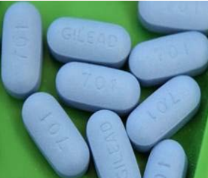
What is HIV PrEP?
PrEP stands for Pre-Exposure Prophylaxis
Helps prevent the spread of HIV infection
1.1 million people living with HIV
37,832 new cases of HIV in 2018
When a person is exposed to HIV, PrEP helps prevent the HIV from infecting that person
Notes:
Theoretically, if HIV replication can be inhibited from the moment it enters the body, it may not be able to establish a permanent infection.
Right now the medications recommended for PrEP are daily Tenofovir/emtricitabine in a fixed dose combination pill.
Truvada chosen out of the almost 30 drugs for potency, safety, tolerability, convenience
PrEP is not a lifelong prevention strategy: periods of high risk.

Slide 29
What is HIV PrEP?
HIV-negative individuals before exposure on a daily basis during periods of risk
Fixed-dose combination tablet
Tenofovir + emtricitabine (TRUVADA® or Descovy ®) *
Take 1 tablet every day PLUS safe sex practices (condoms)
FDA approved Truvada for PrEP in 2012
FDA approved Descovy for PrEP in 2019 for MSM and Transwomen (not vaginal sex)
Notes:
Theoretically, if HIV replication can be inhibited from the moment it enters the body, it may not be able to establish a permanent infection.
Right now the medications recommended for PrEP are daily Tenofovir/emtricitabine in a fixed dose combination pill.
Truvada chosen out of the almost 30 drugs for potency, safety, tolerability, convenience
PrEP is not a lifelong prevention strategy: periods of high risk.

Slide 30
Who should Consider taking PrEP?
People who are HIV-negative AND have substantial risk of getting HIV
Sexual transmission:
Ongoing relationship with HIV-positive partner
Sex without regular condom use with:
Partners of unknown HIV status
Partners with high risk of getting HIV
STI in the past 6 months
Injection transmission:
Inject illicit drugs in the past 6 months
Sharing injection equipment
In particular,
--Transgender women
--Men who have sex with men of color
http://www.cdc.gov/hiv/basics/prep.html

Slide 31
Who should consider taking PrEP?
 | Men Who Have Sex with Men |  | Heterosexual Women and Men |  | Injection Drug Use
Detecting Substantial Risk of Acquiring HIV | HIV+ sexual partner Recent bacterial STI Many sex partners Hx of inconsistent or no condom use Commercial sex work |  | HIV+ sexual partner Recent bacterial STI Many sex partners Hx of inconsistent or no condom use Commercial sex work In high prevalence area or network |  | HIV+ injecting partner Sharing injection equipment Recent drug tx (but currently injecting)
Clinically Eligible | Documented negative HIV test result before prescribing PrEP No signs/symptoms of acute HIV infection Normal renal function No medication contraindications Documented hepatitis B virus infection and vaccination status
Prescription | Daily, continuing, oral doses of TDF/FTC (Truvada / DescovyTM) ≤ 90 day supply
Other Services | F/u visits at least every 3 months HIV testing, adherence, behavioral risk reduction, AEs, STIs Every 3-6 months: assess renal function Every 6 months: STIs
 | Oral/rectal STI test | Pregnancy intent Pregnancy test q 3months |  | Clean needles/syringes Drug tx services

Slide 32
Who should consider taking PrEP?
Anyone asking for it!

Slide 33
It’s the law
NEW HIV LEGISLATIVE LAW EFFECTIVE JANUARY 1st 2017
NEW CALIFORNIA LAW: Public Health: HIV (Assembly Bill 2640 of 2016)
SUMMARY: A medical care provider or person administering a test for human immunodeficiency virus (HIV) must provide patients who test negative for HIV infection, and are determined to be at high risk for HIV infection information about methods that prevent or reduce the risk of contracting HIV. This information must include, but not be limited to, pre-exposure prophylaxis and post-exposure prophylaxis, consistent with guidance of the federal Centers for Disease Control and Prevention.

Slide 34
How effective is PrEP?
Men who have sex with men
Heterosexually active men and woman
HIV discordant couples
Centers for Disease Control and Prevention (CDC). Preexposure Prophylaxis for the Prevention of HIV Infection in the United States: A Clinical Practice Guidelines. Published May 2014.
Centers for Disease Control and Prevention (CDC). Preexposure Prophylaxis for the Prevention of HIV Infection in the United States: A Clinical Practice Guidelines. Published May 2014.
Notes:
In the different studies, the reduction in HIV acquisition was between 44-75%
But when assessed in those with detectable TDF blood levels, the reduction rate was 74-92%
Adherence is very important for efficacy: compare the overall reduction in risk of HIV infection for participants on PrEP with the subgroup on PrEP who had detectable medication in their blood. The reduction in risk was much higher for the group with detectable levels of medication, which indicates they were taking the medication regularly. TDF2 reported on adherence and efficacy in a slightly different way: of the people in the study who became infected, only half of those had detectable levels of medication in their blood. Those who became infected and did have detectable levels of medication had very low levels of medication present. All had lower levels than matched participants who did not become infected during the trial.
Self-assessment of risk may be important for motivation and adherence. The Fem-PREP and VOICE trials had low levels of adherence measured by level of medication in the blood. One thought about this is that women did not assess themselves to be at high risk of HIV, although the researchers had targeted a group they defined as high risk.

Slide 35
Treatment Arms | TDF/FTC (n=1226) | Placebo (n=1225)
Methods | HIV negative men or transgender women who have sex with men
 | TDF/FTC once daily | Placebo once daily
Results: | 36 HIV infections TDF/FTC detected in: 22/43 HIV-negative pts 3/34 HIV-positive pts | 64 HIV infections
Notes:
IpREX

Slide 36
Iprex Study
IPREX:
42% - data from trial
92% - detectable drug
99% - modeling data
76% for 2/week
96% for 4/week
99% for 7/week
Adherence likely does NOT need to be perfect
NOT (yet) approved for intermittent use
Anderson P, Liu A, Buchbinder S, Lama J, Guanira J et al. (2012) Intracellular tenofovir-DP concentrations associated with PrEP efficacy in MSM from iPrEx. 19th Conference on Retroviruses and Opportunistic Infections. Washington: Seattle
Anderson PL, Glidden DV, Liu A, et al. Emtricitabine-tenofovir concentrations and pre-exposure prophylaxis efficacy in men who have sex with men. Sci Transl Med. 2012;4:151ra125
Notes:
42% reduction in hiv acquisition
92% reduction in those with detectable drug levels
They did modeling noting that if you take 4x per week reduce risk by 96%
IPERGAY trial studied intermittent use of PrEP published in NEJM 2015 found RRR 85%.

Slide 37
RESISTANCE

Slide 38
STEPS TO PRESCRIBE PREP
Take a sexual history
P – Partners: What is the gender of your sex partners? How many sex partners have you had in the last 6 months?
R – Receptive or Insertive sex: Do you bottom or top?
E – Ever had an STI: Have you ever had an STI?
P – Protection/PrEP: How often do you use condoms? Have you heard about PrEP?
Offer PrEP to patients you have identified at risk
Obtain intake labs: HIV testing, Scr, hepatitis B testing, STIs
Start patients on PREP. Monitor with visits, STI testing and labs every 3 months and 90 day prescription.
Consider listing self on PleasePrEPMe.org

Slide 39
Clinical follow-up and monitoring
Managing side effects
Uncommon; usually resolve 1st month
OTCs for H/A, nausea, and flatulence
Counsel on signs of acute HIV infection or renal injury
Initial follow-up
Confirm HIV status
Early side effects
Medication adherence
Answer questions
At least every 3 months
At least every 6 months
HIV testing / acute infection
Pregnancy testing
TDF/FTC Rx or refill for ≤ 90 days
Risk behaviors
Kidney function
STI testing
At least every 12 months
Re-evaluate continuing PrEP
Clinic visit
Notes:
May also monitor for bone mineral density, especially in patients who are higher risk

Slide 40
STI Screening is Important
Kaiser SF data--Volk, CID 2015
Notes:
Referrals for PrEP increased dramatically in a large clinical practice at Kaiser SF since 2012.
Despite HIGH STI rates of infections, were no new HIV infections in this population.
Limitations of our data:
No control group
Fewer condoms ≠ more HIV risk ?
“PrEP-sorting”
Undetectable viral loads

Slide 41
Stopping PrEP
Positive HIV result (Link to HIV care)
Acute HIV signs or symptoms
Non-adherence
Renal disease
Changed life situation: lower HIV risk
http://www.cdc.gov/hiv/pdf/guidelines/PrEPguidelines2014.pdf
Notes:
If a patient seroconverts on PrEP, check CD4 and VL, send genotype and link to HIV care. Counsel on HIV transmission prevention and offer partner notification services.
Upon discontinuation, document: HIV status, reason for discontinuation, and recent adherence and reported sexual risk behavior.

Slide 42
What not to use or do
ARVs other than TDF/FTC or taf/ftc
Other ARVs should not REPLACE or be ADDED to the regimen
Dosing frequency other than once daily
Intermittent or pre/post sex dosing is not recommended at this time
Prescribe PrEP as expedited partner therapy
Only prescribe PrEP to individuals under your care
Prescribe PrEP to patients with chronic renal failure
Only prescribe if CrCl > 60 ml/min or >30 ml/min in Descovy
Weigh risks and benefits for: pregnancy, breastfeeding, chronic HBV, and adolescents
Notes:
Other ARVs have not been studied for efficacy and safety for PrEP: should not be using 3 ARVs or using other ARVs
Expedited partner therapy: give to infected partner to take home to his/her partner; not recommended b/c diligent f/u is necessary for PrEP
Insufficient evidence in adolescents

Slide 43
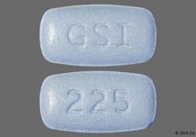
Which medications should I prescribe for PrEP?
Truvada (TDF/FTC)
Descovy (TAF/FTC)
Effectiveness:
For multiple populations
Safety
Small in eGFR and BMD
Cost
$1845/month
Generic in 2020
Effectiveness:
For MSM and transwomen
? for other populations
Safety
Small in LDL and weight
Cost
$1,845/month (patient assistance programs)

Slide 44
PrEP Summary
BENEFITS
Effective
FDA approved (Descovy for MSM and Transwomen)
Well-tolerated
DRAWBACKS
Short-term data only
Daily adherence required
Side effects
Drug resistance in acute infection
Could lead to fewer condoms being used
$$$/Logistics
As of 1/1/2017 the law requires anyone requesting or taking an HIV test to be offered education on PrEP and PEP.
Test!!!
Screen for HIV and other STIs
Counsel your patients about safer sex and substance use
Don’t be afraid to speak to your patients regardless of their (or your) age

Slide 45
Non-occupational Post Exposure Prophylaxis
High risk exposure
As soon as possible (<72h from exposure)
28 day course
Preferred regimen:
Truvada once daily (fixed dose combo 200mg emtricitabine/300mg tenofovir)
PLUS
Raltegravir (Issentress) 400mg twice daily
OR
Dolutegravir (Tivicay) 50 mg daily
Toxicity monitoring: BUN, creatinine, LFTs (tenofovir); rash (emtricitabine); headache/nausea (raltegravir)
https://www.cdc.gov/stophivtogether/library/prescribe-hiv-prevention/brochures/cdc-lsht-php-brochure-pep-faq.pdf
Notes:
The CDC has an occupational exposure prophylaxis guideline from 2016, which also lists tenofovir/emtricitabine and raltegravir or Truvada/dolutegravir as the preferred PEP regimen.
PEP initiation should be considered in people whose vagina, rectum, eye, mouth or other mucuous membrane, non-intact skin, or perforated skin (eg, needle stick) come into contact with potentially contaminated body fuids from an HIV-infected source, as long as exposure has occurred within a 72-hour window. If the source is of unknown HIV status, a case-by-case determination can be made.4 PEP is not recommended for use in people whose exposure occurred 73 hours or more before they sought treatment, or in people who are considered to have a negligible risk for HIV exposure because of exposure to non-blood contaminated secretions such as urine, saliva, sweat, tears, or nasal secretions.

Slide 46
Thank You!

Slide 47
EVALUATION LINK
http://bit.ly/elicaeval

Slide 48
References
CDC. Monitoring selected national HIV prevention and care objectives by using HIV surveillance data – United States and 6 dependent areas – 2012. HIV Surveillance Supplemental report 2014;19(No.3). Published November 2014.
CDC. Estimated HIV incidence in the United States, 2007-2010. HIV Surveillance Supplemental Report 2012;17(No.4). Published December 2012.
Centers for Disease Control and Prevention (CDC). Preexposure Prophylaxis for the Prevention of HIV Infection in the United States: A Clinical Practice Guidelines. Published May 2014.
http://www.who.int/hiv/amds/who_elimination_vertical_transmission_n_shaffer.pdf
PAETC HIV Learning Network, Didactic Serious, Pre-Exposure Prophylaxis, Anita Kadakia, MD, Owen Clinic UCSD, 3/12/15
Grant, RM et al. Preexposure chemoprophylaxis for HIV prevention in men who have sex with men. N Engl J Med 2010;363:2587-2599.
Thigpen, MC et al. Antiretroviral preexposure prophylaxis for heterosexual HIV transmission in Botswana. N Engl J Med 2012;364:423-434.
Baeten, JM et al. Antiretroviral prophylaxis for HIV prevention in heterosexual men and women. N Engl J Med 2012;5:399-410.
Choopanya, K et al. Antiretroviral prophylaxis for HIV infection in injecting drug users in Bangkok, Thailand (The Bangkok Tenofovir Study): a randomized, double-blind, placebo-controlled phase 3 trial. Lancet 2013;2013:2083-2090.
McCormack, S and Dunn, D. Pragmatic open-label randomized trial of preexposure prophylaxis: the PROUD study. CROI; Feb 23-25, 2015; Seattle, WA. 22LB.
Molina, JM et al. On demand PrEP with oral TDF-FTC in MSM: results of the ANRS Ipergay trial. CROI; Feb 23-25, 2015. Seattle, WA. 23LB.

