Slide 1
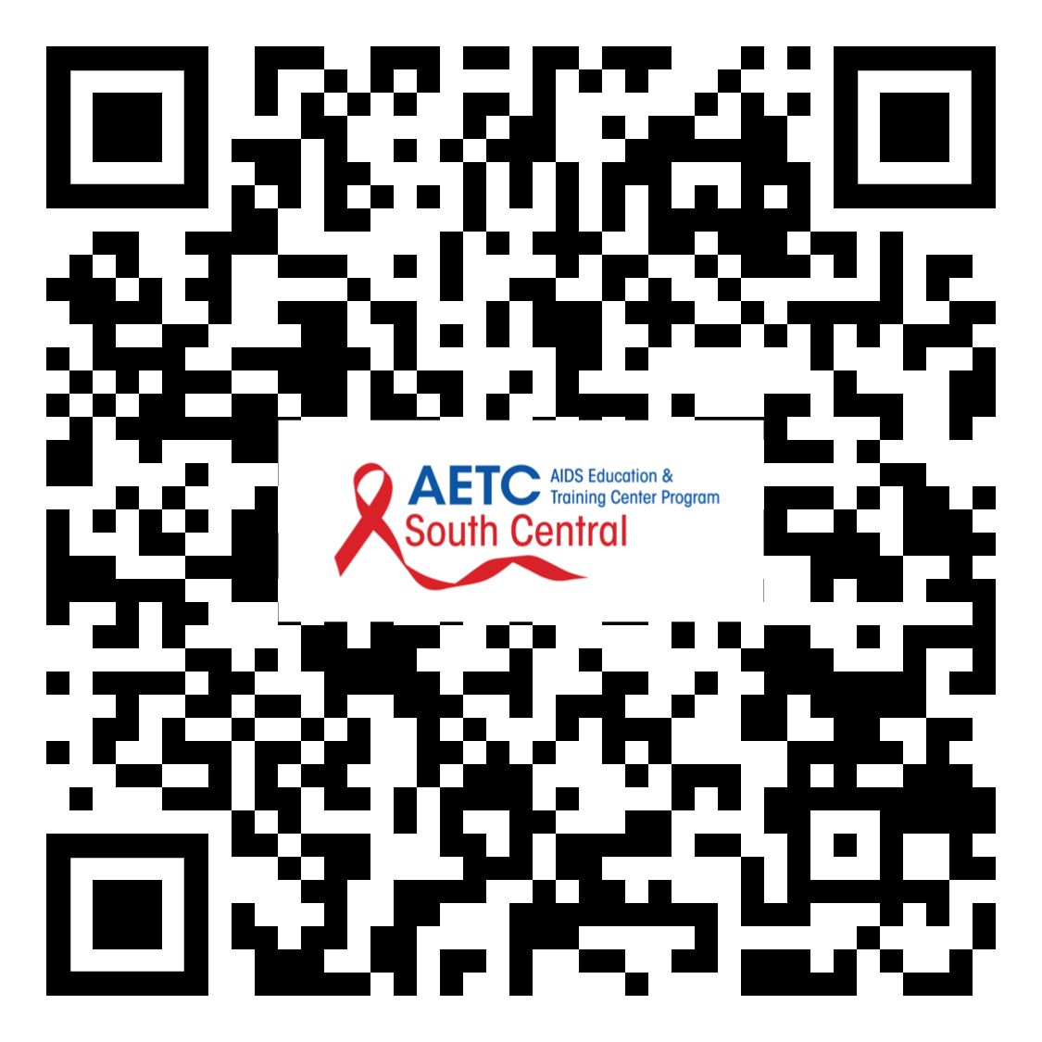
To Register:
Use your smartphone’s camera to scan the QR code to the right
Click the link in the chat
Go to https://echo.unm.edu/scaetc/participant-dashboard
1

Slide 2
HIV on the Mexico – US Border
Gerardo Anaya, FNP-C
Centro San Vicente, Be Prepared Clinic!
Notes:
Version date 072020

Slide 3
Conflict of Interest Disclosure Statement
Gerardo Anaya, FNP-C has no conflicts of interest to disclose.
This project is supported by the Health Resources and Services Administration (HRSA) of the U.S. Department of Health and Human Services (HHS). Under grant number U1OHA33225 (South Central AIDS Education and Training Center). It was awarded to the University of New Mexico. No percentage of this project was financed with non-governmental sources. This information or content and conclusions are those of the authors and should not be construed as the official position or policy of, nor should any endorsements be inferred by HRSA, HHS, or the U.S. Government.

Slide 4
Learning Objectives
Identify elements that make the Mexico-U.S. border dynamic in flow.
Identify unique HIV risk factors along the Mexico-U.S. border.
Identify the HIV/STI link in at-risk populations along the Mexico-U.S. border.

Slide 5
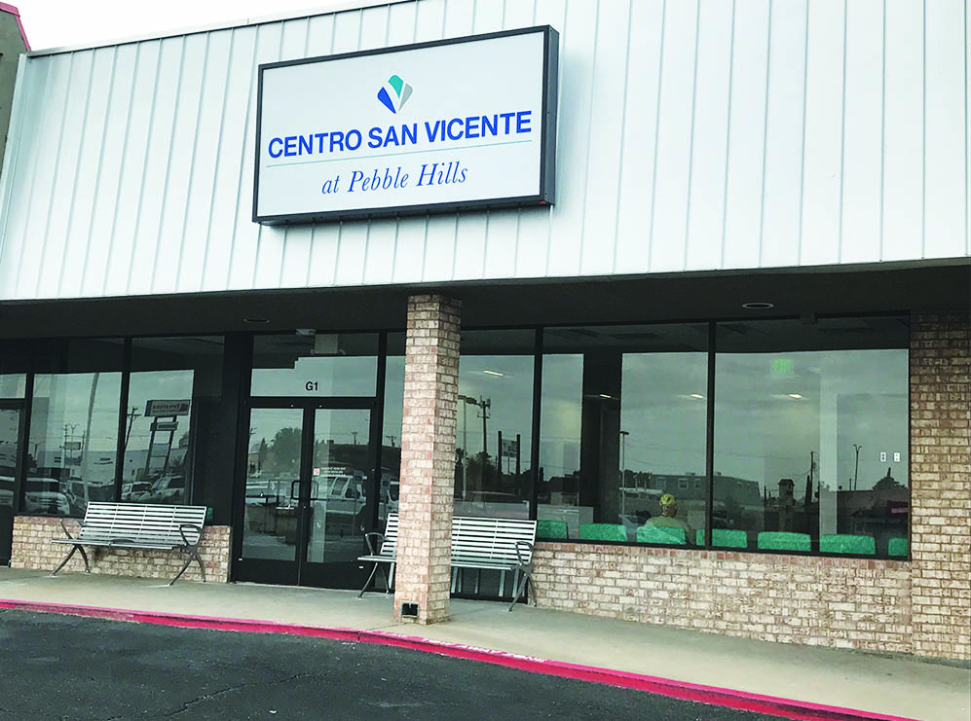
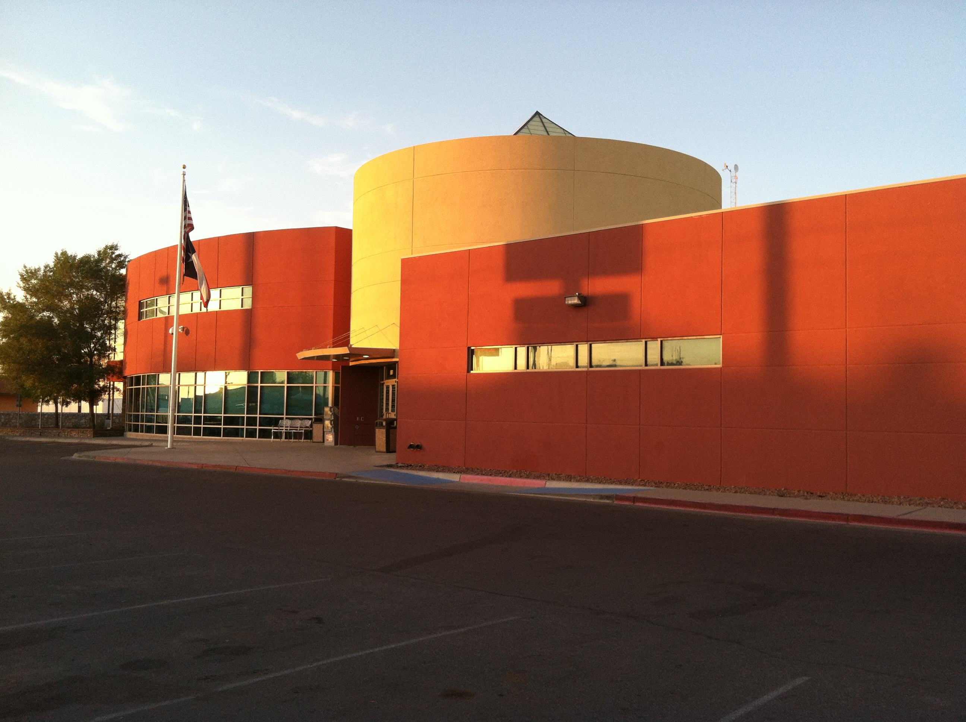
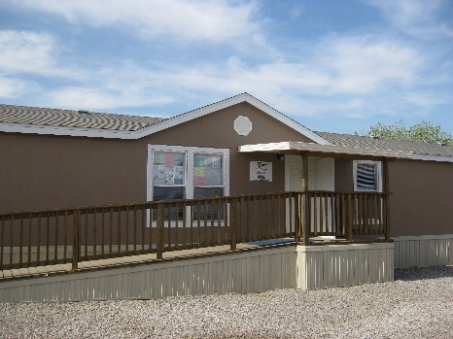
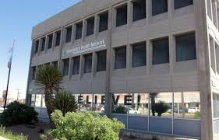
Homeless Health Center
1208 Myrtle Avenue
El Paso, Texas 79901
(Homeless Consumers)
Pebble Hills Health Center
10780 Pebble Hills Blvd, Ste. G-1
El Paso, Texas 79935
(PrEP/Express STI Clinic/ LGBTQ)
Alameda Health Center
8061 Alameda Avenue
El Paso, Texas 79915
(Justice involved adults –Transitions Clinic)
San Elizario Health Center
13017 Perico
EL Paso, TX 79902
(Immigrants)
Centro San Vicente
@ Emergence
10780 Pebble Hills Blvd, Ste. G-1
El Paso, Texas 79935
(Seriously Mentally Ill)
Notes:
notes

Slide 6
Mexico – U.S. Border: Bidirectional Mobility & Environment
GEOGRAPHY
ASSESSMENT
DEMOGRAPHY
POPULATION
POLITICALLY
48 counties in four US states
80 municipalities in six Mexico states
15 sister cities/regions
Spans 2,000 miles x 62.15 miles
Zone of opportunity for Mexican citizens
Competitive labor market for U.S. Citizens
14 million; 90% in 15 pairs of border “sister cities”
Border population expected to increase by additional 4.6 million (2020) and 9.3
million (2030)
Interdependent sister states/cities with unique economic relationships
https://www.epa.gov/usmexicoborder
Ramos, et al 2009. Rivera et al 2009. Marks et al 2019. Truby et al. 2014.
Notes:
Source(s):
United States Environmental Protection Agency (2020). Border 2020: U.S.-Mexico Environmental Program. https://www.epa.gov/usmexicoborder
Ramos, R., Ferreira-Pinto, J. B., Brouwer, K. C., Ramos, M. E., Lozada, R. M., Firestone-Cruz, M. F., Strathdee, S. A. (2009). A tale of two cities: Social and environmental influences shaping risk factors and protective behaviors in two Mexico-US border cities. Health & Place, 15, 999-1005.
Rivera, J. O., Ortiz, M. & Cardenas, V. (2009). Cross-Border purchase of medications and healthcare in a sample of residents of El Paso, Texas and Ciudad Juarez, Mexico. Journal of National Medical Association; 101 (2) 167-173.
Marks C, Zúñiga ML. CAM practices and treatment adherence among key subpopulations of HIV+ Latinos receiving care in the san diego-tijuana border region: A latent class analysis. Frontiers in public health. 2019; 7:179. https://search.datacite.org/works/10.3389/fpubh.2019.00179. doi: 10.3389/fpubh.2019.00179
Truby, K. (2014). Bodies on the border: The state, civil society and HIV at Mexico's Fronteras. Policy and Society, 33, 53-64. doi: http://dx.doi.org/10.1016/j.polsoc.2014.03.003

Slide 7
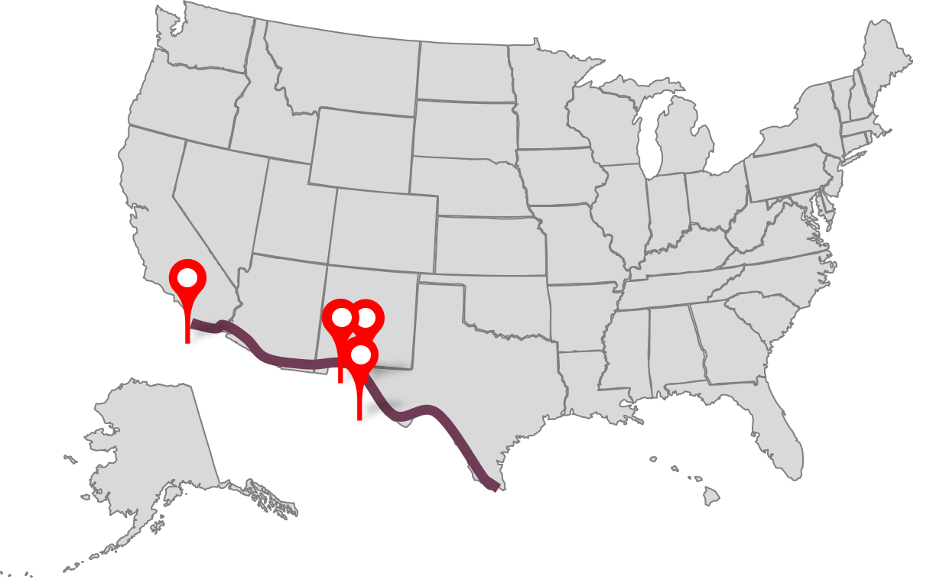
Mexico – US Border
PDNUno: Save time crossing the border. The International Bridges Steering Committee Web site. https://pdnuno.com/. Accessed July 03, 2020.
Texas Department of State Health Services. Office of Border Public Health-Texas Mexico Border. TDSHS Web site. https://www.dshs.texas.gov/borderhealth/. Accessed March. 04, 2020.

Slide 8
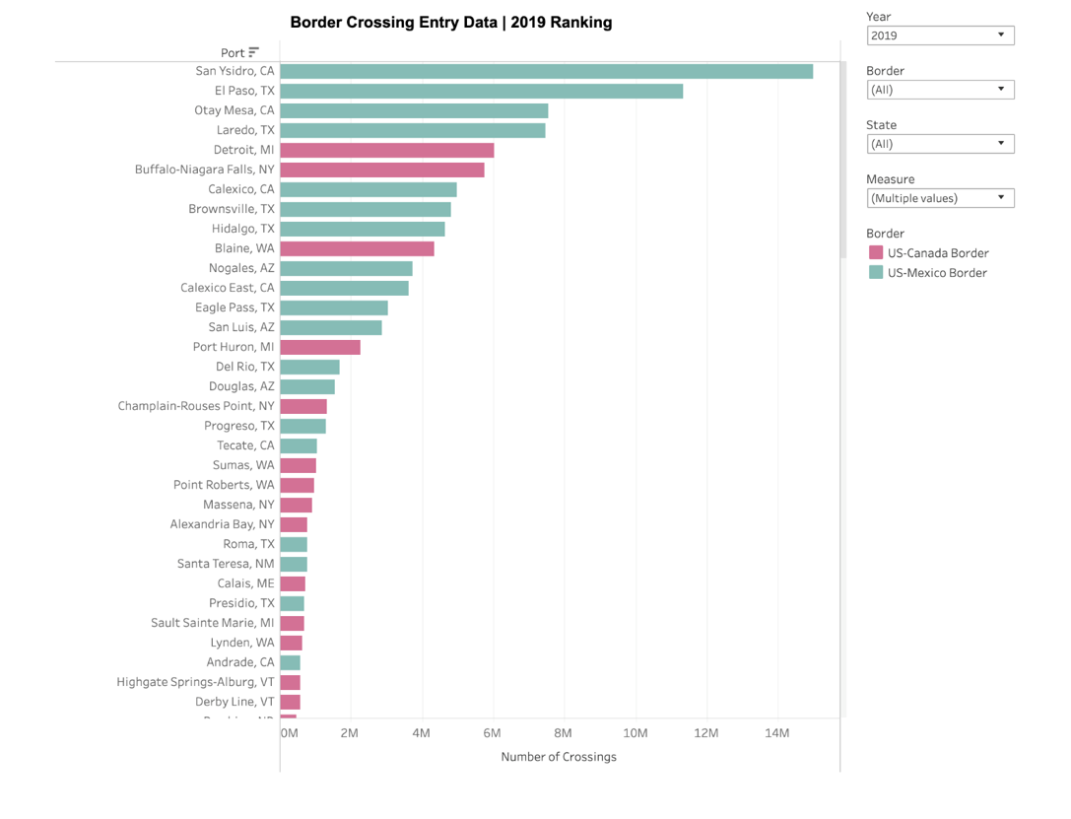
Mexico – US Border Crossings (Ranked)
Border crossing/Entry data. United States Department of Transportation Web site. https://www.bts.gov/content/border-crossingentry-data. Published 2020. Accessed July 29, 2020.
Diaz L, Gonzalez JL. World’s busiest border falls quiet with millions of Mexicans barred from U.S. Reuters Web site. https://www.reuters.com/article/us-health-coronavirus-border/worlds-busiest-border-falls-quiet-with-millions-of-mexicans-barred-from-u-s-idUSKBN21I0MR. Published March 31, 2020. Accessed July 28, 2020.

Slide 9
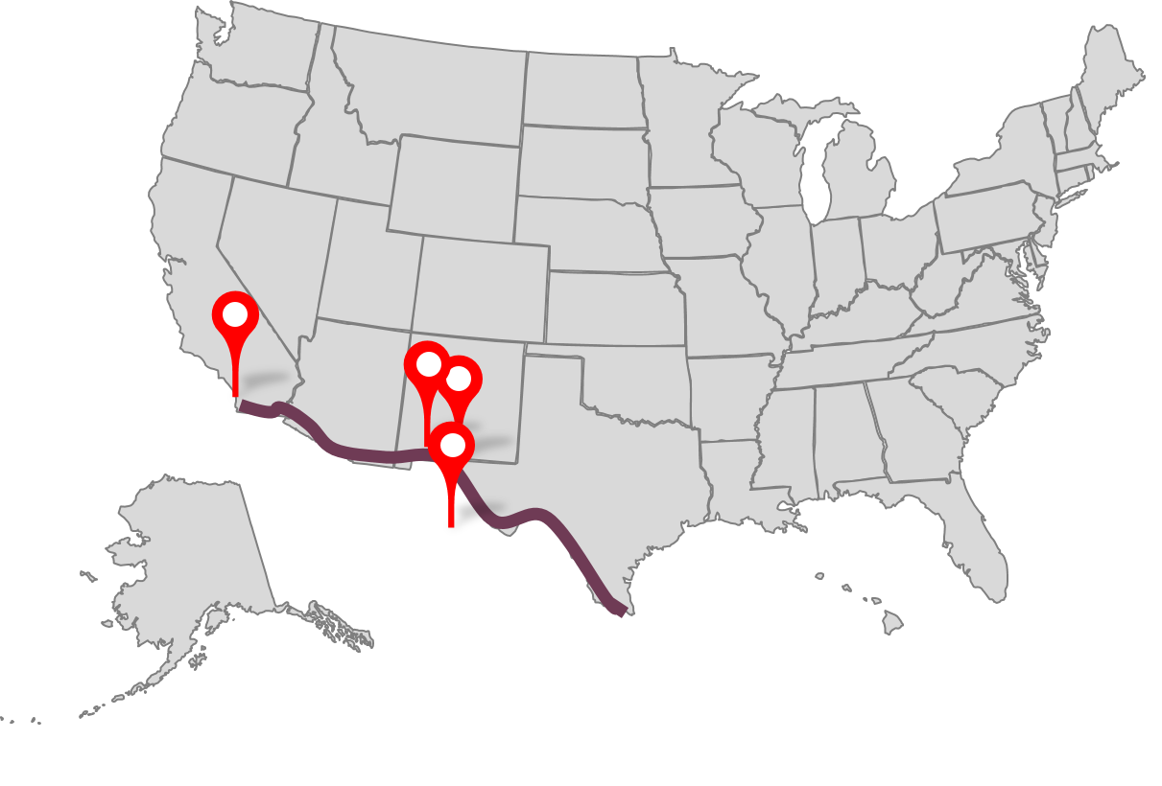
Mexico – US Border
With over 2.7 million people, this binational region is the 2nd largest metropolitan area (San Diego-Tijuana being the largest) on the U.S.-Mexico boarder
El Paso population: 600,647, 81% Hispanic, 23% live in poverty, Median income/person $18,369 (2010 Census)
Home of Fort Bliss Army: 8,000 residents (2010 Census)
Ramos R,, et al. A tale of two cities: Social and environmental influences shaping risk factors and protective behaviors in two Mexico-US border cities. Health & Place. 20009;15:999-1005. Rivera JO, et al. Cross-Border purchase of medications and healthcare in a sample of residents of El Paso, Texas and Ciudad Juarez, Mexico. Journal of National Medical Association. 2009;101(2):167-173.

Slide 10
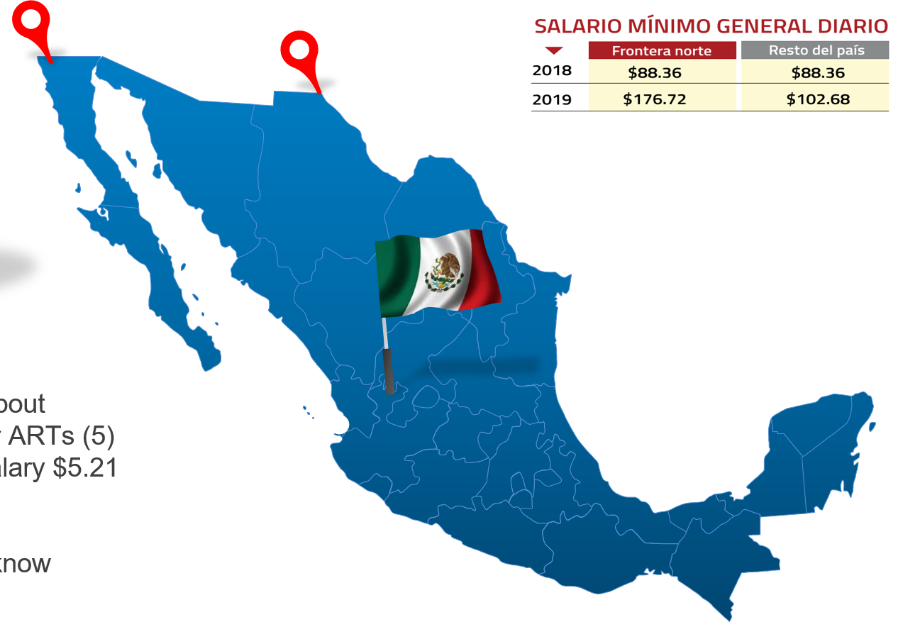
Demographic Mexico Profile
Living with HIV costs about $1,421 ($72.1 USD) for ARTs
Minimum wage daily salary $5.21 USD
Only 60% on ART
1 in 3 PWH do not know

Slide 11
Paso Del Norte Region – Tri State Cross Border Communities

Slide 12
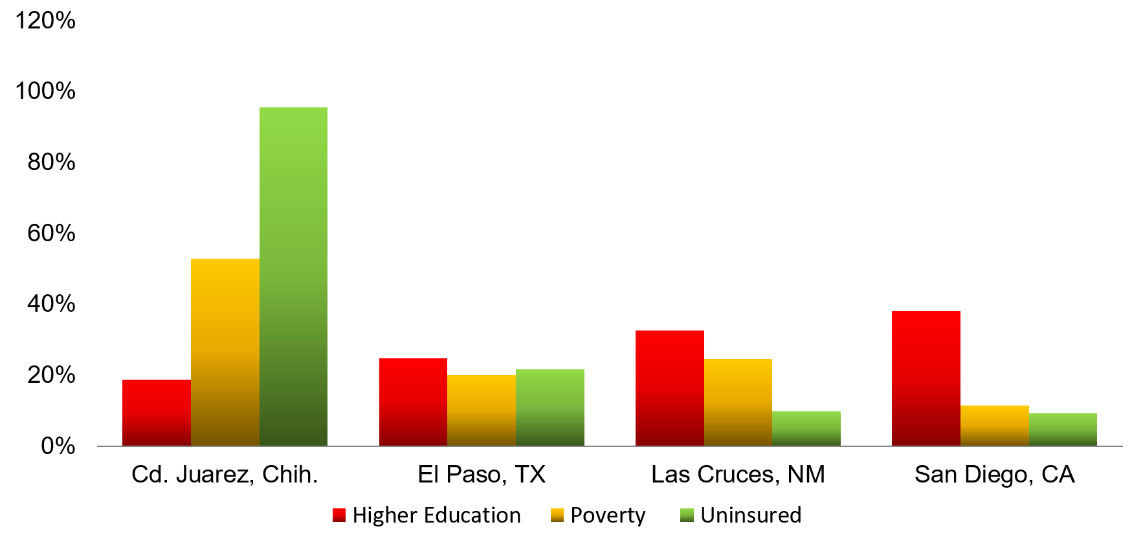
Paso Del Norte Region – Tri State Cross Border Communities

Slide 13
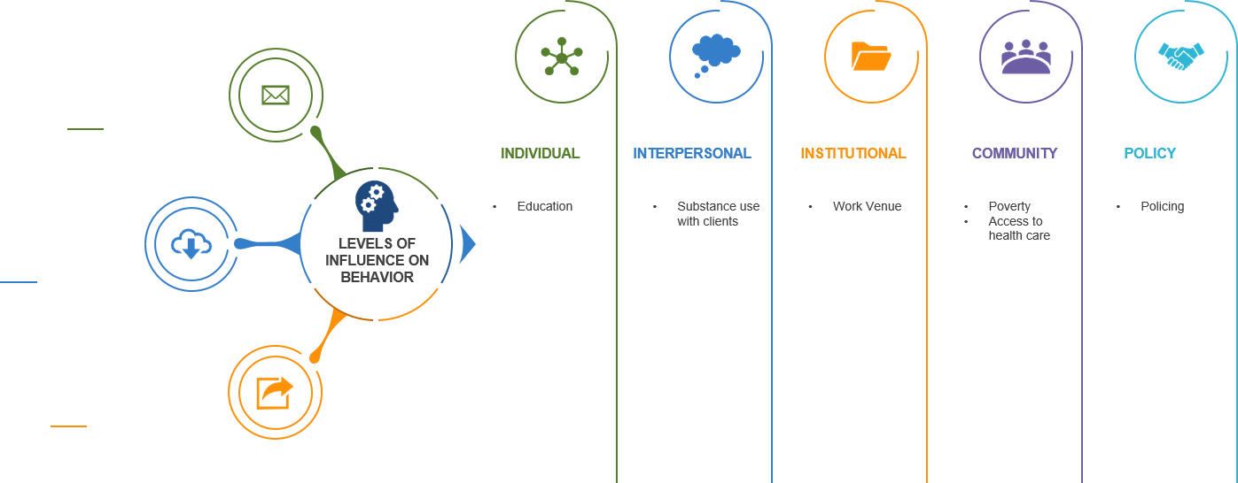
Social Ecological Model

Slide 14
HIV Risk Environment Factors Contributing to Elevated HIV Risk
HIV RISK ASSESSMENT
FEMALE SEX WORKERS
(FSWs)
IV DRUG USE
(IDU)
MIGRANTS
MSM
INDIVIDUAL & INTERPERSONAL
COMMUNITY
& POLICY
Petterson, et al 2019. Ospina-Escobar et al. 2018 Marks et al, 2019, Zuniga et al 2012. Mehta, et al, 2017. School et al, 2010. Zhang et al, 2017. Ramos, et al, 2009. Shedli, et al 2013. Strathdee et al 2008.
Notes:
Source(s):
Patterson, T. L., Strathdee, S.A., Semple, S. J., Chavarin, C.V., Abramovitz, D., Gaines, T. L., Mendoza, D., Staines, H., Aarons, G. A., Magis-Rodriguez, C. (2019). Prevalenc of HIV/STIs and correlates with municipal characteristics among female sex workers in 13 Mexican cities. Salud Publica Mexicana; 61:116-124. https://doi.org/10.21149/8863
Ospina-Escobar, A., Magis-Rodriguez, C., Juarez, F., Werb, D., Arredondo, Bautista Arredondo, S., Carreon, R., Ramos, M. E. & Strathdee, S. (2018). Comparing risk environments for HIV among people who inject drugs from three cities in Nothern Mexico. Harm Reduction Journal, 15:27. doi: https://doi.org/10.1186/s12954-018-0225-y
Mehta, S. R. et. al (2017). Impact of public safety policies on HIV transmission dynamics in Tijuana, Mexico. ISDA.
Scholl., E. & Nicholson, J. (July 2010). United States Agency International Development. HIV Prevention on the U.S.-Mexico Border: Addressing the needs of most-at-risk populations. AIDSTAR-One: AIDS support and technical assistance resources.
Marks C, Zúñiga ML. CAM practices and treatment adherence among key subpopulations of HIV+ Latinos receiving care in the san diego-tijuana border region: A latent class analysis. Frontiers in public health. 2019; 7:179.
Zuniga, M. L., Blanco, E., Brennan, J. J., Scolari, R., Artamonova, I. V., Strathdee, S. A. (2012). Binational care-seeking behaviour and health-related quality of life among HIV-infected Latinos in the U.S.-Mexico Border Region. Journal Association Nurses AIDS Care. 2011; 22(3): 162-172. doi:10.1016/j.jana.2010.09.001
Zhang, X., Martinez-Donate, A. P., Simon, N. J., Hovell, M. F., Rangel, M. G., Magis-Rodriguez, C. & Sipan, C. L. (2017). Risk behaviours for HIV infection among traveling Mexican migrants: The Mexico-US border as a contextual risk factor. Global Public Health, 12(1); 65-83. doi:10.1080/17441692.2016.1142591
Ramos, R., Ferreira-Pinto, J. B., Brouwer, K. C., Ramos, M. E., Lozada, R. M., Firestone-Cruz, M. F., Strathdee, S. A. (2009). A tale of two cities: Social and environmental influences shaping risk factors and protective behaviors in two Mexico-US border cities. Health & Place, 15, 999-1005.
Shedli, M. G., Decena, C. U. & Beltran, O. (2013). Geopolitical and cultural factors affecting ARV adherence on the US-Mexico Border. Journal of Immigrant Minority Health, 15(5): 969-974. doi:10.1007/s10903-012-9681-8
Strathdee, S. A. & Magis-Rodriguez, C. (2008). Mexico’s Evolving HIV Epidemic. JAMA, 300(5): 571-573. doi:10.1001/jama.300.5.571

Slide 15
Mexico – US Border
BRIDGING COMMUNITIES
MEXICO
USA
Cd. Juarez-Tijuana
HIV
HIV
El Paso, TX
Adolescent-Adult HIV prevalence (‘06)
HIV incidence rate (‘18)
HIV prevalence (‘11)
HIV prevalence
Roots of Mexico epidemic
Tijuana Crossings
Cd. Juarez Crossings
Tijuana HIV-1 prevalence
HIV incidence rate (‘17)
Dutton, et al, 2000. Mehta, et al, 2010. Zhang, et al, 2017. Patterson, et al, 2019. Marks, et al, 2019. CENSIDA 2019. Truby, et al, 2014.
Notes:
Source(s):
Dutton, R. J., Weldon, M., Shannon, J. & Bowcock, C. (2000). Survey of health and environmental conditions in Texas border cities and colonias: Executive summary. Texas Department of Health
Mehta, S. R., Delport, W., Brouwer, K. C., Espitia, S., Patterson, T., Pond, S. K., . . . Smith, D. M. (2010). The relatedness of HIV epidemics in the united States–Mexico border region. AIDS Research and Human Retroviruses, 26(12), 1273-1277. doi:10.1089/aid.2010.0021
Zhang, X., Martinez-Donate, A. P., Simon, N. J., Hovell, M. F., Rangel, M. G., Magis-Rodriguez, C. & Sipan, C. L. (2017). Risk behaviours for HIV infection among traveling Mexican migrants: The Mexico-US border as a contextual risk factor. Global Public Health, 12(1); 65-83. doi:10.1080/17441692.2016.1142591
Patterson, T. L., Strathdee, S.A., Semple, S. J., Chavarin, C.V., Abramovitz, D., Gaines, T. L., Mendoza, D., Staines, H., Aarons, G. A., Magis-Rodriguez, C. (2019). Prevalenc of HIV/STIs and correlates with municipal characteristics among female sex workers in 13 Mexican cities. Salud Publica Mexicana; 61:116-124. https://doi.org/10.21149/8863
Marks C, Zúñiga ML. CAM practices and treatment adherence among key subpopulations of HIV+ Latinos receiving care in the san diego-tijuana border region: A latent class analysis. Frontiers in public health. 2019; 7:179. https://search.datacite.org/works/10.3389/fpubh.2019.00179. doi: 10.3389/fpubh.2019.00179
Centro Nacional Para la Prevencion y el Control del VIH y el SIDA (CENSIDA). (2019). Vigilancia epidemiologica de casos e VIH/SIDA en Mexico Registro Nacional de Casos de SIDA actualizacion al cierre del 2018.
Truby, K. (2014). Bodies on the border: The state, civil society and HIV at Mexico's Fronteras. Policy and Society, 33, 53-64. doi: http://dx.doi.org/10.1016/j.polsoc.2014.03.003

Slide 16
Texas Border Counties
Population-Based Household Survey
N = 2,194 Households (6 most populous TX border counties)
Dutton, et al. 2000.
Notes:
Source(s): Dutton, R. J., Weldon, M., Shannon, J. & Bowcock, C. (2000). Survey of health and environmental conditions in Texas border cities and colonias: Executive summary. Texas Department of Health
1. The Survey of Health and Environmental Conditions in Texas Border Counties and Colonias was conducted to provide the first population-based data on health concerns on the border.

Slide 17
Mobile Populations Interest Populations
Mobility & the Self
Mobility & Pleasure
Refugees
Stigmatized populations
Sex Workers
Tourists
‘Bridging Populations’
Mobility & Work
Husbands who work away from home
Modes of HIV transmission reflect modes of transmission in their countries of origin
Professionals
Migrant laborers
Thomas et al, 2009. Patterson et al, 2012. School et al, 2010. Truby et al, 2014.
Notes:
Source(s):
Thomas, F., Haour-Knipe, M. & Aggleton, P. (2009). Mobility, Sexuality and AIDS: Sexuality, Culture and Health. Routledge Taylor & Francis Group: London and New York.
Patterson, T. L., Volkmann, T., Gallardo, M., Goldenberg, S., Lozada, R., Semple, S. J., Anderson, C. M. & Strathdee, S. A. (2012). Identifying the HIV transmission bridge: Which men are having unsafe sex with female sex workers and with their own wives or steady partners? Journal of Acquired Immune Deficiency Syndrome, 60(4): 414-420. doi: 10.1097/QAI.0b013e31825693f2
Scholl., E. & Nicholson, J. (July 2010). United States Agency International Development. HIV Prevention on the U.S.-Mexico Border: Addressing the needs of most-at-risk populations. AIDSTAR-One: AIDS support and technical assistance resources.
Truby, K. (2014). Bodies on the border: The state, civil society and HIV at Mexico's Fronteras. Policy and Society, 33, 53-64. doi: http://dx.doi.org/10.1016/j.polsoc.2014.03.003

Slide 18
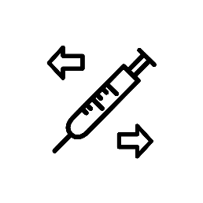
Common Characteristics Among Mobile Populations
Injection Drug Use
(IDU)
Transactional Sex
Rape
Latency Period
Before clinical symptoms & allows greater window of travel while infectious
Needle exchange programs
Condom use
Pre-exposure prophylaxis (PrEP)
Condom use
Pre-exposure prophylaxis (PrEP)
Zhang et al, 2017. Ramos et al, 2009. Truby, K. 2014.
Notes:
Source(s):
Zhang, X., Martinez-Donate, A. P., Simon, N. J., Hovell, M. F., Rangel, M. G., Magis-Rodriguez, C. & Sipan, C. L. (2017). Risk behaviours for HIV infection among traveling Mexican migrants: The Mexico-US border as a contextual risk factor. Global Public Health, 12(1); 65-83. doi:10.1080/17441692.2016.1142591
Ramos, R., Ferreira-Pinto, J. B., Brouwer, K. C., Ramos, M. E., Lozada, R. M., Firestone-Cruz, M. F., Strathdee, S. A. (2009). A tale of two cities: Social and environmental influences shaping risk factors and protective behaviors in two Mexico-US border cities. Health & Place, 15, 999-1005.
Truby, K. (2014). Bodies on the border: The state, civil society and HIV at Mexico's Fronteras. Policy and Society, 33, 53-64. doi: http://dx.doi.org/10.1016/j.polsoc.2014.03.003

Slide 19
HIV Risk Environment Mexico – U.S. Border Risk Factors
AIDS-related mortality rate
2 X national average
20 % ↑ 2003 to 2013
2 x
HIV Incidence Rate
El Paso, TX (2017)
USA (2018)
San Diego, CA (2016)
15.8
Tijuana, Baja
California-San
Diego, California
Cd. Juarez, Chih.-
El Paso, TX
36%
Latinos PWH-
Progress to AIDS
Latinos progress to AIDS within 30 days of initial diagnosis
HIV Prevalence Rate
155.3
El Paso, TX (2018)
6%
Female Sex Workers (FSWs)
6%
Street-based FSWs
https://www.hiv.gov/hiv-basics/overview/data-and-trends/
Notes:
Source(s):
1. U.S. Department of Health & Human Services (June 30, 2020). U.S. statistics: Fast Facts. Retrieved July 04, 2020 available at: https://www.hiv.gov/hiv-basics/overview/data-and-trends/statistics#:~:text=The%20estimated%20number%20of%20HIV,among%20all%20other%20age%20groups
2. Paso del Norte Health Foundation. (2020). Healthy El Paso Del Norte: HIV diagnosis rate. Retrieved July 02, 2020 available at: http://www.healthypasodelnorte.org/indicators/index/view?indicatorId=1584&localeId=2645
3. Marks C, Zúñiga ML. CAM practices and treatment adherence among key subpopulations of HIV+ Latinos receiving care in the san diego-tijuana border region: A latent class analysis. Frontiers in public health. 2019; 7:179. https://search.datacite.org/works/10.3389/fpubh.2019.00179. doi: 10.3389/fpubh.2019.00179.
4. Paso del Norte Health Foundation. (2020). Healthy El Paso Del Norte: HIV prevalence rate. Retrieved July 20, 2020, available at: http://www.healthypasodelnorte.org/?module=indicators&controller=index&action=view&comparisonId=&indicatorId=267&localeTypeId=2&localeId=2645
5. Bazzi AR, Rangel G, Martinez G, et al. Incidence and predictors of HIV and sexually transmitted infections among female sex workers and their intimate male partners in northern Mexico: A longitudinal, multilevel study. American journal of epidemiology. 2015;181(9):723-731. https://www.ncbi.nlm.nih.gov/pubmed/25769307. doi: 10.1093/aje/kwu340.
6. County of San Diego Health and Human Services Agency (2016). HIV/AIDS Epidemiology Report-2016. Retrieved July 20, 2020, available at: https://www.sandiegocounty.gov/content/dam/sdc/hhsa/programs/phs/documents/EpiReport2017final.pdf
7. Health & Human Services Agency. (2020). HIV Epidemiology Unit. Retrieved July 24, 2020, Available at: https://www.sandiegocounty.gov/hhsa/programs/phs/hiv_aids_epidemiology_unit/reports_and_statistics.html

Slide 20
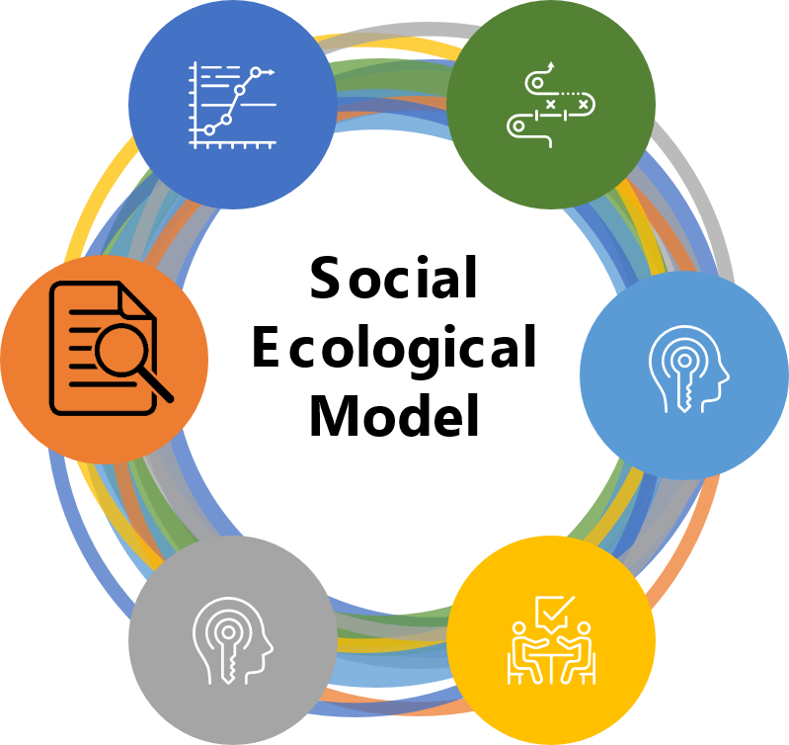
Female Sex Workers (FSWs) Mexico U.S. Border Characteristics
STI RISK FACTORS
STI PREVALENCE
Recent stimulant use
Relationship instability
Tijuana/Cd. Juarez HIV seroprevalence
STI prevalence among IDU-FSWs vs. non-IDU FSWs
HIV/STI INFECTION ODDS
Higher odds of HIV infection
RELATIONSHIP-LEVEL FACTORS
FSWs HIV/STI PREVALENCE
Commercial sex partners
Noncommercial intimate male partners
Condomless sex
n= 1092 FSWs from 13 Mexican cities
Rates of HIV/STI vs. FSWs in Tijuana-Cd. Juarez
Independent level risk factors
COMMERCIAL PARTNERS
Crossborder clients
Bazzi et al, 2015. Patterson et al, 2019. Mehta et al, 2010. Scholl et al, 2010. Mehta et al, 2015. Patterson et al, 2012. Roberson et al, 2014.
Notes:
Source(s):
Bazzi AR, Rangel G, Martinez G, et al. Incidence and predictors of HIV and sexually transmitted infections among female sex workers and their intimate male partners in northern Mexico: A longitudinal, multilevel study. American journal of epidemiology. 2015;181(9):723-731. https://www.ncbi.nlm.nih.gov/pubmed/25769307. doi: 10.1093/aje/kwu340.
Patterson, T. L., Strathdee, S.A., Semple, S. J., Chavarin, C.V., Abramovitz, D., Gaines, T. L., Mendoza, D., Staines, H., Aarons, G. A., Magis-Rodriguez, C. (2019). Prevalenc of HIV/STIs and correlates with municipal characteristics among female sex workers in 13 Mexican cities. Salud Publica Mexicana; 61:116-124. https://doi.org/10.21149/8863
Mehta, S. R., Delport, W., Brouwer, K. C., Espitia, S., Patterson, T., Pond, S. K., . . . Smith, D. M. (2010). The relatedness of HIV epidemics in the united States–Mexico border region. AIDS Research and Human Retroviruses, 26(12), 1273-1277. doi:10.1089/aid.2010.0021
Scholl., E. & Nicholson, J. (July 2010). United States Agency International Development. HIV Prevention on the U.S.-Mexico Border: Addressing the needs of most-at-risk populations. AIDSTAR-One: AIDS support and technical assistance resources.
Mehta, S. R., Wertheim, J. O., Brouwer, K. C. Wagner, K. D. et al. (2015. HIV Transmission Networks in the San Diego-Tijuana border region. EBioMedicine 2, 1456-1463. doi: http://dx.doi.org/10.1016/j.ebiom.2015.07/024
Patterson, T. L., Volkmann, T., Gallardo, M., Goldenberg, S., Lozada, R., Semple, S. J., Anderson, C. M. & Strathdee, S. A. (2012). Identifying the HIV transmission bridge: Which men are having unsafe sex with female sex workers and with their own wives or steady partners? Journal of Acquired Immune Deficiency Syndrome, 60(4): 414-420. doi: 10.1097/QAI.0b013e31825693f2
Robertson, A. M., Syvertsen, J. L., Ulibarri, M. D., Rangel, G., Martinez, G. & Strathdee, S. (2014). Prevalence and correlates of HIV and sexually transmitted infections among female sex workers and their non-commercial male partners in two Mexico-USA border cities. Journal of Urban Health: Bulletin of the New Your Academy of Medicine, 91 (4), doi: 10.1007/s11524-013-9855-2

Slide 21
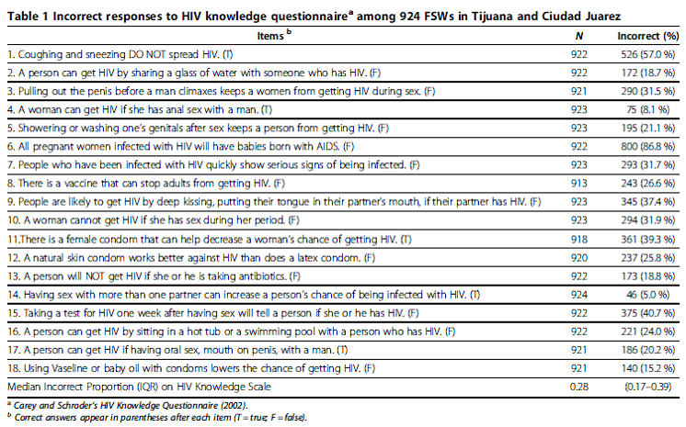
Misconceptions about HIV common among FSWs
Robertson AM, Ojeda VD, Nguyen LL, Martinez GA, Strathdee SA, Patterson TL. Reducing harm from HIV/AIDS misconceptions among female sex workers in Tijuana and Ciudad Juarez, Mexico: A cross sectional analysis. Harm Reduction Jour. 2012; 9(35).

Slide 22
Misconceptions about HIV common among FSWs
Robertson AM, Ojeda VD, Nguyen LL, Martinez GA, Strathdee SA, Patterson TL. Reducing harm from HIV/AIDS misconceptions among female sex workers in Tijuana and Ciudad Juarez, Mexico: A cross sectional analysis. Harm Reduction Jour. 2012; 9(35).

Slide 23
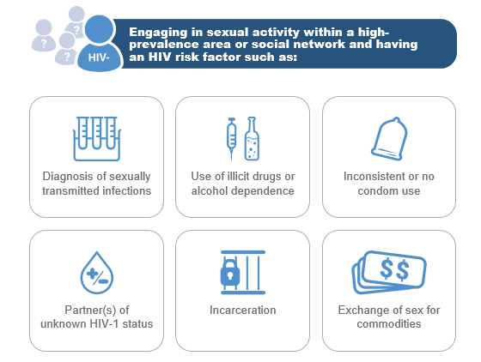
Female Sex Workers (FSWs)
https://www.truvadahcp.com/missed-opportunities
Notes:
Source(s): https://www.truvadahcp.com/missed-opportunities

Slide 24
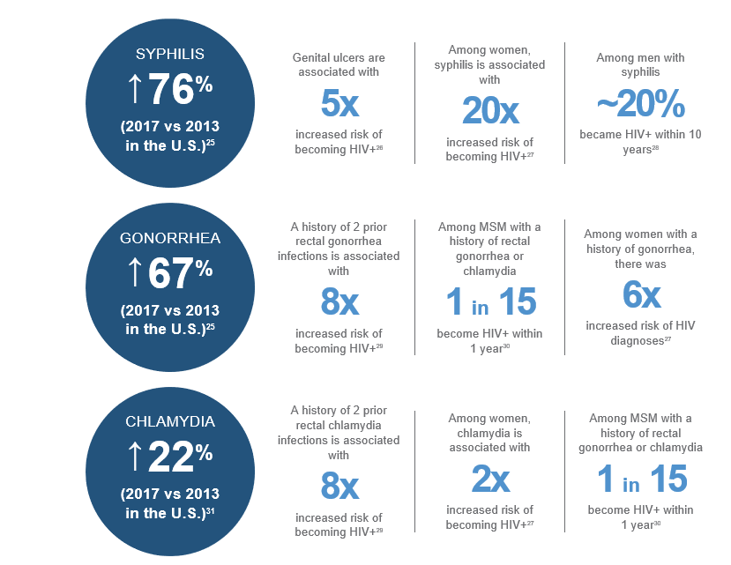
STI/HIV Risks
https://www.truvadahcp.com/missed-opportunities
Notes:
Source(s): https://www.truvadahcp.com/missed-opportunities

Slide 25
People Who Inject Drugs (PWID)
MALE IDU
Homosexual encounters
Lifetime male sexual partners
MSM reporting IDU
TIJUANA
CENSIDA (2010)
HIV prevalence
Commercial sex prevalence
Police harassment
CD. JUAREZ
PWID
CENSIDA (2010)
HIV prevalence
Commercial sex prevalence
Syringe availability
POLICING EFFECT
War on drugs campaign
Confiscation of syringes
Mehta et al, 2010. Ospina-Escobar et al, 2018. School et al, 2010. Mehta et al, 2015. Robertson et al, 2014. Truby , K 2014.
Notes:
Source(s):
Mehta, S. R., Delport, W., Brouwer, K. C., Espitia, S., Patterson, T., Pond, S. K., Smith, D. M. (2010). The relatedness of HIV epidemics in the united States–Mexico border region. AIDS Research and Human Retroviruses, 26(12), 1273-1277. doi:10.1089/aid.2010.0021
Ospina-Escobar, A., Magis-Rodriguez, C., Juarez, F., Werb, D., Arredondo, Bautista Arredondo, S., Carreon, R., Ramos, M. E. & Strathdee, S. (2018). Comparing risk environments for HIV among people who inject drugs from three cities in Nothern Mexico. Harm Reduction Journal, 15:27. doi: https://doi.org/10.1186/s12954-018-0225-y
Scholl., E. & Nicholson, J. (July 2010). United States Agency International Development. HIV Prevention on the U.S.-Mexico Border: Addressing the needs of most-at-risk populations. AIDSTAR-One: AIDS support and technical assistance resources.
Mehta, S. R., Wertheim, J. O., Brouwer, K. C. Wagner, K. D. et al. (20150. HIV Transmission Networks in the San Diego-Tijuana border region. EBioMedicine 2, 1456-1463. doi: http://dx.doi.org/10.1016/j.ebiom.2015.07/024
Robertson, A. M., Syvertsen, J. L., Ulibarri, M. D., Rangel, G., Martinez, G. & Strathdee, S. (2014). Prevalence and correlates of HIV and sexually transmitted infections among female sex workers and their non-commercial male partners in two Mexico-USA border cities. Journal of Urban Health: Bulletin of the New Your Academy of Medicine, 91 (4), doi: 10.1007/s11524-013-9855-2
Truby, K. (2014). Bodies on the border: The state, civil society and HIV at Mexico's Fronteras. Policy and Society, 33, 53-64. doi: http://dx.doi.org/10.1016/j.polsoc.2014.03.003

Slide 26
Migration and HIV
Cassels et al, 2018. Mehtaet al, 2010. Thomas et al, 2009. School et al, 2010. Dias et al, 2020. Zhang et al, 2017. Ramos et al, 2009.
Notes:
1. Cassels, S., Camlin, C. S. & Seeley, J. (2018). One step ahead: timing and sexual networks in population mobility and HIV prevention care. Journal of International the AIDS Society. 21(S4):e25140. doi: https://doi.org/10.1002/jia2.25140
2. Mehta, S. R., Delport, W., Brouwer, K. C., Espitia, S., Patterson, T., Pond, S. K., . . . Smith, D. M. (2010). The relatedness of HIV epidemics in the united States–Mexico border region. AIDS Research and Human Retroviruses, 26(12), 1273-1277. doi:10.1089/aid.2010.0021
3. Thomas, F., Haour-Knipe, M. & Aggleton, P. (2009). Mobility, Sexuality and AIDS: Sexuality, Culture and Health. Routledge Taylor & Francis Group: London and New York.
4. Scholl., E. & Nicholson, J. (July 2010). United States Agency International Development. HIV Prevention on the U.S.-Mexico Border: Addressing the needs of most-at-risk populations. AIDSTAR-One: AIDS support and technical assistance resources.
5. Dias, S., Gama, A., Loos, J., Roxo, L., Simoes, D. & Nostilinger, C. (2020). The role of mobility in sexual risk behaviour and HIV acquisition among sub-Saharan African migrants residing in two European cities. PLoS ONE 15(2):e0228584. doi: https://doi.org/10.1371/journal.pone.0228584
6. Zhang, X., Martinez-Donate, A. P., Simon, N. J., Hovell, M. F., Rangel, M. G., Magis-Rodriguez, C. & Sipan, C. L. (2017). Risk behaviours for HIV infection among traveling Mexican migrants: The Mexico-US border as a contextual risk factor. Global Public Health, 12(1); 65-83. doi:10.1080/17441692.2016.1142591
7. Ramos, R., Ferreira-Pinto, J. B., Brouwer, K. C., Ramos, M. E., Lozada, R. M., Firestone-Cruz, M. F., Strathdee, S. A. (2009). A tale of two cities: Social and environmental influences shaping risk factors and protective behaviors in two Mexico-US border cities. Health & Place, 15, 999-1005.

Slide 27
Bridging Transmission Groups
BRIDGING POPULATIONS
NON-CORE GROUPS
Population transmission from high-risk core group to noncore groups
Linked bridges
Steady partners
Wives
COVARIATES ASSOCIATED
Using drugs with FSWs
Unprotected sex
Sensation-Seeking Scale
Patterson, T. L., Volkmann, T., Gallardo, M., Goldenberg, S., Lozada, R., Semple, S. J., Anderson, C. M. & Strathdee, S. A. (2012). Identifying the HIV transmission bridge: Which men are having unsafe sex with female sex workers and with their own wives or steady partners? Journal of Acquired Immune Deficiency Syndrome, 60(4): 414-420. doi: 10.1097/QAI.0b013e31825693f2
Notes:
Source(s):
1. Patterson, T. L., Volkmann, T., Gallardo, M., Goldenberg, S., Lozada, R., Semple, S. J., Anderson, C. M. & Strathdee, S. A. (2012). Identifying the HIV transmission bridge: Which men are having unsafe sex with female sex workers and with their own wives or steady partners? Journal of Acquired Immune Deficiency Syndrome, 60(4): 414-420. doi: 10.1097/QAI.0b013e31825693f2

Slide 28
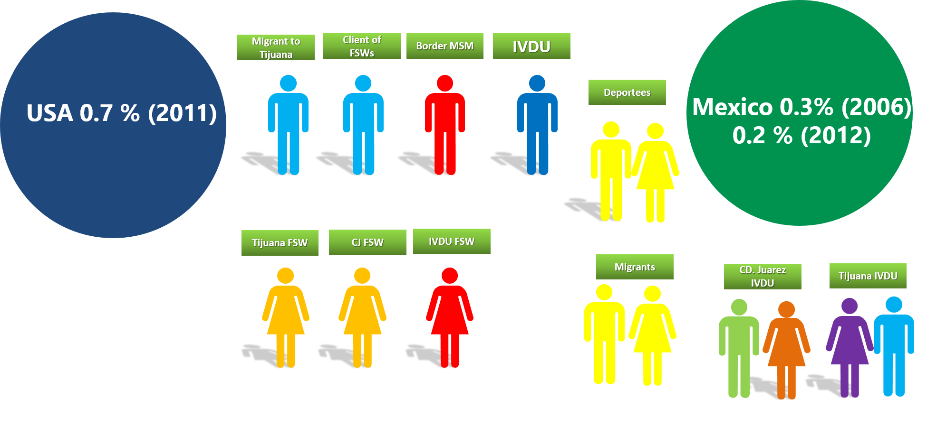
Overview of HIV Prevalence
3.98% 5% 19% 3%
8%
6% 6% 12%
5%
7.7% 4.2%

Slide 29
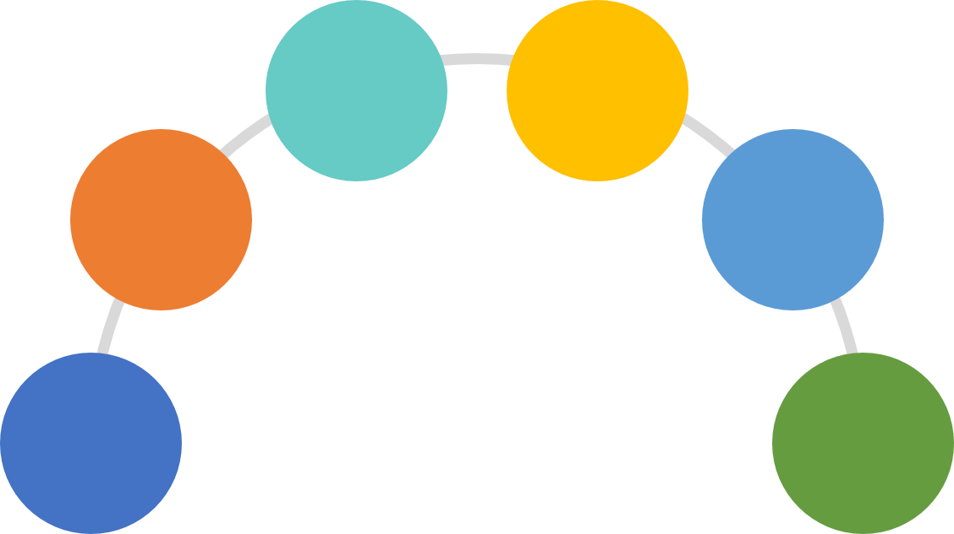
Risk Populations Subgroup Populations
CROSS-BORDER UTILIZATION
CONSENSUAL SEXUAL MOBILITY
Sexual
Mobility
Health
VICTIMS
CONSUMERS
SEX
TOURISM
Immigrants
POST- MIGRATION
MOBILITY
MALE SEX WORKERS (MSWs)
INTIMATE PARTNERS OF IDU-MSM
TRANS POPULATION ALONG MX-US BORDER
MSM
Sexual
Minorities

Slide 30
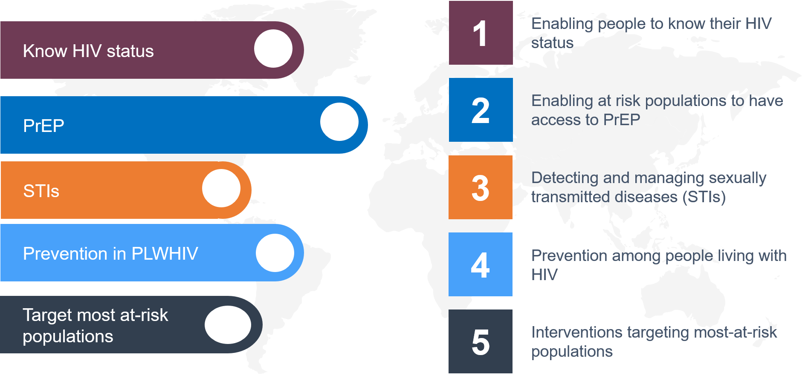
Call to Action
Prevention in PWH

Slide 31
Resources
Clinical Consultation Center http://nccc.ucsf.edu/
HIV Management
Perinatal HIV
HIV PrEP
HIV PEP line
HCV Management
Substance Use Management
AETC National HIV Curriculum https://aidsetc.org/nhc
AETC National Coordinating Resource Center https://targethiv.org/library/aetc-national-coordinating-resource-center-0
Additional trainings scaetcecho@salud.unm.edu
Notes:
Find an HIV TeleECHO clinic in your area: https://echo.unm.edu/locations-2/echo-hubs-superhubs-united-states/
AETC National HIV Curriculum: 6 core modules for self study; regularly updated; CME, CNE

Slide 32
References
United States Environmental Protection Agency. Border 2020: U.S.-Mexico Environmental Program. Published 2020. Accessed July 01, 2020.
Ramos R, Ferreira-Pinto JB, Brouwer K C, Ramos ME, Lozada RM, Firestone-Cruz MF, et al. A tale of two cities: Social and environmental influences shaping risk factors and protective behaviors in two Mexico-US border cities. Health & Place. 20009;15:999-1005.
PDNUno: Save time crossing the border. The International Bridges Steering Committee Web site. https://pdnuno.com/. Accessed July 03, 2020.
Texas Department of State Health Services. Office of Border Public Health-Texas Mexico Border. TDSHS Web site. https://www.dshs.texas.gov/borderhealth/. Accessed March. 04, 2020.
Border crossing/Entry data. United States Department of Transportation Web site. https://www.bts.gov/content/border-crossingentry-data. Published 2020. Accessed July 29, 2020.
Diaz L, Gonzalez JL. World’s busiest border falls quiet with millions of Mexicans barred from U.S. Reuters Web site. https://www.reuters.com/article/us-health-coronavirus-border/worlds-busiest-border-falls-quiet-with-millions-of-mexicans-barred-from-u-s-idUSKBN21I0MR. Published March 31, 2020. Accessed July 28, 2020.
Ramos R, Ferreira-Pinto JB, Brouwer K C, Ramos ME, Lozada RM, Firestone-Cruz MF, et al. A tale of two cities: Social and environmental influences shaping risk factors and protective behaviors in two Mexico-US border cities. Health & Place. 20009;15:999-1005.
Rivera JO, Ortiz M, Cardenas V. Cross-Border purchase of medications and healthcare in a sample of residents of El Paso, Texas and Ciudad Juarez, Mexico. Journal of National Medical Association. 2009;101(2):167-173.

Slide 33
References
Prado HS. Retiran apoyo a programas de VIH/Sida aquí. El Diario de Mexico Web site. Published July 08, 2019. Accessed March 11, 2020.
Deslandes A. Mexico is setting a global example on HIV treatment. The Slate Group Web site. https://foreignpolicy.com/2019/11/13/mexico-global-hiv-treatment-amlo-funding-cuts/. Accessed November 13, 2019.
Lopez, O. Thousands feared at risk after Mexico reforms HIV+ regime. Reuters Web site. Published April 17, 2019. Accessed July 15, 2020.
Carmona, FJ. Los casos de VIH se disparan en la frontera de Chihuahua. Televisa.news Web site. https://noticieros.televisa.com/ultimas-noticias/casos-vih-disparan-frontera-chihuahua/. Accessed November 14, 2019.
Instituto Municipal de Investigacion y Planeaceon: Ciudad Juarez, Chihuahua. Radiografía Socioeconómica del Municipio de Juárez 2018, Así comenzó 2019. IMIP Web site. https://www.imip.org.mx/imip/node/50. Accessed March 04, 2020.
Valadez, B, Hernandez, N, Gamboa, R. En Mexico, dos casos de VIH y sida cada hora. Milenio 2020 Web site. https://www.milenio.com/ciencia-y-salud/en-mexico-dos-casos-de-vih-y-sida-cada-hora. Accessed March 04, 2020.
Diaz L, Gonzalez JL. World’s busiest border falls quiet with millions of Mexicans barred from U.S. Reuters Web site. https://www.reuters.com/article/us-health-coronavirus-border/worlds-busiest-border-falls-quiet-with-millions-of-mexicans-barred-from-u-s-idUSKBN21I0MR. Published March 31, 2020. Accessed July 28, 2020.
Quick facts: El Paso city, Texas; Las Cruces city, New Mexico; San Diego city, California U.S. Department of Commerce Web site. https://www.census.gov/quickfacts/fact/table/sandiegocitycalifornia,elpasocitytexas,lascrucescitynewmexico/PST045219. Accessed July 20, 2020.
Iturriza MF, De Anda SM, Callejo ED, Rodallegas A, Villa D, Ortega D, Ponce de Leon G, Sias I, Informe pobreza en Juárez 2020. Ciudad Juárez, México: Plan Estratégico de Juárez, A.C. Published 2020. Accessed July 23, 2020.

Slide 34
References
Patterson TL, Strathdee SA, Semple SJ, Chavarin CV, Abramovitz D, Gaines TL, Mendoza D, Staines H, Aarons GA, Magis-Rodriguez C. Prevalence of HIV/STIs and correlates with municipal characteristics among female sex workers in 13 Mexican cities. Salud Publica Mexicana. 2019;61:116-124. https://doi.org/10.21149/8863
Ospina-Escobar, A, Magis-Rodriguez C, Juarez F, Werb D, Bautista AS, Carreon R, Ramos ME, Strathdee S. Comparing risk environments for HIV among people who inject drugs from three cities in Nothern Mexico. Harm Reduction Journal. 2018;15:27. doi: https://doi.org/10.1186/s12954-018-0225-y
Mehta SR. et. al. Impact of public safety policies on HIV transmission dynamics in Tijuana, Mexico.Clin Infect Dis. 2018; 66(5):758-764. doi: 10.1093/cid/cix884.
Scholl E, Nicholson J. United States Agency International Development. HIV Prevention on the U.S.-Mexico Border: Addressing the needs of most-at-risk populations. AIDSTAR-One: AIDS support and technical assistance resources. Published July 2010. Accessed July 13, 2020.
Marks C, Zúñiga ML. CAM practices and treatment adherence among key subpopulations of HIV+ Latinos receiving care in the san diego-tijuana border region: A latent class analysis. Frontiers in public health. 2019;7:179.
Zuniga ML, Blanco E, Brennan JJ, Scolari R, Artamonova IV, Strathdee SA. Binational care-seeking behaviour and health-related quality of life among HIV-infected Latinos in the U.S.-Mexico Border Region. Journal Association Nurses AIDS Care. 2011; 22(3): 162-172. doi:10.1016/j.jana.2010.09.001
Zhang X, Martinez-Donate AP, Simon NJ, Hovell MF, Rangel MG, Magis-Rodriguez C, Sipan CL. Risk behaviours for HIV infection among traveling Mexican migrants: The Mexico-US border as a contextual risk factor. Global Public Health, 2017;12(1); 65-83. doi:10.1080/17441692.2016.1142591
Ramos R, Ferreira-Pinto JB, Brouwer KC, Ramos ME, Lozada RM, Firestone-Cruz MF, Strathdee SA. A tale of two cities: Social and environmental influences shaping risk factors and protective behaviors in two Mexico-US border cities. Health & Place. 2009;15:999-1005.
Shedli MG, Decena CU, Beltran O. Geopolitical and cultural factors affecting ARV adherence on the US-Mexico Border. Journal of Immigrant Minority Health. 2013;15(5):969-974. doi:10.1007/s10903-012-9681-8
Strathdee SA, Magis-Rodriguez C. Mexico’s Evolving HIV Epidemic. JAMA. 2008; 300(5): 571-573. doi:10.1001/jama.300.5.571
UNAIDS. Global HIV & AIDS statistics-2019 fact sheet. Published 2020. https://www.unaids.org/en/resources/fact-sheet Accessed March 04, 2020.
Kutner BA, Nelson KM, Simoni JM, Sauceda JA, Wiebe JS. Factors associated with sexual risk HIV transmission among HIV-positive Latino men who have sex with men on the U.S.-Mexico Border. AIDS Behavior, 2017;21(3): 923-934. doi: 10.1007/s10461-016-1449-z

Slide 35
References
Dutton RJ, Weldon M, Shannon J, Bowcock C. Survey of health and environmental conditions in Texas border cities and colonias: Executive summary. Texas Department of Health. Published 200. Accessed June 01, 2020.
Mehta SR et al. The relatedness of HIV epidemics in the united States–Mexico border region. AIDS Research and Human Retroviruses, 2010;26(12), 1273-1277. doi:10.1089/aid.2010.0021
Zhang X, Martinez-Donate AP, Simon NJ, Hovell MF, Rangel MG, Magis-Rodriguez C, Sipan CL. Risk behaviours for HIV infection among traveling Mexican migrants: The Mexico-US border as a contextual risk factor. Global Public Health, 2017;12(1); 65-83. doi:10.1080/17441692.2016.1142591
Patterson TL, Strathdee SA, Semple SJ, Chavarin CV, Abramovitz D, Gaines TL, Mendoza D, Staines H, Aarons GA, Magis-Rodriguez C. Prevalence of HIV/STIs and correlates with municipal characteristics among female sex workers in 13 Mexican cities. Salud Publica Mexicana. 2019;61:116-124. https://doi.org/10.21149/8863
Marks C, Zúñiga ML. CAM practices and treatment adherence among key subpopulations of HIV+ Latinos receiving care in the san Diego Tijuana border region: A latent class analysis. Frontiers in public health. 2019;7:179. https://search.datacite.org/works/10.3389/fpubh.2019.00179. doi: 10.3389/fpubh.2019.00179
Centro Nacional Para la Prevencion y el Control del VIH y el SIDA (CENSIDA). Vigilancia epidemiologica de casos e VIH/SIDA en Mexico Registro Nacional de Casos de SIDA actualizacion al cierre del 2018. Published 2019. Accessed July 10, 2020.
Dutton RJ, Weldon M, Shannon J, Bowcock C. Survey of health and environmental conditions in Texas border cities and colonias: Executive summary. Texas Department of Health. Published 2000. Accessed July 05, 2020. The Survey of Health and Environmental Conditions in Texas Border Counties and Colonias was conducted to provide the first population-based data on health concerns on the border.
Thomas F, Haour-Knipe M, Aggleton P. Mobility, Sexuality and AIDS: Sexuality, Culture and Health. 3rd ed. Routledge Taylor & Francis Group: London and New York; 2009.
Patterson TL, Volkmann T, Gallardo M, Goldenberg S, Lozada R, Semple SJ, Anderson CM, Strathdee SA. Identifying the HIV transmission bridge: Which men are having unsafe sex with female sex workers and with their own wives or steady partners? Journal of Acquired Immune Deficiency Syndrome. 2012; 60(4): 414-420. doi: 10.1097/QAI.0b013e31825693f2
Scholl E, Nicholson J. United States Agency International Development. HIV Prevention on the U.S.-Mexico Border: Addressing the needs of most-at-risk populations. AIDSTAR-One: AIDS support and technical assistance resources. Published July 2010. Accessed July 13, 2020.
Truby, K. Bodies on the border: The state, civil society and HIV at Mexico's Fronteras. Policy and Society. 2014;33:53-64. doi: http://dx.doi.org/10.1016/j.polsoc.2014.03.003

Slide 36
References
Zhang X, Martinez-Donate AP, Simon NJ, Hovell MF, Rangel MG, Magis-Rodriguez C, Sipan CL. Risk behaviours for HIV infection among traveling Mexican migrants: The Mexico-US border as a contextual risk factor. Global Public Health, 2017;12(1); 65-83. doi:10.1080/17441692.2016.1142591
Ramos R, Ferreira-Pinto JB, Brouwer KC, Ramos ME, Lozada RM, Firestone-Cruz MF, Strathdee SA. A tale of two cities: Social and environmental influences shaping risk factors and protective behaviors in two Mexico-US border cities. Health & Place. 2009;15:999-1005.
Truby, K. Bodies on the border: The state, civil society and HIV at Mexico's Fronteras. Policy and Society. 2014;33:53-64. doi: http://dx.doi.org/10.1016/j.polsoc.2014.03.003
1. U.S. Department of Health & Human Services. U.S. statistics: Fast Facts. Accessed July 04, 2020. https://www.hiv.gov/hiv-basics/overview/data-and-trends/statistics#:~:text=The%20estimated%20number%20of%20HIV,among%20all%20other%20age%20groups
2. Paso del Norte Health Foundation: Healthy El Paso Del Norte: HIV diagnosis rate. Accessed July 02, 2020. http://www.healthypasodelnorte.org/indicators/index/view?indicatorId=1584&localeId=2645
3. Marks C, Zúñiga ML. CAM practices and treatment adherence among key subpopulations of HIV+ Latinos receiving care in the san Diego-Tijuana border region: A latent class analysis. Frontiers in public health. 2019;7:179. https://search.datacite.org/works/10.3389/fpubh.2019.00179. doi: 10.3389/fpubh.2019.00179.
4. Paso del Norte Health Foundation. Healthy El Paso Del Norte: HIV prevalence rate. Accessed July 20, 2020. http://www.healthypasodelnorte.org/?module=indicators&controller=index&action=view&comparisonId=&indicatorId=267&localeTypeId=2&localeId=2645
5. Bazzi AR, Rangel G, Martinez G, et al. Incidence and predictors of HIV and sexually transmitted infections among female sex workers and their intimate male partners in northern Mexico: A longitudinal, multilevel study. American journal of epidemiology. 2015;181(9):723-731. https://www.ncbi.nlm.nih.gov/pubmed/25769307. doi: 10.1093/aje/kwu340.
6. County of San Diego Health and Human Services Agency: HIV/AIDS Epidemiology Report-2016. Accessed July 20, 2020. https://www.sandiegocounty.gov/content/dam/sdc/hhsa/programs/phs/documents/EpiReport2017final.pdf
7. Health & Human Services Agency: HIV Epidemiology Unit. Accessed July 24, 2020. https://www.sandiegocounty.gov/hhsa/programs/phs/hiv_aids_epidemiology_unit/reports_and_statistics.html

Slide 37
References
Bazzi AR, Rangel G, Martinez G, et al. Incidence and predictors of HIV and sexually transmitted infections among female sex workers and their intimate male partners in northern Mexico: A longitudinal, multilevel study. American journal of epidemiology. 2015;181(9):723-731. https://www.ncbi.nlm.nih.gov/pubmed/25769307. doi: 10.1093/aje/kwu340.
Patterson TL, Strathdee SA, Semple SJ, Chavarin CV, Abramovitz D, Gaines TL, Mendoza D, Staines H, Aarons GA, Magis-Rodriguez C. Prevalence of HIV/STIs and correlates with municipal characteristics among female sex workers in 13 Mexican cities. Salud Publica Mexicana. 2019;61:116-124. https://doi.org/10.21149/8863
Mehta SR et al. The relatedness of HIV epidemics in the united States–Mexico border region. AIDS Research and Human Retroviruses, 2010;26(12), 1273-1277. doi:10.1089/aid.2010.0021
Scholl E, Nicholson J. United States Agency International Development. HIV Prevention on the U.S.-Mexico Border: Addressing the needs of most-at-risk populations. AIDSTAR-One: AIDS support and technical assistance resources. Published July 2010. Accessed July 13, 2020.
Meht SR et al. HIV Transmission Networks in the San Diego-Tijuana border region. EBioMedicine. 2015; 2: 1456-1463. doi: http://dx.doi.org/10.1016/j.ebiom.2015.07/024
Patterson TL, Volkmann T, Gallardo M, Goldenberg S, Lozada R, Semple SJ, Anderson CM, Strathdee SA. Identifying the HIV transmission bridge: Which men are having unsafe sex with female sex workers and with their own wives or steady partners? Journal of Acquired Immune Deficiency Syndrome. 2012; 60(4): 414-420. doi: 10.1097/QAI.0b013e31825693f2
Robertson AM, Syvertsen JL, Ulibarri MD, Rangel G, Martinez G, Strathdee S. Prevalence and correlates of HIV and sexually transmitted infections among female sex workers and their non-commercial male partners in two Mexico-USA border cities. Journal of Urban Health: Bulletin of the New Your Academy of Medicine. 2014;91(4).doi: 10.1007/s11524-013-9855-2
Robertson, AM, Ojeda, VD, Nguyen, LL, Martinez, GA, Strathdee, SA, Patterson, TL. Reducing harm from HIV/AIDS misconceptions among female sex workers in Tijuana and Ciudad Juarez, Mexico: A cross sectional analysis. Harm Reduction Jour. 2012; 9(35). http://www.harmreductionjournal.com/content/9/1/35 Accessed March 30, 2020.
Conners, EE, West, BS, Roth, AM, Meckel-Parker, KG, Mei-Po, K, Magis-Rodriguez, C, Staines-Orozco, H, Clapp, JD, Brouwer, KC. Quantitative, qualitative and geospatial methods to characterize HIV risk environments. PLosONE, 2016; 11(5):e0155693. Doi:10.1371/journal.pone.0155693
Robertson AM, Ojeda VD, Nguyen LL, Martinez GA, Strathdee SA, Patterson TL. Reducing harm from HIV/AIDS misconceptions among female sex workers in Tijuana and Ciudad Juarez, Mexico: A cross sectional analysis. Harm Reduction Jour. 2012; 9(35). http://www.harmreductionjournal.com/content/9/1/35 Accessed March 30, 2020.

Slide 38
References
https://www.truvadahcp.com/missed-opportunities
https://www.truvadahcp.com/missed-opportunities
Mehta SR et al. The relatedness of HIV epidemics in the united States–Mexico border region. AIDS Research and Human Retroviruses, 2010;26(12), 1273-1277. doi:10.1089/aid.2010.0021
Ospina-Escobar, A, Magis-Rodriguez C, Juarez F, Werb D, Bautista AS, Carreon R, Ramos ME, Strathdee S. Comparing risk environments for HIV among people who inject drugs from three cities in Nothern Mexico. Harm Reduction Journal. 2018;15:27. doi: https://doi.org/10.1186/s12954-018-0225-y
Scholl E, Nicholson J. United States Agency International Development. HIV Prevention on the U.S.-Mexico Border: Addressing the needs of most-at-risk populations. AIDSTAR-One: AIDS support and technical assistance resources. Published July 2010. Accessed July 13, 2020.
Mehta, S. R., Wertheim, J. O., Brouwer, K. C. Wagner, K. D. et al. (20150. HIV Transmission Networks in the San Diego-Tijuana border region. EBioMedicine 2, 1456-1463. doi: http://dx.doi.org/10.1016/j.ebiom.2015.07/024
Robertson AM, Syvertsen JL, Ulibarri MD, Rangel G, Martinez G, Strathdee S. Prevalence and correlates of HIV and sexually transmitted infections among female sex workers and their non-commercial male partners in two Mexico-USA border cities. Journal of Urban Health: Bulletin of the New Your Academy of Medicine. 2014;91(4). doi: 10.1007/s11524-013-9855-2
Truby, K. Bodies on the border: The state, civil society and HIV at Mexico's Fronteras. Policy and Society. 2014;33:53-64. doi: http://dx.doi.org/10.1016/j.polsoc.2014.03.003

Slide 39
References
Cassels S, Camlin CS, Seeley J. One step ahead: timing and sexual networks in population mobility and HIV prevention care. Journal of International the AIDS Society. 2018;21(S4):e25140. doi: https://doi.org/10.1002/jia2.25140
Mehta SR et al. The relatedness of HIV epidemics in the united States–Mexico border region. AIDS Research and Human Retroviruses, 2010;26(12), 1273-1277. doi:10.1089/aid.2010.0021
Thomas F, Haour-Knipe M, Aggleton P. Mobility, Sexuality and AIDS: Sexuality, Culture and Health. 3rd ed. Routledge Taylor & Francis Group: London and New York; 2009.
Scholl E, Nicholson J. United States Agency International Development. HIV Prevention on the U.S.-Mexico Border: Addressing the needs of most-at-risk populations. AIDSTAR-One: AIDS support and technical assistance resources. Published July 2010. Accessed July 13, 2020.
5. Dias S, Gama A, Loos J, Roxo L, Simoes D, Nostilinger C. The role of mobility in sexual risk behaviour and HIV acquisition among sub-Saharan African migrants residing in two European cities. PLoS ONE. 2020;15(2):e0228584. doi: https://doi.org/10.1371/journal.pone.0228584
6. Zhang X, Martinez-Donate AP, Simon NJ, Hovell MF, Rangel MG, Magis-Rodriguez C, Sipan CL. Risk behaviours for HIV infection among traveling Mexican migrants: The Mexico-US border as a contextual risk factor. Global Public Health, 2017;12(1); 65-83. doi:10.1080/17441692.2016.1142
7. Ramos R, Ferreira-Pinto JB, Brouwer KC, Ramos ME, Lozada RM, Firestone-Cruz MF, Strathdee SA. A tale of two cities: Social and environmental influences shaping risk factors and protective behaviors in two Mexico-US border cities. Health & Place. 2009;15:999-1005.
8. Deslandes A. Mexico is setting a global example on HIV treatment. The Slate Group Web site. https://foreignpolicy.com/2019/11/13/mexico-global-hiv-treatment-amlo-funding-cuts/. Accessed November 13, 2019.

Slide 40
References
Patterson TL, Volkmann T, Gallardo M, Goldenberg S, Lozada R, Semple SJ, Anderson CM, Strathdee SA. Identifying the HIV transmission bridge: Which men are having unsafe sex with female sex workers and with their own wives or steady partners? Journal of Acquired Immune Deficiency Syndrome. 2012; 60(4): 414-420. doi: 10.1097/QAI.0b013e31825693f2
Mehta SR et al. The relatedness of HIV epidemics in the united States–Mexico border region. AIDS Research and Human Retroviruses, 2010;26(12), 1273-1277. doi:10.1089/aid.2010.0021
Scholl E, Nicholson J. United States Agency International Development. HIV Prevention on the U.S.-Mexico Border: Addressing the needs of most-at-risk populations. AIDSTAR-One: AIDS support and technical assistance resources. Published July 2010. Accessed July 13, 2020.
Zhang X, Martinez-Donate AP, Simon NJ, Hovell MF, Rangel MG, Magis-Rodriguez C, Sipan CL. Risk behaviours for HIV infection among traveling Mexican migrants: The Mexico-US border as a contextual risk factor. Global Public Health, 2017;12(1); 65-83. doi:10.1080/17441692.2016.1142591
Truby, K. Bodies on the border: The state, civil society and HIV at Mexico's Fronteras. Policy and Society. 2014;33:53-64. doi: http://dx.doi.org/10.1016/j.polsoc.2014.03.003
Patterson TL, Volkmann T, Gallardo M, Goldenberg S, Lozada R, Semple SJ, Anderson CM, Strathdee SA. Identifying the HIV transmission bridge: Which men are having unsafe sex with female sex workers and with their own wives or steady partners? Journal of Acquired Immune Deficiency Syndrome. 2012; 60(4): 414-420. doi: 10.1097/QAI.0b013e31825693f2
Bazzi AR, Rangel G, Martinez G, et al. Incidence and predictors of HIV and sexually transmitted infections among female sex workers and their intimate male partners in northern Mexico: A longitudinal, multilevel study. American journal of epidemiology. 2015;181(9):723-731. https://www.ncbi.nlm.nih.gov/pubmed/25769307. doi: 10.1093/aje/kwu340.
Robertson AM, Syvertsen JL, Ulibarri MD, Rangel G, Martinez G, Strathdee S. Prevalence and correlates of HIV and sexually transmitted infections among female sex workers and their non-commercial male partners in two Mexico-USA border cities. Journal of Urban Health: Bulletin of the New Your Academy of Medicine. 2014;91(4).doi: 10.1007/s11524-013-9855-2
Ospina-Escobar, A, Magis-Rodriguez C, Juarez F, Werb D, Bautista AS, Carreon R, Ramos ME, Strathdee S. Comparing risk environments for HIV among people who inject drugs from three cities in Nothern Mexico. Harm Reduction Journal. 2018;15:27. doi: https://doi.org/10.1186/s12954-018-0225-y

Slide 41
References
Dias S, Gama A, Loos J, Roxo L, Simoes D, Nostilinger C. The role of mobility in sexual risk behaviour and HIV acquisition among sub-Saharan African migrants residing in two European cities. PLoS ONE. 2020;15(2):e0228584. doi: https://doi.org/10.1371/journal.pone.0228584
Conners EE, West BS, Roth AM, Meckel-Parker KG, Mei-Po K, Magis-Rodriguez C, Staines-Orozco H, Clapp JD, Brouwer KC. Quantitative, qualitative and geospatial methods to characterize HIV risk environments. PLosONE, 2016;11(5):e0155693. doi:10.1371/journal.pone.0155693
United States Environmental Protection Agency. Border 2020: U.S.-Mexico Environmental Program. Published 2020. Accessed July 01, 2020.
Marks C, Zúñiga ML. CAM practices and treatment adherence among key subpopulations of HIV+ Latinos receiving care in the san diego-tijuana border region: A latent class analysis. Frontiers in public health. 2019;7:179. https://search.datacite.org/works/10.3389/fpubh.2019.00179. doi: 10.3389/fpubh.2019.0017
Truby, K. Bodies on the border: The state, civil society and HIV at Mexico's Fronteras. Policy and Society. 2014;33:53-64. doi: http://dx.doi.org/10.1016/j.polsoc.2014.03.003

