Slide 1
Intersectionality of HIV and Domestic Violence
Alexis Roberts, BSW
Cassidy Stiles, MA

Slide 2
Conflict of Interest Disclosure Statement
Speaker has no conflicts to disclose
This project is supported by the Health Resources and Services Administration (HRSA) of the U.S. Department of Health and Human Services (HHS). Under grant number U1OHA33225 (South Central AIDS Education and Training Center). It was awarded to the University of New Mexico. No percentage of this project was financed with non-governmental sources. This information or content and conclusions are those of the authors and should not be construed as the official position or policy of, nor should any endorsements be inferred by HRSA, HHS, or the U.S. Government.

Slide 3
What You Think You Know
https://create.kahoot.it/v2/details/38b0c11b-26da-4726-86c1-6be478625df6

Slide 4
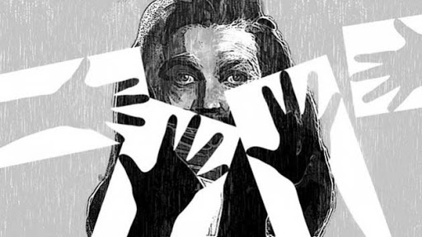
What Is Domestic Violence?
A pattern of coercive and controlling behaviors used by one person over another to gain power and control. This may include verbal abuse, financial abuse, emotional, sexual and physical abuse.

Slide 5
Statistics on Domestic Violence
1 in 4 women and 1 in 9 men experience severe intimate partner physical violence, intimate partner contact sexual violence, and/or intimate partner stalking with impacts such as injury, fearfulness, post-traumatic stress disorder, use of victim services, contraction of sexually transmitted diseases, etc.
1 in 4 women and 1 in 7 men have been victims of severe physical violence (e.g. beating, burning, strangling) by an intimate partner in their lifetime.
16% (about 1 in 6) of homicide victims are killed by an intimate partner
On a typical day, there are more than 20,000 phone calls placed to domestic violence hotlines nationwide.
The presence of a gun in a domestic violence situation increases the risk of homicide by 500%.
Domestic victimization is correlated with a higher rate of depression and suicidal behavior.
Only 34% of people who are injured by intimate partners receive medical care for their injuries.
On average, nearly 20 people per minute are physically abused by an intimate partner in the United States. During one year, this equates to more than 10 million women and men. (NCADV, 2020)

Slide 6
Warning Signs of DV
Dr. Jekyll/Mr. Hyde dual personality
Cruelty to animals
Unrealistic expectations
Breaking/striking objects
Blames others/never takes responsibility

Slide 7
Duluth Model

Slide 8
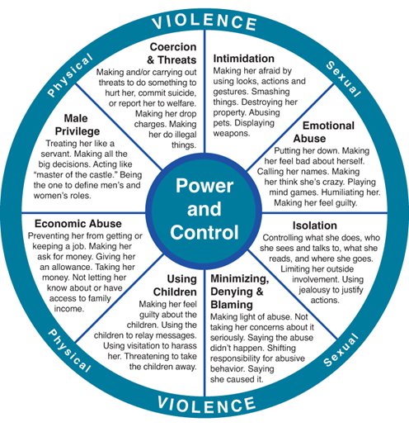
Power & Control Wheel
Most common tactics abusers use to gain POWER and CONTROL
Abusive relationship vs non abusive relationship
Works on a continuum

Slide 9
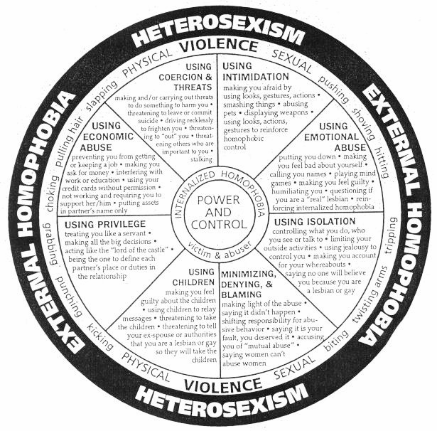
LGBTQIA P & C.W.
Lets Define:
“Homophobic Control”- Using fear tactics to influence your actions and beliefs, tactics that are based on societal and systematic oppression of the LGBTQIA community and lifestyle.
“Internalized Homophobia”-Internalized homophobia happens to LGBTQIA people, and even heterosexuals, who have learned and been taught that heterosexuality is the socially acceptable norm. Witnessing negative depictions of LGBTQIA people can lead us to internalise, or take in, these negative messages. Some LGB people suffer from mental distress as a result. (The Rainbow Project, 2020)
Notes:
Denial of your sexual orientation to yourself and others.
02. Attempts to alter or change your sexual your orientation.
03. Feeling you are never good enough.
04. Engaging in obsessive thinking and/or compulsive behaviours.
05. Under-achievement or even over-achievement as a bid for acceptance.
06. Low self esteem, negative body image.
07. Contempt for the more open or obvious members of the LGBT community.
08. Contempt for those at earlier stages of the coming out process.
09. Denial that homophobia, heterosexism, biphobia or sexism are serious social problems.
10. Contempt for those that are not like ourselves or contempt for those who seem like ourselves. Sometimes distancing by engaging in homophobic behaviours – ridicule, harassment, verbal or physical attacks on other LGB people.
11. Projection of prejudice onto another target group.
12. Becoming psychologically abused or abusive or remaining in an abusive relationship.
13. Attempts to pass as heterosexual, sometimes marrying someone of the other sex to gain social approval or in hope of ‘being cured’.
14. Increased fear and withdrawal from friend and relatives.
15. Shame or depression; defensiveness; anger or bitterness.
16. School truancy or dropping out of school. Also, work place absenteeism or reduced productivity.
17. Continual self-monitoring of one’s behaviours, mannerisms, beliefs, and ideas.
18. Clowning as a way of acting out society’s negative stereotypes.
19. Mistrust and destructive criticism of LGBT community leaders.
20. Reluctance to be around or have concern for children for fear of being seen as a paedophile.
21. Conflicts with the law.
22. Unsafe sexual practices and other destructive risk-taking behaviours-including risk for HIV and other STIs.
23. Separating sex and love, or fear of intimacy. Sometimes low or lack of sexual drive or celibacy.
24. Substance abuse, including drink and drugs.
25. Thinking about suicide, attempting suicide, death by suicide

Slide 10
How are domestic violence and HIV connected?

Slide 11
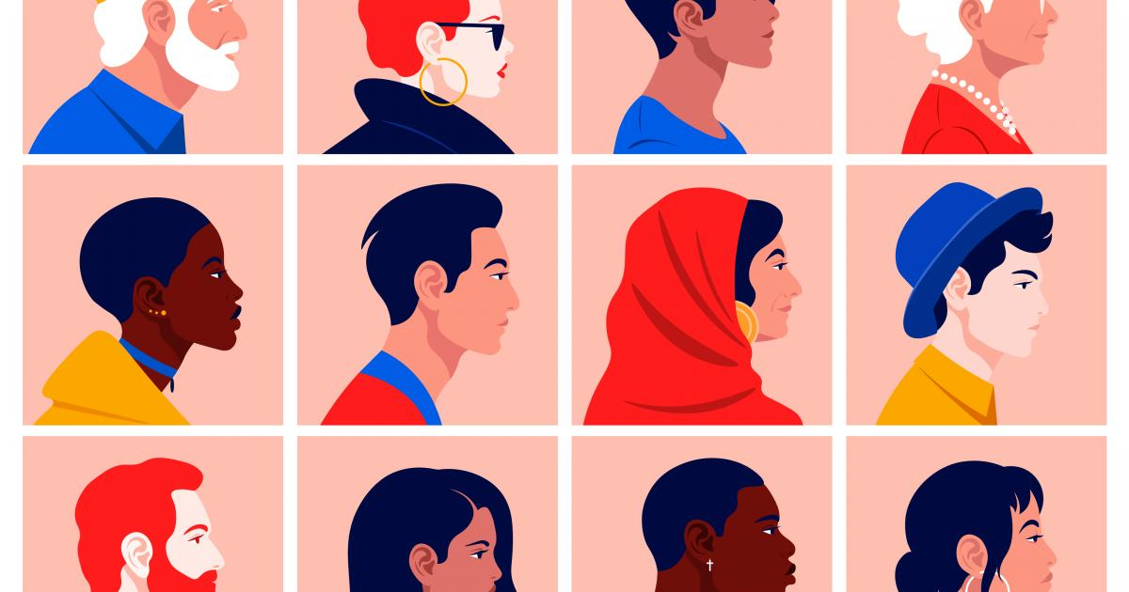
HIV and Domestic Violence Transcend all Socioeconomic, Ethinic, Cultural, Racial, Educational and Gender and Sexual Orientation Lines.

Slide 12
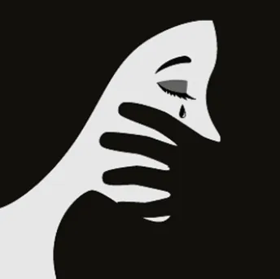
Commonalities Between HIV and DV
Stigmatized
Underrepresented
Misunderstood
Ignored
Lethal

Slide 13
Statistics
In a study of HIV service providers, 24% reported at least 1 patient who disclosed their HIV status and then experienced physical abuse. 45% of providers had patients who feared physical abuse upon disclosure.
People living with HIV may experience prolonged DV with increased severity when compared to people who are HIV-negative and experiencing DV.
Individuals experiencing DV are at higher risk for HIV/AIDS because they might..
Be forced to have sex with an infected partner
Have limited ability to negotiatie safe sex practices
(Fact Sheet About HIV/AIDS & Domestic Violence, 2018) & (Harrigan, 2019)

Slide 15
Domestic Violence & Risk of Contracting HIV
Victims are often unable to negotiate the use of safer sex practices with coercive partners, as well as safer drug use.
Abusers may rape or sexually assault their victims as part of their pattern of control, making it unlikely that the abuser will use a condom. In fact, some abusers may intentionally infect their partners with HIV in an attempt to keep the victim from leaving.
Abusive partners who engage in sexual activity outside the relationship, potentially expose victims to STD’s including HIV.
(New York State, 2020)

Slide 16
Domestic Violence & Risk of Contracting HIV
Abusive partners may force victims to engage in sexual activities with others.
Victims of domestic violence often suffer a wide range of health-related problems caused or exacerbated by the abuse. This negative effect on their health may compromise their immune system in ways that increase their risk of HIV.
Abusers may prevent victims from receiving medical care which may, in turn, negatively impact their health and increase their risk of contracting HIV.
(New York State, 2020)

Slide 17
How Abusers Use an HIV Status as Leverage
Threats to reveal HIV+ status to children, family, friends, employer.
Threatening to use victim’s HIV+ status as grounds for paternal custody.
Reinforcing a victim’s guilt about the HIV+ status of children.
Sexually humiliating or degrading the victim for having HIV. Telling the victim s/he is "dirty" or undesirable. (New York State, 2020)

Slide 18
How Abusers Use an HIV Status as Leverage
Isolating the victim on the basis that s/he poses a threat of infection to others.
Threatening or refusing to assist the victim when s/he is sick.
Abusers may use victim’s HIV+ status as an excuse for their violence.
Abusers who are HIV+ may fake illness in order to convince victims not to leave or to woo them back if they have left.
Abusers who are HIV+ and who require caregiving may be successful at manipulating victims into providing care.
(New York State, 2020)

Slide 19
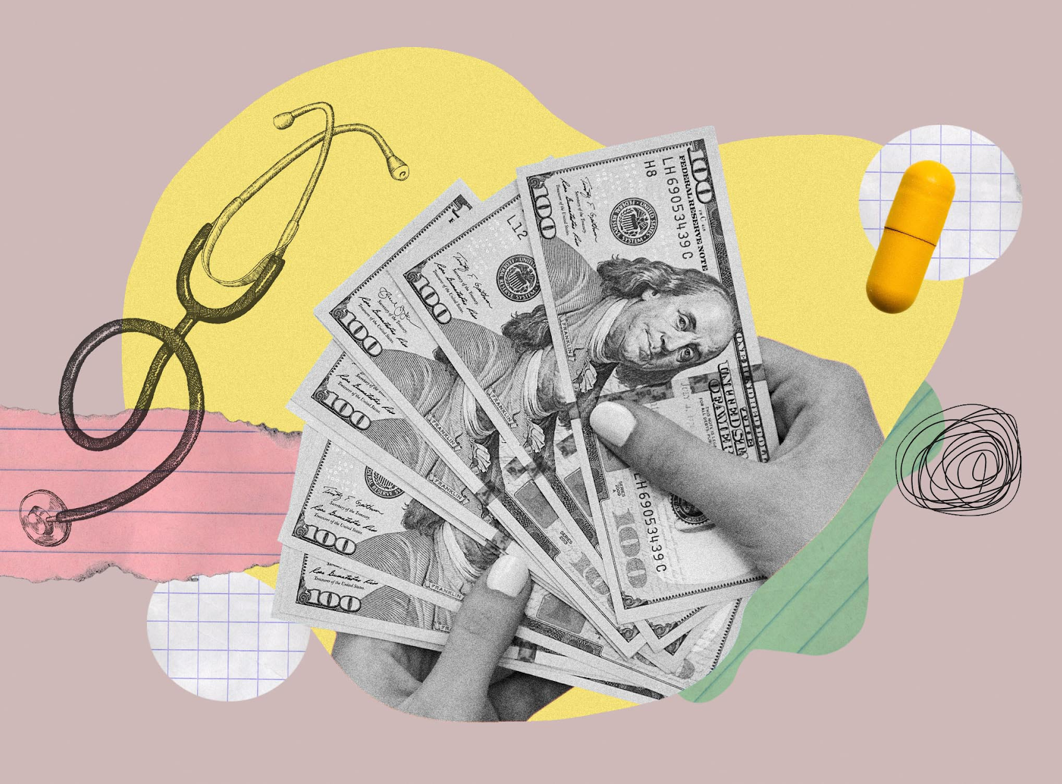
DV as an obstacle to HIV treatment/care
Access to medical care, finances, and support systems is often controlled by the abuser.
For victim with AIDS diagnosis, disability or fixed income may lead to financial dependency.
As the disease progresses, the ability to take care of oneself may diminish. In turn, the victim becomes more dependent on abuser & increasingly “trapped” in the relationship
(New York State, 2020)

Slide 20
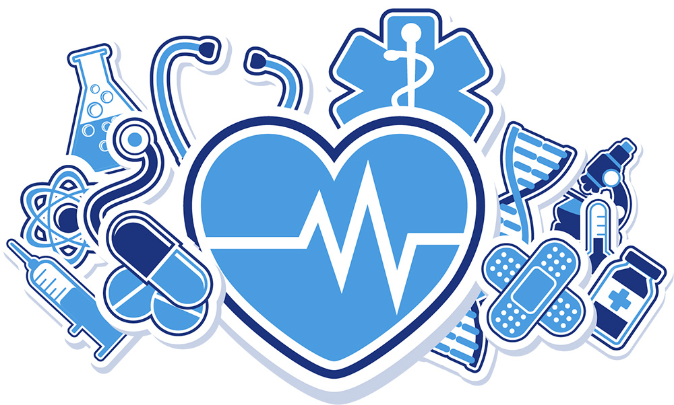
DV as an obstacle to HIV treatment/care
Partner notification practices may put victim who is HIV+ at further risk, therefore decreasing the likelihood they will seek services
LGBTQ victims may have less of a support system if they’ve been ostracized based on sexual orientation-causing dependency on abusive partner.
Reluctant to leave out of concern for care for children should HIV/AIDS incapacitate them
(New York State, 2020)

Slide 21
DV as an obstacle to HIV treatment/care
Women who experience DV were 21% less likely to be on treatment, reported 53% lower adherence to medication, and where 36% less likely to be virally suppressed than women who had not experience DV
Men who have experienced DV were 1.95x more likely to have had a clinically significant interruption in care (defined as having an undetectable viral load and leaving care for at least one year, then returning to care with a detectable viral load and 1.55x more likely to have had a hospitalization related to HIV

Slide 22
Assisting Our Clients Through Recovery
Using Empowerment and Education

Slide 23
Reduce The Stigma
Know the facts. Educate yourself about the HIV and DV, as well as the intersectionality between the two.
Be aware of your attitudes and behaviour. Be willing to confront your own biases. Change starts with “us”.
Choose your words carefully. The way we speak can affect the attitudes of others.
Educate others. Pass on facts and positive attitudes; challenge myths and stereotypes. Be willing to create and support an environment that holds space for empowering and educating dialogue.
Focus on the positive. DV and HIV are only a part of anyone's larger picture.
Treat everyone with dignity and respect; offer support and encouragement.
Demand policies and space which nurture inclusivity.

Slide 24
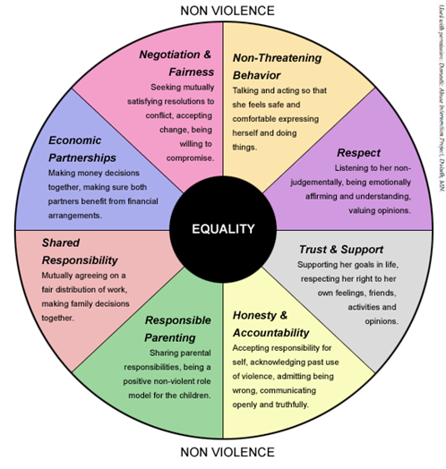
Empowerment
HIV+ status is not a death sentence, nor is it a sentence to be alone for the rest of their lives.
Everyone DESERVES healthy relationships. We do NOT have to “settle”.
Encourage clients to take an active role in decision making, with the understanding that they are the experts on their life.

Slide 25
Education
HIV
General Virus Education
Prevention and Maintenance Planning
Risk and Protective Factors
The Power of Community
Resources
Domestic Violence
Warning Signs
Power & Control Wheel
Safety Planning
Risk and Protective Factors
The Power of Community
Resources

Slide 26
Education

Slide 27
Resources and Referrals
It’s crucial that we familiarize ourselves with local resources to help our clients.
Who in your community serves victims of domestic violence?
Who in your community serves individuals with HIV?
How can you help them get connected?
Think about:
Support groups, medical facilities (low cost or no insurance), financial help, crisis/advocacy center, emergency shelter, crisis hotlines

Slide 28
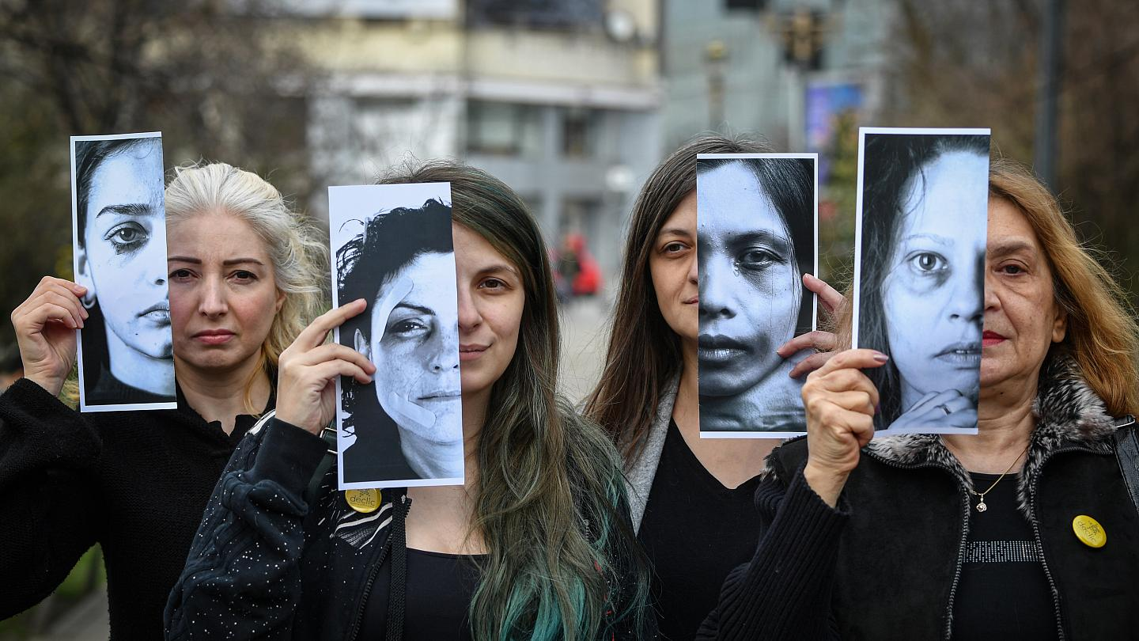
(Mihailescu, 2020).

Slide 29
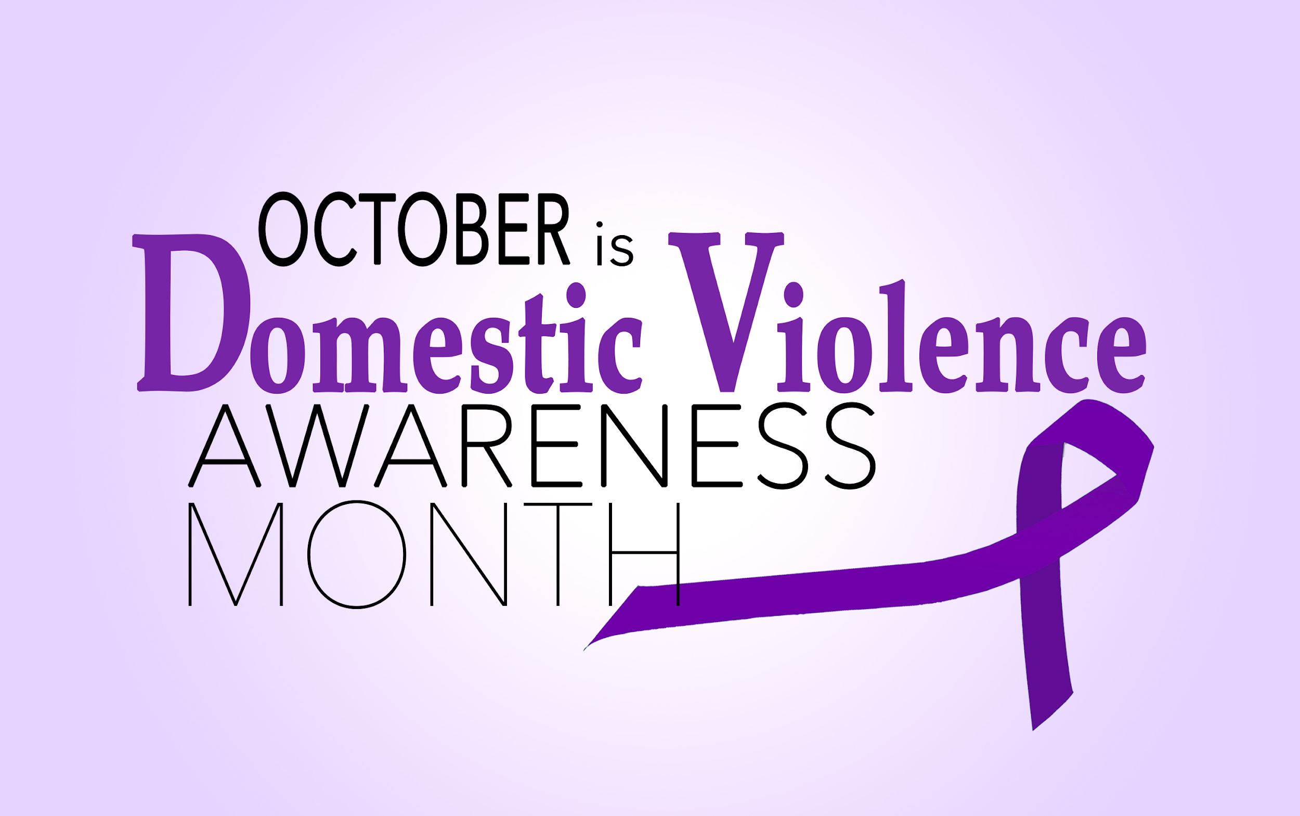

Slide 30
References
http://www.mass.gov/eopss/crime-prev-personal-sfty/personal-sfty/sexual-and-dom-viol/overview/definition-of-domestic-violence.html.
MIHAILESCU, D. (2020). Domestic violence cases jump 30% during lockdown in France. Retrieved 5 October 2020, from https://www.euronews.com/2020/03/28/domestic-violence-cases-jump-30-during-lockdown-in-france
New York State. (2020). Domestic Violence and HIV/AIDS - NYS OPDV. Retrieved 5 October 2020, from https://opdv.ny.gov/professionals/health/hivaids.html
Harrigan, M. (2019). The link between intimate partner violence and HIV. Retrieved 5 October 2020, from https://www.catie.ca/en/pif/fall-2019/link-between-intimate-partner-violence-and-hiv
What is The Duluth Model? (n.d.). Retrieved October 05, 2020, from https://www.theduluthmodel.org/what-is-the-duluth-model/
The Rainbow Project. (2020). Internalised Homophobia. Retrieved 5 October 2020, from https://www.rainbow-project.org/internalised-homophobia
NCADV. (2020). NCADV | National Coalition Against Domestic Violence. Retrieved 5 October 2020, from https://ncadv.org/STATISTICS

