Slide 1
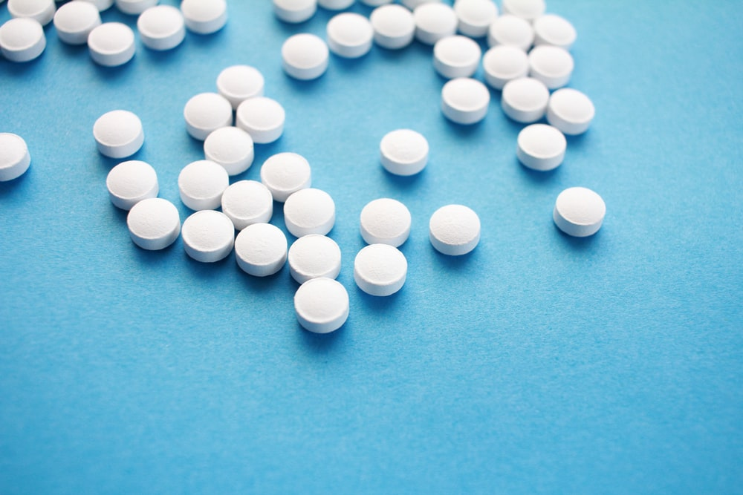
Webcast Wednesday: Outpatient OUD Treatment
Michael Baca-Atlas, MD, FASAM
Clinical Assistant Professor
UNC Department of Family Medicine
UNC WakeBrook Primary Care
12/2/2020
Notes:
Photo by Halacious on Unsplash
Primary audience is PC NPs, RNs will be attending
Overall Unfavourable Disease
Bring up Kratom in outpatient setting and Loperamide

Slide 2
Disclosure/Conflict of Interest
I have no actual or potential conflicts of interest in relation to this program and no disclosures.

Slide 3
Objectives:
Describe the epidemiology of opioid use and addiction at the national and state levels, highlighting impact of COVID-19
Review key principles of addiction medicine including definitions, the brain disease model and substance use disorder (SUD) diagnostic criteria
Discuss three FDA approved treatment options for opioid use disorder (OUD), with a focus on various buprenorphine formulations.
Review important adjunct medications to providing care to individuals with OUD including PrEP, PEP and Naloxone
Describe the recent expansion of Tele-behavioral health treatment for OUD
Notes:
Addiction medicine in the context of COVID-19 (how are people receiving treatment during this time? Have overdoses gone up? Have substance-use diagnosis' increased during this time?)

Slide 4
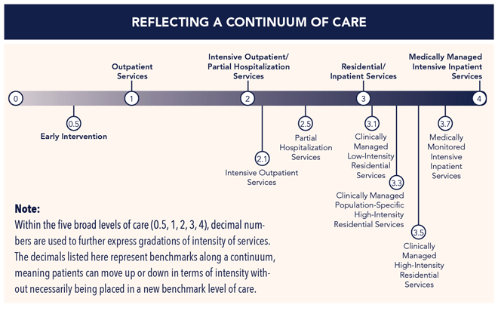
Treatment of OUD: ASAM Placement Criteria
The ASAM Criteria: Treatment Criteria for Addictive, Substance-Related, and Co-Occurring Conditions (2013)
Levels of Care
Notes:
Collaboration that began in the 1980s to define one national set of criteria for providing outcome-oriented and results-based care in the treatment of addiction. Today the criteria have become the most widely used and comprehensive set of guidelines for placement, continued stay and transfer/discharge of patients with addiction and co-occurring conditions. -
Setting-Intensity-Duration-Approach
philosophy or conceptual understanding of addiction
techniques employed and role of medication

Slide 5
Treatment of OUD: ASAM Placement Criteria
Levels of Care
The ASAM Criteria: Treatment Criteria for Addictive, Substance-Related, and Co-Occurring Conditions (2013)
Notes:
Collaboration that began in the 1980s to define one national set of criteria for providing outcome-oriented and results-based care in the treatment of addiction. Today the criteria have become the most widely used and comprehensive set of guidelines for placement, continued stay and transfer/discharge of patients with addiction and co-occurring conditions. -
Setting-Intensity-Duration-Approach
philosophy or conceptual understanding of addiction
techniques employed and role of medication

Slide 6
Inpatient OUD Treatment

Slide 7
Inpatient OUD Treatment
Detox Evidence-Based Treatment

Slide 8
Inpatient OUD Treatment
Project SHOUT - Inpatient MOUD
https://drive.google.com/drive/folders/0BzCWVzSBFKcTNzhOWXlvYXkxenM

Slide 9
Case
34 yo G2P1102 F with history of opioid and tobacco use disorders who presents to your clinic to establish care.
She reports using intranasal heroin daily and smokes 1 pack of cigarettes daily.

Slide 10
Case
34 yo G2P1102 F with history of opioid and tobacco use disorders who presents to your clinic to establish care.
She reports using intranasal heroin daily and smokes 1 pack of cigarettes daily.
Reports hx overdoses and has not received formal treatment in the past. ROS+ for insomnia, nausea, intermittent diarrhea, increased anxiety, anhedonia, irritability.
What are your next steps?...

Slide 11
Definition of Addiction
Addiction is a primary, chronic and relapsing brain disease characterized by an individual pathologically pursuing reward and/or relief by substance use and other behaviors despite adverse consequences.
Notes:
ASAM definition
It means that a substance can produce the harmful effect associated with its toxic properties only if it reaches a susceptible biological system within the body in a high enough concentration

Slide 12
Definition of Addiction
Addiction is a primary, chronic and relapsing brain disease characterized by an individual pathologically pursuing reward and/or relief by substance use and other behaviors despite adverse consequences.
“All things are poison, and nothing is without poison. Solely the dose determines that a thing is not a poison.”
–Paracelsus 1500s
Notes:
ASAM definition
It means that a substance can produce the harmful effect associated with its toxic properties only if it reaches a susceptible biological system within the body in a high enough concentration

Slide 13
What are Opioids?
“Natural,” referred to as Opiates
Morphine, codeine, opium
Notes:
This seems like a pretty basic point to make, but this has clinical relevance. because of urine drug testing.
We wont be covering urine drug screening in this talk so I wanted to highlight this point, need for additional training. ASAM white paper on UDS.
Buprenorphine, oxycodone
https://americandrugtest.com/12-panel-urine-drug-test-cup-with-alcohol-free-shipping-25case/?gclid=CjwKCAjw583nBRBwEiwA7MKvoAtOBvnOEklfCoj2_euMJ4ss2w2BCT5nY0W-T5lMHodXD9fhBhL6sRoCrcEQAvD_BwE

Slide 14
What are Opioids?
“Natural,” referred to as Opiates
Morphine, codeine, opium
Synthetic referred to as Opioids
Semisynthetic: heroin, oxycodone, buprenorphine
Fully Synthetic: fentanyl, tramadol, methadone
Notes:
This seems like a pretty basic point to make, but this has clinical relevance. because of urine drug testing.
We wont be covering urine drug screening in this talk so I wanted to highlight this point, need for additional training. ASAM white paper on UDS.
Buprenorphine, oxycodone
https://americandrugtest.com/12-panel-urine-drug-test-cup-with-alcohol-free-shipping-25case/?gclid=CjwKCAjw583nBRBwEiwA7MKvoAtOBvnOEklfCoj2_euMJ4ss2w2BCT5nY0W-T5lMHodXD9fhBhL6sRoCrcEQAvD_BwE

Slide 15
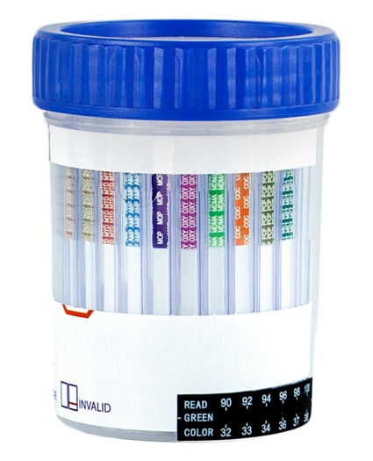
What are Opioids?
“Natural,” referred to as Opiates
Morphine, codeine, opium
Synthetic referred to as Opioids
Semisynthetic: heroin, oxycodone, buprenorphine
Fully Synthetic: fentanyl, tramadol, methadone
Opioids = “Natural” + Synthetic
Notes:
This seems like a pretty basic point to make, but this has clinical relevance. because of urine drug testing.
We wont be covering urine drug screening in this talk so I wanted to highlight this point, need for additional training. ASAM white paper on UDS.
Buprenorphine, oxycodone
https://americandrugtest.com/12-panel-urine-drug-test-cup-with-alcohol-free-shipping-25case/?gclid=CjwKCAjw583nBRBwEiwA7MKvoAtOBvnOEklfCoj2_euMJ4ss2w2BCT5nY0W-T5lMHodXD9fhBhL6sRoCrcEQAvD_BwE

Slide 16
Global Perspective
Notes:
Factors include treating pain as the “fifth vital sign,”⁴ patient expectations about reducing pain using nonopioid alternatives, health care providers’ varied prescribing practices, pharmaceutical and drug distribution industry marketing behavior, and the wide availability of relatively inexpensive heroin and fentanyl.
Consumption in defined daily doses for statistical purposes (S-DDD)/million inhabitants/day
Organization for Economic Co-operation and Development
The Economic Survey of the United States, released in June 2018, highlights the substantial and profound economic cost of the opioid epidemic in the United States, where opioid prescription rates per capita are significantly higher than in other OECD countries.
http://www.oecd.org/health/health-systems/opioids.htm
https://oecdecoscope.blog/2018/06/15/opioid-addiction-costs-many-lives-and-harms-livelihoods/

Slide 17
“Triple Wave”

Slide 18
“Triple Wave”
“Fourth Wave” -> Methamphetamines

Slide 19
Deaths/year in US Related to Drug Use
>480,000
95,000
50,042
10,724
14,666
Notes:
In spite of the public tendency to focus on illicit drug use and its consequences, among psychoactive drugs, tobacco and alcohol continues to be the dominant source of drug-related morbidity and mortality in this country and worldwide. The individual-based mortality data shown here becomes even more dramatic if we consider the impact that alcohol abuse has on so many non-using individuals, through violence, accidents, family disruption and emotional trauma.

Slide 20
Deaths/year in US Related to Drug Use
PRE-COVID-19
POST-COVID-19
Tobacco >480,000
Alcohol 95,000
Opioid OD 50,042
Benzodiazepine OD 10,724
Cocaine OD 14,666
Opioids represent OD deaths from all opioids: analgesics, heroin, illicit synthetics.
Reported by US CDC: Alcohol (2011-2015), tobacco (2014) cocaine/benzodiazepines (2018), opioids (2019)
???
Notes:
In spite of the public tendency to focus on illicit drug use and its consequences, among psychoactive drugs, tobacco and alcohol continues to be the dominant source of drug-related morbidity and mortality in this country and worldwide. The individual-based mortality data shown here becomes even more dramatic if we consider the impact that alcohol abuse has on so many non-using individuals, through violence, accidents, family disruption and emotional trauma.

Slide 21
Unintentional overdose deaths involving illicit opioids* decreased from 2017 to 2018 while deaths involving stimulants increased
North Carolina
Notes:
The epidemic of med/drug overdose is mostly driven by opiates. Historically, prescription opioids (drugs like hydrocodone, oxycodone, morphine) have contributed to an increasing number of medication/drug overdose deaths. More recently, other synthetic narcotics (heroin, fentanyl, and fentanyl analogues*) are resulting in increased deaths, though from 2017-2018 there was a decrease in the number of deaths involving illicit opioids (and commonly prescribed opioids). The number of deaths involving other substances like cocaine, benzodiazepines, alcohol, antiepileptics, and psychostimulants with misuse potential (which includes methamphetamine) continue to rise.
These counts are not mutually exclusive. If the death involved multiple drugs it can be counted on multiple lines. A growing number deaths involve multiple substances in combination.
*Fentanyl analogues are drugs that are similar to fentanyl but have been chemically modified in order to bypass current drug laws.
Technical Notes:
The data provided here are part of the Vital Registry System of the State Center for Health Statistics and have been used to historically track and monitor the drug overdose burden in NC using ICD10 codes. The definitive data on deaths come from the NC Office of the Chief Medical Examiner (OCME). For the most recent data and data on specific drugs, please contact at OCME at http://www.ocme.dhhs.nc.gov/annreport/index.shtml

Slide 22
COVID-19 & OUD
Compromised lung conditions (tobacco, vaping, opioids)
Exacerbation of existing racial inequity in US Healthcare System
Harm Reduction Efforts w/ Physical Distancing
Likely decrease in observed overdoses
Distribution and subsequent reversal with naloxone may be less likely
Treatment
Limited social supports/isolation (mutual help groups, restricted travel)
Barriers to obtaining medications

Slide 23
COVID-19 & SUD & Racial Disparities Volkow et al., Molecular Psychiatry, 2020
People w/ SUDs -> higher risk of contracting + worse consequences from COVID-19 (African Americans 13.8% vs. 8.6% for whites)
Opioids = 10.2x “more likely than those w/o SUD to have COVID”
Tobacco= 8.2x
Alcohol= 7.8x
Cocaine= 6.5x
Cannabis=5.3x
Volkow Blog
Notes:
people with SUDs are indeed at higher risk of contracting and suffering worse consequences from COVID-19. This was especially true for African Americans.

Slide 24
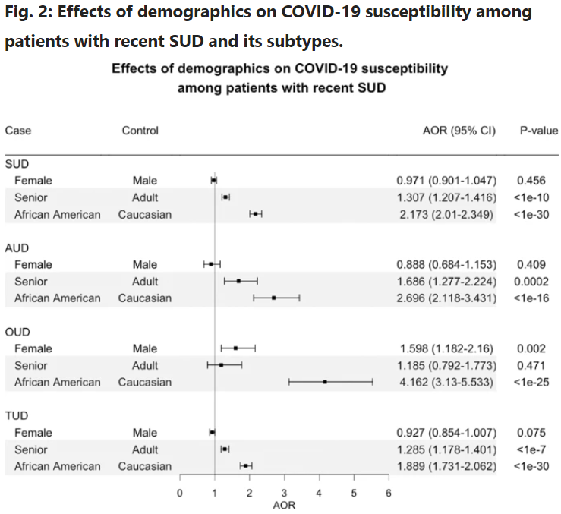
COVID-19 & OUD & Racial Disparities Volkow et al., Molecular Psychiatry, 2020
People w/ SUDs -> higher risk of contracting + worse consequences from COVID-19 (African Americans 13.8% vs. 8.6% for whites)
Opioids = 10.2x “more likely than those w/o SUD to have COVID”
Tobacco= 8.2x
Alcohol= 7.8x
Cocaine= 6.5x
Cannabis=5.3x
Volkow Blog
Notes:
people with SUDs are indeed at higher risk of contracting and suffering worse consequences from COVID-19. This was especially true for African Americans.

Slide 25
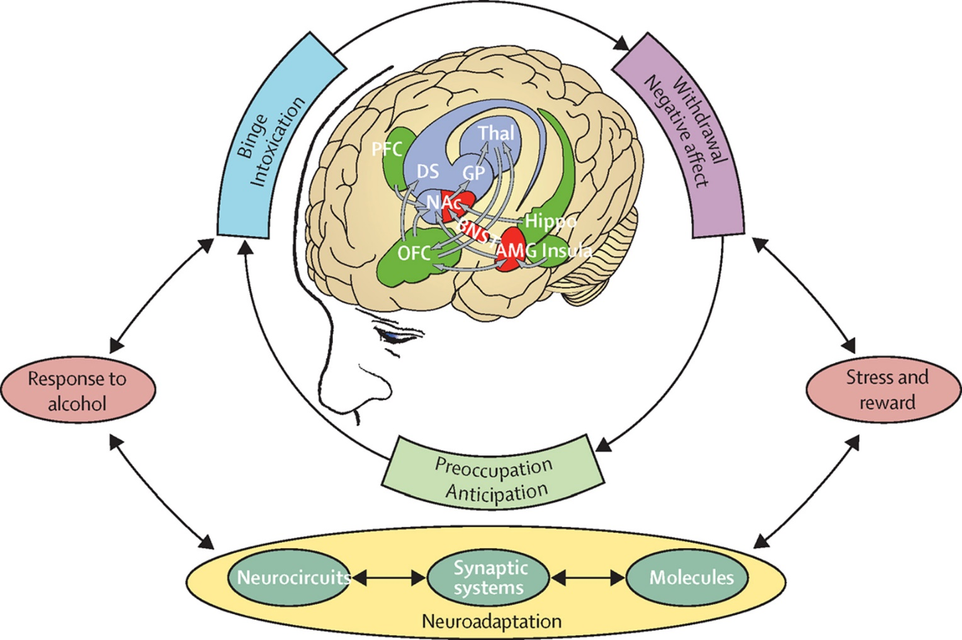
Neurobiology of Addiction
Volkow and Koob, The Lancet, 2015
Notes:
https://www.thelancet.com/journals/lanpsy/article/PIIS2215-0366(15)00236-9/fulltext
We will come back to in more detail later on, demonstrate complexity

Slide 26
JAMA, 284:1689-1695, 2000
Notes:
Source: JAMA, 284:1689-1695, 2000. Relapse rates for people treated for substance use disorders are compared with those for people treated for high blood pressure and asthma. Relapse is common and similar across these illnesses. Therefore, substance use disorders should be treated like any other chronic illness. Relapse serves as a sign for resumed, modified, or new treatment.

Slide 27
Comparison of Chronic Diseases
 | Diabetes Mellitus | Addiction
Relapse Rates | 30-50% | 40-60%
Medication Adherence | 30-50% | 40-60%
Screening/Monitoring | A1C | Urine Drug Screens
Access to Treatment | ++++ | +
Behavioral Interventions | Nutritionist/DM educator | Individual Counseling/Groups
Pharmacotherapy | Multiple formulations | Multiple Formulations
Refractory to Treatment | Endocrinology | Addiction Medicine/Psychiatry
HealthCare Stigma | + | ++++

Slide 28
DSM-5 Criteria for OUD
Notes:
28
Key Point: For a DSM diagnosis of SUD, meet criteria
Loss of control of use (more, craving)
Continued use despite negative consequences (medical, social, legal)
Physiologic changes (tolerance ,withdrawal)
Not diagnosed if only tolerance + withdrawal are met (SSRI, Wellbutrin, Clonidine)

Slide 29
DSM-5 Criteria for OUD
Loss of Control
Notes:
29
Key Point: For a DSM diagnosis of SUD, meet criteria
Loss of control of use (more, craving)
Continued use despite negative consequences (medical, social, legal)
Physiologic changes (tolerance ,withdrawal)
Not diagnosed if only tolerance + withdrawal are met (SSRI, Wellbutrin, Clonidine)

Slide 30
DSM-5 Criteria for OUD
Loss of Control
Use Despite Neg Consequences
Notes:
30
Key Point: For a DSM diagnosis of SUD, meet criteria
Loss of control of use (more, craving)
Continued use despite negative consequences (medical, social, legal)
Physiologic changes (tolerance ,withdrawal)
Not diagnosed if only tolerance + withdrawal are met (SSRI, Wellbutrin, Clonidine)

Slide 31
DSM-5 Criteria for OUD
Loss of Control
Use Despite Neg Consequences
Physiologic Changes
Mild = 3
Moderate = 4-5
Severe ≥ 6
Notes:
31
Key Point: For a DSM diagnosis of SUD, meet criteria
Loss of control of use (more, craving)
Continued use despite negative consequences (medical, social, legal)
Physiologic changes (tolerance ,withdrawal)
Not diagnosed if only tolerance + withdrawal are met (SSRI, Wellbutrin, Clonidine)

Slide 32
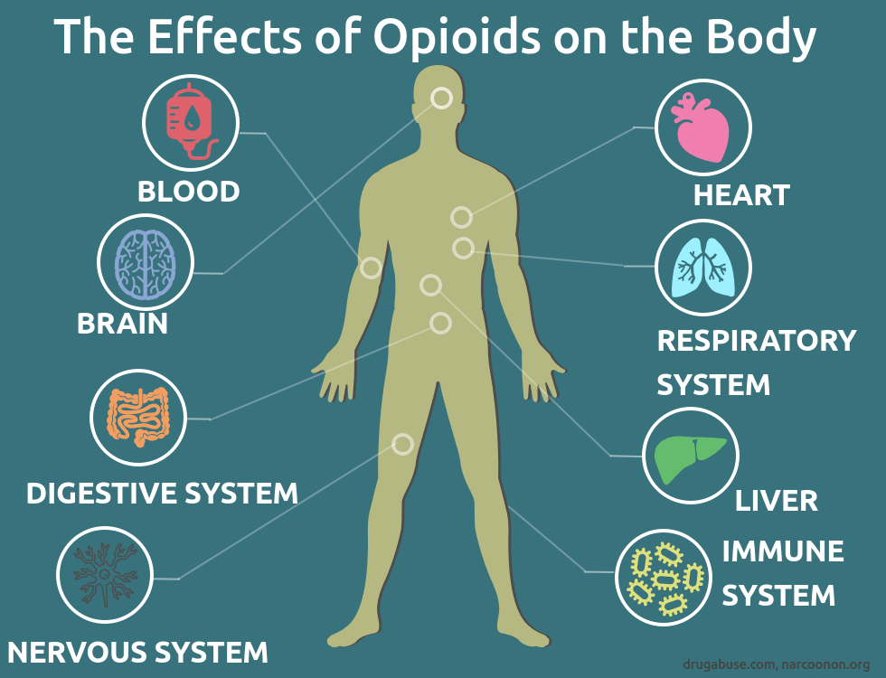
How do Medications for OUD Treatment Work?
Provides physiological and psychological stabilization that can allow recovery to take place
Reduce/prevent withdrawal
Diminish/eliminate cravings
Notes:
So that recovery can take place. Improving mental and physical health, rebuilding connections with friends and families.
neurological, respiratory, Gastrointestinal
https://www.google.com/search?q=effects+of+opioids+on+the+body&rlz=1C1GCEB_enUS859US859&sxsrf=ACYBGNQB2Wr5w5Wxmrq8QxqSa-FcmsvpJw:1574030968131&source=lnms&tbm=isch&sa=X&ved=0ahUKEwio4uGlqvLlAhWBzlkKHc90ABUQ_AUIEigB&biw=1522&bih=688&dpr=1.25#imgrc=GM3N-wVPQ4qS8M:

Slide 33
How do Medications for OUD Treatment Work?
Provides physiological and psychological stabilization that can allow recovery to take place
Reduce/prevent withdrawal
Diminish/eliminate cravings
Block the euphoric effect
Restore physiological function
Notes:
So that recovery can take place. Improving mental and physical health, rebuilding connections with friends and families.
neurological, respiratory, Gastrointestinal
https://www.google.com/search?q=effects+of+opioids+on+the+body&rlz=1C1GCEB_enUS859US859&sxsrf=ACYBGNQB2Wr5w5Wxmrq8QxqSa-FcmsvpJw:1574030968131&source=lnms&tbm=isch&sa=X&ved=0ahUKEwio4uGlqvLlAhWBzlkKHc90ABUQ_AUIEigB&biw=1522&bih=688&dpr=1.25#imgrc=GM3N-wVPQ4qS8M:

Slide 34
Opioid Use Disorder (OUD)
Most effective treatment is
Medication Assisted Treatment (MAT)
Notes:
Term MAT is misleading because it implies that medications play an adjunctive role in treatment for OUD, more accurate to simply refer to medications as “treatment.” Standard of care.
SAMHSA recommends replacing the term “Medication Assisted Treatment (MAT)” with “Medications for Opioid use Disorder (MOUD).” The term “MAT” implies that medication plays a secondary role to other approaches while the term “MOUD” reinforces the idea that medication is its own treatment form.
Not talking about intoxication, withdrawal, or overdose.

Slide 35
Opioid Use Disorder (OUD)
Most effective treatment is
Medication Assisted Treatment (MAT)
Medication for OUD (MOUD)
Notes:
Term MAT is misleading because it implies that medications play an adjunctive role in treatment for OUD, more accurate to simply refer to medications as “treatment.” Standard of care.
SAMHSA recommends replacing the term “Medication Assisted Treatment (MAT)” with “Medications for Opioid use Disorder (MOUD).” The term “MAT” implies that medication plays a secondary role to other approaches while the term “MOUD” reinforces the idea that medication is its own treatment form.
Not talking about intoxication, withdrawal, or overdose.

Slide 36
Is MOUD Effective for Opioid Addiction?
Decreases:
Illicit use, death rate¹
HIV, Hep C infections²⁻⁴
Crime⁵
Increases:
Social functioning and retention in treatment⁶⁻⁷
1.Kreek J, SubstAbuse Treatment 2002
2.MacArthur, BMJ, 2012
3.Metzgar, Public Health Reports 1998
4. K Page, JAMA IM, 2014
5.Gerstein DR et al, CALDATA General Report, CA Dept of Alcohol and Drug Programs, 1994
6. Mattick RP et al, Cochrane Database of Systematic Reviews, 2009
7. Mattick RP et al, Cochrane Database of Systematic Reviews, 2014
Notes:
Every $1 invested in addiction treatment returns a yield of $4 to $7 in reducing drug related crimes

Slide 37
Special Populations
Neonates (NOWS)
Adolescents/Young Adults
Pregnancy
Veterans
Older Adults
Justice Involved
Healthcare Providers (NCPHPs)
Notes:
Not enough time to cover these unique populations

Slide 38
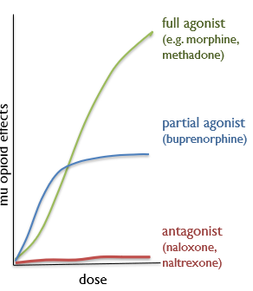
FDA Approved MOUD for Opioid Use Disorder
Methadone
Buprenorphine
Naltrexone (*PO, IM)
SAMHSA, TIP Series 63, 2018
Notes:
Buprenorphine and Methadone activate receptor; Naltrexone blocks.
Agonist therapy takes advantage of cross-reactivity, substituting a less euphorigenic, less abusable medication for the short acting opioid
https://www.pewtrusts.org/en/research-and-analysis/fact-sheets/2016/11/medication-assisted-treatment-improves-outcomes-for-patients-with-opioid-use-disorder

Slide 39
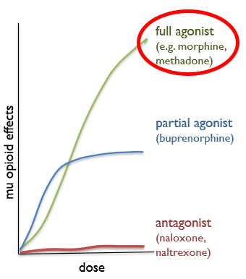
Methadone
Long-acting, half-life 15-60 hrs
Full agonist
21 CFR 1306.07 (c)
Notes:
Nat’l Average dose = 80 mg/day
Pain dosing -> Usually TID dosing is STANDARD, do not need to adjust for renal dysfunction or if treating Hep C.
Methadone written as daily prescription is inappropriate, as well as BID.

Slide 40
Methadone
Long-acting, half-life 15-60 hrs
Full agonist
Generally 80-120 mg/day
Dangerous in overdose with polysubstance
QT prolongation
21 CFR 1306.07 (c)
Notes:
Nat’l Average dose = 80 mg/day
Pain dosing -> Usually TID dosing is STANDARD, do not need to adjust for renal dysfunction or if treating Hep C.
Methadone written as daily prescription is inappropriate, as well as BID.

Slide 41
Methadone
Long-acting, half-life 15-60 hrs
Full agonist
Generally 80-120 mg/day
Dangerous in overdose with polysubstance
QT prolongation
Can continue methadone for maintenance while inpatient
If admitted for reason other than OUD, can initiate while inpatient
21 CFR 1306.07 (c)
Notes:
Nat’l Average dose = 80 mg/day
Pain dosing -> Usually TID dosing is STANDARD, do not need to adjust for renal dysfunction or if treating Hep C.
Methadone written as daily prescription is inappropriate, as well as BID.

Slide 42
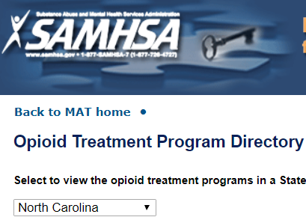
Opioid Treatment Programs (OTPs)
Methadone can only be prescribed in a federally-regulated OTP when used for treatment of addiction
Most common approach used worldwide
Salsitz, Mt Sinai J of Medicine, 2000
Notes:
Has anyone heard of an OTP? What about a methadone clinic?
84 OTPs in NC
83% offer Bupe and Methadone
65% offer Vivitrol
Methadone accounts for nearly 1 in 3 prescription overdose deaths in the US.
Clinically relevant Methadone-drug interactions: some may increase or decrease levels.

Slide 43
Opioid Treatment Programs (OTPs)
Methadone can only be prescribed in a federally-regulated OTP when used for treatment of addiction
Most common approach used worldwide
Daily, directly observed therapy
Can obtain take home doses
Not reported in PDMP
Not referred to as “Methadone clinics”
Salsitz, Mt Sinai J of Medicine, 2000
Notes:
Has anyone heard of an OTP? What about a methadone clinic?
84 OTPs in NC
83% offer Bupe and Methadone
65% offer Vivitrol
Methadone accounts for nearly 1 in 3 prescription overdose deaths in the US.
Clinically relevant Methadone-drug interactions: some may increase or decrease levels.

Slide 44
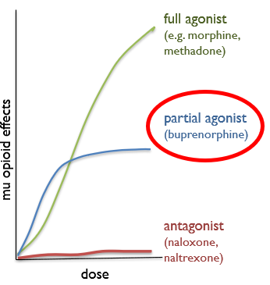
Buprenorphine
Partial mu-opioid agonist
Kappa-opioid antagonist
Half-life ~24-36 hrs
SAMHSA, 2018
Orman & Keating, 2009
Notes:
Compared to Methadone, minimal respiratory suppression and no respiratory arrest when used as prescribed
DATA Waiver 2000 (X waiver) - > use in outpatient clinics.

Slide 45
Buprenorphine
Partial mu-opioid agonist
Kappa-opioid antagonist
Half-life ~24-36 hrs
20-40x more potent than morphine
Highest affinity for opioid receptor
Blocks/displaces other opioids
Can precipitate withdrawal
SAMHSA, 2018
Orman & Keating, 2009
Notes:
Compared to Methadone, minimal respiratory suppression and no respiratory arrest when used as prescribed
DATA Waiver 2000 (X waiver) - > use in outpatient clinics.

Slide 46
Buprenorphine Formulations
 | Route | Product Name
Buprenorphine With Naloxone (combo product) | SL | Suboxone® (film/tablet)
 | SL | Zubsolv® (tablet)
 | Buccal | Bunavail® (film)
Buprenorphine Without Naloxone (mono product) | SL | Subutex® (tablet) - generic
 | Implant – q6 mo | Probuphine®
 | SC injection – q 30d | Sublocade®
FDA Approved - Pain | IV | Buprenex®
 | Transdermal – q7 days | BuTrans®
 | Buccal | Belbuca® (film)
 | Methadone Buprenorphine | Short acting opioid
Route | Oral Sublingual | Oral, injected (IV), Intranasal (IN)
Onset | 60 min. or more | IV, IN: seconds Oral: 15-20 min.
Duration | 8 to 24 hrs. | 2 to 4 hours
Euphoria | Absent | Present: moderate to pronounced
Notes:
46
46
46
Mention that many forms exist, can’t just say Suboxone or Buprenorphine

Slide 47
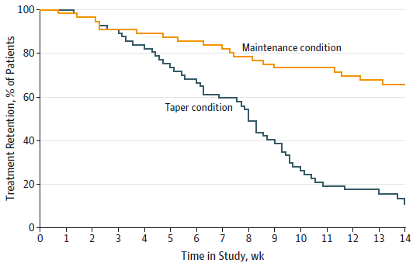
Buprenorphine: Maintenance vs. Taper (Prescription Opioid Dependence)
beginning
of taper
end of
taper
Fiellin et al., 2014
Notes:
One of many trials that have shown that medically-assisted withdrawal, including tapering after a short period of stabilization with buprenorphine, is unlikely to retain patients in treatment or prevent return to substance use.

Slide 48
Office-Based Outpatient Treatment (OBOT)
DATA 2000 -> physicians prescribe Buprenorphine for OUD in an office setting
8 hrs of training, DEA assigns X license #
1st year = 30 pts; request increase to 100 pts
Notes:
Substance Use Disorder Prevention That Promotes Opioid Recovery and Treatment for Patients and Communities

Slide 49
Office-Based Outpatient Treatment (OBOT)
DATA 2000 -> physicians prescribe Buprenorphine for OUD in an office setting
8 hrs of training, DEA assigns X license #
1st year = 30 pts; request increase to 100 pts
Comprehensive Addiction Recovery Act (CARA) 2016
Authorizes NPs + PAs to obtain DEA X license
24 hrs of training
SUPPORT Act 2018
11/2/2020 – permanently allowing NP + PAs to be considered qualifying practitioner
Clinical Nurse Specialist, Certified RN Anesthetist, Certified Nurse Midwife
Temporarily includes these individuals as “qualifying practitioners”
Notes:
Substance Use Disorder Prevention That Promotes Opioid Recovery and Treatment for Patients and Communities

Slide 50
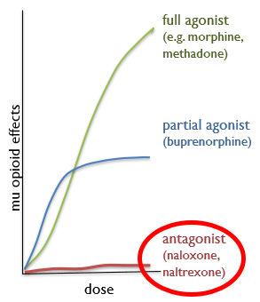
Naltrexone
Full Antagonist
Formulations
Tablets: Revia®: FDA approved in 1984
Extended-Release intramuscular injection:
Vivitrol®: FDA approved in 2010
SAMHSA, 2018
Orman & Keating, 2009
Notes:
2018 study - Patients receiving XR-naltrexone had twice the rate of treatment retention at 6 months compared with those taking oral naltrexone.
No additional training needed
Tell them to stop using heroin for a week or more…

Slide 51
Naltrexone
Full Antagonist
Formulations
Tablets: Revia®: FDA approved in 1984
Extended-Release intramuscular injection:
Vivitrol®: FDA approved in 2010
Administration
Abstain from opioids:
> 7 days (short-acting) vs. 10-14 (long-acting)
Difficulty initiating inpatient/outpatient
SAMHSA, 2018
Orman & Keating, 2009
Notes:
2018 study - Patients receiving XR-naltrexone had twice the rate of treatment retention at 6 months compared with those taking oral naltrexone.
No additional training needed
Tell them to stop using heroin for a week or more…

Slide 52
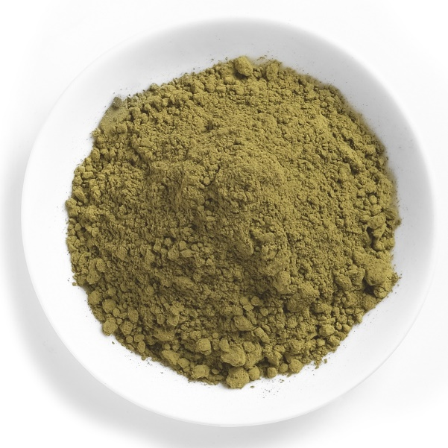
Mitragyna speciosa
Major alkaloid: Mitragynine
Low dose -> Stimulant-like effect (≤ 5 g)
Higher doses -> Opioid-like effect (~15 g)
Withdrawal – onset 12-18 hrs, several days
No controlled trials, similar to other opioids
Treatment for Kratom Use Disorder?
Notes:
Kratom (Mitragyna speciosa), an herb with opioid and stimulant-like properties, contains indole alkaloids, principally mitragynine and 7-HO-mitragynine, with mu-opioid receptor agonism
Opioid withdrawal symptoms emerge 12 to 24 hours after last use and persist for up to seven days. There are no controlled trials supportive of specific pharmacologic treatment of kratom withdrawal

Slide 53
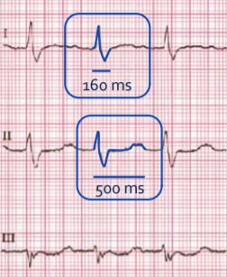
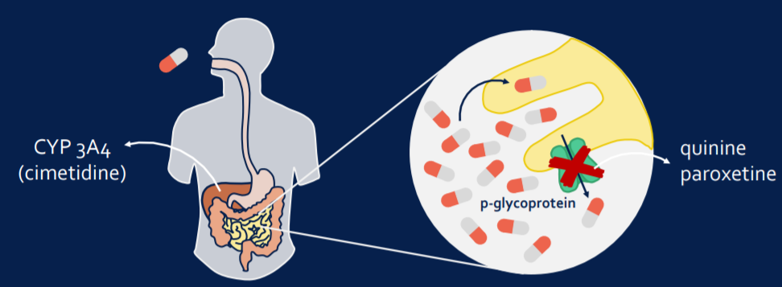
Loperamide for Opioid Withdrawal?
“Poor Man’s Methadone,” “Lope-Dope”
Euphoria, Withdrawal Mgmt
Blocks Na+ & HERG K+ Channels
Wu P and Juurlink D (Ann Emerg Med 2017)
Notes:
Recommended dose 4-16 mg
100-200 mg, seen with Benadryl and Omeprazole
Important to get good med rec, full substance use history: Ask more specific questions.

Slide 54
Loperamide for Opioid Withdrawal?
“Poor Man’s Methadone,” “Lope-Dope”
Euphoria, Withdrawal Mgmt
Blocks Na+ & HERG K+ Channels
Wu P and Juurlink D (Ann Emerg Med 2017)
Notes:
Recommended dose 4-16 mg
100-200 mg, seen with Benadryl and Omeprazole
Important to get good med rec, full substance use history: Ask more specific questions.

Slide 55
Adjunct Treatment
Opioid Use Disorder
Notes:
Term MAT is misleading because it implies that medications play an adjunctive role in treatment for OUD, more accurate to simply refer to medications as “treatment.” Standard of care.
SAMHSA recommends replacing the term “Medication Assisted Treatment (MAT)” with “Medications for Opioid use Disorder (MOUD).” The term “MAT” implies that medication plays a secondary role to other approaches while the term “MOUD” reinforces the idea that medication is its own treatment form.
Not talking about intoxication, withdrawal, or overdose.

Slide 56
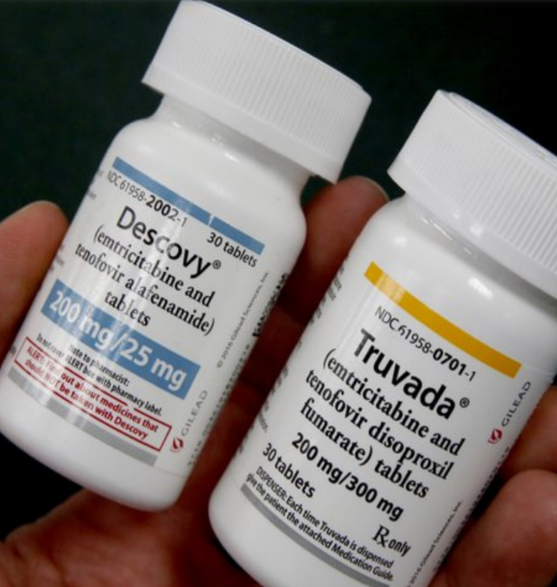
HIV Prevention: PrEP/PEP
Prophylactic daily antiretroviral
Truvada® (Tenofovir disproxil fumarate/Emtricitabine)
Descovy® (Tenofovir alafenamide/Emtricitabine)
Excludes: risk involving receptive vaginal intercourse
CDC Recommendation for PWID
Based on a single RCT in Bangkok
Notes:
Sharing injection equipment.
Lastly, just to note that PrEP is offifcially indicated for injection drug use. PrEP is a concept – the idea of preexposure prophylaxis – taking antiretrovirals daily to prevent HIV acquisition. The current drug used for prep is a combination of two antiretrovirals – tenofovir and emtricitabine. However, there is not great data to support its use for people who inject drugs – there is one large study in Bangkok in which they did directly observed PrEP.
In order to prescribe PrEP you need patients to periodically follow-up in clinic and so we’ve just not had many patients who are injection drug users, who have been offered prep and regularly follow-up in clinic. But in theory this is an option and something we should offer motivated patients with ongoing injection.
Lastly, there is PEP or post exposure prophylaxis but this is complicated when thinking about injection drug users and I’ll leave for a separate discussion.

Slide 57
HIV Prevention: PrEP/PEP
Prophylactic daily antiretroviral
Truvada® (Tenofovir disproxil fumarate/Emtricitabine)
Descovy® (Tenofovir alafenamide/Emtricitabine)
Excludes: risk involving receptive vaginal intercourse
CDC Recommendation for PWID
Based on a single RCT in Bangkok
Challenging in real-world practice
Requires regular engagement in care
PEP (post-exposure prophylaxis)
Notes:
Sharing injection equipment.
Lastly, just to note that PrEP is offifcially indicated for injection drug use. PrEP is a concept – the idea of preexposure prophylaxis – taking antiretrovirals daily to prevent HIV acquisition. The current drug used for prep is a combination of two antiretrovirals – tenofovir and emtricitabine. However, there is not great data to support its use for people who inject drugs – there is one large study in Bangkok in which they did directly observed PrEP.
In order to prescribe PrEP you need patients to periodically follow-up in clinic and so we’ve just not had many patients who are injection drug users, who have been offered prep and regularly follow-up in clinic. But in theory this is an option and something we should offer motivated patients with ongoing injection.
Lastly, there is PEP or post exposure prophylaxis but this is complicated when thinking about injection drug users and I’ll leave for a separate discussion.

Slide 58
Adjunct Treatments
Pharmacotherapy
Hepatitis C
Co-occurring mental illness
Tobacco/Nicotine use
Vaccinations
Hep A
Hep B
PSV23
Tdap
Influenza
COVID-19?...

Slide 59
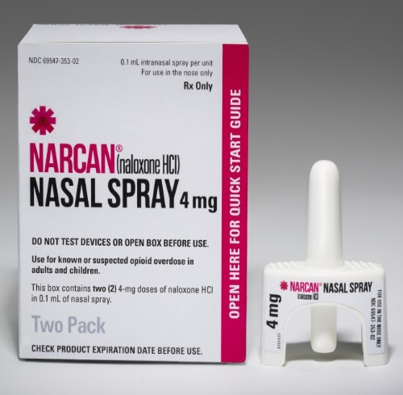
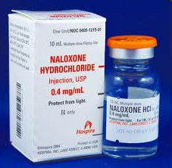
Naloxone
No effect other than blocking opioids
No potential for abuse
Naloxone ≠ MAT!!
Increased shelf life for Narcan®! (Aug 2020)
Narcan® Nasal Spray
Adapt Pharma
Auto-injector Evzio® (generic)
Kaleo Inc.
Intramuscular Injection
Various Companies
Notes:
Naloxone is NOT MAT (not mentioned with other 3) → Not GENERIC
Generic version available -> Walgreens (2 of them)
IV > Nasal > IM
Can cause agitation/aggression when it reverses the opiate. If the individual has OUD, the lowest dose of naloxone to reverse respiratory apnea should be administered.
Duration of action 30-90 min
Repeat dosing needed for long acting opioids (75% of cases required 2 doses)
Narcan NASAL SPRAY increasing it from 24 months to 36 months.
For all patients who are prescribed opioid pain relievers
For all patients who are prescribed medicines to treat OUD,
For other patients at increased risk of opioid overdose
Evizio - $4451 for two; Generic $107 with good Rx coupon at Walgreens
Narcan Nasal - $120 for two.

Slide 60
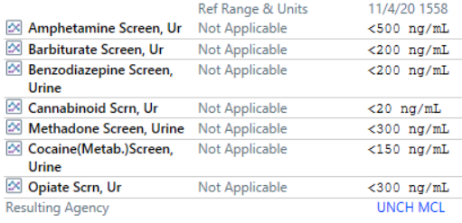
Urine Drug Testing
Rationale for testing
Frequency, types of testing, cross check PDMP
Screening vs. confirmation
Positive result…
Negative result…
POC Testing?
Notes:
+ does not diagnose addiction
Does not definitively indicate diversion

Slide 61
Urine Drug Testing
Rationale for testing
Frequency, types of testing, cross check PDMP
Screening vs. confirmation
Positive result…
Negative result…
POC Testing?
Notes:
+ does not diagnose addiction
Does not definitively indicate diversion

Slide 62
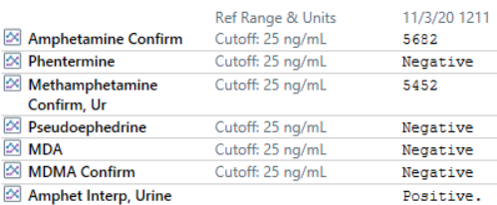
Urine Drug Testing
Rationale for testing
Frequency, types of testing, cross check PDMP
Screening vs. confirmation
Positive result…
Negative result…
POC Testing?
Notes:
+ does not diagnose addiction
Does not definitively indicate diversion

Slide 63
Behavioral Treatment to Facilitate Recovery
Studies of MAT efficacy all in combination with behavioral treatment;
MAT outcomes best when integrated with behavioral interventions
Mutual support/self-help groups
AA, NA, Smart Recovery, Women for Sobriety
Psychosocial and non-pharmacologic treatments
Cognitive Behavioral Therapy
Dialectical Behavioral Therapy
Motivational Enhancement Therapy
Contingency or Incentive Based Therapy
Community Reinforcement and Couples Based Therapies
Notes:
Main Point: Do not exclude someone from treatment because not engaged in Counseling
CM:
Example: Earning vouchers exchangeable for retail products contingent on attendance or negative urine toxicology results
Example: Earning methadone take-home privileges for negative urine drug screens
63

Slide 64
Behavioral Health’s Role in OUD Treatment
Optional psychosocial treatment should be offered in conjunction with pharmacotherapy.
Notes:
Example of depression treatment: medication and/or therapy

Slide 65
Behavioral Health’s Role in OUD Treatment
Optional psychosocial treatment should be offered in conjunction with pharmacotherapy.
A decision to refuse psychosocial treatment/absence of available treatment should not preclude or delay MAT.
Notes:
Example of depression treatment: medication and/or therapy

Slide 66
Behavioral Health’s Role in OUD Treatment
Optional psychosocial treatment should be offered in conjunction with pharmacotherapy.
A decision to refuse psychosocial treatment/absence of available treatment should not preclude or delay MAT.
Refusing psychosocial services should not generally be used as rationale for discontinuing current MAT.
Notes:
Example of depression treatment: medication and/or therapy

Slide 67
What can/should I do at an Outpatient Visit?
Enhancing likelihood of long-term recovery:
Check State Prescription Drug Monitoring Program
Introduce UDS if not done previously
Collaborative Care: Integrated BH care (IMPACT model)
Infectious disease evaluation (PrEP, PEP, Vaccines)
Assess for IPV/housing/sexual health
Harm reduction (needle exchange, naloxone)
Safe storage of medications
Assess tobacco/nicotine use
Notes:
The single most important factor for predicting outcome is the recovery environment
Prescription Monitoring Program – Aware
IPV – intimate partner violence

Slide 68
“Case Management” Adapting Treatment Based on Outcome
Based on ongoing assessment, consider need to:
Increase level of care
Improve recovery environment
Joblessness / Homelessness
Substance use in the living environment
Assess/access treatment for co-morbid psychiatric problems
Assess and integrate primary care
Is there now a need for MOUD?
If on MOUD, how is adherence? Can it be improved?
Notes:
Co-occurring psychiatric symptoms may represent:
Psychiatric symptoms resulting from drug/alcohol use
Independent/autonomous psychiatric disorders
Substance-induced disorders (including toxicity, withdrawal, protracted abstinence syndromes)
Psychiatric disorders triggered/unmasked by substance use

Slide 69
Tele-BH for OUD
Expansion of Services During COVID-19:
Initially audio/video only for MOUD prescribing
DHHS, DEA, SAMSHA – 3/31/2020
Buprenorphine induction via telephone
Low threshold treatment access/Reach Vulnerable populations
Not well studied
Relaxation of Requirements for OTPs
Changes in reimbursement for Tele-BH services
Notes:
The Ryan Haight Online Pharmacy Consumer Protection Act prohibits the prescription of controlled substances without an initial in-person visit with a provider. Enacted to prevent the trafficking of opioid medications by online pharmaceutical companies, this federal law has limited the use of telehealth for buprenorphine initiation with very narrow exceptions including a declared state of emergency, as we have seen with the COVID19 pandemic.
Increased access to services
Increased consumer convenience
Enhanced recruitment and retention of providers in underserved areas
Decreased professional isolation
Reduced geographic and SES health disparities
Reduced stigma associated with receiving BH services
Improved coordination of care across the BH system
Improved consumer compliance with treatment

Slide 70
Words Matter!
What we say and how we say it makes a difference to our patients with substance use disorder(s).
Stigmatizing Language | Non- Stigmatizing Language
Addict, drunk, junkie | Person with a substance use disorder
Drug habit Abuse Drug problem | Substance use disorder Risky, unhealthy or heavy use
Clean | Person in recovery Abstinent Not drinking or taking drugs
Clean or dirty drug screen | Positive or negative (toxicology screen results)
Notes:
Stigmatizing language used in medical records to describe patients can influence subsequent physicians-in-training in terms of their attitudes towards the patient and their medication prescribing behavior. This is an important and overlooked pathway by which bias can be propagated from one clinician to another. Attention to the language used in medical records may help to promote patient-centered care and to reduce healthcare disparities for stigmatized populations.

Slide 71
Words Matter!
What we say and how we say it makes a difference to our patients with substance use disorder(s).
Stigmatizing Language | Non- Stigmatizing Language
Addict, drunk, junkie | Person with a substance use disorder
Drug habit Abuse Drug problem | Substance use disorder Risky, unhealthy or heavy use
Clean | Person in recovery Abstinent Not drinking or taking drugs
Clean or dirty drug screen | Positive or negative (toxicology screen results)
Notes:
Stigmatizing language used in medical records to describe patients can influence subsequent physicians-in-training in terms of their attitudes towards the patient and their medication prescribing behavior. This is an important and overlooked pathway by which bias can be propagated from one clinician to another. Attention to the language used in medical records may help to promote patient-centered care and to reduce healthcare disparities for stigmatized populations.

Slide 72
Words Matter!
What we say and how we say it makes a difference to our patients with substance use disorder(s).
Stigmatizing Language | Non- Stigmatizing Language
Addict, drunk, junkie | Person with a substance use disorder
Drug habit Abuse Drug problem | Substance use disorder Risky, unhealthy or heavy use
Clean | Person in recovery Abstinent Not drinking or taking drugs
Clean or dirty drug screen | Positive or negative (toxicology screen results)
Notes:
Stigmatizing language used in medical records to describe patients can influence subsequent physicians-in-training in terms of their attitudes towards the patient and their medication prescribing behavior. This is an important and overlooked pathway by which bias can be propagated from one clinician to another. Attention to the language used in medical records may help to promote patient-centered care and to reduce healthcare disparities for stigmatized populations.

Slide 73
Words Matter!
What we say and how we say it makes a difference to our patients with substance use disorder(s).
Stigmatizing Language | Non- Stigmatizing Language
Addict, drunk, junkie | Person with a substance use disorder
Drug habit Abuse Drug problem | Substance use disorder Risky, unhealthy or heavy use
Clean | Person in recovery Abstinent Not drinking or taking drugs
Clean or dirty drug screen | Positive or negative (toxicology screen results)
Notes:
Stigmatizing language used in medical records to describe patients can influence subsequent physicians-in-training in terms of their attitudes towards the patient and their medication prescribing behavior. This is an important and overlooked pathway by which bias can be propagated from one clinician to another. Attention to the language used in medical records may help to promote patient-centered care and to reduce healthcare disparities for stigmatized populations.

Slide 74
Words Matter!
What we say and how we say it makes a difference to our patients with substance use disorder(s).
Stigmatizing Language | Non- Stigmatizing Language
Addict, drunk, junkie | Person with a substance use disorder
Drug habit Abuse Drug problem | Substance use disorder Risky, unhealthy or heavy use
Clean | Person in recovery Abstinent Not drinking or taking drugs
Clean or dirty drug screen | Positive or negative (toxicology screen results)
Notes:
Stigmatizing language used in medical records to describe patients can influence subsequent physicians-in-training in terms of their attitudes towards the patient and their medication prescribing behavior. This is an important and overlooked pathway by which bias can be propagated from one clinician to another. Attention to the language used in medical records may help to promote patient-centered care and to reduce healthcare disparities for stigmatized populations.

Slide 75
Case Follow Up
34 yo G2P1102 F with hx opioid and tobacco use disorders who presented to your clinic to establish care.
Stabilized cravings/withdrawal on Buprenorphine/naloxone 8/2 mg SL tablet BID.
Engaged pt using motivational interviewing for tobacco use, stopped smoking after ~12 months. Pt requested IUD for contraception and eventually would like to start counseling for past hx trauma.

Slide 76
Summary Points
Addiction is a chronic disease and primarily involves the rewarding effects of dopamine.
Pharmacotherapy is strongly evidence-based for opioid use disorder, consistently demonstrating better long-term outcomes than no MOUD (detox/medically supervised withdrawal).
Consider adjunct pharmacotherapies (PrEP, PEP, Naloxone) when working with individuals with opioid use disorder.
Tele-behavioral health services allow for buprenorphine prescribing, increasing access to treatment.

Slide 77
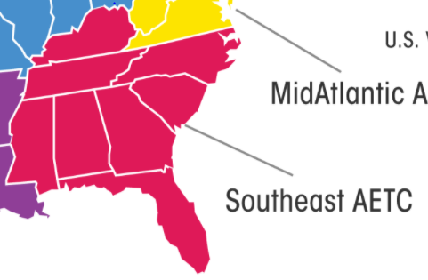
SE AETC MOUD ECHO (Telementoring)
KY - https://krhio.org/project-echo/
TN - https://www.etsu.edu/com/cme/project_echo_main.php
NC - www.echo.unc.edu | https://mahec.net/event/58626
SC - https://scmataccess.org/
AL - https://www.uabmedicine.org/web/medicalprofessionals/project-echo
GA, FL, MS-?
Notes:
Case Based Learning: Spokes from the community bring cases for discussion
Short didactic

Slide 78
References
https://www.ncbi.nlm.nih.gov/pmc/articles/PMC4942381/
https://www.asam.org/Quality-Science/definition-of-addiction
Center for Behavioral Health Statistics and Quality. (2018). 2019 National Survey on Drug Use and Health (NSDUH): Graphics from the Key Findings Report. Substance Abuse and Mental Health Services Administration, Rockville, MD.
https://www.cdc.gov/drugoverdose/epidemic/index.html
https://www.cdc.gov/nchs/products/databriefs/db356.htm#:~:text=Data%20from%20the%20National%20Vital,than%20in%202017%20(21.7).
https://www.cdc.gov/tobacco/data_statistics/fact_sheets/health_effects/tobacco_related_mortality/index.htm
https://www.cdc.gov/chronicdisease/resources/publications/factsheets/alcohol.htm
https://www.injuryfreenc.ncdhhs.gov/DataSurveillance/Poisoning.htm
Wang, Q.Q., Kaelber, D.C., Xu, R. et al. Correction: COVID-19 risk and outcomes in patients with substance use disorders: analyses from electronic health records in the United States. Mol Psychiatry (2020).
Volkow ND, Koob G. Brain disease model of addiction: why is it so controversial?. Lancet Psychiatry. 2015;2(8):677-679.
McLellan AT, Lewis DC, O'Brien CP, Kleber HD. Drug dependence, a chronic medical illness: implications for treatment, insurance, and outcomes evaluation. JAMA. 2000 Oct 4;284(13):1689-95.
American Psychiatric Association. Diagnostic and Statistical Manual of Mental Disorders. 5th ed. Washington D.C.: 2013.
https://dpt2.samhsa.gov/treatment/directory.aspx
https://www.cdc.gov/mmwr/preview/mmwrhtml/mm6126a5.htm
Donovan DM, Anton RF, Miller WR, Longabaugh R, Hosking JD, Youngblood M; COMBINE Study Research Group. Combined pharmacotherapies and behavioral interventions for alcohol dependence (The COMBINE Study): examination of posttreatment drinking outcomes. J Stud Alcohol Drugs. 2008 Jan;69(1):5-13.
https://www.ncbi.nlm.nih.gov/pmc/articles/PMC7391072/
Miller, Shannon C., et al. The ASAM Principles of Addiction Medicine. Wolters Kluwer, 2019.
Notes:
https://americandrugtest.com/12-panel-urine-drug-test-cup-with-alcohol-free-shipping-25case/?gclid=CjwKCAjw583nBRBwEiwA7MKvoAtOBvnOEklfCoj2_euMJ4ss2w2BCT5nY0W-T5lMHodXD9fhBhL6sRoCrcEQAvD_BwE

Slide 79
References
https://americandrugtest.com/12-panel-urine-drug-test-cup-with-alcohol-free-shipping 25case/?gclid=CjwKCAjw583nBRBwEiwA7
MKvoAtOBvnOEklfCoj2_euMJ4ss2w2BCT5nY0W-T5lMHodXD9fhBhL6sRoCrcEQAvD_BwE
Office of Applied Studies. Results From the 2013 National Survey on Drug Use and Health: Summary of National Findings. Section 7.3. Alcohol Use Treatment and Treatment Need. HHS Publication No. (SMA) 14-4863. Rockville, MD: Substance Abuse and Mental Health Services Administration; September 2014.
https://www.cochranelibrary.com/cdsr/doi/10.1002/14651858.CD001867.pub3/epdf/abstract
Anton RF et al. Efficacy of gabapentin for the treatment of alcohol use disorder in patients with alcohol withdrawal symptoms: A randomized clinical trial. JAMA Intern Med 2020 Mar 9.
Fouz‐Rosón, N., Montemayor‐Rubio, T., Almadana‐Pacheco, V., Montserrat‐García, S., Gómez‐Bastero, A. P., Romero‐Muñoz, C., and Polo‐Padillo, J. (2017) Effect of 0.5 mg versus 1 mg varenicline for smoking cessation: a randomized controlled trial. Addiction, 112: 1610– 1619.
https://pubmed.ncbi.nlm.nih.gov/24688036/
https://pubmed.ncbi.nlm.nih.gov/26198192/
https://www.ncbi.nlm.nih.gov/pmc/articles/PMC3959999/
https://ebm.bmj.com/content/17/3/96

Slide 80
Thank you! Questions?
Michael Baca-Atlas, MD, FASAM
michael_baca-atlas@med.unc.edu
https://www.cdc.gov/drugoverdose/resources/hhs.html
https://www.samhsa.gov/medication-assisted-treatment
https://www.asam.org/resources/publications
https://www.hhs.gov/about/agencies/iea/partnerships/opioidtoolkit/index.html
https://www.asam.org/membership/state-chapters
Notes:
PCSS is a national training and clinical mentoring project developed in response to the opioid use disorder crisis. Our education and training resources were developed for primary care providers. The overarching goal of PCSS is to provide the most effective evidenced-based clinical practices in the prevention of OUD through proper opioid prescribing practices, identifying patients with OUD, and the treatment of opioid use disorder.

