Slide 1
Injectable HIV Treatment
Alexandra Danforth, PharmD, BCACP, AAHIVP
Manager, Clinical Pharmacy
Trillium Health
Rochester, NY

Slide 2
Disclosures
“This [project/publication/program/website] [is/was] supported by the Health Resources and Services Administration (HRSA) of the U.S. Department of Health and Human Services (HHS) as part of an award totaling $3,879,101 with zero percentage financed with nongovernmental sources. The contents are those of the author(s) and do not necessarily represent the official views of, nor an endorsement, by HRSA, HHS or the U.S. Government.”

Slide 3
Learning Objectives
Describe injectable antiretroviral therapies in clinical trials for HIV treatment and prevention.
Review patients who might be good candidates for injectable therapy.
Describe challenges that providers might face implementing these new therapies.

Slide 4
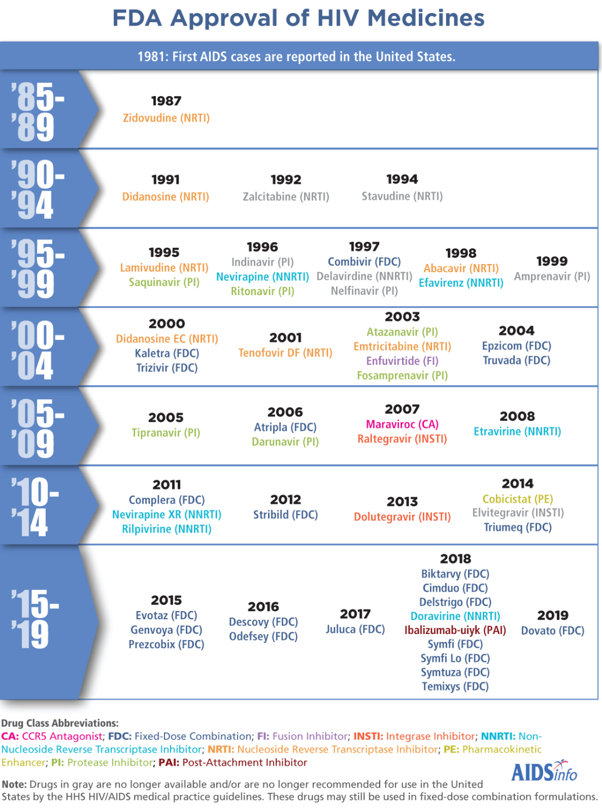
2020
Fostemsavir (AI)
2021
Cabotegravir (INSTI)

Slide 5
What to start?
https://aidsinfo.nih.gov/guidelines/html/1/adult-and-adolescent-arv
https://www.positivelyaware.com/articles/choice-options

Slide 6
Do we even need more new drugs?
Options for heavily treatment experienced patients
More convenience
PrEP options

Slide 7
New Horizons in Therapy
Patient desires
Freedom from stigma
Decreased pill burden or side effects
Ideal long-acting ARV characteristics
Potent
Extended dosing intervals
Low volume injections
Patient self-administration

Slide 8
IBALIZUMAB

Slide 9
HIV Entry Inhibitors
*
*FDA approved
Adapted from Moore JP, PNAS 2003; 100: 10598-10602.

Slide 10
Ibalizumab-uiyk (IBA, Trogarzo®)
Post attachment inhibitor
Binds to CD4 and prevents HIV entry into the cell
IV infusion every 2 weeks
Loading dose of 2000mg; Maintenance dose of 800mg
Observe patient for 1 hr post loading dose, if no reaction can be 15 min for maintenance doses
Need to re-load if more than 3 days late for maintenance
ADRs: diarrhea, dizziness, rash, nausea

Slide 11
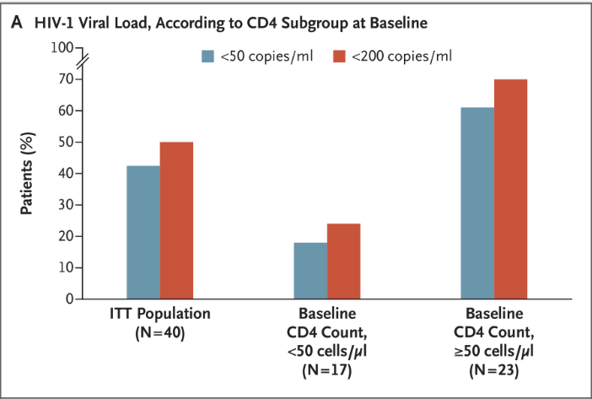
IBA: Phase 3 Trial
Single arm, open-label Phase III study
40 adults with multi-drug resistant HIV, VL>1000 cp/mL
IBA with optimized background regimen with at least 1 fully active agent
At 24 wks, 43% of patients has VL<50 copies/mL
In 48 wk completer analysis, 67% (16/24) were VL<50 copies/mL
Emu et al. N Engl J Med; 2018; 379:645-654.
Emu et al. Glasgow 2018, #O345

Slide 12
What are nanosuspensions?
Drug nanocrystals suspended in liquid
Varied size of nanoparticles leads to prolonged dissolution
Currently approved drug examples:
Invega Sustenna® and Trinza® (paliperidone)
Abilify Maintena® (aripiprazole)

Slide 13
Question #1
Which of the following does NOT affect the pharmacokinetics of a long acting injectable nanoformulation?
Nanoparticle size and shape
Injection site (muscle vs fat)
Injection route (IM vs SC)
Lipophilicity of the drug

Slide 14
CABOTEGRAVIR

Slide 15
Question #2
Which statement about Cabotegravir (CAB) is TRUE?
CAB is a new nucleoside reverse trascriptase inhibitor (NRTI).
Patients preferred taking oral CAB to injectable CAB.
CAB has been used for both HIV treatment and prevention in clinical trials.
CAB is not effective for PrEP in cis-women.

Slide 16
Cabotegravir (CAB)
INSTI, similar to dolutegravir
Active against some INSTI resistant strains
Half-life is 21-50 days
Nanosuspension, given IM or SC
ADRs: mild injection site reactions, nodules with SC

Slide 17
CAB/RPV: FLAIR Study
Multicenter randomized, open-label, Phase 3 trial
Treatment naïve adults
Orkin et al. CROI 2019, #140LB
Slide credit: clinicaloptions.com

Slide 18
CAB/RPV: FLAIR Study
Orkin et al. CROI 2019, #140LB
Slide credit: clinicaloptions.com

Slide 19
CAB/RPV: ATLAS Study
Multicenter, randomized, open-label Phase 3 switch study
Swindells et al. CROI 2019, #139
Slide credit: clinicaloptions.com

Slide 20
CAB/RPV: ATLAS Study
Swindells et al. CROI 2019, #139
Slide credit: clinicaloptions.com

Slide 21
ATLAS Study: Patient Satisfaction
Use of patient reported outcome tools to assess patient views on switching to CAB/RPV injections vs continuing baseline oral ART suggested injectable treatment was well tolerated through Week 48
Health status and QoL were similar between LA and oral ART groups
Treatment acceptance was significantly higher with LA vs oral ART group
90% of patients receiving LA treatment scored ISRs as totally or very acceptable and 86% scored pain as totally or very acceptable
Greater improvement in treatment satisfaction with LA vs oral ART group
97% of patients receiving LA treatment said they preferred LA treatment to daily oral therapy
Murray et al. IAS 2019, #MOAB0103

Slide 22
ATLAS 2M
Multicenter, randomized, open-label, phase 3 non-inferiority trial
Overton et al. CROI 2020, #34
Slide credit: clinicaloptions.com

Slide 23
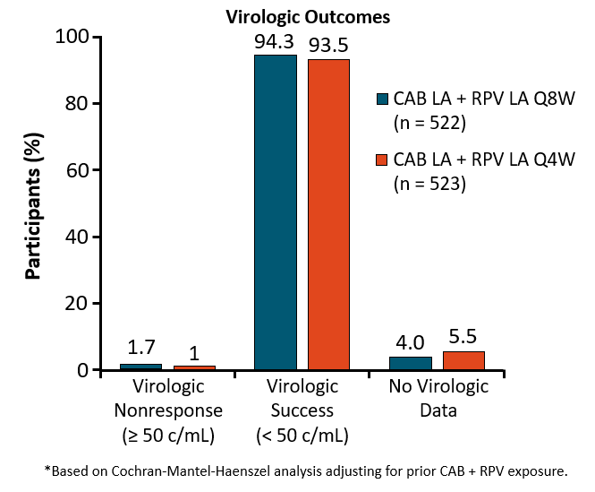
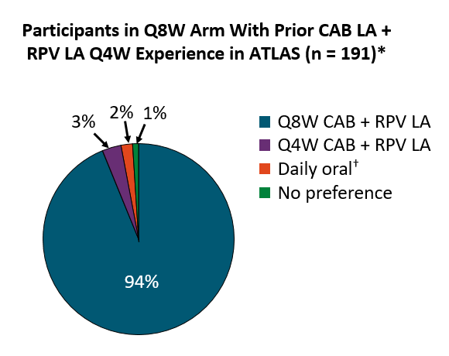
ATLAS 2M
Overton et al. CROI 2020, #34
Slide credit: clinicaloptions.com

Slide 24
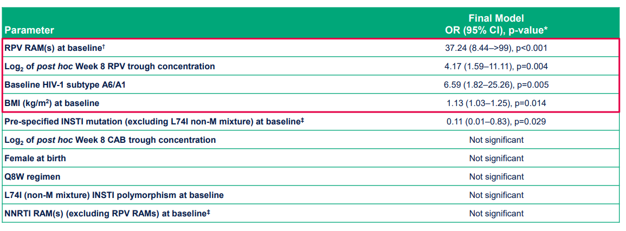
CAB/RPV Treatment Failures
Multivariate post hoc analysis of the confirmed virologic failures in ATLAS, FLAIR, ATLAS-2M (n=13/1039)
About 1% in each study
Four factors were associated with increased odds ratio for CVF
Margolis et al. HIV Drug Therapy Glasgow 2020, O442

Slide 25
CAB/RPV Treatment Failures
CVF was rare and associated with the presence of at least 2 baseline factors: RPV resistance mutations, BMI>30, HIV-1 subtype A6/A1
Margolis et al. HIV Drug Therapy Glasgow 2020, O442

Slide 26
CAB/RPV (Cabenuva®) Approved 1/21/21!
Approved for switch in stable suppressed patients (VL<50)
No history of treatment failure or known/suspected resistance to CAB or RPV
1 month oral lead in phase with 30mg CAB (Vocabria®) and 25mg RPV (Edurant®) daily
Initiation dose: 3mL 600mg CAB; 3mL 900mg RPV
Maintenace dose: 2mL 400mg CAB; 2mL 600mg RPV

Slide 27
CAB/RPV (Cabenuva®) Approved 1/21/21!
Contraindicated with
Carbamazepine, oxcarbazepine, phenobarbital, phenytoin
Rifabutin, rifampin, reiapentine
St Johns wort
Dexamethasone (more than a single dose treatment)
ADRs: injection site reactions, fatigue, fever, headache, nausea, musculoskeletal pain

Slide 28
CAB for PrEP: HPTN 083
Phase 2b/3 randomized, double-blind, double-dummy @ 43 sites globally
MSM/TGW age 18+
Risk: any nCRAI, >5 partners, stimulant drug use, incident rectal or urethral STI (or incident syphilis) in past 6 months; or SexPro Score ≤16 (US only)
Generally good health
No HBV or HCV
No contraindication to gluteal injections, seizures, gluteal tattoos/skin conditions
Planned enrollment 5000
≥ 50% under age 30
≥ 10% TGW
≥ 50% of US enrollment Black
Primary efficacy endpoint: Incident HIV infections during blinded comparison
Primary safety endpoint: G2 or higher clinical and laboratory AEs
Landovitz et al. AIDS 2020, #OAXLB01

Slide 29
CAB for PrEP: HPTN 083
Landovitz et al. AIDS 2020, #OAXLB01

Slide 30
CAB for PrEP: HPTN 083
66% reduction in risk of HIV infection in CAB group
CAB well tolerated, ISR
Landovitz et al. AIDS 2020, #OAXLB01

Slide 31
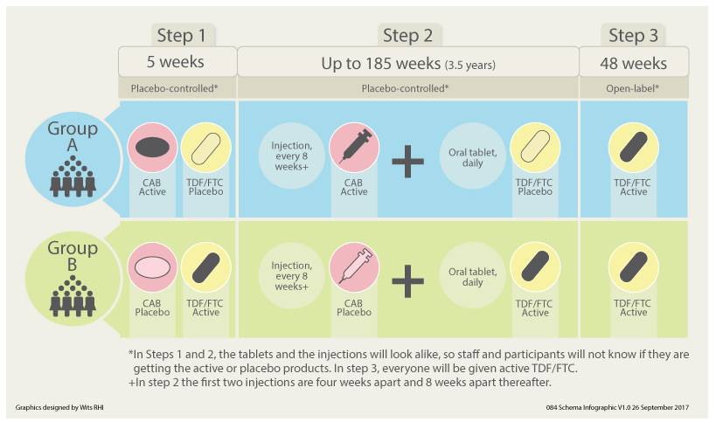
CAB for PrEP: HPTN 084
Planned enrollment of 3,200 cis-women in sub-Saharan Africa as risk for HIV acquisition
https://www.hptn.org/research/studies/hptn084#views-field-field-public-files

Slide 32
CAB for PrEP: HPTN 084
Stopped early in November 2020, was designed to go to 2022
3223 cisgender women enrolled
CAB was superior to TDF/FTC at preventing HIV
HIV incidence
0.21% in CAB group, n=4
1.79% in TDF/FTC group, n=38
https://www.084life.org/study-results/

Slide 33
Question #3
In HPTN 083 and 084, cabotegravir (CAB) was ___________ to TDF/FTC daily oral tablets for PrEP.
Non-inferior
Inferior
Superior

Slide 34
New Mechanisms of Action
Translocation inhibitor
Capsid inhibitor

Slide 35
ISLATRAVIR

Slide 36
Islatravir (ISL, MK-8591)
Nucleoside reverse transcriptase translocation inhibitor (NRTTI)
Chain terminator and translocation inhibitor
Half-life is 50-60hrs in plasma
Daily or once weekly dosing!
Low doses orally and parenteral formulations
Potent activity with broad coverage for HIV-1 and HIV-2 and NRTI resistant strains
Minimal cross resistance with other NRTIs

Slide 37
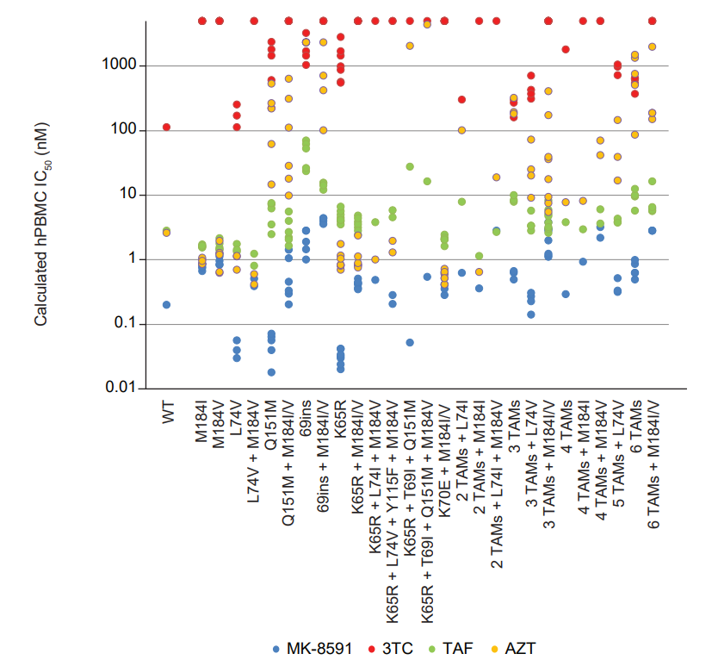
ISL: Activity against NRTI resistant strains
Grobler et al. CROI 2019, #481

Slide 38
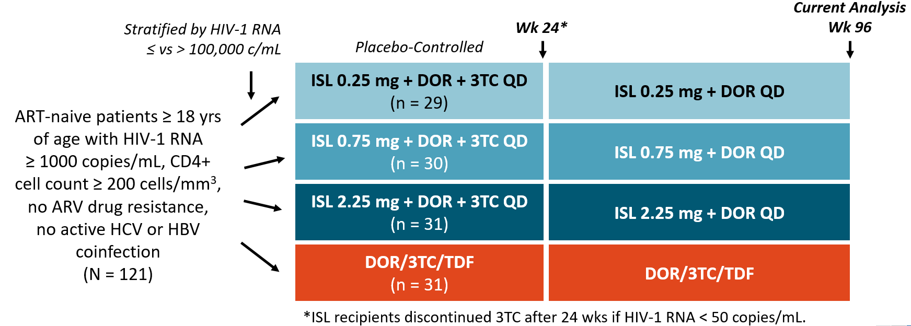
ISL + DOR: Phase 2B
International, randomized, double-blind trial
Molina et al. HIV Drug Therapy Glasgow 2020, #O415
Slide credit: clinicaloptions.com

Slide 39
ISL + DOR: Phase 2B
Molina et al. HIV Drug Therapy Glasgow 2020, #O415
Slide credit: clinicaloptions.com

Slide 40
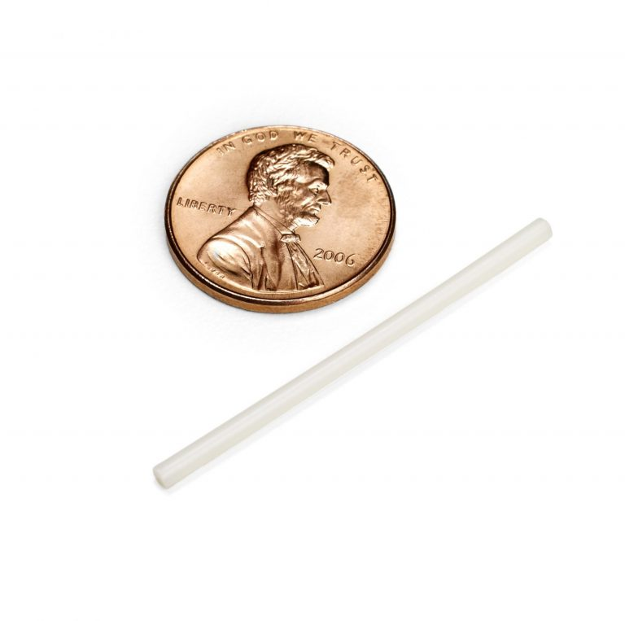
Why implants?
Advantages
Removable
Consistent drug release
PK not dependent on injection site
Can be in place for years
Disadvantages
Need implantation device
Minor procedure to remove
Difficult to bring to market as a generic

Slide 41
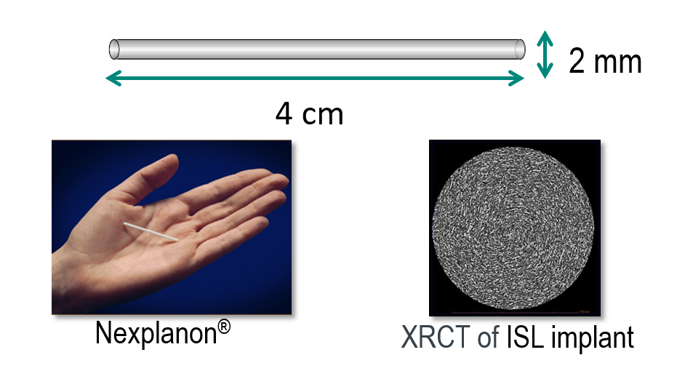
ISL for PrEP: Long acting implant
ISL prototype design based on Nexplanon®/Implanon®
Uses same applicator and polymer
Removable
Double-blind, placebo-controlled in healthy volunteers
Groups had either 54mg or 62mg implant
Placed in upper arm of non-dominant hand
Removed after 12 weeks
Matthews et al. IAS 2019; # TUAC0401LB

Slide 42
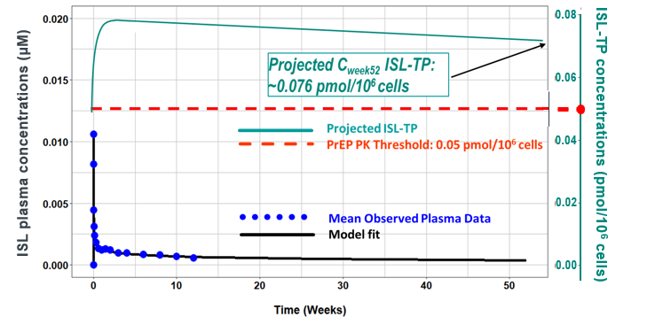
ISL for PrEP: Long acting implant
Modeling suggests 62mg implant would have protective levels at 52 weeks, approximately 16 mo before under PK threshold
Half-life after removal similar to oral ISL
Well tolerated with most implantation site reactions self-resolving
Matthews et al. IAS 2019; # TUAC0401LB

Slide 43
lenacapavir

Slide 44
HIV Capsid Inhibitor
Sager et al. CROI 2019, #141

Slide 45
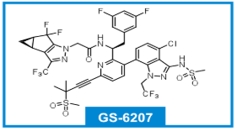
Lenacapavir (LEN): Capsid Inhibitor
First in-class inhibitor of HIV capsid inhibitor with picomolar potency
Given as subcutaneous suspension
Also has oral formulation in trials
In-vitro: active against HIV-1 variants and resistant strains
Low clearance and low solubility→very long half life
In clinical trials, for both treatment and PrEP
Sager et al. CROI 2019, #141

Slide 46
LEN: PK Study
Phase 1 PK and safety data in healthy volunteers
Potential for every 6-mo dosing, will need oral loading dose
Most ADEs were mild injection site reactions
Begley et al. AIDS 2020, #PEB0265
Slide credit: clinicaloptions.com

Slide 47
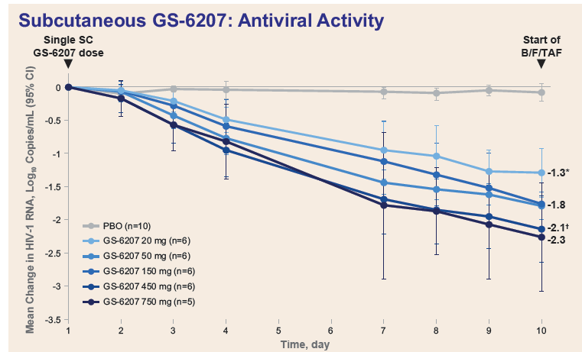
LEN: HIV Capsid Inhibitor
Phase 1b, double-blind, randomized, placebo controlled, dose ranging study
Single subcutaneous injection, then started B/F/TAF at day 10
Current trials: treatment naïve patients, heavily treatment experienced
Daar et al. CROI 2020, #469

Slide 48
Who might benefit?
Patients who
Have issues with tablet size
Have issues with stigma
Trouble remembering to take their meds
Can commit to attend appointments
Drug interactions
Have resistance to current options

Slide 49
Challenges
Administration
Office visits
Missed appointments
Techniques
Injection vs infusion
Insurance coverage
Patient factors
Pregnancy potential
Managing adverse effects
Drug drug interactions
Body composition

Slide 50
Summary
Injectable and implantable ARV therapy have great potential for both HIV treatment and prevention
Patients may face challenges with access and administration but also may prefer this to traditional oral therapy

Slide 51
HIV - HCV - PrEP - PEP
Clinical Consultations
For Providers in Upstate NY
Call or E-mail for a consultation:
518-262-6864
Monday – Friday 8:00 a.m. – 4:30 p.m.
prokopw@amc.edu
If you have experienced an occupational exposure such as a needle stick, please call 518-262-4043. You will be given an opportunity on the telephone menu to speak to a physician 24 hours a day.
www.amc.edu/hiv

Slide 52
Questions? adanforth@trilliumhealth.org

