Slide 1

Antiretroviral Therapy:
Keys to Success
Joanne Orrick Urban, PharmD, BCPS, AAHIVP
Clinical Pharmacist
North Florida AIDS Education and Training Center
University of Florida

Slide 2
Disclosure of Financial Relationships
This speaker has the following financial relationship to disclose:
  Bristol-Myers Squibb (spouse’s employer)
This slide set has been peer-reviewed to ensure that there are
no conflicts of interest represented in the presentation.
Notes:
2
2

Slide 3
Objectives
Discuss initial antiretroviral therapy (ART) options according to the most recent Department of Health and Human Services (DHHS) Guidelines for the Use of Antiretroviral Agents in Adults and Adolescents Living with HIV
List factors involved in selecting initial antiretroviral therapy (ART)
Utilizing patient case scenarios, select initial regimens taking into account co-morbidities, drug-drug interactions, and patient preferences
Identify resources to assist patients in maintaining access to ART

Slide 4
Objectives
Discuss initial antiretroviral therapy (ART) options according to the most recent Department of Health and Human Services (DHHS) Guidelines for the Use of Antiretroviral Agents in Adults and Adolescents with HIV
List the factors involved in selecting initial antiretroviral therapy (ART)
Utilizing patient case scenarios, select initial regimens taking into account co-morbidities, drug-drug interactions, and patient preferences
Identify resources to assist patients in maintaining access to ART

Slide 5
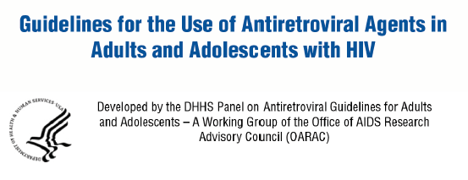
HIV Treatment Guidelines
Panel on Antiretroviral Guidelines for Adults and Adolescents. Guidelines for the Use of Antiretroviral Agents in Adults and Adolescents with HIV. Department of Health and Human Services. February 24, 2021.
Unless otherwise noted, information in this presentation is adapted from these guidelines.
Available at https://clinicalinfo.hiv.gov/en/guidelines/adult-and-adolescent-arv

Slide 6







Recommended Initial Regimens for Most People with HIV
INSTI + 2 NRTIs
 | Bictegravir/tenofovir alafenamide/emtricitabine
 | Dolutegravir/abacavir/lamivudine Only if HLA-B*5701 negative and no hepatitis B virus (HBV) coinfection
 | Dolutegravir + tenofovir¹ + (emtricitabine or lamivudine)
 | Raltegravir + tenofovir¹ + (emtricitabine or lamivudine)
+
OR
OR
+
OR
1. Tenofovir alafenamide (TAF) or tenofovir disoproxil fumarate (TDF)

Slide 7

Recommended Initial Regimens for Most People with HIV (Continued)
INSTI + 1 NRTI
 | Dolutegravir/lamivudine Only if - HIV RNA < 500,000 copies/mL - no HBV coinfection - genotype results shows no reverse transcriptase resistance

Slide 8
Initial Regimens-
Certain Clinical Situations
INSTI + 2 NRTIs
Elvitegravir/cobicistat/tenofovir¹/emtricitabine
Boosted PI + 2 NRTIs (In general, boosted darunavir preferred) /r or /c indicates ritonavir or cobicistat for boosting
Darunavir/c or darunavir/r + tenofovir¹ + (emtricitabine or lamivudine)
Atazanavir/c or atazanavir/r + tenofovir¹ + (emtricitabine or lamivudine)
Darunavir/c or darunavir/r + abacavir/lamivudine Only if HLA-B*5701 negative and no HBV coinfection
1. Tenofovir alafenamide (TAF) or tenofovir disoproxil fumarate (TDF)

Slide 9
Initial Regimens-
Certain Clinical Situations
NNRTI + 2 NRTIs
Doravirine + tenofovir¹ + (emtricitabine or lamivudine)
Efavirenz + tenofovir¹ + (emtricitabine or lamivudine)
Rilpivirine/tenofovir¹/emtricitabine If HIV RNA < 100,000 and CD4 > 200
1. Tenofovir alafenamide (TAF) or tenofovir disoproxil fumarate (TDF)

Slide 10
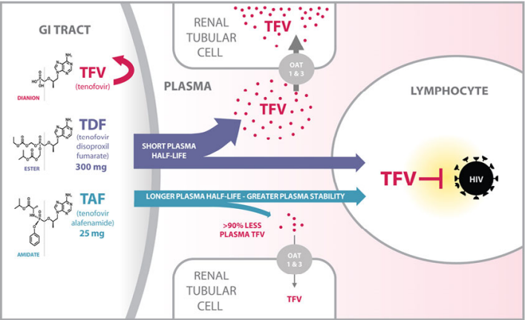
TAF vs. TDF: What is the Difference?
Antela, et al. HIV Medicine (2016), 17 (Suppl. 2), 4--16 Available at http://onlinelibrary.wiley.com/doi/10.1111/hiv.12401/pdf

Slide 11
TAF vs TDF
Drug | Use for Hep B | Use for PrEP | Use in Pregnancy | Increased lipids | Renal Effects | Weight Gain
TAF | Yes | Yes¹ | Yes² | More³ | Less | More⁴
TDF | Yes | Yes | Yes | Less | More | Less
TAF/FTC (Descovy) is approved for use in PrEP in men or transgender women who have sex with men
Alternative NRTI in pregnant women or women trying to conceive(see https://clinicalinfo.hiv.gov/en/guidelines/perinatal/table-5-situation-specific-recommendations-use-antiretroviral-drugs-pregnant)
Higher LDL, HDL and triglycerides but no difference in total cholesterol/HDL ratio-clinical significance unknown
More common in women and Black or Hispanic patients.

Slide 12
TAF vs. TDF-Use in Renal Dysfunction and Hemodialysis (HD)
Drug | CrCL (mL/min) | Dose
TAF | < 15 and not on HD¹ | Not recommended
 | < 15 and on HD² | One tablet once daily
TDF | 30-49 | 300 mg every 48 hours
 | 10-29 | 300 mg twice weekly (every 72-96 hours)
 | < 10 and not on HD | No recommendation
 | On HD² | 300 mg every 7 days³
Recommendations vary depending on co-formulation used. See https://clinicalinfo.hiv.gov/en/guidelines/adult-and-adolescent-arv/antiretroviral-dosing-recommendations-patients-renal-or-hepatic
Dose after HD if given on HD day(s)
Assumes three HD sessions of 4 hours duration each

Slide 13
Patient Case Ricky
Ricky is a 28 year old man who was recently discharged from the hospital where he was diagnosed with HIV/AIDS and disseminated Mycobacterium avium complex infection
He comes to the clinic to initiate ART
He states he has no preference with respect to food requirements or the need for a single tablet regimen but would prefer a once daily regimen

Slide 14

Patient Case Ricky
Labs:
  Genotype: pansensitive
  AST/ALT: WNL
  eGFR 103 mL/min
  VL 182,000 copies/mL CD4 43 cells/mm³
Allergies: NKDA
Medications: rifabutin 300 mg po once daily, azithromycin 500 mg po once daily, ethambutol 1000 mg po once daily, trimethoprim/sulfamethoxazole 1 DS tab po once daily

Slide 15
Why is a TAF-containing regimen not recommended for Ricky?
TAF may not be as effective as TDF in patients with high viral loads
Due to drug-drug interactions, TAF levels would be expected to be increased
Due to drug-drug interactions, TAF levels would be expected to be decreased
I’m not sure, I thought TAF could be used in all patients

Slide 16

TAF Drug Interactions
Strong P-glycoprotein (P-gp) inducers are expected to ↓ TAF concentrations
  Rifamycins (i.e., rifampin, rifabutin)
  St. John’s Wort
  Carbamazepine
  Oxcarbazepine
  Phenytoin
  Phenobarbital

Slide 17
Objectives
Discuss initial antiretroviral therapy (ART) options according to the most recent Department of Health and Human Services (DHHS) Guidelines for the Use of Antiretroviral Agents in Adults and Adolescents with HIV
List the factors involved in selecting initial antiretroviral therapy (ART)
Utilizing patient case scenarios, select initial regimens taking into account co-morbidities, drug-drug interactions, and patient preferences
Identify resources to assist patients in maintaining access to ART

Slide 18

Factors in Regimen Selection
Viral load and CD4 cell count
HIV resistance
HLA-B*5701 status
Co-morbid conditions
Co-infections
Pregnancy or pregnancy potential
Potential adverse effects
Potential drug-drug interactions
Patient preferences
Access/cost

Slide 19
Specific Comorbid Conditions
Comorbid Conditions
  E.g., Cardiovascular disease, hyperlipidemia, obesity, renal disease, osteoporosis or decreased bone density, psychiatric illness
Coinfections: hepatitis C virus (HCV), hepatitis B virus (HBV), tuberculosis (TB)

Slide 20
Regimen/Drug Factors
Potential adverse effects
Potential drug-drug interactions
Convenience (e.g., pill burden, dosing frequency, food requirements)
Regimen’s genetic barrier to resistance (i.e., how easy is it for the virus to become resistant to the medicines in the event of missed doses)
Cost

Slide 21

Conversations About Patient Preferences and Barriers to Adherence
Dosing frequency, pill burden, food requirements, size of pills, potential side effects
What is the patient’s typical day like?
What time would be most convenient to take medications?
  It is best to tailor the regimen to predictable and routine daily events
    How will schedule differ on weekends?
    What will happen if they travel?
Will the cost of medications impact access?

Slide 22
Objectives
Discuss initial antiretroviral therapy (ART) options according to the most recent Department of Health and Human Services (DHHS) Guidelines for the Use of Antiretroviral Agents in Adults and Adolescents with HIV
List the factors involved in selecting initial antiretroviral therapy (ART)
Utilizing patient case scenarios, select initial regimens taking into account co-morbidities, drug-drug interactions, and patient preferences
Identify resources to assist patients in maintaining access to ART

Slide 23
Patient Case Cynthia
Cynthia is a 28 year old woman recently diagnosed with HIV infection who presents to the clinic to start ART through a rapid start program
Baseline labs: drawn at visit, not yet available.
PMH: treated for chlamydia x 2
Social history: unmarried, never smoked, does not drink alcohol, has 1 child (3 years old) and is interested in having more. Her only birth control method is condoms.

Slide 24
What regimen would you choose for Cynthia?
BIC/TAF/FTC (Biktarvy)
DRV/c + TAF/FTC (Prezcobix + Descovy)
DTG + TAF/FTC (Tivicay + Descovy)
DTG + TDF/FTC (Tivicay + Truvada)

Slide 25
INSTI Risk of Neural Tube Defects
Very small increased risk of neural tube defects seen with DTG
Advantages of DTG include once daily dosing, well-tolerated, rapid viral suppression
Perinatal guidelines now list DTG as a preferred agent throughout pregnancy and in women trying to conceive
Guidelines stress importance of patient counseling and informed decision making
See https://clinicalinfo.hiv.gov/en/guidelines/perinatal/whats-new-guidelines

Slide 26
Patient Case James
James is a 23 year old man recently diagnosed with HIV infection
CD4 482 cells/mm³, VL 29,852 copies/mL (no resistance detected)
eGFR 98 mL/min, CBC and CMP: WNL
No hepatitis B coinfection
He states he would prefer a one pill once a day regimen and does not want a regimen that has to be taken with food

Slide 27
What regimen would you choose for James?
DTG/3TC (Dovato)
DTG/ABC/3TC (Triumeq)
BIC/TAF/FTC (Biktarvy)
RPV/TAF/FTC (Odefsey)
DRV/c/TAF/FTC (Symtuza)

Slide 28









ART with Food Requirements
Should be Taken With Food
 | Atazanavir (ATV, Reyataz)/r OR ATV/c (Evotaz)
 | Darunavir/r (DRV, Prezista)/r OR DRV/c (Prezcobix) OR DRV/c/TAF/FTC (Symtuza)
 | EVG/c/TDF/FTC (Stribild) OR EVG/c/TAF/FTC (Genvoya)

Slide 29





ART with Food Requirements
Should be Taken With a Full Meal
 | Rilpivirine (Edurant) OR RPV/TDF/FTC (Complera) OR RPV/TAF/FTC (Odefsey) OR RPV/DTG (Juluca)
Should be Taken on an Empty Stomach
 | EFV/FTCTDF (Atripla) OR EFV (Sustiva) OR EFV/3TC/TDF (Symfi)

Slide 30
Patient Case Alicia
Alicia is a 58 year old woman recently diagnosed with HIV infection who is being seen to initiate ART
Baseline resistance test: no mutations detected
CD4 375 cells/mm³, VL 10,502 copies/mL
eGFR 58 mL/min, AST 58, ALT 62
Hepatitis screening
  Hepatitis B infected, Hep B VL 1.2 million IU/mL
  Hepatitis C uninfected
  Hepatitis A nonimmune

Slide 31
Which regimen below would NOT be appropriate for Alicia?
DTG/3TC (Dovato)
TDF/FTC (Truvada) + DTG (Tivicay)
BIC/TAF/FTC (Biktarvy)
DRVc/TAF/FTC (Symtuza)
All of the above are appropriate options

Slide 32
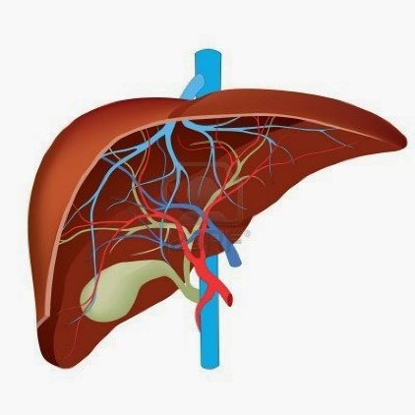
Regimens for HBV Coinfected Patients
It is important to use two drugs that are active against hepatitis B in people with HIV infection and HBV coinfection
    Tenofovir (TAF or TDF)
    Emtricitabine (FTC) or lamivudine (3TC)
Poor adherence or lapses in therapy in people with HBV can lead to severe liver disease including failure and death

Slide 33
Patient Case Jessica
Jessica is a 32 year old woman who was diagnosed with HIV infection in 2018.
She is stable on a regimen of bictegravir/emtricitabine/tenofovir alfenamide (Biktarvy)
  VL < 20 and CD4 789 cells/mm³ on recent labs
Concomitant medications: omeprazole 20 mg once daily, ethinyl estradiol/norgestimate (Sprintec) 1 tab daily, ferrous sulfate 325 mg twice daily (iron supplement)

Slide 34
Which medication is expected to interact with BIC/TAF/FTC (Biktarvy)?
Omeprazole
Ethinyl estradiol/norgestimate
Ferrous sulfate
None of the above

Slide 35
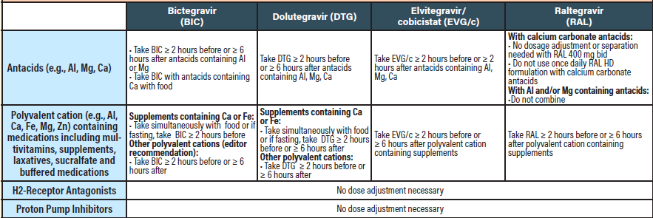
INSTI Interactions

Slide 36
Objectives
Discuss initial antiretroviral therapy (ART) options according to the most recent Department of Health and Human Services (DHHS) Guidelines for the Use of Antiretroviral Agents in Adults and Adolescents with HIV
List the factors involved in selecting initial antiretroviral therapy (ART)
Utilizing patient case scenarios, select initial regimens taking into account co-morbidities, drug-drug interactions, and patient preferences
Identify resources to assist patients in maintaining access to ART

Slide 37

Patient Case Bill
Bill is a 32 year old man with HIV infection who is seen at the clinic to restart ART
He was previously well-controlled on bictegravir/tenofovir alafenamide/emtricitabine (Biktarvy)
He has private insurance through his job and was using a local pharmacy that told him his copay was $1000. He got frustrated and fell out of care for 1 year.

Slide 38


Patient Case Steven
Patient came to your clinic to re-establish HIV care
He stated that he has been well-controlled on efavirenz/emtricitabine/tenofovir disoproxil fumarate (Atripla) since 2009. HIV VL of < 20 and CD4 of 779 (25%)
  Copay used to be less than $10 but as of the 1st of the year, the copay increased to $900 per month. He paid the copay when he could but started taking the medication every other day to stretch it out.
  Client has Medicare but no longer has the low income subsidy

Slide 39
What resources could have been utilized to assist Bill and Steven in obtaining ART each month?

Slide 40
Copay Assistance Programs
Program | Website | Limitations
Pharmaceutical company programs | https://www.gileadadvancingaccess.com/ https://www.viivconnect.com/ https://www.merck.com/patients/patient-financial-assistance/ https://www.janssencarepath.com/ | Cannot be used in patients with federally funded insurance (e.g. Medicare, Medicaid, Tricare) No income limitations
Good Days | www.mygooddays.org | Can be used in patients with federally-funded insurance Income limitations
Patient Advocate Foundation | www.copays.org/funds/hiv-aids-and-prevention/ | Can be used in patients with federally-funded insurance Income limitations

Slide 41
Other Resources for Copays
ADAP Premium Plus/copay assistance
Ryan White medical case management

Slide 42

Patient Case-Anna
Anna is a 48 year old woman who is seen in the clinic for follow-up of HIV infection.
She is well-controlled on a regimen of emtricitabine/tenofovir alafenamide/darunavir/cobicistat (Symtuza). HIV VL < 20, CD4 1032 (48%)
She is suffering from migraines and her provider has prescribed a new medication since sumatriptan is no longer working for her.

Slide 43
Patient Case-Anna
Anna has no insurance and is currently on ADAP.
She asks her Ryan White case manager for assistance in obtaining the medication since it is not on the ADAP formulary.
You find out the medication is called galcanezumab-gnlm (Emgality) and costs over $800 per month.

Slide 44
Medication Resources
  GoodRX-provides discount cards for medications
    https://www.goodrx.com/
  Pharmaceutical assistance programs
    www.needymeds.org
  Ryan White medical case management
  Other area specific resources

Slide 45
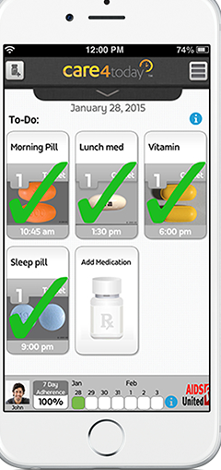
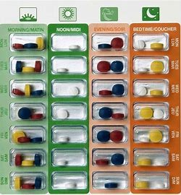
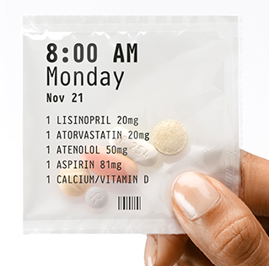

Adherence Interventions
Prescription and/or co-pay assistance programs
Community resources to promote adherence (e.g., family, peer advocates)
Pillboxes, planners, alarms, cell phone apps
Referral to specialty pharmacy

Slide 46
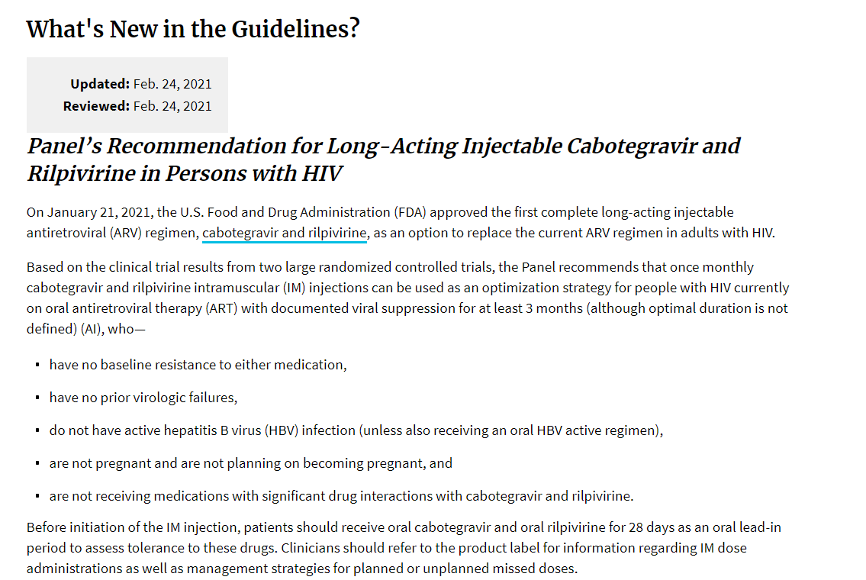
Cabotegravir/rilpivirine (Cabenuva)

Slide 47
Keys to Success
Regimens are selected based on a variety of factors to optimize chances for treatment success
Consider patient preferences in regimen selection
Remember that patient circumstances change over time
Let all patients know that there are resources to assist them in staying on ART and they should communicate any access issues to their provider or case manager immediately

Slide 48
Keys to Success
At every visit, assess any barriers to obtaining and taking medications
  Pharmacy not filling prescriptions on time
  Pharmacy providing partial antiretroviral regimen and/or filling medications on different dates throughout the month
  Lack of transportation to pick up medications
  Travel
  Inability to afford copays and/or insurance premiums
  Side effects
  Forgetting to take medication or not taking the same time each day

Slide 49
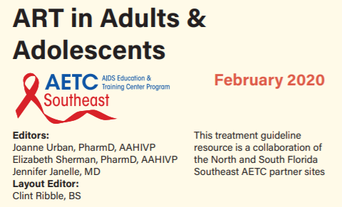
Antiretroviral Resources
Update in progress
http://www.seaetc.com/provider-resources/reference/

Slide 50
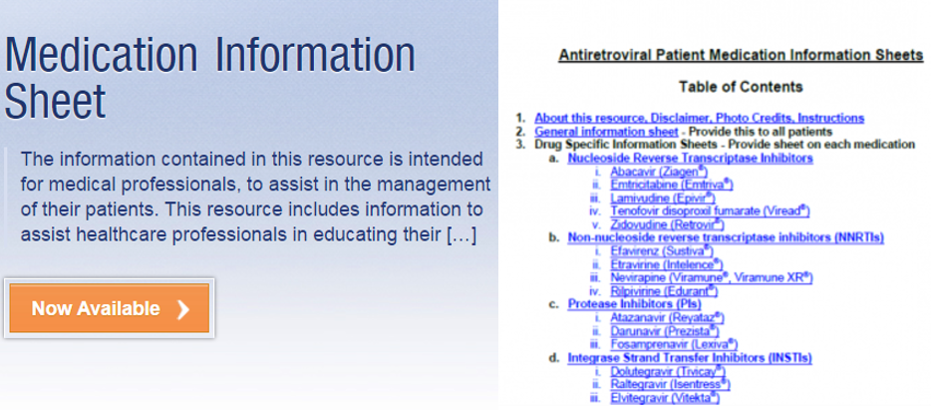
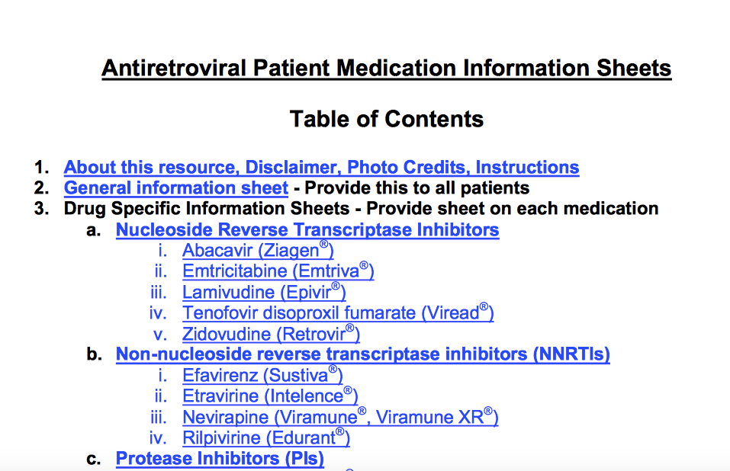
Antiretroviral Resources
http://aetc.medicine.ufl.edu/resources/drug-information-sheets /

Slide 51


